Slide 1
Advanced Computer Networks
高级计算机网络
华东师范大学 软件工程学院
肖波
数学馆 215
Email: bxiao@sei.ecnu.edu.cn

Slide 2
Chapter 1
Introduction
引言

Slide 3
Internet structure: network of networks
…
…
access
net
access
net
access
net
access
net
access
net
IXP
access
net
access
net
ISP A
…
…
IXP
access
net
access
net
ISP B
ISP C
access
net
access
net
access
net
regional net
access
net
…
access
net
access
net
…
access
net

Slide 4
多样化的网络形态
互联网
无线网络
移动通信网
卫星网
物联网
数据中心网络
专用网络
……
智慧城市
信息物理融合系统（CPS）
嵌入式网络计算
雾计算、边缘计算
工业4.0、智能制造
5G、6G …

Slide 5




















What’s the Internet
PC
millions of connected computing devices:
hosts = end systems
running network apps
mobile network
server
wireless
laptop
global ISP
smartphone
communication links
fiber, copper, radio, satellite
transmission rate: bandwidth
home
network
regional ISP
wireless
links
wired
links
Packet switches: forward packets (chunks of data)
routers and switches
router
institutional
network
Notes:
5

Slide 6
What’s the Internet
Internet: “network of networks”
Interconnected ISPs
protocols control sending, receiving of msgs
e.g., TCP, IP, HTTP, Skype, 802.11
Internet standards
RFC: Request for comments
IETF: Internet Engineering Task Force
mobile network
global ISP
home
network
regional ISP
institutional
network

Slide 7



What’s a protocol? 协议
a human protocol and a computer network protocol:
Hi
TCP connection
request
Hi
TCP connection
response
Got the
time?
Get http://www.awl.com/kurose-ross
2:00
<file>
time
Q: other human protocols?

Slide 8
基本概念
网络体系结构
完成计算机间的通信合作，把每个计算机互联的功能划分成有明确定义的层次，并规定同层次进程通信的协议及相邻层之间的接口服务
协议（Protocol）
协议就是为实现网络中的数据交换建立的规则标准或约定。协议由语法、语义和交换规则三部分组成，即协议的三要素。

Slide 9
接口(Interface)
分层结构中各相邻层之间要有一个接口，它定义了较低层向较高层提供的原始操作和服务。相邻层通过它们之间的接口交换信息，高层并不需要知道低层是如何实现的，仅需要知道该层通过层间的接口所提供的服务，这样使得两层之间保持了功能的独立性。

Slide 10
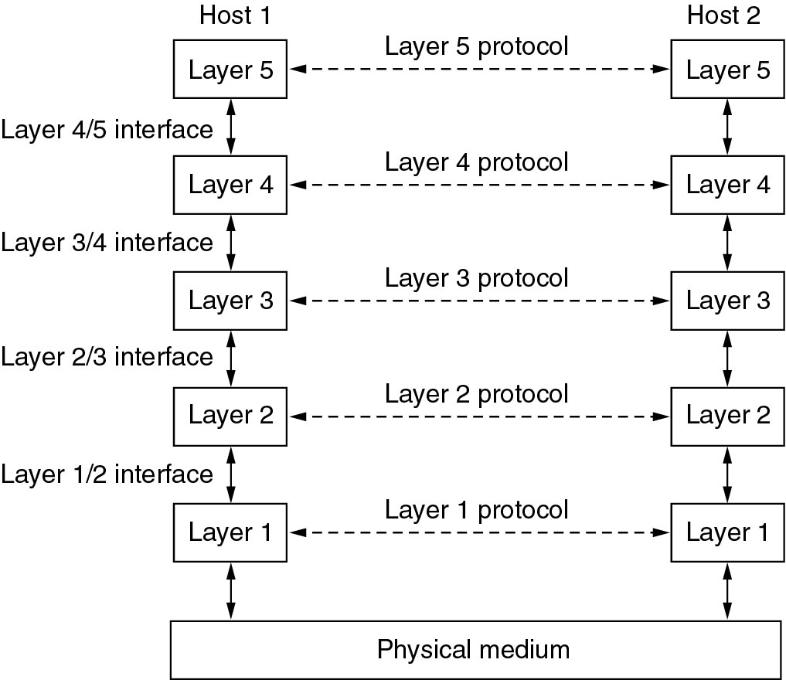
网络协议层次
Layers, protocols, and interfaces.

Slide 11
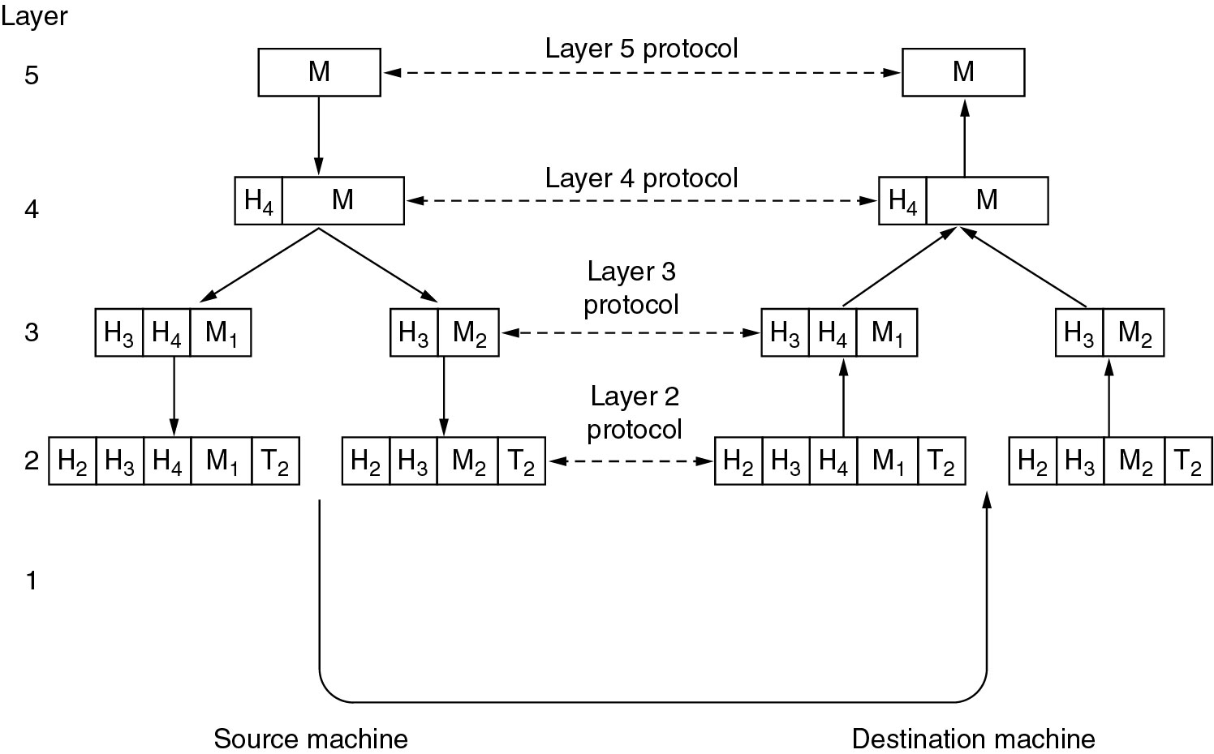
协议层次
Example information flow supporting virtual communication in layer 5.

Slide 12
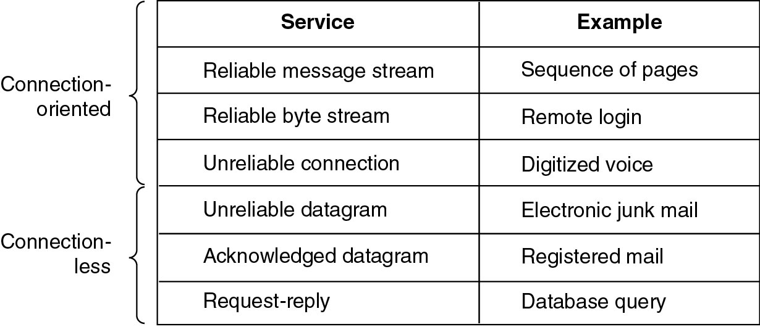
Connection-Oriented and Connectionless Services(2)
Six different types of service.

Slide 13
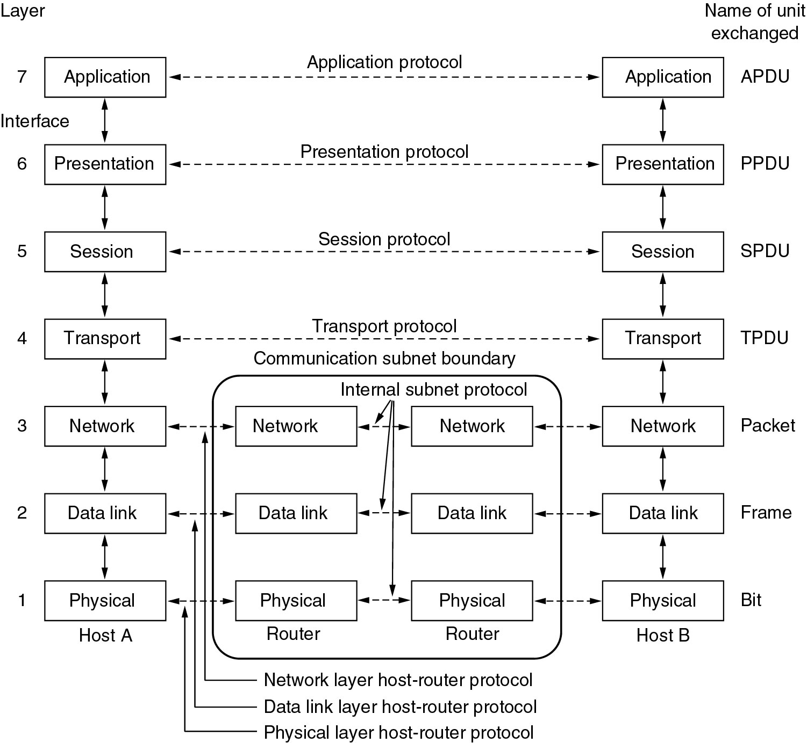
Reference Models
The OSI reference model.

Slide 14
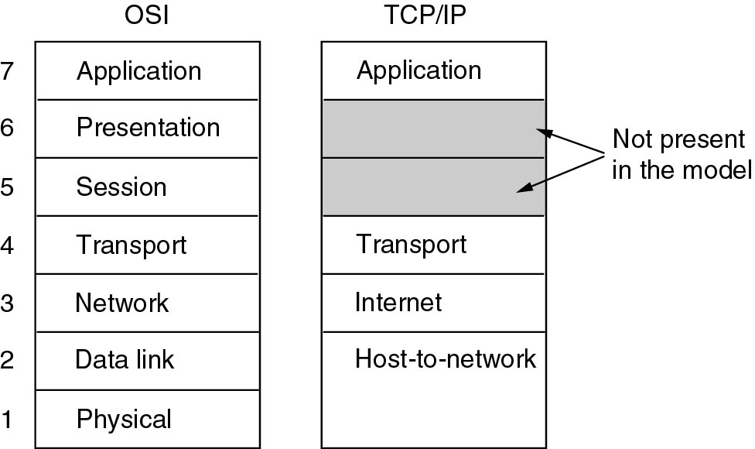
Reference Models (2)
The TCP/IP reference model.

Slide 15
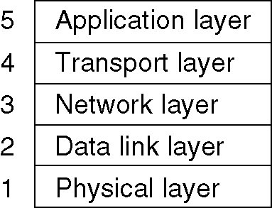
Hybrid Model
The hybrid reference model to be used in this book.

Slide 16
封装 Encapsulation
source
message
M
application
transport
network
link
physical
segment
H_{t}
M
H_{t}
datagram
H_{n}
H_{n}
H_{t}
M
frame
H_{l}
H_{n}
H_{t}
M
link
physical
switch
destination
H_{n}
H_{t}
M
network
link
physical
M
application
transport
network
link
physical
H_{l}
H_{n}
H_{t}
M
H_{n}
H_{t}
M
H_{t}
M
H_{n}
H_{t}
M
H_{l}
H_{n}
H_{t}
M
router

Slide 17
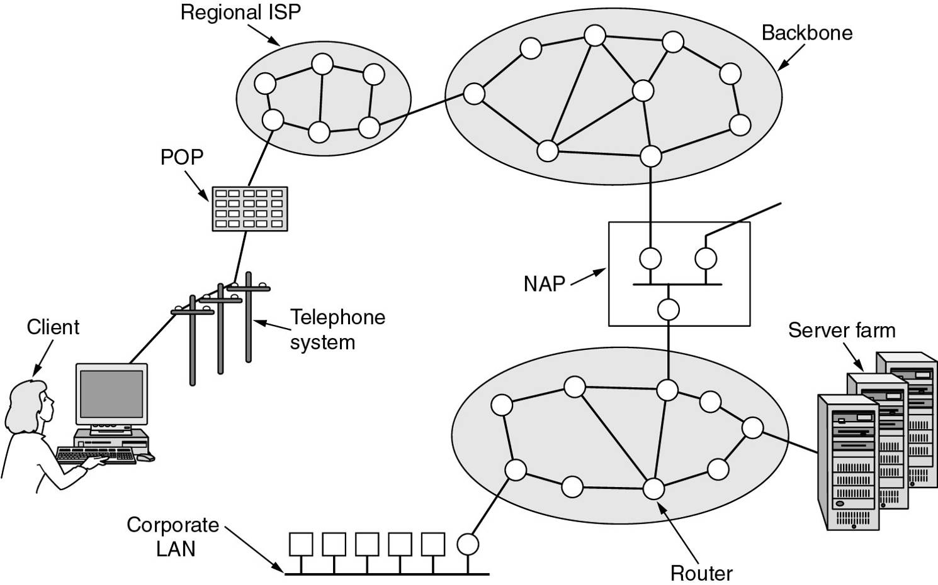
Architecture of the Internet
Overview of the Internet.

Slide 18
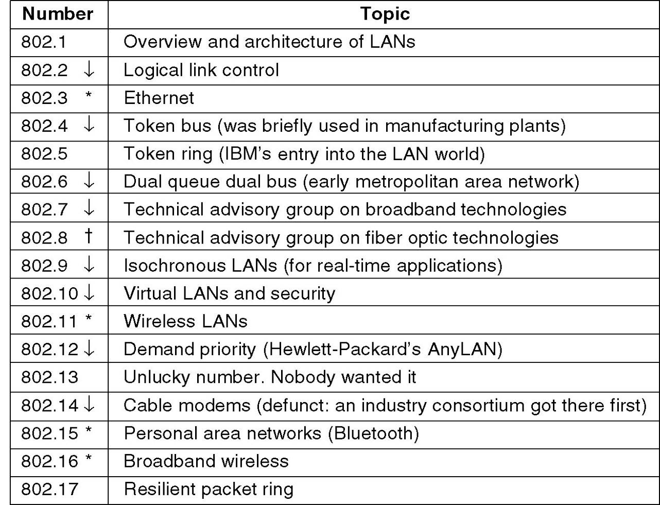
IEEE 802 Standards
The 802 working groups. The important ones are marked with *. The ones marked with ↓ are hibernating. The one marked with † gave up.

