Slide 1
Welcome to CIS 6930 – Embedded Systems
Introduction
Course Requirements
Grading Criteria
Course Policies
Textbook
Embedded Systems Basics
Course Outline
CIS 6930 – Spring 2008 Copyright © 2007 Prabhat Mishra

Slide 2
Introduction
Instructor
  Prabhat Mishra E470 prabhat@cise.ufl.edu
  Office hours: Tue 1:55 – 2:45, Thu 1:55 – 3:50
TA
  Mingsong Chen E309 mchen@cise.ufl.edu
  Office hours: Tue 1:55 – 2:45, Thu 1:55 – 3:50
Course Page
  http://www.cise.ufl.edu/~prabhat/system.html
  Visit regularly for updates and announcements
Class Meets
  Tue 3:00-4:55 and Thu 4:05-4:55 in CSE E221
  Please be on time

Slide 3
Course Requirements
No graduate levels courses necessary
Assumes good knowledge of
  CDA 3101 - Computer Organization
  COP 3530 - Data Structures and Algorithms
  Programming in C ( or C++/Java)
Knowledge of Computer gdfhh Architecture and Operating Systems is plus.

Slide 4
Grading Criteria
Two Homeworks – 10%
  Literature survey and analysis
One Project – 10%
  Implementation based on homeworks
  Two-page report submission outlining results
Two Exams
  Midterm – 30%
  Comprehensive Final – 45%
Pop Quiz – 5%
Grading will be on the curve

Slide 5
Course Policies
No grades for late submissions.
Complete homeworks/projects on your own.
  “Zero Tolerance” policy towards cheating
Exams are closed book/notes.
  US letter size paper -- hand-written on one side
  Scientific calculator
Re-grading requests within a week.
  One week from when it is available.
Attendance, Cell Phones, …
  http://www.cise.ufl.edu/~prabhat/system.html

Slide 6
Tentative Schedule
Homework 1: Jan 24 Feb 07 (11:59 PM)
Homework 2: Feb 21 Mar 07 (11:59 PM)
Midterm: Mar 06 4:05 – 5:05 in CSE 221
Project : Mar 18 April 24 (11:59 PM)
Final: April 22 3:00 – 4:55 in CSE 221

Slide 7
Textbook
No textbooks
  Materials will be from various books and journal articles
References
  Books
    Peter Marwedel – Embedded Systems Design, Kluwer 2003
    …
  Embedded Systems Courses
    Sangiovanni-Vincentelli @ Berkeley, Gupta @ UCSD, …
  Newsgroups
    comp.arch.embedded, …
  Conferences/Journals
    DAC, ICCAD, …, ACM TODAES/TECS, IEEE TCAD/TVLSI
  Web Resources
    www.embedded.com, www.eet.com, …

Slide 8



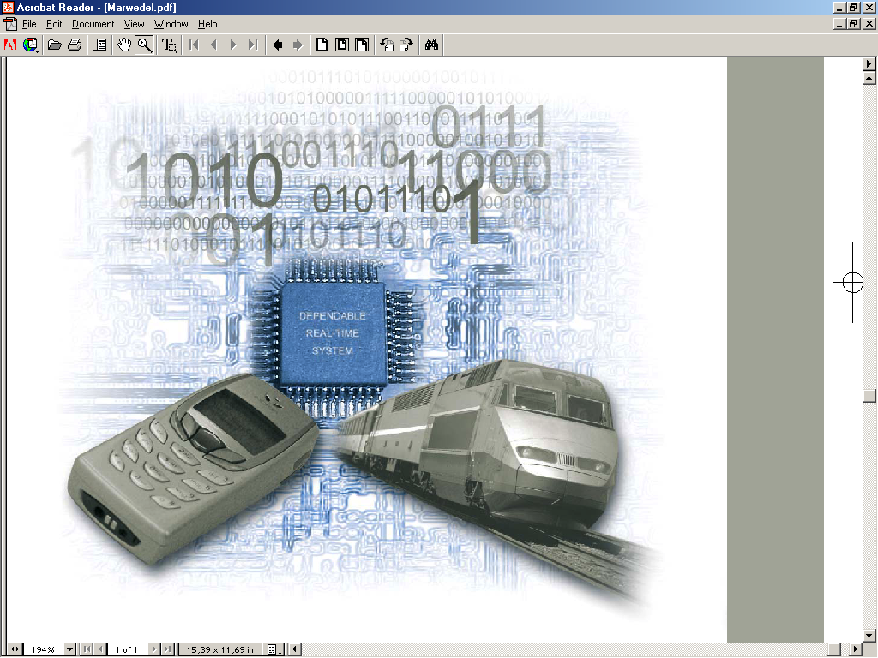
Embedded Systems
Embedded systems =
  information processing systems embedded into a larger product
      Peter Marwedel
Two types of computing
  Desktop – produced millions/year
  Embedded – billions/year
Non-Embedded Systems
  PCs, servers, and notebooks
The future of computing!
  Automobiles, entertainment, communication, aviation, handheld devices, military and medical equipments.

Slide 9

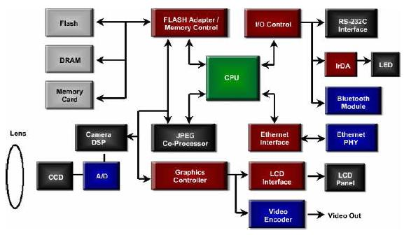
An Example Embedded System
Digital Camera Block Diagram

Slide 10
Components of Embedded Systems
Memory
Controllers
Interface
Software
(Application Programs)
Processor
Coprocessors
ASIC
Converters
Analog
Digital
Analog

Slide 11
Components of Embedded Systems
Analog Components
  Sensors, Actuators, …
Digital Components
  Processor, Coprocessors, Memories, Buses
  Controllers, Application Specific Hardwares
Converters
  Analog-to-Digital (A2D), D2A, …
Software
  Operating systems
  Middleware
  Applications (MPEG-x, GSM-kernel, …)

Slide 12

Example: BMW 745i
2, 000, 000 LOC
Windows CE OS
53 8-bit μP
11 32-bit μP
7 16-bit μP
Multiple Networks
Buggy!

Slide 13
Characteristics
Application Specific
  Applications are known a priori
  Optimize for cost, area, power, and performance
Digital Signal Processing
  Signals are represented digitally
Reactive
  Reacts to changes in the system’s environment
Real-time
  Compute certain tasks before deadline
Distributed, Networked, …

Slide 14
Characteristics
Reliability
  Probability of system working correctly provided that is was working at t=0
Maintainability
  Probability of system working correctly d time units after error occurred.
Safety
  Not harmful for user
Security
  Confidential and authentic communication

Slide 15
Traditional Design Challenges
Low cost
Light weight
Reliability
Low power
Portable
Complexity
Ease of use
Mixed digital/analog requirements
Shrinking time-to-market
Short product lifetime
Real-time processing
Inherent concurrency
HW/SW co-design

Slide 16
Recent Design Challenges
Design Complexity
Ultra low power
  Highly adaptive
  Active power management (voltage scaling, etc.)
  Alternative energy source (scavenge, solar, etc.)
Internet aware
  Incorporate RF technologies
  Networking capabilities
    Larger OS, middleware, etc.
    Understanding of many/changing protocols
  Co-operative operation (trashcan & refrigerator)
Verification
Security

Slide 17
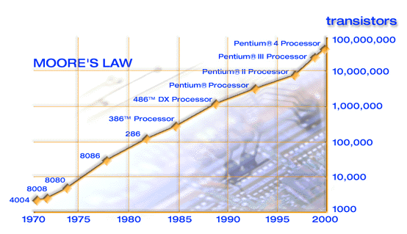
Design Complexity
Exponential Growth – doubling of transistors every couple of years

Slide 18
Design Complexity
1,000,000,000
Sony Graphic Synthesizer
IBM Power4
NVIDIA NV40
NVIDIA NV30 GPU
100,000,000
NVIDIA NV25 GPU
Sony Graphic Synthesizer
Intel
Pentium 4
Intel
Pentium III
10,000,000
Intel
Pentium II
Intel
Pentium
1,000,000
Intel
486
Number of Transistors
NVIDIA NV20 GPU
Intel
386
Motorola G4
AMD Athlon XP
100,000
Intel
286
Intel Centrino
NVIDIA NV35 GPU
Intel
8086
ATI Radeon X800
10,000
Intel
8080
Intel
Intel
8008
1000
4004
1970
1975
1980
1985
1990
1995
2000
2005

Slide 19
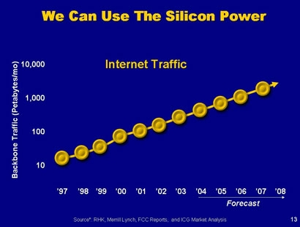
Use of Silicon Power

Slide 20
Technology and Demand
#of transistors are doubling every 2 years
Technology
Demand
Communication, multimedia, entertainment, networking
Exponential growth of design complexity verification complexity

Slide 21
Who wants to be a Millionaire
You double your investment everyday
  Starting investment - one cent.
How long it takes to become a millionaire
  20 days
  27 days
  37 days
  365 days
  Lifetime ++

Slide 22
Who wants to be a Millionaire
You double your investment everyday
  Starting investment - one cent.
How long it takes to become a millionaire
  20 days One million cents
  27 days Millionaire
  37 days Billionaire
Believe it or not
  Each of us have more than a million ancestors in last 20 generations.
Doubling transistors every 18 months
  This growth rate is hard to imagine, most people underestimate

Slide 23
Time-to-Market
Time required to develop a product to the point it can be sold to customers
Market window
  Period during which the product would have highest sales
Average time-to-market constraint is about 8 months
Delays can be costly
Revenues ($)
Time (months)

Slide 24
Losses due to Delayed Market Entry
Simplified revenue model
  Product life = 2W, peak at W
  Time of market entry defines a triangle, representing market penetration
  Triangle area equals revenue
Loss
  The difference between the on-time and delayed triangle areas (shaded region)
Peak revenue
Peak revenue from delayed entry
Revenues ($)
On-time
Market rise
Market fall
Delayed
D
W
2W
On-time Delayed
entry entry
Time

Slide 25
Delayed Market Entry (cont.)
Area = 1/2 * base * height
  On-time = 1/2 * 2W * W
  Delayed = 1/2 * (W-D+W)*(W-D)
Percentage revenue loss = (D(3W-D)/2W²)*100%
Try some examples
Peak revenue
Peak revenue from delayed entry
Revenues ($)
On-time
Market rise
Market fall
Delayed
  Lifetime 2W=52 wks, delay D=4 wks Loss = (4*(3*26 –4)/2*26²) = 22%
  Lifetime 2W=52 wks, delay D=10 wks
  Loss = (10*(3*26 –10)/2*26²) = 50%
  Delays are costly!
D
W
2W
On-time Delayed
entry entry
Time

Slide 26
Cost
Unit cost
  the monetary cost of manufacturing each copy of the system, excluding NRE cost
NRE cost (Non-Recurring Engineering cost)
  The one-time monetary cost of designing the system
Total cost
  NRE cost + unit cost * # of unit
Per-product cost
  total cost / # of units = (NRE cost / # of units) + unit cost
Example
  NRE=$2000, unit=$100
  For 10 units
    total cost = $2000 + 10*$100 = $3000
    per-product cost = $2000/10 + $100 = $300
Amortizing NRE cost over the units results in an additional $200 per unit

Slide 27
NRE versus Unit Cost
High NRE, low production cost
Unit Cost
Low NRE, high production cost
Volume

Slide 28
Technology
Processor technology
  Computation engine to implement the functionality
    General purpose, application-specific, single purpose
Integrated Circuit (IC) technology
  A digital implementation (gate-level) is mapped to silicon or other mediums.
    Full-custom, ASIC, PLD, …
Design technology
  The methodology that convert the concept of desired system functionality into an implementation
    Concept → Specification → HW+SW → Implementation

Slide 29
Processor technology
Processors vary in customization for the given problem
total = 0
for i = 1 to N loop
total += M[i]
end loop
Desired functionality
General-purpose processor
Application-specific processor
Single-purpose processor

Slide 30
General-purpose processors
Programmable device used in a variety of applications
  Also known as “microprocessor”
Features
  Program memory
  General datapath with large register file and general ALU
User benefits
  Low time-to-market and NRE costs
  High flexibility
Examples
  Pentium, Athlon, PowerPC
Controller
Datapath
Control
logic and State register
Register
file
General
ALU
IR
PC
Program memory
Data
memory
Assembly code for:
total = 0
for i =1 to …

Slide 31
Single-purpose processors
Digital circuit designed to execute exactly one program
  coprocessor, hardware accelerator
Features
  Contains only the components needed to execute a single program
  No program memory
Benefits
  Fast
  Low power
  Small size
Controller
Datapath
Control logic
index
total
State register
+
Data
memory

Slide 32
Application-specific processors
Optimized for a applications with common characteristics
  Compromise between general-purpose and single-purpose
Features
  Program memory
  Optimized datapath
  Special functional units
Benefits
  Some flexibility, good performance, size and power
Controller
Datapath
Control
logic and State register
Registers
Custom
ALU
IR
PC
Data
memory
Program memory
Assembly code for:
total = 0
for i =1 to …

Slide 33
IC technology
A digital implementation (gate-level) is mapped to silicon using various layers
  Full-custom/VLSI
  Semi-custom ASIC (gate array and standard cell)
  PLD (Programmable Logic Device)
gate
IC package
IC
oxide
source
channel
drain
Silicon substrate

Slide 34
Full-custom/VLSI
All layers are optimized for an embedded system’s particular implementation
  Placing transistors
  Sizing transistors
  Routing wires
Benefits
  Excellent performance, small size, low power
Drawbacks
  High NRE cost (e.g., $300k), long time-to-market

Slide 35
Semi-custom
Lower layers are fully or partially built
  Designers are left with routing of wires and maybe placing some blocks
Benefits
  Good performance, good size, less NRE cost than a full-custom implementation (perhaps $10k to $100k)
Drawbacks
  Still require weeks to months to develop

Slide 36
PLD (Programmable Logic Device)
All layers already exist
  Designers can purchase an IC
  Connections on the IC are either created or destroyed to implement desired functionality
  Field-Programmable Gate Array (FPGA) very popular
Benefits
  Low NRE costs, almost instant IC availability
Drawbacks
  Penalty on area, cost (perhaps $30 per unit), performance, and power

Slide 37
Design Technology
The manner in which we convert our concept of desired system functionality into an implementation
Compilation/
Synthesis
Libraries/
IP
Test/
Verification
System
specification
System
synthesis
Hw/Sw/
OS
Model simulat./
checkers
Compilation/Synthesis: Automates exploration and insertion of implementation details for lower level.
Behavioral
specification
Behavior
synthesis
Cores
Hw-Sw
cosimulators
Libraries/IP: Incorporates pre-designed implementation from lower abstraction level into higher level.
RT
specification
RT
synthesis
RT
components
HDL simulators
Test/Verification: Ensures correct functionality at each level, thus reducing costly iterations between levels.
Logic
specification
Logic
synthesis
Gates/
Cells
Gate
simulators
To final implementation

Slide 38
Design productivity gap
10,000
100,000
1,000
10,000
Logic transistors per chip
(in millions)
100
1000
10
Gap
Productivity
(K) Trans./Staff-Mo.
IC capacity
100
1
10
0.1
1
0.01
productivity
0.1
0.001
0.01
1981
1983
1985
1987
1989
1991
1993
1995
1997
1999
2001
2003
2005
2007
2009
1981 leading edge chip required 100 man-months
  10,000 transistors / 100 transistors/month
2002 leading edge chip requires 30K man-months
  150,000,000 / 5000 transistors/month
Designer cost increase from $1M to $300M

Slide 39
The mythical man-month
In theory, adding designers to team reduces project completion time
In reality, productivity per designer decreases due to complexities of team management and communication overhead
In the software community, known as “the mythical man-month” (Brooks 1975)
At some point, can actually lengthen project completion time!
15
Team
1M transistors, one designer=5000 trans/month
Each additional designer reduces for 100 trans/month
So 2 designers produce 4900 trans/month each
60000
16
16
50000
19
18
40000
24
23
30000
Months until completion
20000
43
10000
Individual
0
10
20
30
40
Number of designers

Slide 40









Course Outline
Hardware Components
Hardware
HW/SW
Partitioning
Design
(Synthesis, Layout, …)
Concept
Specification
Design
(Compilation, …)
Estimation -
Exploration
Software Components
Software
Validation and Evaluation (area, power, performance, …)

