Slide 1
Control Systems
Introduction
Open-loop Control
Closed-loop Control
PID Control
Computer-based Control
Conclusion
CIS 6930 – Spring 2008 Copyright © 2008 Prabhat Mishra

Slide 2










Embedded Systems Design Flow
Hardware Components
Hardware
Concept
HW/SW
Partitioning
Design
(Synthesis, Layout, …)
Specification
Control Systems
Design
(Compilation, …)
Estimation -
Exploration
Software Components
Software
Validation and Evaluation (area, power, performance, …)

Slide 3
Introduction
Control systems are a common class of embedded systems
Goal is to make a system’s output track a desired reference value
  Cruise control, thermostat, VCR tape speed, etc.
We’ll take a look at open-loop and closed-loop control systems
We’ll take a look at PID control

Slide 4
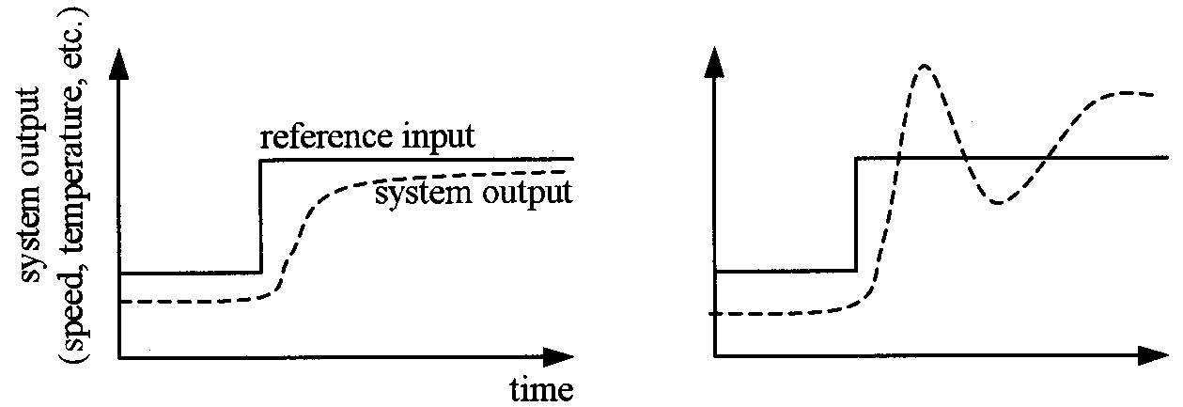
Tracking

Slide 5
Open-Loop Control
Controller
u_{k} = F(r_{k})
Plant
Actuator
r_{k}
u_{k}
u(t)
v(t)
r_{k} is the reference (to be controlled) value
k is a discrete time variable
t = k × ΔT is a continues time variable

Slide 6
Open-Loop Control Example
c(x) bound x to [0-2⁸]
Controller
every 10ms do {
u_{k} = (r_{k} / 1000.0) × 5.0
u_{k} = c(u_{k} × (2⁸ – 1) / 5.0)
}
r_{k}
v(t)
u_{k}
0-5V
8-bit
D/A
DC Motor
Open load response:
0V = 0 RPM
5V = 1000 RPM
u(t)
ΔT = .01 sec
r_{k} = [0..1000]
What if a load is placed on the motor?

Slide 7
Closed-Loop Control
Plant
D/A
Actuator
Controller
u_{k} = F(e_{k})
u_{k}
u(t)
e_{k}
+
+
v(t)
r_{k}
v_{k}
A/D
Sensor
–
r_{k} is the reference (to be controlled) value
k is a discrete time variable
t = k × ΔT is a continues time variable
e_{k} = r_{k} – v_{k} is plant error

Slide 8
Closed-Loop Control Example
Controller
every 10ms do {
u_{k} = (e_{k} / 1000.0) × 10.0
u_{k} = c((u_{k} × (2⁸ – 1) / 5.0)
}
c(x) bound x to [0-2⁸]
e_{k}
+
+
0-5V
8-bit
A/D
v(t)
r_{k}
–(1000 / 2⁸)
v_{k}
u_{k}
0-5V
8-bit
D/A
DC Motor
Open load response:
0V = 0 RPM
5V = 1000 RPM
u(t)
ΔT = .01 sec
r_{k} = [0..1000]
Assume DC motor will run slower under load

Slide 9
General Comments
Both in open-loop and closed-loop systems, a model of the plant is needed
  First order
  Second order
  More sophisticated models
The more accurate the model, the better the control quality
  Stability: all values should remain bounded
  Actuator/sensor saturation must be taken into account
  Performance: how well system tracks reference
    Rise time, Overshoot, Settling time

Slide 10
Model of the Plant
May not be necessary
  Can be done through experimenting and tuning
But,
  Can make it easier to design
  May be useful for deriving the controller
Example: throttle that goes from 0 to 45 degree
  On flat surface at 50 mph, open the throttle to 40 degree
  Wait 1 “time unit”
  Measure the speed, let’s say 55 mph
  Then the following equation satisfy the above scenario
    v_{t+1}=0.7*v_{t}+0.5*u_{t}
    55 = 0.7*50+0.5*40
  IF the equation holds for all other scenario
    Then we have a model of the plant

Slide 11
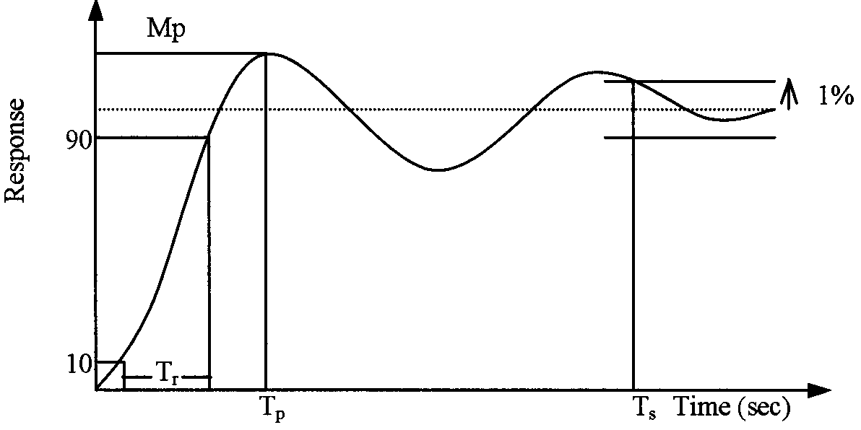
Performance
Rise time
  Time it takes form 10% to 90%
Peak time
Overshoot
  Percentage by which Peak exceed final value
Settling time
  Time it takes to reach 1% of final value

Slide 12
Proportional Integral Derivative (PID) Controllers
Proportional control: A controller that multiplies the error by a constant
  u_{k} = e_{k} × P
Integral control: A controller that considers the integral of error over time (using history)
  u_{k} = (e₀ + e₁ + … + e_{k}) × I
Derivative control: A controller that considers the differential of error over time (predict future)
  u_{k} = (e_{k} – e_{k–1}) × D

Slide 13
Intuition Behind PID
Proportional
  Deal with current error now
Integral
  Apply constant control even when error is zero
Derivative
  Anticipate and react to rapid rate of change before error grows too quick

Slide 14
PID Control
A PID controller does:
  u_{k} = e_{k} × P + (e_{k} – e_{k–1}) × D + (e₀ + e₁ + … + e_{k}) × I
But how to choose P, I, and D?
  There are many books written just on this
  Try, setting I=D=0 and adjusting P
  Then, introduce I followed by D
Software implementation must consider:
  Numerical stability
  Computation speed
PID is the most common form of closed loop control!

Slide 15
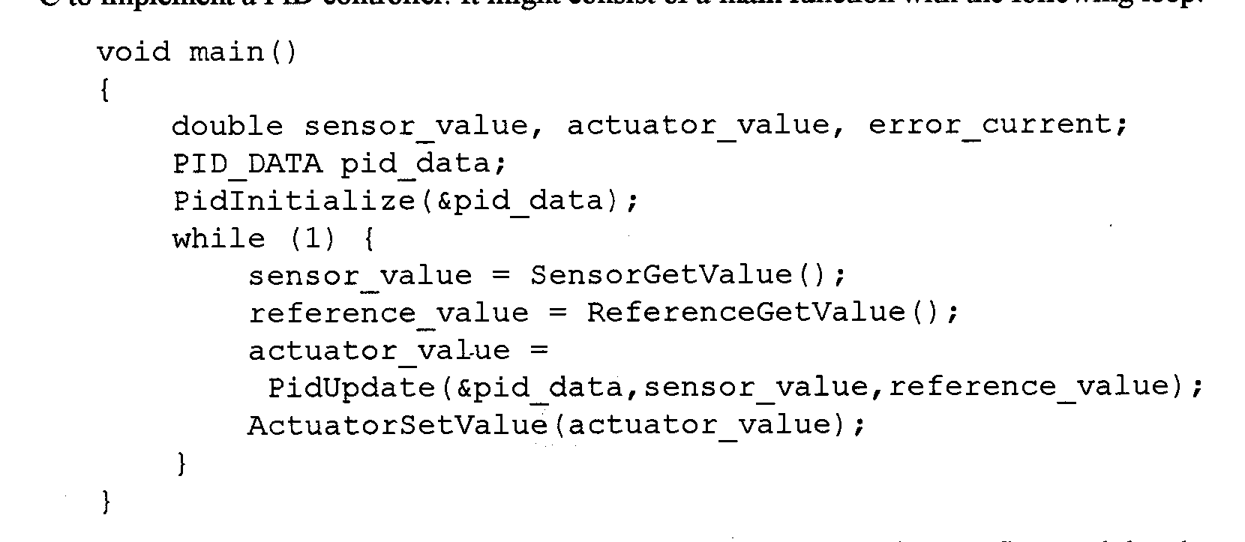
Software Coding
Main function loops forever, during each iteration
  Read plant output sensor
    May require A2D
  Read current desired reference input
  Call PidUpdate, to determine actuator value
  Set actuator value
    May require D2A

Slide 16
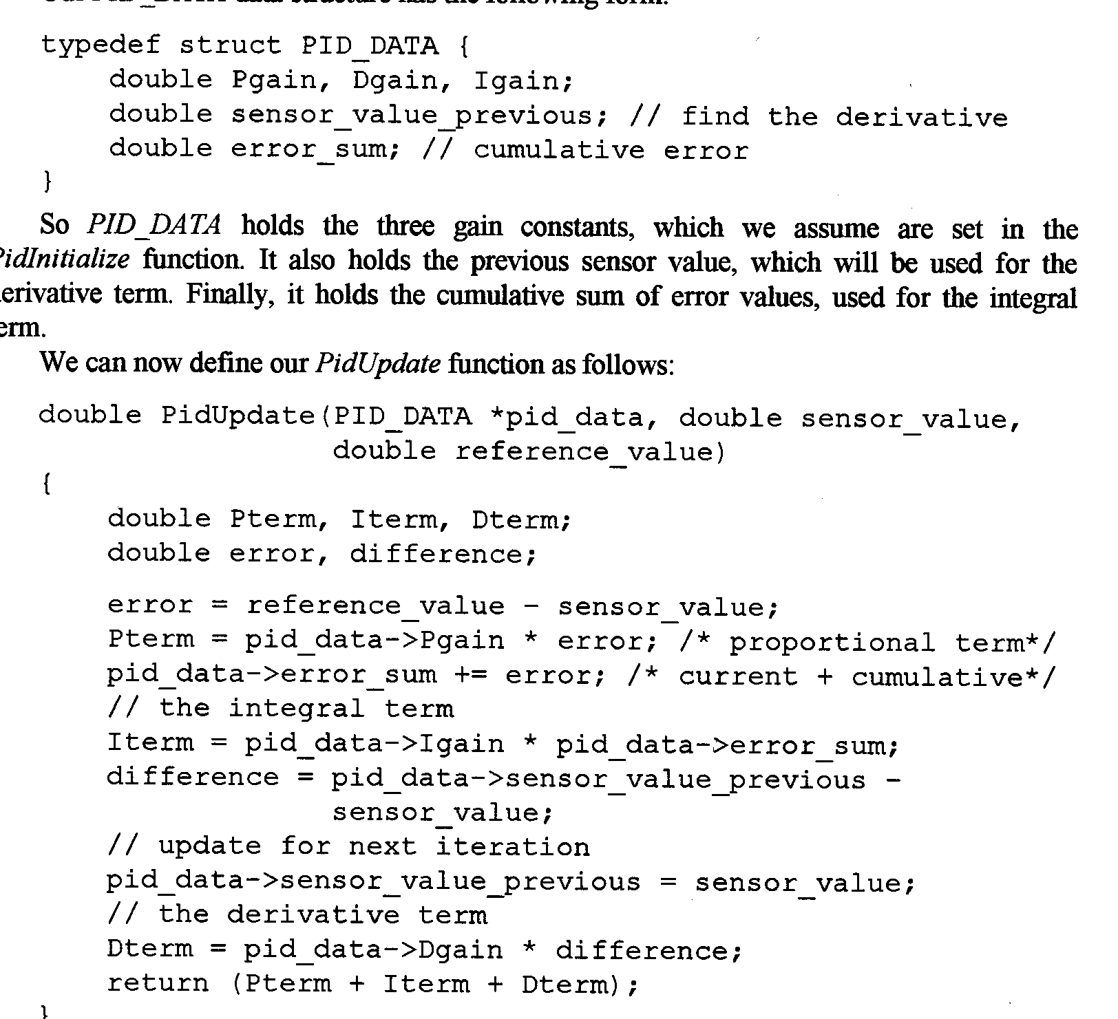
Computation
u_{t}=P*e_{t}+I*(e₀+e₁+…+e_{t})+D*(e_{t}-e_{t-1})

Slide 17
PID tuning
Analytically deriving P, I, D may not be possible
  E.g. plant not is not available, or to costly to obtain
Ad hoc method for getting “reasonable” P, I, D
  Start with a small P, I=D=0
  Increase D, until seeing oscillation
    Reduce D a bit
  Increase P, until seeing oscillation
    Reduce D a bit
  Increase I, until seeing oscillation
Iterate until cannot change anything without excessive oscillation

Slide 18
Practical Issues with Computer-Based Control
Quantization
Overflow
Aliasing
Computation Delay

Slide 19
Quantization & Overflow
Quantization
  Can’t store 0.36 as 4-bit fractional number
  Can only store 0.75, 0.59, 0.25, 0.00, -0.25, -050,-0.75, -1.00
  Choose 0.25
    Result in quantization error of 0.11
Sources of quantization error
  Operations, e.g. 0.50*0.25=0.125
    Can use more bits until input/output to the environment/memory
  A2D converters
Overflow
  Can’t store 0.75+0.50 = 1.25 as 4-bit fractional number
Solutions
  Use fix-point representation/operations carefully
    Time-consuming
  Use floating-point co-processor
    Costly

Slide 20
Computation Delay
Inherent delay in processing
  Actuation occurs later than expected
Need to characterize implementation delay to make sure it is negligible
Hardware delay is usually easy to characterize
  Synchronous design
Software delay is harder to predict
  Should organize code carefully so delay is predictable and minimized
  Write software with predictable timing behavior (be like hardware)
    Time-Triggered Architecture
    Synchronous Software Language

Slide 21
Benefits of Computer Control
Cost
  Expensive to make analog control immune to
    Age, temperature, manufacturing error
  Computer control replace complex analog hardware with complex code
Programmability
  Computer Control can be “upgraded”
    Change in control mode, gain, are easy to do
  Computer Control can be adaptive to change in plant
    Due to age, temperature, …etc
  “future-proof”
    Easily adapt to change in standards,..etc

Slide 22
Conclusion
Embedded Systems Design
  Too many design and other constraints
  Creates optimization opportunities
Efficient design and verification technqiues
  Need to specify and analyze the system
  Capture hardware/software modules as well as analog/digital components
  Perform design automation including
    Compiler/simulator generation
    Estimation and evaluation
    Design space exploration
    Architecture synthesis
    Functional verification

