Slide 1
Software Components
Introduction
Prediction of execution time
Scheduling in real-time systems
  Classification of scheduling algorithms
  Aperiodic scheduling
  Periodic scheduling
  Resource access protocols
Embedded operating systems
  Real-time OS
Middleware
Conclusion
CIS 6930 – Spring 2008 Copyright © 2007 Prabhat Mishra

Slide 2










Embedded Systems Design Flow
Hardware Components
Hardware
Design
(Synthesis, Layout, …)
Concept
HW/SW
Partitioning
Specification
Design
(Compilation, …)
Estimation -
Exploration
Software
Software Components
Validation and Evaluation (area, power, performance, …)

Slide 3
Reuse of standard software components
Knowledge from previous designs to be made available in the form of intellectual property (IP, for SW & HW).
  Operating systems
  Middleware
  Real-time data bases
  Standard software (MPEG-x, GSM-kernel, …)
Includes standard approaches for scheduling (requires knowledge about execution times).

Slide 4
Worst Case Execution Time
Def.: The worst case execution time (WCET) is an upper bound on the execution times of tasks.
  Computing such a bound is undecidable
    Possible for programs without recursion and finite loops
      Pipeline hazards, interrupts, caches ➔ serious overestimates
Approaches:
  Hardware: typically requires hardware synthesis
  Software: requires availability of machine programs; complex analysis

Slide 5
Average Execution Time
Estimated cost and performance values
  Difficult to generate sufficiently precise estimates
  Balance between run-time and precision
Accurate cost and performance values
  Can be done with normal tools (such as compilers).
  As precise as the input data is.

Slide 6
Software Components
Prediction of execution time
Scheduling in real-time systems
  Classification of scheduling algorithms
  Aperiodic scheduling
  Periodic scheduling
  Resource access protocols
Embedded operating systems
  Real-time OS
Middleware

Slide 7
Real-Time Scheduling
Assume that we have a task graph G=(V,E).
A schedule of G is a mapping, V → T, of a set of tasks V to start times from domain T.
Schedules have to respect a set of constraints, such as resource, dependency, and deadlines.
  Scheduling is the process of finding such a mapping.
During the design of embedded systems, scheduling has to be performed several times
  early rough scheduling as well as late precise scheduling

Slide 8
Software Components
Prediction of execution time
Scheduling in real-time systems
  Classification of scheduling algorithms
  Aperiodic scheduling
  Periodic scheduling
  Resource access protocols
Embedded operating systems
  Real-time OS
Middleware

Slide 9
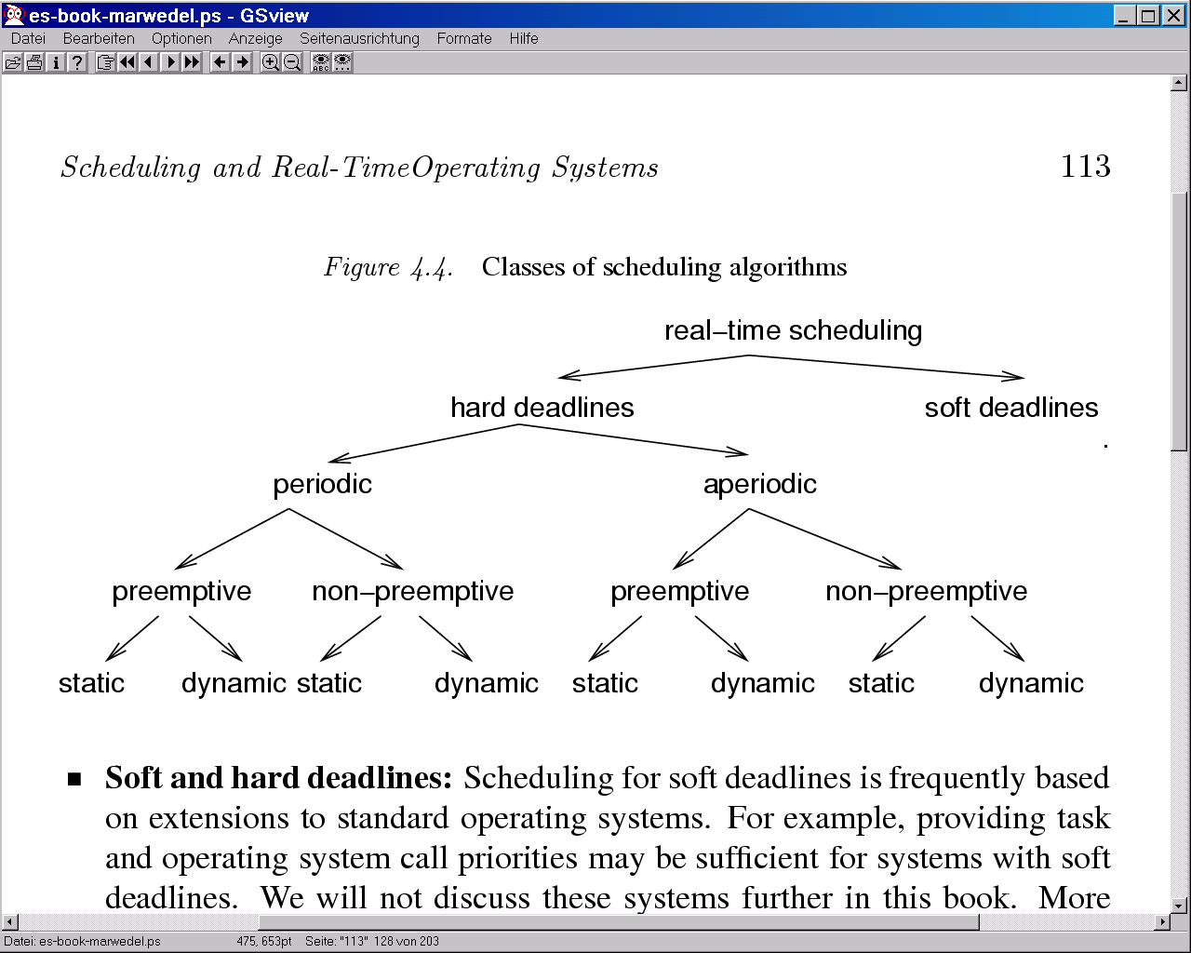
Classification of Scheduling Algorithms

Slide 10
Hard and Soft Deadlines
Def.: A time-constraint (deadline) is called hard if not meeting that constraint could result in a catastrophe [Kopetz, 1997]. All other time constraints are called soft.
We will focus on hard deadlines.

Slide 11
Periodic and Aperiodic Tasks
Def.: Tasks which must be executed once every p units of time are called periodic tasks. p is called their period. Each execution of a periodic task is called a job.
  All other tasks are called aperiodic.
Def.: Aperiodic tasks requesting the processor at unpredictable times are called sporadic, if there is a minimum separation between the times at which they request the processor.

Slide 12
Preemptive and Non-preemptive Scheduling
Preemptive and non-preemptive scheduling: Non-preemptive schedulers are based on the assumption that tasks are executed until they are done. As a result the response time for external events may be quite long if some tasks have a large execution time.
  Preemptive schedulers have to be used if some tasks have long execution times or if the response time for external events is required to be short.

Slide 13
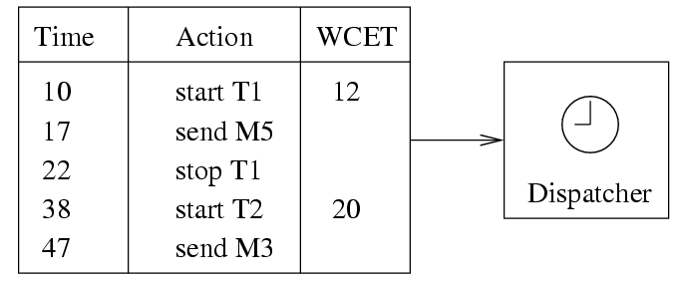
Static and Dynamic Scheduling
Dynamic scheduling: Processor allocation decisions (scheduling) done at run-time.
Static scheduling: Processor allocation decisions (scheduling) done at design-time.
  Dispatcher allocates processor when interrupted by a timer. The timer is controlled by a table generated at design time.

Slide 14
Centralized and Distributed Scheduling
Centralized and distributed scheduling
  Multiprocessor scheduling either locally on one or distributed on several processors
Mono- and multi-processor scheduling
  Simple scheduling algorithms handle single processors, more complex algorithms handle multiple processors.
Online- and offline scheduling:
  Online scheduling is done at run-time based on the information about the tasks arrived so far.
  Offline scheduling assumes prior knowledge about arrival times, execution times, and deadlines.

Slide 15
Software Components
Prediction of execution time
Scheduling in real-time systems
  Classification of scheduling algorithms
  Aperiodic scheduling
  Periodic scheduling
  Resource access protocols
Embedded operating systems
  Real-time OS
Middleware

Slide 16
Schedulability
A set of tasks is said to be schedulable under a given set of constraints, if a schedule exists for that set of tasks and constraints.
  Exact tests are NP-hard in many situations.
  Sufficient tests: sufficient conditions for guaranteeing a schedule are checked.
    Small probability of false negative.
  Necessary tests: checking necessary conditions. Can be used to show that no schedule exists.
    Always not possible to prove even if no schedule exists.

Slide 17
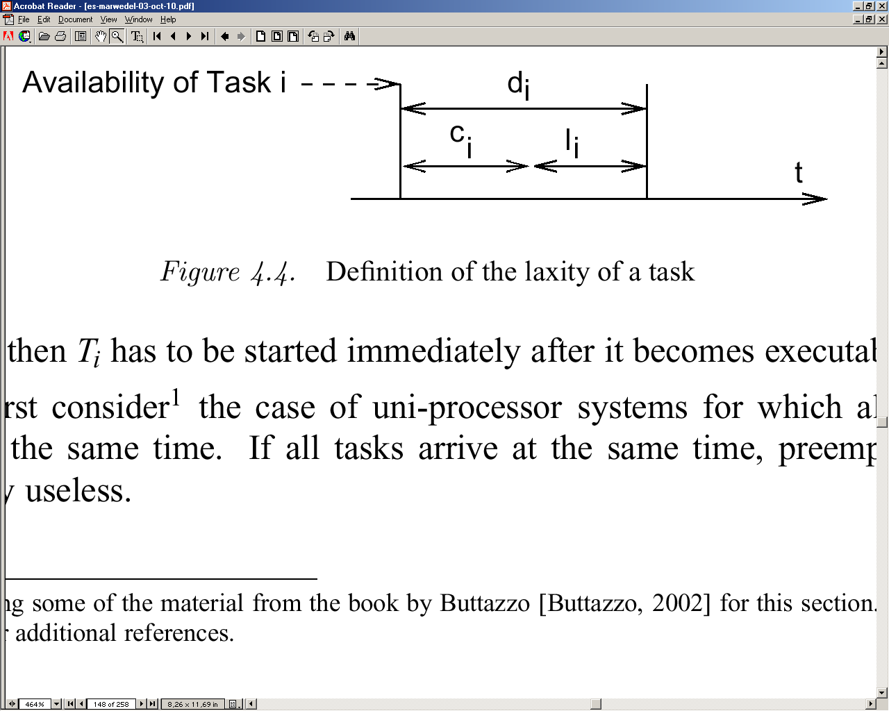
Cost Functions
Cost function: Different algorithms aim at minimizing different functions.
Def.: Maximum lateness is defined as the difference between the completion time and the deadline, maximized over all tasks.
  Maximum lateness is negative if all tasks complete before their deadline.

Slide 18
Scheduling with no Precedence Constraints
Let {T_{i} } be a set of tasks. Let:
  c_{i} be the execution time of T_{i} ,
  d_{i} be the deadline interval, that is, the time between T_{i} becoming available
  and the time until which T_{i} has to finish execution.
  l_{i} be the laxity or slack, defined as l_{i} = d_{i} - c_{i}

Slide 19
Uniprocessor with Same Arrival Times
Preemption is useless.
Earliest Due Date (EDD): Based on Jackson's rule:
  Given a set of n independent tasks, any algorithm that executes the tasks in order of non-decreasing deadlines is optimal with respect to minimizing the maximum lateness. Proof: See [Buttazzo, 2002]
  EDD requires all tasks to be sorted by their deadlines. Complexity is O(n log(n)).

Slide 20
Earliest Deadline First (EDF)
Different arrival times
  Preemption potentially reduces lateness.
Theorem [Horn74]: Given a set of n independent tasks with arbitrary arrival times, any algorithm that at any instant executes the task with the earliest absolute deadline among all the ready tasks is optimal with respect to minimizing the maximum lateness.
Earliest deadline first (EDF): each time a new ready task arrives, it is inserted into a queue of ready tasks, sorted by their deadlines. If a newly arrived task is inserted at the head of the queue, the currently executing task is preempted.
  If sorted lists are used, the complexity is O(n²)

Slide 21
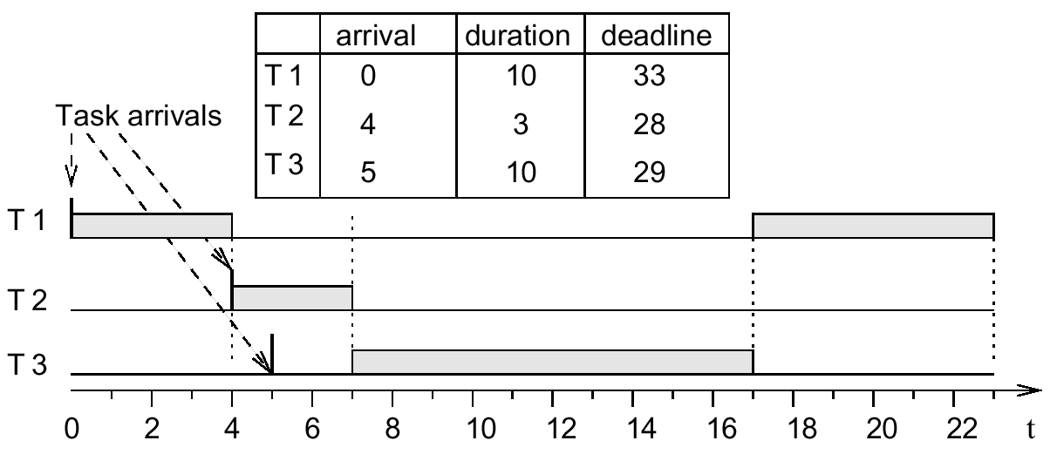
Earliest Deadline First (EDF)
Earlier deadline
☞ preemption
Later deadline
☞ no preemption

Slide 22
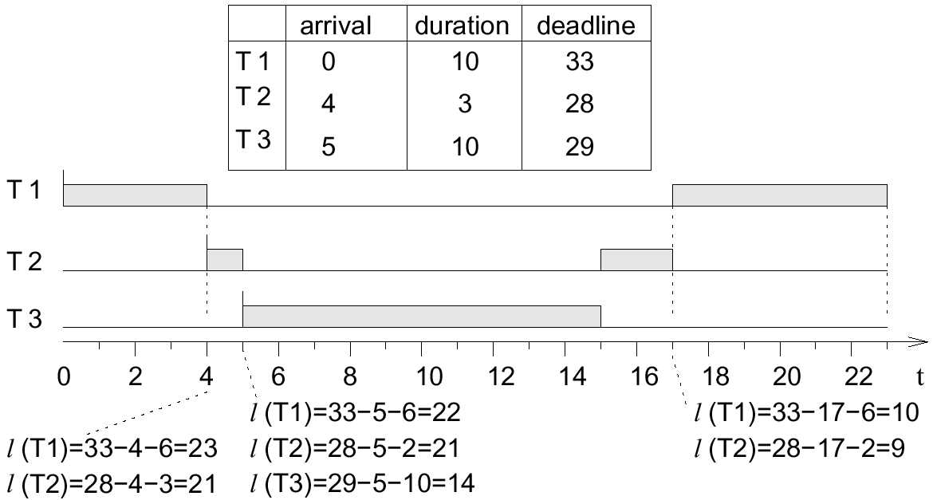
Least laxity, Least Slack Time First
Priorities = decreasing function of the laxity (the less laxity, the higher the priority); dynamically changing priority; preemptive.
Requires calling the scheduler periodically, and to recompute the laxity. Overhead for many calls of the scheduler and many context switches.Detects missed deadlines early.

Slide 23
Properties
LL is also an optimal scheduling for uni-processor systems. Dynamic priorities cannot be used with a fixed priority OS.
LL scheduling requires the knowledge of the execution time.
Scheduling without Preemption
Lemma: If preemption is not allowed, optimal schedules may have to leave the processor idle at certain times.
Proof: Assume optimal schedulers never leave processor idle

Slide 24
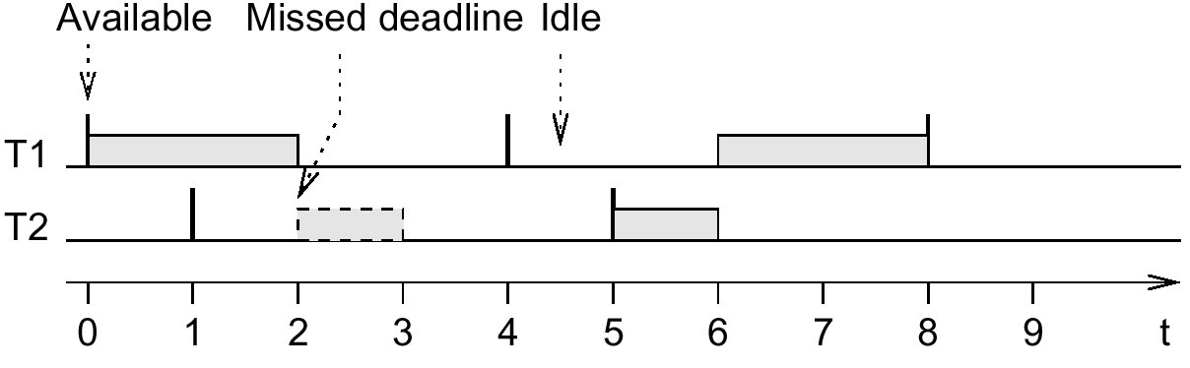
Scheduling without Preemption
T1: periodic, c₁ = 2, p₁ = 4, d₁ = 4
T2: occasionally available at times 4*n+1, c₂= 1, d₂= 1
T1 has to start at t=0
deadline missed, but schedule is possible
  start T2 first
  scheduler is not optimal ➔ contradiction!

Slide 25
Scheduling without Preemption
Optimal schedules may leave processor idle to finish tasks with early deadlines arriving late.
  Knowledge about the future is needed for optimal
  scheduling algorithms
    No online algorithm can decide whether or not to keep idle.
EDF is optimal among all sched. algorithms not keeping the processor idle at certain times.
If arrival times are known a priori, the sched. problem becomes NP-hard in general.
  Branch and bound techniques are typically used.

Slide 26
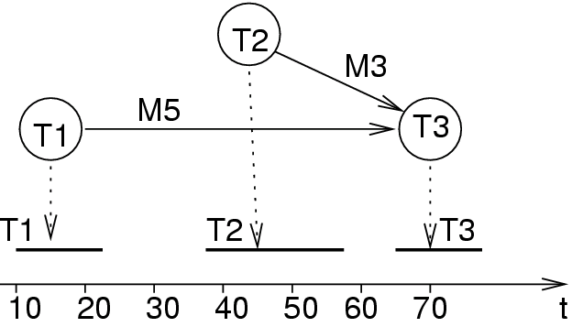
Scheduling with Precedence Constraints
Task graph and possible schedule:
Schedule can be stored in a table.

Slide 27
Synchronous Arrival Times
LDF [Lawler, 1973]: Generation of total order compatible with the partial order described by the task graph (LDF performs a topological sort).
LDF reads the task graph and inserts tasks with no successors into a queue. It then repeats this process, putting tasks whose successor have all been selected into the queue.
  At run-time, the tasks are executed in the generated total order.
  LDF is non-preemptive and is optimal for uni-processors.
Latest Deadline First (LDF)

Slide 28
Asynchronous Arrival Times
This case can be handled with a modified EDF algorithm.
  The key idea is to transform the problem from a given set of dependent tasks into a set of independent tasks with different timing parameters [Chetto90].
This algorithm is optimal for uni-processor systems.
If preemption is not allowed, the heuristic algorithm developed by [Stankovic and Ramamritham 1991] can be used.

Slide 29
Software Components
Prediction of execution time
Scheduling in real-time systems
  Classification of scheduling algorithms
  Aperiodic scheduling
  Periodic scheduling
  Resource access protocols
Embedded operating systems
  Real-time OS
Middleware

Slide 30
Periodic Scheduling
T1
T2
For periodic scheduling, the best that we can do is to design an algorithm which will always find a schedule if one exists.
  A scheduler is defined to be optimal iff it will find a schedule if one exists.

Slide 31
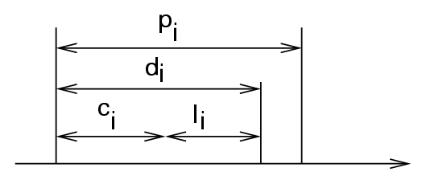
Periodic scheduling
Let
  p_{i} be the period of task T_{i},
  c_{i} be the execution time of T_{i},
  d_{i} be the deadline interval, that is, the time between a job of T_{i} becoming available and the time after which the same job T_{i} has to finish execution.
  l_{i} be the laxity or slack, defined as l_{i} = d_{i} - c_{i}

Slide 32
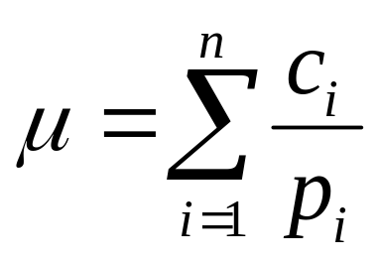
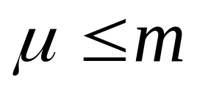
Accumulated Utilization
Accumulated utilization:
Necessary condition for schedulability
(with m = number of processors):

Slide 33
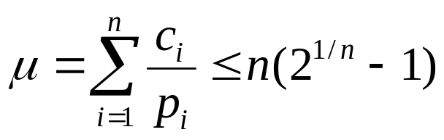
Rate Monotonic (RM) Scheduling
Well-known technique for scheduling independent periodic tasks [Liu, 1973].
Assumptions:
  All tasks that have hard deadlines are periodic.
  All tasks are independent.
  d_{i}=p_{i}, for all tasks.
  c_{i} is constant and is known for all tasks.
  The time required for context switching is negligible
  For a single processor with n tasks, the following equation holds for the accumulated utilization µ:

Slide 34
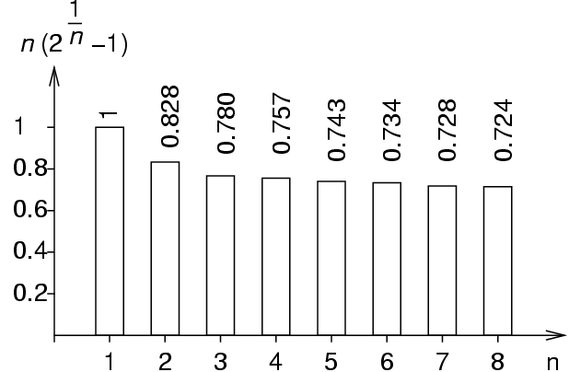
Rate Monotonic (RM) Scheduling
RM policy: The priority of a task is a monotonically decreasing function of its period.
At any time, a highest priority task among all those that are ready for execution is allocated.
If all assumptions are met, schedulability is guaranteed.
Maximum utilization as a function of the number of tasks:

Slide 35
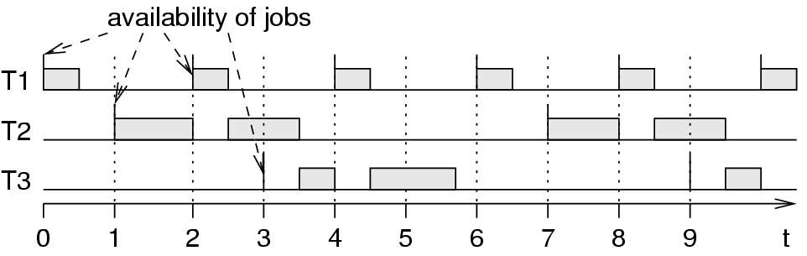
Example: RM-generated schedule
Period Execution Time
T1: 2 0.5
T2: 6 2
T3: 6 1.75
T1 preempts T2 and T3.
T2 and T3 do not preempt each other.

Slide 36
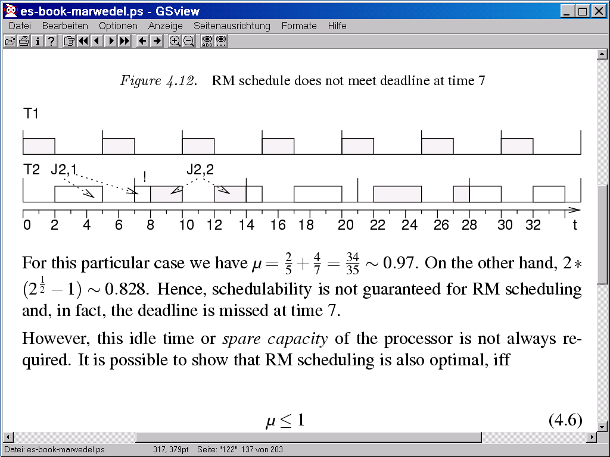
Case of Failing RM Scheduling
Task 1: period 5, execution time 2
Task 2: period 7, execution time 4
µ=2/5+4/7=34/35 ≈ 0.97
2(2^{1/2}-1) ≈ 0.828
Not enough idle time
Missed deadline
Missing computations scheduled in the next period

Slide 37
Properties of RM Scheduling
RM scheduling is based on static priorities.
  This allows RM scheduling to be used in standard OS, such as Windows NT.
  Many variations of RM scheduling exists.
In the context of RM scheduling, many formal proofs exist. The idle capacity is not required if the period of all tasks is a multiple of the period of the highest priority task
  Necessary condition for schedulability: µ ≤ 1

Slide 38
EDF
EDF can also be applied to periodic scheduling.
EDF optimal for every period
  Optimal for periodic scheduling
  EDF must be able to schedule the example in which RMS failed.
EDF requires dynamic priorities
  EDF cannot be used with a standard operating system just providing static priorities.

Slide 39
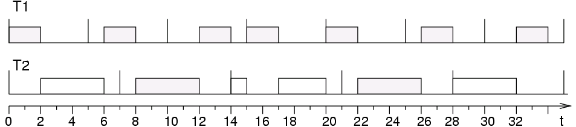
Comparison EDF/RMS
RMS:
EDF:
T2 not preempted, due to its earlier deadline.

Slide 40
Dependent Tasks
The problem of deciding whether or not a schedule exists for a set of dependent tasks and a given deadline is NP-complete [Garey/Johnson].
Strategies:
  Add resources, so that scheduling becomes easier
  Split problem into static and dynamic part so that decisions during run-time is minimized.

Slide 41
Sporadic Tasks
If sporadic tasks were connected to interrupts, the execution time of other tasks would become very unpredictable.
  Introduction of a sporadic task server,
  periodically checking for ready sporadic tasks;
  Sporadic tasks are essentially turned into periodic tasks.

Slide 42
Software Components
Prediction of execution time
Scheduling in real-time systems
  Classification of scheduling algorithms
  Aperiodic scheduling
  Periodic scheduling
  Resource access protocols
Embedded operating systems
  Real-time OS
Middleware

Slide 43
Resource access protocols
Critical sections: sections of code at which
exclusive access to some resource must be guaranteed.
Can be guaranteed with semaphores S.
Task 1
Task 2
P(S) checks semaphore to see if resource is available
and if yes, sets S to “used“. Uninterruptable operations!
If no, calling task has to wait.
V(S) sets S to “unused“ and starts sleeping task (if any).
P(S)
P(S)
Exclusive
access
to resource
guarded by
S
V(S)
V(S)

Slide 44
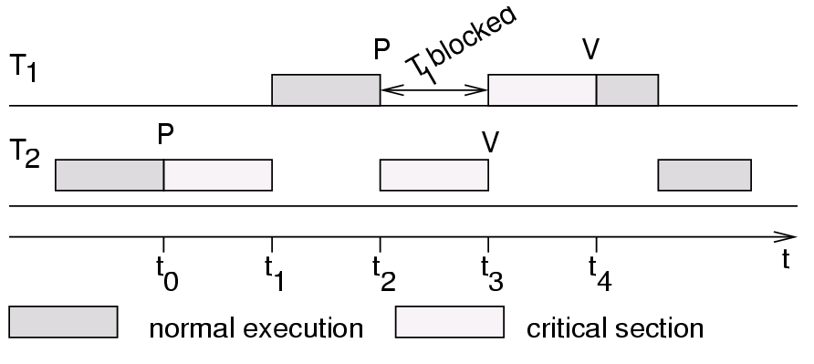
Priority Inversion
Priority T₁ assumed to be > than priority of T₂.
If T₂ requests exclusive access first (at t₀), T₁ has to wait until T₂ releases the resource (time t₃), thus inverting the priority:
Duration of inversion bounded by length of critical section of T₂.

Slide 45
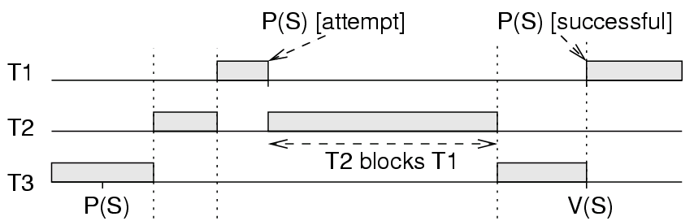
Priority Inversion with >2 Tasks
Duration of priority inversion with >2 tasks can exceed the length of critical section
Priorities: T1 > T2 > T3.
  T2 preempts T3:
  T2 can prevent T3 from releasing the resource.

Slide 46
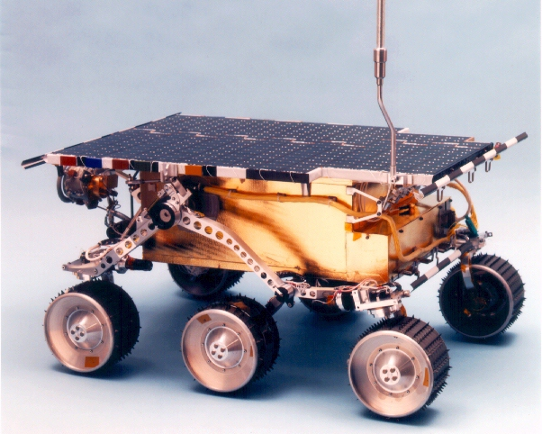
The MARS Pathfinder Problem
“But a few days into the mission, not long after Pathfinder started gathering meteorological data, the spacecraft began experiencing total system resets, each resulting in losses of data. The press reported these failures in terms such as "software glitches" and "the computer was trying to do too many things at once".” …

Slide 47
The MARS Pathfinder Problem
“VxWorks provides preemptive priority scheduling of threads. Tasks on the Pathfinder spacecraft were executed as threads with priorities that were assigned in the usual manner reflecting the relative urgency of these tasks.”
“Pathfinder contained an "information bus", which you can think of as a shared memory area used for passing information between different components of the spacecraft. A bus management task ran frequently with high priority to move certain kinds of data in and out of the information bus. Access to the bus was synchronized with mutual exclusion locks (mutexes).”

Slide 48
The MARS Pathfinder Problem
“The meteorological data gathering task ran as an infrequent, low priority thread, and used the information bus to publish its data. When publishing its data, it would acquire a mutex, do writes to the bus, and release the mutex. If an interrupt caused the information bus thread to be scheduled while this mutex was held, and if the information bus thread then attempted to acquire this same mutex in order to retrieve published data, this would cause it to block on the mutex, waiting until the meteorological thread released the mutex before it could continue. The spacecraft also contained a communications task that ran with medium priority.”
High priority: retrieval of data from shared memory
Medium priority: communications task
Low priority: thread collecting meteorological data

Slide 49
The MARS Pathfinder Problem
“Most of the time this combination worked fine. However, very infrequently it was possible for an interrupt to occur that caused the (medium priority) communications task to be scheduled during the short interval while the (high priority) information bus thread was blocked waiting for the (low priority) meteorological data thread. In this case, the long-running communications task, having higher priority than the meteorological task, would prevent it from running, consequently preventing the blocked
information bus task from running. After some time had passed, a watchdog timer would go off, notice that the data bus task had not been executed for some time, conclude that something had gone drastically wrong, and initiate a total system reset. This scenario is a classic case of priority inversion.”

Slide 50
Priority Inheritance
Tasks are scheduled according to their active priorities. Tasks with the same priorities follows FCFS.
If task T1 executes P(S) and exclusive access granted to T2: T1 is blocked. If priority(T2) < priority(T1): T2 inherits the priority of T1.
  Tasks inherit the highest priority of tasks blocked by it.
When T2 executes V(S), its priority is decreased to the lowest priority of the tasks blocked by it.
  If no other task blocked by T2: priority(T2):= orig. value.
  Highest priority task so far blocked on S is resumed.
Priority inheritance is transitive: if T1 blocks T0
and T2 blocks T1, then T2 inherits the priority of T0.

Slide 51
Example
How would priority inheritance affect our example with 3 tasks?
T3 inherits the priority of T1 and T3 resumes.
V(S)

Slide 52
Priority Inversion on Mars
Priority inheritance also solved the Mars Pathfinder problem: the VxWorks operating system used in the pathfinder implements a flag for the calls to mutex primitives. This flag allows priority inheritance to be set to “on”. When the software was shipped, it was set to “off”.
The problem on Mars was corrected by using the debugging facilities of VxWorks to change the flag to “on”, while the Pathfinder was already on the Mars [Jones, 1997].

Slide 53
Remarks on Priority Inheritance
Priority inheritance protocol does not solve
  Large number of tasks with high priority.
  Possible deadlocks.
More sophisticated protocol: priority ceiling protocol [Sha et al., 1990].

Slide 54
Software Components
Prediction of execution time
Scheduling in real-time systems
  Classification of scheduling algorithms
  Aperiodic scheduling
  Periodic scheduling
  Resource access protocols
Embedded operating systems
  Real-time OS
Middleware

Slide 55
Embedded OS: Requirements
Configurability
No single RTOS will fit all needs, no overhead for unused functions tolerated ➔ configurability needed.
  simplest form: remove unused functions.
  Conditional compilation (using #if and #ifdef commands).
  Dynamic data might be replaced by static data.
  Advanced compile-time evaluation useful.
  Object-orientation could lead to a derivation subclasses.
Verification is a potential problem
  Each derived OS must be tested thoroughly;
    Example: eCos (open source RTOS from RedHat), including 100 to 200 configuration points [Takada, 01].

Slide 56
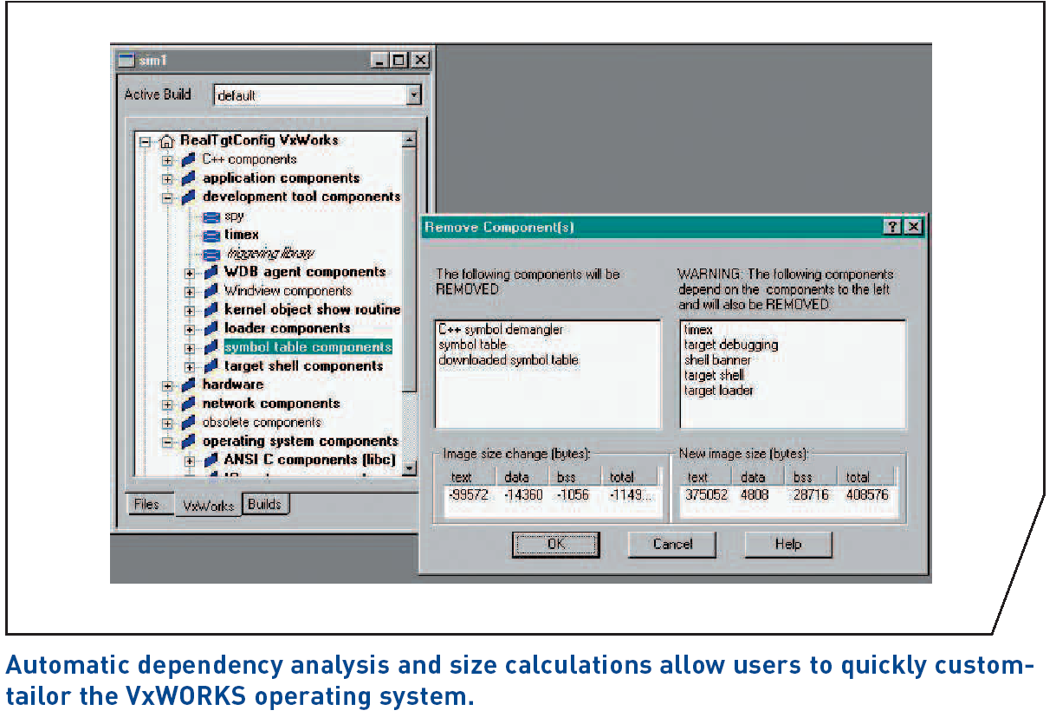
Configuration of VxWorks
© Windriver

Slide 57
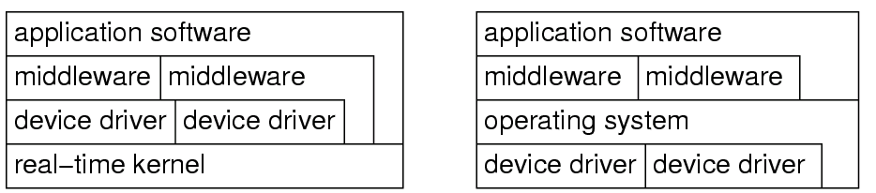
Disc and network handled by tasks
Disc and network handled by tasks instead of integrated drivers
  Many ES without disc, keyboard, screen or mouse.
  Effectively no device that needs to be supported by all versions of the OS, except maybe system timer.
  Relatively slow discs & networks can be handled by tasks.
RTOS
Standard OS

Slide 58
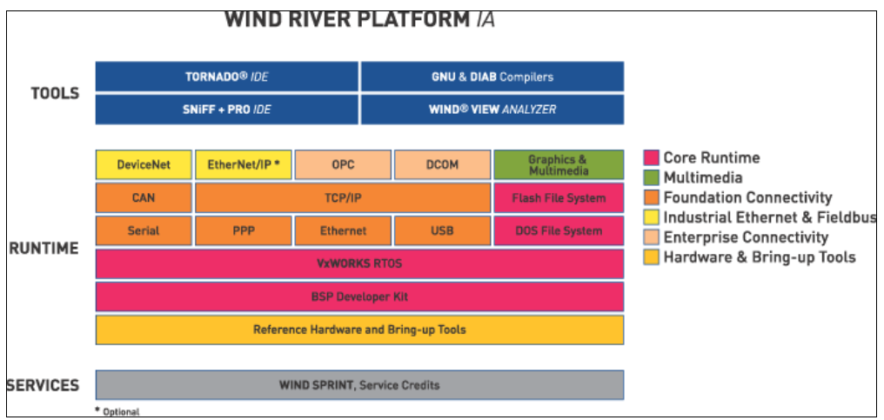
WindRiver Platform Industrial Automation
© Windriver

Slide 59
Protection is Optional
Protection mechanisms not always necessary
  ES typically designed for a single purpose,
  untested programs rarely loaded, SW considered reliable.
    protection mechanisms may be needed for safety and security reasons.
  No desire to implement I/O instructions as privileged instructions and tasks can be allowed to do their own I/O.
  Example: Let switch be the address of some switch
  Simply use
  load register,switch
  instead of OS call.

Slide 60
Interrupts not restricted to OS
Interrupts can be employed by any process
  [For standard OS: serious source of unreliability]
  embedded programs can be considered to be tested,
  since protection is not necessary and
  since control over a variety of devices is required,
It is possible to let interrupts directly start or stop tasks
  Store the tasks start address in the interrupt table.
  More efficient than going through OS services.
    composability suffers: if a specific task is connected to some interrupt, it may be difficult to add another task which also needs to be started by an event.

Slide 61
Real-Time Operating Systems (RTOS)
Def.: (A) real-time operating system is an operating system that supports the construction of real-time systems [Takada, 2001]
Three key requirements
The timing behavior of OS must be predictable
  short times during which interrupts are disabled,
  contiguous files to avoid unpredictable head movements.
OS must manage timing and scheduling
  OS possibly has to be aware of task deadlines; OS must provide precise time services with high resolution.
The OS must be fast

Slide 62
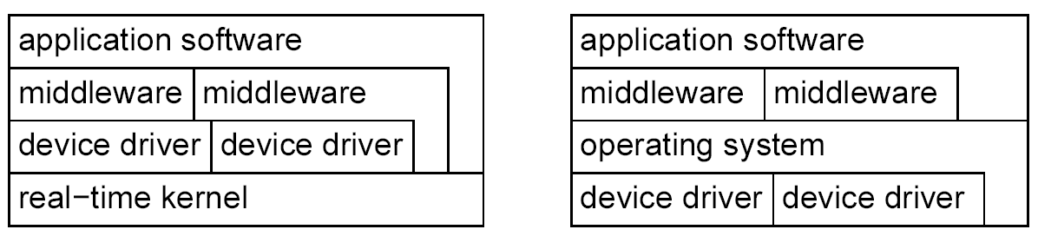
RTOS-Kernels
Real-time Kernel
General Purpose OS
Distinction between
  general RTOSes and RTOSes for specific domains,
  standard APIs (e.g. POSIX RT-Extension of Unix, ITRON, OSEK) or proprietary APIs.

Slide 63
Functionality of RTOS-Kernels
Includes
  processor management,
  memory management,
  and timer management;
  task management (resume, wait etc),
  inter-task communication and synchronization.
resource management

Slide 64
1. Fast Proprietary Kernels
For complex systems, these kernels are inadequate, because they are designed to be fast, rather than to be predictable in every respect
[R. Gupta, UCSD]
  Examples
    QNX, PDOS, VCOS, VTRX32, VxWORKS.

Slide 65
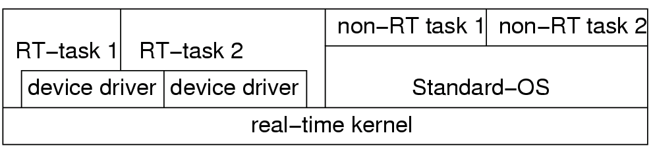
2. Real-time ext. to standard OS
Attempt to exploit main stream OSes.
RT-kernel running all RT-tasks.
Standard-OS executed as one task.
+ Crash of standard-OS does not affect RT-tasks;
- RT-tasks cannot use Standard-OS services;
less comfortable than expected

Slide 66
3. Research OS
Research systems trying to avoid limitations.
  MARS, Spring, MARUTI, Arts, Hartos, DARK, Melody
Research issues [Takada, 2001]:
  Low overhead memory protection,
  Temporal protection of computing resources
  RTOSes for on-chip multiprocessors
  Support for continuous media
  Quality of service (QoS) control.
Competition between
  Traditional vendors (e.g. Wind River Systems) and
  Embedded Windows XP and Windows CE

Slide 67
Software Components
Prediction of execution time
Scheduling in real-time systems
  Classification of scheduling algorithms
  Aperiodic scheduling
  Periodic scheduling
  Resource access protocols
Embedded operating systems
  Real-time OS
Middleware
  Real-time databases
  Access to remote objects

Slide 68
Real-time Databases
Goal: store and retrieve persistent information
Transaction= sequence of read and write operations
Changes not final until they are committed
Requested (“ACID”) properties of transactions
  Atomic: state information as if transaction is either completed or had no effect at all.
  Consistent: Set of values retrieved from several accesses to the database must be possible in the world modeled.
  Isolation: No user should see intermediate states of transactions
  Durability: results of transactions should be persistent.

Slide 69
Real-time Databases
Problems with implementing real-time databases:
  transactions may be aborted various times before they are finally committed.
  For hard discs, the access times to discs are hardly predictable.
Possible solutions:
  Main memory data bases
  Relax ACID requirements

Slide 70
Software Components
Prediction of execution time
Scheduling in real-time systems
  Classification of scheduling algorithms
  Aperiodic scheduling
  Periodic scheduling
  Resource access protocols
Embedded operating systems
  Real-time OS
Middleware
  Real-time databases
  Access to remote objects

Slide 71
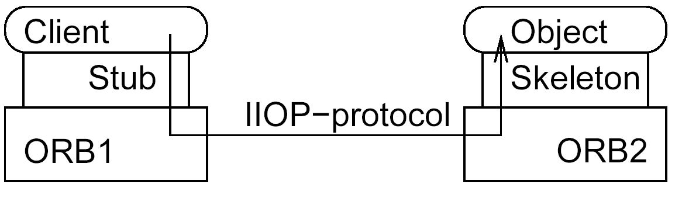
Access to Remote Objects
Software packages for access to remote services
Example: CORBA -Common Object Request Broker Architecture
Information sent to Object Request Broker (ORB) via local stub.
ORB determines location to be accessed and sends information via the IIOP I/O protocol.
Access times not predictable.

Slide 72
Real-time (RT-) CORBA
Essential features of RT-CORBA
  end-to-end predictability of timeliness in a fixed priority system.
  This involves respecting thread priorities between client and server for resolving resource contention,
  and bounding the latencies of operation invocations.
  Thread priorities might not be respected when threads obtain mutually exclusive access to resources (priority inversion).
  RT-CORBA includes provisions for bounding the time during which such priority inversion can happen.

Slide 73
Message Passing Interface (MPI)
Message passing interface (MPI)
  alternative to CORBA
MPI/RT: a real-time version of MPI
  [MPI/RT forum, 2001].
MPI-RT does not cover issues such as thread creation and termination.
MPI/RT is conceived as a potential layer between the operating system and standard (non real-time) MPI.

