Slide 1
IMGUR API (and koalas?)
Rich Chang
Phil House

Slide 2
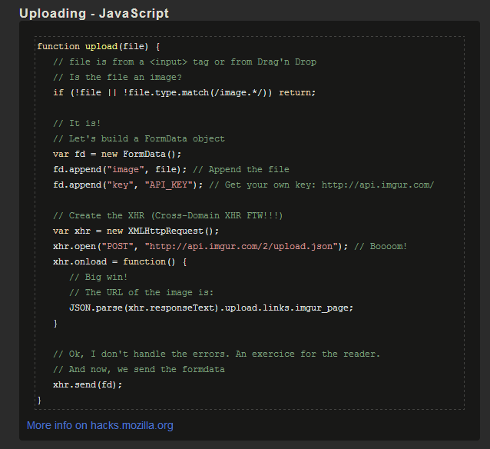
Making the URL pt.1

Slide 3
Making the URL pt2
Imgur returns
http://imgur.com/XoLwv
We want
http://i.imgur.com/Xolwvb.jpg
add i.imgur in the middle
Add b at the end for thumbnail
Add .jpg at the end

Slide 4
Adding img to html
var img = document.createElement("img");
img.src = url;
var imgur = document.getElementById('imgur');
imgur.appendChild(img);

Slide 5
koalastothemax
Koalastothemax.com?<img.url>
var koala_url = "http://www.koalastothemax.com/?"+url;
var lnk = document.createElement("a");
lnk.href = koala_url;
lnk.innerHTML = 'koala';
var koala = document.getElementById('koala');
koala.appendChild(lnk);

