Slide 1
NDN-Hangman
Chih Chang
Dennis Chan, dennischan@ucla.edu
Jinda Zhuang, jindazhuang@gmail.com

Slide 2

The Big Picture!
Why Hangman?
A multiplayer mobile hangman game provides several unique challenges and potential for future considerations in NDN architecture design

Slide 3
Key Points
Goals and problem definition
NDN specific designs and reasoning
Schedule and progress
Notes:
Future consideration: how our little protocol can be used for chat (borrowing CSMA/CA ideas “don’t interrupt people”)

Slide 4
The complexity of Hangman
1
Goals and problem definition

Slide 5
Goals
Implement an Android game on NDN using NFD-Android
Understand naming complexity
Design and build a protocol to facilitate host-less synchronous communication with minimal overhead

Slide 6
Related Protocols
ChronoSync
Host-less sync protocol with persistent storage
Maintain history in data packet
Maintain Sync Interest
ACT
Exclusion filter
“Conference initiator”
Generate list using “outstanding” Interest

Slide 7
The NDN way of thinking
2
Designs and reasoning

Slide 8
Our Little Protocol
Instead of waiting for new sync data, those who have created data should be responsible for telling everyone else
Alice produces new data
Alice sends “i have new data” Interest prefix
Bob replies “I acknowledge your new data” Data
Bob sends “I want new data” Interest
Alice replies with new Data
Notes:
History is irrelevant. All we care about is the next sequence.
No need to maintain a sync interest because new data will be broadcasted first
A conference initiator may also delegate the task of announcing the conference to a third-party node or other participants in the conference.

Slide 9
Our Little Protocol (continued)
Only communicates delta
Use ACT method to update current list of participants
Exclusion filter generated implicitly by step 3
(Alternatively) Assume fixed participants
(Hangman Specific) Fixed participant and fixed order

Slide 10
Name
Game List
/ndn/hangman/public/lobby/
/ndn/hangman/public/lobby/<GameTitle>
/ndn/hangman/public/lobby/<GameTitle>/<Player>/joinAck
Start Game
/ndn/hangman/private/ingame/<GameTitle>/requestStart (from Game Creator)
/ndn/hangman/private/ingame/<GameTitle>/reqAnswer (from Players)
Notes:
joinAck can be replaced by outstanding player Interest
RequestStart is to set UI for every player and to generate word
reqAnswer seeks for the answer from the game creator

Slide 11
Name (continued)
<prefix> := /ndn/hangman/private/ingame/<GameTitle>/
End of Turn
<prefix>/<TurnNumber>/<Player>/requestEOT
<prefix>/<TurnNumber>/<Player>/update

Slide 12
Schedule and progress

Slide 13
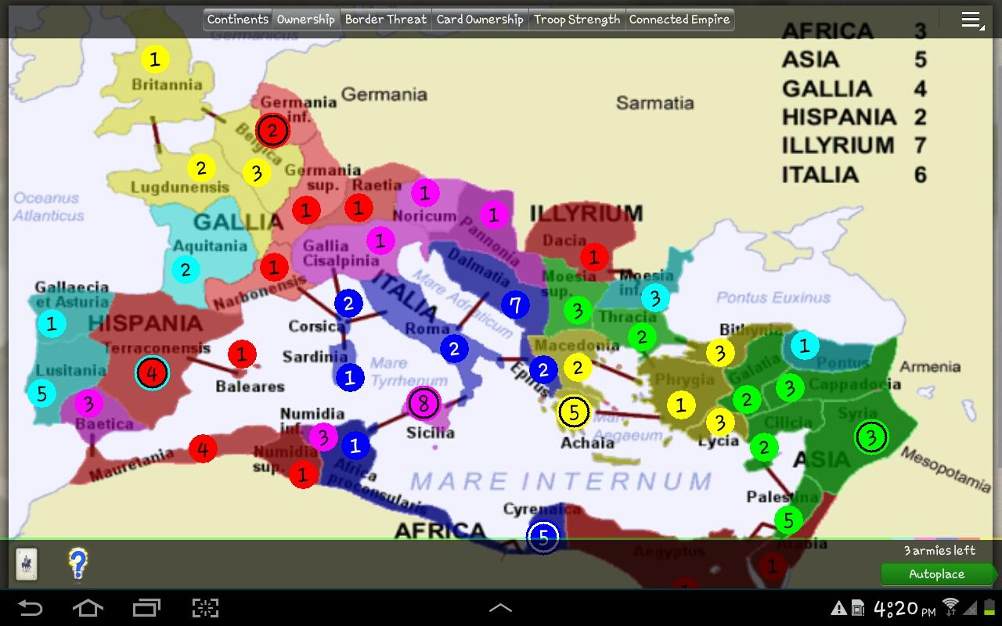
Overly Ambitious: Domination
Original idea
Port open-source game Domination
Source: https://play.google.com/store/apps/details?id=net.yura.domination

Slide 14
Overly Ambitious: Domination (continued)
Problems
Large codebase difficult to understand in short amount of time
Substantial amount of modifications needed to remove reliance on server
Not the focus of this class

Slide 15
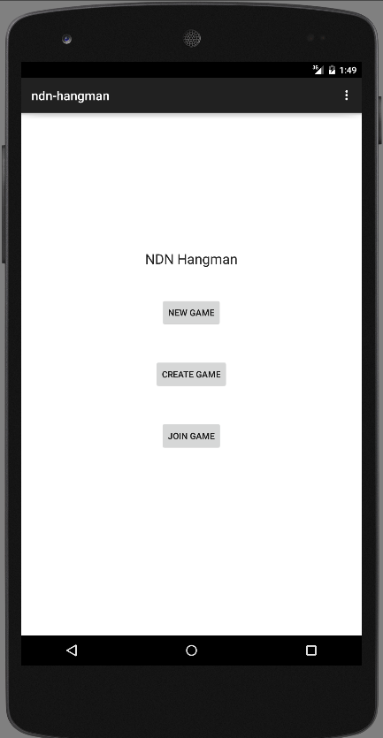
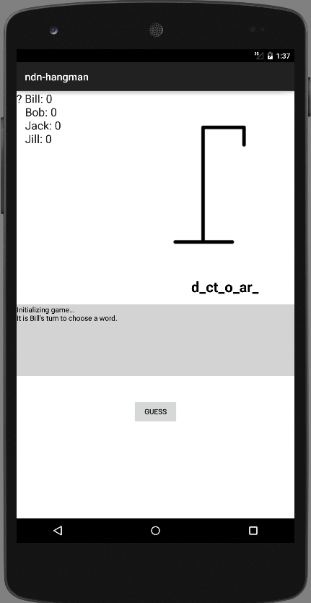
Basic Interface

Slide 16
Basic Interface (continued)
Game logic
‘New Game’ allows single player to play against AI opponents in order to test game functionality
‘Create Game’ and ‘Join Game’ still in progress
Multiplayer will use the same game screen

Slide 17
Milestones
Tentative Schedule
(5/10)Initialize and establish game sessions
(5/18)Create join game logic and initialize game state
(5/26)Implement current turn phase game logic
(6/1)Implement end game logic and cleanup
(6/5)Full function app test and debug
(TBD)Add game complexity/function (if time allows)

Slide 18
Questions?

