Slide 1


ANODR:
AN onymous O n-D emand R outing with Untraceable Routes for Mobile Ad Hoc Networks
MobiHOC 2003
June 3, 2003
Jiejun Kong, Xiaoyan Hong
Wireless-Adaptive-Mobility Laboratory
Department of Computer Science
University of California, Los Angeles

Slide 2

Passive Routing Attacks in MANET
Location Privacy Attack:
Correlate nodes’ ids and their locations
Location Privacy Attack:
Correlate nodes’ ids and their locations
Motion Inference Attack:
Visualize nodes’ motion patterns
Motion Inference Attack:
Visualize nodes’ motion patterns
Route Tracing Attack:
Visualize (multi-hop) ad hoc routes
Route Tracing Attack:
Visualize (multi-hop) ad hoc routes
Passive Attacker

Slide 3
Passive Routing Attacks in MANET
Location privacy attack
  Correlate a mobile node with its locations (at the granularity of adversary’s adjustable radio receiving range)
  Counting/analyzing mobile nodes in a cell
Route tracing attack
  Visualizing ad hoc routes
Motion inference attack
  Visualizing motion patterns of mobile nodes
  Deducing motion pattern of a set of nodes
Other traffic analysis
  Analyzing packet flow metrics (as in Internet traffic analysis)
Orthogonal to routing disruption attacks
Notes:
Why is it important? Military MANET.

Slide 4
Adversary in Mobile Ad Hoc Networks
External adversary: wireless link intruder
  Eavesdropper
  Traffic analyst (not necessary to break cryptosystem)
  Unbounded interception: adversary can sniff anywhere anytime
Internal adversary: mobile node intruder
  Capture, compromise, tamper
  Passive internal adversary is hard to detect due to lack of exhibition of malicious behavior
  Bounded: otherwise secure networking is impossible

Slide 5
Problems of Ad Hoc Routing
Must rely on neighbors in data forwarding
  Neighbors need to know routing info
  “I can forward your packets”: All existing ad hoc routing protocols reveal nodes’ identity to its neighbors — abundant chances for passive attackers to obtain static info
[MobiHOC’01, BasagniHBR] Encrypted routing information can be decrypted by other internal nodes
  Traceable by traffic analysts (without compromising cryptographically protected information)
  Allows internal adversary, no location privacy support

Slide 6
Motivations for New Secure Routing
Resistance against location privacy, route tracing, motion inference attacks
  Using established security methodologies
Efficiency
  Comparable to existing ad hoc routing schemes
Low probability of detection, interception, and exploitation (LPD/LPI/LPE)
  Focus on data forwarding, not on physical layer radio signal processing

Slide 7
Related Work
Other on-demand routing
  DSR, AODV
Other anonymity research for wired network
  Onion routing, Crowds, Hordes
Other MANET security protocols with orthogonal goals
  For routing integrity: SEAD, Ariadne, ARAN, etc.
  For network access control: URSA, etc.
Either do not address anonymity & untraceability concerns, or not fit in MANET

Slide 8
Design Challenges
Passive traffic analysis
  Side channels: time correlation, content correlation
Passive internal adversary
  Simple encryption does not solve the problem
Intrusion Tolerance
  No single point of compromise or failure
  Fully distributed design, no centralized control in MANET
Avoid expensive processing overheads
  Our measurement & simulation show expensive processing overheads cause non-trivial routing performance degradation

Slide 9
Processing Overhead
(Measured on iPAQ3670, Intel StrongARM 206MHz CPU)
Asymmetric key cryptosystem | Single decryption/signing | Single encryption/verifying
ECAES (160-bit key) RSA (1024-bit key) El Gamal (1024-bit key) | 42 ms 900 ms 80 ms | 160 ms 30 ms 100 ms
Symmetric key cryptosystem (128-bit) | Decryption bit-rate | Encryption bit-rate
AES/Rijndael RC6 Mars Serpent TwoFish | 29.2 Mbps 53.8 Mbps 36.8 Mbps 15.2 Mbps 30.9 Mbps | 29.1 Mbps 49.2 Mbps 36.8 Mbps 17.2 Mbps 30.8 Mbps

Slide 10
Goal and Design
Efficient routing while anonymous & untraceable to all thy (legitimate & adversarial) neighbors: Mission impossible?
Clues: MANET on-demand routing likely has two broadcast mechanisms
  Global route discovery (aka. RREQ flooding)
  Per-hop wireless local radio broadcast
Our design
  On demand routing
  Broadcast with anonymous trapdoor assignment

Slide 11
Framework of Anonymous Route Discovery
(between src and dest)
Similar to existing on demand routing schemes
  Route-REQuest
  ⟨RREQ,seqnum,to_be_opened_by_dest_{anonymous_trapdoor}⟩
  Route-REPly
  ⟨RREP, presented_by_dest_{anonymous_proof}⟩
A global trapdoor can only be opened by dest
  Not required to know where dest is
  dest can present an anonymous proof of door opening
Need more design to address per-hop

Slide 12




Per-hop Local Wireless Broadcast with
Anonymous Trapdoor Assignment
Efficient
Trapdoor Info
Efficient
Trapdoor Info
Trapdoored messages are delivered to specific node(s)
  But not other nodes in the same receiving group
Notes:
When are the trapdoors embedded? RREQ phase
On-demand destination plays the role of “MIX-Net sender”, on-demand source plays the role of “MIX-Net recipient”

Slide 13
ANODR Route Discovery
(using TBO - Trapdoor Boomerang Onion)
E
Nym_{E}
Nym_{D}
Route-REPly
Nym_{C}
C
D
K_{A}(N_{A}, hello)
K_{B}(N_{B}, K_{A}(N_{A}, hello))
K_{C}(N_{C}, K_{B}(N_{B}, K_{A}(N_{A}, hello)))
K_{A}(N_{A}, hello)
K_{C}(N_{C}, K_{B}(N_{B}, K_{A}(N_{A}, hello)))
K_{B}(N_{B}, K_{A}(N_{A}, hello))
Nym_{B}
B
ANODR: destination E receives
⟨RREQ, seqnum, open_by_E, onion⟩ where
A
Route-REQuest
onion = K_{D}(N_{D}, K_{C}(N_{C}, K_{B}(N_{B}, K_{A}(N_{A}, hello))))
⟨RREP, proof_from_E, onion, Nym_{X}⟩
Nym_{X} is selected by X and shared on the hop

Slide 14
Make On demand Routes Untraceable
ANODR-TBO is robust against node intrusion
  Fully anonymous: no node identity revealed
  Fully distributed control: avoid single point of compromise
  Multiple paths feasible: avoid single point of failure
So far anonymous only, and symmetric key only
  More complexity in realizing untraceability to hide side channels & resist traffic analysis
Protect RREP flow
  Need an asymmetric secret channel
    Modified RREQ: Embed a temporary asymmetric key ecpk1
    ⟨RREQ, ecpk1, seqnum, open_by_E, onion⟩
    Modified RREP: Exchange a secret seed Nym K_{seed}
    ⟨RREP, ecpk1(K_{seed}), K_{seed} (proof_from_E, onion)⟩

Slide 15
Make Routes Untraceable (cont’d)
Protect reused route pseudonyms
  Using K_{seed} to do self-synchronized route pseudonym update
  So far all pseudonyms/aliases are one-time aliases!
Playout “Mixing”
  Resist traffic analysis:
  Time correlation
  Content correlation
Buffer, Re-order, Batch send,
Insert dummy/decoy packets
Alice
Bob
MIX
Eve

Slide 16
QualNet® Simulation
Metrics
  Data delivery ratio, end-to-end latency, normalized overhead, playout “mixing” performance
Impact of
  Processing overhead (no routing optimization on ANODRs)
    AODV with routing optimization and no cryptographic overhead
    Anonymous-only ANODR-TBO: symmetric key processing only
    Anonymous+Untraceable ANODR-TBO:
    2) + limited asymmetric key processing
    ANODR-PO, a naïve MIX-Net ported from wired networks, asymmetric key processing in anonymous route discovery
  Communication overhead (≈ 400bit onion, etc.)
  Mobility
  Playout “mixing” buffer size r_{X} & window size t_{X}

Slide 17
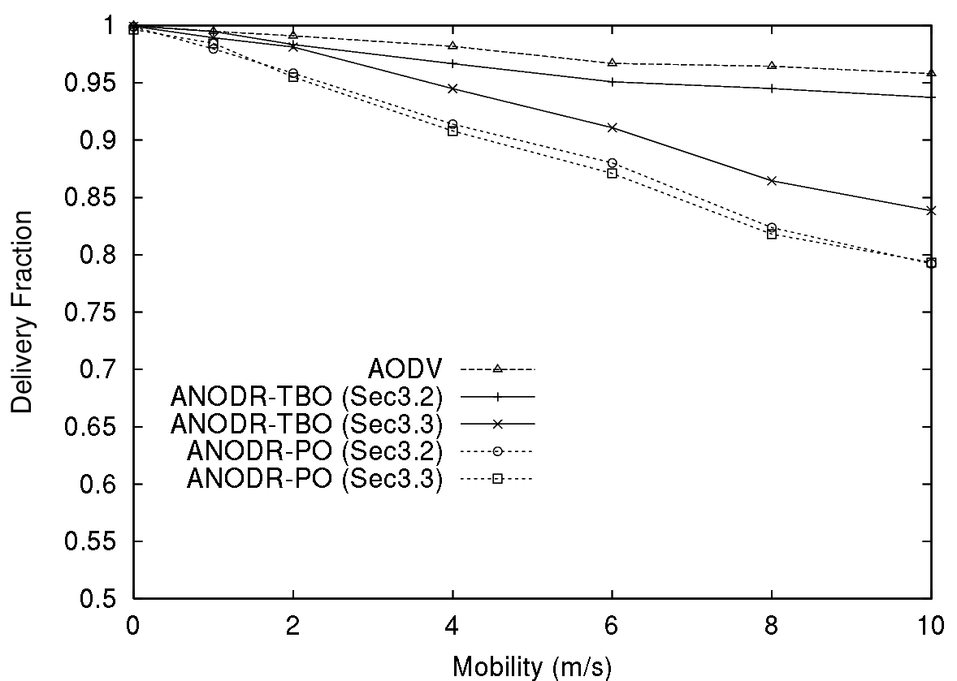
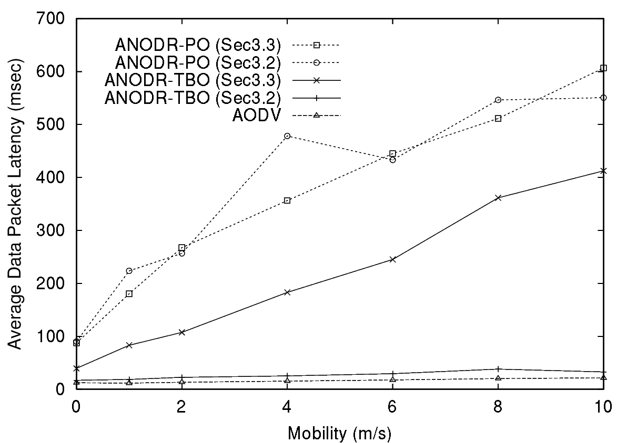
Evaluation: Delivery Ratio & Latency (vs. mobility)
Anonymous+Untraceable
Anonymous only
Anonymous+Untraceable
Anonymous only
Anonymous only
Anonymous+Untraceable
Anonymous only
Anonymous+Untraceable
Acceptable delivery ratio degradation for both “anonymous-only” (≈3%) and “anonymous + untraceable” (≈12%) schemes
If without untraceability support (which uses asymmetric key cryptosystems), ANODR-TBO’s performance is similar to AODV
  Asymmetric key processings cause performance degradation

Slide 18
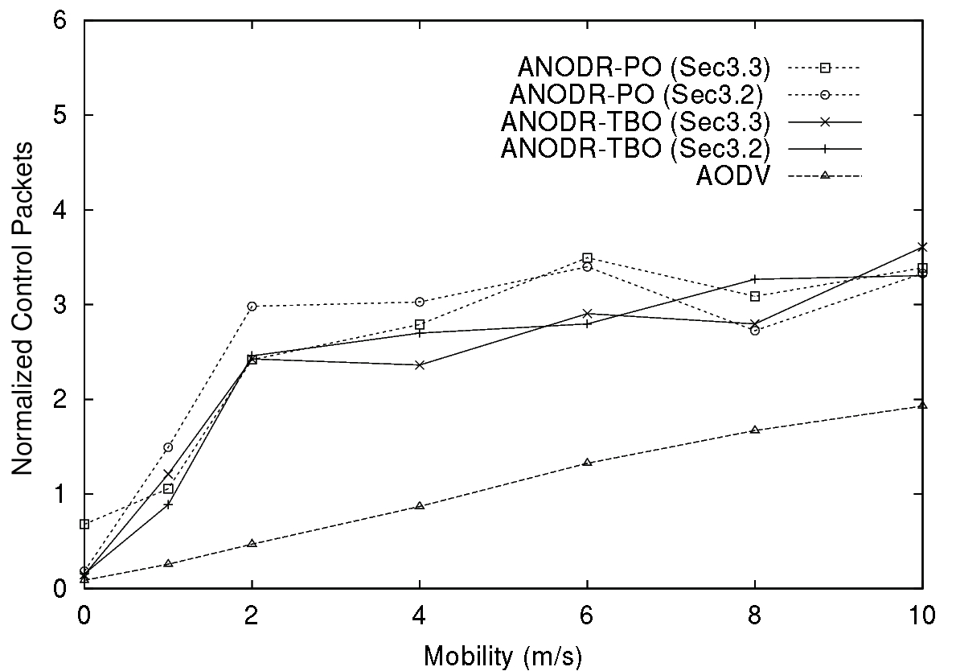
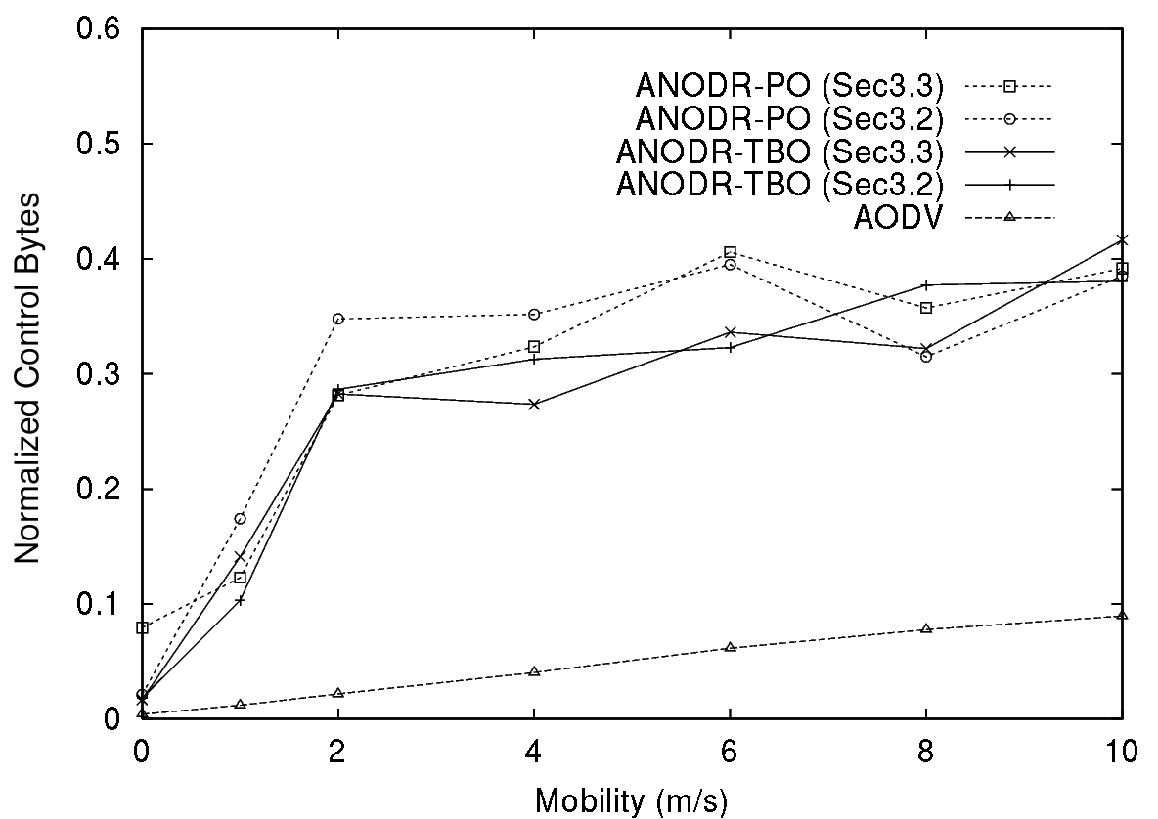
Evaluation: Control Packet Overhead (vs. mobility)
Anonymous+Untraceable
Anonymous+Untraceable
Anonymous only
Anonymous only
Anonymous+Untraceable
Anonymous+Untraceable
Anonymous only
Anonymous only
Control packet overhead largely due to onion size
  Elliptic curves cryptosystems feature comparable storage (but not latency) overhead with symmetric key cryptosystems

Slide 19
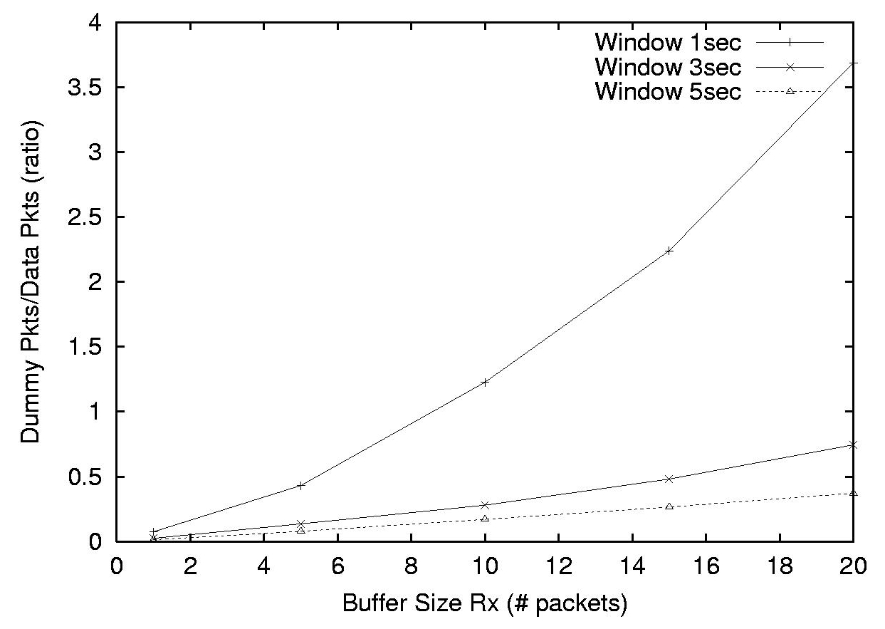
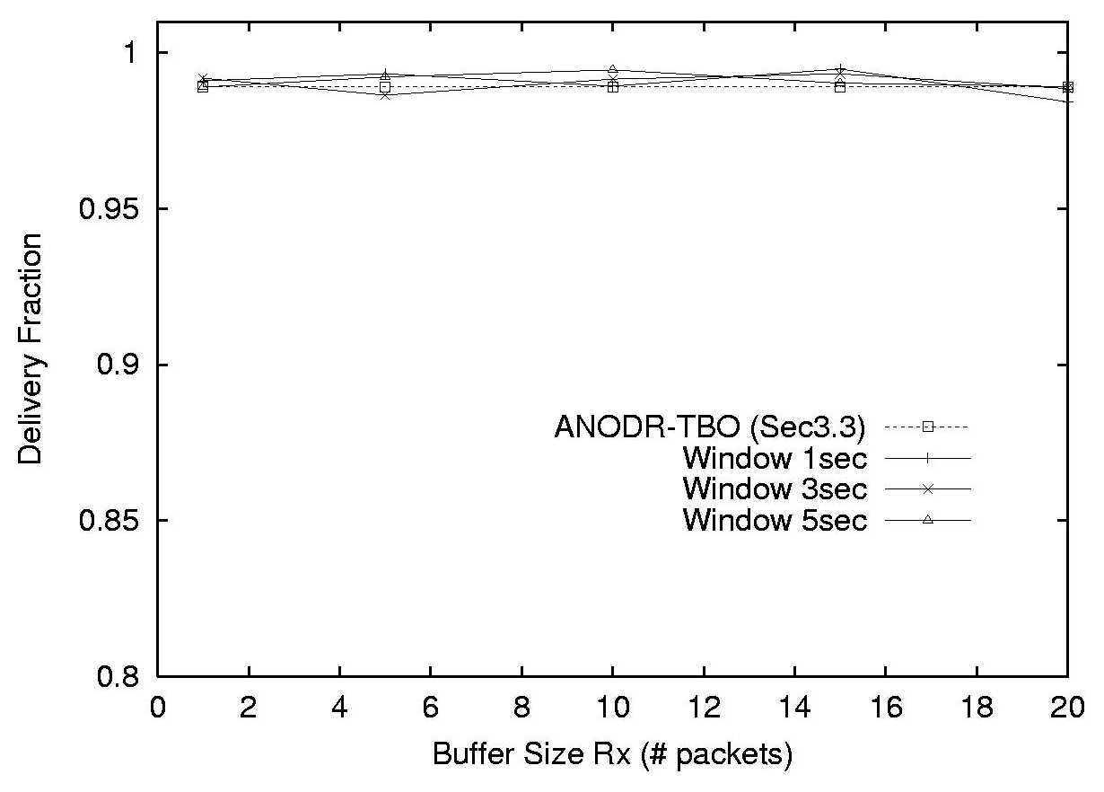
Evaluation: Playout “Mixing” Performance (vs. r_{X})
Anonymous+Untraceable
Playout buffer size r_{X} and playout time window size t_{X} are critical parameters
  In some cases, dummy/data ratio is predictable
May consume resources like battery power, but does not significantly affect data delivery ratio

Slide 20
Conclusions and Future Work
Anonymous on demand routing is feasible and efficient in MANET
  Comparable performance to existing on-demand protocol
  Intrusion tolerant, esp. against passive adversaries
Adding untraceable route support is feasible with some efficiency degradation
  Limited asymmetric key processing
  Tradeoffs in playout “mixing”
Future improvements
  Adaptive “mixing” for better performance
  Integration with routing integrity countermeasures
  Multi-path routes to address mobility and disruption

Slide 21
Thank You

Slide 22

This slide is intentionally left blank
Backup Slides Follow

Slide 23
MIX and “Mixing”
In wireless network, Eve can trivially eavesdrop packets in-and-out a node
Eve can correlate incoming and outgoing message by
  Contents: data and its size
  Causality: arrival/departure timing
“Mixing”: lower correlation ratio
  Buffer, reorder, batch sending
  Insert dummy packets
MIX can be chained together
  Multi-hop routing: MIX-Net
Buffer,Re-order,Batch send
Insert dummy/decoy packets
Alice
Bob
MIX
Eve

Slide 24
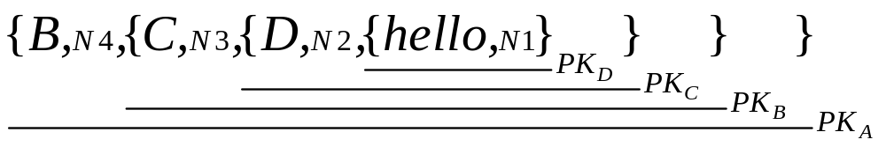
MIX-Net
The source pre-selects the path, and sends downstream a layered message, each MIX peels off a layer — “onion”
  Also stops traffic analysis by “mixing”: buffer, packet reorder & shuffle, introduce random delay and dummy, batch sending
A
B
dest
D
source
C
Notes:
Each node knows its downstream node (not good)

Slide 25
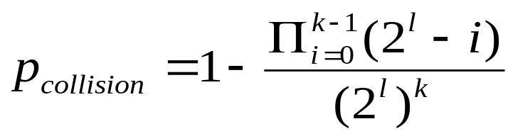
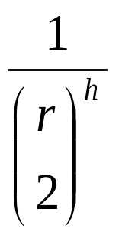
Analysis
The route pseudonymity approach works
  Pseudonym collision probability is negligible for sufficiently large length l
    p_{collision} is greater than ½
    when k is around 2 ^{l /2}
    (birthday paradox): k is not that large in MANET neighborhood. For small k, p_{collision} is smaller than message digest failure
The approach is resilient to attacks
  For intrusion, define a route traceable ratio R
    R is 0 when no forwarder is intruded
    R is100% when all forwarders are intruded
  For timing analysis, r=#(data+dummy), h=hop, success ratio=
  Rapidly approach zero when r or h increases

Slide 26
Comparisons
Proactive: OLSR, TBRPF
  All passive routing attacks applicable
  Easily attacked by external adversaries
On-demand: DSR, AODV
  All passive routing attacks applicable
  Easily attacked by external adversaries
Implement futuristic link protection at any hop anywhere
  Not available yet, likely based on expensive asymmetric key cryptosystems
  Not robust against any passive internal adversary
    No location privacy support in presence of such adversary
  Not robust against passive external traffic analyst

