Slide 1
Secure and Anonymous Mobile Ad-hoc Routing
Jiejun Kong, Mario Gerla
Department of Computer Science
University of California, Los Angeles
August 4, 2005 @ ONR Meeting

Slide 2





Battle between Two MANETs
5.5.5.6
5.5.5.16
5.5.5.11
Correlate nodes’ identities and their locations
Visualize ad hoc routes
5.5.5.234
Visualize mobile nodes’ motion patterns
Disrupt ad hoc communications
10.10.10.3
5.5.5.82
5.5.5.78
5.5.5.3
5.5.5.18
5.5.5.147
5.5.5.9
5.5.5.153
10.10.10.4
5.5.5.69
5.5.5.211

Slide 3
Outline
Adversary
  Mobile traffic sensor
Stop passive attacks
  Privacy-preserving (anonymous) routing
    Anonymous On Demand Routing (ANODR)
Stop active attacks
  Secure routing
    Community-based Security (CBS)

Slide 4

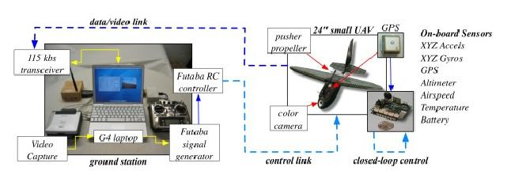
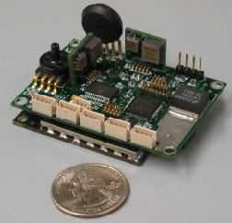
The Adversary: Mobile Traffic Sensor
Mobile traffic analyst
  Unmanned aerial vehicle (UAV)
  Coordinated positioning
  (tri-lateration / tri-angulation)
  can reduce venue uncertainty
If moving faster than
the transmitter, can
always trace the victim
venue

Slide 5

WASP Micro-Aerial Vehicle (MAV)
Wingspan: 13 inches
Combined wing structure (Lithium-Ion battery pack): 4.25 ounces (120 gm)
Total weight of the vehicle: 6 ounces (170 gm)
Power: 9 Watts during the flight.
Flying time: 1 hour and 47 min

Slide 6
Outline
Adversary
  Mobile traffic sensor
Stop passive attacks
  Privacy-preserving (anonymous) routing
    Anonymous On Demand Routing (ANODR)
Stop active attacks
  Secure routing
    Community-based Security (CBS)

Slide 7
Proactive Routing vs. On-demand Routing
Hiding network topology from adversary
  Critical demand in mobile networks. If revealed, adversary knows who is where (via adversarial localization)
Proactive routing schemes vulnerable
  In OLSR, each update pkt carries full topology info
  Network topology revealed to single adversarial sender
On-Demand routing more robust to motion detection
  AODV, DSR etc

Slide 8
Recent Anonymous On-demand Routing
ANODR [MobiHoc’03]: initiates anonymous on-demand routing
MASK [Zhang et al.INFOCOM’05], SDAR [Boukerche et al.,LCN’04]
  Like ANODR, route discovery is on-demand
  Differs in Key agreement and data delivery
ASR [Zhu et al., LCN’04]
  Nearly identical to ANODR, except some minor revisions

Slide 9
ANODR Revisited:
The 1st On-demand Anonymous Scheme
ANonymous On Demand Routing
On-demand, Identity-free routing
  Identity-free routing: node identity not used & revealed (identity anonymity)
  protects location & motion pattern privacy
    MASK and SDAR are not identity-free
    ASR (an ANODR variant) is also identity-free

Slide 10
Identity-free Routing
K_{X}(m) denotes using symmetric key K (only known by X) to encrypt a message m
E
_{#E}
#_{D}
Route-REPly
#_{C}
C
D
K_{A}(hello)
K_{B}( K_{A}(hello))
K_{A}(hello)
K_{C}( K_{B}( K_{A}(hello)))
K_{C}( K_{B}( K_{A}(hello)))
K_{B}( K_{A}(hello))
#_{B}
B
ANODR: destination E receives
⟨RREQ, global_trap, onion⟩ where
A
Route-REQuest
onion = K_{D}( K_{C}( K_{B}( K_{A}(hello))))
⟨RREP, global_proof, onion ⟩
⟨RREP, global_proof, onion, #_{X}⟩
#_{X} is a random packet stamp selected by X
and shared on the hop

Slide 11
ANODR’s Identity-free Packet Flow
4342747
5452343
9746411
6175747
5422819
8543358
1745634

Slide 12
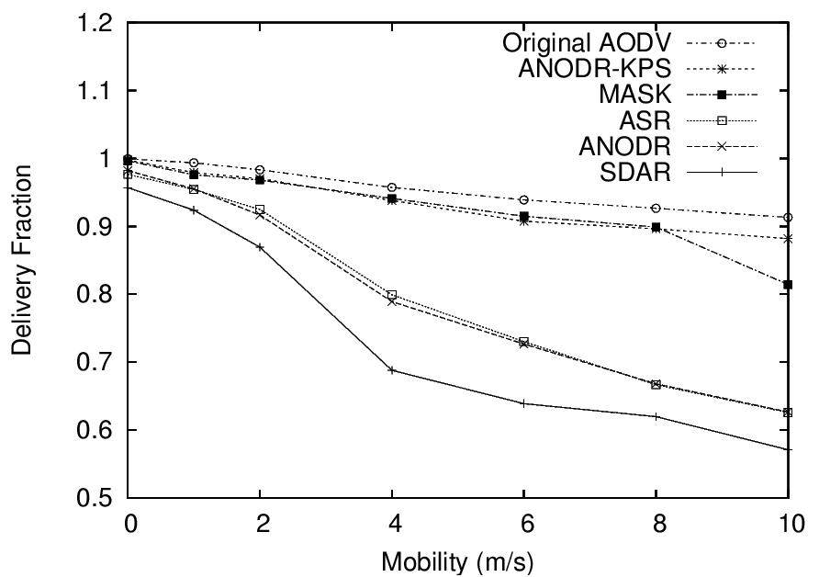
Evaluation: Delivery Ratio (vs. mobility)
Delivery ratio degradation is small for efficient schemes like ANODR-KPS, but large for SDAR, ASR and unoptimized ANODR

Slide 13
Outline
Adversary
  Mobile traffic sensor
Stop passive attacks
  Privacy-preserving (anonymous) routing
    Anonymous On Demand Routing (ANODR)
Stop active attacks
  Secure routing
    Community-based Security (CBS)

Slide 14
Community Based Security (CBS)
Stops active disruption attacks
End-to-end communication between ad hoc terminals
Community-to-Community forwarding (not node-to-node)

Slide 15
Community: 2-hop scenario
Community
Area defined by intersection of 2 collision domains
Node redundancy is common in MANET
  Not unusually high, need 1 “good” node inside the community area
Community leadership is determined by contribution
  Leader steps down (being taken over)
  if not doing its job (doesn’t forward within a timeout Tforw)

Slide 16
Community: multi-hop scenario
Communities
dest
source
The concept of “self-healing community” is applicable to multi-hop routing

Slide 17
Re-config: 2-hop scenario
Old community becomes stale
due to random node mobility etc.
PROBE
(PROBE, upstream, …)
(PROBE_REP, hop_count, …)
oldF
S
X no ACK
D
newF
Newly re-configured community
PROBE_REP
Node D's roaming trace

Slide 18
Re-config: multi-hop scenario
PROBE
PROBE_REP
source
X no ACK
dest
Optimization
  Probing message can be piggybacked in data packets
  Probing interval Tprobe adapted on network dynamics
  Simple heuristics: Slow Increase Fast Decrease

Slide 19
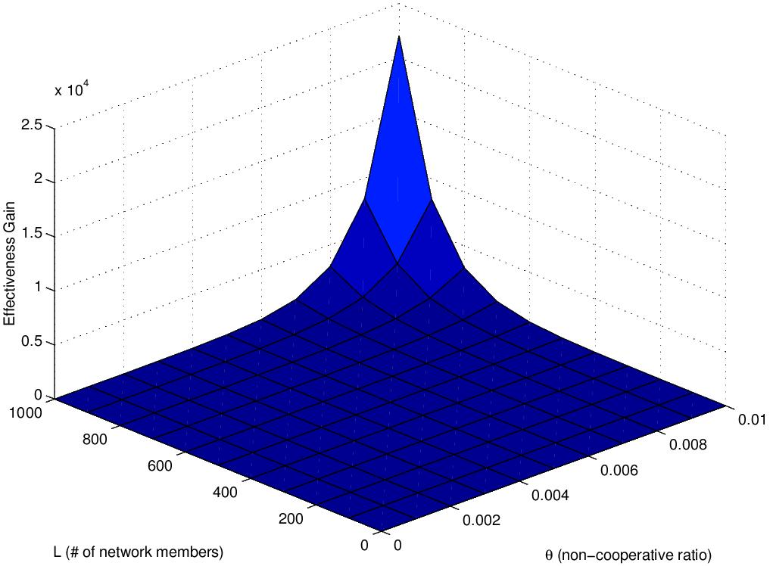
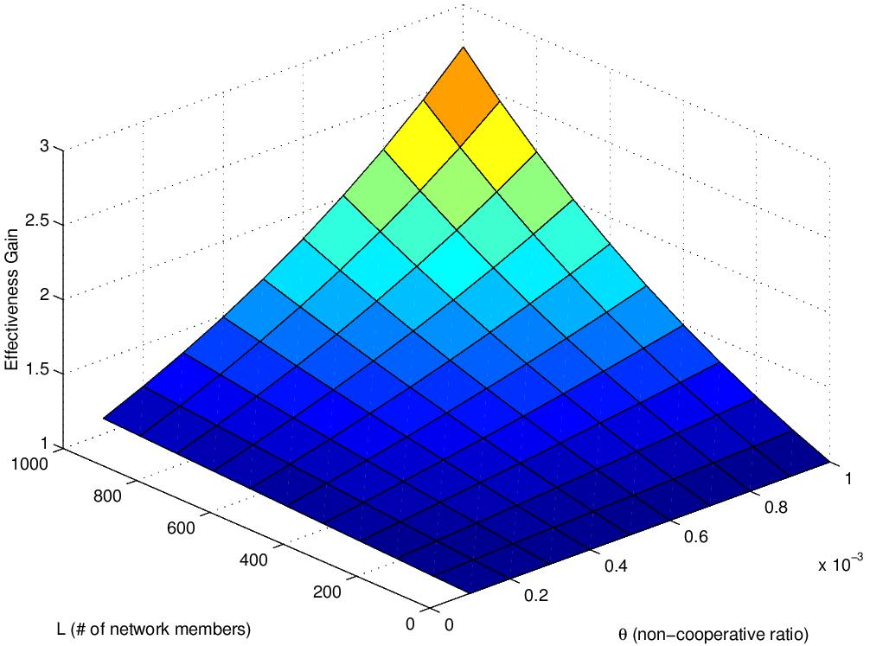
Community Based Security
P_{community}
P_{regular}
N
θ
N
θ
In summary, in mobile networks haunted by non-cooperative behavior, community-based security has exponential gain

Slide 20
QualNet® simulation verification
Perfermance metrics
  Data delivery fraction, end-to-end latency, control overhead
  # of RREQ
x-axis parameters
  Non-cooperative ratio θ
  Mobility (Random Way Point Model, speed min=max)
Protocol comparison
  AODV: standard AODV
  RAP-AODV: Rushing Attack Prevention (WiSe’03)
  CBS-AODV: Community Based Security

Slide 21
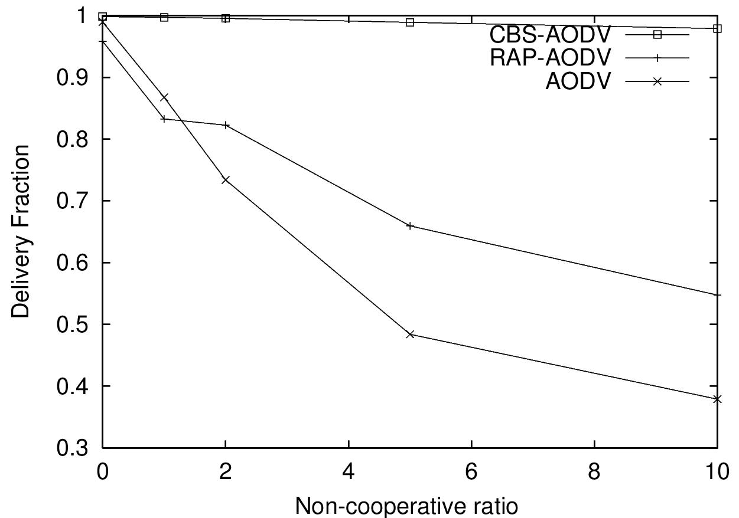
Performance Gap
%
CBS-AODV’s performance only drops slightly with more non-cooperative behavior
Tremendous Exp Gain justifies the big gap between CBS-AODV and others

Slide 22
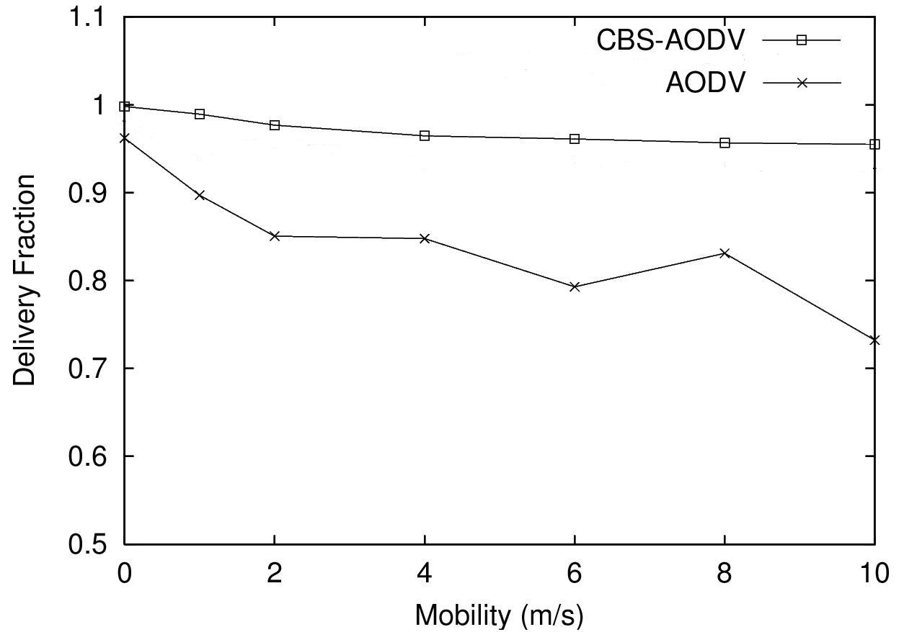
Mobility’s impact

Slide 23
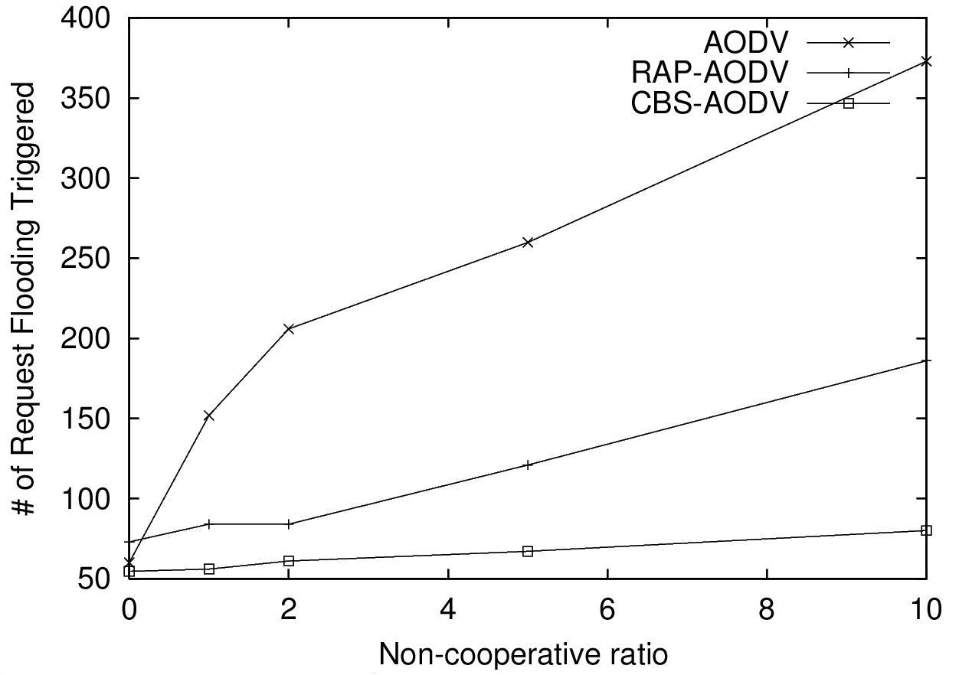
Less RREQ
%
In CBS-AODV, # of RREQ triggered by an attack is less sensitive to non-cooperative ratio θ
Enforcing RREQ rate limit is more practical in CBS-AODV

Slide 24
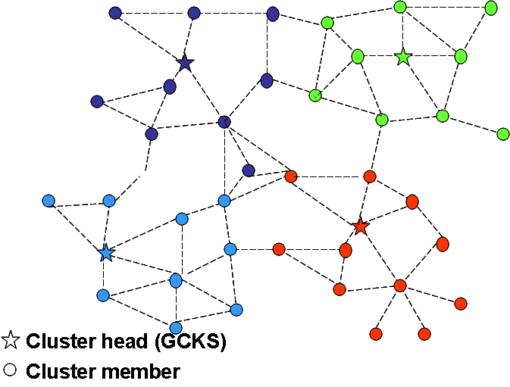
Multicast Security (MSEC) Testbed
Resisting passive eavesdroppers
IETF MSEC charter
  Standard group key management using GCKS (Group Control / Key Server)
  Centralized solution in the infrastructure
Our testbed
  Distributed GCKS backbone
  Service provided by the nearest GCKS node
  Automated load balancing and resistance to denial-of-service attacks

Slide 25
Summary
Ad hoc networks can be monitored, disrupted and destroyed
  More privacy-preserving (anonymous) routing to defend against passive enemy
  More secure routing to defend against active enemy
  Given comparable network resources, the most anonymous and most secure MANET wins
ANODR has the best anonymity-performance guarantee
  Better than other anonymous on-demand schemes
CBS has exponential performance gain
  Better than other secure routing paradigms

