Slide 1


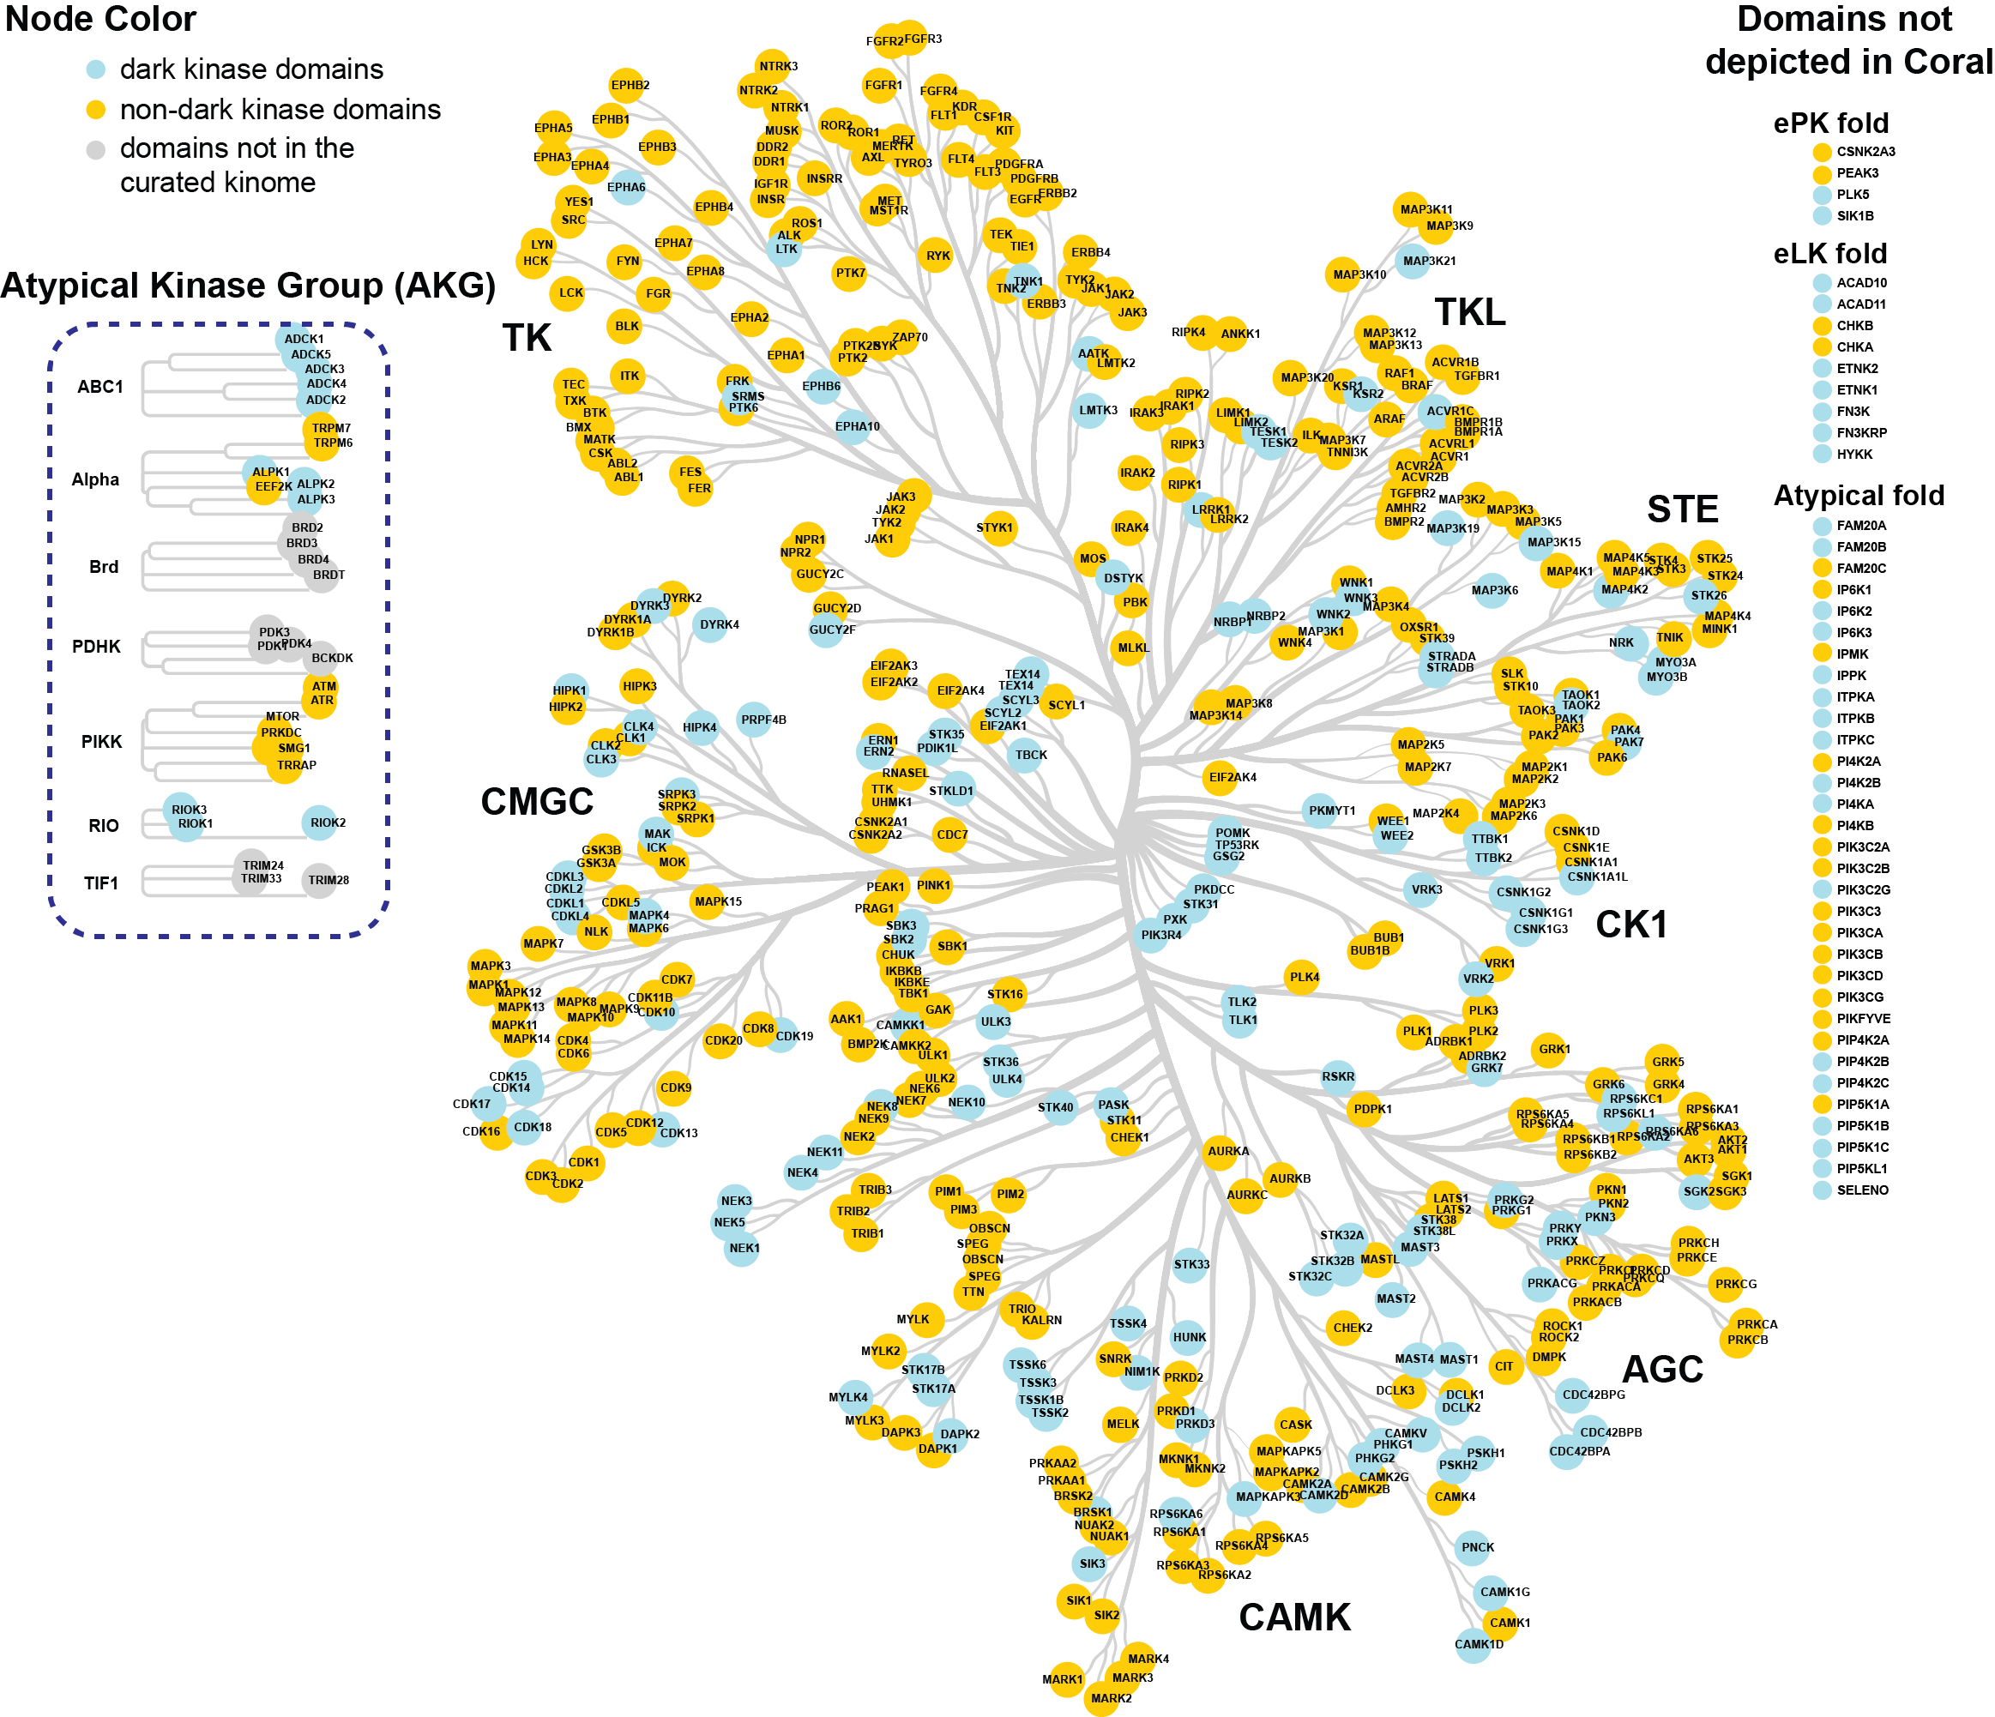
About
Funding
Download
Setting
Welcome to Kinome.org!
Kinome.org is designed by the Laboratory of Systems Pharmacology to help researchers understand which proteins are members of the kinome under varying criteria.
Start exploring the human kinome

Slide 2
About
Funding
Download
Setting
Filters
HGNC Symbol | Approved Name | Fold_Annotation | Group | INDRA_network
AAK1 | AP2 associated kinase 1 | Eukaryotic Protein Kinase (ePK) | Other | http://ndexbio.org/#/network/3363143...
CHKA | choline kinase alpha | Eukaryotic Like Kinase (eLK) | - | http://ndexbio.org/#/network/8fd4c9f…
ITPKA | inositol-trisphosphate 3-kinase A | Atypical | - | http://ndexbio.org/#/network/478e…
BCKDK | branched chain keto acid dehydrogenase kinase | Unrelated to Protein Kinase | AKG | http://ndexbio.org/#/network/2422…
DOLK | dolichol kinase | Unknown | - | http://ndexbio.org/#/network/37d9…
CDK14 | cyclin dependent kinase 14 | Eukaryotic Protein Kinase (ePK) | CMGC | http://ndexbio.org/#/network/5f79497…
HASPIN | histone H3 associated protein kinase | Eukaryotic Protein Kinase (ePK) | Other | http://ndexbio.org/#/network/f969d…
MAP3K19 | mitogen-activated protein kinase kinase kinase 19 | Eukaryotic Protein Kinase (ePK) | STE | http://ndexbio.org/#/network/a08d…
STK17A | serine/threonine kinase 17a | Eukaryotic Protein Kinase (ePK) | CAMK | http://ndexbio.org/#/network/c415…
+
Protein fold
+
Compounds
+
Knowledge
+
Biological Relevance
+
Resources
+
Conventional Classification
+
Custom list
Display columns
HGNC Symbol
Approved Name
INDRA_network
Fold Annotation
Group
Number of MS/SS cmpds
Statistic dark kinase
IDG dark kinase
IDG dark kinase
Alzeheimer’s disease
Essential cell lines
Cancer

Slide 3
About
Funding
Download
Setting
Filters
HGNC Symbol | Approved Name | Fold_Annotation
AAK1 | AP2 associated kinase 1 | Eukaryotic Protein Kinase (ePK)
CHKA | choline kinase alpha | Eukaryotic Like Kinase (eLK)
ITPKA | inositol-trisphosphate 3-kinase A | Atypical
CDK14 | cyclin dependent kinase 14 | Eukaryotic Protein Kinase (ePK)
HASPIN | histone H3 associated protein kinase | Eukaryotic Protein Kinase (ePK)
MAP3K19 | mitogen-activated protein kinase kinase kinase 19 | Eukaryotic Protein Kinase (ePK)
STK17A | serine/threonine kinase 17a | Eukaryotic Protein Kinase (ePK)
-
Protein fold
Protein Kinase Like
Eukaryotic Protein Kinase (ePK)
Eukaryotic Like Kinase (eLK)
Atypical
Unrelated to Protein Kinase Like
Unknown
+
Compounds
+
Knowledge
+
Biological Relevance
Display columns
HGNC Symbol
Approved Name
INDRA network
Fold Annotation
Number of MS/SS cmpds
IDG dark kinase
Statistic dark kinase
Cancer
Alzeheimer’s disease
Chronic obstructive pulmonary disease
Essential cell lines
Structures
Commercial Assays available
Pseudokinase
Manning Kinase
Kinhub Kinase
Group
Family
PfamDomain
Domain Start
Domain End
Number of INDRA statements
TIN-X_Score
PHAROS_Target_Development_Level
gene_id
Uniprot Entry
Uniprot Entry name
Gene names
+
Resources
+
Conventional Classification

Slide 4
About
Funding
Download
Setting
Filters
HGNC Symbol | Approved Name | Protein Fold | Number of MS/SS cmpds
AAK1 | AP2 associated kinase 1 | Eukaryotic Protein Kinase (ePK) | 1
MTOR | mechanistic target of rapamycin kinase | Atypical | 4
ITK | IL2 inducible T cell kinase | Eukaryotic Protein Kinase (ePK) | 3
CDK14 | cyclin dependent kinase 14 | Eukaryotic Protein Kinase (ePK) | 1
HASPIN | histone H3 associated protein kinase | Eukaryotic Protein Kinase (ePK) | 1
MAP3K19 | mitogen-activated protein kinase kinase kinase 19 | Eukaryotic Protein Kinase (ePK) | 3
STK17A | serine/threonine kinase 17a | Eukaryotic Protein Kinase (ePK) | 2
+
Protein fold
-
Compounds
With at least 1 most selective/ semi-selective compounds
+
Knowledge
+
Biological Relevance
+
Resources
+
Conventional Classification
+
Custom list

Slide 5
About
Funding
Download
Setting
Filters
HGNC Symbol | Approved Name | Fold_Annotation | Number of MS/SS cmpds | IDG dark kinase | INDRA network
CDK14 | cyclin dependent kinase 14 | Eukaryotic Protein Kinase (ePK) | 1 | 1 | http://ndexbio.org/#/network/5f794973-5d8c-11ea-bfdc-0ac135e8bacf
HASPIN | histone H3 associated protein kinase | Eukaryotic Protein Kinase (ePK) | 1 | 1 | http://ndexbio.org/#/network/f969d7ca-5dad-11ea-bfdc-0ac135e8bacf
MAP3K19 | mitogen-activated protein kinase kinase kinase 19 | Eukaryotic Protein Kinase (ePK) | 3 | 1 | http://ndexbio.org/#/network/a08d89b8-5d92-11ea-bfdc-0ac135e8bacf
STK17A | serine/threonine kinase 17a | Eukaryotic Protein Kinase (ePK) | 2 | 1 | http://ndexbio.org/#/network/c415bdf4-5d99-11ea-bfdc-0ac135e8bacf
+
Protein fold
+
Compounds
-
Knowledge
IDG dark kinase
Statistically defined dark kinase
Both
Either
+
Biological Relevance
+
Resources
Display columns
HGNC Symbol
Approved Name
INDRA network
Fold Annotation
Number of MS/SS cmpds
IDG dark kinase
Statistic dark kinase
Cancer
Alzeheimer’s disease
Chronic obstructive pulmonary disease
Essential cell lines
Structures
Commercial Assays available
Pseudokinase
Manning Kinase
Kinhub Kinase
Group
Family
PfamDomain
Domain Start
Domain End
Number of INDRA statements
TIN-X_Score
PHAROS_Target_Development_Level
gene_id
Uniprot Entry
Uniprot Entry name
Gene names
+
Conventional Classification
+
Custom list

Slide 6
About
Funding
Download
Setting
Filters
HGNC Symbol | Approved Name | Fold_Annotation | Number of MS/SS cmpds | IDG dark kinase | INDRA network
CDK14 | cyclin dependent kinase 14 | Eukaryotic Protein Kinase (ePK) | 1 | 1 | http://ndexbio.org/#/network/5f794973-5d8c-11ea-bfdc-0ac135e8bacf
HASPIN | histone H3 associated protein kinase | Eukaryotic Protein Kinase (ePK) | 1 | 1 | http://ndexbio.org/#/network/f969d7ca-5dad-11ea-bfdc-0ac135e8bacf
MAP3K19 | mitogen-activated protein kinase kinase kinase 19 | Eukaryotic Protein Kinase (ePK) | 3 | 1 | http://ndexbio.org/#/network/a08d89b8-5d92-11ea-bfdc-0ac135e8bacf
+
Protein fold
+
Compounds
+
Knowledge
-
Biological Relevance
Cancer
Alzheimer’s disease
Chronic obstructive pulmonary disease
Essential in at least cell lines
Display columns
HGNC Symbol
Approved Name
INDRA network
Fold Annotation
Number of MS/SS cmpds
IDG dark kinase
Statistic dark kinase
Cancer
Alzeheimer’s disease
Chronic obstructive pulmonary disease
Essential cell lines
Structures
Commercial Assays available
Pseudokinase
Manning Kinase
Kinhub Kinase
Group
Family
PfamDomain
Domain Start
Domain End
Number of INDRA statements
TIN-X_Score
PHAROS_Target_Development_Level
gene_id
Uniprot Entry
Uniprot Entry name
Gene names
+
Resources
+
Conventional Classification
+
Custom list

Slide 7
About
Funding
Download
Setting
Filters
HGNC Symbol | Approved Name | Fold_Annotation | Number of MS/SS cmpds | IDG dark kinase | INDRA network | Structures | kinaseform_in_ReactionBiology
CDK14 | cyclin dependent kinase 14 | Eukaryotic Protein Kinase (ePK) | 1 | 1 | http://ndexbio.org/#/network/5f794973-5d8c-11ea-bfdc-0ac135e8bacf | - | CDK14/cyclin Y (PFTK1)
HASPIN | histone H3 associated protein kinase | Eukaryotic Protein Kinase (ePK) | 1 | 1 | http://ndexbio.org/#/network/f969d7ca-5dad-11ea-bfdc-0ac135e8bacf | 2VUW;2WB8… | GSG2
MAP3K19 | mitogen-activated protein kinase kinase kinase 19 | Eukaryotic Protein Kinase (ePK) | 3 | 1 | http://ndexbio.org/#/network/a08d89b8-5d92-11ea-bfdc-0ac135e8bacf | - | YSK4/MAP3K19
+
Protein fold
+
Compounds
+
Knowledge
+
Biological Relevance
-
Resources
Structures
Commercial assays
Display columns
Conventional Classification
HGNC Symbol
Approved Name
INDRA network
Fold Annotation
Number of MS/SS cmpds
IDG dark kinase
Statistic dark kinase
Cancer
Alzeheimer’s disease
Chronic obstructive pulmonary disease
Essential cell lines
Structures
Commercial Assays available
Pseudokinase
Manning Kinase
Kinhub Kinase
Group
Family
PfamDomain
Domain Start
Domain End
Number of INDRA statements
TIN-X_Score
PHAROS_Target_Development_Level
gene_id
Uniprot Entry
Uniprot Entry name
Gene names
+
+
Custom list

Slide 8
About
Funding
Download
Setting
Filters
HGNC Symbol | Approved Name | Fold_Annotation | Number of MS/SS cmpds | IDG dark kinase | INDRA network | Structures | kinaseform_in_ReactionBiology
CDK14 | cyclin dependent kinase 14 | Eukaryotic Protein Kinase (ePK) | 1 | 1 | http://ndexbio.org/#/network/5f794973-5d8c-11ea-bfdc-0ac135e8bacf | - | CDK14/cyclin Y (PFTK1)
HASPIN | histone H3 associated protein kinase | Eukaryotic Protein Kinase (ePK) | 1 | 1 | http://ndexbio.org/#/network/f969d7ca-5dad-11ea-bfdc-0ac135e8bacf | 2VUW;2WB8… | GSG2
MAP3K19 | mitogen-activated protein kinase kinase kinase 19 | Eukaryotic Protein Kinase (ePK) | 3 | 1 | http://ndexbio.org/#/network/a08d89b8-5d92-11ea-bfdc-0ac135e8bacf | - | YSK4/MAP3K19
+
Protein fold
+
Compounds
+
Knowledge
+
Biological Relevance
+
Resources
-
Conventional Classification
Manning Kinases
KinHub Kinases
Both
Either
+
Custom list

Slide 9
About
Funding
Download
Setting
Filters
HGNC Symbol | Approved Name | Fold_Annotation | Number of MS/SS cmpds | IDG dark kinase | INDRA network | Structures | kinaseform_in_ReactionBiology
CDK14 | cyclin dependent kinase 14 | Eukaryotic Protein Kinase (ePK) | 1 | 1 | http://ndexbio.org/#/network/5f794973-5d8c-11ea-bfdc-0ac135e8bacf | - | CDK14/cyclin Y (PFTK1)
HASPIN | histone H3 associated protein kinase | Eukaryotic Protein Kinase (ePK) | 1 | 1 | http://ndexbio.org/#/network/f969d7ca-5dad-11ea-bfdc-0ac135e8bacf | 2VUW;2WB8… | GSG2
MAP3K19 | mitogen-activated protein kinase kinase kinase 19 | Eukaryotic Protein Kinase (ePK) | 3 | 1 | http://ndexbio.org/#/network/a08d89b8-5d92-11ea-bfdc-0ac135e8bacf | - | YSK4/MAP3K19
+
Protein fold
+
Compounds
+
Knowledge
+
Biological Relevance
+
Resources
+
Conventional Classification
-
Pseudokinase
Pseudokinase
+
Custom list

Slide 10
About
Funding
Download
Setting
Filters
HGNC Symbol | Approved Name | Fold_Annotation | Number of MS/SS cmpds | IDG dark kinase | INDRA network | Structures | kinaseform_in_ReactionBiology
CDK14 | cyclin dependent kinase 14 | Eukaryotic Protein Kinase (ePK) | 1 | 1 | http://ndexbio.org/#/network/5f794973-5d8c-11ea-bfdc-0ac135e8bacf | - | CDK14/cyclin Y (PFTK1)
HASPIN | histone H3 associated protein kinase | Eukaryotic Protein Kinase (ePK) | 1 | 1 | http://ndexbio.org/#/network/f969d7ca-5dad-11ea-bfdc-0ac135e8bacf | 2VUW;2WB8… | GSG2
MAP3K19 | mitogen-activated protein kinase kinase kinase 19 | Eukaryotic Protein Kinase (ePK) | 3 | 1 | http://ndexbio.org/#/network/a08d89b8-5d92-11ea-bfdc-0ac135e8bacf | - | YSK4/MAP3K19
+
Protein fold
+
Compounds
+
Knowledge
+
Biological Relevance
+
Resources
+
Conventional Classification
+
PseudoKinase
-
Custom list

