Slide 1

Development of Online Education Platform Based on Django CMT 404 Viva
Cardiff school of Computer Science & Informatics

Slide 2
Contents
Code introduction
Project demonstration
Unfinished functions
Conclusion

Slide 3
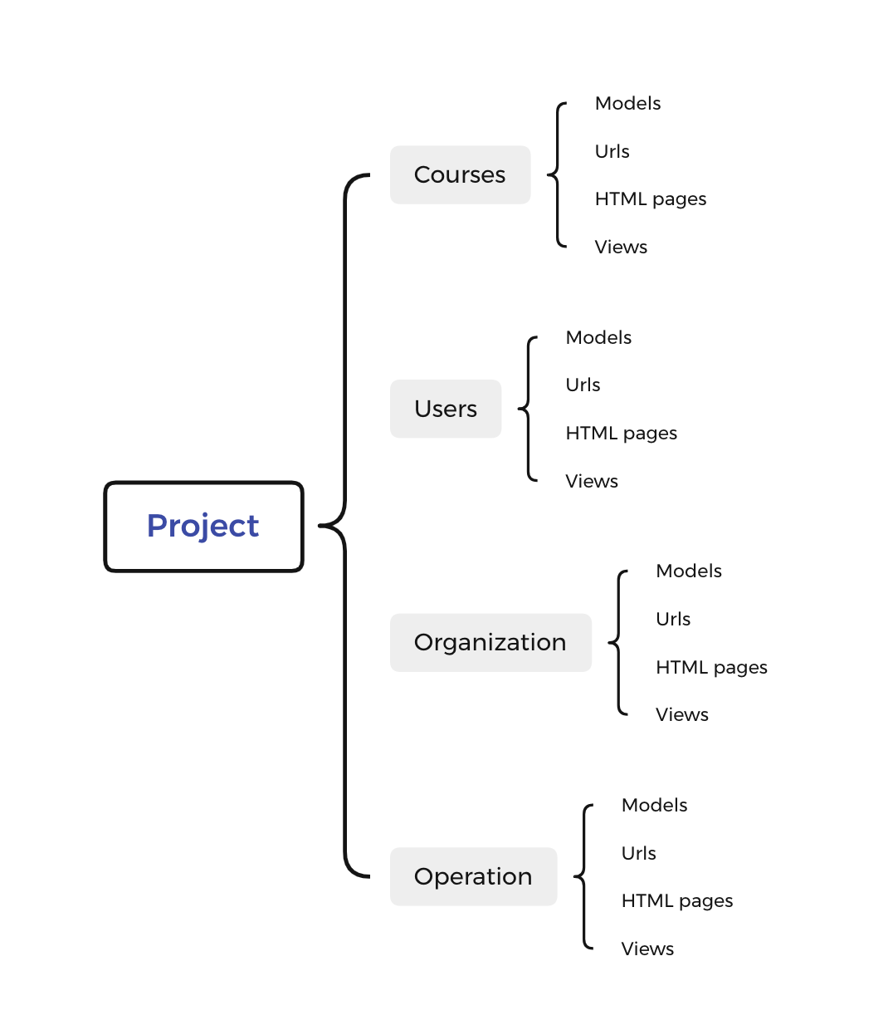
1. Code introduction
1.Four apps
2.database models
3.Urls
4.HTML pages
5.Views

Slide 4
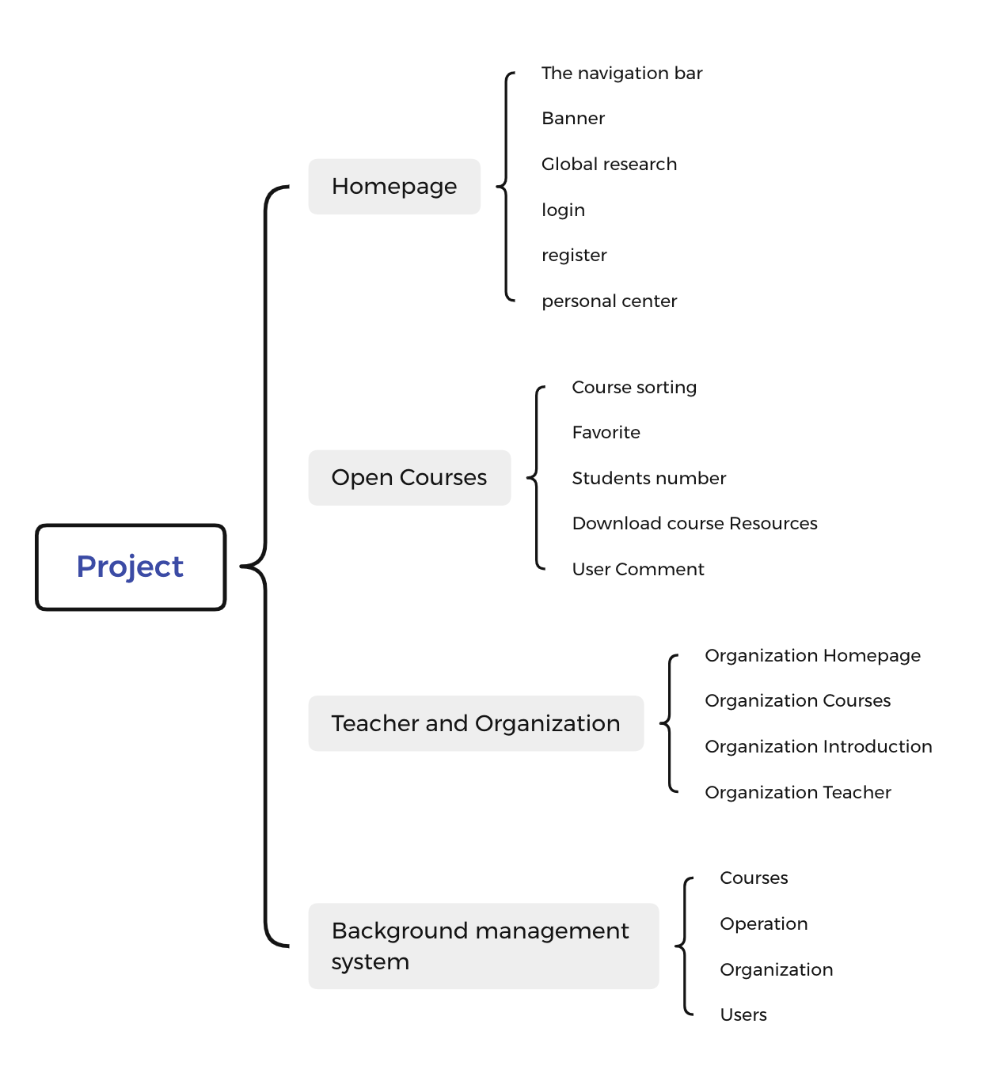
2. project demonstration
1.Home page
2.Open Courses
3.Teacher and Organization
4.Background management system

Slide 5
3.Unfinished function
1.Video play
2. Email address verification

Slide 6
4.Conclusion
•In this project, I learned how to use Django to develop an online education platform and the configuration of the background management system. And through the design of this project, I reviewed some front-end knowledge, which deepened my understanding of front-end design. Unfortunately, I still had a few unfinished functions, and I didn't have the entire project deployed online. Therefore, I evaluate my performance of this project as merit.

Slide 7
Thank you!

