Slide 1
sed

Slide 2
Learning Objectives
What is sed?
sed command line basics
sed command line flags
Advanced sed commands
Writing sed scripts

Slide 3
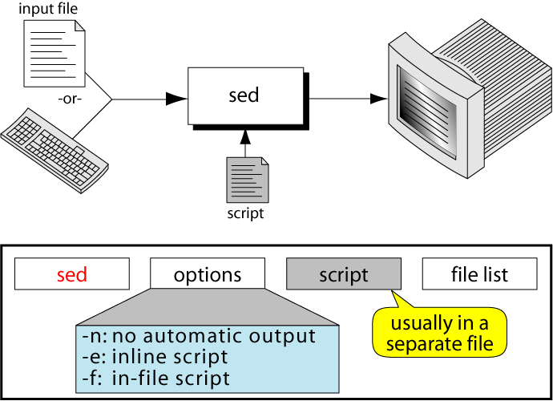
The sed Command

Slide 4
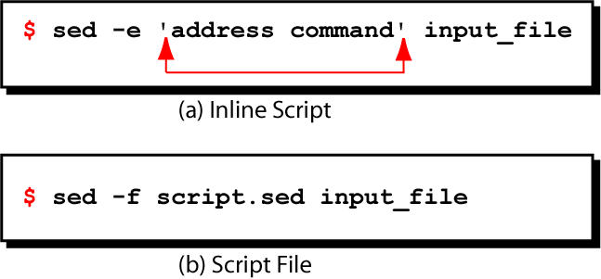
Examples of sed Scripts

Slide 5
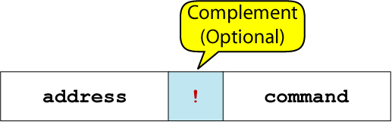
Instruction Format

Slide 6
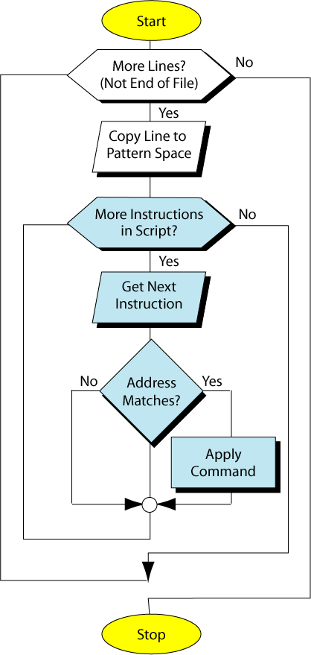
Processing Flow

Slide 7
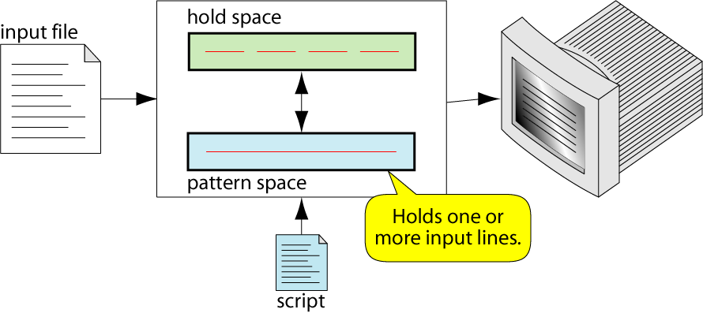
sed Operations

Slide 8
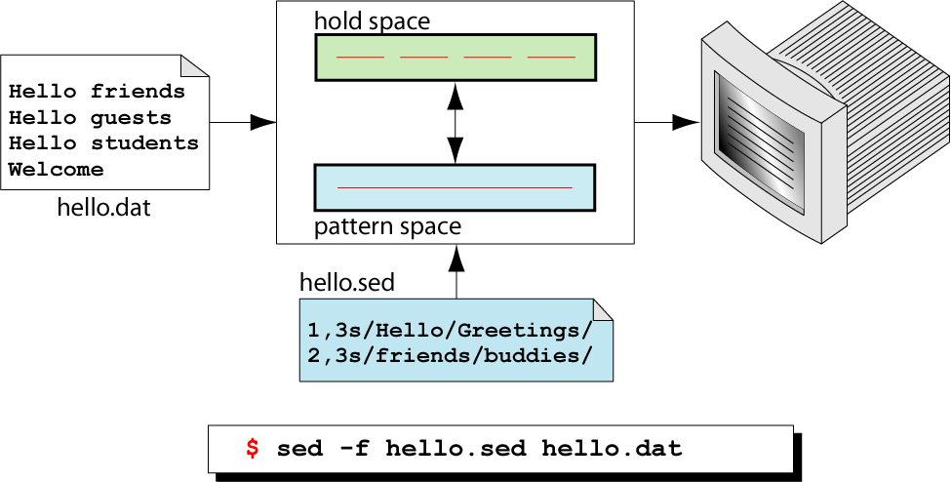
Script Execution

Slide 9
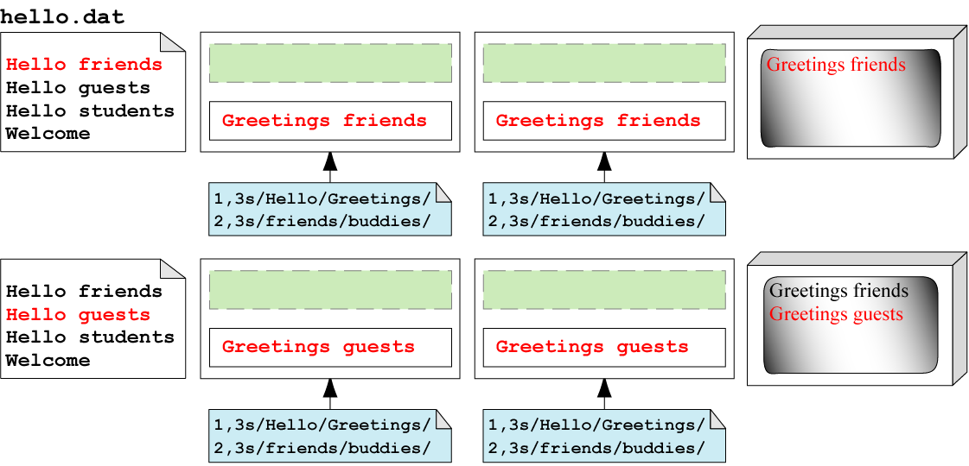
Trace Script Execution (1)

Slide 10
Trace Script Execution (2)
Notes:
Traditionally, commands take single-letter options preceded by a single hyphen, like –d. A more recent convention allows long options preceded by two hyphens, like –debug. Often, a feature can be invoked through either the old style or the new style of options.

Slide 11
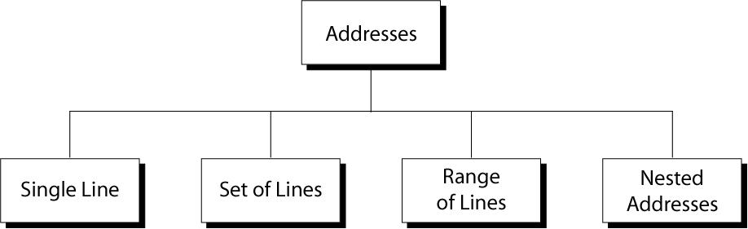
Line Addresses

Slide 12
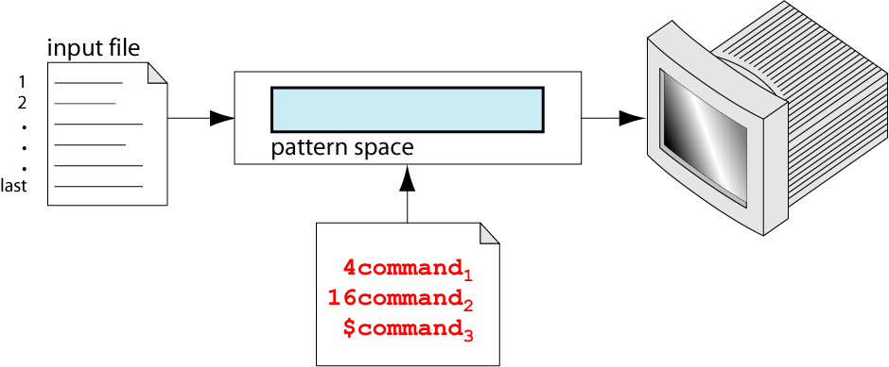
Single Line Address

Slide 13
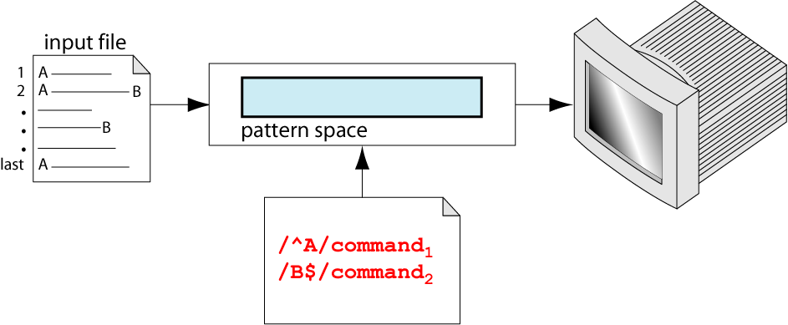
Set-of-line Address

Slide 14
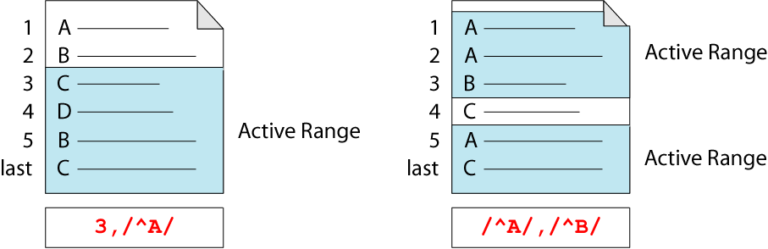
Address Range

Slide 15
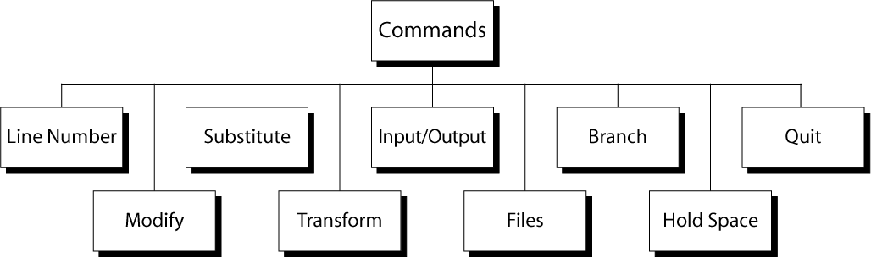
Command Groups

Slide 16
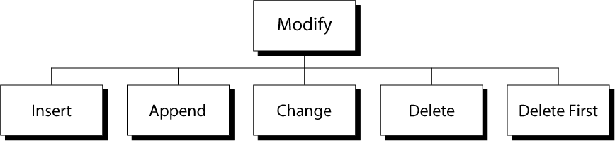
Modify Commands

Slide 17
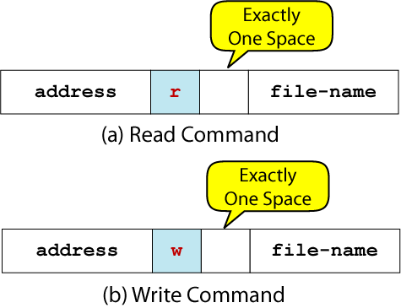
Read/Write Command Format

Slide 18
Editing Entire Lines
a appends line
i inserts lines
c changes lines
Notes:
Every command I've shown you so far affects only one line at a time, but SED's "a", "i", and "c" commands append, insert, or change one or more entire lines at the same time. However, SED is still inherently line-oriented, so whenever you use these three SED commands you must use backslash newline to mark the beginning of the new line or lines.
This is in addition to the fact that if you use any of these commands on the shell command line, you must use quoting, or some other form of escape, to protect the newline from the shell. The basic "a" command appends one or more lines of text after the single line specified by its address. Here's how it looks in action. On lines containing "down", we will append a line that looks like this. So, this "a" command has the same effect as the "r" command we looked at earlier.

Slide 19
Problem Challenge
Write the main() function from array.c to the file main.c using sed
If you are familiar with c programming language, try to make the command as generic as possible

Slide 20
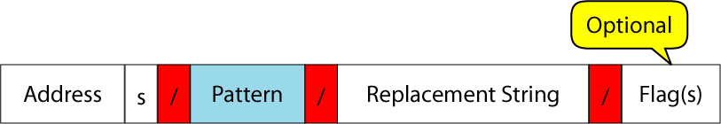
Substitute Commands

Slide 21
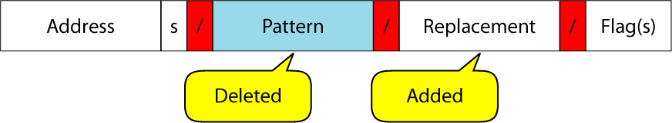
Substitute Operation

Slide 22
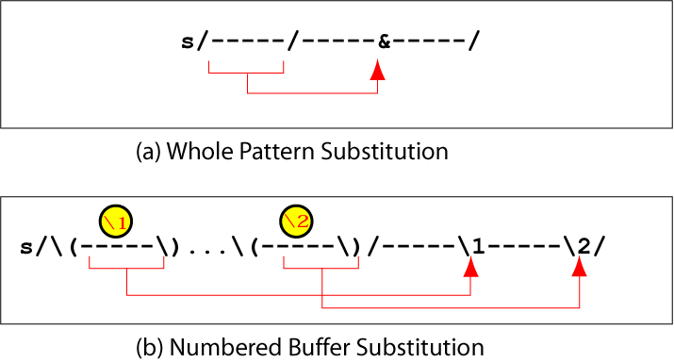
Substitution Back Reference

Slide 23
Transforming with y

Slide 24
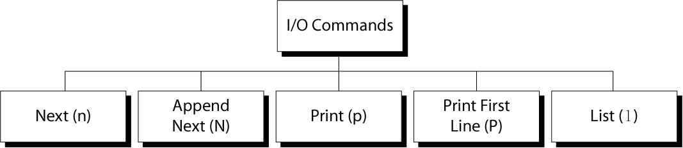
Input/Output Commands

Slide 25
sed Scripts
{…} groups commands into blocks
n gets the next line
q exits the program
# introduces a comment
= and l are used for debugging
Notes:
n command prints the content of the pattern space, empties the pattern space, and gets the next line into the pattern space.
Exiting with "q" and "d"
- The "q" command prints the current line again in less the -n flag was used on the command line and exits the script completely. This can be used to a work processing when a certain line is encountered. For example, on lines containing again, quit, dukeofyork.txt, so this reads through the file until it finds the word again and then stops. Now, you could have done this just by printing. You could do sed -n '1,/again/p', could have done the same thing that way, but like "n" the "q" command really comes into its' own in scripts.
For example, we can take the example script from the previous section and add a "q" to the end. I'll use the vi editor which I have a whole other course about. This script looks for the word marched, puts two parenthesis at the beginning of the following line, and two closed parenthesis at the end of the line after that. We can modify this so that after printing that second set of parenthesis, it quits. So let's take a look at that script, put it up on the screen so you can see it while we run it.
Example
/marched/{
n
=
s/^/((//
n
=
s/$/))
=
}

Slide 26
Advanced sed
N, P, D to manage multi-line pattern space
:, b, t to manage program flow control
g, G, h, H, x to manage the hold buffer
Notes:
The N command is similar to lower case n, except that it does not print the pattern space and it does not empty it. Instead it ends a new line character which is represented in regular expressions by backslash n, to the end of the pattern space, then gets the next line and appends it to the pattern space after that new line. After this has been done, the pattern space, which now contains multiple lines
Like the lower case d command, capital D stops processing but it doesn't get the next line unless it leaves the pattern space empty. Now usually SED edits lines one at a time. Even a block that affects a range of lines affects each line in the range individually. If you want to use SED to make changes that affect multiple lines, for example adjoining two lines together, you need to understand a little bit more about how SED works. When SED reads a line from the input, it first copies the line into an internal butter called the pattern space.

Slide 27
Managing Multiline Pattern Space
N appends a new line and reads in the next input line
P prints up to the first line
D deletes up to and including the first new line
Notes:
Like d, D stops processing, but doesn’t get the next line unless it leaves the pattern space empty

Slide 28
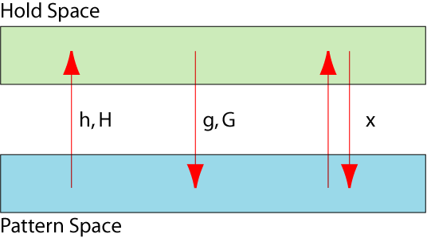
Hold Space Operations
Notes:
The hold (h, H) commands move data into the hold space and the get (g, G) commands move data from the hold space back into the pattern space.
The difference between the lowercase and uppercase version of the same command is that the lowercase command overwrites the contents of the target buffer, the uppercase command appends to the buffer’s existing contents.

Slide 29
Problem Challenge 2
Change the first three words of each line in the input to ALL CAPS
Use the hold buffer and y command

