Slide 1
Filters

Slide 2
Topics
Filters
tr, uniq
cut and paste
sort
Networking utilities

Slide 3
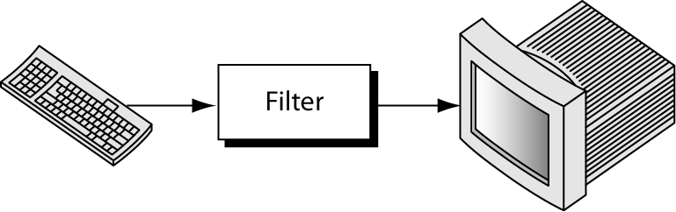
Filters
A filter is a command that takes input from the standard input, manipulates it, and sends the result to the standard output
Notes:
We have already seen these filters: cat, more, less, head, and tail. We will study 4 more.

Slide 4
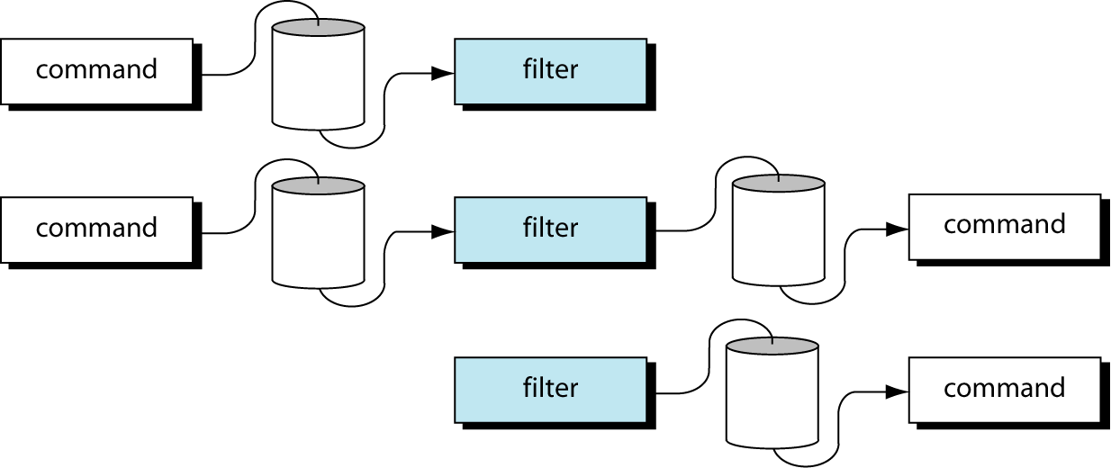
Using Filters with Pipes
A filter is a command that takes input from the standard input, manipulates it, and sends the result to the standard output
Notes:
Filters work naturally with pipes. Because a filter can send its output to the monitor, it can be used on the left of a pipe; because a filter can receive its input from the keyboard, it can be used on the right of a pipe. In other words, a filter can be used on the left of a pipe, between two pipes, and on the right of a pipe.

Slide 5
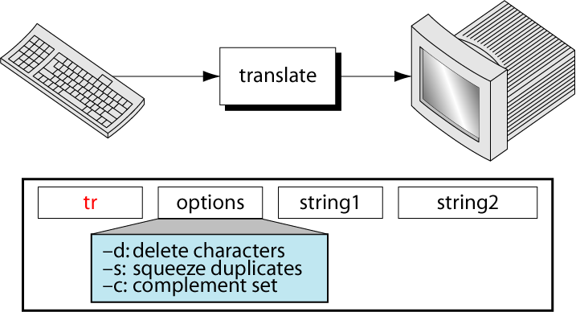
tr – Replaces Characters
Notes:
There are many reasons for translating characters from one set to another. One of the most common ones is to convert lower case to upper case, or vice versa.
The tr command replaces each character in a user-specified set of characters with a corresponding character in a second specified set.
The first character in the first set is replaced by the first character in the second set, and so forth until all of matching characters have been replaced. E.g.:
tr “aeiou” “AEIOU” (“” optional)
tr 123 45 (string1 is longer: unmatched will be changed to the last character in string2, up to the last unmatched character in string1) 123 455 1234 4554 3456 5456
tr ab ABC aabbccdd AABBccdd (if string1 is shorter, extra characters in string2 is ignored.
If string2 is shorter, the unmatched characters in string1 will be changed to the last character in string2, up to the last character in string1): tr abc AB aabbcc AABBBB aabbccdd AABBBBdd
Delete a character tr –d aeoour Boulevard Blvd tr –d ‘\015’ < pc.file (remove carriage return from the carriage return/newline pair that a PC file uses as a line terminator)
Squeeze output – deletes consecutive occurrences of the same character in the output. tr –s chael kke michael mike
Complement – specify what characters are NOT to be changed:
tr ‘\015’ ‘\012’ < file.mac > file.unix (change carriage return to newline character in unix)

Slide 6
tr Examples
Translate case cat myfile |tr a-zA-Z A-Za-z OR a-zA-Z A-Za-z < myfile
Encode & decode cat myfile | tr a-mA-Mn-z N-Za-mA-M > mysecret cat mysecret | tr n-zN-Za-mA-M a-mA-Mn-zN-Z
Break lines
cat myfile | tr –c a-zA-Z "\n"
Notes:
Sometimes you just have to make changes to a file to change all occurrences of one term or character to another. For example, you might have reversed the case in a file (by accidentally typing with Caps Lock on...argh!) and need to change it back. Or you might want to turn a document into a list of words (one per line) that you can sort or count. The tr utility is just what you need.
Syntax: tr [options] string1 [string2]
Options
-c complements string1, causing tr to match all characters except those in string1.
-d deleted characters that match those specified in string1.

Slide 7
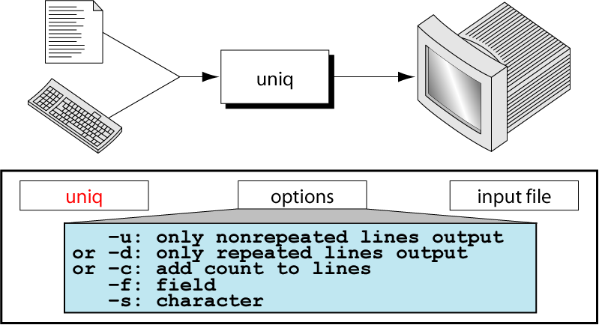
uniq – Eliminate Duplicates
Notes:
uniq deletes duplicate lines when they are adjacent, keeping the first and deleting the rest.
Example (~victoryu/cis18a/in_class_examples/uniqFile) uniq –u uniqFile (lists only the unique lines while suppressing the output of duplicate lines) uniq –d uniqFile (the opposite to the above, writes out only the duplicate lines) uniq –c uniqFile (writes all of the lines, suppressing the duplicates, with a count of the number of duplicates at the beginning of the line)
While the default compares the whole line to determine if two lines are duplicate, we can also specify where the compare is to begin. The skip duplicate fields option (-f) skips the number of fields specified starting at the beginning of the line and any spaces between them. Remember that a field is defined as a series of ASCII characters separated by either a space or by a tab. Two consecutive spaces would be two fields; that’s the reason uniq skips leading spaces between fields. uniq –d –f 4 uniqFile_wFields

Slide 8
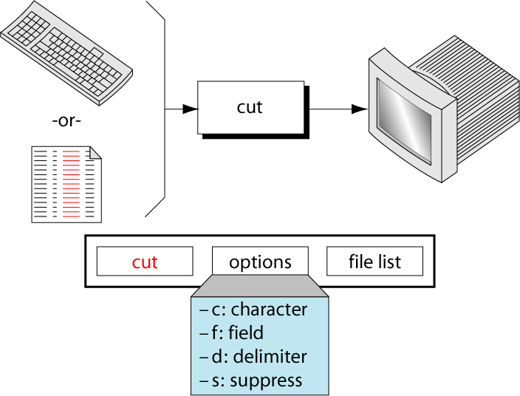
cut - Selects Characters/Fields
Notes:
The basic purpose of the cut command is to extract one or more columns of data from either standard input or from one or more files.
Since cut looks for columns, we must have some way to specify where the columns are located. This is done with one of two command options. We can specify what we want to extract based on character positions within a line or by a field number.
To specify that the file is formatted with fixed columns, we use the character option, -c, followed by one or more column specifications. A column specification can be one column or a range of columns in the format N-M, where N is the start column and M is the end column, inclusively. Multiple columns are separated by commas. $ cut -c1-14,19-25 censusFixed
Chicago 2783726
Houston 1630553
Los Angeles 3485398
New York 7322564
Philadelphia 1585577 In specifying the columns, we were careful to include the space that separates the city from the population figures.
Note that there is no space after the comma and before the next column specification. If you put a space in an option, the option is terminated. In this case, cut would think that the second column specification was a filename.
$ cat censusSlash
Chicago/IL/2783726/3005072/1434029
Houston/TX/1630553/1595138/1049300
Los Angeles/CA/3485398/2968528/1791011
New York/NY/7322564/7071639/3314000
Philadelphia/PA/1585577/1688210/736895
$ cut -f1,3,5 -d"/" censusSlash
Chicago/2783726/1434029
Houston/1630553/1049300
When we coded the cut command, we listed the columns for the name first followed by the columns for the size. Note that they are displayed in the order they are found in the file. You can specify the columns in any order; they are always cut in the order they are found in the file. If you overlap the columns, cut simply combines them into one column; no data are duplicated. Thus, following command simply displays everything from the file size to the end of the line. $ ls -l | cut -c56-70,36-60
5781 Apr 5 12:53 TheRaven
698 May 14 13:18 census
823 May 13 18:39 censusFixed
512 Apr 10 21:25 mail
868 Mar 27 14:30 yanks On the other hand, if you make a mistake, such as the end column smaller than the start column, cut displays an error message as shown in the following example. If you don’t see it immediately, the error is in the second cut range; the end column is less than the start column. $ ls -l | cut -c56-70,36-6
Bad list for c/f option
ls –l | cut –c2-10 kkk output the permissions of the files in the working directory. Selects 2 through 10 from each input line.
ls -l | tr -s ' ' ' ' | cut -f5,9 -d' ' outputs the size and name of each file in the working directory. The –f option selects the fifth and ninth fields. The –d option tells cut to use SPACEs, not TABs, as delimiters. The tr utility with the –s option changes sequences of more than one SPACE character into a single SPACE; otherwise, cut counts the extra SPACE characters as separate fields.
cut –d: -f5 /etc/passwd

Slide 9
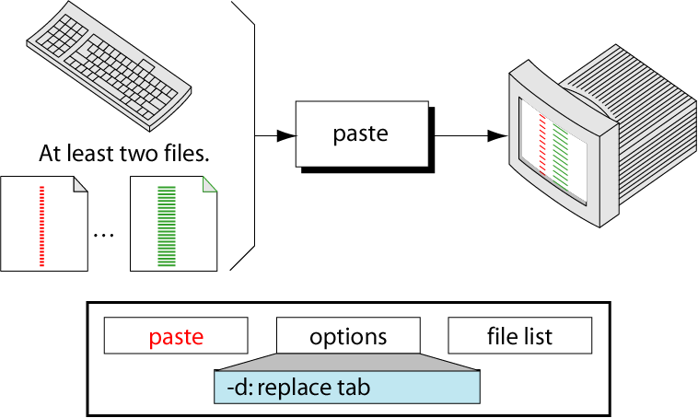
paste – Joins Lines from Files
Notes:
The paste utility reads lines from the file-list and joins corresponding lines in its output. By default output lines are separated by a TAB
The file-list is a list of ordinary files. When you specify a hyphen (-) instead of a filename, paste reads from standard input.
Examples: $cat numbers 1 2 3 4 $cat params one two three four $paste -d="=" params numbers one=1
two=2
three=3
four=4
The cat and paste commands are similar: The cat command combines files vertically (by lines). The paste command combines files horizontally (by columns).

Slide 10
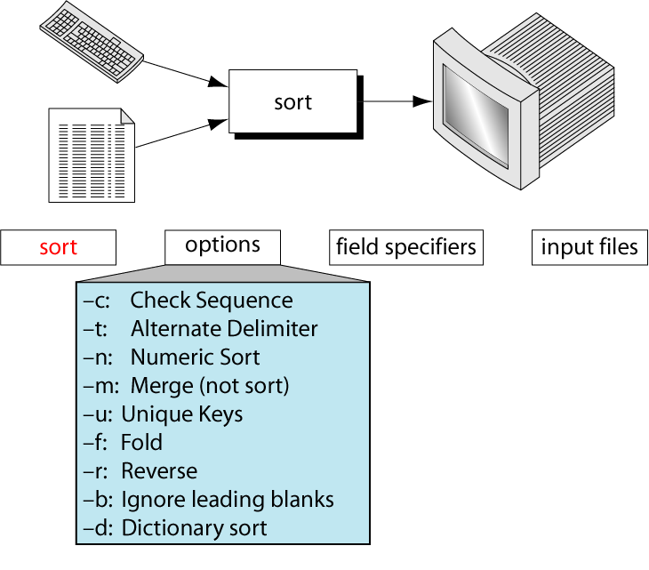
The sort Utility
Notes:
Options
-c: Check sequence. The check sort option (–c) verifies that the file is sorted. If it is not sorted, the first out-of-sequence line is displayed. [victoryu@voyager:~/cis18a/filters ] $sort -c +1 -2 census
sort: census:5: disorder: Philadelphia PA 1585577 1688210 1736895
-t: Alternate delimiter.
-k: [victoryu@voyager:~/cis18a/filters ] $sort -c +1 -2 census
sort: census:5: disorder: Philadelphia PA 1585577 1688210 1736895

Slide 11
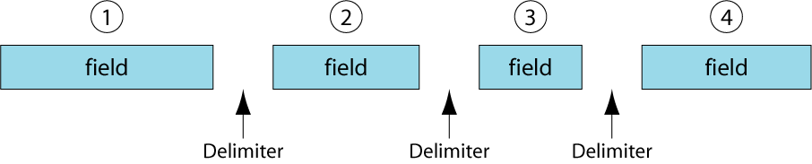
Fields Within A Line
Notes:
sort defines a field as a set of characters delimited by the space or tab after it.
sort numbers the fields in a line. The first field is 1, the second field 2, and so forth until the last field.

Slide 12
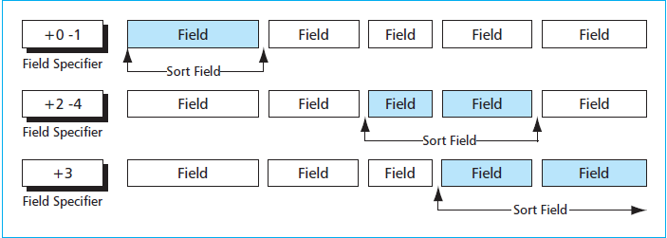
Sort By Fields
Field Specifiers:
+number₁ -number₂
Notes:
When a field sort is required, we need to define which fields are used for the sort. Field specifiers are a set of two numbers that together identify the first and last field in a sort key.
sort defines a field as a set of characters delimited by a single space or tab.
sort numbers the field as field number 1, field number 2, and so forth until the last field.
Field specifies: define which field is to be used for sort. The format is: +number1 –number2 number₁ specifies the number of fields to be skipped to get to the beginning of the sort field, whereas number₂ specifies the number of fields to be skipped, relative to the beginning of the line.
If no end field is specified, the end of line is assumed.
[victoryu@voyager:~/cis18a/filters ] $sort -t $'\t' -k 2,2 censusTabs
Chicago IL 2783726 3005072 1434029
Houston TX 1630353 1595138 1049300
Los Angeles CA 3489358 2968528 1791011
New York NY 7322564 7071639 3314000
Philadelphia PA 1585577 1688210 1736895
[victoryu@voyager:~/cis18a/filters ] $sort -t$'\t' -k2 census
Los Angeles CA 3489358 2968528 1791011
Chicago IL 2783726 3005072 1434029
New York NY 7322564 7071639 3314000
Philadelphia PA 1585577 1688210 1736895
Houston TX 1630353 1595138 1049300

Slide 13
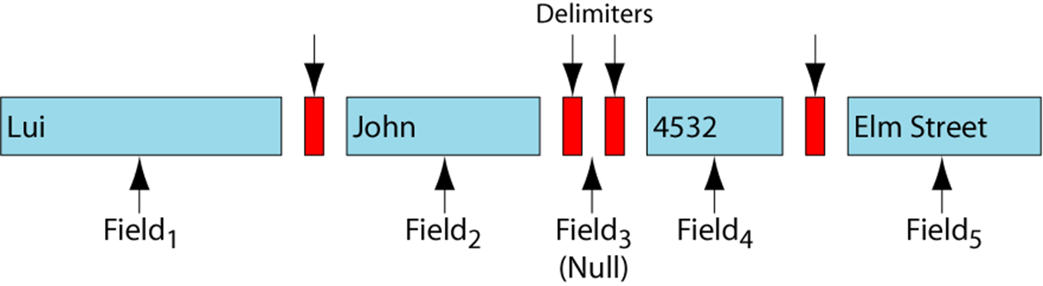
Null Field Impact
Notes:
As we mentioned earlier, sort defines a field as a word delimited by one space or tab. This means that each line in the file must be carefully formatted. If two spaces are found between two fields, then by sort’s definition, there is a null field between the two spaces. An extra space or tab changes the number of fields on a line and can cause the sort to give strange-looking results. Fortunately, there is a sort option that ignores duplicate blanks.

Slide 14
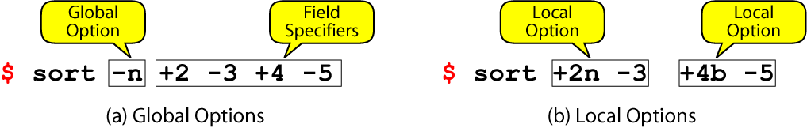
Global and Local Options
Notes:
Options can be used globally, in which case they apply to all field specifiers, or locally, in which case they apply to only the current field specifier. Global options are specified before all field specifiers. Local options are after the start field in the field specification.
Example:
sort –t”/” –n +2 -4 censusSlash

Slide 15
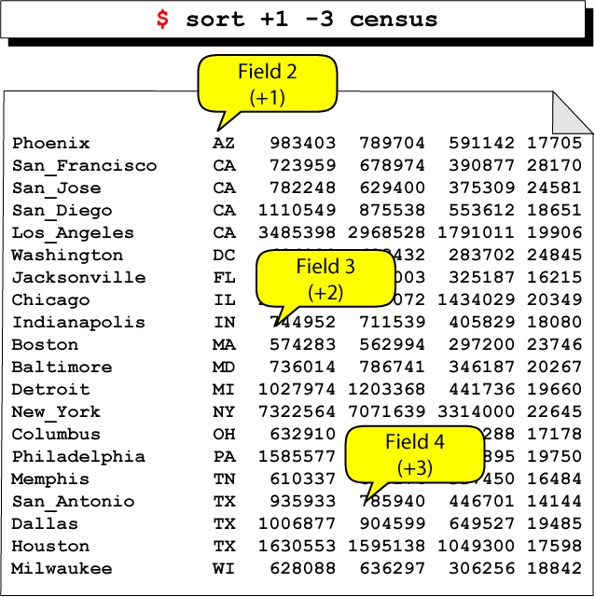
Sort Adjacent Fields

Slide 16
Sort By Lines
Unsorted | Sorted
James | Bond
Bond | James
8 | !
27 | 27
! | 8
~ | Paula
Paulo | Paulo
Paula | ~

Slide 17
unique Command
Notes:
The uniq command deletes duplicate lines, keeping the first and deleting the others. To be deleted, the lines must be adjacent. Duplicate lines that are not adjacent are not deleted. To delete nonadjacent lines, the file must be sorted. Unless otherwise specified, the whole line can be used for comparison. Options provide for the compare to start with a specified field or character. The compare, whether line, field, or character, is to the end of the line. It is not possible to compare one field in the middle of the line.

Slide 18
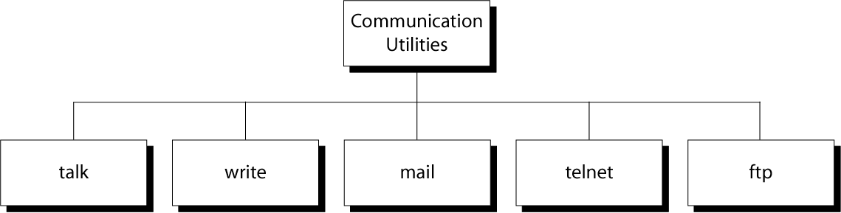
Communication Utilities

Slide 19
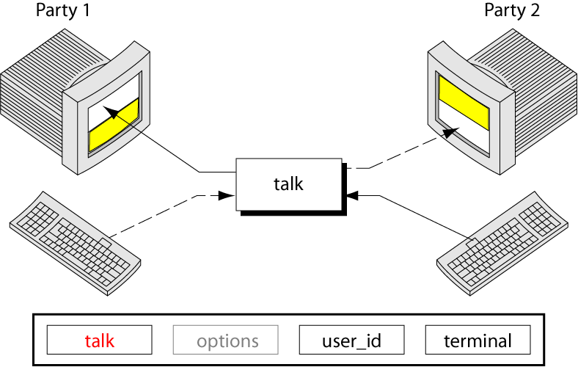
The talk Command
Notes:
The talk command allows two UNIX users to chat with each other just like you might do on the phone except that you type rather than talk. When one user wants to talk to another, he or she simply types the command talk and the other person’s login id.
The conversation doesn’t begin, however, until the called user answers. When you send a request to talk, the user you are calling gets a message saying that you want to talk. The message is shown here:
If your friend doesn’t want to talk, he or she can ignore the message, much like you don’t have to answer the phone when it rings. However, UNIX is persistent. It will keep repeating the message so that the person you are calling has to respond.
There are two possible responses. The first, which agrees to accept the call, is a corresponding talk command to connect to you. This response is seen in the third line of the preceding example. Note that all that is needed is the user id. The address, starting with the at sign (@) is not required if the person calling is on the same system.
To refuse to talk, the person being called must turn messages off. This is done with a message (mesg) command as shown here:
mesg n
The message command has one argument, either y , yes I want to receive messages, or n, no I don’t want to receive messages. It is normally set to receive messages when you log into the system. Once you turn it off, it remains off until you turn it back on or restart. To turn it on, set it to yes as follows:
mesg y

Slide 20
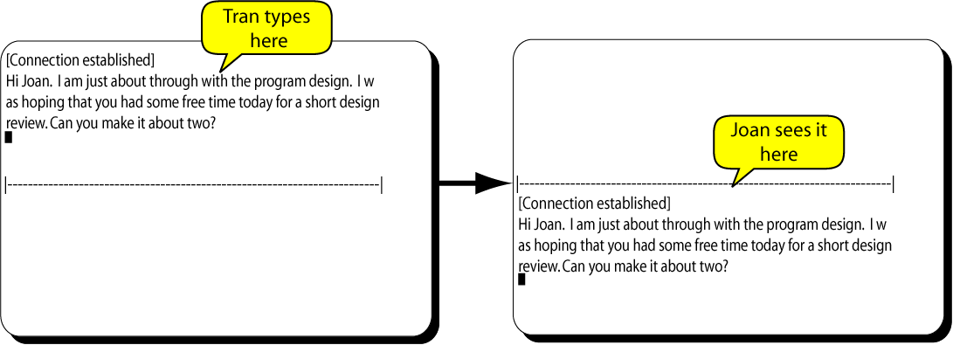
A Complete talk Session (1)

Slide 21
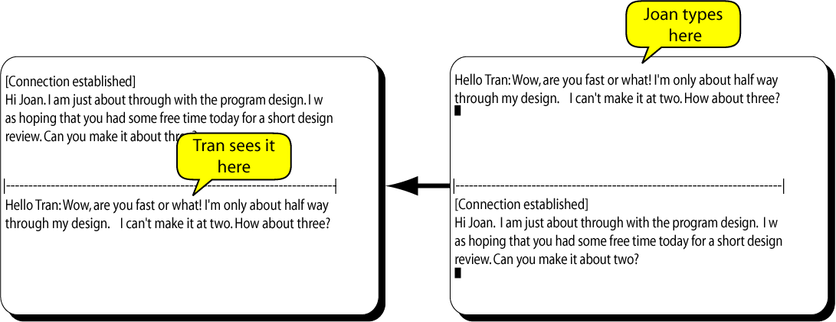
A Complete talk Session (2)

Slide 22
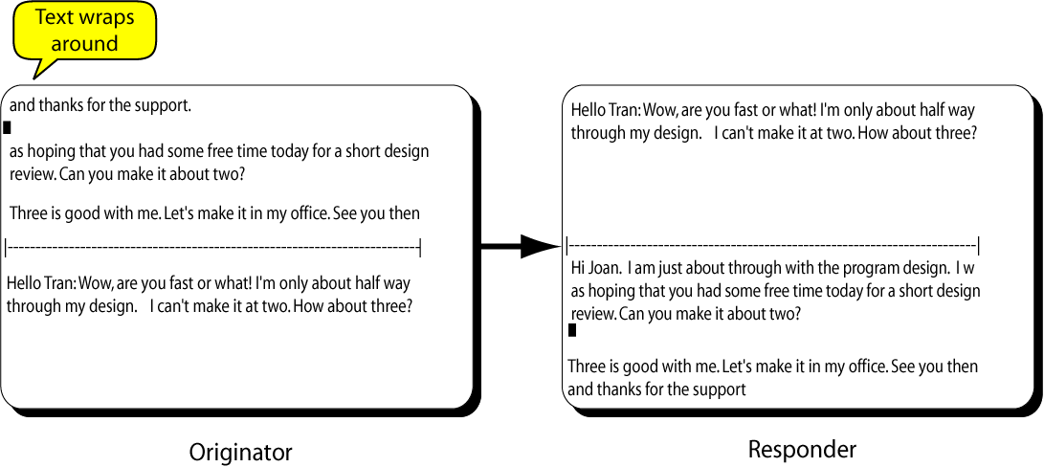
A Complete talk Session (3)

Slide 23
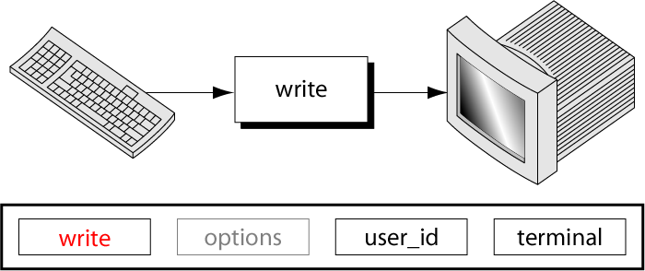
The write Command

Slide 24
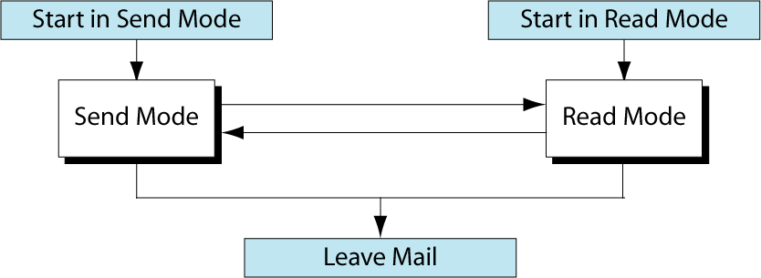
The mail System

Slide 25
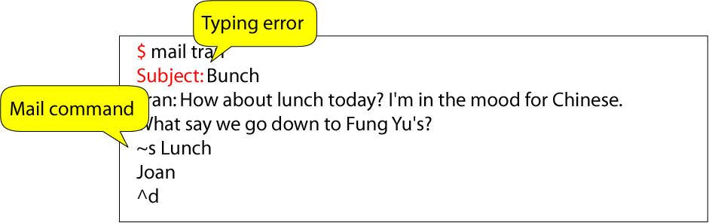
mail Command Example

Slide 26
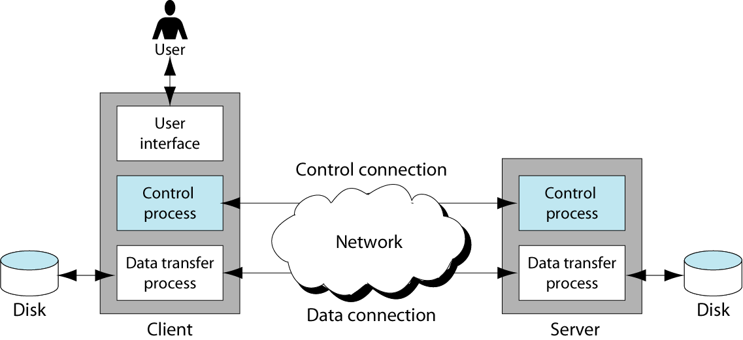
File Transfer Protocol
Notes:
Whenever a file is transferred from a client to a server, a server to a client, or between two servers, a transfer utility is used. In UNIX, the ftp utility is used to transfer files.

Slide 27
ftp - Transfer Files
ftp is a user interface to the standard File Transfer Protocol (FTP)
ftp [options] [remote-system]
To establish an FTP connection, you must have access to an account on the remote system
FTP is not a secure protocol. Use sftp for secured ftp
sftp>help
Notes:
The ftp Command
File Transfer Protocol (ftp) is a TCP/IP standard for copying a file from one computer to another. Transferring files from one computer to another is one of the most common tasks expected from a networking or internetworking environment.

Slide 28
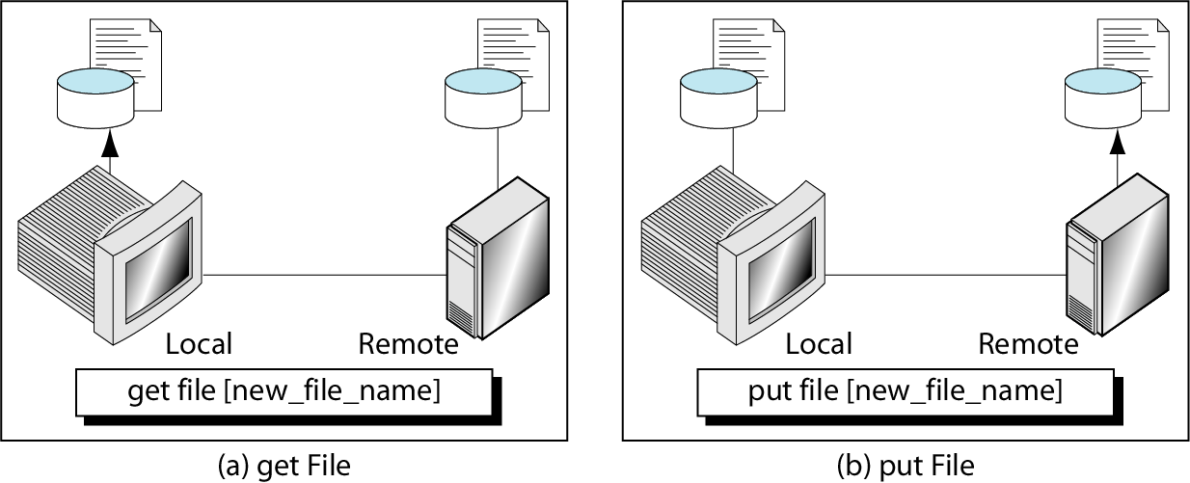
get and put
Notes:
get – download file- download multiple files
mget
put – upload file
! command – execute ‘command’ in local shell
help or ? – sftp command help

