Slide 1

The Teacher and the Curriculum
Group 6
Notes:
NOTE:
To change the image on this slide, select the picture and delete it. Then click the Pictures icon in the placeholder to insert your own image.

Slide 2
1. What is the suggested plan of action in the process of curriculum evaluation?
Analyze information
Collect or gather information
Organize the information
Recycle the information for continuous feedback
A. I, II, IV, and III
B. II, I, III, and IV
C. II, III, I, and IV
D. III, IV, I, and II

Slide 3
Curriculum Evaluation
To determine whether or not the newly adopted curriculum is producing the intended results and meeting the objectives that it has set forth
can include examining whether or not the 'AIMS and OUTCOMES' of the curriculum have been met.
Teacher what to know whether what they are doing in the classroom is effective.

Slide 4

Table
Collect or Gather Information
Collect the data needed Identify the kinds of data to make that decision
Organize the Information
Organize the needed information needed for decision makers
Analyze the information
Analyze data based on the criteria
Recycle the information for continuous feedback
Recycle the information for continuous feedback, modification and adjustment to be made.

Slide 5
1. What is the suggested plan of action in the process of curriculum evaluation?
Analyze information
Collect or gather information
Organize the information
Recycle the information for continuous feedback
A. I, II, IV, and III
B. II, I, III, and IV
C. II, III, I, and IV
D. III, IV, I, and II

Slide 6
2. The following question relate with the first fundamental principle of Ralph Tyler except:
How do you want your students to learn?
What do students need to be successful?
What objectives and goals does the school have?
What philosophy can be drawn out from the school purpose?

Slide 7
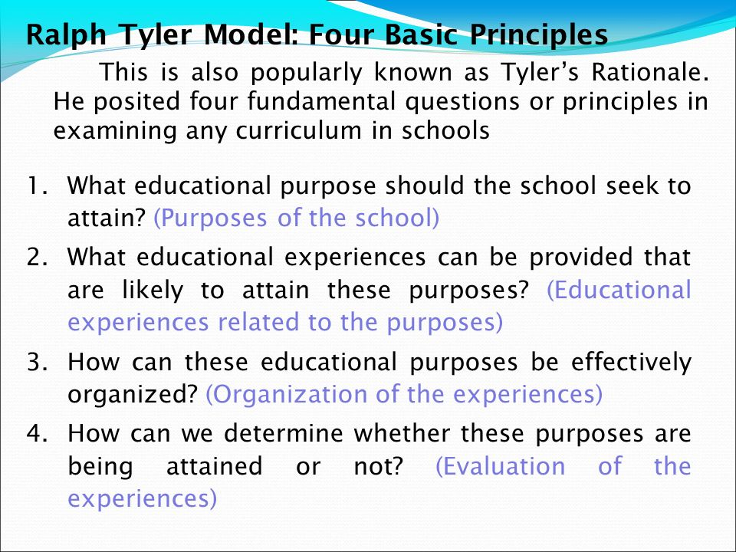
Title and Content Layout with Chart

Slide 8
The first fundament principle of Ralph Tyler
What educational purpose should the school seek to attain?
What do students need to be successful?
What objectives and goals does the school have?
What philosophy can be drawn out from the school purpose?

Slide 9
2. The following question relate with the first fundamental principle of Ralph Tyler except:
How do you want your students to learn?
What do students need to be successful?
What objectives and goals does the school have?
What philosophy can be drawn out from the school purpose?

Slide 10
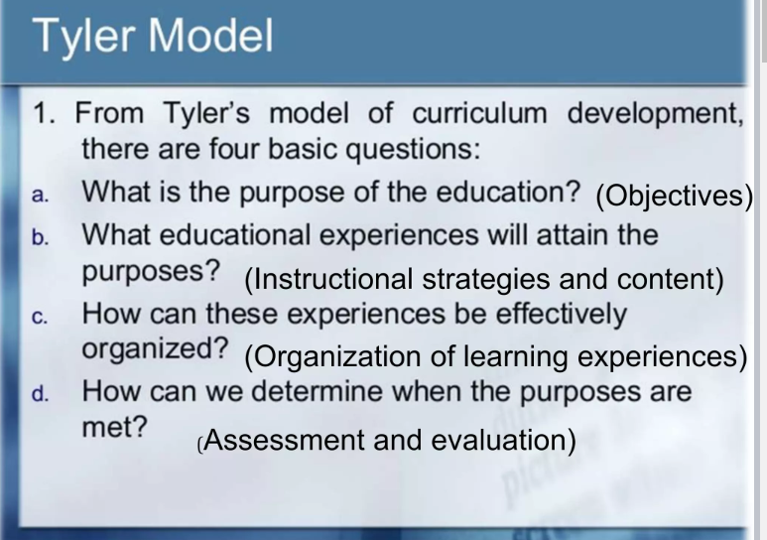
Picture with Caption Layout
Caption

Slide 11
3. The following describe Tyler’s Rationale on Curriculum Development except:
A. Deductive
B. Reflects the teacher’s approach
C. Believes that administration should design curriculum
D. Lays the main stress on aims, evaluation, and control

Slide 12
TABA – TYLER
Rationales

Slide 13
Tyler’s Rationale on Curriculum Development
deductive
argues from the administrator approach
believes that administration should design the curriculum and the teachers implement it.
lays the main stress on aims, evaluation, and control.
This approach may be perfect, perhaps, for market-oriented education, but inadequate for the development of responsible and creative individuals able to meet the challenges of the constantly changing circumstances

Slide 14
Taba’s Rationale on Curriculum Development
inductive
Reflects the teacher’s approach
believes that the teachers are aware of the students needs; hence teachers should be the ones to develop the curriculum and implement in practice.
Her rationale does not start with objectives, as she believes that the demand for education in a particular society should be studied first
pays attention to the selection of the content and its organization with an aim to provide students with an opportunity to learn with comprehension.

Slide 15
3. The following describe Tyler’s Rationale on Curriculum Development except:
A. Deductive
B. Reflects the teacher’s approach
C. Believes that administration should design curriculum
D. Lays the main stress on aims, evaluation, and control

Slide 16
4. The following describe Taba’s Grassroots Approach in Curriculum Development except:
A. Inductive
B. Reflects the teachers approach
C. Believes that teachers are aware of students needs
D. Starts with objectives and ends with demands education

Slide 17
THE TABA MODEL
Hilda Taba believes in an inductive approach to curriculum development. Her model is a teacher approach and she believes that the teachers are aware to the student’s need.
7 STEPS IN TABA MODEL
Diagnosis of leamers needs and expectations of the larger society.
2. Formulation of learning objectives.
3. Selection of the learning content.
4. Organization of learning content
5. Selection of the learning experiences
6. Organization of learning activities
7. Determination of what to evaluate and the means of doing it.

Slide 18
THE TABA MODEL
DIAGNOSIS OF NEEDS
FORMULATION OBJECTIVES
SELECTING CONTENT
ORGANIZING CONTENT
SELECTING LEARNING EXPERIENCES
ORGANIZING LEARNING EXPERIENCES
EVALUATION

Slide 19
4. The following describe Taba’s Grassroots Approach in Curriculum Development except:
A. Inductive
B. Reflects the teachers approach
C. Believes that teachers are aware of students needs
D. Starts with objectives and ends with demands education

Slide 20
Reference/s
I E R umiversity of peshawar. (n.d.). Taba model of curriculum development. https://www.slideshare.net/sohail9595/taba-model-of-curriculum-development

