Slide 1
Software Testing Methodology
Lecture 9
Gregory S. DeLozier, Ph.D.

Slide 2
Reasons For Failure
Wrong requirements
Defective code
Defective tools
Problem in execution environment
This probably is the most common reason for outage
Really expensive
Sophisticate software architectures are making it worse

Slide 3
Reasons for Environmental Failure
Missing dependencies
Libraries
Tools
Volumes
Ports
Connections
Credentials

Slide 4
Reasons for Environmental Failure
Lack of capacity
Memory
Disk space
CPU speed
Network Bandwidth
Parallel capacity

Slide 5
Reasons for Environmental Failure
Changes in the environment
Additional activity
Capacity consumption
Connectivity issues
Patches
Interference – side effects from other work
Malware
Credentialing issues
Power failure

Slide 6
How does this relate to testing?
Testing the environmental requirements
Repeating that test on the target environments
Periodically verifying the target environment
Environmental assessment in case of failure

Slide 7
Environment as Software
Tools have been made to _create_ environments.
Batch files
Recipes
Containers
These can be adapted to testing work
Test the correct execution of the setup program
Compare recipes to current state
Evaluate container construction _and_ state

Slide 8
Recipes
Create a tool to describe desired state
Put an agent on a machine, tell it which recipe to follow
Agent updates machine to match recipe
Recipe conformance is testable

Slide 9
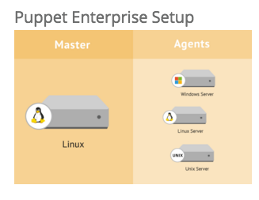
Puppet
https://puppetlabs.com/
https://puppetlabs.com/puppet/what-is-puppet

Slide 10
Catalogs
Puppet configures systems in two main stages:
Compile a catalog
Apply the catalog
What is a Catalog?
A catalog is a document that describes the desired system state for one specific computer. It lists all of the resources that need to be managed, as well as any dependencies between those resources.

Slide 11
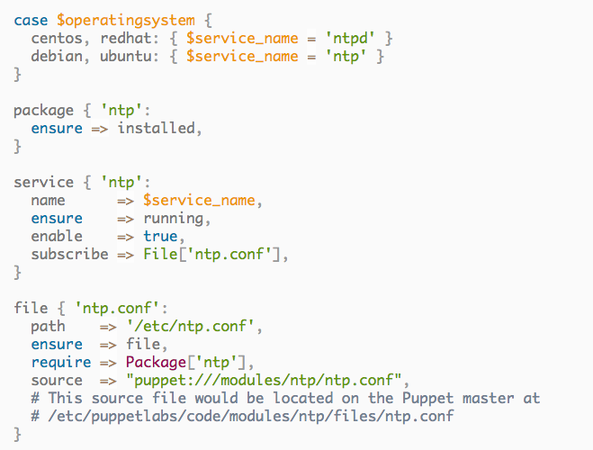
Example Manifest

Slide 12
Some fun stuff
https://www.youtube.com/watch?v=3MjioGNw_rY

Slide 13
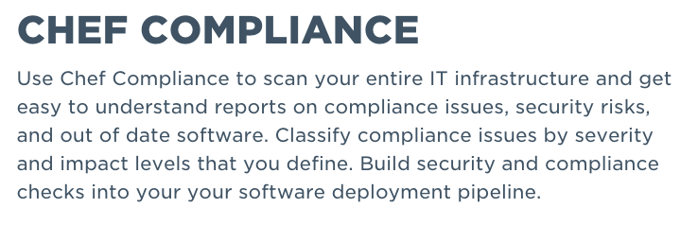
Chef – Alternative to Puppet
This is where the “recipe” term comes from
Scanning for compliance is a large draw here:

Slide 14
Chef is an alternative to Puppet
https://learn.chef.io/
It turns out we can play with this one
< Tutorial Time >
https://learn.chef.io/learn-the-basics/ubuntu/configure-a-resource/

Slide 15
Ansible – a recent addition
http://www.ansible.com/
Modules define actions to be taken
Playbooks contain information about desired state

Slide 16
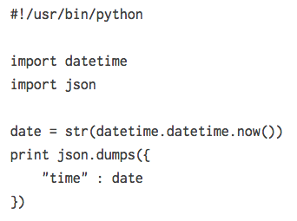
Ansible Modules
Small bits of code that do useful things
More examples:
http://docs.ansible.com/ansible/developing_modules.html

Slide 17
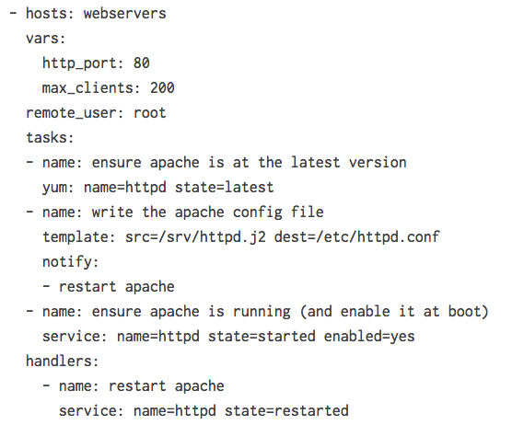
Ansible Playbooks

Slide 18
Ansible – video tour
https://ansible.wistia.com/medias/qrqfj371b6

Slide 19
Programmatic Solutions
Remote control of machines
Write function in, say, python
Part of the function is executed remotely
These allow you to program remote machines
Functions to set things up – configuration
Functions to return values – testing
Paramiko – remote control
Fabric – convenient configuration
Yarn – alternative for Python 3.x

Slide 20
Paramiko
www.paramiko.org
Implements SSH for remote login
Very low-level
http://jessenoller.com/blog/2009/02/05/ssh-programming-with-paramiko-completely-different

Slide 21
Paramiko Example
import paramiko
ssh = paramiko.SSHClient()
ssh.connect('127.0.0.1', username='jesse', password='lol')
ssh.set_missing_host_key_policy( paramiko.AutoAddPolicy()) <- add
stdin, stdout, stderr = ssh.exec_command("uptime")
type(stdin)
stdout.readlines()
['13:35 up 11 days, 3:13, 4 users, load averages: 0.14 0.18 0.16\n']

Slide 22
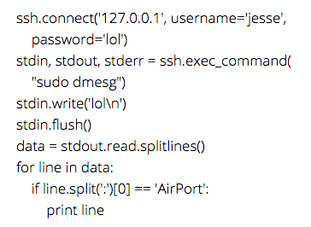
More Paramiko

Slide 23
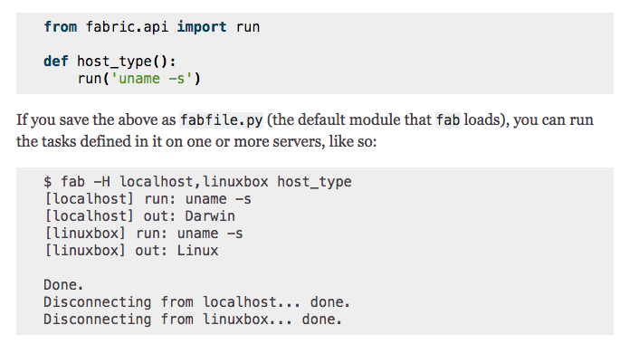
Fabric – a Python 2.7 remote solution

Slide 24
Fabric Issues
http://www.fabfile.org/
Only Python 2.7 at this time
Author is not porting
Ports are available

Slide 25
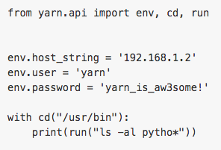
Yarn – a Fabric Replacement
https://github.com/Python-Yarn/Yarn
Written in Python 3
Uses Paramiko
Very easy to use :

Slide 26
Yarn Demo
Demo Time

Slide 27
Homework
Get a remote computer running
Vagrant or cloud computer
Execute some yarn commands against it
Use python unittest framework to test some setup parameters
Is <?> installed?
Is <?> directory created?
Does this directory have the right permissions?
…etc
As always, send me something showing that you did this.

Slide 36
Future Topics
We will cover the following additional chapters:
8 – Deployment
11 – Forms
13 – Javascript
15,16 – Mocking
17 – Logging
18 – Outside-In
19 – Test Isolation
22 – Test Architecture and Topics

Slide 37
Regarding Software Engineering (Spring 16)
We will be using this book for some topics in SWE
Continuous Integration
Deployment preparation
Deployment management and DevOps
Environment validation and testing
Authentication and Security
Database migration
A few other things here and there. ☺

