Slide 1
Two-stream hierarchical Videogpt
Mentor name:Zhiqi Chen
Member ：Jinchang Zhang

Slide 2
CONTENTS
Overview of
Algorithm
1
GPT and
Hierarchical GPT
4
Two-stream
3D-ConvNet
2
5
Model Comparison
VQ-VAE
3
6
Experiment

Slide 3
1
Overview of Algorithm

Slide 4
1
Overview of Algorithm
A Two-stream
3D-ConvNet
B VQ-VAE
。
A
论文
D Hierarchical GPT
B
C GPT
D
C
。

Slide 5
2
Two-stream 3D-ConvNet

Slide 6
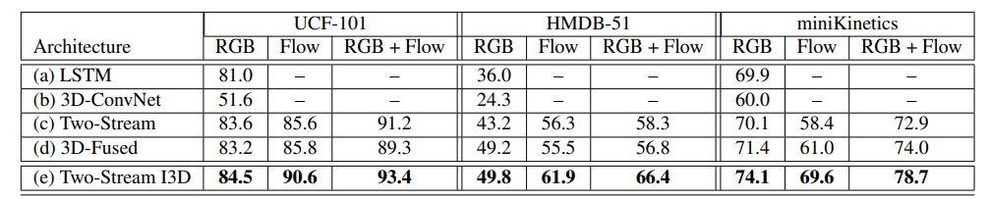
Two-stream 3D-ConvNet
2
Two-stream 3D-ConvNet

Slide 7
Two-stream 3D-ConvNet
2
Two-stream 3D-ConvNet

Slide 8
3
VQ-VAE

Slide 9
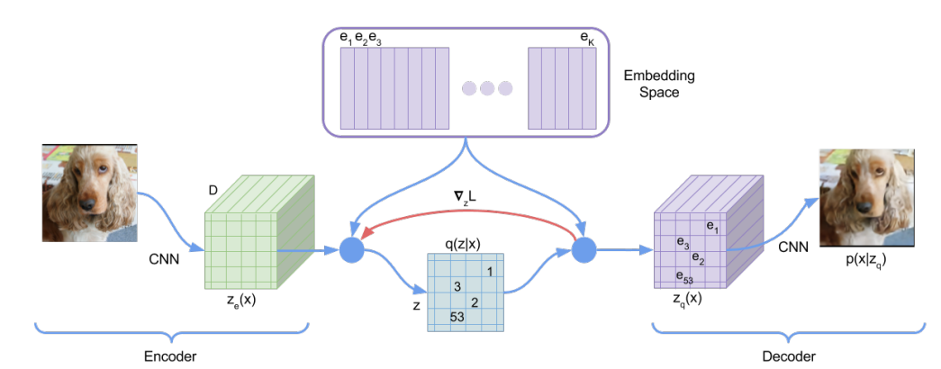
VQ-VAE Architecture
3
VQ-VAE

Slide 10
VQ-VAE
3
VQ-VAE
1. vector quantisation to Discrete Latent variables
2. use Autoregressive model to fit prior
Why use Discrete Latent variables?
1)Many important things in the real world are discrete;
2)easier to model priors,
3)Continuous representations are often discretized by encoder/decoder

Slide 11
VQ-VAE detail
3
VQ-VAE
Discrete Latent space
Learning

Slide 12
4
GPT

Slide 13
4
GPT
Autoregressive model
P(x) is prior of VQVAE
GPT model as auto regressive
Why we can use GPT model to computer problem ?

Slide 14
GPT Architecture
4
GPT

Slide 15
4
GPT
pre-training,
Use unlabelled data to train
task
For a image, cover a few pixels, and use the remaining residual image to guess the pixels of the cover? Like the language model's gpt
method
auto-regressively (AG): use 1,2,…,i-1 to predict i
Train

Slide 16
4
GPT
we apply a layer norm in the final transformer layer,

Slide 17
Hierarchical GPT

Slide 18
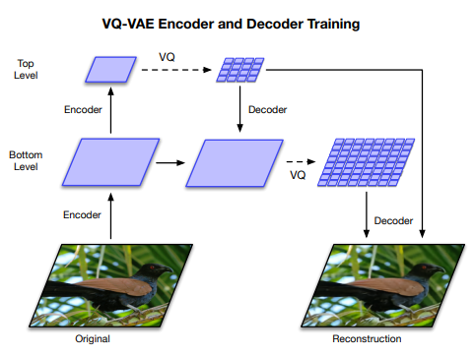
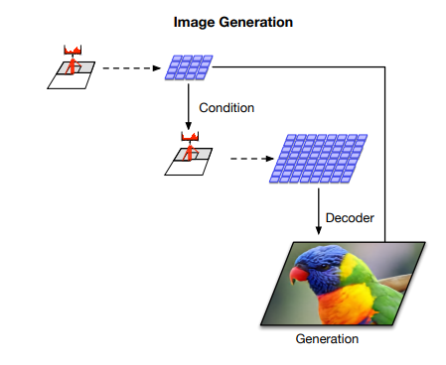
Hierarchical GPT

Slide 19
5
Model Comparison

Slide 20
5
Model Comparison
VideoGPT VS Two-stream hierarchical Videogpt
建 议
1
3D ConvNet VS Two-stream
2
VQVAE VS hierarchical VQVAE

Slide 21
6
Experiment

Slide 22
