Slide 1

RNA Design with Backbone k-Tree Model
RNA Informatics Laboratory
The University of Georgia
Notes:
<number>

Slide 2
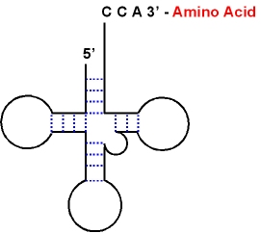


RNA Design/Inverse Folding
Given a target structure, of determining one or more RNA sequences that fold into the structure.
RNA engineering is offering new routes for deciphering genetic regulation and for developing therapeutic and bioengineering applications.
Numerous tools for design of RNA secondary structures.
INFO-RNA(dynamic programming),
RNAinverse(ViennaRNA package),
RNA designer(stochastic local search), etc.

Slide 3
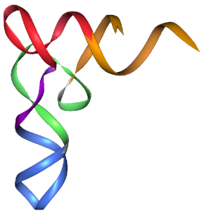
Our problem
Input: coordinates of the backbone of a target RNA 3D structure.
Output: one or more sequences that fold into the target structure.

Slide 4
RNA-Redesign
The only web server for designing 3D structure.
To find sequence variants compatible with a given backbone structure.
Input is a pdb file with backbone and sugar heavy atoms.
Rosetta packer algorithm, to sample the base identity and side-chain torsions, is well-developed for protein design.
Optimized based on 3 routines: glycosidic torsion angles, placement of 2'-OH hydrogen, side-chain conformation and identity.
Minutes for 20 nts.

Slide 5
RNA-Redesign Results
Singal recognition particle domain IV RNA (PDB ID: 1LNT).
One of its conserved A-C base pair could be mutated to an A-G pair, which yields a lower Rosetta score.
J4/5 motif from the P4-P6 domain of gourp I Tetrahymena ribozyme (PDB ID: 1GID), which forms contacts in the core.
A conserved G-U pair above an unpaired A and two sheared A-A pairs. Three pairs form contacts between P4-P6 domain and the full ribozyme's catalyic core.
Mutations of A-A pairs to A-U and A-C pairs, suggesting that A-A pairs are not necessary for the structure, but for the structure roles.
A GGAA tetraloop. Several mutations do not affect the overall folding.

Slide 6
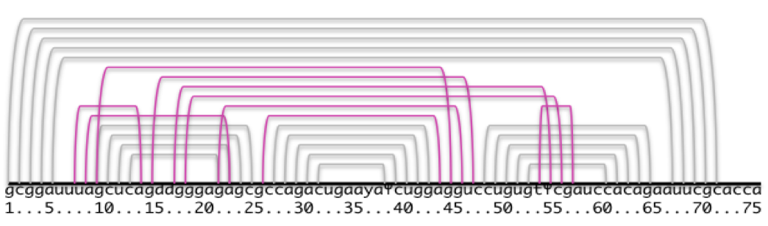
BkTree-Design
Preprocessing input coordinates to generate a backbone graph:
To determine a non-backbone edge: choose a cutoff C1-C1 distance: 17.5 angstrom(avg+2*std)
Merge close non-backbone edges, e.g., in 2DU3,
(0 63), (0 64), (0 65), (0 67), (0 69), (0 70) become (0, 63);
(8 12), (8 13), (8 14), (8 15), (8 19), (8 20), (8 21), (8 22), (8 23), (8 24), (8 25), (8 26), (8 41), (8 42), (8 43), (8 44), (8 45), (8 46), (8 47), (8 57), (8 58) become (8 13), (8 20), (8 45), (8 57).

Slide 7
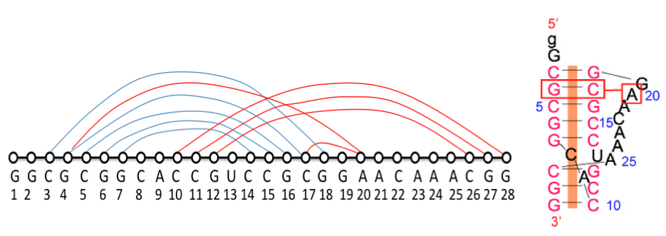
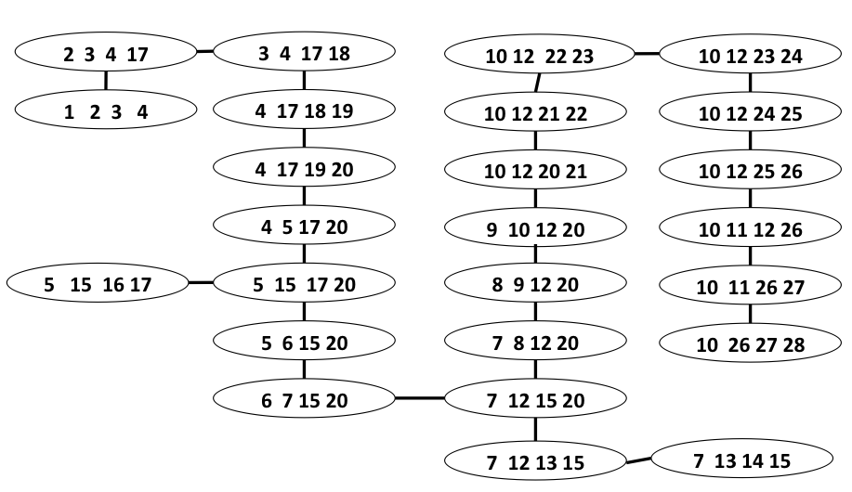
BkTree-Design
Run BkTree program to generate a backbone 3-tree for the backbone graph.

Slide 8
BkTree-Design
Build a pattern database for every 4 nucleotides (form a 4-clique of a backbone 3-tree) from resolved 3D structures of RNAs.
[10, 10, 10, 19, 20, 5][4, 4, 1]5 :
UGGG['', '', '', '', '', 's35'] 1 ;
AGUC['', '', '', '', '', 'perp'] 1 ;
GACG['', 'cWW', 's55', '', '', 's35'] 1 ;
CGCC['cWW', '', '', '', '', 's35'] 1 ;
AAAG['', '', '', '', '', 's35'] 1 ;

Slide 9
RNA Design/Inverse Folding
Given a target structure, of determining one or more RNA sequences that fold into the structure.
RNA engineering is offering new routes for deciphering genetic regulation and for developing therapeutic and bioengineering applications.
Numerous tools for design of RNA secondary structures.
INFO-RNA(dynamic programming),
RNAinverse(ViennaRNA package),
RNA designer(stochastic local search), etc.

Slide 10
BkTree-Design
DP algorithm on the backbone 3-tree to calculate the best assembling of patterns of all 4-cliques in the 3-tree.
Not only predict a sequence, but also predict a set of interactions.
Produce a constant number of best sequences.

Slide 11
Problems
Some 4-cliques cannot find the exact matching pattern.
One solution is to allow some similar patterns to match the 4-cliques.
How to score each pattern? Geometric alignment of the target and its candidates?
How to evaluate the predicted sequences?

