Slide 1


Chapter 2 Greedy Strategy
I. Independent System
Ding-Zhu Du

Slide 2
Max and Min
Min f is equivalent to Max –f.
However, a good approximation for Min f may not be a good approximation for Min –f.
For example, consider a graph G=(V,E). C is a minimum vertex cover of G if and only if V-C is a maximum independent of G. The minimum vertex cover has a polynomial-time 2-approximation, but the maximum independent set has no constant-bounded approximation unless NP=P.

Slide 3
Greedy for Max and Min
Max --- independent system
Min --- submodular potential function

Slide 4
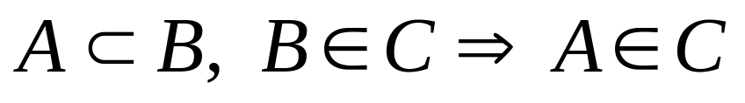
Independent System
Consider a set E and a collection C of subsets of E. (E,C) is called an independent system if

Slide 5
Maximization
+
c: E→R
max c(A)
s.t. AεC
c(A) = ΣxεA c(x)

Slide 6
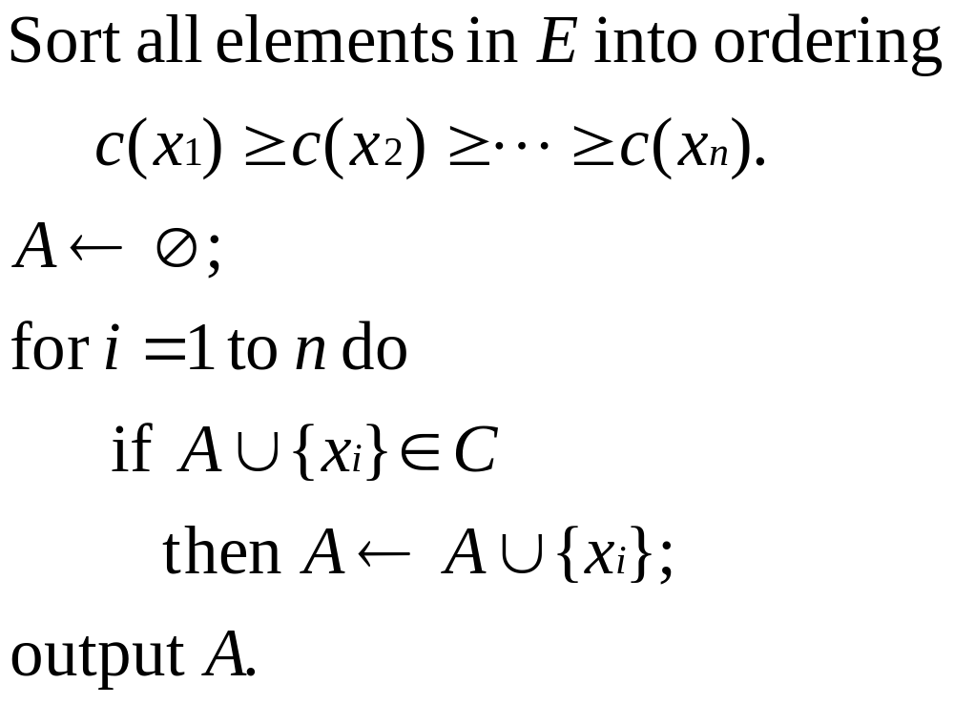
Greedy Approximation MAX

Slide 7
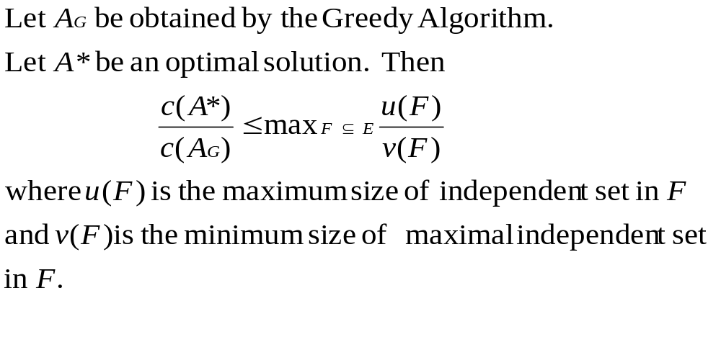
Theorem

Slide 8
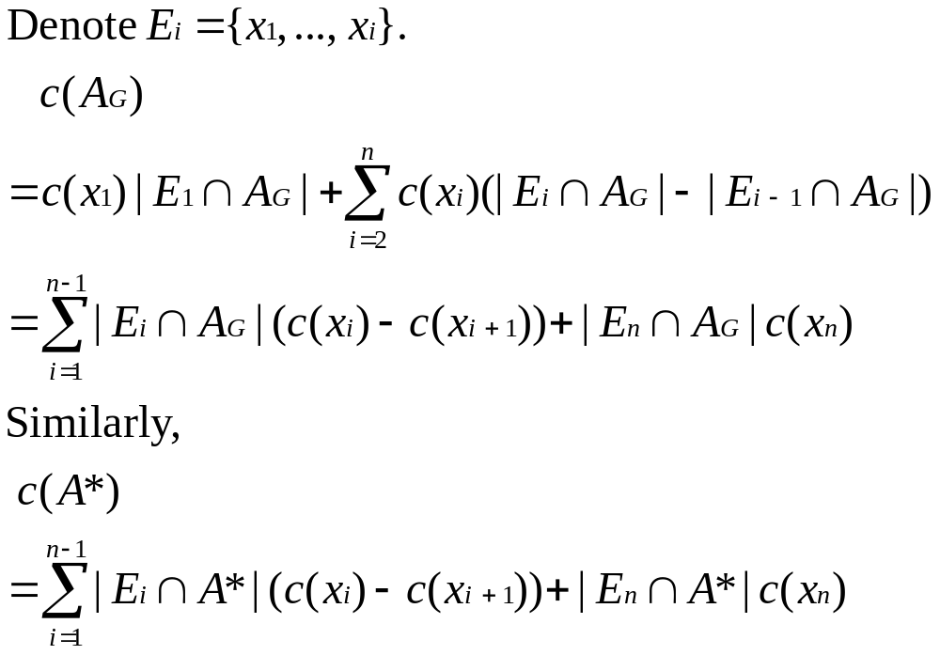
Proof

Slide 9
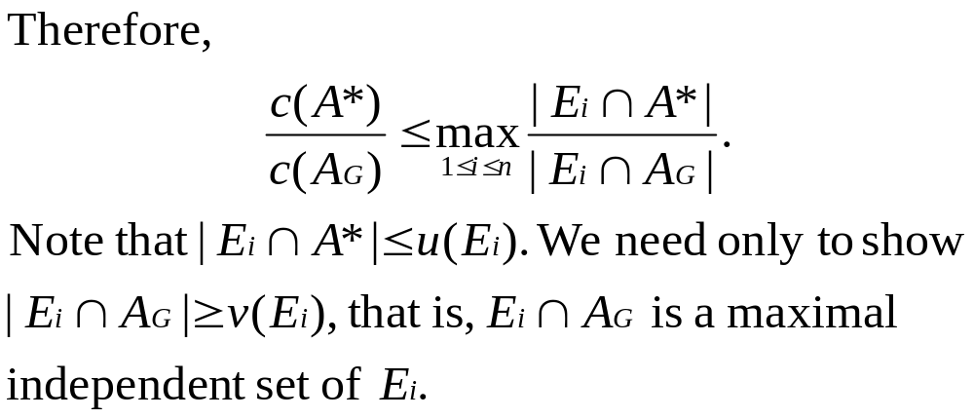

Slide 10
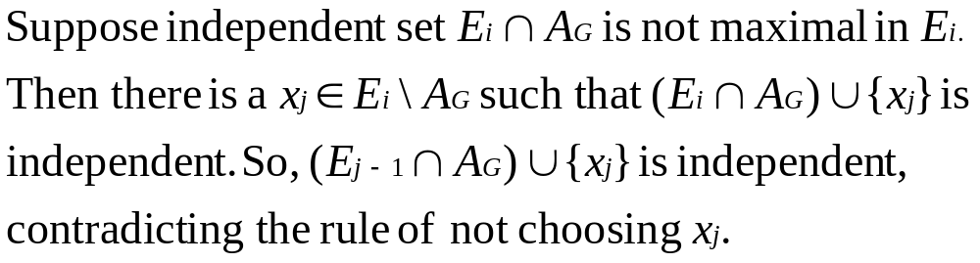

Slide 11
Maximum Weight Hamiltonian Cycle
Given an edge-weighted complete graph, find a Hamiltonian cycle with maximum total weight.

Slide 12
Independent sets
E = {all edges}
A subset of edges is independent if it is a Hamiltonian cycle or a vertex-disjoint union of paths.

Slide 13
Maximal Independent Sets
Consider a subset F of edges. For any two maximal independent sets I and J of F,
|J| < 2|I|

Slide 14
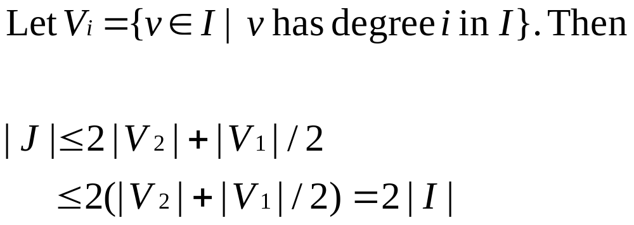

Slide 15
Maximum Weight Directed Hamiltonian Cycle
Given an edge-weighted complete digraph, find a Hamiltonian cycle with maximum total weight.

Slide 16
Independent sets
E = {all edges}
A subset of edges is independent if it is a directed Hamiltonian cycle or a vertex-disjoint union of directed paths.

Slide 17
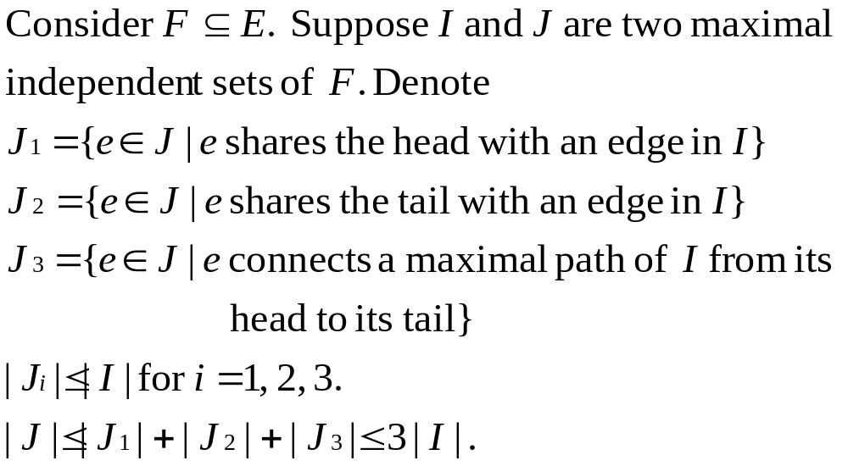

Slide 18
Tightness
ε
1
1
1
1+ε

Slide 19
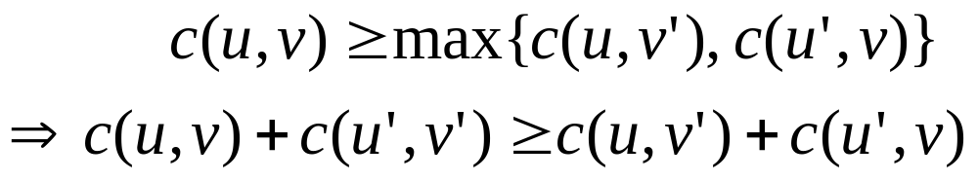
A Special Case
If c satisfies the following condition:
Then the greedy approximation for maximum weight Hamiltonian path has performance ratio 2.

Slide 20
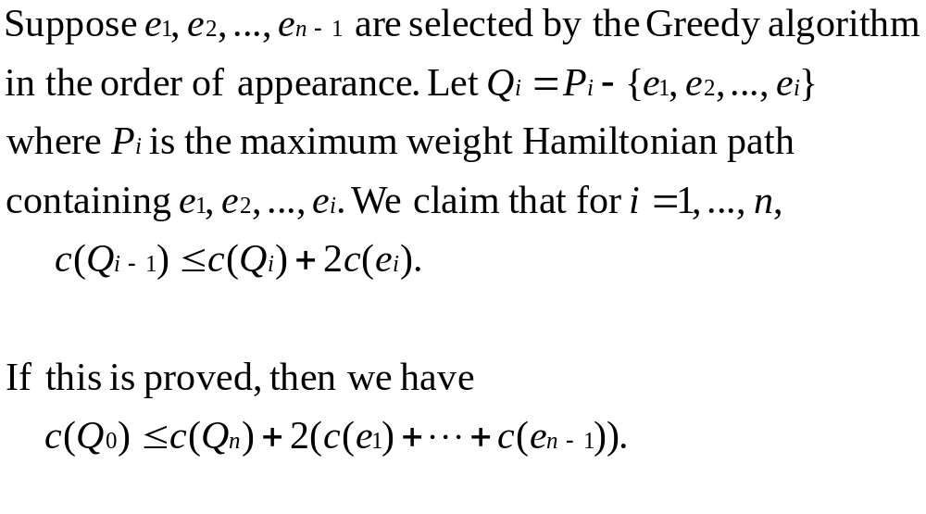

Slide 22
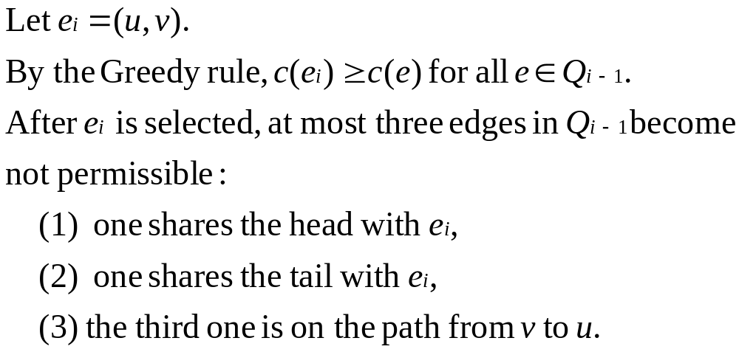

Slide 23
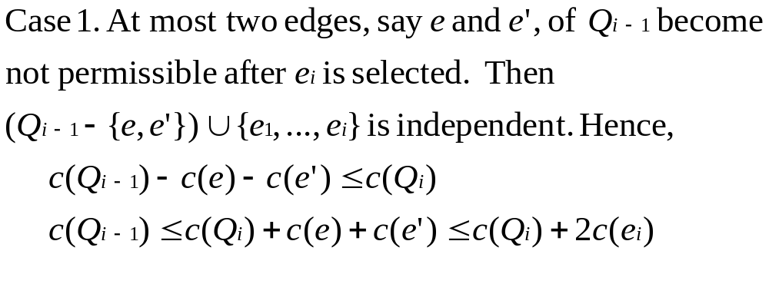

Slide 24
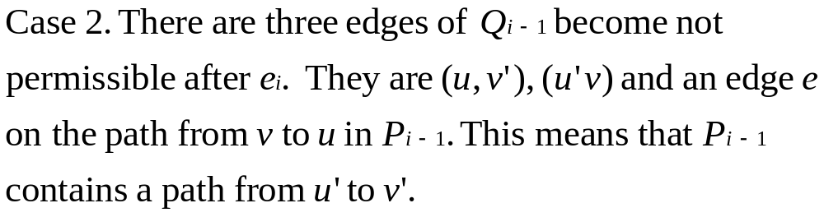
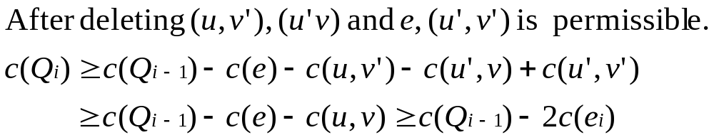
u
v’
u’
v

Slide 25
Superstring
Given n strings s1, s2, …, sn, find a shortest string s containing all s1, s2, …, sn as substrings.
No si is a substring of another sj.

Slide 26
Overlap
|ov(u,v)| = max{|w| | there exist x and y
such that u=xw and v=wy}
Overlapping graph is a complete directed
digraph:
V = {s1, s2, …, sn}
|ov(u,v)| is edge weight.

Slide 27
Hamiltonian Path

Slide 28
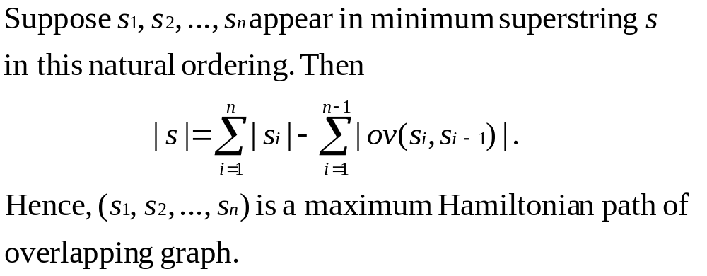

Slide 29
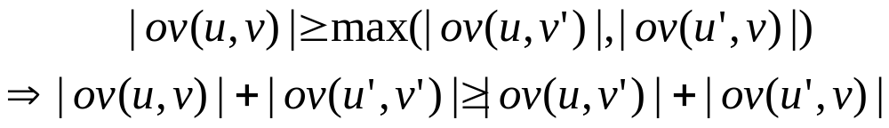
The condition
u’
v
u
v’

Slide 30
Theorem
The Greedy approximation MAX for maximum Hamiltonian path in overlapping graph has performance ratio 2.
Conjecture: This greedy approximation also give the minimum superstring an approximation solution within a factor of 2 from optimal.

Slide 31
Matroid
An independent system (E,C) is called a matroid if for any subset F of E,
u(F)=v(F).
Theorem An independent system (E,C) is a matroid iff for any cost function c( ), the greedy algorithm MAX gives a maximum solution.

Slide 32
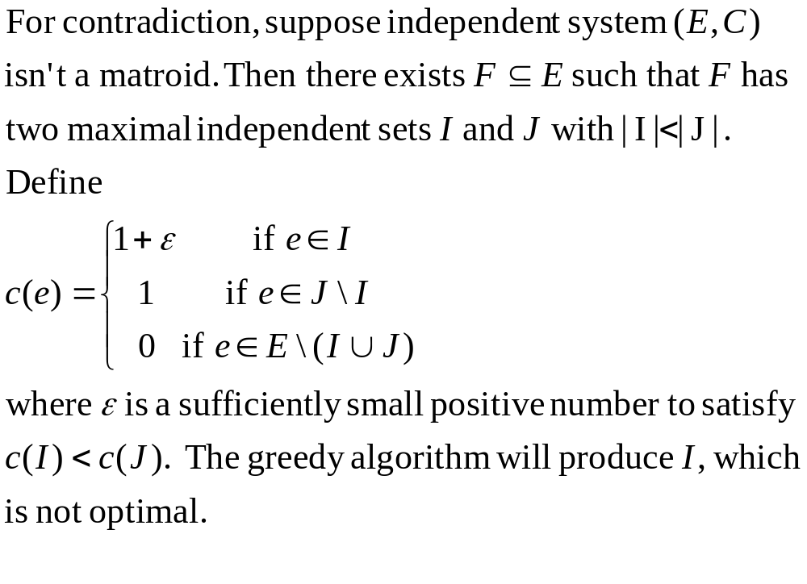
Sufficiency

Slide 33
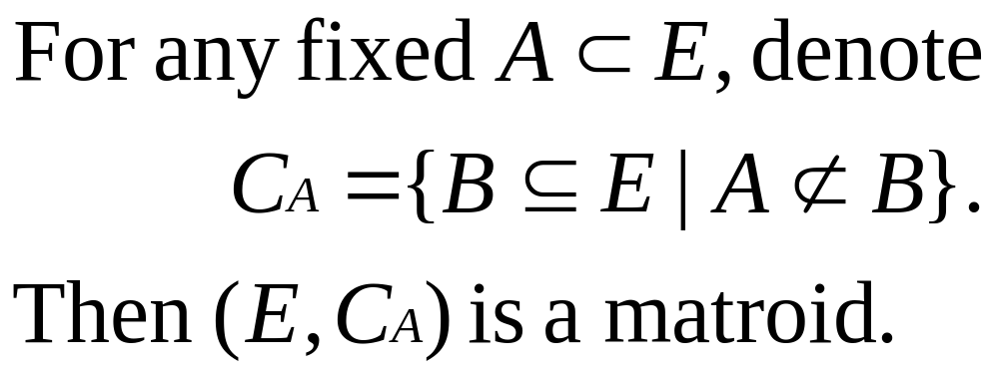
Example of Matroid

Slide 34
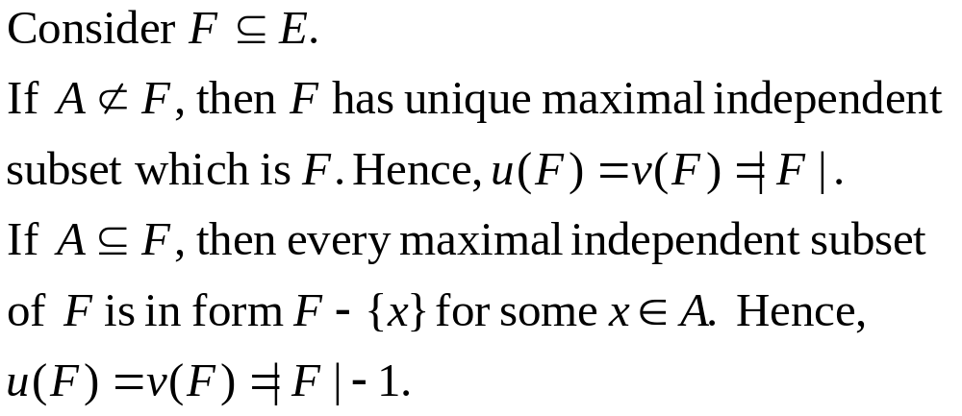
Proof

Slide 35
Theorem
Every independent system is an intersection of several matroids.

Slide 36
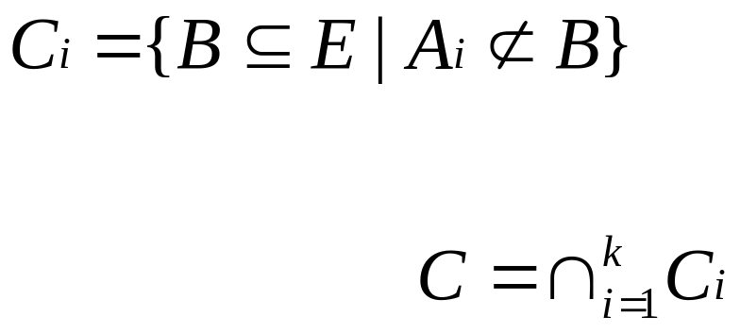
circuit
A minimal dependent set is called a circuit.
Let A1, …, Ak be all circuits of independent system (E,C).
Let

Slide 37
Theorem
If independent system (E,C) is the intersection of k matroids (E,Ci), then for any subset F of E,
u(F)/v(F) < k.

Slide 38
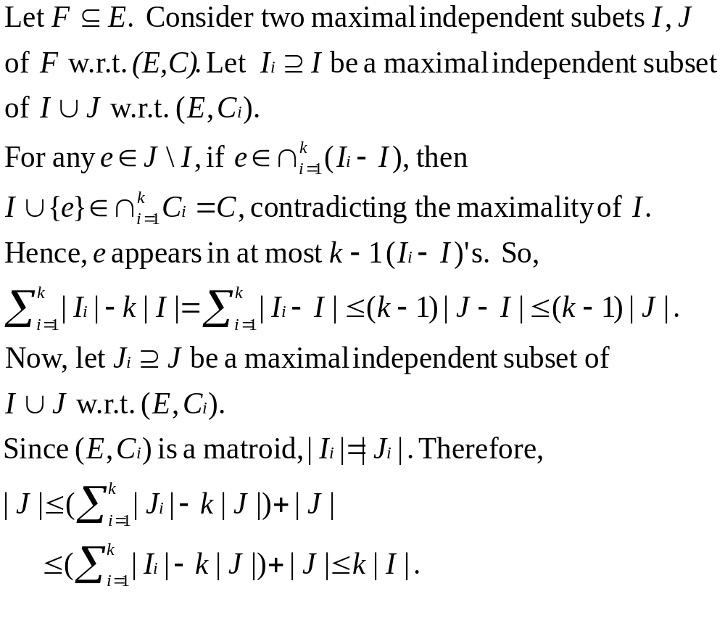
Proof

Slide 39
Applications
Many combinatorial optimization problem can be represented as an intersection of matrods. (see Lawler: Combinatorial Optimization and Matroid.)

Slide 40

Thanks, End

