Slide 1
Cloud Hosting
Philip Johnson
Collaborative Software Development Laboratory
Information and Computer Sciences
University of Hawaii
Honolulu HI 96822

Slide 2
What we're "really" talking about
How to:
  Share code with fellow developers
  Make it available to the world
  Coordinate development asynchronously
  Coordinate development synchronously
More or less, this module speaks to the "essence" of software engineering!

Slide 3
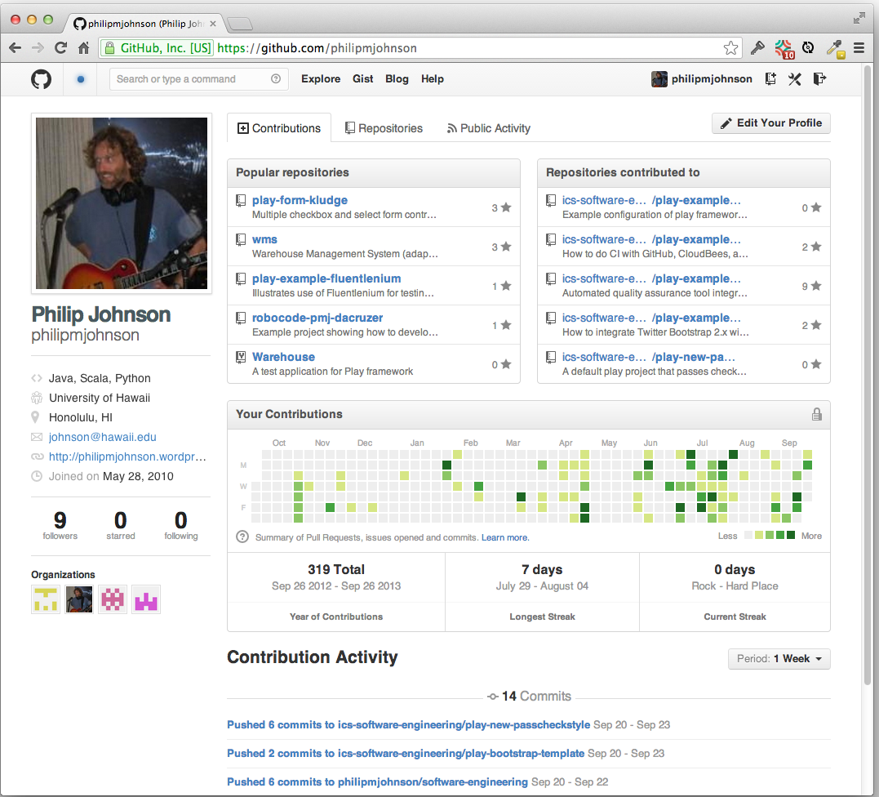
GitHub

Slide 4
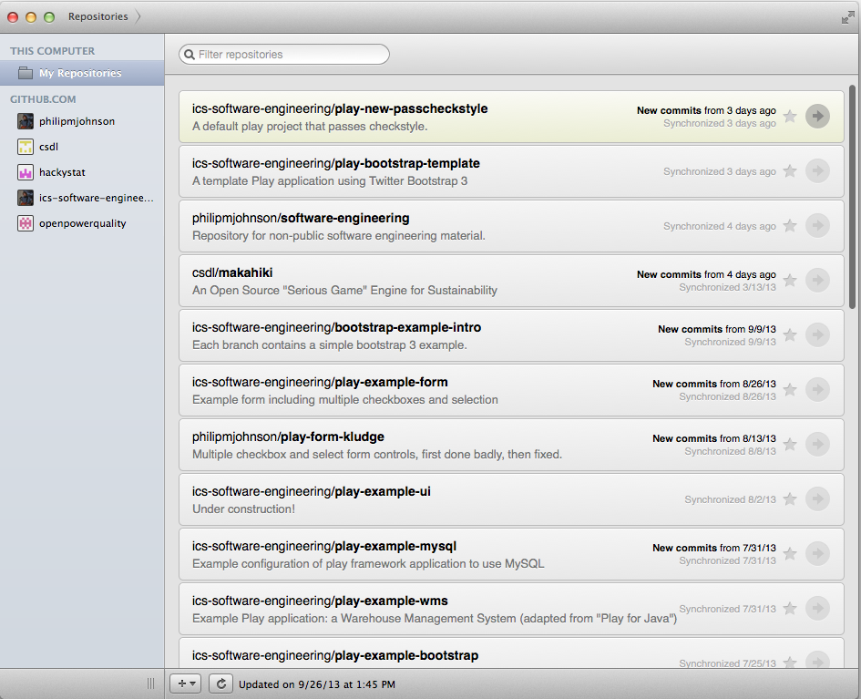
GitHub App

Slide 5
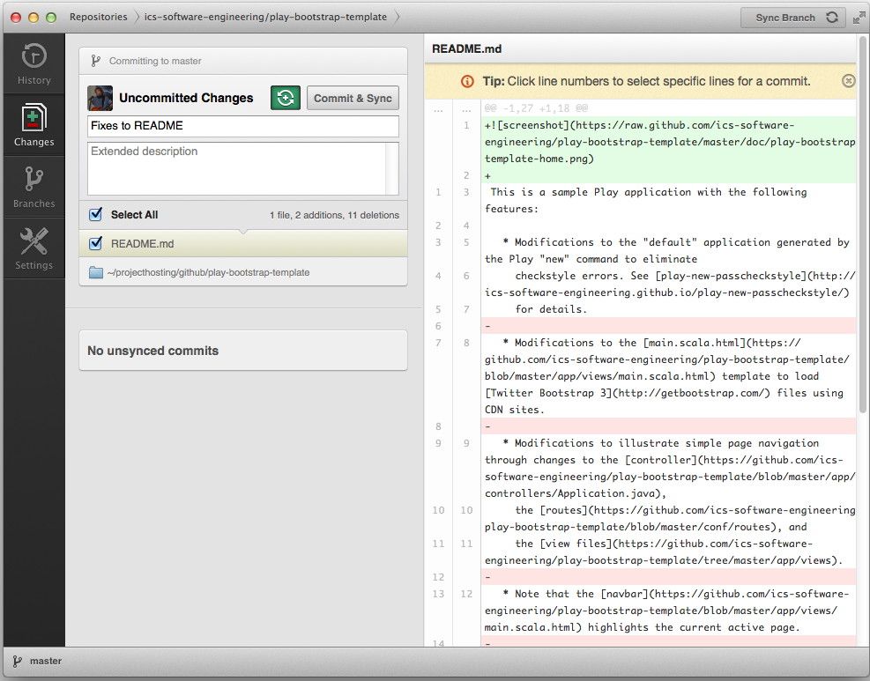
Committing changes

Slide 6
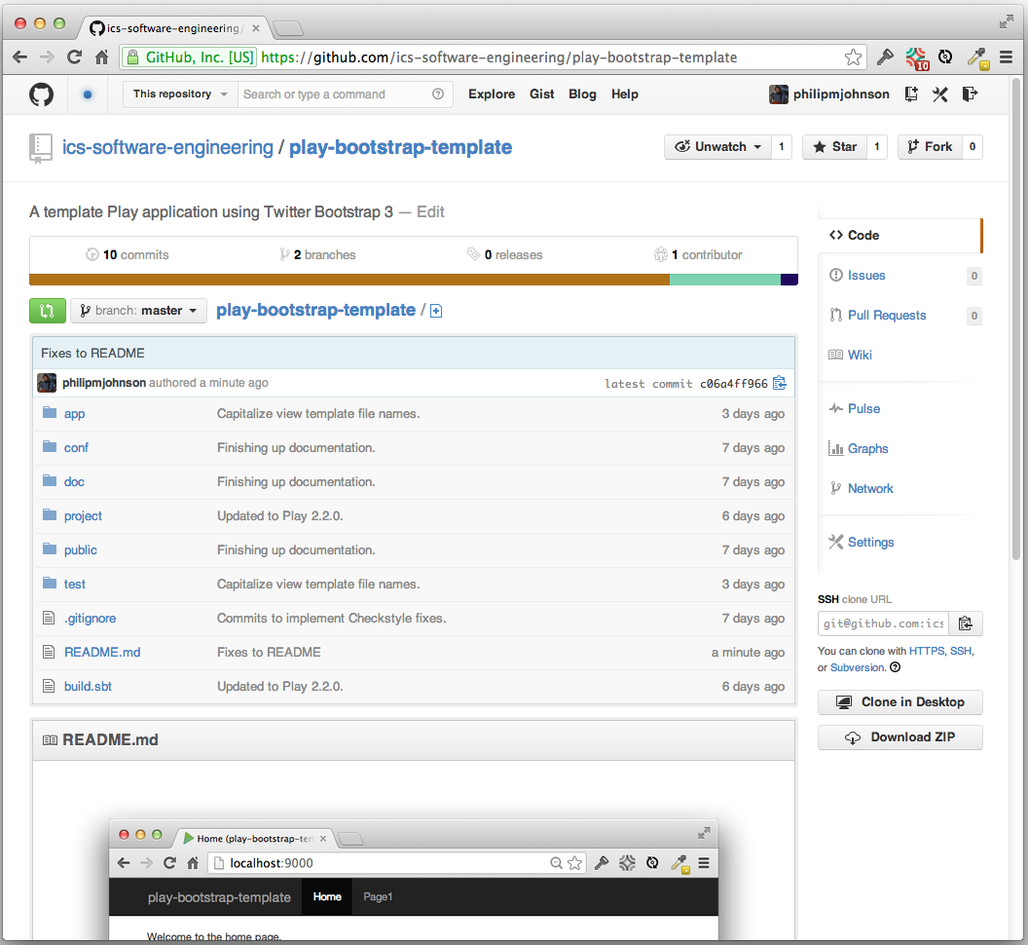
"Developer" Home Page

Slide 7
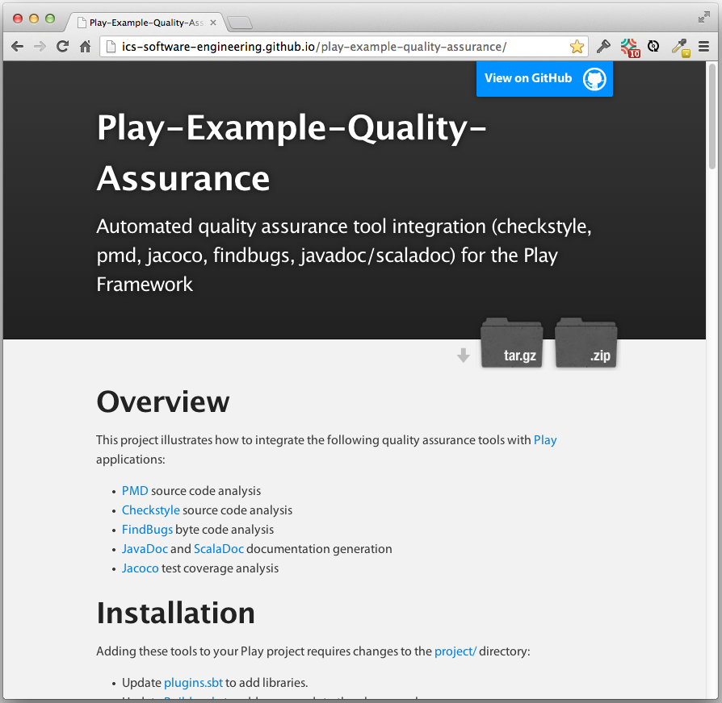
"User" Home Page

Slide 8
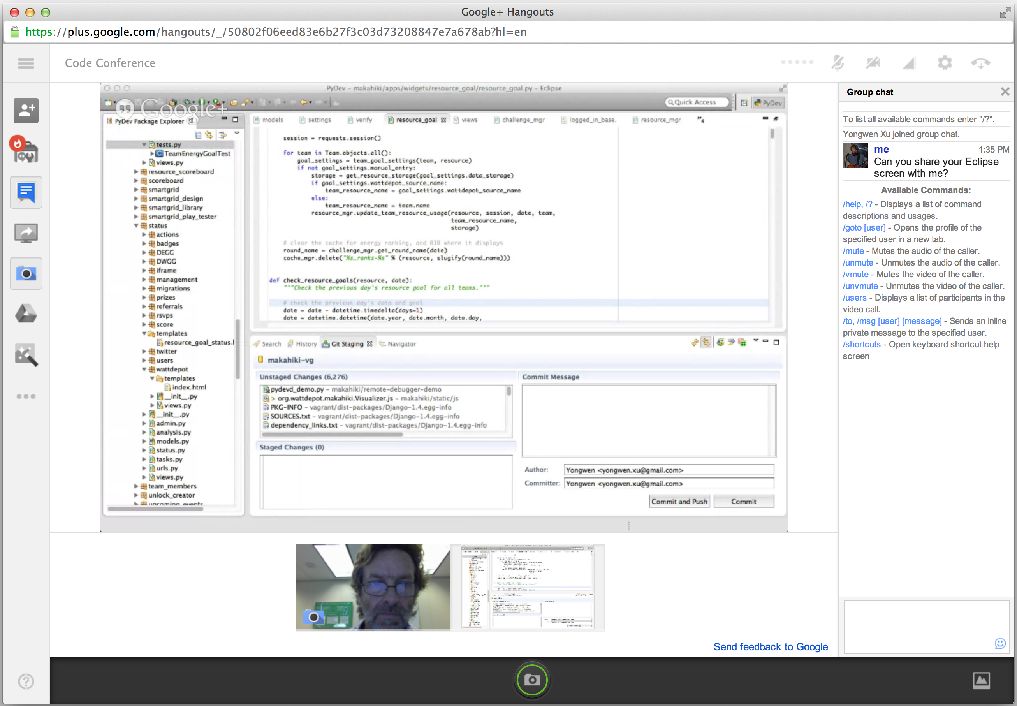
Google Hangout

Slide 9
Cool stuff to learn
Basic use of git version control system.
Basic use of GitHub project hosting.
"Centralized" development (commit & sync)
  We will use fork->pull request later
Google Hangouts
  For synchronous, distributed development.

