Slide 1
Introduction to Version Control and Configuration Management
Philip Johnson
Collaborative Software Development Laboratory
Information and Computer Sciences
University of Hawaii
Honolulu HI 96822

Slide 2
Why do we care
Software is written:
  As a combination of modules
  In one or more languages
  For one or more applications
  Using one or more libraries
Things that may (will) change over time:
  The modules required and used
  The languages employed
  The application requirements
  The libraries
Each change could cause the system to break.

Slide 3
You know you have a CM problem when…
“But the system was working fine yesterday! What happened?”
“But I can’t reproduce your bug in my copy of the system!”
“But I already corrected that code last week! What happened to my fix?”
“I wonder if that bug was fixed in this copy too?”

Slide 4
CM Defined
Configuration management attempts to identify and track all relevant elements of the configuration of a system, so that all possible errors can be identified, and possible solutions to the problems found.
Version control is a special case of configuration management, where we are concerned with maintaining multiple versions of a software system.
Defect tracking systems monitor the status of error reports from first identification to resolution. Defect tracking relates to CM because defects occur as a result of changes, and defect removal typically requires a change in configuration.

Slide 5
The Three Classic CM Problems
Any configuration management approach must address at least the following “classic” problems:
The double maintenance problem
  Must prevent occurrence of multiple copies of the same file that must be independently updated.
The shared data problem
  Must allow two or more developers to access the same file/data.
The simultaneous update problem
  Must prevent “clobbering” when two developers update the same file at the same time.
  “clobbering”: only the second developer’s changes survive.

Slide 6
Versions vs. Configurations (Traditional)
Files exist in multiple versions
  Sequences of updates over time
  Parallel variants
Systems exist in multiple configurations
  For different platforms
  For different customers
  For different functionality/pricing levels
Foo.java
(1.1)
Foo.java
(1.2)
Foo.java
(1.3)
Foo.java
(1.4)
Foo.java
(1.5)
Foo.java
(1.2.1)
Foo.java
(1.2.2)
Bar.java
(1.1)
Bar.java
(1.2)
Bar.java
(1.3)
1.0.0
1.0.1
1.1.0

Slide 7
Version Control
Version control systems support:
  Multiple versions of a file
  Multiple paths of file revision
  Locking to prevent two people from modifying the same file at the same time
  Recovery of any prior version of a file
  Efficient storage via “deltas” (forward or backward)
Foo.java
(1.1)
Foo.java
(1.2)
Foo.java
(1.3)
Foo.java
(1.4)
Foo.java
(1.5)
Branch
Merge
Foo.java
(1.2.1)
Foo.java
(1.2.2)

Slide 8
RCS: Revision Control System
When foo.java is put under RCS control, a new file called RCS/foo.java,v is created that represents:
  The most recent version of foo.java
  Backward deltas allowing reconstruction of any older version of the file in space-efficient manner.
  Information on who has a lock on the file (if anyone)
For details, download, etc:
  http://www.gnu.org/software/rcs/

Slide 9
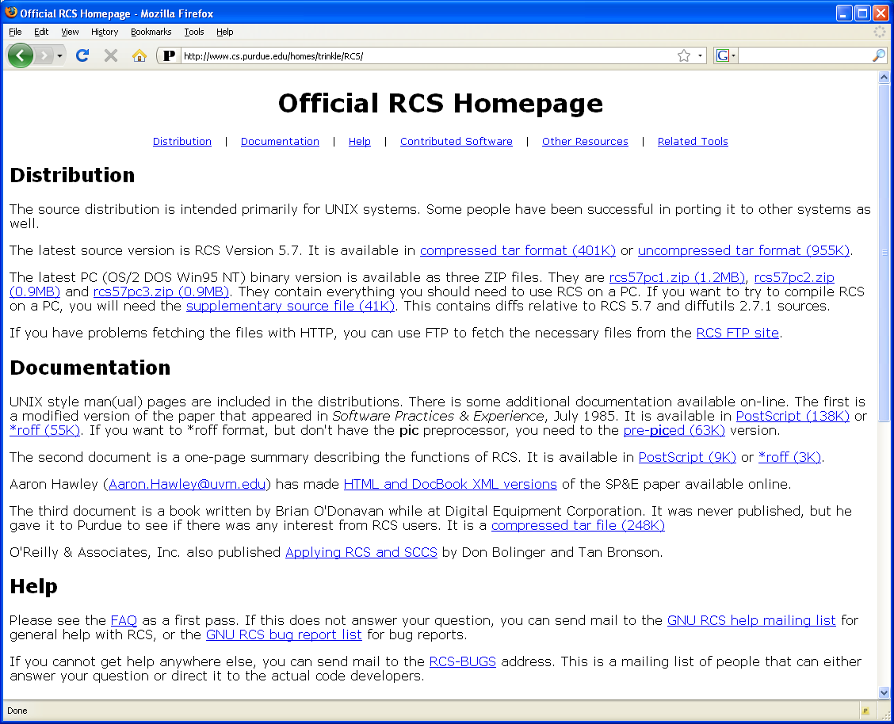

Slide 10
Example RCS Commands
% ci foo.java
  Submit foo.java for version control, or submit updated version.
  Creates RCS/foo.java,v
  Deletes foo.java
  Prompts you to supply a string documenting updates.
% co foo.java
  Obtain read only copy of latest version of foo.java.
% co –l foo.java
  Request a lock so file is read/write
% rcsmerge –r1.4 –r1.2.2 foo.java
  Merge multiple versions into one file
% rcsdiff –r1.4 –r1.2.2 foo.java
  See differences between versions 1.4 and 1.2.2

Slide 11
RCS and the 3 CM Problems
The double maintenance problem
  RCS provides a repository with a single “master copy” of each file.
The shared data problem
  Multiple developers can access the directory containing the checked out version of the file.
The simultaneous update problem
  To edit a file, a developer must obtain a lock.
  RCS changes file permissions/ownership to implement the lock.

Slide 12
RCS Summary
Free, open source, former “industry standard”
Easy to install and setup.
Non-GUI, unix-based, command line interface.
Provides version control, not configuration management.
All developers must access the same (Unix) file system to solve double maintenance and shared data problems.
Locking is “pessimistic”
  Leads to many emails with “Please release lock on file foo.java.”

Slide 13
CVS: Concurrent Versions System
Uses RCS as backend for version control, adds configuration management support.
Client-server architecture enables:
  checkin and checkout over Internet
  Developers do not need to access single (Unix) file system
“Optimistic” locking
  Multiple developers can modify same file simultaneously.
  At checkin, any “merge conflicts” are detected and given to developers to resolve.
Versions and configurations still on a “per-file” basis
  SVN will take a different approach.

Slide 14
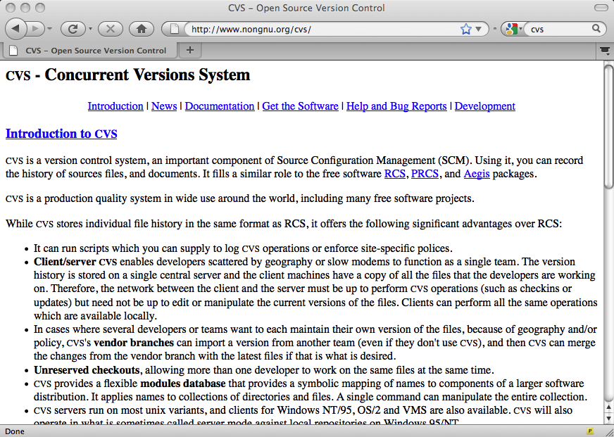

Slide 15
Basic steps for CVS
Administrator sets up CVS server and provides developers with CVS accounts and passwords.
Developers configure their workstations with CVS repository location, account, and password information.
Basic development cycle:
  Check out a copy of system to your computer.
  Edit files locally.
  Commit your changes to repository when ready.
  Update your local code tree to synchronize it with repository when desired.
  Address merge conflicts as they occur.
  Tag a set of file versions to create a configuration when ready to release.

Slide 16
CVS and the 3 CM problems
The double maintenance problem
  CVS uses RCS to provide a repository with a single “master copy” of each file.
The shared data problem
  Multiple developers can create local copies of the master copy to work on.
The simultaneous update problem
  Multiple developers can edit a file simultaneously!
  File clobbering is prevented by CVS notifying a developer when an attempt to commit creates “merge conflicts”.
  CVS creates a “merged” file with all changes.

Slide 17
CVS Summary
Free, open source, used to be“industry standard”
Centralized server architecture
Non-trivial to install server; security issues.
GUI and CLI clients available for many platforms.
Provides version control and configuration management but not:
  Build system
  Defect tracking
  Change management
  Automated testing
Optimistic locking creates work during merge.

Slide 18
Subversion
Designed as a "compelling replacement" for CVS.
  CVS code base old and crufty.
  File-based versions create problems.
  The current “industry standard”
Similar to CVS in many respects (checkout, commit, optimistic locking)
Some major differences:
  Back-end repository not files, but a DB.
  Versions are not file-based, but repository-wide.
  "Directory" based tags and branches.
  Arbitrary metadata.
Downloads, etc: http://subversion.apache.org

Slide 19
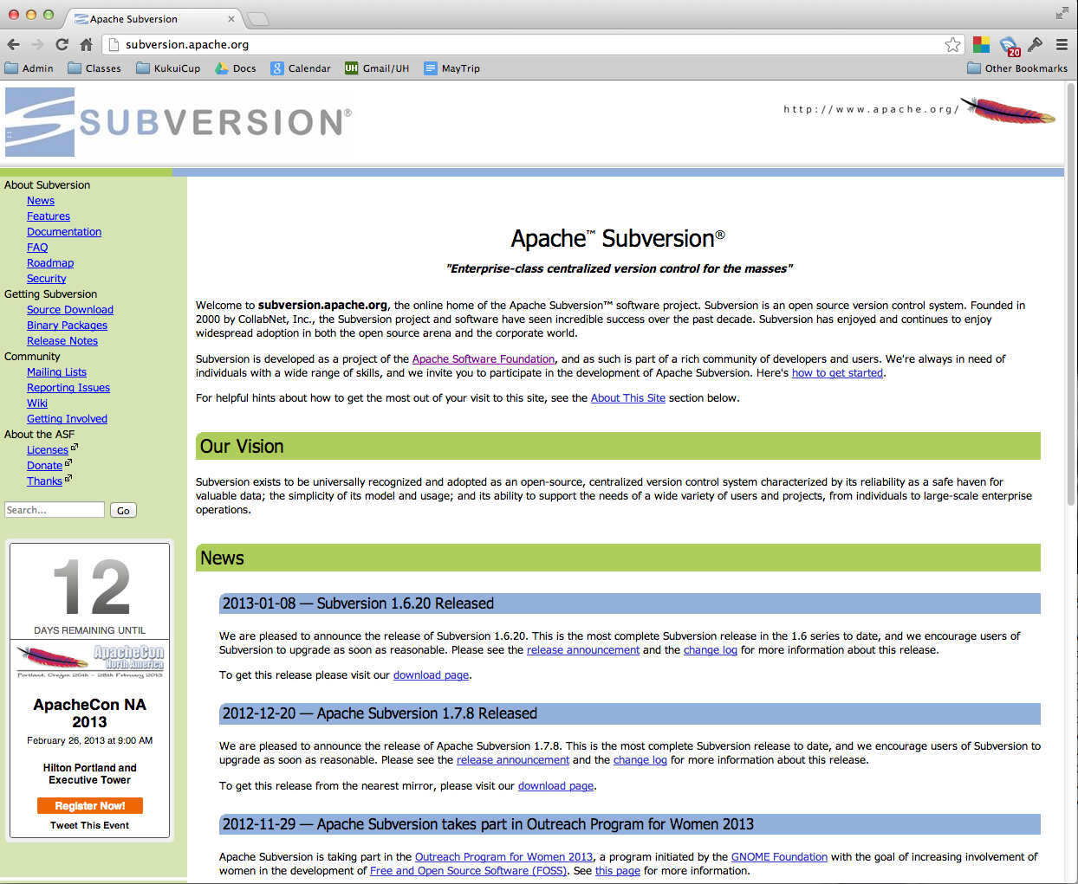

Slide 20
SVN vs. CVS
Repository:
  CVS uses flat files; SVN uses BerkeleyDB
Speed:
  SVN is faster.
Tags and Branches:
  CVS uses metadata; SVN uses folder conventions
File Types:
  CVS designed for ASCII, supports binary via 'hacks'; SVN handles all types uniformly.
Transactional commit:
  SVN supports; CVS does not.
Deletion and renaming:
  CVS support is bogus; SVN support is good.
Popularity:
  Most popular for new projects, but Git is gaining!

Slide 21
Git
A distributed version control system.
  multiple redundant repositories
  branching is a “first class concept”
Every user has a complete copy of the repository (including history) stored locally.
“commit access” is not the primary model for collaboration. Instead, you decide which users repositories to merge with your own.
The "centralized repo" is a special case of collaboration with Git; there are many other possibilities.

Slide 22
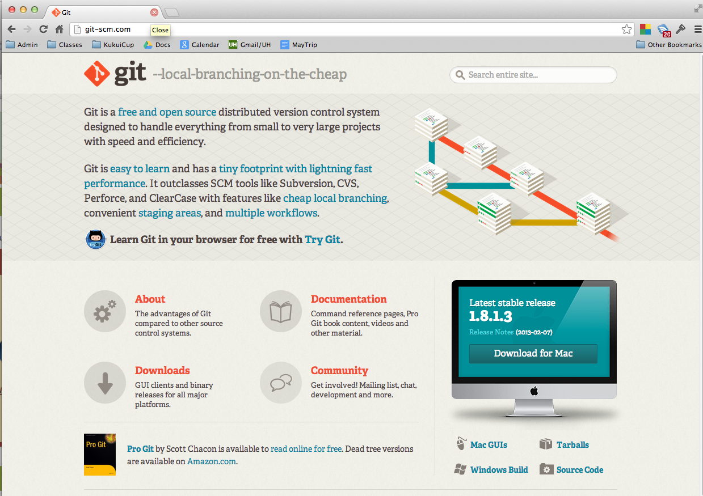

Slide 23
Git vs. SVN
Advantages of Git:
  Most operations much faster.
  Git requires much less storage than SVN.
  Git supports decentralized development.
    No “czar”
    Many more workflows possible
Advantages of SVN:
  Easier to learn, commands less complicated.

Slide 24
Centralized CM Workflow
(in a nutshell)
Repository

Slide 25
Centralized CM Workflow
(in a nutshell)
Commit
Repository

Slide 26
Centralized CM Workflow
(in a nutshell)
Commit
Repository
Commit

Slide 27
Centralized CM Workflow
(in a nutshell)
Commit
Commit
Repository
Commit

Slide 28
Distributed CM Workflow
(in a nutshell)
Repository

Slide 29
Distributed CM Workflow
(in a nutshell)
Repository
Clone
Repository

Slide 30
Distributed CM Workflow
(in a nutshell)
Commit
Repository
Repository

Slide 31
Distributed CM Workflow
(in a nutshell)
Repository
Repository
Clone
Repository

Slide 32
Distributed CM Workflow
(in a nutshell)
Repository
Repository
Repository
Commit

Slide 33
Distributed CM Workflow
(in a nutshell)
Repository
Commit
Commit
Repository
Repository
Commit

Slide 34
Distributed CM Workflow
(in a nutshell)
Push
Repository
Repository
Repository

Slide 35
Distributed CM Workflow
(in a nutshell)
Repository
Repository
Pull
Repository

Slide 36
Yet More CM Alternatives
Bazaar (bzr):
  Decentralized configuration management
    P2P, not centralized server
  Individuals publish branches to a web server.
BitKeeper:
  Decentralized
  Not open source!
ClearCase, Visual Source Safe, etc.
  Commercial, costly solutions.
  Include additional services (workflow, issue tracking, etc.)

