Slide 1
Introduction to
GitHub Desktop
(Part 3)
Merge Conflicts
Philip Johnson
Collaborative Software Development Laboratory
Information and Computer Sciences
University of Hawaii
Honolulu HI 96822

Slide 2
What is a merge conflict?
Consider the following situation:
branch2
master
branch1
Each dot represents a change to the codebase.
Notice that:
  When branch1 merges into master, master has not changed since branch1 was created.
  When branch2 merges into master, master has changed! (It now has branch2’s modifications)

Slide 3
What is a merge conflict?
branch2
master
branch1
No merge conflict possible

Slide 4
What is a merge conflict?
branch2
master
branch1
Merge conflict possible!

Slide 5
What is a merge conflict?
branch2
master
branch1
Actions that produce merge conflicts:
  Branch1 deletes f.txt, Branch2 edits f.txt.
  Branch1 and Branch2 edit the same line of g.txt

Slide 6
What is a merge conflict?
branch2
master
branch1
Actions that do not produce merge conflicts:
  Branch1 deletes f.txt, Branch2 does not change f.txt.
  Branch1 and Branch2 edit different lines of g.txt

Slide 7
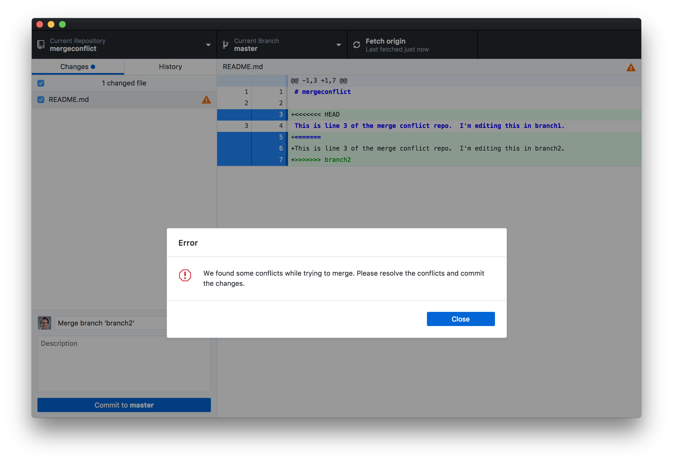
Merge conflict notifications in GitHub desktop

Slide 8
What happened?
Created repo “mergeconflict”
  Added text to line 3 of README.md
Created branch “branch1”
Created branch “branch2”
In branch1:
  Edited line 3 of README.md
  Committed change to branch1
  Merged branch1 into master.
In branch2:
  Edited line 3 of README.md
  Committed change to branch2.
  Tried to merge branch2 into master

Slide 9
Graphically…
branch2
master
branch1
branch1 and branch2 both edited the same line in the file README.md.
Git will not merge branch2 back into master, because branch1 edited a line that was also edited in branch2.

Slide 10
What happens now?
When git detects a merge conflict, it inserts into the file indicators of where the merge conflict exists.
You must now edit the file to remove those indicators (effectively indicating what the “correct” version of the offending line(s) should be.
Then commit the correct version and proceed.

Slide 11
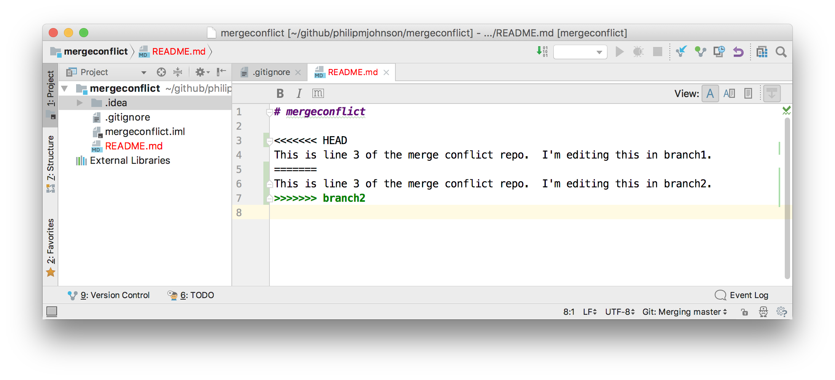
Example of merge conflict file
The file shows both versions of line 3. “HEAD” is what is currently in master (after the merge of branch1).
Below it is the line from the attempted merge.
Notice that IntelliJ prints the conflicted filename in red.

Slide 12
What to do next
Option 1: edit the file manually to replace everything between >>>> and <<<< with the intended text.
Option 2: use IntelliJ’s “Resolve Conflicts” tool.

Slide 13
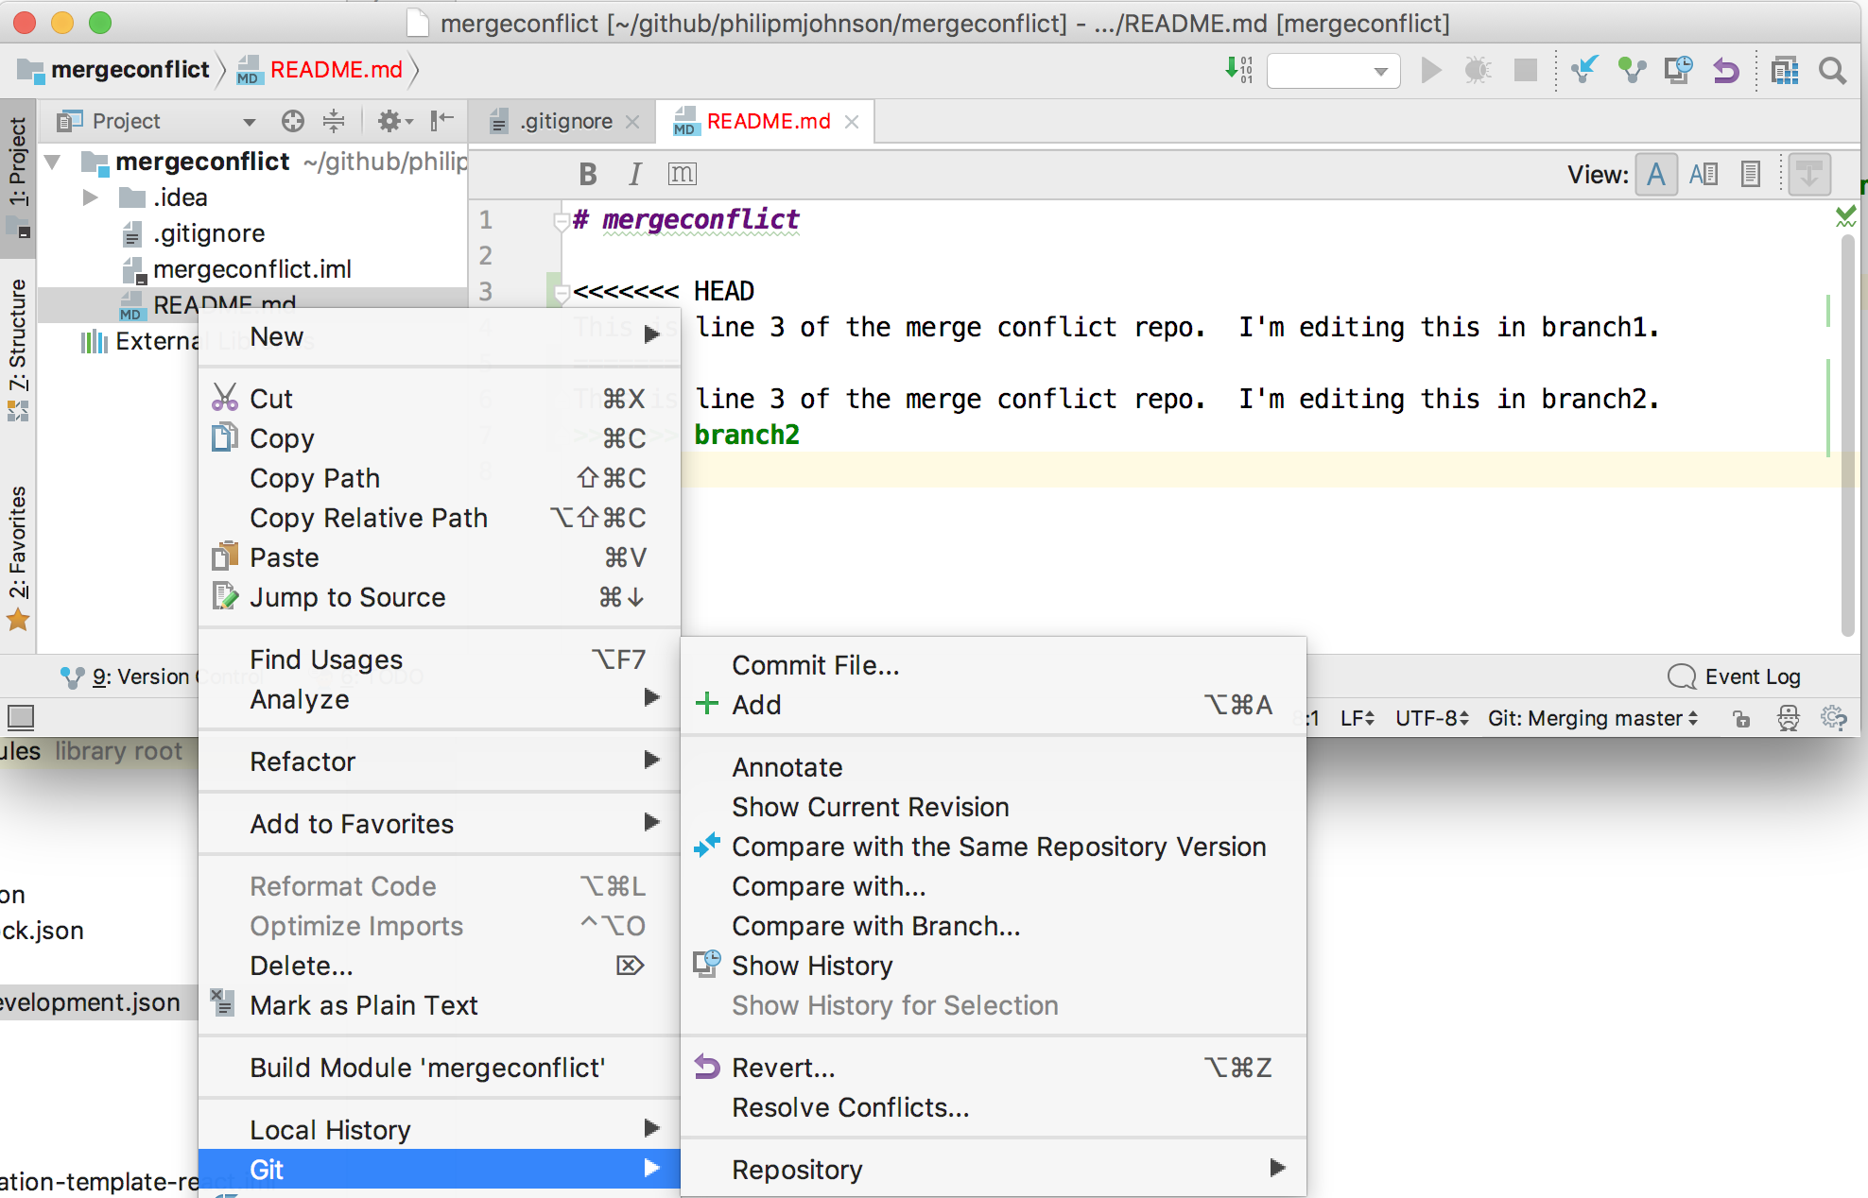
Right-click on file, select git > resolve conflicts

Slide 14
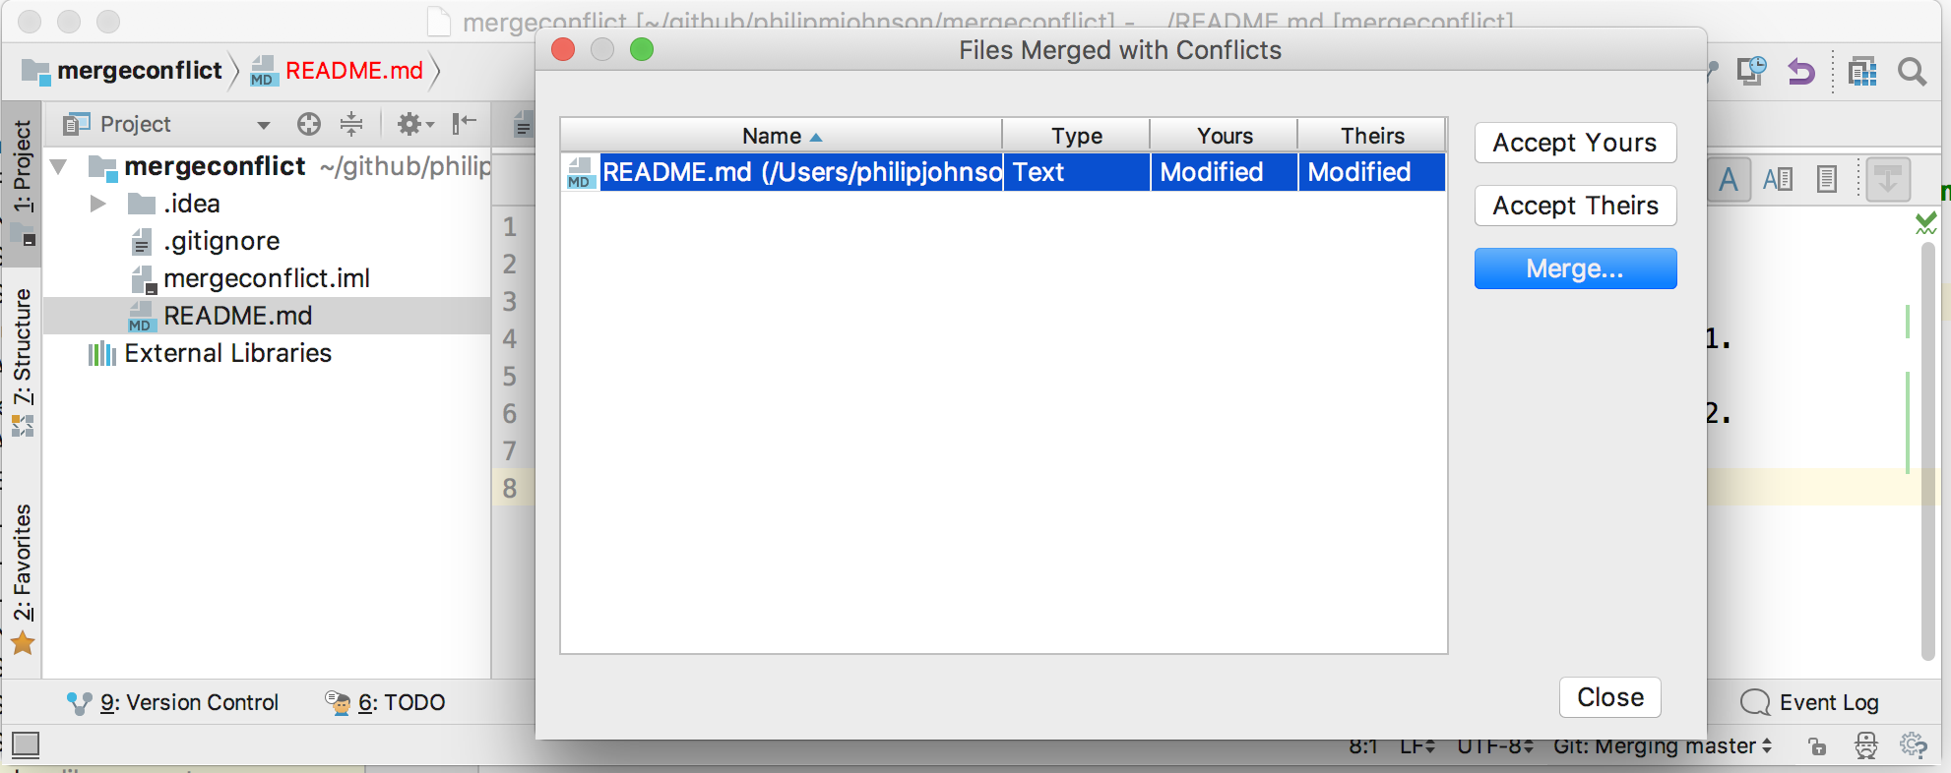
You can resolve with:
(a) your version of the file,
(b) or the version from the branch being merged,
(c) or click “Merge” to decide on each individually

Slide 15
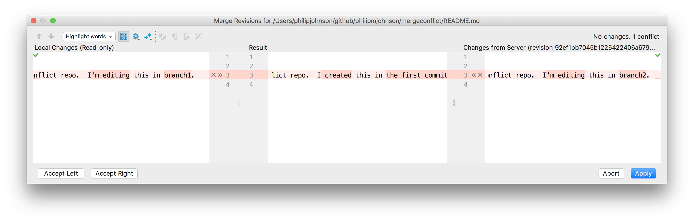
Merge button results

Slide 16
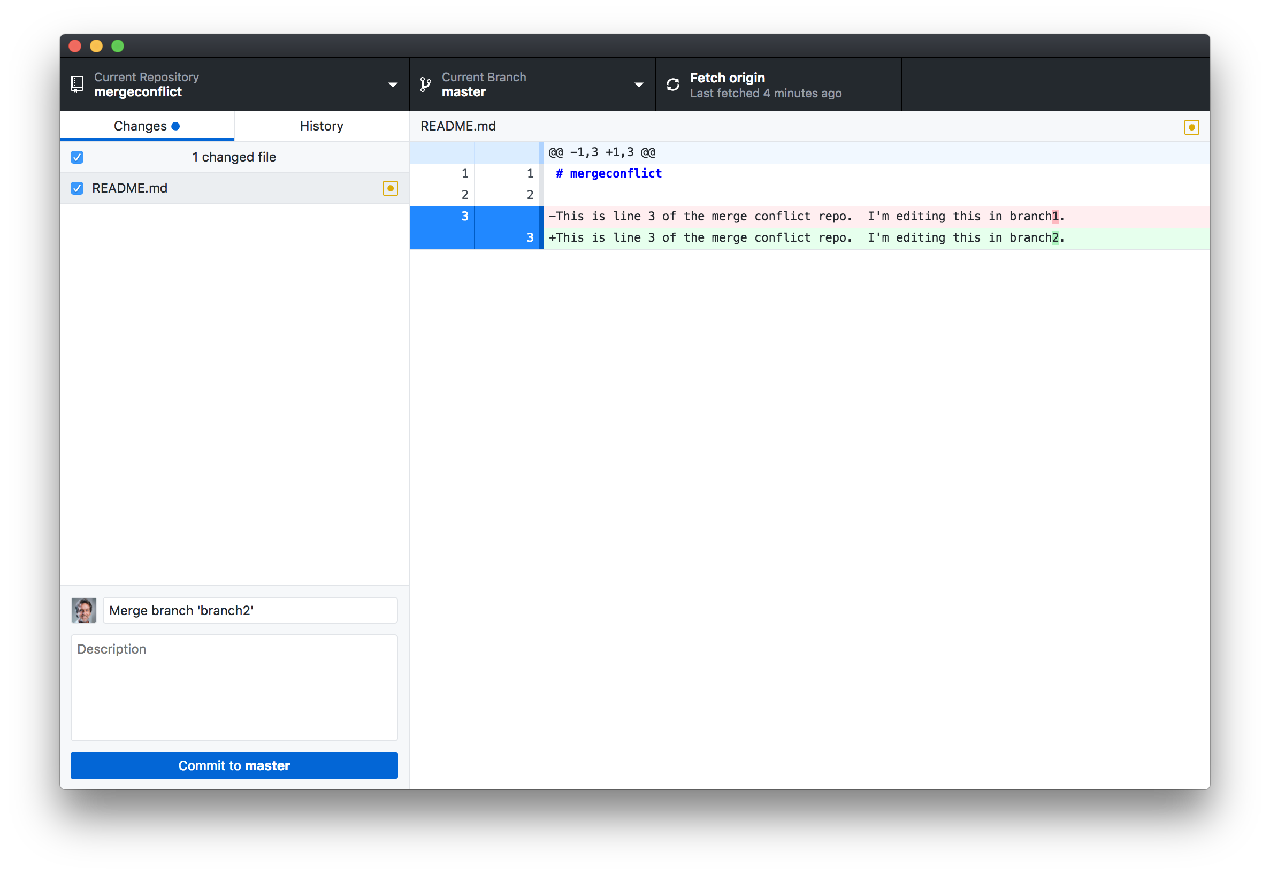
After resolving the conflict, commit resolution in GitHub Desktop

Slide 17
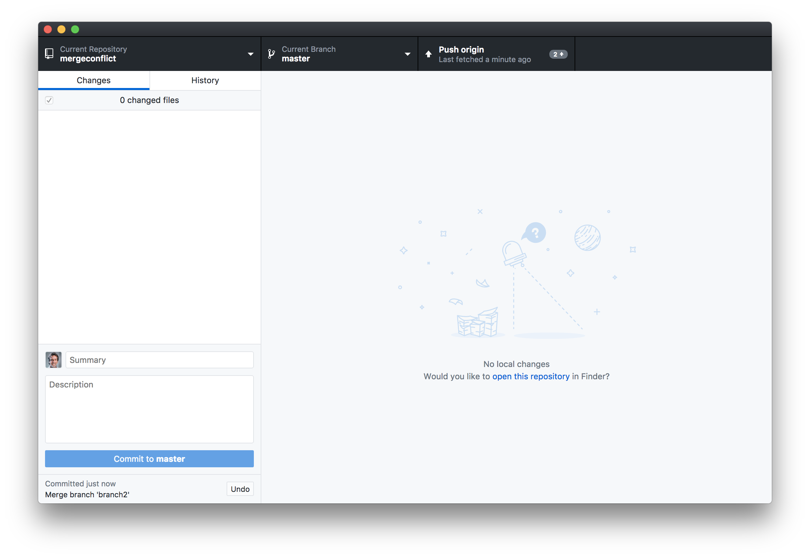
And push your commit to origin (i.e. GitHub)

Slide 18
Let’s try it live

