Slide 1
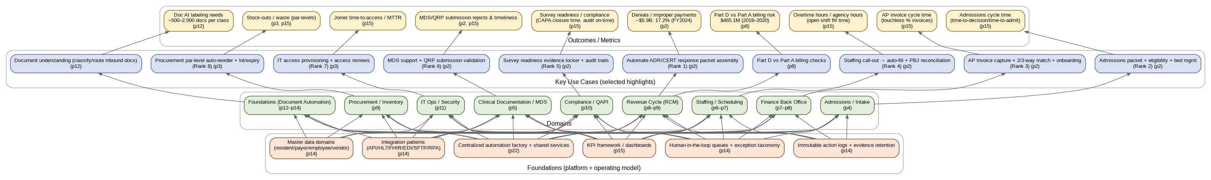
SNF Automation & AI Opportunity Landscape — One-page Map
Foundations → Domains → Use Cases → Outcomes/Metrics (all page refs shown inside boxes)
Notes:
[
Sources]
- Marquis_SNF_Automation_AI_Opportunity_Landscape.pdf (visual synthesized from p2, p8, p12, p14–p15, p22)
[/Sources]

Slide 2
Legend / How to read the map
Foundations
Platform + operating model elements that enable reuse at scale
Domains
Functional areas in the report (Admissions, RCM, Finance, Staffing, etc.)
Use Cases
Specific automations/AI use cases (ranked items + selected highlights)
Outcomes/Metrics
KPIs and quantified claims (only if explicitly stated in the report)
Notes
• Page references are shown in parentheses (e.g., “p2”).
• If a value is not explicit in the PDF, it is labeled “Not stated in report.”
Notes:
[
Sources]
- Marquis_SNF_Automation_AI_Opportunity_Landscape.pdf (legend reflects map structure derived from p2, p14–p15, p22)
[/Sources]

Slide 3
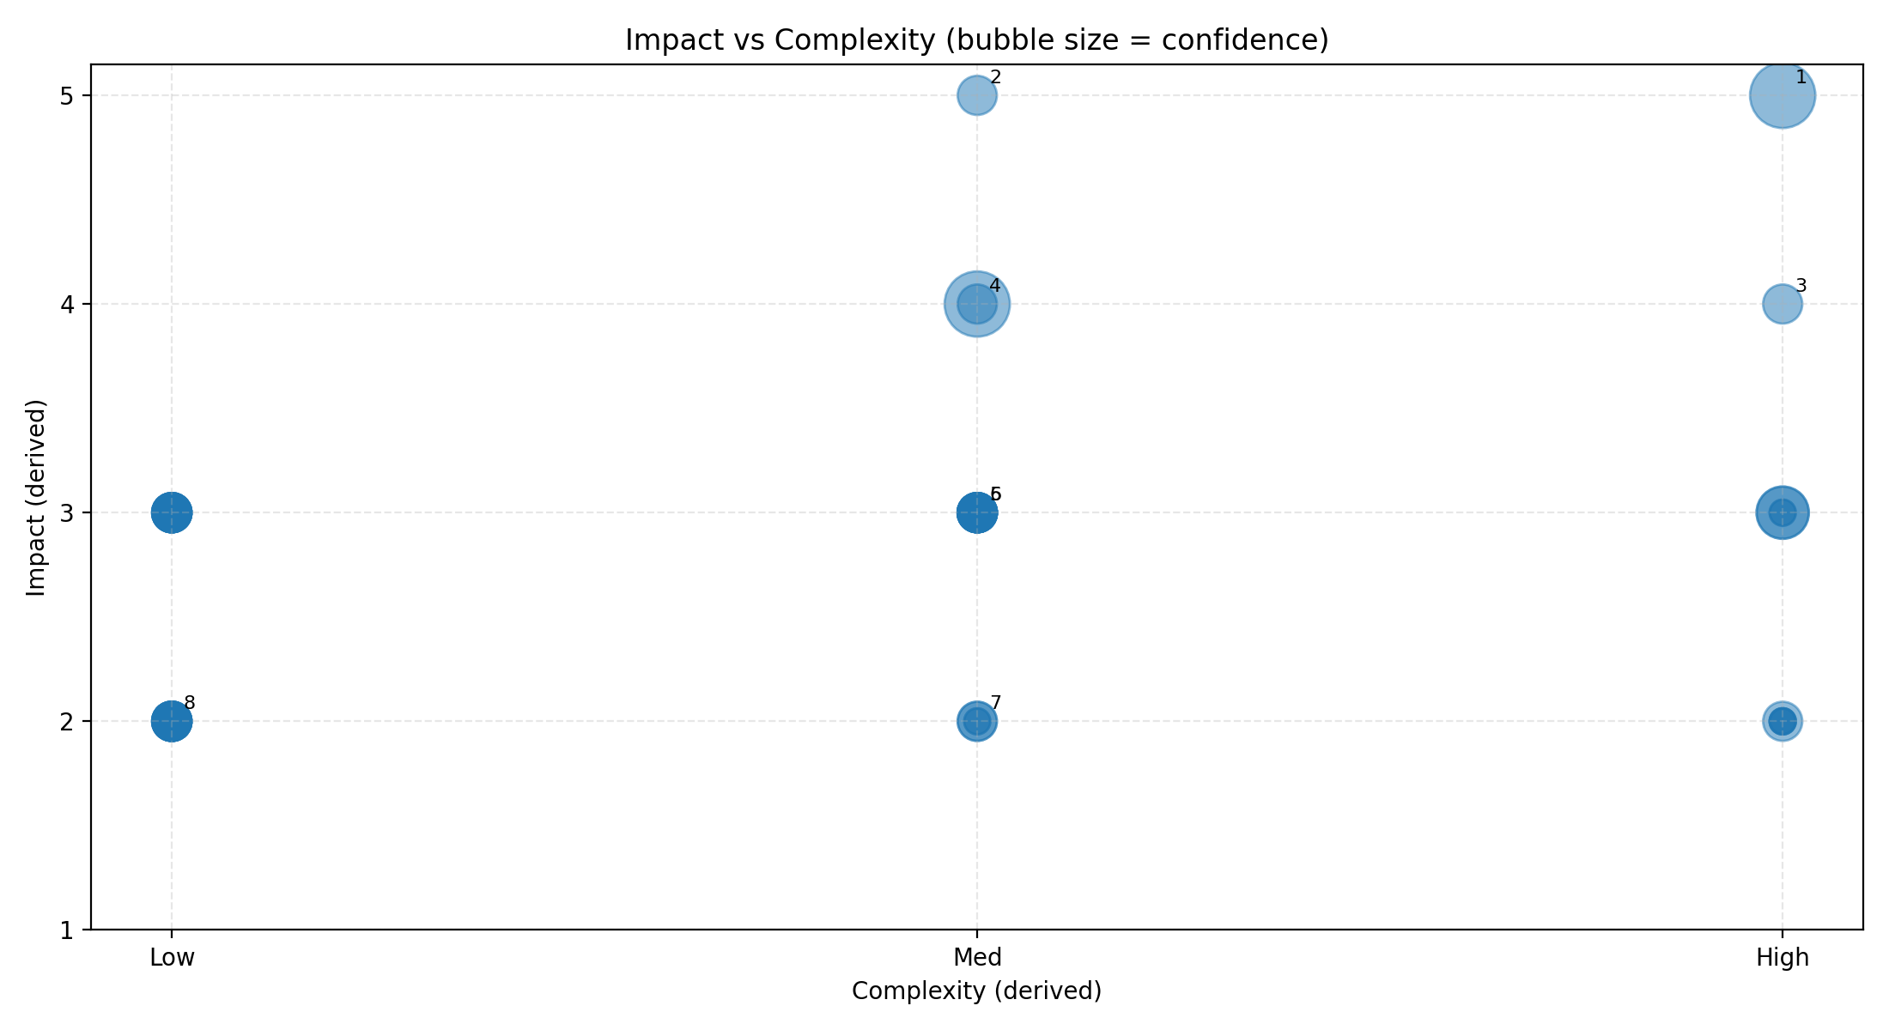
Portfolio view — Impact vs Complexity
Bubble size = confidence (higher when numeric evidence is present in the report)
Notes:
[
Sources]
- Marquis_SNF_Automation_AI_Opportunity_Landscape.pdf (impact ranks from p2–p3; scoring derived from “ranked by operational impact” language)
[/Sources]

Slide 4
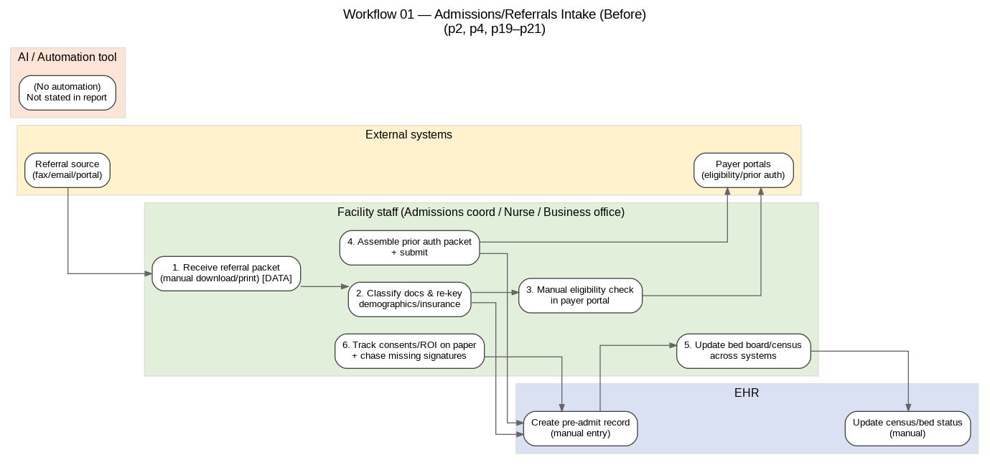
Workflow 01 — Admissions/Referrals Intake & Conversion — Before
Source pages: p2, p4, p19–p21
Notes:
[
Sources]
- Marquis_SNF_Automation_AI_Opportunity_Landscape.pdf (p2, p4, p19–p21)
[/Sources]

Slide 5
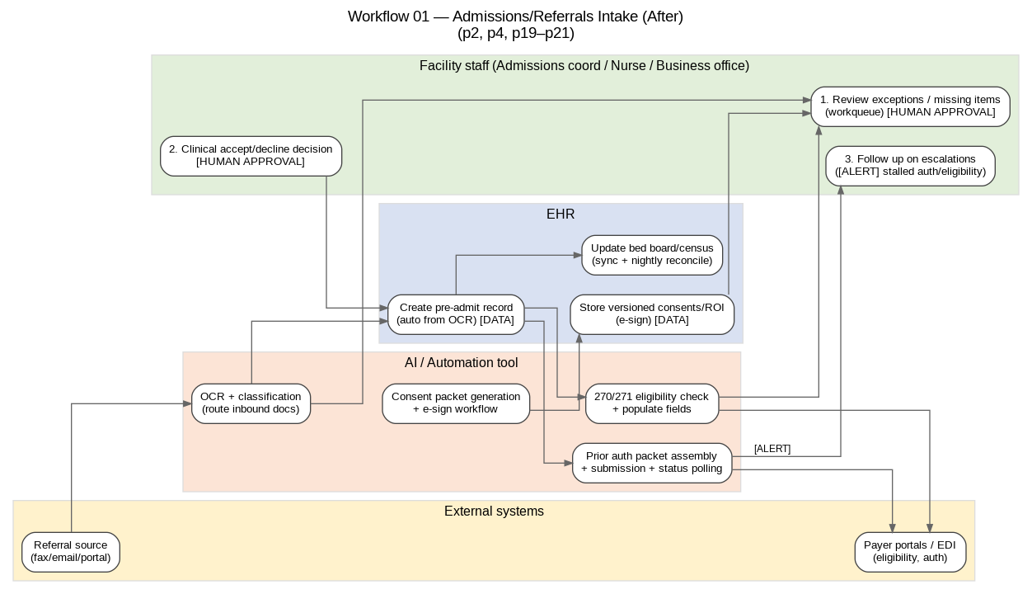
Workflow 01 — Admissions/Referrals Intake & Conversion — After
Source pages: p2, p4, p19–p21
Notes:
[
Sources]
- Marquis_SNF_Automation_AI_Opportunity_Landscape.pdf (p2, p4, p19–p21)
[/Sources]

Slide 6
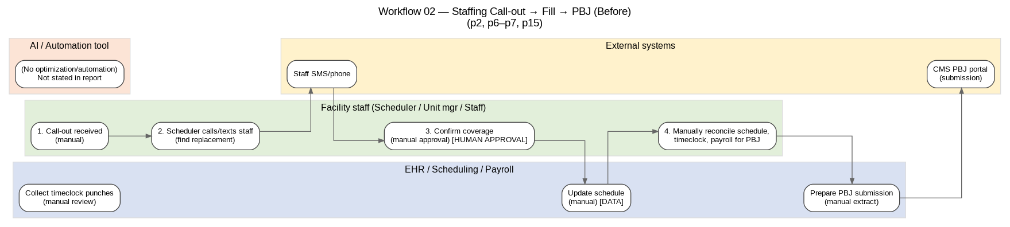
Workflow 02 — Staffing/Scheduling & Agency Reduction — Before
Source pages: p2, p6–p7, p15
Notes:
[
Sources]
- Marquis_SNF_Automation_AI_Opportunity_Landscape.pdf (p2, p6–p7, p15)
[/Sources]

Slide 7
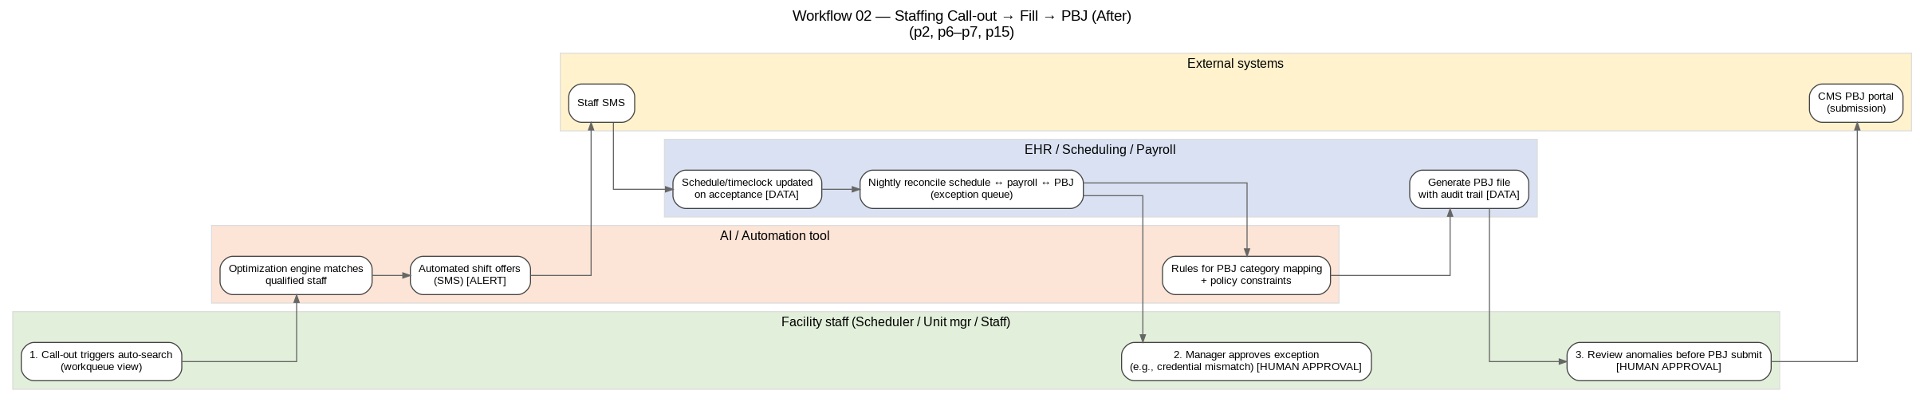
Workflow 02 — Staffing/Scheduling & Agency Reduction — After
Source pages: p2, p6–p7, p15
Notes:
[
Sources]
- Marquis_SNF_Automation_AI_Opportunity_Landscape.pdf (p2, p6–p7, p15)
[/Sources]

Slide 8
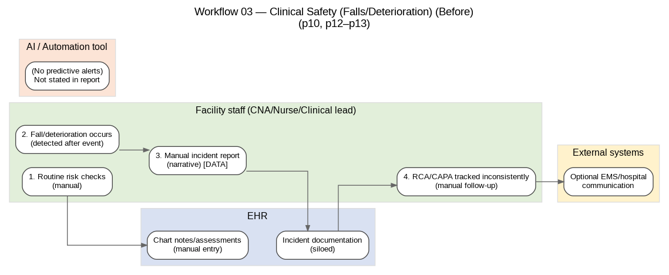
Workflow 03 — Clinical Safety: Falls/Deterioration Response — Before
Source pages: p10, p12–p13
Notes:
[
Sources]
- Marquis_SNF_Automation_AI_Opportunity_Landscape.pdf (p10, p12–p13)
[/Sources]

Slide 9
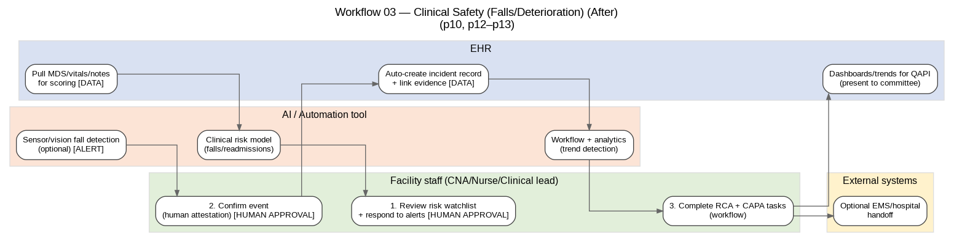
Workflow 03 — Clinical Safety: Falls/Deterioration Response — After
Source pages: p10, p12–p13
Notes:
[
Sources]
- Marquis_SNF_Automation_AI_Opportunity_Landscape.pdf (p10, p12–p13)
[/Sources]

Slide 10
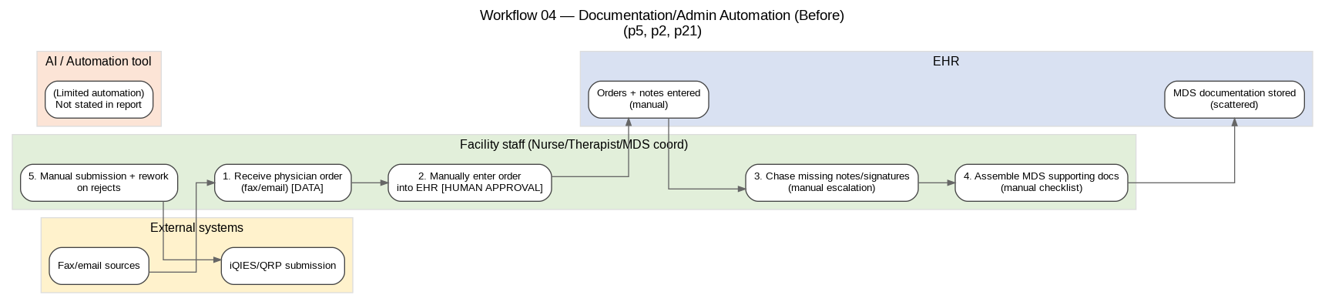
Workflow 04 — Documentation/Admin Automation (Orders + Chart/MDS) — Before
Source pages: p2, p5, p12, p21
Notes:
[
Sources]
- Marquis_SNF_Automation_AI_Opportunity_Landscape.pdf (p2, p5, p12, p21)
[/Sources]

Slide 11
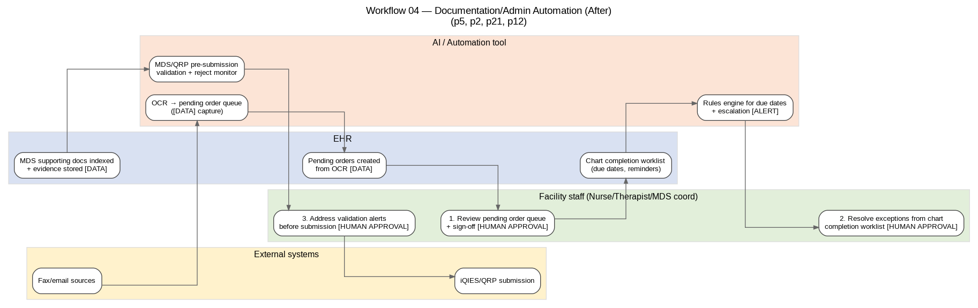
Workflow 04 — Documentation/Admin Automation (Orders + Chart/MDS) — After
Source pages: p2, p5, p12, p21
Notes:
[
Sources]
- Marquis_SNF_Automation_AI_Opportunity_Landscape.pdf (p2, p5, p12, p21)
[/Sources]

Slide 12
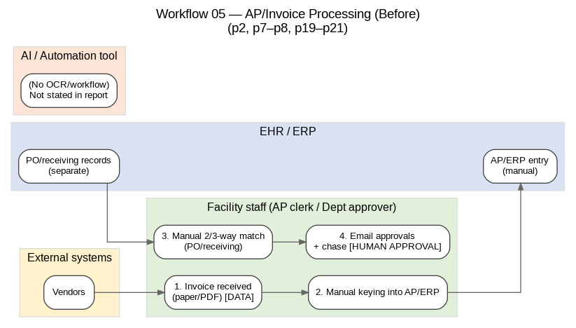
Workflow 05 — AP/Invoice Processing Automation — Before
Source pages: p2, p7–p8, p19–p21
Notes:
[
Sources]
- Marquis_SNF_Automation_AI_Opportunity_Landscape.pdf (p2, p7–p8, p19–p21)
[/Sources]

Slide 13
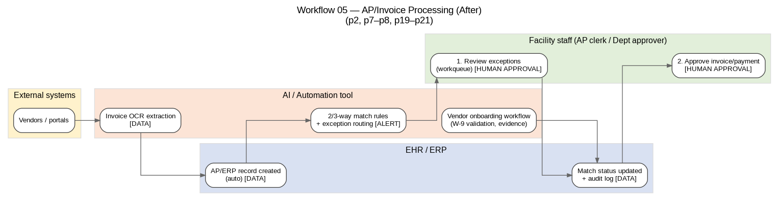
Workflow 05 — AP/Invoice Processing Automation — After
Source pages: p2, p7–p8, p19–p21
Notes:
[
Sources]
- Marquis_SNF_Automation_AI_Opportunity_Landscape.pdf (p2, p7–p8, p19–p21)
[/Sources]

