Slide 1
Web Development Lesson 1: HTML

Slide 2
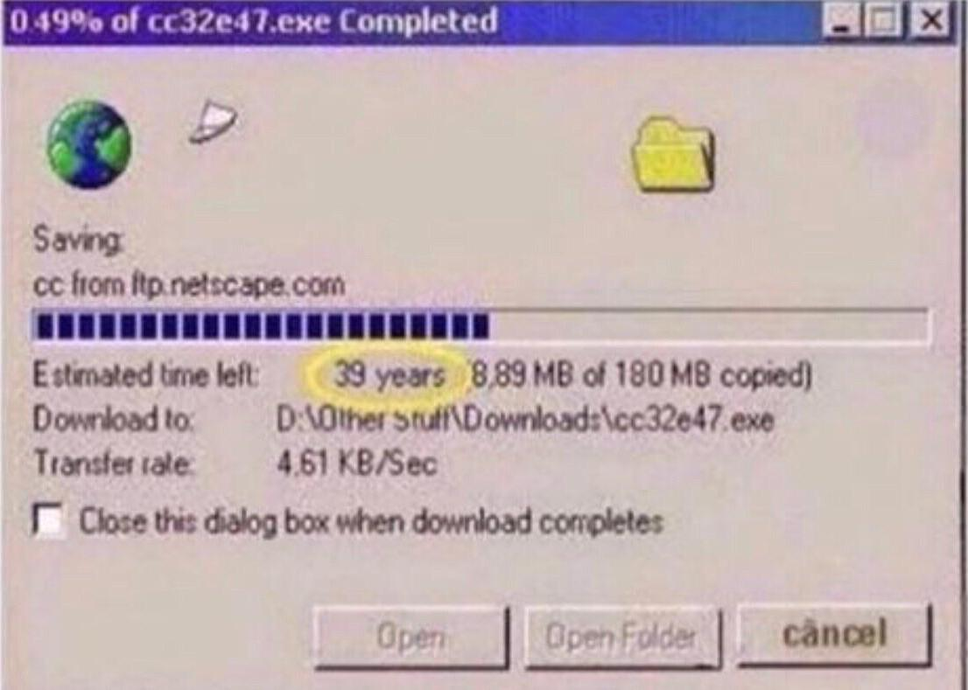
How does the Internet work?

Slide 3
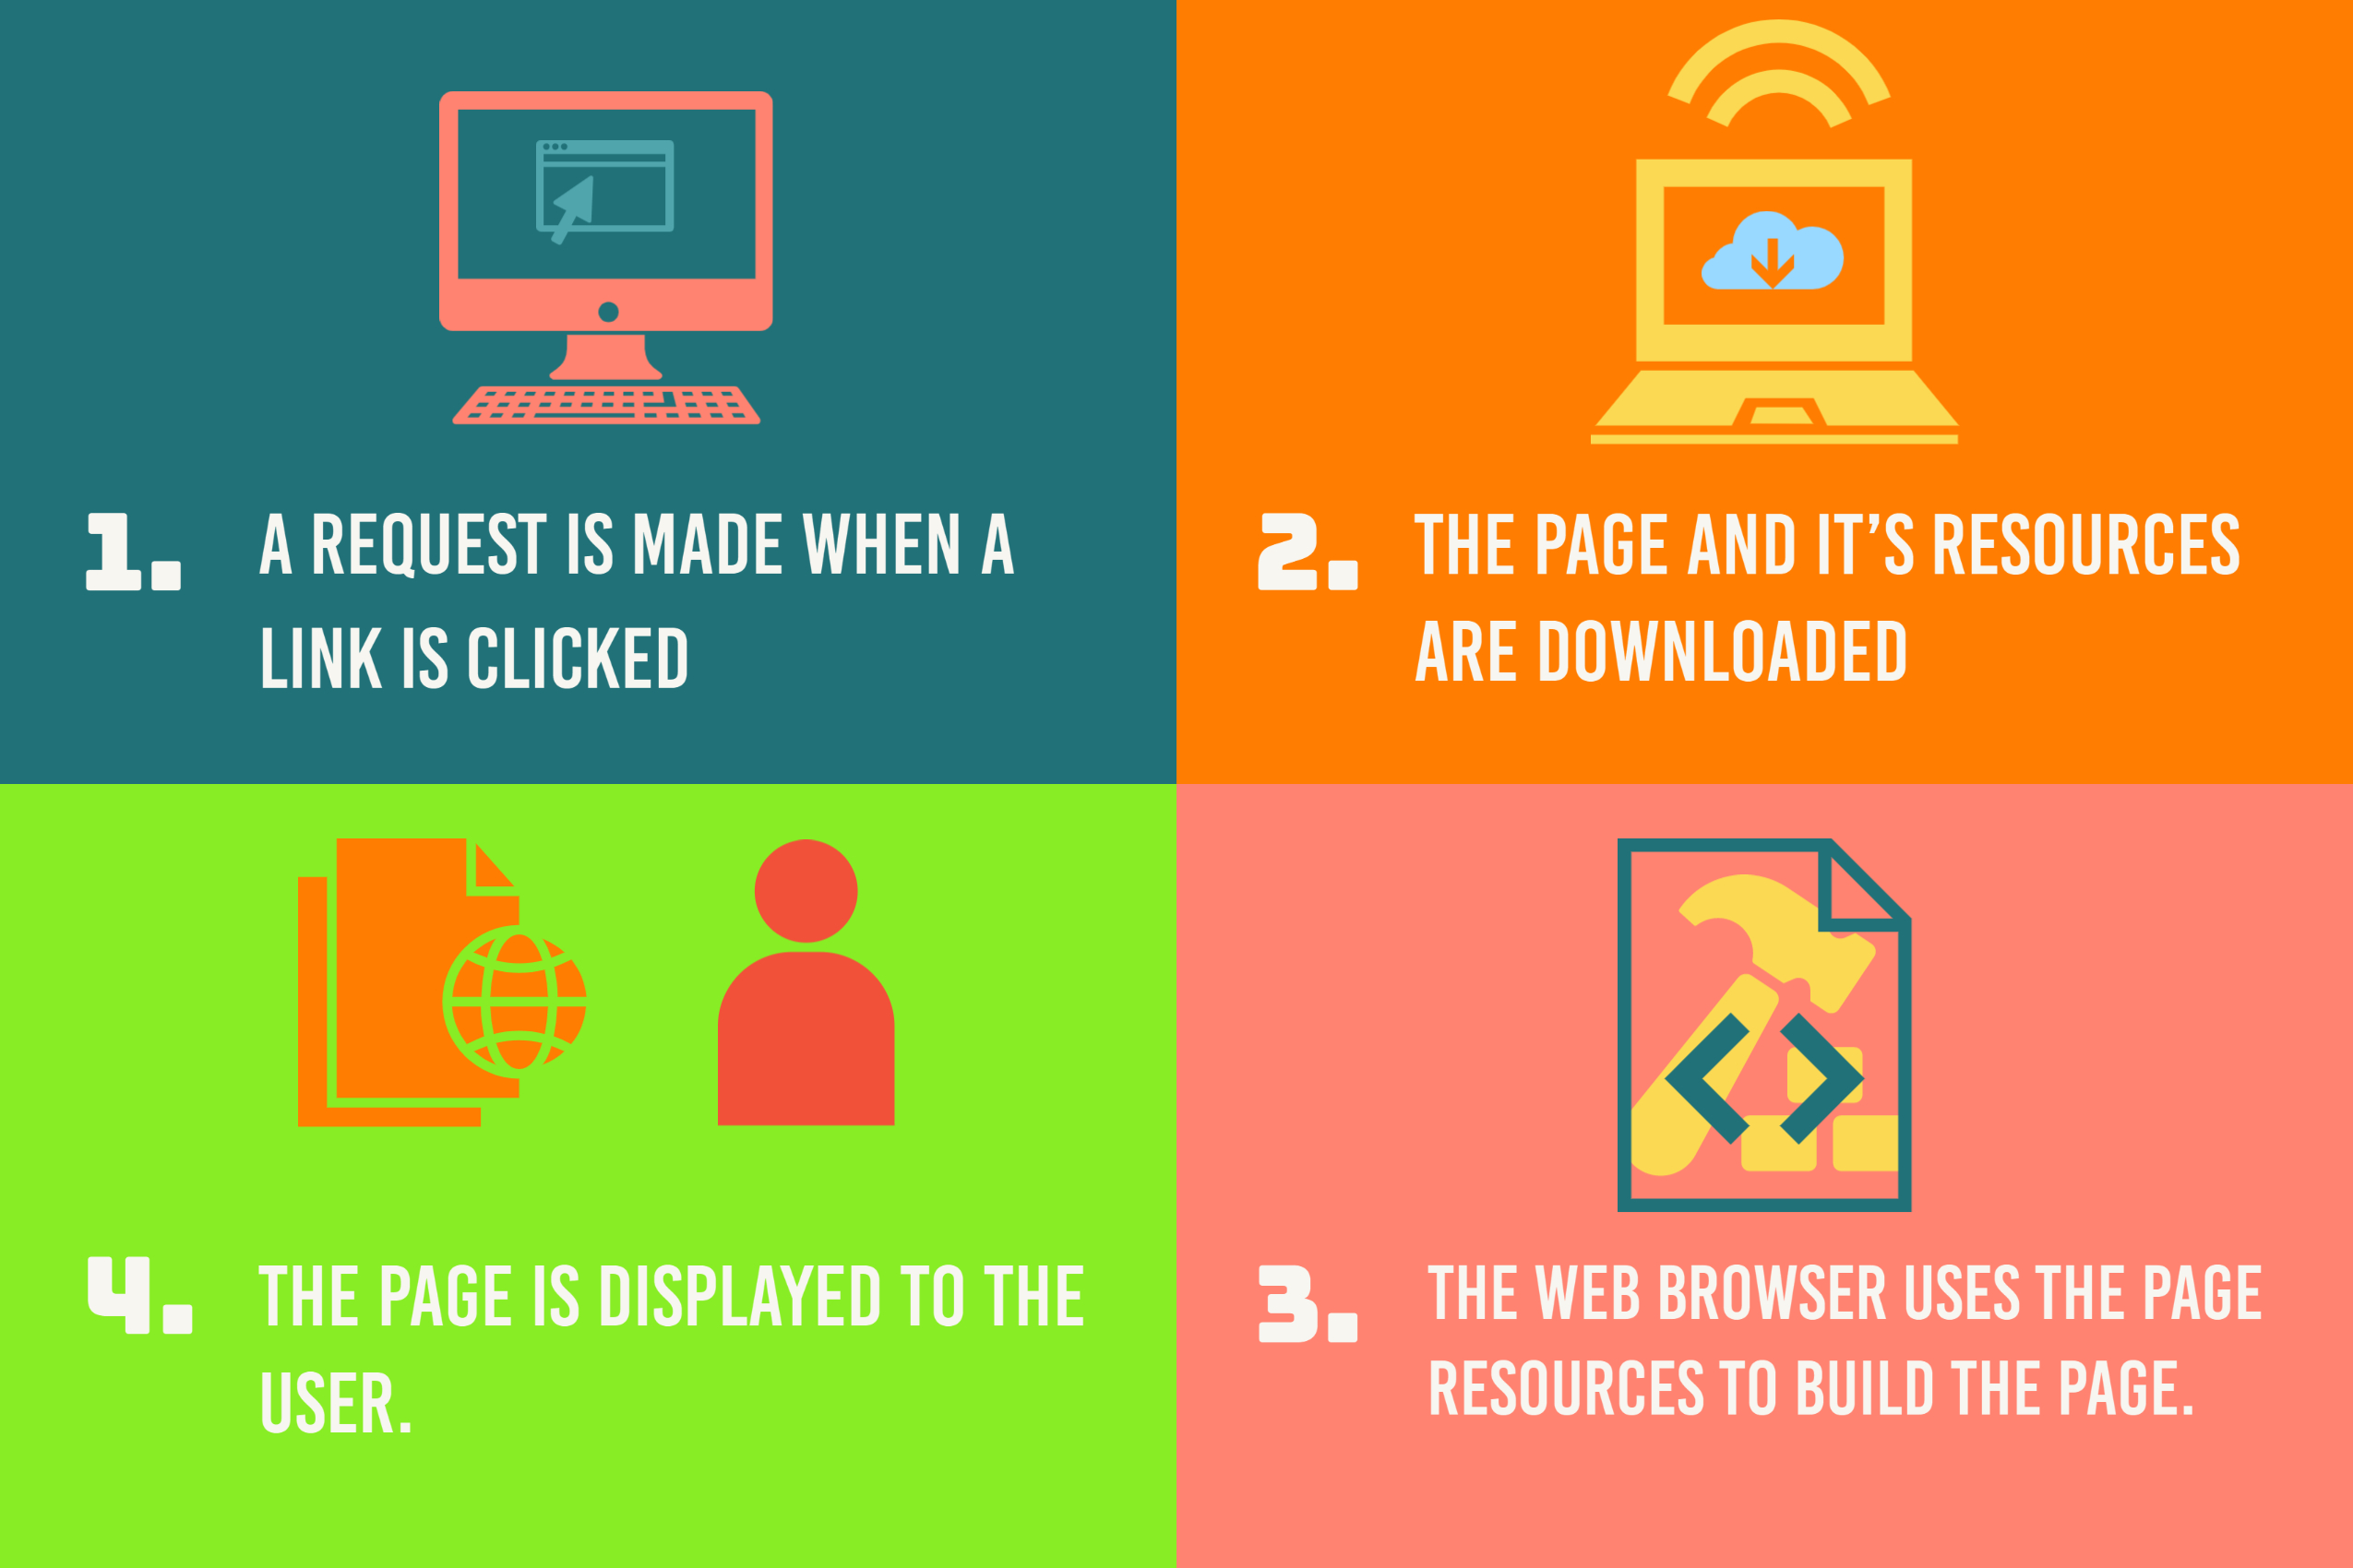
How does your browser display a web page

Slide 4
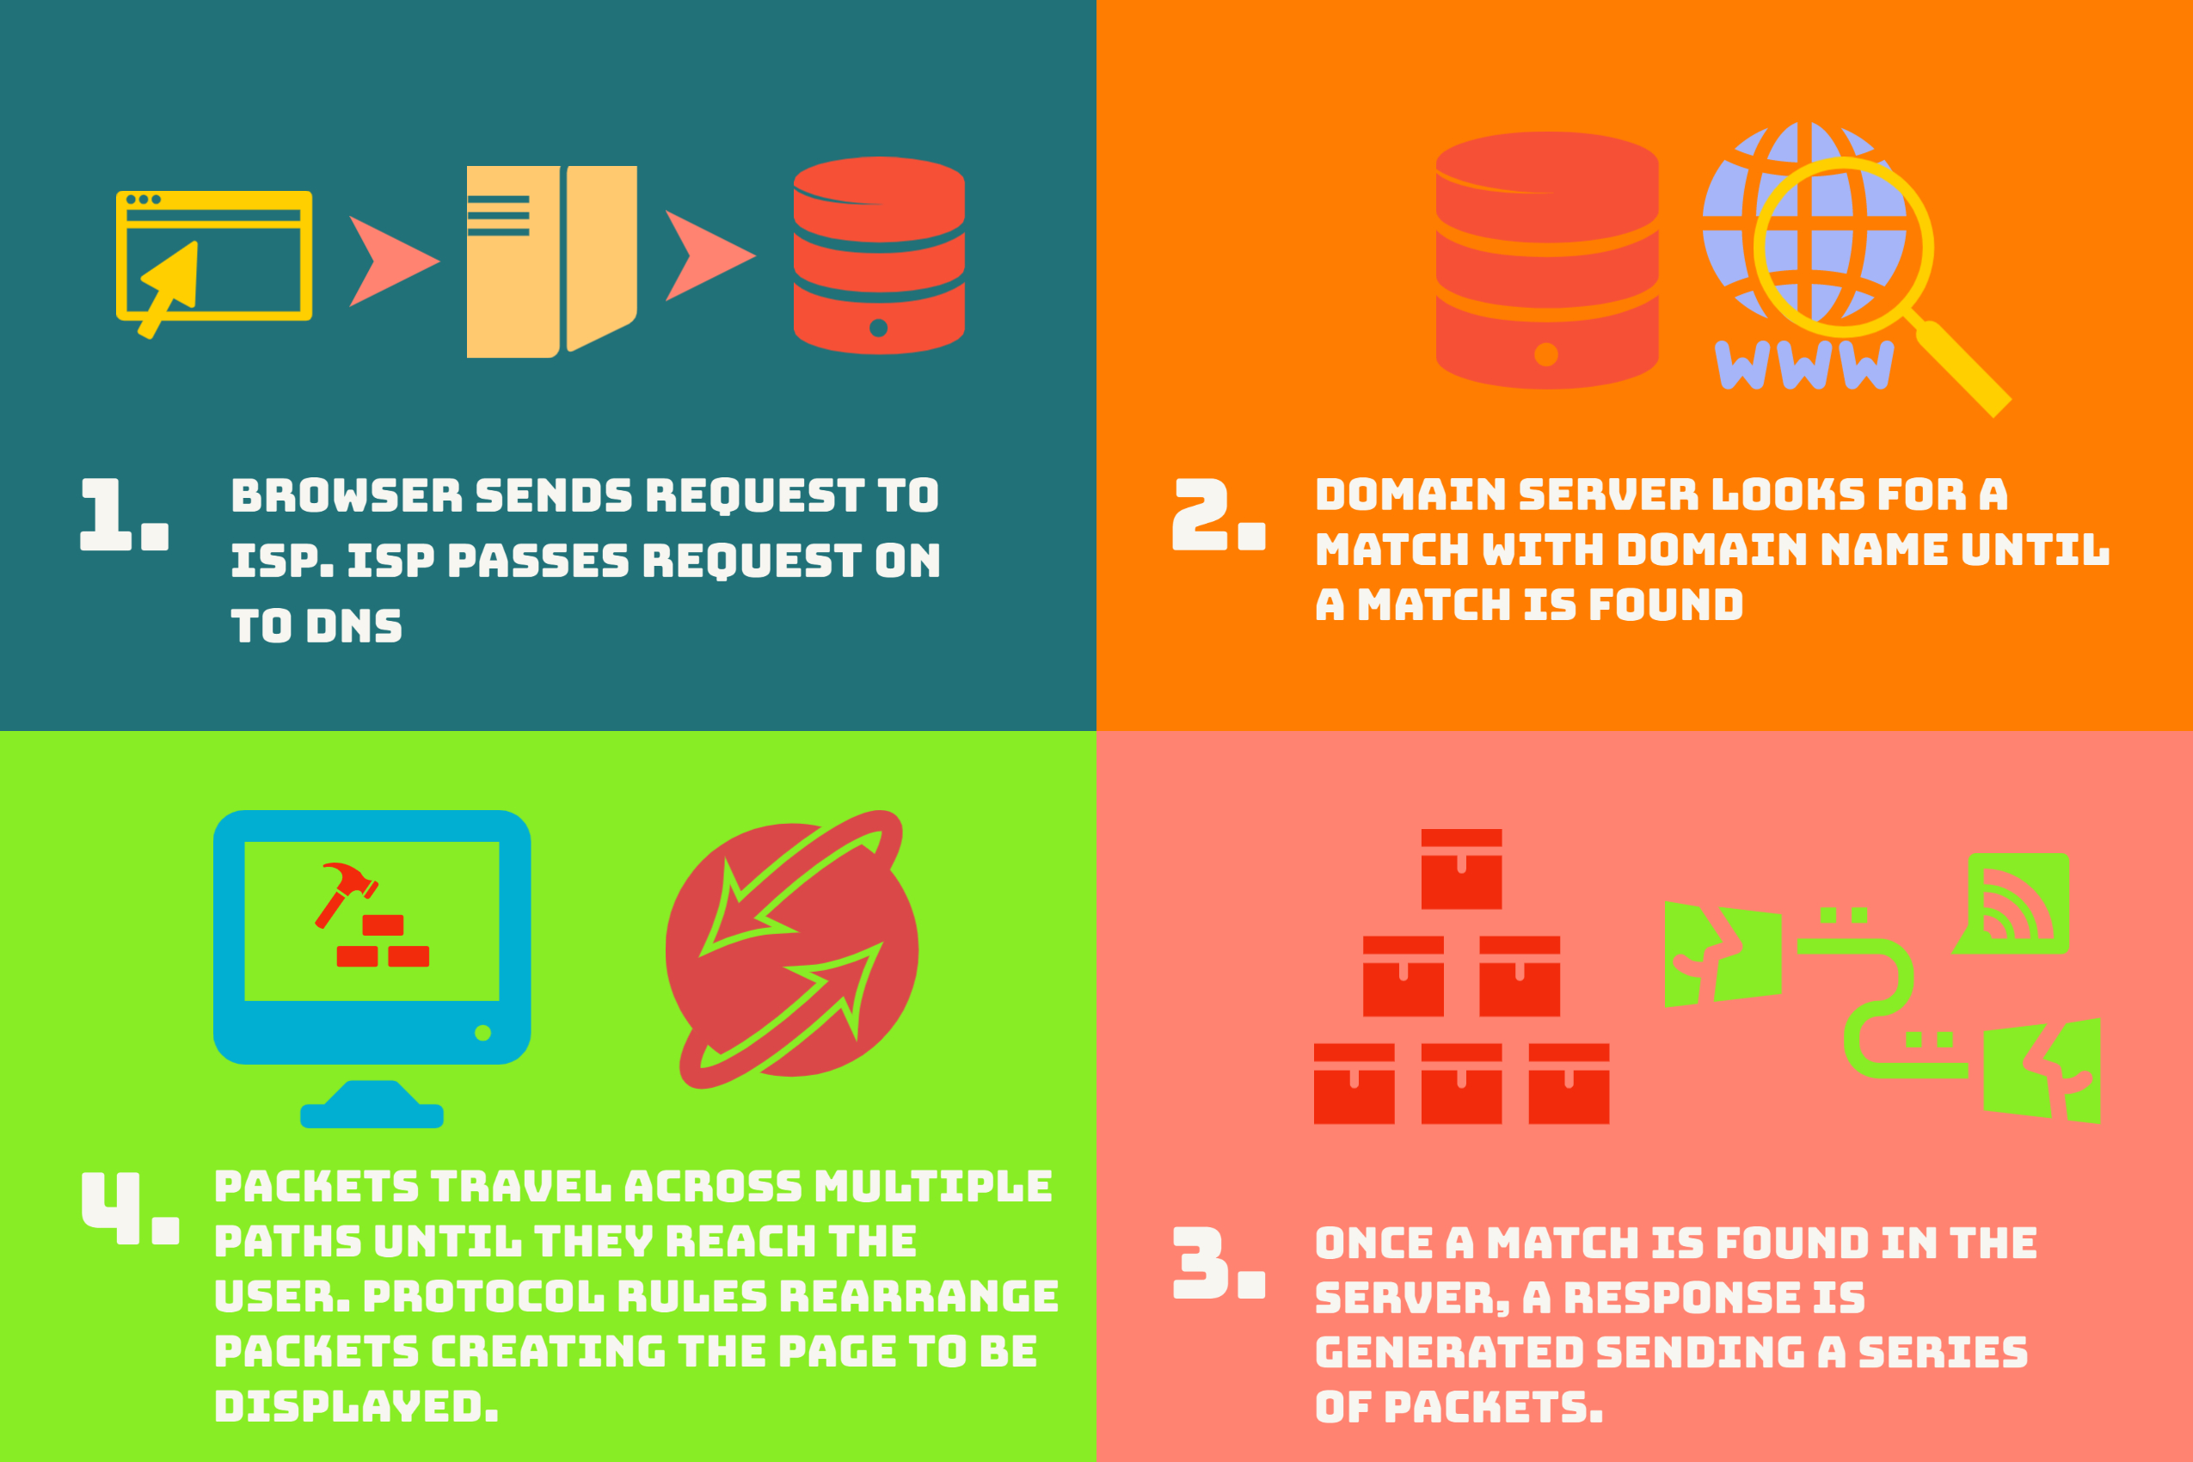
How does your browser display a web page

Slide 5
What is HTML
HTML stands for Hyper Text Mark-up Language.
It’s a mark-up language that is used to create web pages.
HTML consists of elements which we use to define the structure of web pages.
An element tells the browser how to display the page

Slide 6
HTML TAGS
<html>
<head>
<body>
<h1> to <h6>
<p>
<div>
<ul>, <ol>, <li>

Slide 7
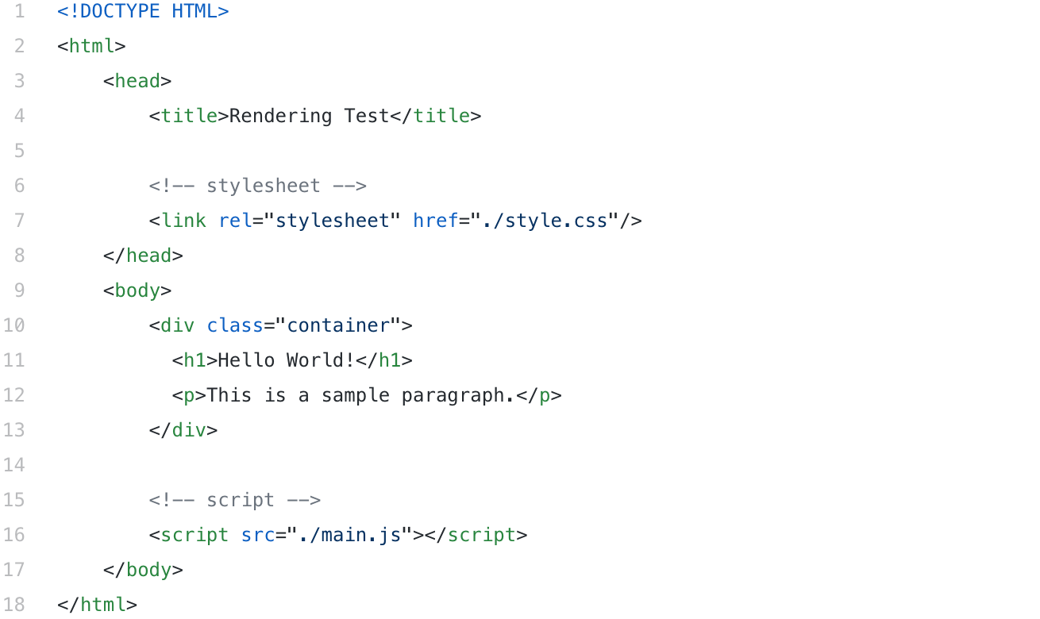
HTML LAYOUT
<html>
<head>
<title>This is a title</title>
</head>
<body>
<div>
<p>Hello world!</p>
</div>
</body>
</html>

Slide 8
Homework
Create a simple page using HTML.
HTML intro: https://www.w3schools.com/html/html_intro.asp
First page with VS Code: https://www.youtube.com/watch?v=WTdLcipEqsc&feature=emb_logo&ab_channel=KulkanTech
Installing Visual Studio Code: https://code.visualstudio.com/

