Slide 1
Web Development Lesson 2: CSS

Slide 2
What is CSS
CSS known as Cascaded Style Sheets.
CSS is used to describe how HTML elements are displayed on a page.
We can use CSS to define the design, layout, style and text font, colours of the page.
CSS is stored in CSS files.
Was created by the World Wide Web Consortium to style format HTML pages.

Slide 3
HOW TO LINK CSS to HTML
<head>
<link rel="stylesheet" href="./css/index.css" type="text/css">
</head>

Slide 4
CSS SELECTORS
* (selects all elements)
element
.class
#id

Slide 5
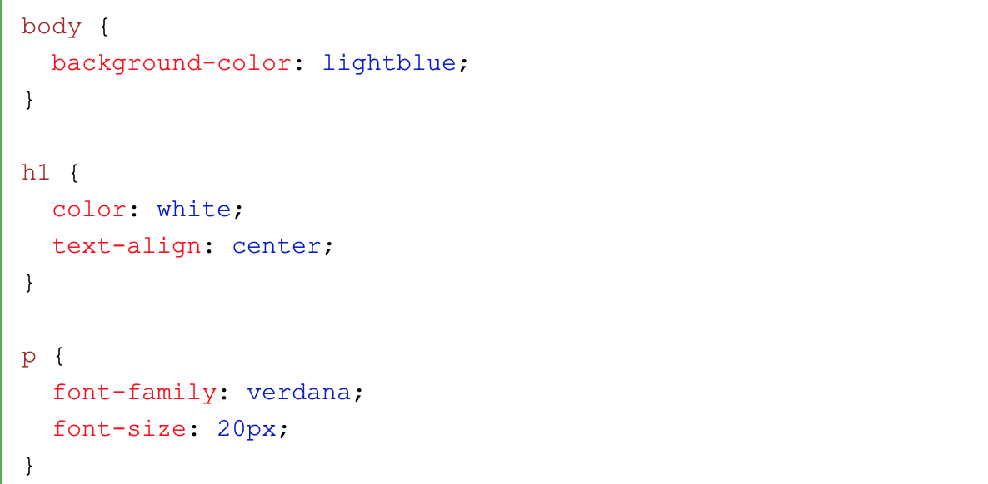
CSS LAYOUT
<html>
<head>
<title>This is a title</title>
</head>
<body>
<div>
<p>Hello world!</p>
</div>
</body>
</html>

Slide 6
CSS PROPERTIES
color
background-color
font
font-family
font-style {normal, italic, oblique}
font-weight {normal, bold, lighter, bolder}
text-align
display {block, inline-block, inline, none}
position {static, relative, absolute, fixed, sticky}
z-index

Slide 7
CSS PROPERTIES
height (max-height / min-height)
width (max-width / min-width)
margin
padding
border
border-color
border-width
border-style
border-radius {none, solid, dotted, inset...}

Slide 8
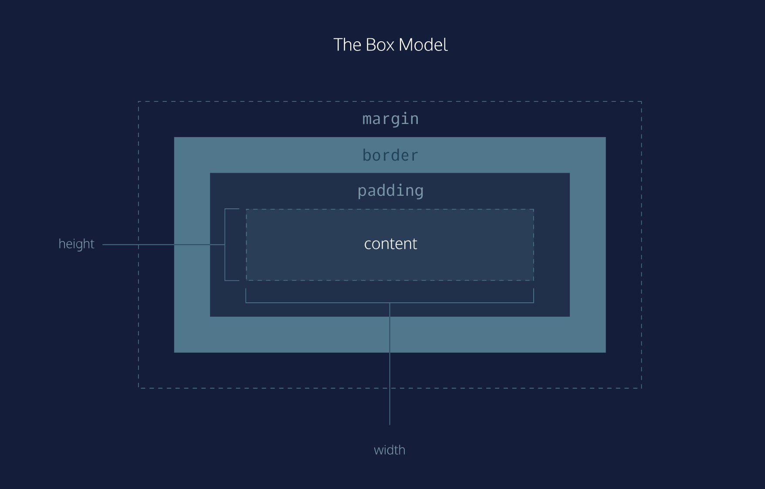
CSS BOX MODEL

Slide 9
Homework
Add CSS styling to your HTML webpage.
Adding CSS to HTML tutorial: https://www.w3schools.com/CSS/css_howto.asp
CSS Properties: https://www.w3schools.com/cssref/default.asp
CSS Padding:
https://developer.mozilla.org/en-US/docs/Web/CSS/padding

