Slide 1

CI/CD
ENVIRONMENT CONSTRUCTION
—— 陈志扬 余心如

Slide 2
01、 Introduction
02、Tools
CONTENTS
03、CI
04、CD
05.Summary

Slide 3
Part One
Introduction

Slide 4
CI Introduction
Definition : Continuous Integration (CI) is a development practice where developers integrate code into a shared repository frequently, preferably several times a day. Each integration can then be verified by an automated build and automated tests. While automated testing is not strictly part of CI it is typically implied.
Benefit : One of the key benefits of integrating regularly is that you can detect errors quickly and locate them more easily.
Martin Fowler, Chief Scientist of ThoughtWorks says:
Continuous Integration doesn’t get rid of bugs, but it does make them dramatically easier to find and remove..
LEARN MORE

Slide 5
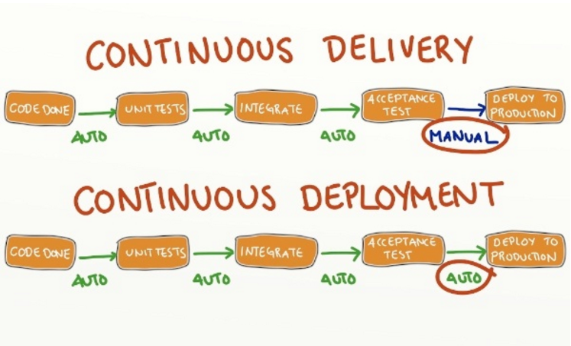
CD Introduction
LEARN MORE

Slide 6
Part Two
Tools

Slide 7



Jenkins
“The leading open source automation server, Jenkins provides hundreds of plugins to support building, deploying and automating any project.”
Heroku
A platform as a service (PaaS) that enables developers to build, run, and operate application.
Github
A hosting platform for open source and private software projects

Slide 8
Part Three
CI

Slide 9
Use Jenkins + Github build CI
Step 1 :
Download and install Jenkins

Slide 10
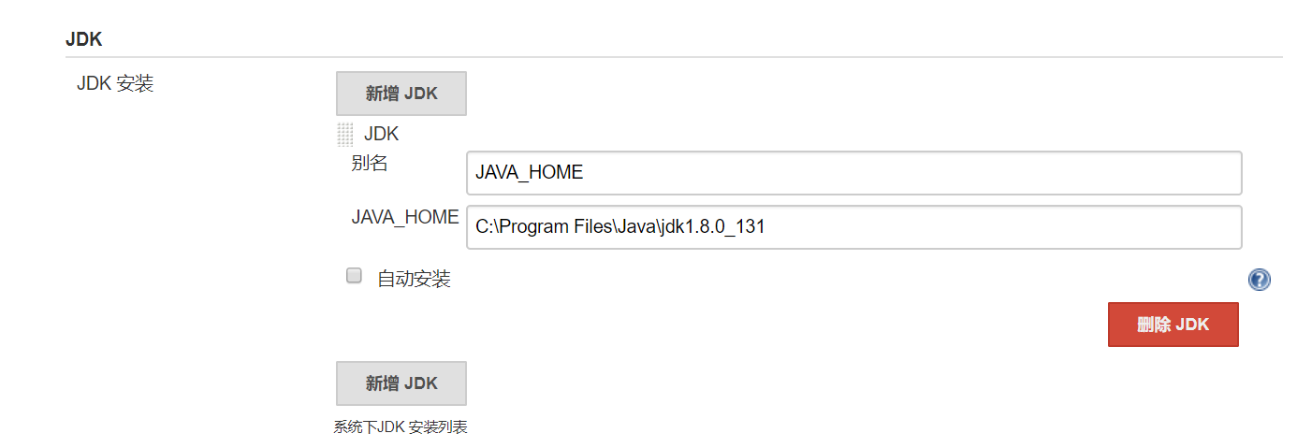
Step 2 :
Set the environment for Jenkins
①JDK Setting

Slide 11
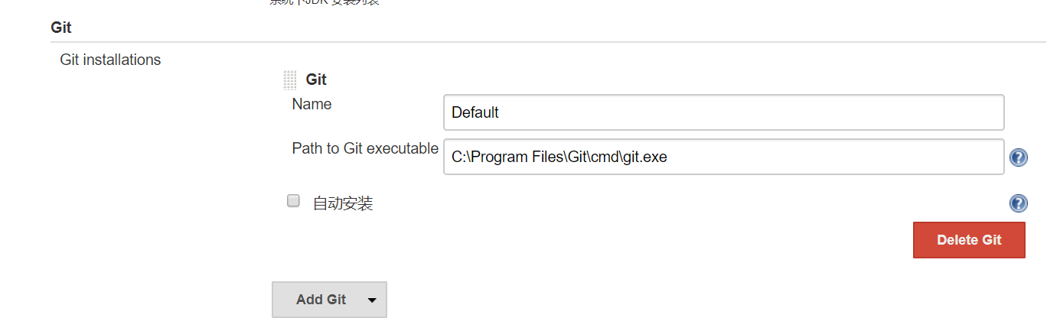
② Git Setting

Slide 12

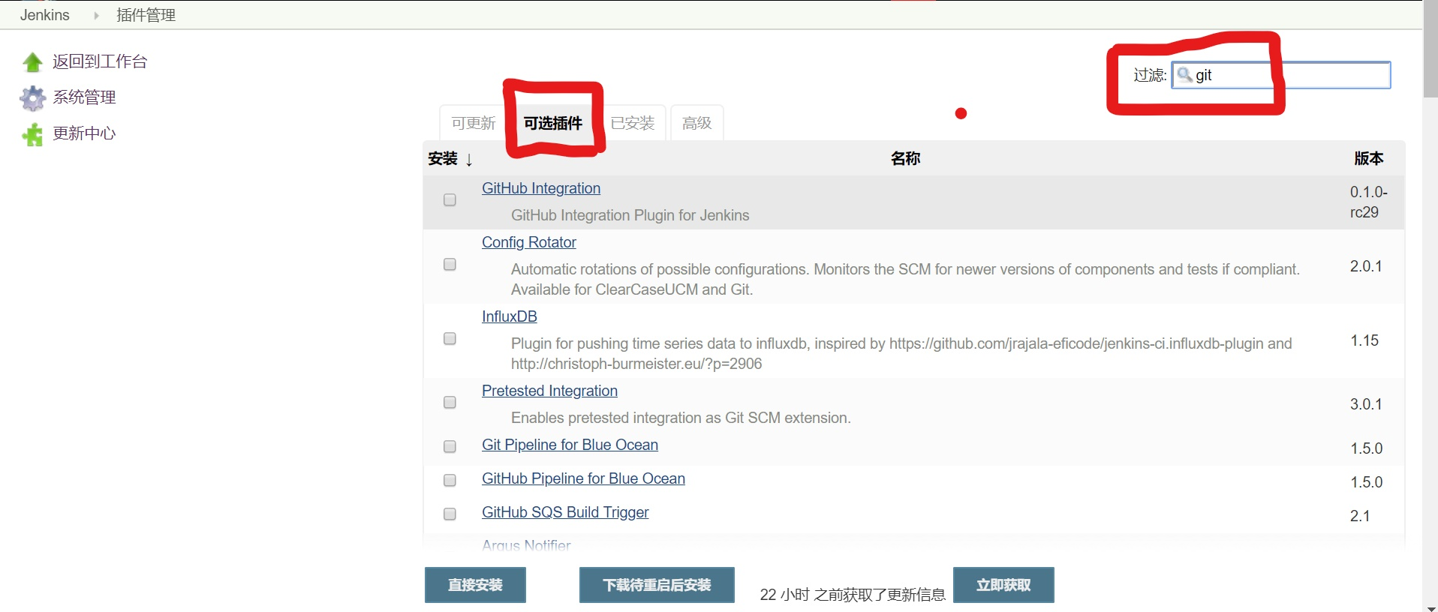
Step 3 :
Add plugins on Jenkins
①Git Plugin + Github Plugin

Slide 13
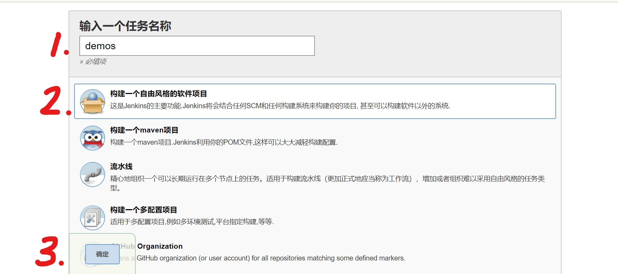
Step 4 :
Create a project
①Name it

Slide 14
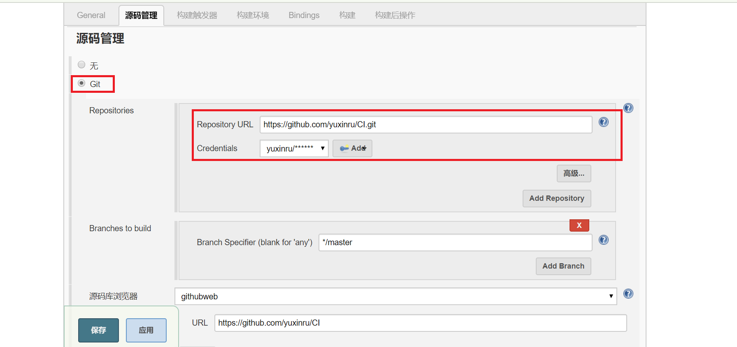
②Setting
{
Note：
①As we choose Github as the source of our code，we choose git here
②Write the repository url which ended in .git，not the url of webbrowser
}

Slide 15
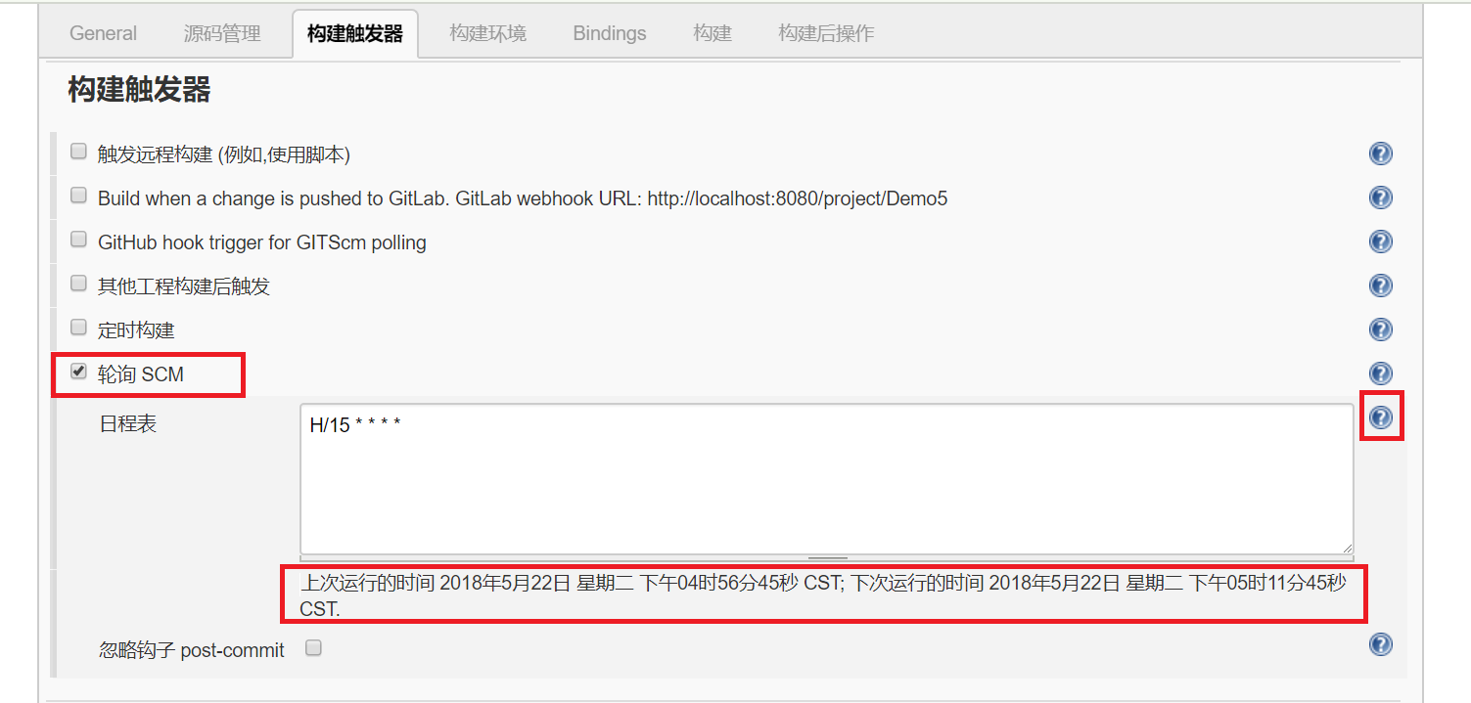
{
Note：
①Choose Polling SCM，we can build it at set intervals
②The detailed information will be shown by clicking the "?" in the column
}

Slide 16
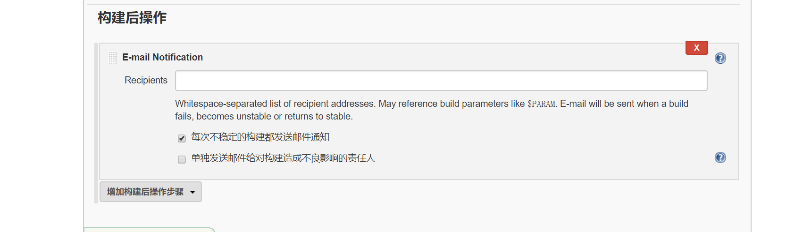

Slide 17
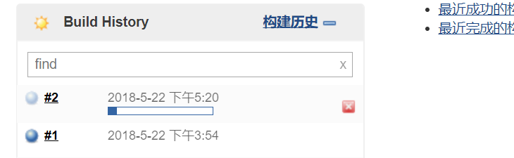
Step 5 :
Save
Then a CI is done

Slide 18
Part Four
CD

Slide 19

Use Heroku build CD
Process
▪Login with Heroku

Slide 20

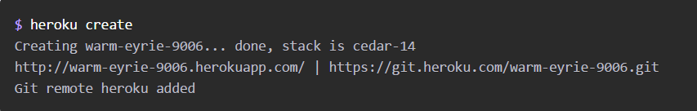
▪Clone the application from github repo to local
▪Create an app on Heroku,which prepares Heroku to receive source code

Slide 21

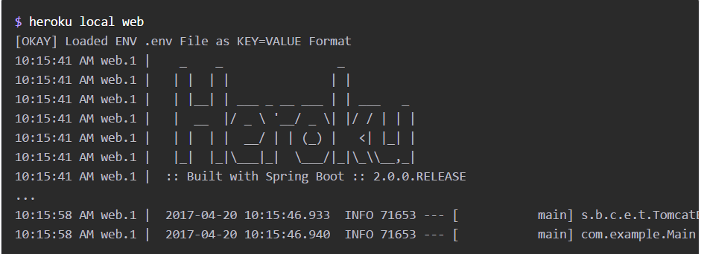
▪Make changes and run locally for test

Slide 22


▪Add the modified files to the local git repository
▪Commit the changes to the repository

Slide 23


▪Deploy
▪Open the website

Slide 24
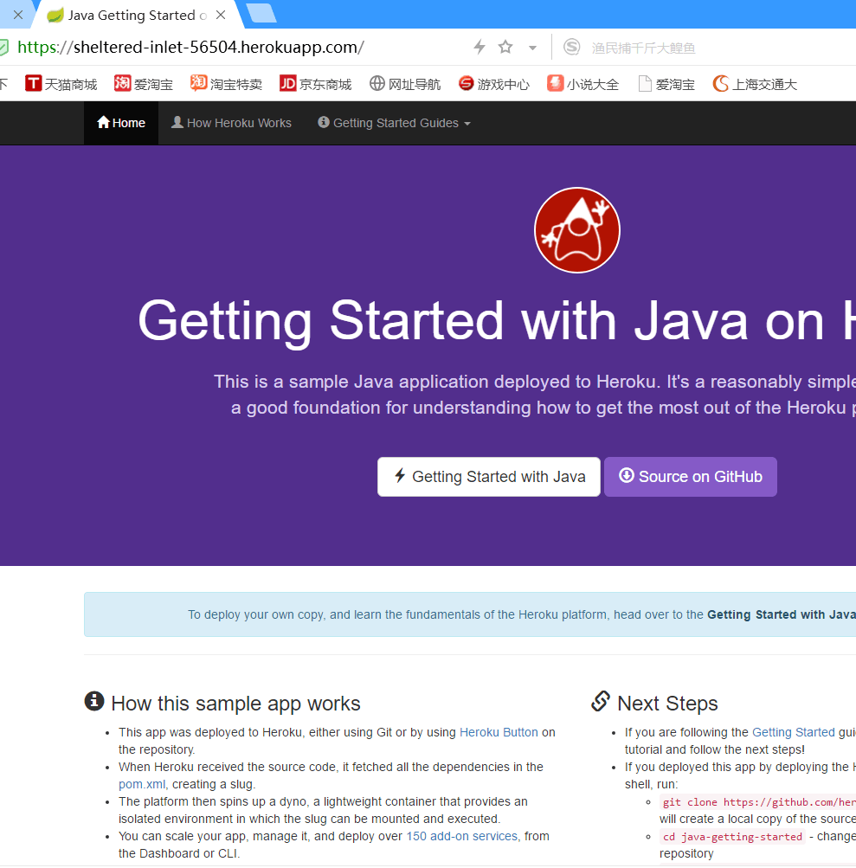
▪ We can see the deployed app
Notes:
24

Slide 25
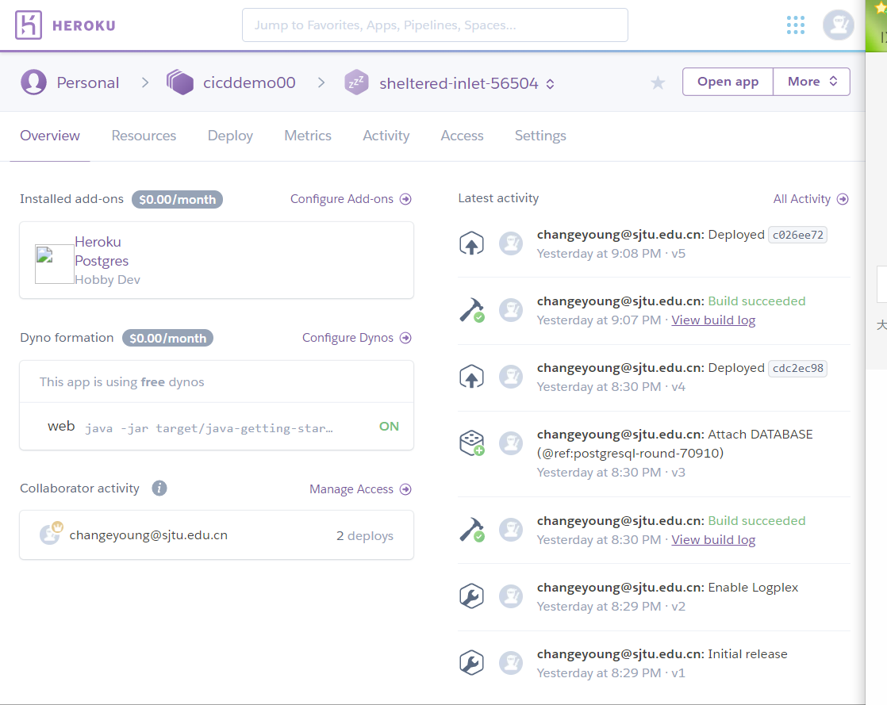
▪ And the personal page of Heroku will show your activity
Notes:
25

Slide 26
Part Five
Summary

Slide 27
Sum
SERVICE
SERVICE
SERVICE
With the steps above, every time we make changes to our code and push the new project to github, CI will help us build and test at set intervals, while CD will deploy our project with a few command-line operations.
SERVICE

Slide 28
THANK YOU
By faith I mean a vision of good one cherishes and the enthusiasm that pushes one to seek its fulfillment regardless of obstacles. By faith I By faith I mean a vision of good one cherishes and the enthusiasm that pushes one to seek its fulfillment regardless of obstacles. By faith I

