Slide 1
Cache Partitioning A Solution for Cache Pollution
Ammar Saeed

Slide 2
Contents
Cache Pollution
Partitioned Cache Design
Benchmark Results
Use Case Scenarios
Conclusion

Slide 3
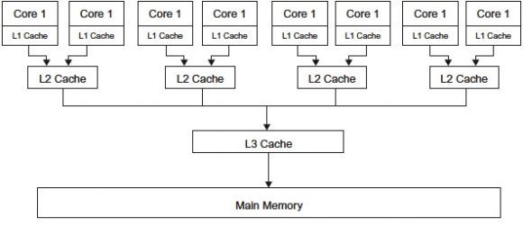
Cache Pollution In Multicore Architectures
A Generic Multicore Architecture
Individual L1 data and instruction caches
Shared L2 Caches
Shared L3 Cache
Cache Pollution
Unnecessary data caching
Resulting in eviction of useful data
Cache Pollution from different Cores
Effect of Inclusive caches on Cache Pollution

Slide 4
Cachebench Benchmarking
Cachebench : Linux LLC benchmark for cache performance.
Replacement of BW with miss rate using ARM PMU
Scenarios:
No process running on other core (No Load)
A heavy cache pollution process on other core (Load)
Different test times

Slide 5
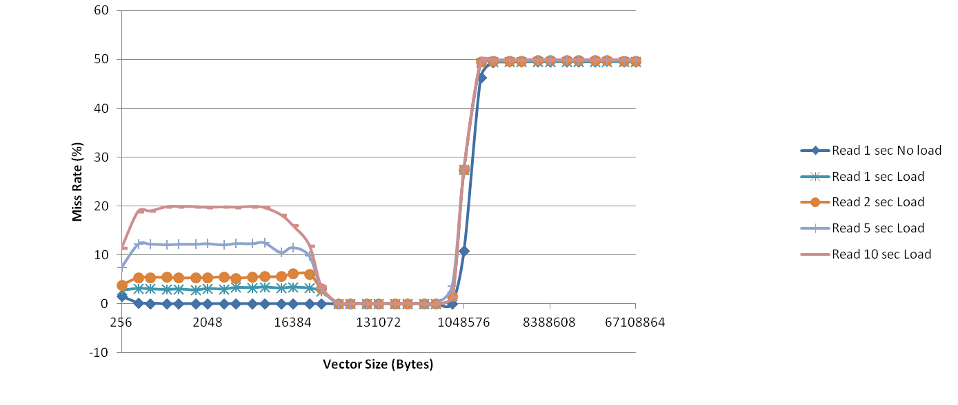
Effect of Cache Pollution (1)
Increase in miss rate from less then 1 % to up to 20 %
Effect is time dependent
Effect of L1 Size and L2 Size
As vector size exceed L1 size the hit rate increase, that’s why effect not visible in range from 32K
As vector size increase L2 size, most access creates misses that’s why cache pollution is not visible

Slide 6
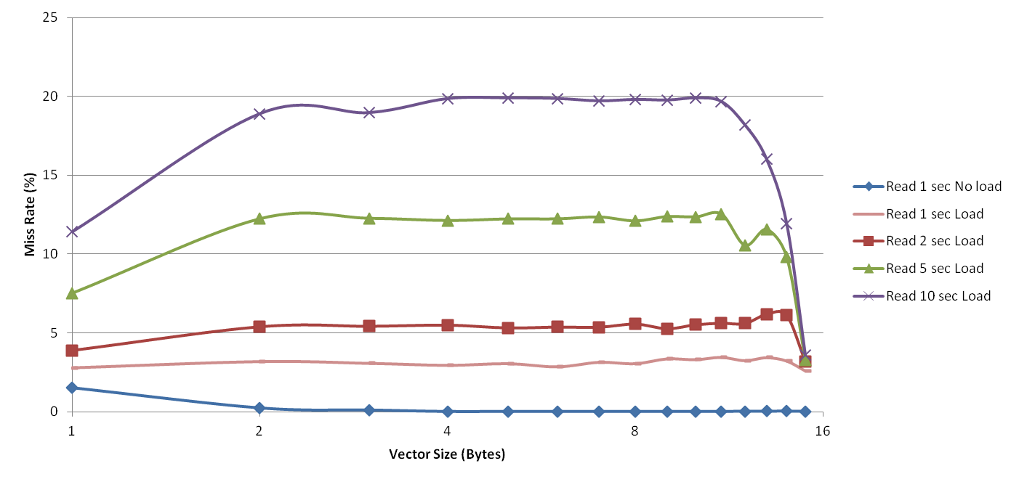
Effect of Cache Pollution (2)
Increase in miss rate from less then 1 % to up to 20 %
Effect is time dependent
Effect of L1 Size and L2 Size
As vector size increase L1 size the hit rate increase, that’s why effect not visible in range from 32
As vector size increase L2 size, most access creates misses that’s why cache pollution is not visible

Slide 7
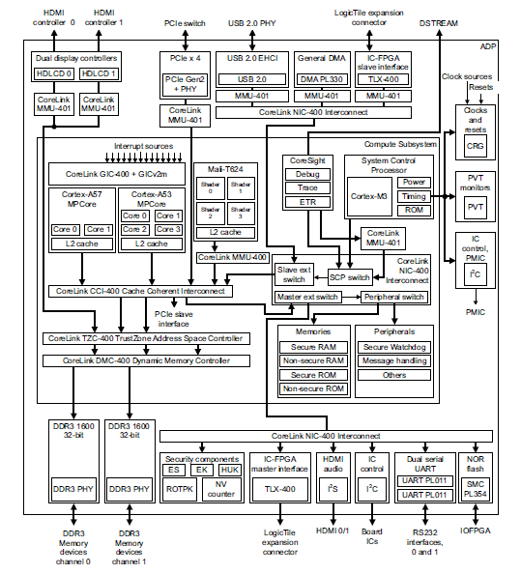
Cache Partitioning Prototype
Idea : Avoid cache pollution from different cores
Basic Principle:
Each core assigned with some partition of cache
Core only cache data within its partition
Partitions can overlap
Prototyping Platform (Juno Board):
Dual Core Cortex A57
Quad Core Cortex A53
FPGA Board Attachment (LogicTile FPGA Board)

Slide 8
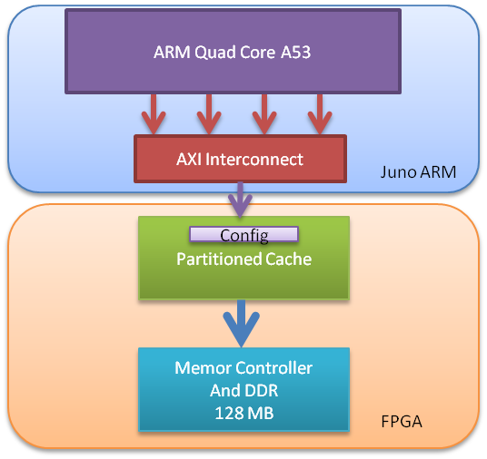
Design
Partition allocation through mask bits for each way per core
Only masked ways can be replaced
Partitioning of Cache in Vertical blocks
Different masking for each block
Benchmarking (Cachebench)
Mapping of vector to partitioned cached
Vector uncached in local SoC caches
Replacement of ARM PMU with Partitioned Cache monitors
Line Size | 64 byte
Associativity | 8 Way
Write Policy | Write back
Cache lines | 1024
Blocks | 4 Blocks (256 Lines x 8 way each)
Partition configuration granularity | 256 Lines x 16 way (One block)
Cached Memory | 128 MB
Cached Address | 0x68000000 - 0x6FFFFFFF
Configuration Memory | 16 Word (64 bit wide)
Configuration Memory Base Address | 0x61000000

Slide 9
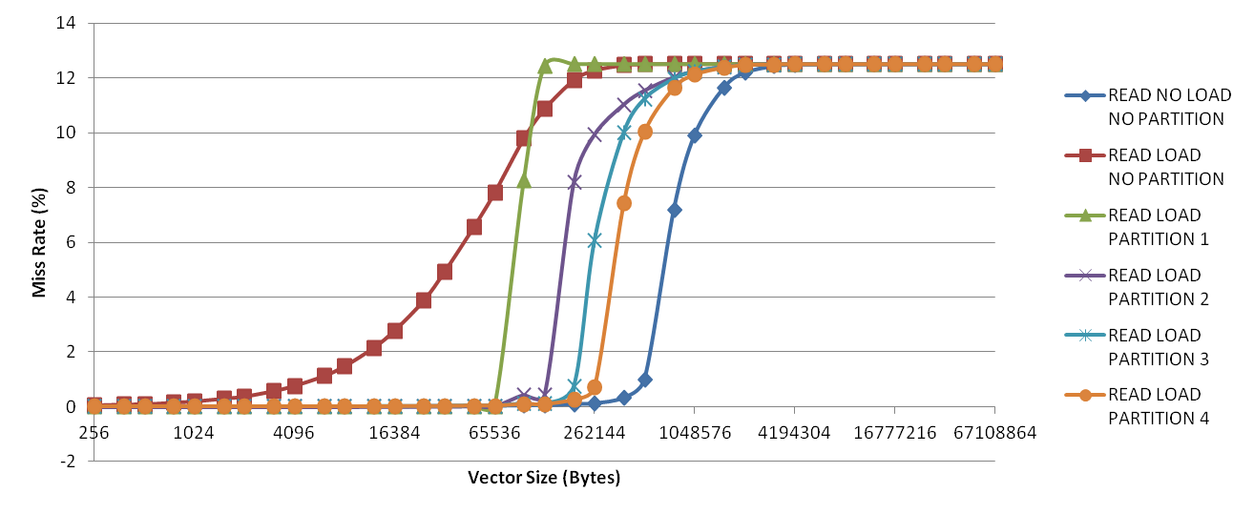
Benchmark with Partitioned Cache – Read
Miss rate close to no load achieved
Increase in miss rate as vector size goes out of assigned partitions

Slide 10
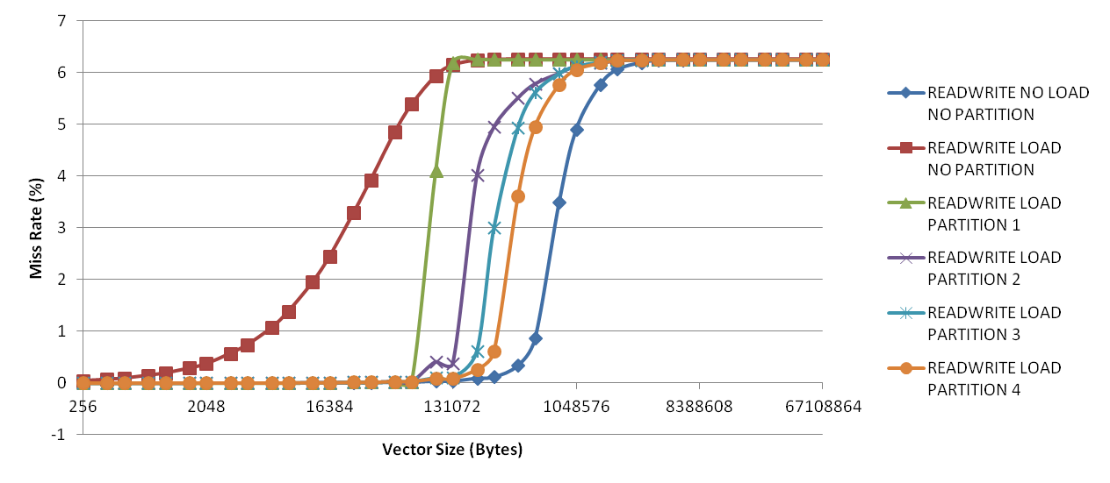
Benchmark with Partitioned Cache – Read Write
Miss rate close to no load achieved
Increase in miss rate as vector size goes out of assigned partitions

Slide 11
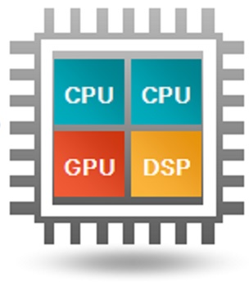
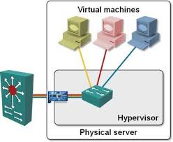
Use Cases
Heterogeneous Platforms
Cache pollution from different type of processing platforms (LL Shared cache between DSPs CPU GPUs etc)
Dynamically allocating partitions to each processing unit as per requirement
Datacenters
Cache pollution effects between different VMs
Solution: Having cache partitioning for different VM

Slide 12
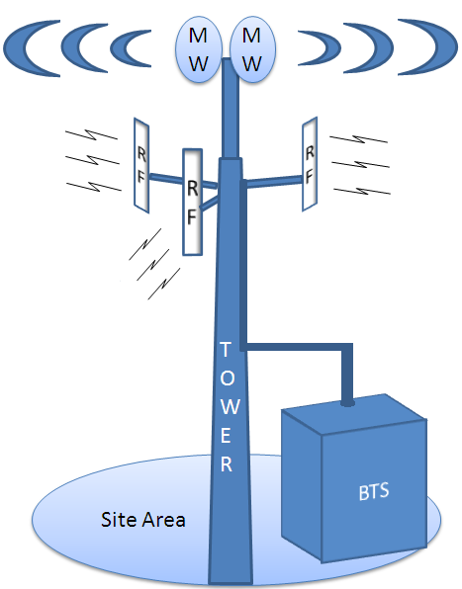
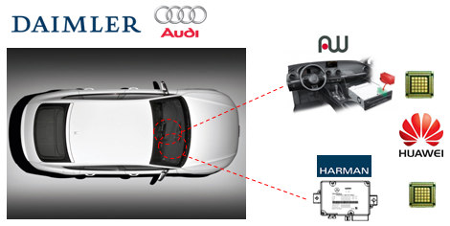
Use Cases (2)
Real Time Systems
Cache pollution can effect the deterministic behavior of an application
Many real time systems have hard or soft real time requirements for different applications
Base Transceiver Station
Automotive Controllers
Today’s Real Time Controllers = Manycore !
Solution : Tie up time critical application to particular cores with allocation required partition sizes

Slide 13
Conclusion
Cache pollution can effect miss rate (increase from ~1% to ~20%)
Partitioning can mitigate the cache pollution effect
Cache partitioning can be useful in application ranging from embedded to data centre applications

