Slide 1
Cache Partitioning Simulation Model
Uzair Sharif

Slide 2
Outline
Objective
Virtual Platforms
Model; Design and Implementation
Performance Analysis
Conclusion

Slide 3
Objective
Set up a full system simulation framework
Based on ARM ISA (like ARMv8)
Multicore CPUs
Setup OS for workload analysis
Integrate own cache-hierarchy within the system
Develop in SystemC for portability
Analyze Cache Pollution effects on multicore system
Cache partitioning scheme as viable solution to tackle Cache Pollution?

Slide 4


Virtual Platform
Virtual Platforms
Captures HW in an executable program
Run executable to simulate system
Primarily used for
Computer Architecture research
Early SW development before availability of actual HW
Proprietary solutions
ARM Fast Models, Cadence Virtual System Platform, Synopsys Platform Creator etc
Open Source solutions
QEMU, OVP, GEM5 etc
OVP
Open-source; C++ based; primarily used for early SW development
Easy integration with custom SystemC modules
License issues for ARMv8 based systems
GEM5
Open-source, Python-C++ based; primarily used for computer architecture research
Highly modular design incorporating high configurability
Increasingly used in industry now e.g ARM Research

Slide 5
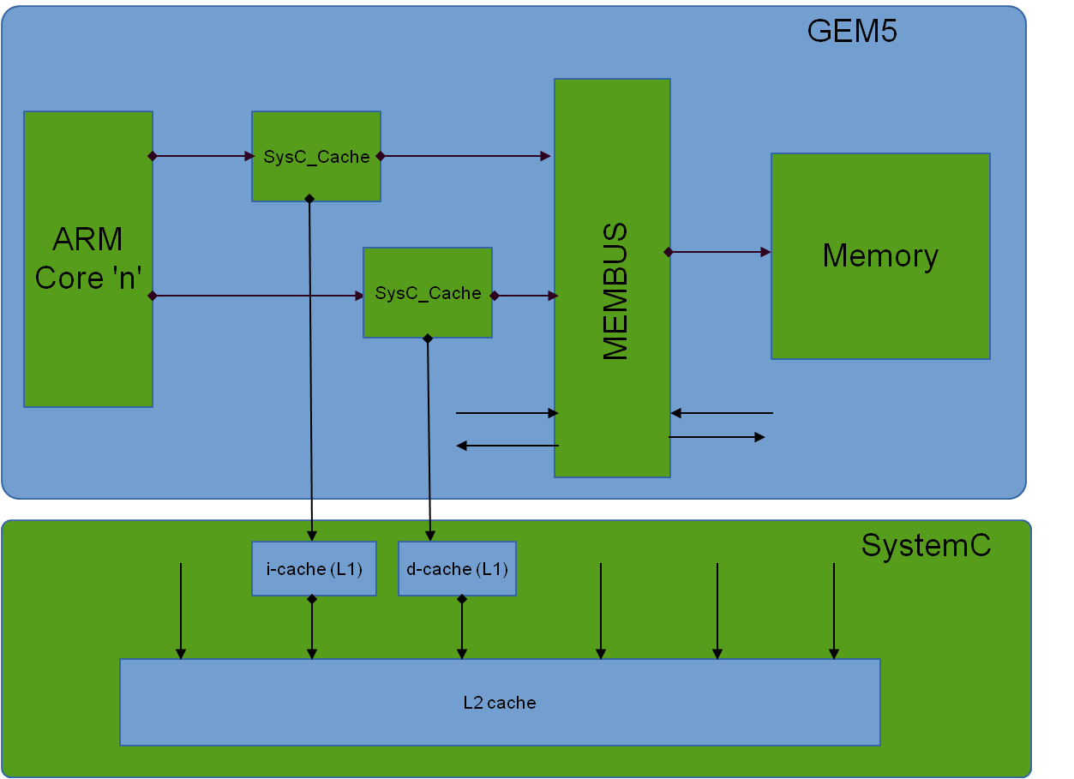
Model Design
Cache specs
Block Diagram
Block Size | 64 B
Partition Config. Granularity | Entire cache (1 block)
Eviction Policy | Random
Write Hit Policy | Write-back
Write Miss Policy | Write-Allocate
L1 Size | 32 KB
L1 Associativity | 2
L2 Size | 2 MB
L2 Associativity | 8

Slide 6
Model Implementation
Configurable Cache Hierarchy Models
In SystemC
Strictly inclusive property
Configurable as per #blocks, block size, eviction policy etc
Removing gem5 cache hierarchy
Within gem5 system, cache hierarchy directly interfaced with CPUs
Replaced built-in cache hierarchy by stub modules that act as ports to external SystemC world
Implemented gem5 memory semantics within the memory module
SystemC integration
Using the patch provided by TU Kaiserslautern research team
Modified the patch so as to directly interface with gem5 CPUs instead of gem5 system bus
Timing annotations
Implemented timing model within SystemC cache modules based on hits/misses
Timing annotations effect integrated into gem5
Cache Register interface
Cache hits/misses estimation at run-time
Modify cache partition allocation at run-time

Slide 7
Performance Analysis
Cache benchmarking via LLCBench suite on primary core
Load application on other core interfering with benchmark application

Slide 8
Performance Analysis

Slide 9
Conclusion
Setup ARMv8 based simulation model
Multicores running SMP OS kernel
Custom SystemC cache hierarchy
Cache Pollution
Cache Partitioning to tackle Cache Pollution

Slide 10
QUESTIONS??

