Slide 1
Modeling Cache effects for ARM based platforms

Slide 2
OVP simulation environment
Open Source tools
Customizability
SystemC, TLM2.0 support

Slide 3
OVP simulation environment
Complete simulation setup for ARM platforms
SMP-Linux kernel running on platform
Demos provided to quickly get the system up and running

Slide 4
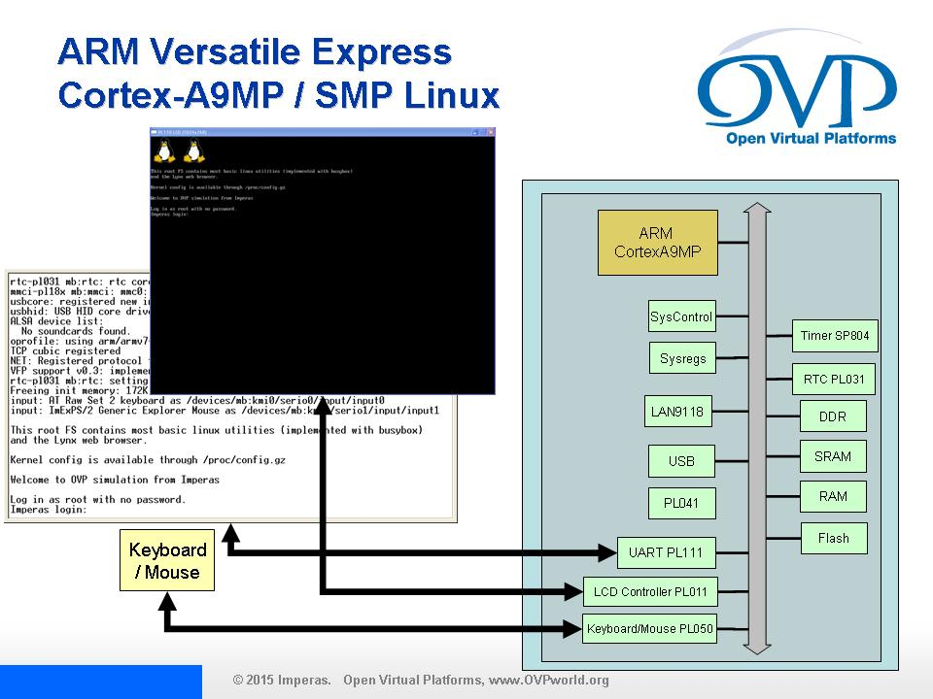
Our Platform setup

Slide 5
Starting out with the platform
Need valid OVP license to build this platform
OVP stuff is 32 bits so have to use 32 bit SystemC library
Have to compile & link with -m32 option for gcc on 64bit host

Slide 6
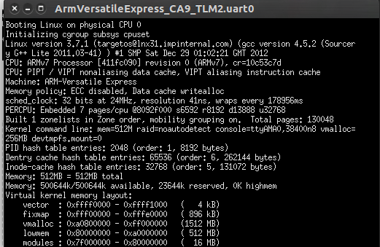
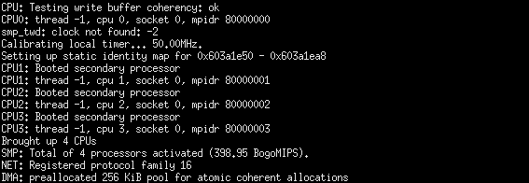
Starting out with the platform
Successfully built the simulation executable
Running the executable boots linux-smp kernel

Slide 7
Starting out with the platform
By default, the OVP SystemC models use SystemC DMI interface
This makes instruction simulation very fast – linux kernel boots within seconds – but no visibility
If DMI is disabled for visibility then it takes 35-40 mins to boot linux

Slide 8
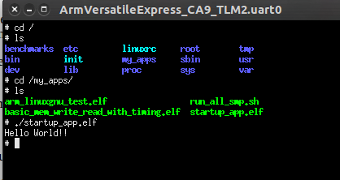
Custom Linux Application
OVP recommends Sourcery Codebench toolchain for ARM GNU/Linux (Open-source)
Built a simple C HelloWorld application (.elf format) targeting ARM Cortex-A9
Ported the executable to platform's linux init-rd filesystem using OVP utility

Slide 9
Internals of Platform model
All the sockets are using SystemC TLM interface
ARM_CA9_Mpx4
Memory
Memory bus
Peripheral bus
System bus

Slide 10
Internals of Platform model
All SystemC models in platforms use Loosely Timed Coding style using b_transport() socket interface
How the memory requests (instruction/data) flow from CPU to Memory model?
  For simulation efficiency, OVP CPU models use transport_dbg() socket interface for instruction fetches first
  Followed by actual instruction fetch via b_transport()
  So support for transport_dbg() needed in any SystemC module to interconnect it with CPU

Slide 11
Internals of Platform model
Only one Instruction/Data socket pair for the whole CPU
No way to identify which SMP core actually requested the memory transaction
To enable this capability, we customized the OVP CPU model

Slide 12
Customization of OVP CPU model
Internally all the OVP SystemC models use ICM API
The OVP CPU model uses icmCpuMasterPort class
  This translates the internal memory transaction to SystemC TLM transaction and transmits via socket
  Increased the Instruction/Data pair sockets in this class (one pair for each smp core)
  Within this class, we figured out the actual SMP core using ICM API
  Directed the memory transaction then to corresponding socket

Slide 13
Customization of OVP CPU model
icmCpu
Master
Port
logic
ARM Cortex-A9-Mpx4
Custom SystemC
Model
System bus
System bus
System bus
System bus

Slide 14
Starting out with cache model
Developed a simple cache model using SystemC
The model currently supports
  Configurable cache size in bytes
  Configurable cache line size in bytes
  Set-associativity
  Write-back/Write-through update schemes
  LRU, LFU, random eviction policy

Slide 15
Starting out with cache model
Only uses tags & status info for each cache block
Timing modeled
  Cache lookup delay
  Cache2cpu transfer delay
  Cpu2cache transfer delay
  Cache2mem transfer delay
  Mem2cache transfer delay
No support for cache coherency yet

Slide 16
Integration in platform
After sanity testing, we integrated the cache model within the platform
Used in between the CPU and System Bus
DMI is disabled on CPU so as to get memory requests onto cache model
But in cache, DMI is enabled to increase simulation speed – linux kernel boots in ~5 minutes

Slide 17
Integration in platform
Built a simple linux app that causes each of smp cores to issue memory transactions
Each smp core accesses memory in its own dedicated space so as not to cause overlapping
Cache timing delays are being observed in linux application execution time

Slide 18
Future work
Now looking into the possibility of using shared L2 cache for the whole CPU
Coherency support in cache model

Slide 19
Support
Suitable documentation of source code
Right now, maintaining a git repo for project code on github

Slide 20
Questions

