Slide 1
Boolean Algebra Combinational Circuits
Pavel Kryukov 10 October 2015

Slide 2
Layers of Abstraction in Computes Science
Application
Algorithms
Programming Language
Operating System
Instruction Set Architecture
Microarchitecture
Gates/Register-Transfer Level (RTL)
More about logical circuits
Topics of
this lecture
Circuits
Less about physics, wires and transistors…
Physics

Slide 3
Abstracting From Physics
Real physical circuits deal with physical properties, such as voltages and currents
Digital circuits use the abstractions of 0 and 1 to represent the presence or absence of these physical properties (signals) rather than a continuous range
voltage
It could not be a stable state: should not occur in the circuit except during transitions from one state to he other
5 V
Logic 1
3.5 V
Weak 1
undefined
1.5 V
Weak 0
Logic 0
0 V
Boolean algebra describes two-stated systems

Slide 4
Boolean Algebra

Slide 5
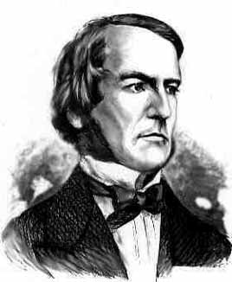
Boolean Algebra
Boolean Algebra (BA) works with object that can take only two values (true and false, or 1 and 0)
Such object is called a Boolean object (term bit of information is used in CS)
BA defines operations on Boolean objects → Boolean operations and functions
It is convenient to represent these operations and functions via truth tables:
George Boole
(1815 – 1864)
English mathematician, philosopher and logician
a | b | c
0 | 0
a | b | c
a | b | c
0 | 0 | c₀₀
a | b | c
0 | 0 | c₀₀
0 | 1 | c₀₁
1 | 0 | c₁₀
1 | 1 | c₁₁
a
c = F(a,b)
c
b
Boolean function
Truth table

Slide 6
Main Boolean operations
inversion (NOT)
The simplest Boolean operation is …
AND (or Boolean multiplication)
AND is often used as a logical key:
x | !x
0 | 1
1 | 0
x
!x
x
x | y | x*y
0 | 0
0 | 1
1 | 0
1 | 1
x*y
0
y
0
0
1
x | y | x*y
0 (closed) | y | 0
1 (open) | y | y

Slide 7
Main Boolean operations
OR (or Boolean addition)
x | y | x+y
0 | 0
0 | 1
1 | 0
1 | 1
0
x
x+y
1
y
1
1
XOR (or exclusive OR, or addition by module 1)
x | y | x ⊕ y
0 | 0
0 | 1
1 | 0
1 | 1
0
x
x ⊕ y
= x*!y + !x*y
1
y
1
0

Slide 8
Main axioms
There about ten axioms and theorems that can be used to create new or to simplify existed functions
Axiom | AND form | OR form
Identity law | 1*x = x | 0 + x = x
Idempotent law | x*x = x | x + x = x
Inverse law | !x*x = 0 | !x + x = 1
Commutative law | xy = yx | x + y = y + x
Associative law | (xy)z = x(yz) | (x + y) + z = x + (y + z)
Distributive law | xy + z = (x + z)(y + z) | (x + y)z = xz + yz
De Morgan's laws | !(xy) = !x + !y | !(x + y) = !x!y
!(!x + y) + !(!x + !y) = x
… and a lot of other useful equations:
(Huntington equation)

Slide 9
Boolean functions
Boolean operations can be combined into functions
F(x, y, z) = x + !y*z
x
x + !y*z
x | y | z | F
0 | 0 | 0
0 | 0 | 1
0 | 1 | 0
0 | 1 | 1
1 | … | … | 1
y
0
z
1
0
0

Slide 10
Examples of reduction
F = (!x!y!z) + (!x y z) + (x !y !z) + (x y !z) =
= (!x !y !z) + (!x y z) + (x !z)(!y + y) =
= (!x !y !z) + (!x y z) + (x !z) =
= !x (!y !z + y z) + (x !z) =
= !x (!y ⊕ z) + (x !z).
= (!x + x)(!y !z) + (!x y z) + (x y !z) =
= (!y!z) + y(!x z + x !z) =
= (!y!z) + y(x ⊕ z) =
= !(y + z) + y(x ⊕ z).

Slide 11
Canonical disjunctive normal form (CDNF)
CDNF is an algorithm of reconstructing a Boolean function from its truth table
Take lines with ‘1’ only
Conjunct all variables in line with correct sign
Make disjunction on expressions
x | y | z | F
0 | 0 | 0 | 1
0 | 0 | 1 | 0
0 | 1 | 0 | 0
0 | 1 | 1 | 1
1 | 0 | 0 | 1
1 | 0 | 1 | 0
1 | 1 | 0 | 1
1 | 1 | 1 | 0
!x * !y * !z
F = (!x!y!z) + (!x y z) + (x !y !z) + (x y !z)
!x * y * z
x * !y * !z
x * y * !z

Slide 12
Canonical conjunctive normal form (CCNF)
CCNF is an algorithm of reconstructing a Boolean function from its truth table
Take lines with ‘0’ only
Make disjunction on all variables in line with correct sign
Conjunct expressions
x | y | z | F
0 | 0 | 0 | 1
0 | 0 | 1 | 0
0 | 1 | 0 | 0
0 | 1 | 1 | 1
1 | 0 | 0 | 1
1 | 0 | 1 | 0
1 | 1 | 0 | 1
1 | 1 | 1 | 0
x + y + !z
x + !y + z
F = (x + y + !z)(x + !y + z)(!x + y + !z)(!x + !y + !z)
!x + y + !z
!x + !y + !z

Slide 13
Combinational Circuits

Slide 14
Combinational Circuits
If the output of a function is completely defined by the current input then the function is called combinational :
Qt = F(xt, yt, zt, …)
Combinational circuit (scheme) is an implementation of a combinational function
A lot of things can be implemented using combinational circuits
Just a few examples that will be presented soon: adder, decoder, multiplexer

Slide 15
Many-input devices
Primitives like OR, AND may be composed to support several inputs
x
x+y
x
y
y
x+y+z+w
x+y+z+w
z
z
z+w
w
w

Slide 16
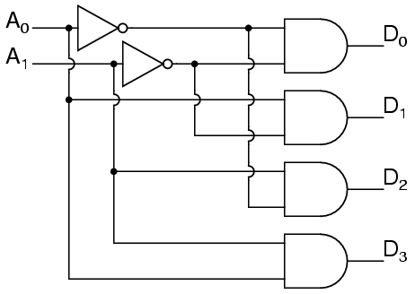
Binary Decoder
A binary decoder is a logic circuit that converts a binary integer value to an associated pattern of output bits.
A₀ | A₁ | D₀ | D₁ | D₂ | D₃
0 | 0 | 1 | 0 | 0 | 0
0 | 1 | 0 | 1 | 0 | 0
1 | 0 | 0 | 0 | 1 | 0
1 | 1 | 0 | 0 | 0 | 1

Slide 17
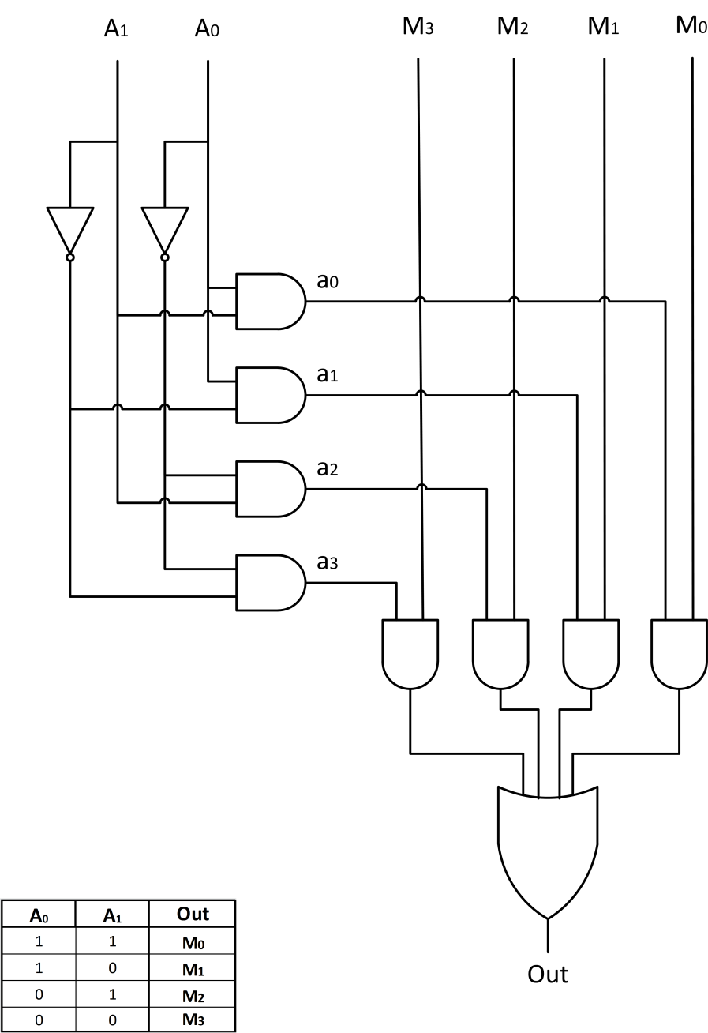
Multiplexer
A multiplexer (or mux) is a device that selects one signals and forwards the selected input into a single line.
The entry wires are address bus and data buses
Address bus is connected via decoder
M₀
M₁
A₀ | A₁ | Out
0 | 0 | M₀
0 | 1 | M₁
1 | 0 | M₂
1 | 1 | M₃
Out
M₂
M₃
A₀
A₁

Slide 18
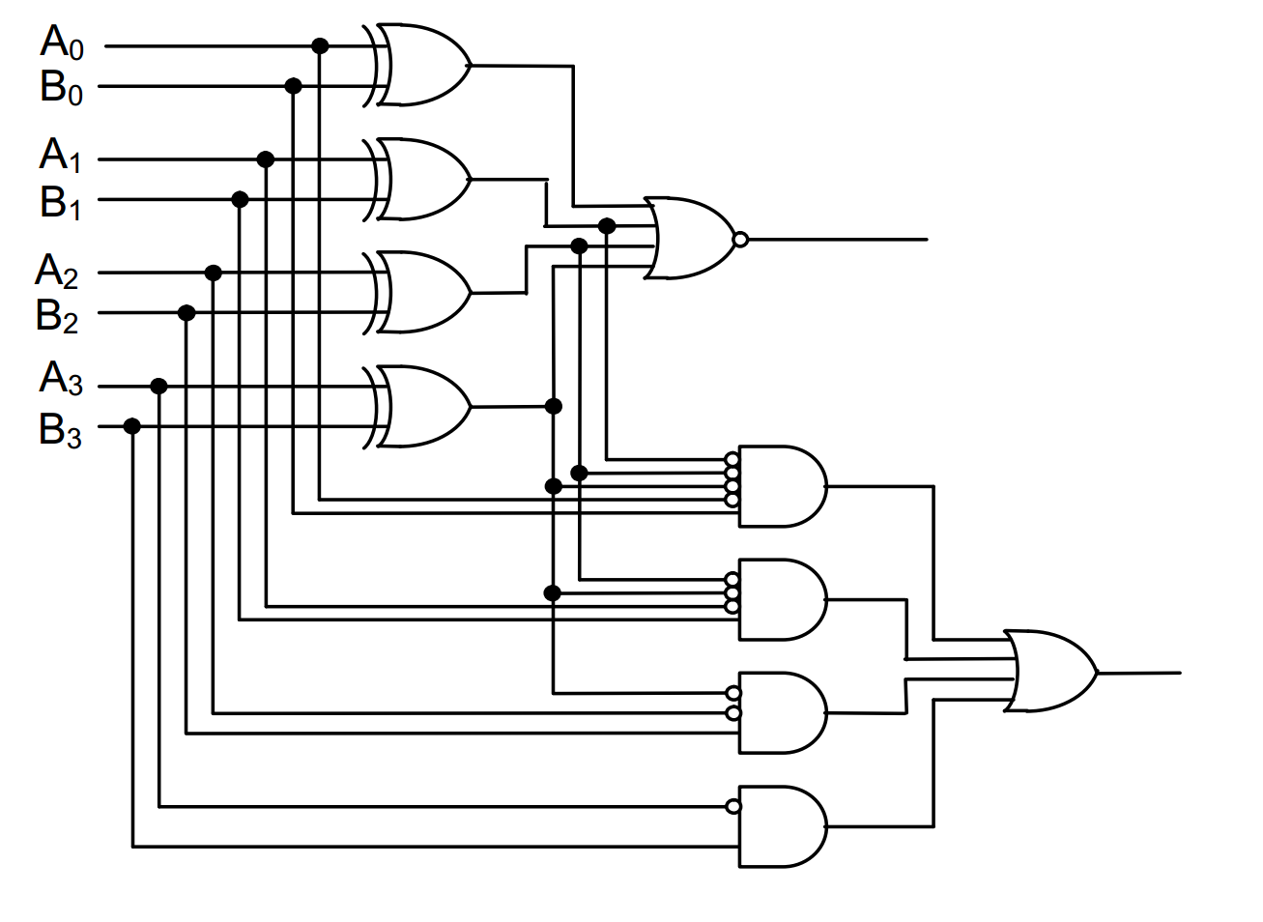
Comparator
A comparator is a device that takes two numbers as input in binary form and determines whether one number is greater than, less than or equal to the other number
 | EQ | LEQ
A>B | 0 | 0
A=B | 1 | 1
A<B | 0 | 1
EQ
LEQ

Slide 19
Adder and ALU

Slide 20
Half adder scheme
It is an adder, but it is not a full adder, because it does not have input carry
It is an adder, but it is not a full adder, because it does not have input carry
x
x | y | s | c
0 | 0
0 | 1
1 | 0
1 | 1
s
y
x
half +
sum
0
0
1
0
y
carry
1
0
0
1
c
Calculations:
Sum =
= !x * y + x * !y =
= x ⊕ y
Carry = x * y

Slide 21
Full adder scheme
xn | yn | cn-1 | sn | cn
0 | 0 | 0
0 | 1 | 0
1 | 0 | 0
1 | 1 | 0
We add input carry here
cn-1
0
0
1
0
half +
1
0
xn
half +
sn
0
1
0 | 0 | 1
0 | 1 | 1
1 | 0 | 1
1 | 1 | 1
1
0
yn
0
1
0
1
1
1
c
Cn
x
+
sum
It is called a full adder
y
carry

Slide 22
Wide adder
We may add more adders to sum numbers wider than 1 bit
yn+1
xn+1
yn
xn
+
+
+
+
+
cn+1
cn
cn-1
sn+1
sn
In real HW, wide adders have more complicated schemes to avoid long “carry chains”

Slide 23
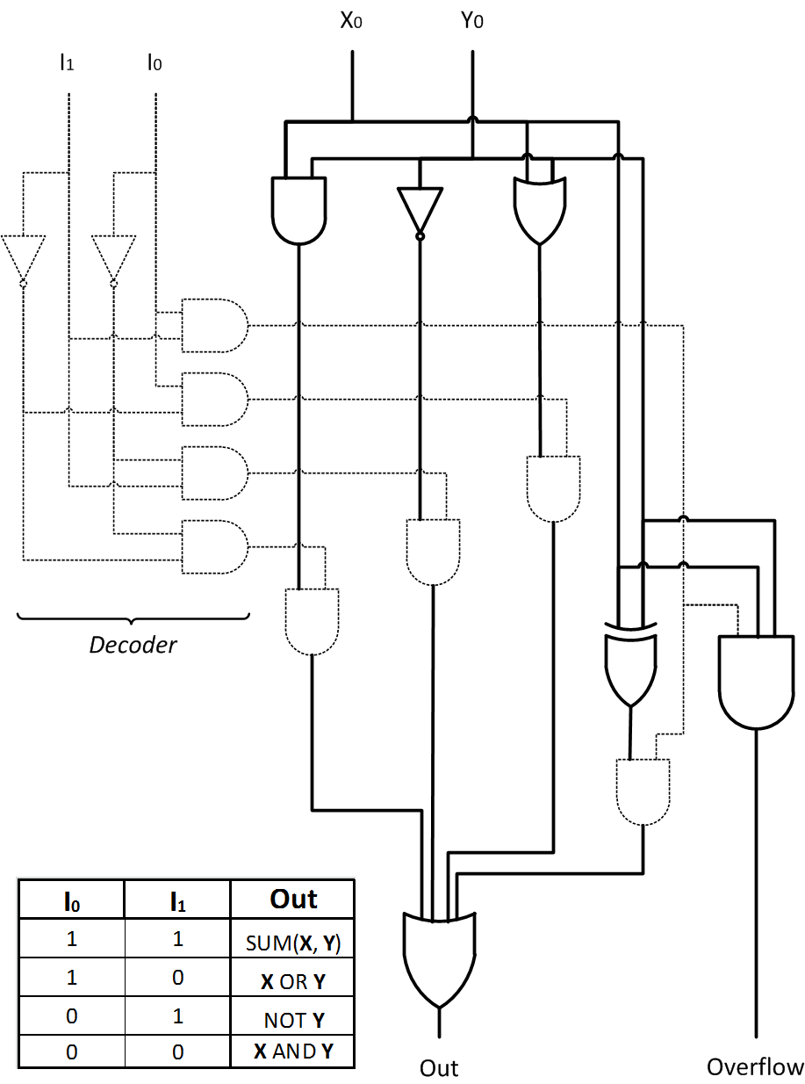
Arithmetic Logic Unit
ALU is a circuit that is able to perform different arithmetic and bitwise logical operations on integer binary numbers
ALU
Operand 1 (X)
Result (out)
Operand 2 (Y)
Opcode (I)

Slide 24
Thank You

