Slide 1
Integrated Circuits Basics
Pavel Kryukov
17 October 2015

Slide 2
Layers of Abstraction in Computer Science (CS)
Application
Algorithms
Programming Language
Operating System
Instruction Set Architecture
Microarchitecture
Gates/Register-Transfer Level (RTL)
More about voltages, wires and transistors…
Circuits
Topics of
this lecture
Less about electrons, semiconductors…
Physics

Slide 3
Why Transistor?
Transistors are the fundamental building blocks for all digital circuits
The main advantage of transistors over other devices (i.e., vacuum tubes) is that they are:
very small (< 22nm)
reliable (the 1946 ENIAC, with over 17,000 vacuum tubes, had a tube failure on average every two days)
power efficient (almost don’t consume energy when the state is not changed)
cheap (production cost of a processor is about several dollars, but it contains billions of transistors)

Slide 4
Semiconductors

Slide 5
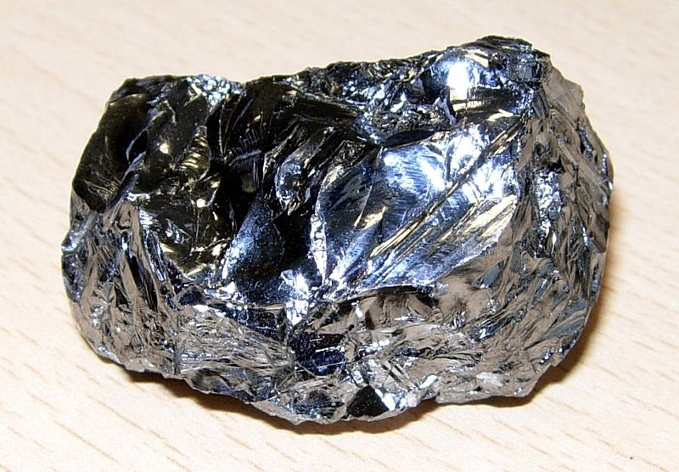





Silicon
Silicon (Si) is a chemical element with atomic number 14
It has four electrons in the outermost shell available for covalent chemical bonding:
$${1s}^{2}$$
$${2s}^{2}$$
$${2p}^{6}$$
$${3s}^{1}$$
$${3p}^{3}$$
Si (+14)
↑↓
↑↓
↑↓
↑↓
↑↓
↑
↑
↑
↑
Stick model of a silicon atom
Purified silicon
Planar structure of silicon crystal

Slide 6
Conduction properties
Pure silicon is a semiconductor: is doesn’t conduct strong electrical current, because it has few free charge carriers
Spontaneous electron-ion par creation
Silicon oxide (SiO₂) is an insulator: sand doesn’t conduct any electrical current.

Slide 7
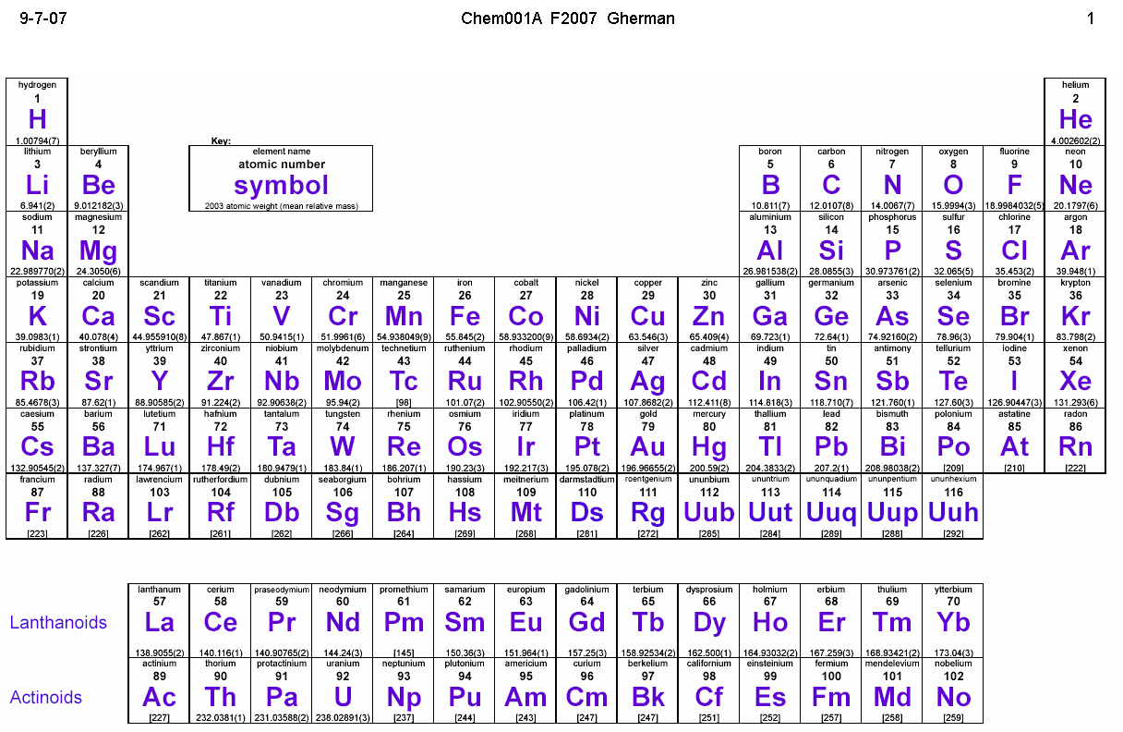










N-type Doping
P
-
+
$${1s}^{2}$$
$${2s}^{2}$$
$${2p}^{6}$$
$${3s}^{1}$$
$${3p}^{3}$$
Si (+14)
↑↓
↑↓
↑↓
↑↓
↑↓
↑
↑
↑
↑
P
$${1s}^{2}$$
$${2s}^{2}$$
$${2p}^{6}$$
$${3s}^{2}$$
$${3p}^{3}$$
-
+
P (+15)
↑↓
↑↓
↑↓
↑↓
↑↓
↑↓
↑
↑
↑
P
+
-
N-type semiconductor (Si doped by P atoms)

Slide 8





P-type Doping
+
Al
-
-
$${1s}^{2}$$
$${2s}^{2}$$
$${2p}^{6}$$
$${3s}^{1}$$
$${3p}^{3}$$
Si (+14)
↑↓
↑↓
↑↓
↑↓
↑↓
↑
↑
↑
↑
Al
$${1s}^{2}$$
$${2s}^{2}$$
$${2p}^{6}$$
$${3s}^{1}$$
$${3p}^{2}$$
Al (+13)
↑↓
↑↓
↑↓
↑↓
↑↓
↑
↑
↑
Al
P-type semiconductor (Si doped by Al atoms)

Slide 9
“Holes” concepts
An electron hole is the conceptual and mathematical opposite of an electron. The concept describes the lack of an electron at a position where one could exist in an atom or atomic lattice.
Tag-game example:
1
5
12
10
14
9
3
15
11
7
8
4
13
2
6

Slide 10
MOSFET

Slide 11
MOSFET
The metal-oxide-semiconductor field-effect transistor (MOSFET) acts as a voltage-controlled switch with three terminals: source, drain, and gate
The gate controls whether current can pass from source to drain or not
There are two variations of the MOSFET: the n-channel (this slide) and the p-channel
Source
Gate
Drain
Metal
Oxide layer
N-type semiconductor
-
-
-
P-type semiconductor
-
-
-
+
+
+
+

Slide 12
Diffusion process
Holes and electrons diffuse into the n-type and p-type semiconductors correspondently
The diffusion process creates the balancing field (Ed) that prevents deeper diffusion
Source
Gate
Drain
Ed
+
+
Ed
Ed
+
+
Ed
-
-
-
-
+
+
+
+
-
-
-
-
-
-
-
-
Ed
Ed

Slide 13
Closed State for N-type MOSFET
For N-type MOSFET if the gate is not connected (high-impedance state, Z) or equal to 0 there is not current through the drain
One of n-p junction is always closed
Source
Gate
Drain
0
0/Z
Z
Ed
Ecc
This p-n junction is closed: its field balances the field of the supply
No current through this p-n junction

Slide 14
Open State for N-type MOSFET
For N-type MOSFET if the gate is equal to V_{t} then the transistor is open: the source value pass to the drain
The current passes though the small channel created by the gate field (more detailed explanation is out of scope of our course)
Source
Gate
Drain
0
V_{t}
0
+
+
+
+
-
-
Eg
N-type channel with free conductors (electrons)

Slide 15
Refresher: Physical Abstraction
Real physical circuits deal with physical properties, such as voltages and currents
Digital circuits use the abstractions of 0 and 1 to represent the presence or absence of these physical properties
voltage
It could not be a stable state: should not occur in the circuit except during transitions from one state to he other
5 V
Logic 1
3.5 V
Weak 1
V_{t}
undefined
1.5 V
Weak 0
Logic 0
0 V

Slide 16
N-type MOSFET logical scheme
Z
0
Weak 1
Drain
Drain
Drain
0
Gate
1
Gate
1
Gate
Source
Source
Source
X
0
1
When the gate is “closed”, transistor does not conduct
When the gate is “open”, transistor can conduct “0”
When the gate is “open”, transistor conducts “1”, but:
Source
Gate
Drain
1
1
Voltage between source and gate is 0, so p-n is not fully “open” (details are beyond the scope of our course)

Slide 17
CMOS Circuits

Slide 18
CMOS Circuits
Complementary metal–oxide–semiconductor (CMOS) is a technology for constructing integrated circuits
The main characteristics of CMOS devices is low static power consumption
There is no current in static state of the scheme (i.e. the power supply is never connected to the ground)
CMOS schemes always contain two complementary parts
One part consists of P-type transistors and is connected to the power supply and provides 1 to the output
The other consists of N-type transistors and is connected to the ground and provides 0 to output
When one part is turned on the other part is disabled (provides Z)

Slide 19
N and P-type MOSFET
N-type MOSFET:
Drain
Gate | State | Input (Source) | Output (Drain)
1 | On (conduct) | 0 | 0
 |  | 1 | weak 1
0 (any other value than 1) | Off (not conduct) | any | Z
Gate
Source
P-type MOSFET (similar to N-type, but all is inverted):
Source
Gate | State | Input (Source) | Output (Drain)
0 | On (conduct) | 0 | weak 0
 |  | 1 | 1
1 (any other value than 0) | Off (not conduct) | any | Z
Gate
Drain

Slide 20
Mix of States in Schemes with MOSFETs
 | 0 | 1 | Z | weak 0 | weak 1
0 | 0 | short | 0 | 0 | short
1 | short | 1 | 1 | short | 1
Z | 0 | 1 | Z | weak 0 | weak 1
weak 0 | 0 | short | weak 0 | weak 0 | short
weak 1 | short | 1 | weak 1 | short | weak 1
 | 0 | 1 | Z | weak 0 | weak 1
0 | 0 | short | 0 | 0 | short
1 | short | 1 | 1 | short | 1
Z | 0 | 1 | Z | weak 0 | weak 1
weak 0 | 0 | short | weak 0 | weak 0 | short
weak 1 | short | 1 | weak 1 | short | weak 1
 | 0 | 1 | Z | weak 0 | weak 1
0 | 0 | short | 0 | 0 | short
1 | short | 1 | 1 | short | 1
Z | 0 | 1 | Z | weak 0 | weak 1
weak 0 | 0 | short | weak 0 | weak 0 | short
weak 1 | short | 1 | weak 1 | short | weak 1
 | 0 | 1 | Z | weak 0 | weak 1
0
1
Z
weak 0
weak 1
 | 0 | 1 | Z | weak 0 | weak 1
0 | 0
1 | short
Z | 0
weak 0 | 0
weak 1 | short
 | 0 | 1 | Z | weak 0 | weak 1
0 | 0 | short | 0 | 0 | short
1 | short | 1 | 1 | short | 1
Z | 0 | 1 | Z | weak 0 | weak 1
weak 0 | 0 | short | weak 0 | weak 0 | short
weak 1 | short | 1 | weak 1 | short | weak 1
 | 0 | 1 | Z | weak 0 | weak 1
0 | 0 | short | 0 | 0 | short
1 | short | 1 | 1 | short | 1
Z | 0 | 1 | Z | weak 0 | weak 1
weak 0 | 0 | short | weak 0 | weak 0 | short
weak 1 | short | 1 | weak 1 | short | weak 1

Slide 21
CMOS Inverter
Input
Output
Input | Output
0 | Z
1 | 0
Input | Output
0 | 1
1 | Z
Input | Output
0 | 1
1 | 0
Vcc
Vcc
Source
1
1
Gate
Drain
Input
Z
Output
Drain
1
0
Gate
0
Source
0
The bottom part
The top part
The full scheme

Slide 22
CMOS NAND Circuit
A
Output
B
Vcc
Vcc
1
1
A | B | Output
0 | 0 | 1
0 | 1 | 1
1 | 0 | 1
1 | 1 | 0
A
B
A
B
Output
Output
Output
A
A
B
B
0
0
The bottom part
The top part
The full scheme

Slide 23
Time and Power

Slide 24

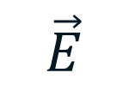
Transistor equivalent scheme
$$\vec{E}$$
$$\vec{j}$$
MOSFET has some parasitic capacities...
and resistivity

Slide 25
Power Consumption in CMOS
Vcc
1
No current in static state, i.e. there is no power consumption
Current exists only at switch from one state to another to recharge the capacities
Input
Output
0
Input
1
+
+
0
Source
Gate
Drain
Drain
Gate
Source
1
-
-
n
n
p
p
p
n
No connection between the power supply and the ground
Output
Gate

Slide 26
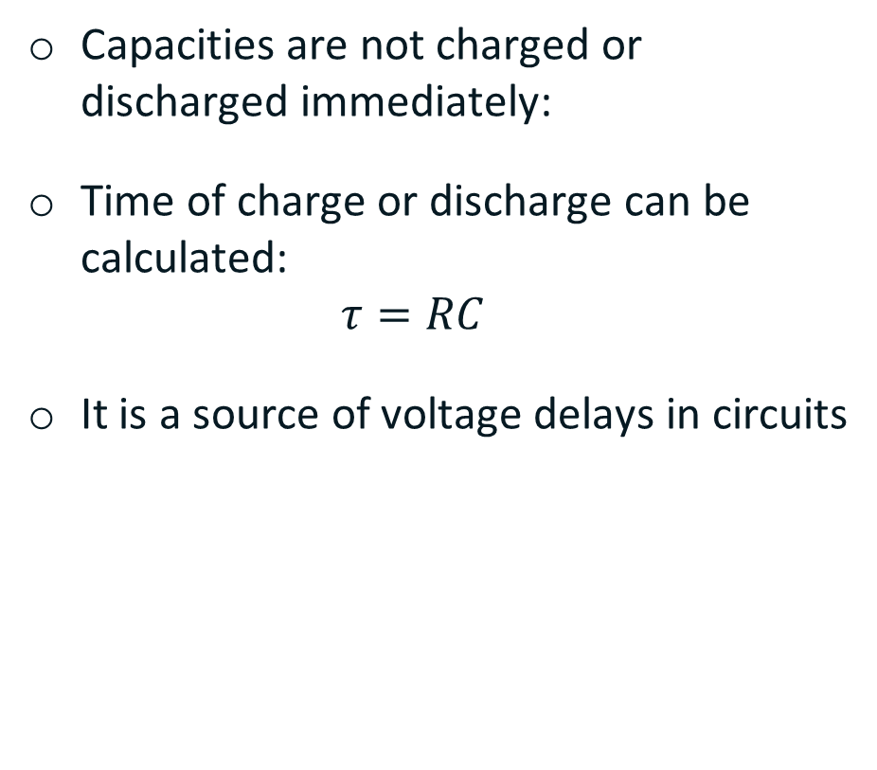
Timing
Capacities are not charged or discharged immediately:
Time of charge or discharge can be calculated: $τ=RC$
It is a source of voltage delays in circuits
Vcc
+ −
0
1
1
Output
1
1
0

Slide 27
Critical paths

Slide 28
What is a critical path of scheme?
Critical path is the slowest logic path in the circuit
Reliable result of whole logic path can not be ready until critical path is passed by signal

Slide 29
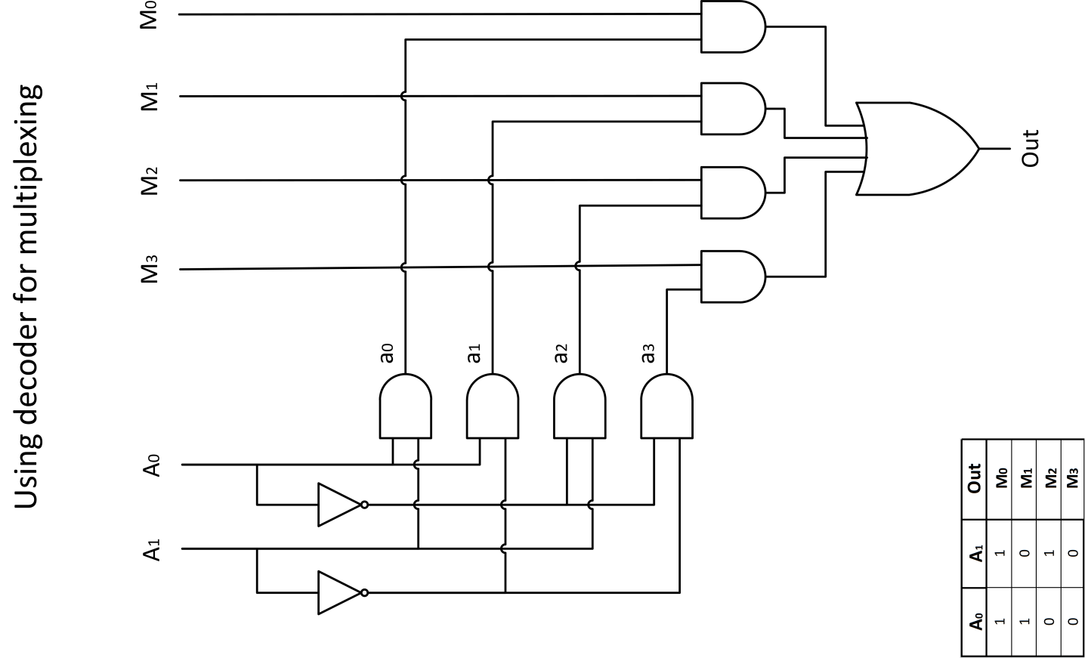
Example of critical path finding: Multiplexer
= 5t
1t
2t
1t
1t

Slide 30
Production

Slide 31
YouTube videos
“How a CPU is made“ explains how integrated circuits (IC) are created
“Intel: The Making of a Chip with 22nm/3D Transistors“ shows the whole process shortly, but, unfortunately, without any description

Slide 32
Thank You

