Slide 1
Performance and Power
Pavel Kryukov
12 December 2015

Slide 2
Performance

Slide 3
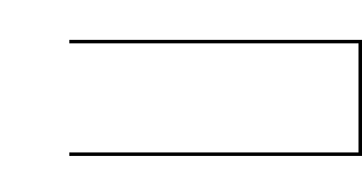
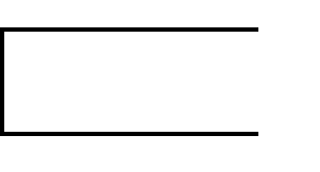
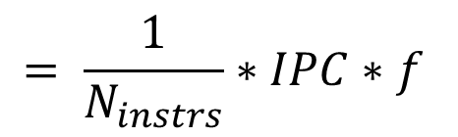

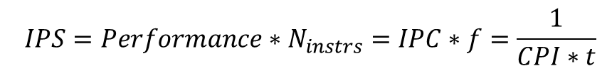
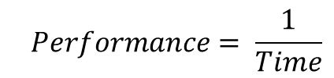
Refresher: Golden rule of CS
What does performance depend on?
$$Performance= \frac{1}{Time}$$
$$= \frac{1}{N_{instrs}∗CPI∗t}$$
$$= \frac{1}{N_{instrs}}∗IPC∗f$$
$$IPS={Performance∗N}_{instrs}=IPC∗f=\frac{1}{CPI∗t}$$
Golden rule of CS

Slide 4
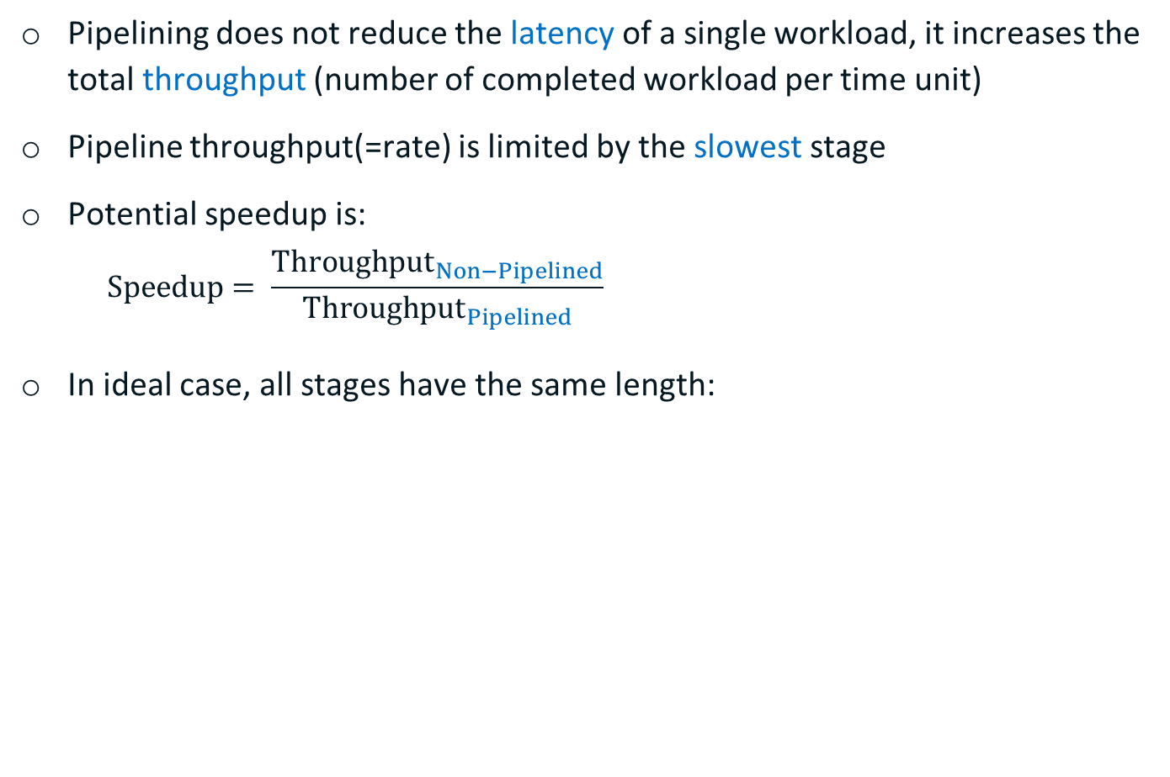
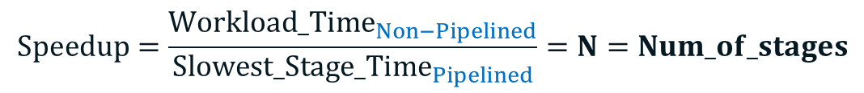
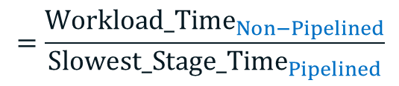
Refresher: Pipeline speedup
Pipelining does not reduce the latency of a single workload, it increases the total throughput (number of completed workload per time unit)
Pipeline throughput(=rate) is limited by the slowest stage
Potential speedup is:
$$Speedup= \frac{{Throughput}_{Non−Pipelined}}{{Throughput}_{Pipelined}}$$
In ideal case, all stages have the same length:
$$=\frac{{Workload_Time}_{Non−Pipelined}}{{Slowest_Stage_Time}_{Pipelined}}$$
$$Speedup=\frac{{Workload_Time}_{Non−Pipelined}}{{Slowest_Stage_Time}_{Pipelined}}=N=Num_of_stages$$

Slide 5
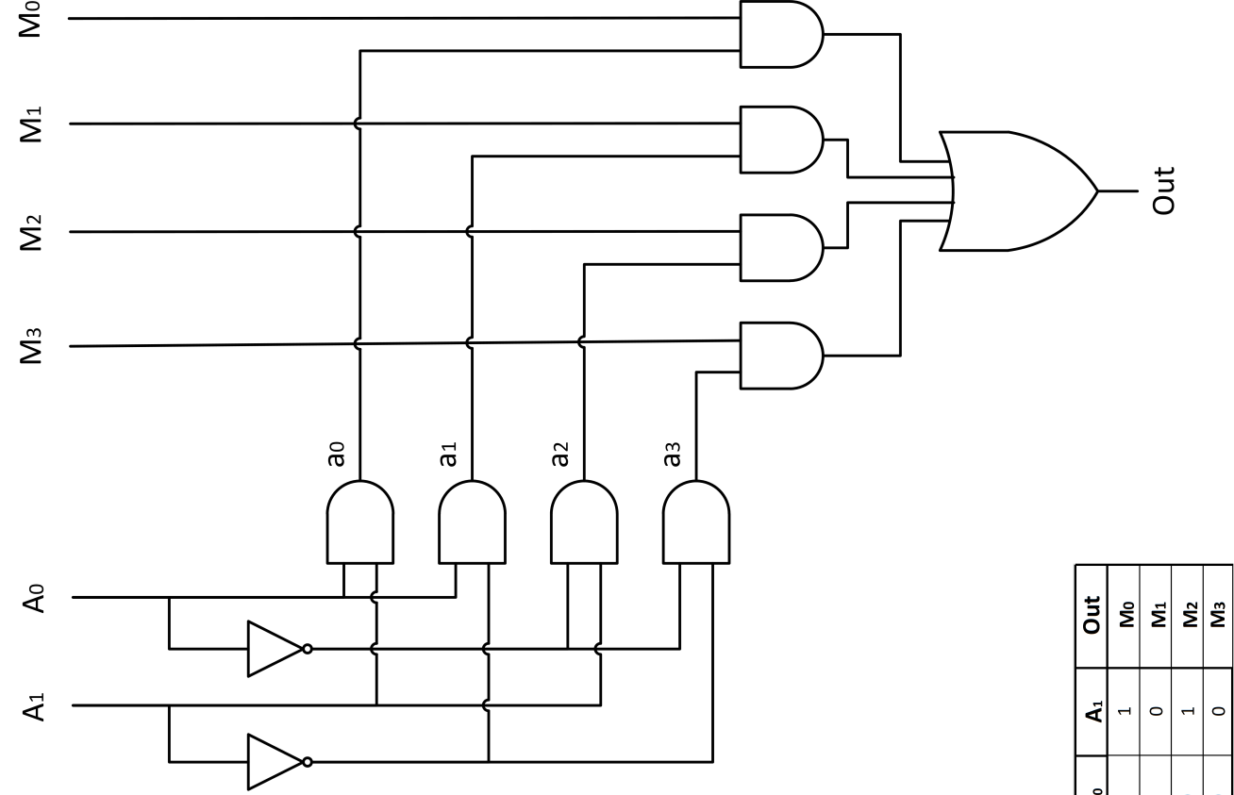
Ways to increase speedup
Partition the pipe to many pipe stages
Balance the work in the pipe stages: make the longest pipe stage to be as short as possible
Latches increase overall latency

Slide 6
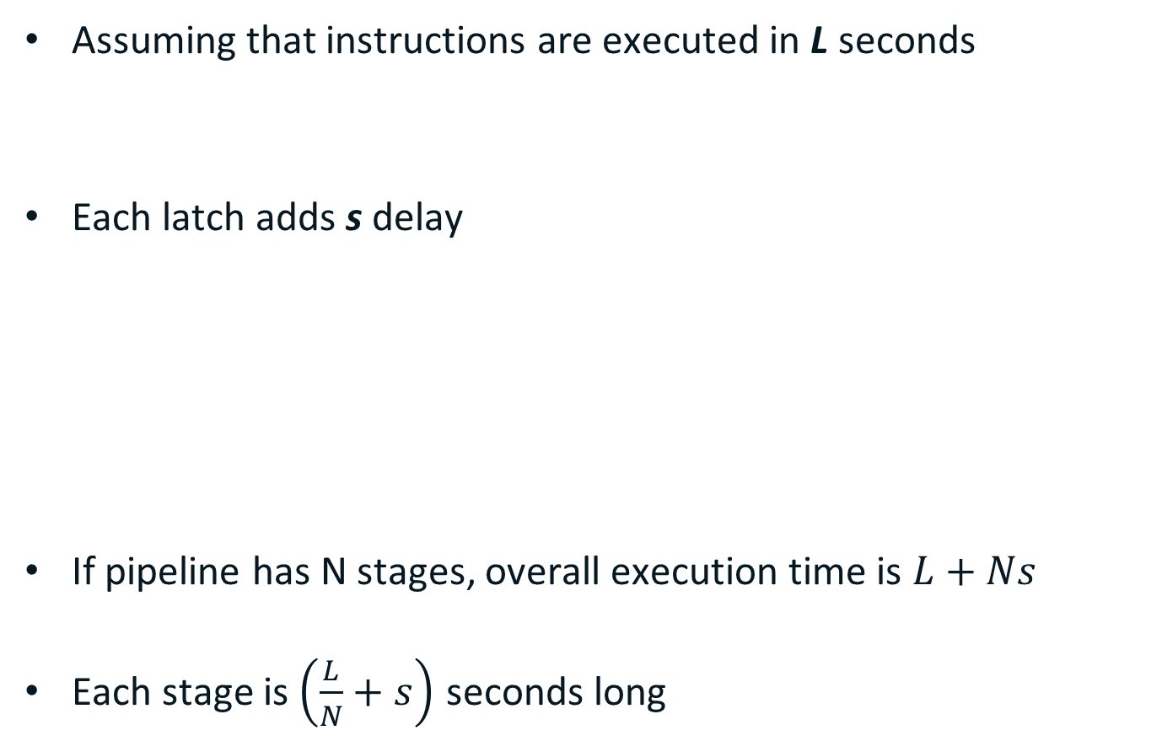
Pipeline Timing Model
Assuming that instructions are executed in L seconds
Each latch adds s delay
If pipeline has N stages, overall execution time is $L+Ns$
Each stage is $\left(\frac{L}{N}+s\right)$ seconds long
s
F
L
D
E
M
W
s
L/2
s
L/2
= L + 2s
s
L/3
s
L/3
s
L/3
= L + 3s

Slide 7
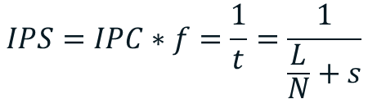
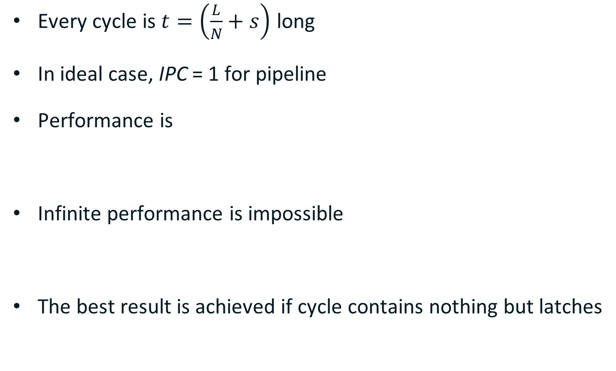


Performance with Latches
Every cycle is $t=\left(\frac{L}{N}+s\right)$ long
In ideal case, IPC = 1 for pipeline
Performance is
Infinite performance is impossible
The best result is achieved if cycle contains nothing but latches
$$IPS=IPC∗f=\frac{1}{t}=\frac{1}{\frac{L}{N}+s}$$
$$\lim_{N→∞}{IPS(N)}=\frac{1}{s}$$
$$\lim_{N→∞}{t(N)}=s$$

Slide 8

Hardware cost
Furthermore, latches require additional HW
Overall cost is
Q
G
Q
G/2
Q
G/2
Q
G/3
Q
G/3
Q
G/3
$$c=NQ+G$$

Slide 9
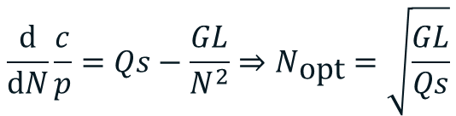


Cost/Performance Trade-off
In 1981, Peter M. Kogge used following metric to find optimal pipeline:
Derivation by N can be used to find minimum:
HW cost is not very important today
Most of CPUs are superscalar
$$\frac{c}{p}=\left(NQ+G\right)\left(\frac{L}{N}+s\right)=LQ+G+NQs+\frac{GL}{N}$$
$$\frac{\text{d}}{\text{d}N}\frac{c}{p}=Qs−\frac{GL}{N^{2}}⇒N_{\text{opt}}=\sqrt{\frac{GL}{Qs}}$$
$$t_{\text{opt}}=s+\sqrt{\frac{QLs}{G}}$$

Slide 10



Improving model: adding BTB Impact
Branch mispredicts stall some fraction (γ) of pipeline
Since they are rare, in average CPI delta is lower:
In general, “alpha” parameter is a function of selected uArch:
how good branches are predicted;
how mispredicts affect pipeline;
bypassing levels;
cache hit rate, out-of-order effects etc.
$$∆CPI=γN$$
$$\overline{∆CPI}=βγN=αN$$
$$\overline{CPI}=1+αN$$

Slide 11
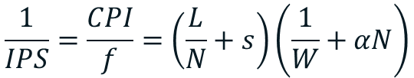

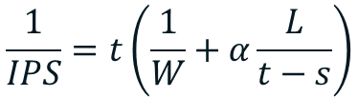
Improving model: adding superscalar
In superscalar CPUs ideal CPI depends on width
Overall, we have an equation for performance
Let’s use clock time for simplicity
$$CPI=\frac{1}{W}+αN$$
$$\frac{1}{IPS}=\frac{CPI}{f}=\left(\frac{L}{N}+s\right)\left(\frac{1}{W}+αN\right)$$
$$\frac{1}{IPS}=t\left(\frac{1}{W}+α\frac{L}{t−s}\right)$$

Slide 12

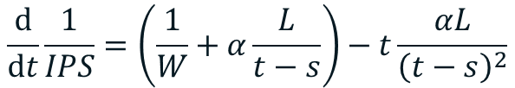
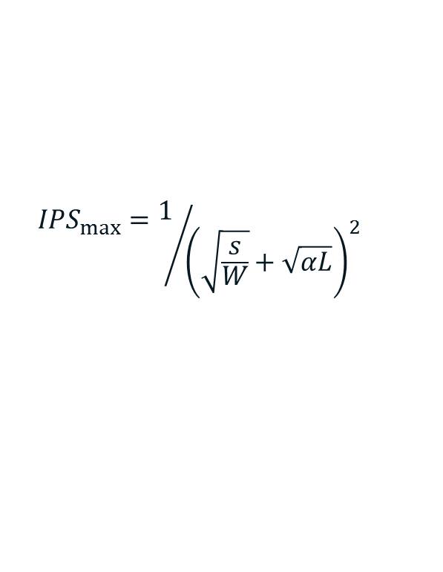
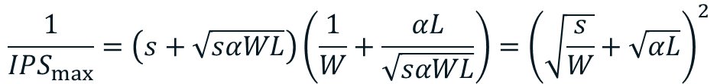
Maximum performance
Performing derivation by t:
Finding maximum performance:
$$\frac{\text{d}}{\text{d}t}\frac{1}{IPS}=\left(\frac{1}{W}+α\frac{L}{t−s}\right)−t\frac{αL}{{\left(t−s\right)}^{2}}$$
$$0=\frac{{(t−s)}^{2}}{W}+αL\left(t−s\right)−tαL⇒t_{opt}=s+\sqrt{sαWL}$$
$$\frac{1}{{IPS}_{max}}=\left(s+\sqrt{sαWL}\right)\left(\frac{1}{W}+\frac{αL}{\sqrt{sαWL}}\right)={\left(\sqrt{\frac{s}{W}}+\sqrt{αL}\right)}^{2}$$
$${IPS}_{max}=1/{{\left(\sqrt{\frac{s}{W}}+\sqrt{αL}\right)}^{2}}$$

Slide 13
Intel CPUs timeline
Prescott P4
What happened?
P4
Pentium Pro
PII
PIII
80386
80486
8086
80286
Pentium

Slide 14
Power

Slide 15
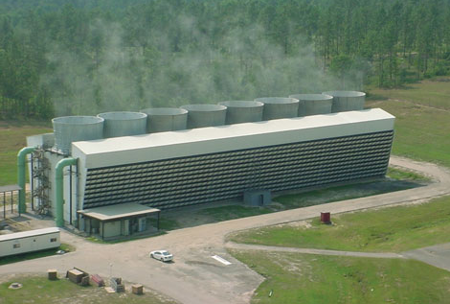
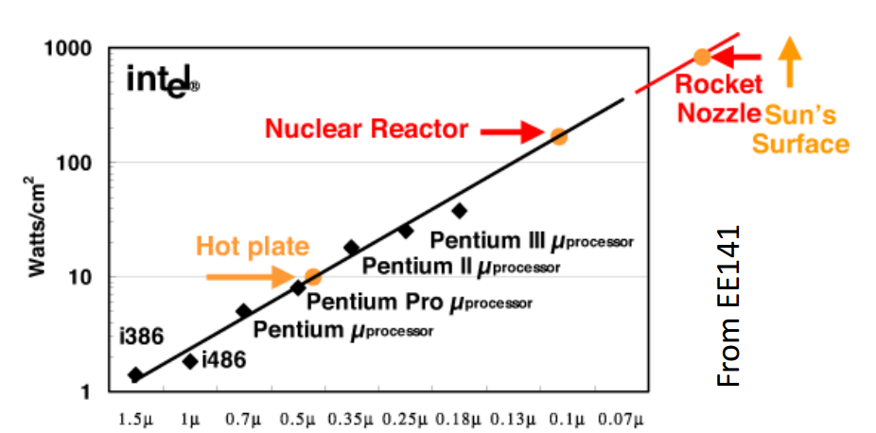
Refresher: Why Power Is Important
Nuclear reactor? No, power supply for a large data center
Why is power important?
Less power -> smaller battery -> smaller/cheaper devices
Less power -> less money for electricity
Power Wall is reached
The maximum power dissipation that cooling systems can handle is reached
We cannot spend more power even if we want

Slide 16
Refresher: Power Consumption in CMOS
Vcc
1
No current in static state, i.e. there is no power consumption
Current exists only at switch from one state to another to recharge the capacities
Input
Output
0
Input
1
+
+
0
Source
Gate
Drain
Drain
Gate
Source
1
-
-
n
n
p
p
p
n
No connection between the power supply and the ground
Output
Gate

Slide 17




Recharging Power
$$E_{R}=\frac{CV^{2}}{2}$$
$$E_{C}=\frac{CV^{2}}{2}$$
$$E_{R}=\frac{CV^{2}}{2}$$
$$P=CV^{2}f$$

Slide 18

Dynamic power
Dynamic power in consumed since transistors change state:
Keep in mind that clock signals are included in dynamic power
Some power is lost due to “crowbars”
~80% of consumed power
dynamic capacity
frequency
$$P_{d}=aCV^{2}f$$
average amount of transistors
Voltage
1
0

Slide 19

Static power
Static power is consumed by leakage
Area S depends on:
number of pipeline stages N (more latches required)
issue width W
branch prediction, caches etc. — α
Leakage current j depends on technical process
~20% of consumed power
$$P_{s}=jSV$$
area
leakage current

Slide 20
Performance/Power balance
Depending on market target, we may optimize:
performance (IPS)
power (Watts)
energy = power / IPS (Joules)
dissipation = power / area (Watts / cm²)
New features are added to CPU regarding to select target
Example 1: deeper pipelining increases power consumption:
higher frequency increases dynamic power
new latches increase both static and dynamic power
Example 2: issue width increases power in ~W times

Slide 21
Overcoming Power Wall
Power saving features
slow down performance, but save energy/power
Multicore systems
shrink the core, but put them on single chip
Simultaneous multithreading
do more tasks on the same area

Slide 22
Thank You Q/A

