Slide 1
Sequential Digital Circuits
Pavel Kryukov
24 October 2015

Slide 2
Layers of Abstraction in Computer Science (CS)
Application
Algorithms
Programming Language
Operating System
Instruction Set Architecture
Microarchitecture
Topics of
this lecture
Gates/Register-Transfer Level (RTL)
Circuits
Physics

Slide 3
Refresher: Combinational Circuits
If the output of a function is completely defined by the current input then the function is called combinational:
Qt = F(xt, yt, zt, …)
Combinational circuit (scheme) is an implementation of a combinational function
A lot of things can be implemented using combinational circuits
Just a few examples that we already know: adder, decoder, multiplexer
But, combinational circuits have a significant limitation:
But, combinational circuits have a significant limitation: they cannot remember any information

Slide 4
Sequential Circuits
If the output of a function depends not only on the current input, but on the previous state, then the function is called sequential
Qt = F(xt, yt, zt, …, Qt-1)
F(xt-1, yt-1, zt-1, …, Qt-2))
F(xt-2, yt-2, zt-2, …, Qt-3)))
Qt = F(xt, yt, zt, …, Qt-1)
Sequential circuit is an implementation of a sequential function
Their main advantage is ability to remember the previous state
Any circuit with memory is a sequential circuit
Sequential circuits are able to store information

Slide 5
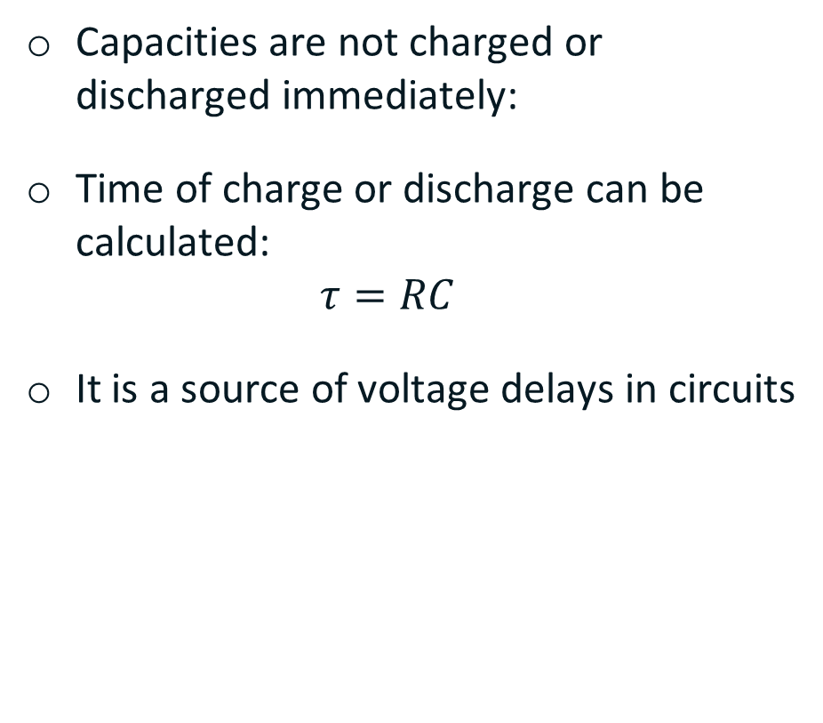
Refresher: Timing
Capacities are not charged or discharged immediately:
Time of charge or discharge can be calculated: $τ=RC$
It is a source of voltage delays in circuits
Vcc
+ −
0
1
1
Output
1
1
0

Slide 6
SR Flip-Flop
The simplest store element:
SR flip-flop:
reset
SR flip-flop:
reset
Q
Q
Q
0
S | R | Qt-1 | Qt
1
0
1
0
0
Q
Q
!Q
0
1
Q
0
!Q
1
!Q
0
1
0
Q
1
1
0
set
set
1
1
Q
0
Prohibited state
0
1
NOR:
x
out
x
out
x | y | out
0 | 0 | 1
0 | 1 | 0
1 | 0 | 0
1 | 1 | 0
y
y
≡
≡
out
0
out
y

Slide 7
SR Flip-Flop
reset
Q
S | R | Qt-1 | Qt
0 | 0 | Q | Q
0 | 1 | Q | 0
1 | 0 | Q | 1
1 | 1 | Q | 0
R
Q
S
!Q
!Q
set
S
1
0
The output will be determined by the fastest signal
R
1
0
Q
1
But, which signal will be really faster will depend on many factors (e.g., temperature).
?
0
!Q
1
?
0

Slide 8
D flip-flop
Data
S
!Q
D
Q
D | we | Qt-1 | Qt
D | 0 | Q | Q
0 | 1 | Q | 0
1 | 1 | Q | 1
R
Q
we
Write enable
Don’t have prohibited states
Asserted by a level of the write enable signal (we)
Store one bit of information
Can be used as building block for creating static memory arrays

Slide 9
Edge-triggered D flip-flop
Data
D
Q
D
Q
out
D | we | Qt-1 | Qt
D
0
Q
Q
we
we
D
1
Q
Q
Write enable
D
↑
Q
D
D
↓
Q
Q
Don’t open for writing neither at we =0 nor at we =1 as one of the triggers is closed
It is open for a very small amount of time when the write enable goes from 0 to 1
The value from the first trigger is written to the second trigger and then the first trigger is closed
It is a trigger asserted by the positive edge of write enable signal
Such types of triggers are mostly used to organize pipelined execution
D
Q
clk

Slide 10
T flip-flop
Q0
Q1
Q2
Q3
T | Qt-1 | Qt
X | 0 | 0
X | 1 | 1
↑ | 0 | 1
↑ | 1 | 0
T
Q
T
Q
T
Q
T
Q
!Q
!Q
!Q
!Q
T flip-flop changes its state to the opposite on each “T” positive edge
It can be treated as counter of incoming pulses
To count more than 2 pulses, more T flip-flops can be added
This scheme can also be used as a frequency divider
clk
Q0
Q1
Q2
Q3

Slide 11
Memory arrays

Slide 12
Single port 2^{M}xN Memory Array
Memory array has 3 input signals and 1 output
Data buses are N bits wide (each chunk is N bits)
Address is M bits wide if 2^{M} is array size
address
address
M
2
Write enable
Write enable
Memory
Array
Memory
Array
N
1
N
1
input data
input data
output data
output data

Slide 13
Single port 4x1 Memory Array
Multiplexer
Write control
Decoder

Slide 14
Single port 4x2 Memory Array
Multiplexer bit[1]
Multiplexer bit[0]
Write control
Decoder

Slide 15
Thank You Q/A

