Slide 1

MIPS Disassembler
Igor Smirnov, Pavel Kryukov
7 November 2015

Slide 2
What is disassembler
Although formatted 4-bytes opcodes are compact and fully readable by processor, for programmer it is very complicated.
People use assembler language — a language with translates understandable and standardized statement.
Every statement can be converted to 4-byte instruction — it is called assembling.
Vice versa, every 4-byte instruction can be converted to statement of assembler language — disassembling.
Disassembling is useful during development of any simulator, architectual or micro-architectual, functional or performance.

Slide 3
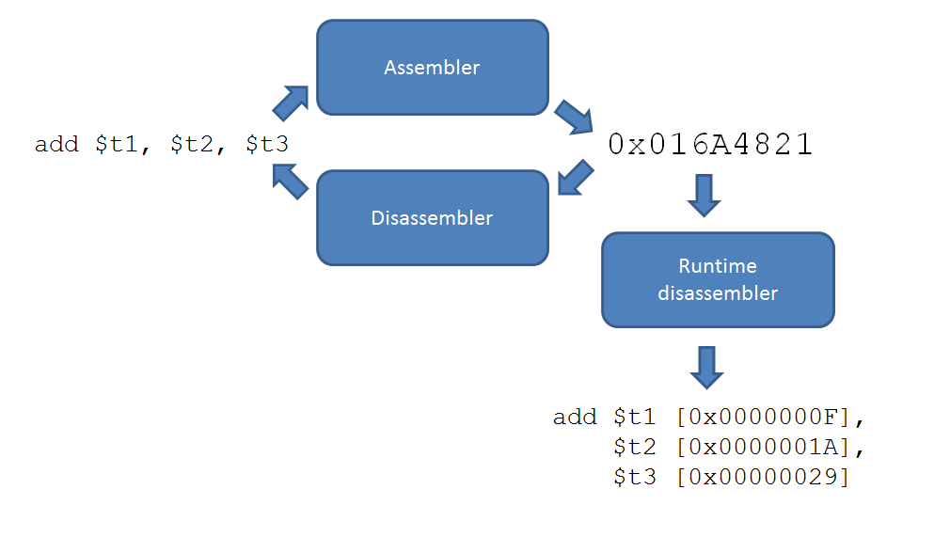
Static and runtime disassembler
We are going to start from static disassembler
It can be simply reused to make a runtime disassembler

Slide 4
C-style union
To handle with complicated bit structures, C-style unions can be used
A union is a special data type available in C that enables you to store different data types in the same memory location
union { struct { unsigned imm:16; unsigned t:5; unsigned s:5; unsigned opcode:6; } asI; struct { // ... } asR; struct { // ... } asJ; uint32 raw; } bytes;

Slide 5
ISA table
To store ISA information we suggest you to use static array. There is example of this array below.
struct ISAEntry { const char* name; uint8 opcode; uint8 func; FuncInstr::FormatType format; FuncInstr::Type type; // ... }; static const ISAEntry[] isaTable;
const FuncInstr::ISAEntry[] FuncInstr::isaTable = { // name opcode func format type { "add ", 0x0, 0x20, FuncInstr::FORMAT_R, FuncInstr::ADD /*...*/ }, // more instructions ... };
Because there are not so many instructions, you may find instruction via iterative search

Slide 6
More information and deadlines
Disassembled program will be loaded from memory model (A1)
You have to check-out to your new branch our version of A1 even if your implementation is fully correct
Link with additional useful materials and list of instructions you have to support will be sent to you
Deadline is 28 Nov
On any questions about A2, please contact Igor Smirnov and/or Pavel Kryukov

Slide 7
Thank You

