Slide 1
3강 - MATLAB Programming

Slide 2
목차
Primitive data type handling
Running MATLAB code
How to debug
Variable / Function naming conventions
Matrix data handling
Boolean and conditional operations
Iterations and For loops
While loops
Functions
Plotting and data visualization

Slide 3
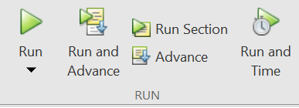
Running MATLAB code
How to run a program
Run - execute all the code!
Run and Advance - execute codes in 1 section, and then pause before starting the next one!
Run Section - execute the code in 1 section, and exit.
Advance - (we don’t use it often)
Run and Time - Measuring time! (but if you need fast time measurement… use C++)

Slide 4
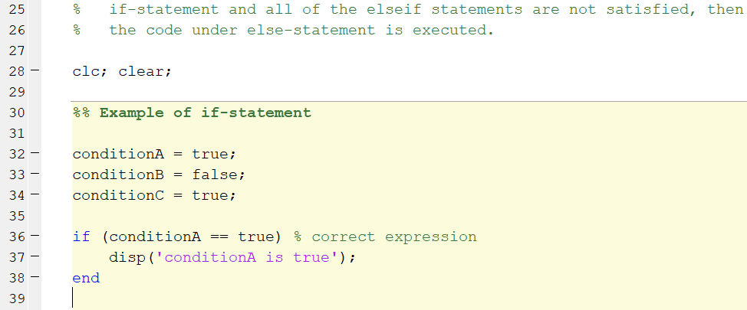
Running MATLAB code
How to make a section
Use %%
How to comment
Use %

Slide 5
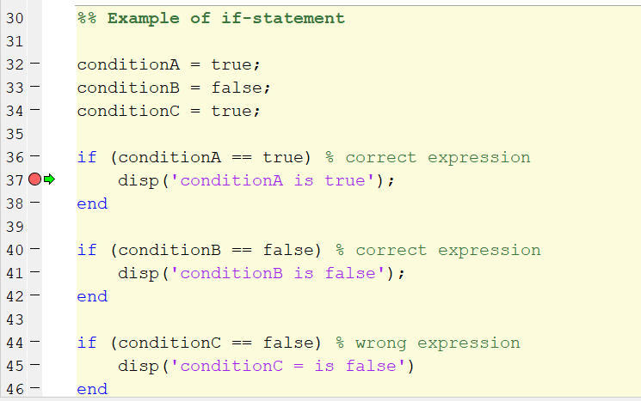
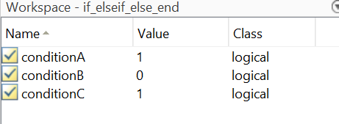
How to debug
Red dot - Pauses code execution for debugging
You can check the values of all variables in the workspace
You can add more code during debugging
How? -> Because MATLAB uses interpreter, not compiler. C++ cannot do this.

Slide 6

How to debug
Make use of clc; clear;
clc - clears the Command Window
clear - clears the workspace
Be careful when using this! Hours of work and data can be wiped ☺
A good tip
Make a section in the beginning using %%
Write clc; clear; in the section.
Experiment with rest of the code using ‘Run Section’

Slide 7
Variable / Function naming conventions
There are two ways to name a variable / function :
numberOfPeople
number_of_people
Always write a unambiguous name for a variable / function
vec1, mat1… (X)
vNumOfPeople, mInputImage (O)

Slide 8
Variable / Function naming conventions
No spaces in a variable / function name
addNumbers() (O)
add_Numbers() (O)
add numbers() (X)
A number cannot go as the first letter of a variable
num1 (O)
firstNum (O)
1num (X)

Slide 9
Variable / Function naming conventions
For variables, we commonly use these terms
k~ suffix for constant values
kPI = 3.141592654…
kSpeedConstant = 3.0;
is~ suffix for Boolean values
isBirthday = true;
(MATLAB) v~ suffix for vector variables
(MATLAB) m~ suffix for matrix variables
(C++) m~ for class member variables

Slide 10
Variable / Function naming conventions
For functions, we commonly use these terms
get~ suffix for a getter function
set~ suffix for a setter function
identity() for getting identity matrix
We start with a verb for function names
filterData()
addNumber()
multiplyMatrix()

Slide 11
Matrix Data Handling
In MATLAB, making a vector / Matrix requires filling in values at initialization.
How to make a vector
Vec = [1 2 3 4];
Vec = [1, 2, 3, 4];
Vec = 1:4 ; (we don’t use this often)
Vec = 1:2:100 (Only in MATLAB)
Vec = linspace(1,100,2) (Only in MATLAB)
Vec = zeros(5,1) (Use this!)
Vec = NaN(5,1) (Or use this!)

Slide 12
Matrix Data Handling
How to make a matrix
Mat = [1,2,3 ; 4,5,6 ; 7,8,9];
Mat = zeros(3,3)
Mat = NaN(3,3)

Slide 13
Matrix Data Handling
Accessing data in a vector / matrix
data = Vec(element)
data = Mat(row,column)
What happens when you do Mat(10,10) on a 3x3 matrix?
Most common mistake in MATLAB appears… (ㅋㅋ)

Slide 14
Matrix Data Handling
Matrix addition / subtraction
mat3 = mat1 + mat2;
Matrix multiplication
mat3 = mat1 * mat2;
Element-wise operations
mat3 = mat1 .* mat2;
Scalar multiplication on a matrix
mat2 = val * mat1;

Slide 15
Matrix Data Handling
Reshape(mat, [row col])
Changes shape of matrix
mat’
transpose

Slide 16
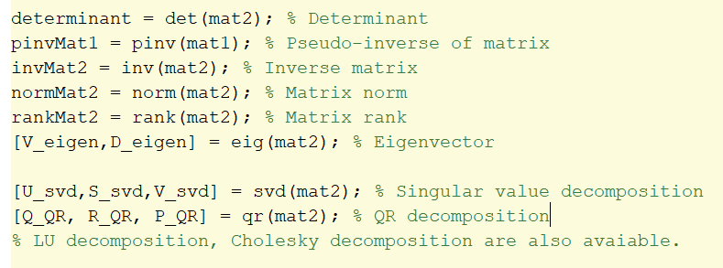
Matrix Data Handling
Other maths functions

Slide 17
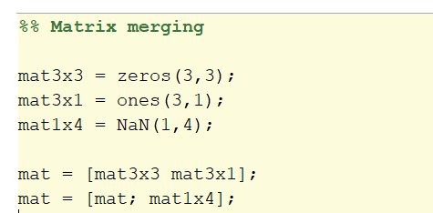
Matrix Data Handling
Matrix merging
Concat
vertConcat
horzConcat…
Or…

Slide 18
Boolean and conditional statements
Boolean = true / false
Conditional operations
== is equal to
~= is not equal to
< / > is less / greater than
<= / >= is less or equal to / is greater or equal to

Slide 19
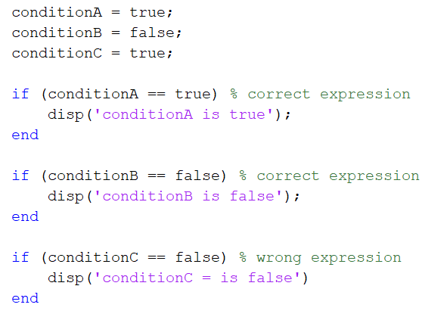
Boolean and conditional statements
Conditional statements (if-statement)
Executes code only when the condition is satisfied.

Slide 20
Boolean and conditional statements
if-statement
If-else statement
If-elseif-else statement
… Refer to the matlab code.

Slide 21
Iterations and for-loops
For-loops use an iterator value
(MATLAB) for i = 1:10
…means the iterator value starts at 1, and increases by 1 every iteration, until it reaches 10.
(C++) for (int i = 0; i < 10 ; i++)
… means the iterator value starts at 0, and performs i++ at the end of every iteration, and escapes the loop when i < 10 is no longer satisfied.

Slide 22
Iterations and for-loops
With for-loop we can…
Easily automate repetitive operations
e.g. vector indexing, matrix indexing
Easily load / save data
Easily log data

Slide 23
While loops
While loops execute codes repetitively, as long as the condition is satisfied.
In most cases, we use while loops for
Optimization
Manual user-in-loop control

Slide 24
Functions
We can make user-defined functions
Why do we want functions?
To avoid repetitions of commands.
Without functions, we need to write all the codes in a single script.
We should separate the code into
1. main script
2. collection of functions

Slide 25
Functions
function myFunc(parameter1, parameter2) operations… end
Need to be located at the bottom of the script.

