Slide 1


Claude Code: From Coding to Workflow Design
ChangHee Lee Computational Team Lunch & Learn 2026-01-14

Slide 2
Agenda
The Paradigm Shift — From coding to orchestration
Context Engineering — The fundamental constraint
Getting Started — Installation and configuration
Vs Cursor and Alternatives — Comparing tools
Demo & Future — Live demo and what's next

Slide 3
Section 1: The Paradigm Shift
From writing code to designing workflows

Slide 4
We are stuck in an old mental model.
Old: Developer writes code line by line
New: Developer describes outcomes
Old: IDE assists with autocomplete
New: Agent plans and executes
Old: Human is the executor
New: Human supervises and validates

Slide 5
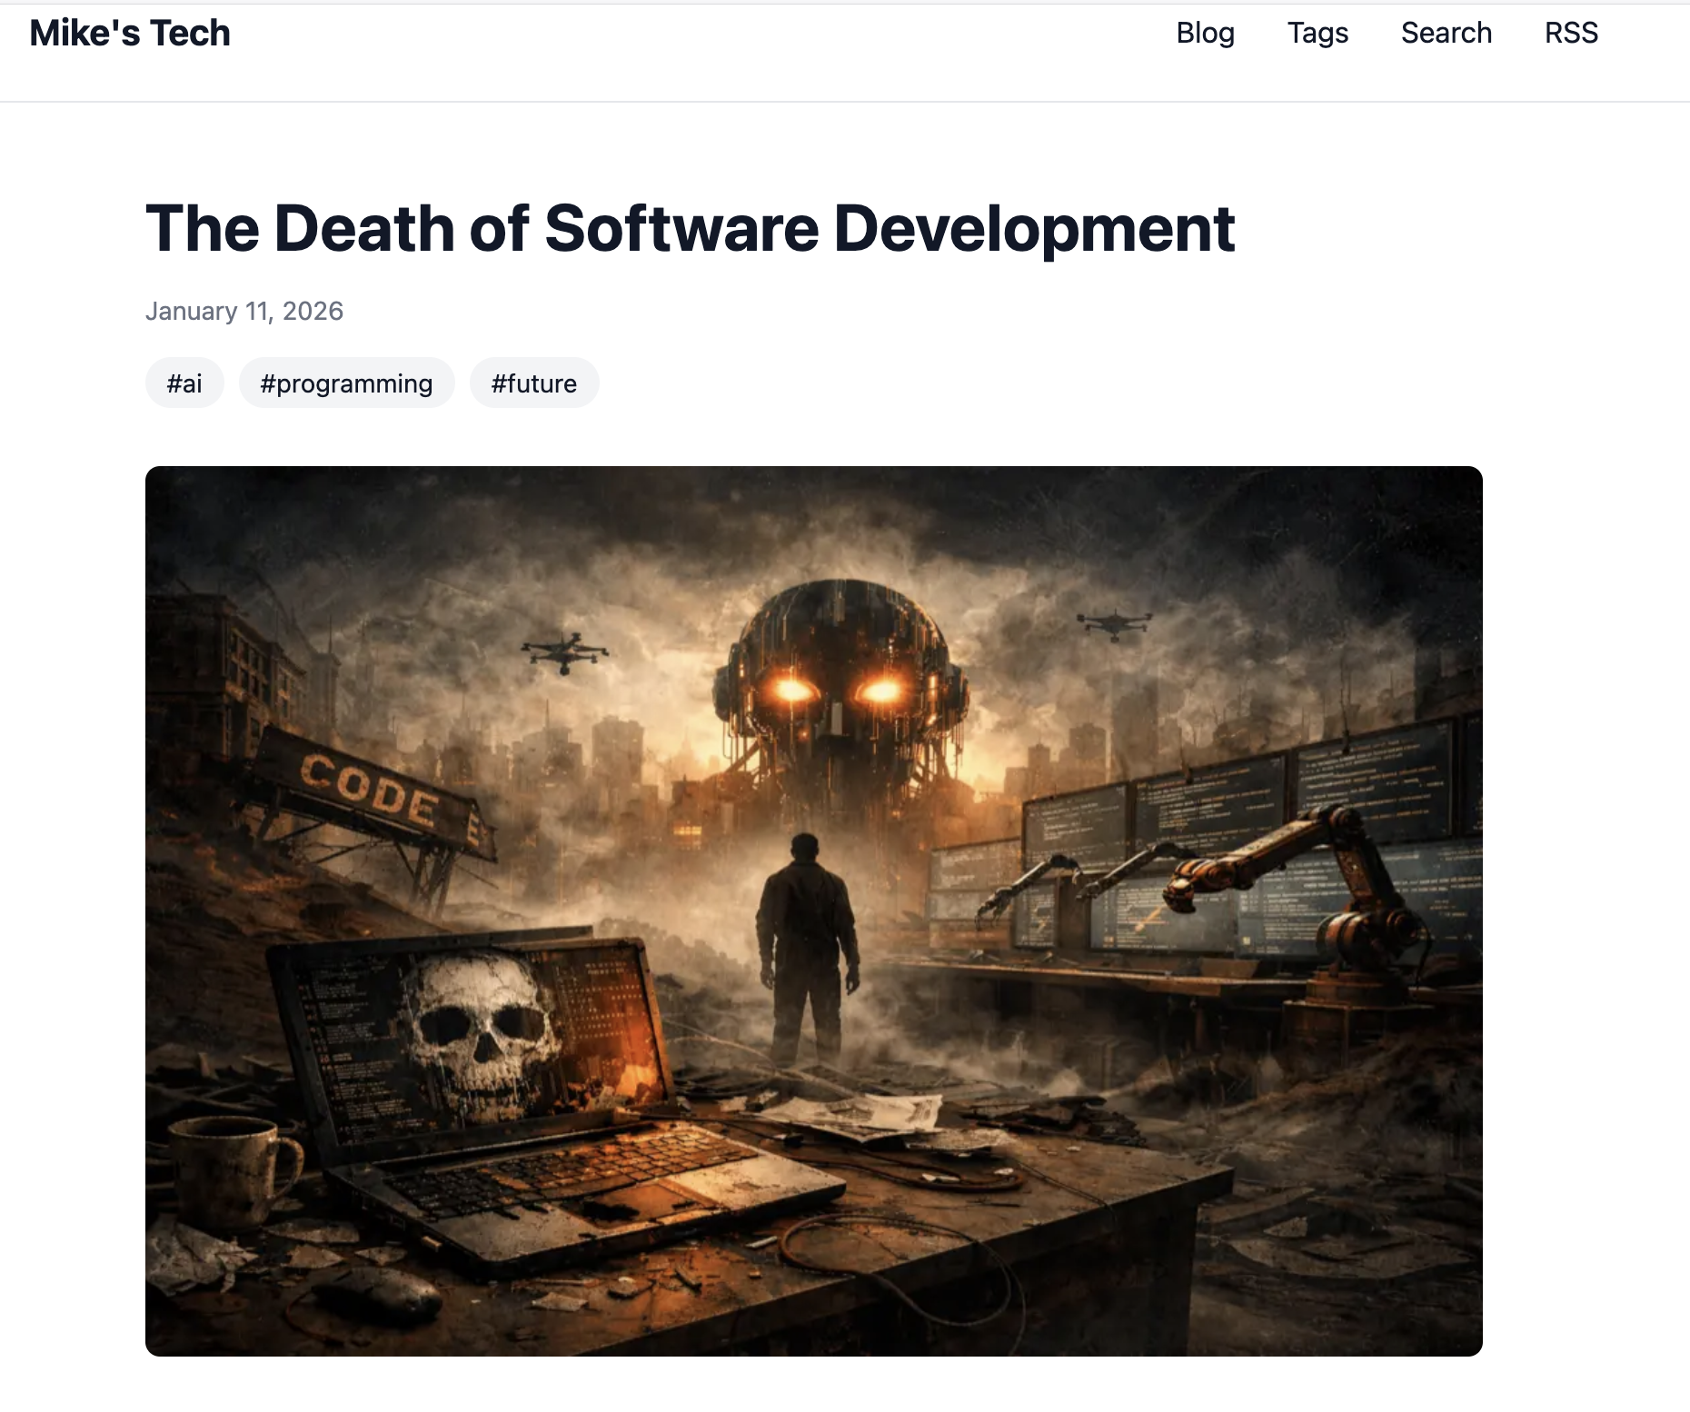
Engineers now design systems.
One person built a Polymarket tool in 2 hours without writing code
The technique mattered more than which AI model (Opus/Gemini etc.) was used
Architecture and process design become primary skills
"The outcome is defined by the process, not the model." — Mike.tech
Notes:
https://mike.tech/blog/death-of-software-development

Slide 6
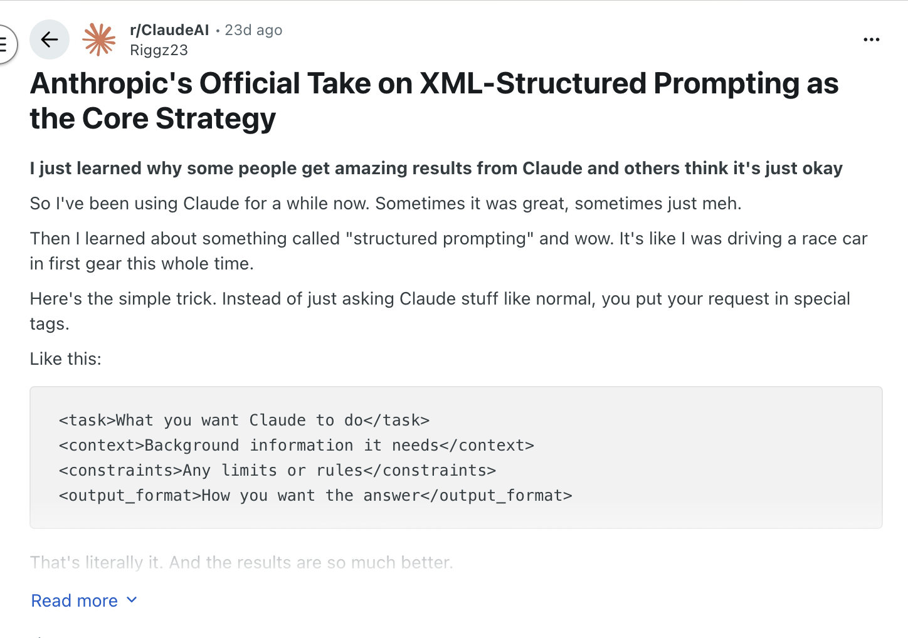

You communicate intent to agents.
Use XML tags: <task>, <context>, <constraints>, <output_format>
Code-Level: "Write a function that..." → Implementation focus
Abstract: "I need to transform X into Y" → Intent focus
"It's like I was driving a race car in first gear."

Slide 7
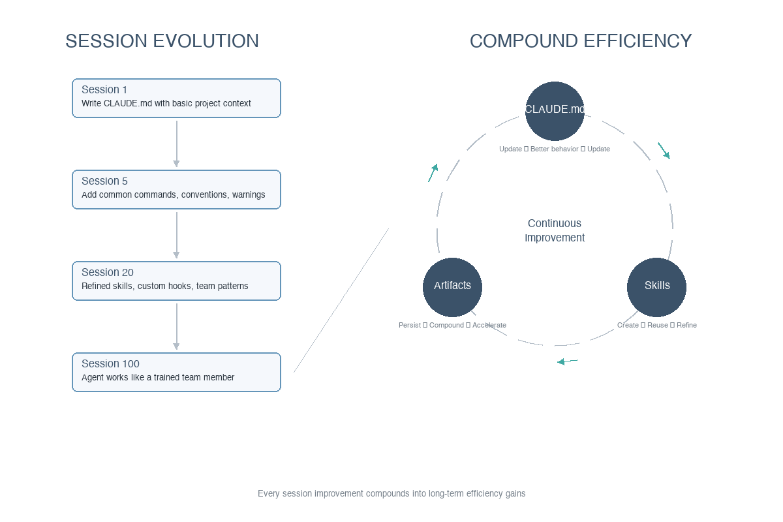
CLAUDE.md / AGENTS.md as improving workflow over time
Session 1: Write CLAUDE.md with basic project context
Session 5: Add common commands, conventions, warnings
Session 20: Refined skills, custom hooks, team patterns
Session 100: Agent works like a trained team member

Slide 8
Claude Code is a general agent.
February 2025: Launch as CLI research preview
October 2025: Web launch on claude.ai
November 2025: $1B revenue run-rate
January 2026: Multi-agent infrastructure (v2.1.0)
(BAD naming)

Slide 9
One of its power comes from simplicity.
No heavyweight protocols needed
Skills are just markdown files the agent reads
Four tools (read, write, edit, bash) outperform complex ecosystems
Outsources hard parts to the LLM harness and computer environment

Slide 10
It automates anything you can type.
File system access (read, write, edit)
Command execution (shell access)
Context awareness (understands project structure)
Autonomous operation (minimal supervision)
"Agents are tools in a loop" — Simon Willison
Notes:
Cellular Intelligence did not have a template for comparison slide.

Slide 11
It is an LLM with filesystem access.
Web Chatbot: Stateless conversations, copy-paste snippets
Claude Code: Persistent filesystem access, direct file read/write
Web Chatbot: Describe your environment, human executes commands
Claude Code: Agent explores and executes autonomously
Seems mundane difference but has significant implications

Slide 12
Section 2: Context Engineering
The fundamental constraint and how to work around it

Slide 13
O(N²) complexity creates hard limits.
Attention mechanism scales quadratically with sequence length
Context window is a hard limit on what the model can "see"
Everything the model knows about your task must fit in this window
Wasted tokens = reduced capability

Slide 14
Context engineering is the key skill.
Minimal system prompts: <1,000 tokens vs competitors' 10,000+
File-based planning: External markdown preserves info across sessions
Progressive disclosure: Load tool docs only when needed
Pre-session artifacts: Research sessions → implementation sessions

Slide 15
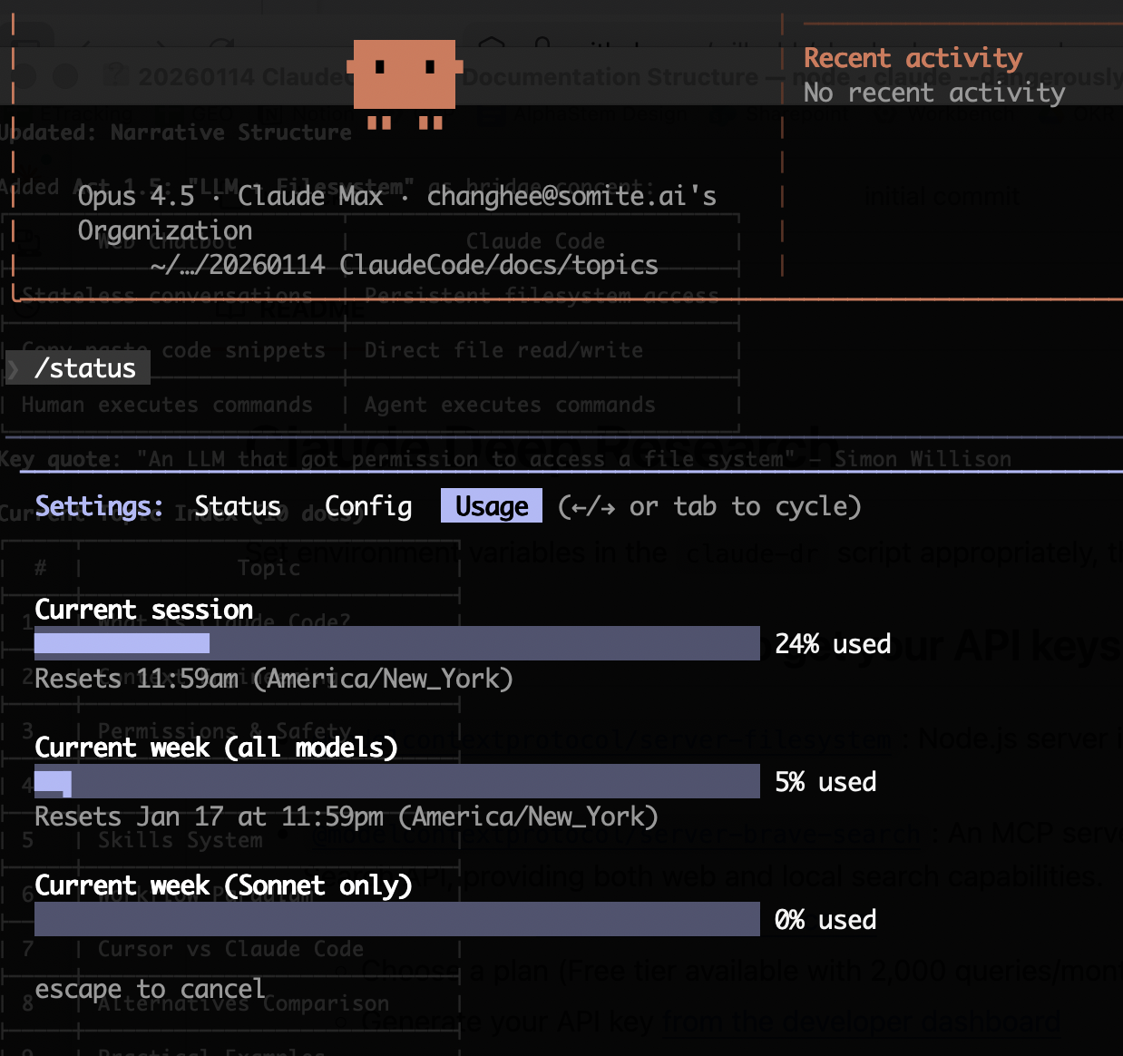
The file system provides ”swap” for context for LLM
AGENTS.md
SKILLs.md
Token limits are secondary, but affect the token efficiency! (Subagents)

Slide 16

/status monitors context in real-time.
Current session: percentage of context window used
Session reset: when the 5-hour window resets
Weekly usage across Opus and Sonnet models

Slide 17
Subagents spawn fresh context windows.
Each subagent gets its own fresh context window
Example: 36 files ÷ 3 subagents = 12 files each
Prevents main agent from sequential overload
Enables parallel processing

Slide 18
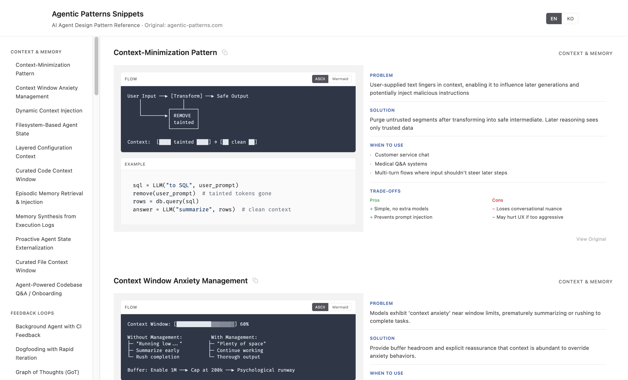
Agentic patterns have emerged.
Context & Memory: Context-minimization, dynamic injection
Feedback Loops: Self-critique, reflection, spec-as-test
Orchestration: Plan-then-execute, phase separation
Tool Use: CLI-first, code-over-API

Slide 19
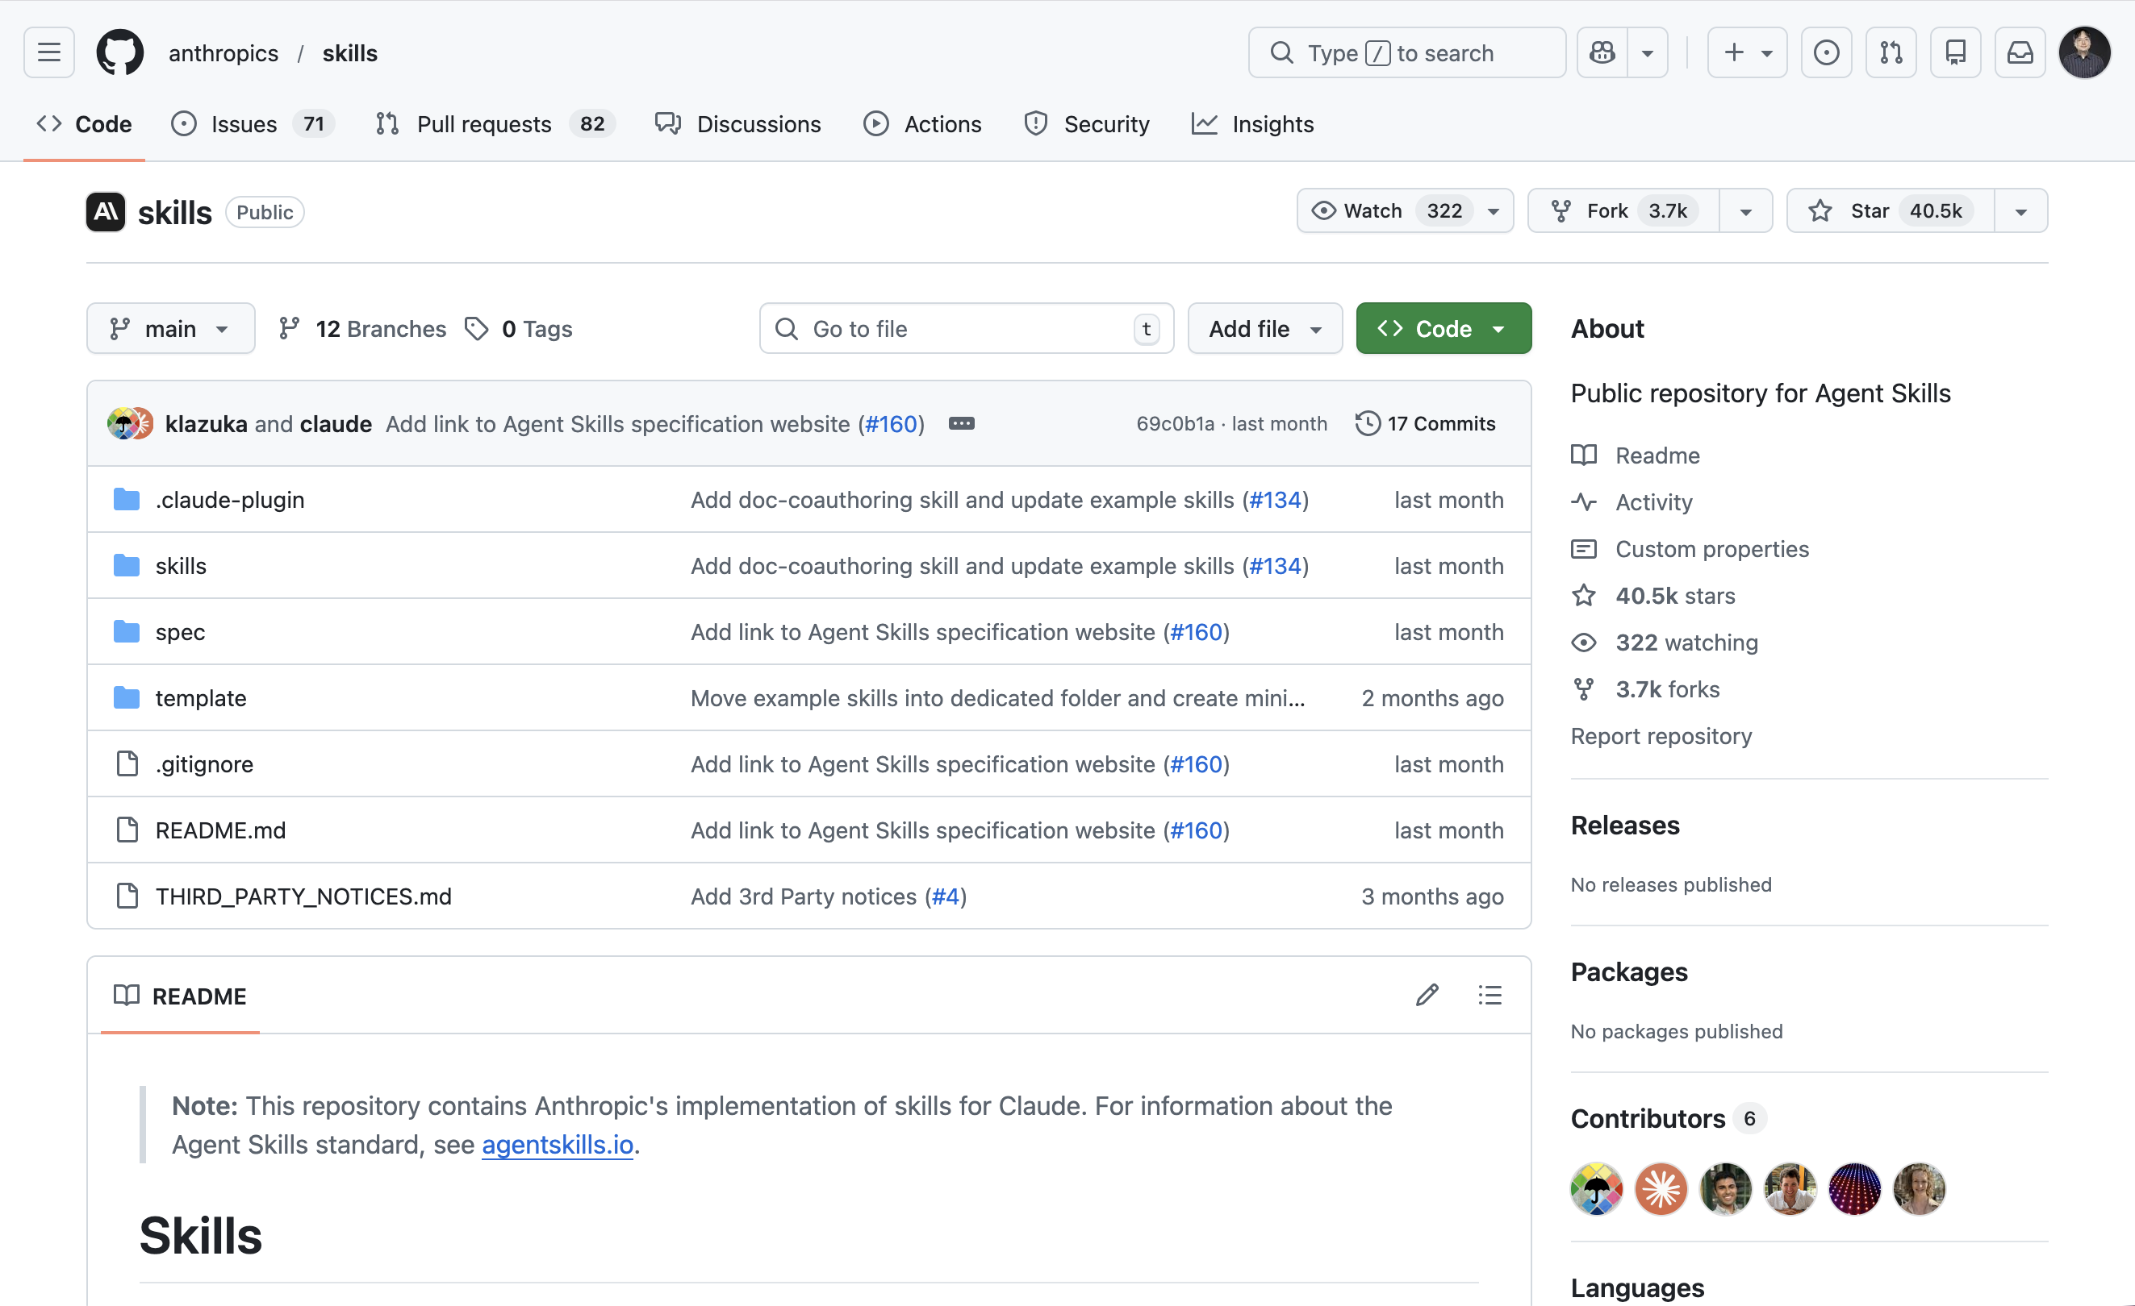
Skills are markdown with instructions.
Just markdown files with YAML metadata
Brief summaries scanned before full load
Shareable across models and tools
No heavyweight protocols

Slide 20
140+ scientific skills are available.
28+ Scientific databases (OpenAlex, PubMed, ChEMBL, UniProt)
55+ Python packages (RDKit, Scanpy, PyTorch)
15+ Scientific integrations (Benchling, DNAnexus)
Categories: Bioinformatics, Cheminformatics, Clinical Research, ML/AI

Slide 21
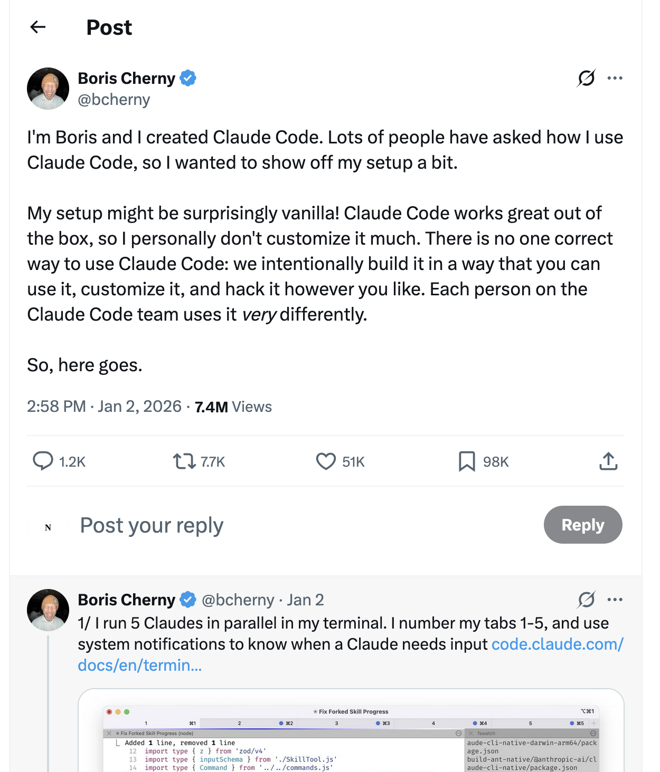
MCP can waste 7-9% of context.
Anti-MCP: Tools you never use still consume tokens
Alternative: CLI tools with README loaded on-demand
Pro-MCP: Convenience of always-available tools
Trade-off: Convenience vs. context efficiency

Slide 22

Git worktree enables parallel sessions.
git worktree add ../feature-auth feature/auth
Run Claude Code in each worktree (separate terminals)
Single Session: Sequential task completion, one context
Parallel Sessions: Simultaneous progress, multiple fresh contexts

Slide 23
Parallelization multiplies efficiency.
1. Workflow Design: Define what agents should do
2. Context Engineering: Optimize what agents can see
3. Parallelization: Scale by running multiple agents
Boris Cherny (Claude Code creator) runs 5 Claudes in parallel!

Slide 24
Section 3: Getting Started
Installation, configuration, and safety

Slide 25
One npm install gets you started.
npm install -g @anthropic-ai/claude-code
claude --version
cd your-project && claude
First run: authenticate, create ~/.claude/, optionally run /init

Slide 26
Plans range from $20 to $200/month.
Pro ($20/month): Light usage, small repos
Max 5x ($100/month): Moderate usage, larger repos
Max 20x ($200/month): Heavy usage, complex projects
Usage shared across Claude web, desktop, and Code

Slide 27
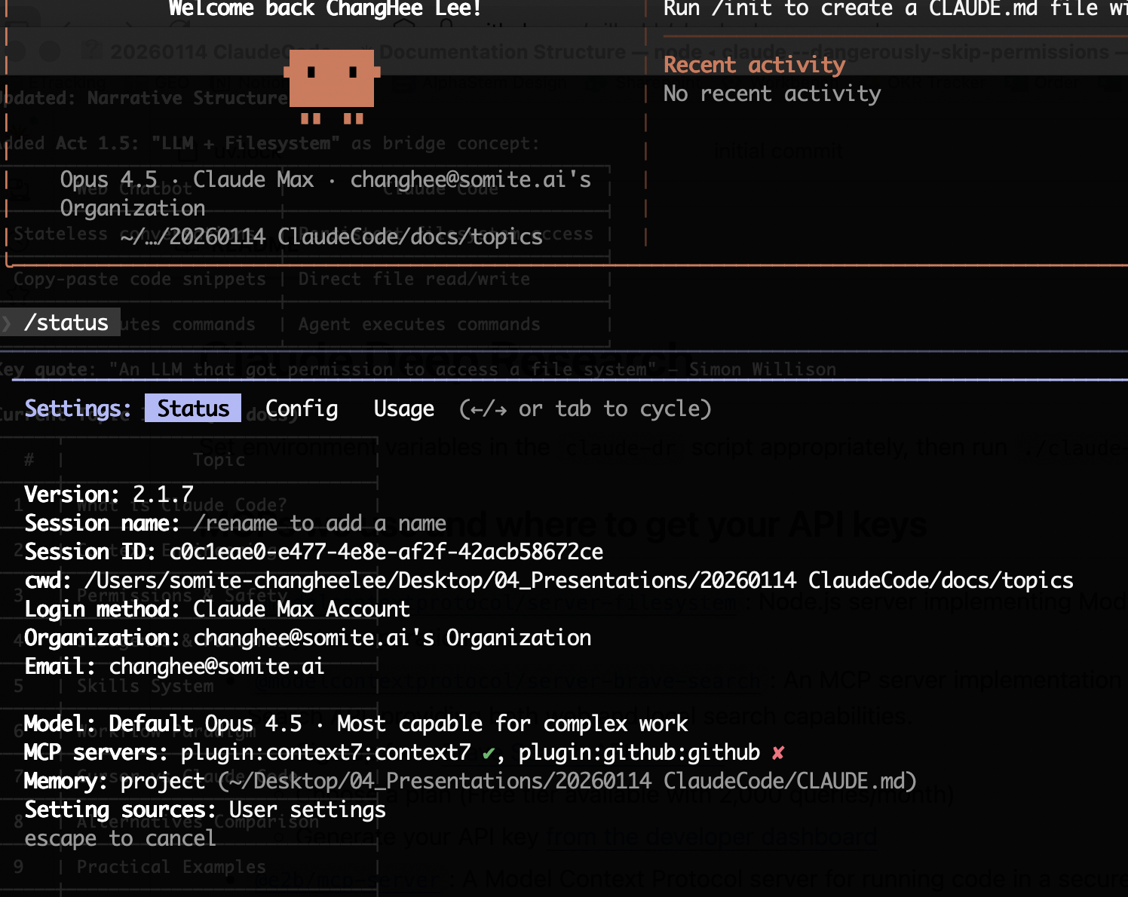
The statusline shows real-time data.
model.display_name: Current model
tokens.input / tokens.output: Token counts
cost.current / cost.total: Cost tracking
Setup: /statusline show the model name and context usage percentage

Slide 28

/status shows session info and usage.
Status tab: Version, session ID, model, MCP servers, memory
Config tab: Preferences, theme, checkpoints
Usage tab: Context percentage, weekly limits
[Figure: status-tab-status.png]

Slide 29
CLAUDE.md provides persistent context.
# Project Name → ## Tech Stack → ## Commands → ## Conventions
Hierarchy: ~/.claude/ → parent → project → subdirectory
The /init command generates a starter file
Updates compound over sessions

Slide 30
Four permission modes are available.
default: Prompts for first use of each tool
acceptEdits: Auto-accepts file edits for session
plan: Read-only analysis, no modifications
bypassPermissions: Skips all prompts (safe environment only)

Slide 31
Granular rules provide fine control.
allow: ["Bash(npm run test:*)", "Bash(git:*)"]
deny: ["Read(./.env)", "Read(**/*.key)"]
ask: ["Bash(git push:*)", "Bash(rm:*)"]
Evaluation order: deny → allow → ask

Slide 32
Hooks run scripts on tool events.
PreToolUse: Run validation before tool executes
PostToolUse: Process results after tool completes
PermissionRequest: Custom permission logic
Can block, modify, or auto-approve based on custom logic

Slide 33
Three elements create security risk.
1. Access to private data (env vars, credentials)
2. Exposure to untrusted content (web pages, user input)
3. External communication ability (network access)
AI cannot reliably detect prompt injection—architecture must prevent it

Slide 34
Section 4: Cursor vs Alternatives
Comparing tools for different workflows

Slide 35
Cursor is an assistant; Claude Code is an agent.
Cursor: Enhanced IDE, GUI (VS Code fork), User-selectable model
Claude Code: Autonomous Agent, CLI/Terminal, Claude (optimized)
Cursor: User-initiated execution, IDE-provided context
Claude Code: Autonomous execution, Full filesystem + shell

Slide 36
Choose based on how you think.
Cursor excels at: Quick inline edits, code explanation, GUI preference
Claude Code excels at: Multi-file refactoring, autonomous tasks
Claude Code excels at: Pipeline automation, shell access tasks
Many developers use both for different contexts

Slide 37
Alternatives offer different trade-offs.
OpenCode: 75+ providers, free — Best for budget, model flexibility
Aider: Code graph, git integration — Best for monorepos, explicit control
Gemini CLI: 1M context, free tier — Best for Google Cloud, docs tasks
Codex CLI: GitHub Actions — Best for CI/CD integration

Slide 38
Claude Code leads SWE-bench at 80.9%.
Claude Code + Opus 4.5: 80.9%
Aider: 67%
Cline: 63%
Gemini 2.5 Pro: 63.8%

Slide 39
Section 5: Demo & Future
Live demonstration and what's coming next

Slide 40
This presentation demonstrates the workflow.
CLAUDE.md (instructions) → scratch/SCRATCH.md (raw notes)
→ docs/topics/*.md (organized knowledge)
→ docs/NARRATIVE.md → docs/PRESENTATION.md
→ *.pptx (Skills-generated output)

Slide 41
Commits document the collaboration.
Initial scaffolding
Phase 1: Research compilation
Additional research: permissions, alternatives
Narrative structure → Slide outline → PPTX generation

Slide 42
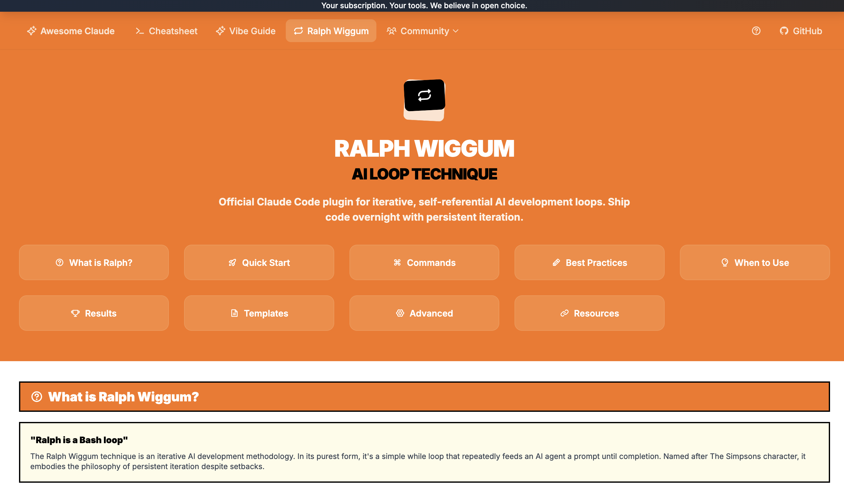
Let us see Claude Code in action.
Show /status, /statusline commands
Install a skill via /plugin
Run /init on a sample project
Simple code modification task

Slide 43

Ralph-Wiggum treats failure as data.
A simple while loop that feeds an AI agent a prompt until completion
Deterministic stopping criteria (not "try once and fail")
Failure-as-data philosophy: setbacks guide refinement
Emerging: Overnight automation, parallel loops, BMAD-METHOD

Slide 44
The future is here—adoption is key.
Old: Write code myself → New: Design workflows that write code
Old: One-shot prompts → New: Iterative loops until done
Old: Static instructions → New: Continuously improved artifacts
Start with CLAUDE.md on one project, refine over 5-10 sessions

Slide 45
Here are the key takeaways.
Claude Code = LLM + filesystem access = general agent
Workflows compound—every CLAUDE.md update makes the system smarter
Context engineering is the fundamental skill
Parallelization via git worktree multiplies efficiency

Slide 46
Here are resources to get started.
Official: code.claude.com/docs
Course: DeepLearning.ai Claude Code course
Skills: github.com/anthropics/skills
Scientific: K-Dense-AI/claude-scientific-skills

Slide 47
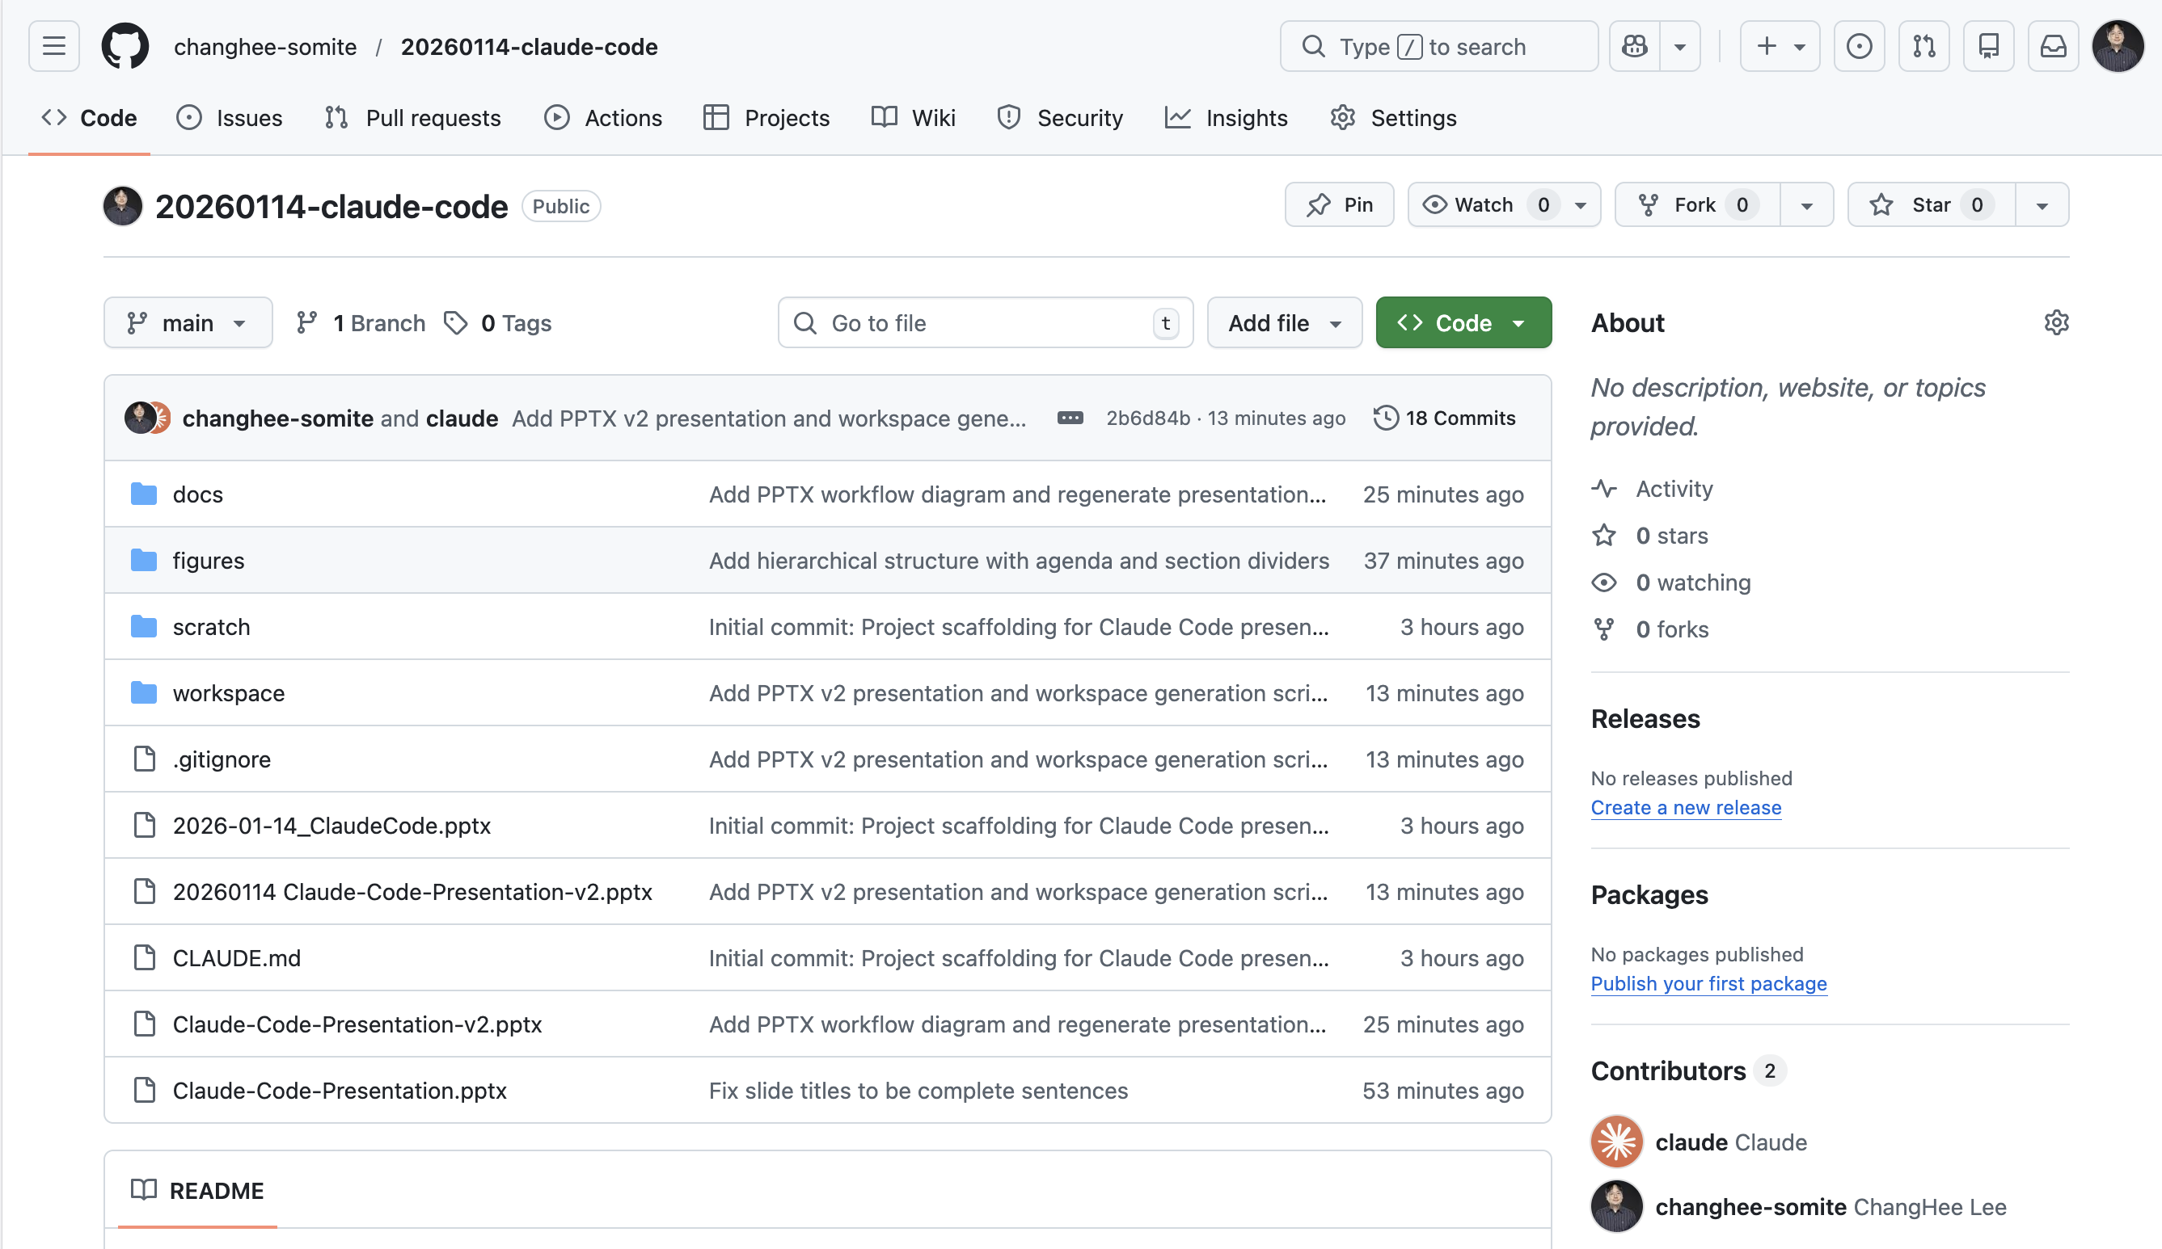
Some examples in house
THIS SLIDE DECK

Slide 48
Questions?
How might this change our team's workflows?
What tasks would benefit most from agent automation?
Security considerations for our environment
Skill development for our specific use cases

Slide 49
Claude Code uses only four core tools.
Read: File contents, images, PDFs
Write: Create new files
Edit: String replacement in files
Bash: Shell command execution

Slide 50
MCP servers extend capabilities.
/plugin install @anthropic-ai/mcp-server-github
/plugin install @anthropic-ai/mcp-server-context7
Available servers: GitHub, databases, APIs
Trade-off: Convenience vs. context window overhead

Slide 51
Gemini CLI offers 1M token context.
1 million token context window
60 requests/minute, 1000/day (free)
Deep Google Cloud integration
Lower SWE-bench scores than Claude

