Slide 1
NPU Sharing for
Asynchronous RL
Resource sharing, readiness scheduling and weight publication
Research review draft 0.2
21 October 2026
01
Notes:
Three mechanisms coordinate resource sharing, request admission and version publication. Internal research review, draft v0.2.
Sources on host 7.150.15.118:
/root/src/changhong94/AReaL/docs/research/npu-sharing/core-mechanisms.md
Evidence cutoff: 2026-10-21 America/Vancouver. Source files can contain historical statements superseded by later appendices. This deck labels the scope of each result.

Slide 2
The objective is earlier training progress
Fixed allocation
Dedicated inference produces answers while the training group waits for a complete batch.
Shared allocation
The training devices run extra inference when their capacity can shorten batch readiness.
Critical-path objective
Useful progress must exceed switching, memory movement and publication costs.
02
Notes:
Optimize whole-loop time while preserving training semantics. More active devices alone do not establish a benefit.
Sources on host 7.150.15.118:
/root/src/changhong94/AReaL/docs/research/npu-sharing/methodology.md
/root/src/changhong94/AReaL/docs/research/npu-sharing/optimizations/R007-single-npu-and-borrowing.md
Evidence cutoff: 2026-10-21 America/Vancouver. Source files can contain historical statements superseded by later appendices. This deck labels the scope of each result.

Slide 3
Three core mechanisms
Mechanism | Responsibility | Recent extension
M1 Resource and memory sharing | Borrow capacity with training priority | Resident training cache budget
M2 Readiness scheduling | Admit, drain and migrate requests | R025 concurrency, R027 return decision
M3 Weight publication | Resume each ready replica independently | Skip unnecessary shared publication
R001–R028 are traceable records, not 28 independent contributions.
03
Notes:
M1 provides safe capacity. M2 assigns and admits useful work. M3 exposes replicas only after their own publication acknowledgement. R025 and R027 extend this architecture.
Sources on host 7.150.15.118:
/root/src/changhong94/AReaL/docs/research/npu-sharing/core-mechanisms.md
/root/src/changhong94/AReaL/docs/research/npu-sharing/optimizations/R025-adaptive-inference-concurrency.md
/root/src/changhong94/AReaL/docs/research/npu-sharing/optimizations/R027-profit-aware-inference-return.md
Evidence cutoff: 2026-10-21 America/Vancouver. Source files can contain historical statements superseded by later appendices. This deck labels the scope of each result.

Slide 4
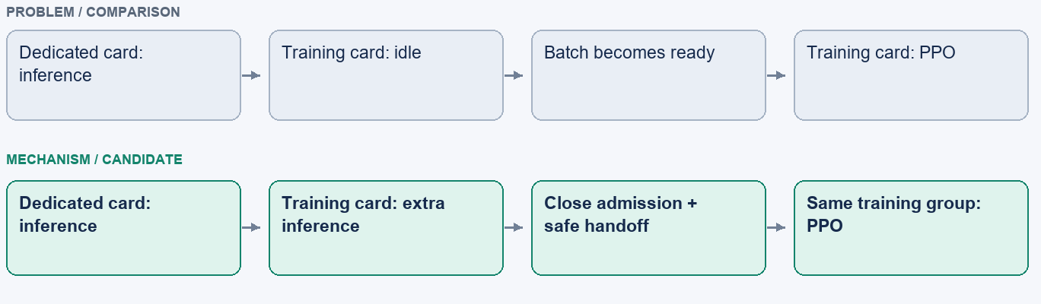
M1: borrow training capacity safely
Mechanism schematic. Geometry does not represent measured time or memory.
Training keeps priority. Sharing changes device roles, not training-group membership.
04
Notes:
Device roles change while the training process group and optimizer ownership remain fixed.
Sources on host 7.150.15.118:
/root/src/changhong94/AReaL/docs/research/npu-sharing/optimizations/R007-single-npu-and-borrowing.md
Evidence cutoff: 2026-10-21 America/Vancouver. Source files can contain historical statements superseded by later appendices. This deck labels the scope of each result.

Slide 5
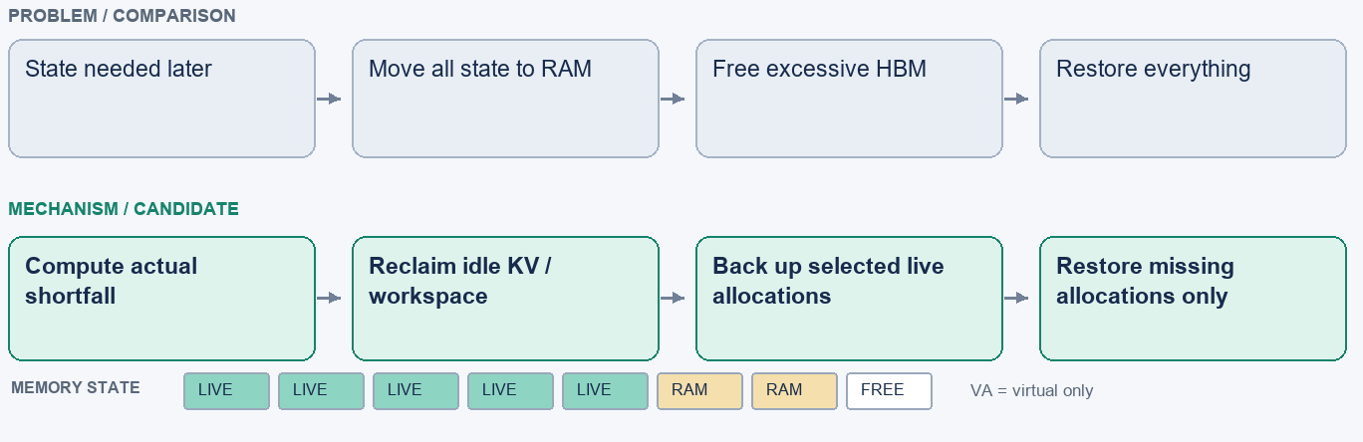
M1: reclaim memory only when needed
Mechanism schematic. Geometry does not represent measured time or memory.
Memory savings and lower loop time are separate outcomes that require separate measurements.
05
Notes:
Dynamic KV mapping, partial offload and prefetch retain useful state when physical memory allows. Budget checks remain mandatory.
Sources on host 7.150.15.118:
/root/src/changhong94/AReaL/docs/research/npu-sharing/optimizations/R017-pressure-driven-partial-offload.md
/root/src/changhong94/AReaL/docs/research/npu-sharing/optimizations/R006-dynamic-kv-pages.md
/root/src/changhong94/AReaL/docs/research/npu-sharing/optimizations/R015-training-cache-parking-prefetch.md
Evidence cutoff: 2026-10-21 America/Vancouver. Source files can contain historical statements superseded by later appendices. This deck labels the scope of each result.

Slide 6
M2: predict data and device readiness
Next training start ≈ max(data ready, device ready)
Data readiness
Estimate completion of all required answers within each question group.
Device readiness
Include draining, migration, memory restoration and publication fences.
Completed-batch windows provide causal inputs. Prediction accuracy still needs validation.
06
Notes:
Use statistics from up to three completed batches. The next training step needs both complete answer groups and the training device.
Sources on host 7.150.15.118:
/root/src/changhong94/AReaL/docs/research/npu-sharing/optimizations/R004-adaptive-draining.md
/root/src/changhong94/AReaL/docs/research/npu-sharing/optimizations/R019-tail-estimation-and-sibling-ablation.md
Evidence cutoff: 2026-10-21 America/Vancouver. Source files can contain historical statements superseded by later appendices. This deck labels the scope of each result.

Slide 7
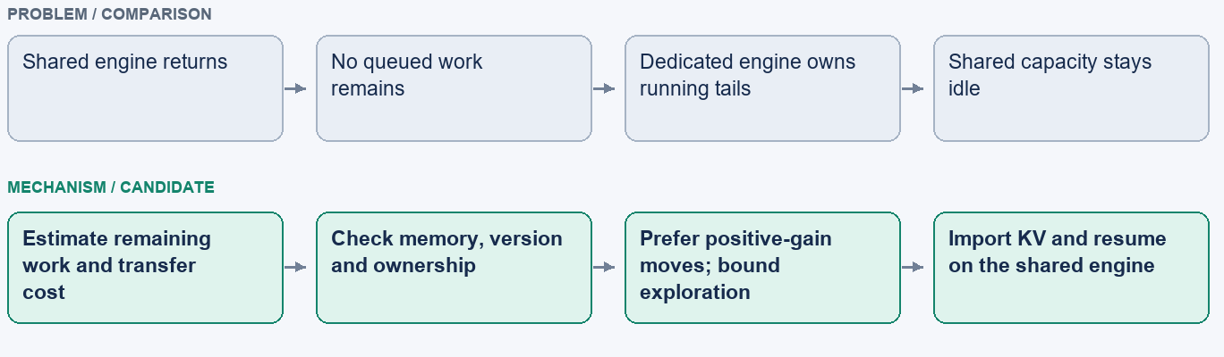
M2: move running work with bounded KV transfer
Mechanism schematic. Geometry does not represent measured time or memory.
Confirmed import_applied events establish completed KV handoffs. Attempts alone do not.
07
Notes:
R001 first considers queued work, then compatible running requests. Accepted exploration permits five requests per probe, two attempts and a two-second cumulative transaction admission budget. Positive-gain plans are separate.
Sources on host 7.150.15.118:
/root/src/changhong94/AReaL/docs/research/npu-sharing/optimizations/R001-runtime-request-rebalancing.md
/root/src/changhong94/AReaL/docs/research/npu-sharing/experiments/2026-10-19-r001-accepted-policy.md
Evidence cutoff: 2026-10-21 America/Vancouver. Source files can contain historical statements superseded by later appendices. This deck labels the scope of each result.

Slide 8
R025: admission follows available capacity
Target = ceil(C × R / F)
Ready / dedicated capacity | 1× | 1.5× | 2× | 3× | 4×
Question target at C = 16 | 16 | 24 | 32 | 48 | 64
Growth is gradual and stops under router backlog.
Off-policy, native sequence/token and per-rank memory limits still apply.
The implemented policy follows ready capacity; throughput-weighted feedback remains future work.
08
Notes:
Current target ceil(C × R / F), with equivalent compatible replicas. C is baseline question concurrency, R ready replicas, F dedicated replicas. TP ranks are not replicas.
Sources on host 7.150.15.118:
/root/src/changhong94/AReaL/docs/research/npu-sharing/optimizations/R025-adaptive-inference-concurrency.md
Evidence cutoff: 2026-10-21 America/Vancouver. Source files can contain historical statements superseded by later appendices. This deck labels the scope of each result.

Slide 9
R027: return to inference only when useful
Observed state | Action
Next batch is already complete | Keep the device resident for training
Extra inference has predicted net benefit | Return to inference and record the actual cost
History is insufficient | Return normally to collect calibration data
Paused work remains after a keep decision | Evacuate every paused request to fixed inference
Skipping a return also skips shared snapshots and memory switching. Fixed weights still update.
09
Notes:
Decide at training completion using current batch readiness and recent measured transition costs. Missing evidence triggers calibration. Formal results primarily validate the next-batch-ready shortcut.
Sources on host 7.150.15.118:
/root/src/changhong94/AReaL/docs/research/npu-sharing/optimizations/R027-profit-aware-inference-return.md
/root/src/changhong94/AReaL/docs/research/npu-sharing/experiments/2026-10-21-r027-resident-training.md
Evidence cutoff: 2026-10-21 America/Vancouver. Source files can contain historical statements superseded by later appendices. This deck labels the scope of each result.

Slide 10
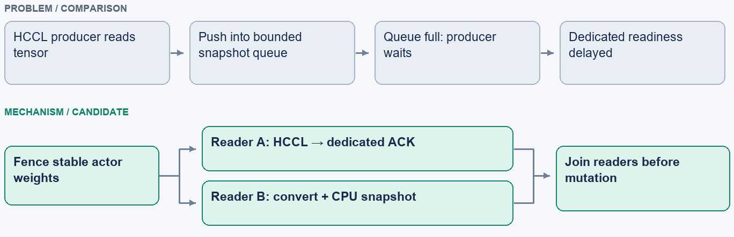
M3: publish to each replica independently
Mechanism schematic. Geometry does not represent measured time or memory.
A fixed replica resumes after its own update. Shared restoration can continue in the background.
10
Notes:
Independent HCCL and snapshot readers remove unnecessary cross-branch waiting. Each branch must acknowledge before its admission opens. Actor mutation waits for active readers.
Sources on host 7.150.15.118:
/root/src/changhong94/AReaL/docs/research/npu-sharing/optimizations/R009-independent-snapshot-reader.md
/root/src/changhong94/AReaL/docs/research/npu-sharing/optimizations/R010-background-step-tail.md
Evidence cutoff: 2026-10-21 America/Vancouver. Source files can contain historical statements superseded by later appendices. This deck labels the scope of each result.

Slide 11
Correctness defines the migration boundary
Condition | Required behavior
Same version and compatible equal-TP layout | Transfer KV with per-rank preflight and import ACK
Different weight versions | Replay the token prefix under target weights; no KV reuse
A device remains assigned to training | Evacuate paused work even when migration is expensive
Ambiguous transfer or ownership | Stop and reconcile rather than duplicate execution
Matching layout does not make KV from different weight versions semantically interchangeable.
11
Notes:
Ownership, version consistency and rank-local budgets take priority over load balancing. Paused same-version TP1 and TP2 probes preserve 256 deterministic tokens and exact logged probabilities.
Sources on host 7.150.15.118:
/root/src/changhong94/AReaL/docs/research/npu-sharing/optimizations/R027-profit-aware-inference-return.md
/root/src/changhong94/AReaL/docs/research/npu-sharing/optimizations/R001-runtime-request-rebalancing.md
Evidence cutoff: 2026-10-21 America/Vancouver. Source files can contain historical statements superseded by later appendices. This deck labels the scope of each result.

Slide 12
Evaluation separates exploration from confirmation
Development comparisons | Formal confirmation
Reuse vLLM with verified initial-weight reset | Start engines independently for each arm
Recreate training and optimizer state | Report initialization separately from loop time
Alternate policies and retain every repetition | Match model, questions, source and tracing
Use results to choose the next candidate | Report tokens, quality, migrations and variability
Identical questions and settings do not guarantee identical generated answers or microbatches.
12
Notes:
Reused engines accelerate exploration but can change runtime state. Formal comparisons initialize each arm independently. Source, workload and observation switches must match.
Sources on host 7.150.15.118:
/root/src/changhong94/AReaL/docs/research/npu-sharing/methodology.md
/root/src/changhong94/AReaL/docs/research/npu-sharing/optimizations/R023-observability-and-reproducibility.md
Evidence cutoff: 2026-10-21 America/Vancouver. Source files can contain historical statements superseded by later appendices. This deck labels the scope of each result.

Slide 13
Earlier shared-system result: 14.72% less loop time
Historical configuration, 19 October 2026. Independent engine startup.
14.72%
lower loop time
576 answers per arm
10 confirmed KV imports
Whole-system comparison. The marginal contribution of KV migration remains an ablation question.
13
Notes:
Independent-start comparison on 2026-10-19: fixed 179.232 s, shared 152.847 s, 576 answers per arm, 137098/138424 tokens, ten confirmed imports. This is a historical configuration, not the current graph result or an isolated R001 ablation.
Sources on host 7.150.15.118:
/root/src/changhong94/AReaL/docs/research/npu-sharing/experiments/2026-10-19-r001-accepted-policy.md
/root/src/changhong94/AReaL/docs/research/npu-sharing/experiments/evidence/r001-moderated-20261019/accepted.json
Evidence cutoff: 2026-10-21 America/Vancouver. Source files can contain historical statements superseded by later appendices. This deck labels the scope of each result.

Slide 14
R025 development result: higher useful concurrency
Development comparison, 20 October 2026. Two reused-engine trials per policy.
15.40%
mean time reduction
Question overlap:
16 to 32
Development evidence
This result does not establish an advantage over a well-tuned static-32 baseline.
14
Notes:
Static-16 shared loops averaged 181.08s, capacity policy 153.20s, a 15.40% reduction. Two reused-engine trials per mode. Tokens fell 1.72%. Static32 and independent-start controls remain pending.
Sources on host 7.150.15.118:
/root/src/changhong94/AReaL/docs/research/npu-sharing/experiments/2026-10-20-r025-capacity-admission.md
Evidence cutoff: 2026-10-21 America/Vancouver. Source files can contain historical statements superseded by later appendices. This deck labels the scope of each result.

Slide 15
Graph-mode confirmation: about 9% less loop time
Qwen2.5-1.5B-Instruct, FSDP, 2 NPUs. Full inference graphs, eager training.
8.99%
aggregate time saved
576 answers per arm
Shared token change:
+0.16% / −0.91%
Most skips occurred after the next batch was already ready. Forecast-only benefit remains unproven.
15
Notes:
Two independent-start FSDP comparisons with full inference graphs and eager training. 96 questions, six answers, batch size16, concurrency16, six batches, offpolicy2. Savings9.01% and8.96%, aggregate8.99%. These validate the combined shared configuration.
Sources on host 7.150.15.118:
/root/src/changhong94/AReaL/docs/research/npu-sharing/experiments/2026-10-21-r027-resident-training.md
/root/src/changhong94/AReaL/docs/research/npu-sharing/experiments/2026-10-21-r027-formal.json
/root/src/changhong94/AReaL/docs/research/npu-sharing/experiments/2026-10-21-r027-formal-repeat.json
Evidence cutoff: 2026-10-21 America/Vancouver. Source files can contain historical statements superseded by later appendices. This deck labels the scope of each result.

Slide 16
Support and validation have different scopes
Scope | Evidence / current limit
Inference graphs with eager training | Two-NPU FSDP formal pairs completed
TP2, multiple equal-TP replicas | Eight-NPU probe confirmed all four directed edges
Megatron shared RL | Earlier TP2 loop benefit 3.69%; startup-inclusive time regressed
R027 + Megatron, current coverage | Publication path repaired; NPU rerun still pending
Full configuration coverage is ongoing. A successful transport probe is not a scaling claim.
16
Notes:
Graph-mode support is validated for the recorded two-NPU FSDP workload. Equal-TP multi-peer transport probes establish functional correctness, not scaling benefit. Today’s Megatron R027 publication fix passed30 CPU tests and awaits NPU confirmation.
Sources on host 7.150.15.118:
/root/src/changhong94/AReaL/docs/research/npu-sharing/experiments/2026-10-21-r027-resident-training.md
/root/src/changhong94/AReaL/docs/research/npu-sharing/experiments/2026-10-19-r001-tp2-megatron.md
/root/src/changhong94/AReaL/docs/research/npu-sharing/optimizations/R001-runtime-request-rebalancing.md
Evidence cutoff: 2026-10-21 America/Vancouver. Source files can contain historical statements superseded by later appendices. This deck labels the scope of each result.

Slide 17
Negative results shape the design
Observation | Consequence
Sibling-answer length scaling reduced benefit | Remove the heuristic; retain its ablation record
Some migration timing gates never fired | Do not count an inactive mechanism as a benefit
Early R027 variants were slower or inconsistent | Preserve resident-cache budgets and measure the whole loop
TP2 changes with model and execution mode | Screen workloads before considering R026 migration
Lower memory use, more occupied devices and more migrations do not guarantee a faster RL loop.
17
Notes:
Retain removed sibling scaling, non-triggering gates, memory overhead and context-dependent TP results. Graph Qwen2-7B screening improved TP2 completion15.21–28.57%, but cross-TP live migration is unimplemented.
Sources on host 7.150.15.118:
/root/src/changhong94/AReaL/docs/research/npu-sharing/optimizations/R019-tail-estimation-and-sibling-ablation.md
/root/src/changhong94/AReaL/docs/research/npu-sharing/optimizations/R020-tp-tail-negative-result.md
/root/src/changhong94/AReaL/docs/research/npu-sharing/experiments/2026-10-20-r026-qwen2-7b-graph-tp-screen.md
/root/src/changhong94/AReaL/docs/research/npu-sharing/experiments/2026-10-21-r027-resident-training.md
Evidence cutoff: 2026-10-21 America/Vancouver. Source files can contain historical statements superseded by later appendices. This deck labels the scope of each result.

Slide 18
Next evidence for a paper
Isolate the mechanisms
Matched M1/M2/M3 ablations, repeated seeds and a static-high-concurrency baseline.
Validate performance together with learning
Measure reward/accuracy, output work, policy age, prediction error and initialization cost.
Extend only after confirmation
Complete graph/Megatron coverage. Treat R026 cross-TP migration and R028 multi-node sharing as proposals.
18
Notes:
The strongest current claim is whole-system improvement on recorded workloads. Next work isolates the three mechanisms, tests stronger baselines and quality, and extends support carefully.
Sources on host 7.150.15.118:
/root/src/changhong94/AReaL/docs/research/npu-sharing/roadmap.md
/root/src/changhong94/AReaL/docs/research/npu-sharing/methodology.md
/root/src/changhong94/AReaL/docs/research/npu-sharing/optimizations/R026-tail-acceleration-via-tp-migration.md
/root/src/changhong94/AReaL/docs/research/npu-sharing/optimizations/R028-multinode-training-inference-sharing.md
Evidence cutoff: 2026-10-21 America/Vancouver. Source files can contain historical statements superseded by later appendices. This deck labels the scope of each result.

Slide 19
Appendix: current benchmark defaults
Parameter | Current default | Formal graph evidence
Training engine / NPUs | FSDP / 2 | FSDP / 2
Questions per batch / answers per question | 32 / 8 | 16 / 6
Question concurrency / batches | 16 / 6 | 16 / 6
Offpolicy / inference mode | 2 / graph | 2 / graph
Shared policy | KV rebalance + capacity + R027 | Same mechanisms; frozen recorded source
Defaults describe operation. Performance claims remain attached to their exact recorded configuration.
19
Notes:
Current defaults differ from the16×6 evidence workload. Coverage varies batch sizes16/32/64 and answer counts4/8/16.
Sources on host 7.150.15.118:
/root/src/changhong94/AReaL/docs/research/npu-sharing/../../../benchmark/npu_share/README.md
/root/src/changhong94/AReaL/docs/research/npu-sharing/../../../benchmark/npu_share/COVERAGE_PLAN.md
Evidence cutoff: 2026-10-21 America/Vancouver. Source files can contain historical statements superseded by later appendices. This deck labels the scope of each result.

Slide 20
Appendix: evidence and implementation record
Evidence | Record in experiments/
Accepted migration configuration | 2026-10-19-r001-accepted-policy.md
Dynamic concurrency development | 2026-10-20-r025-capacity-admission.md
Graph-mode formal pairs | 2026-10-21-r027-resident-training.md
TP2 Megatron comparison | 2026-10-19-r001-tp2-megatron.md
Current coverage failure and repair | Report revision log, 2026-10-21
Source checkout: 28cd7d1 with uncommitted changes at review time.
Each experiment has its own frozen source and configuration evidence.
20
Notes:
Research sources live under docs/research/npu-sharing. The deck records updated status without overwriting historical findings.
Sources on host 7.150.15.118:
/root/src/changhong94/AReaL/docs/research/npu-sharing/report/README.md
Evidence cutoff: 2026-10-21 America/Vancouver. Source files can contain historical statements superseded by later appendices. This deck labels the scope of each result.

