Slide 1
BGS SV target selection
ChangHoon Hahn (Berkeley)
Omar Ruiz Macias (Durham)
target selection telecon — August 1, 2018
Notes:
outline of talk:
motivation: We seek to determine the feasibility more accurately than what we’ve been doing so far using using simulations and contentious bright sky/moon models by using spectroscopic data from the GAMA survey.

Slide 2
BGS SV superset target selection criteria
magnitude limit
bright object mask
star-galaxy separation
Notes:
maybe a slide on legacy survey?

Slide 3
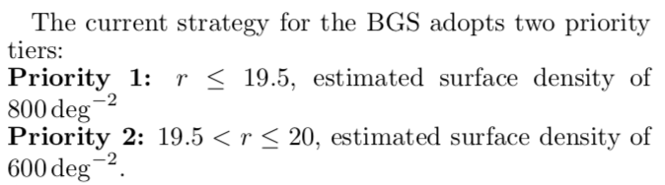
magnitude limit
for the BGS superset, push the magnitude limit to r < 20.1
https://www.overleaf.com/5923731xwddpv#/19875270/
Notes:
maybe a slide on legacy survey?

Slide 4
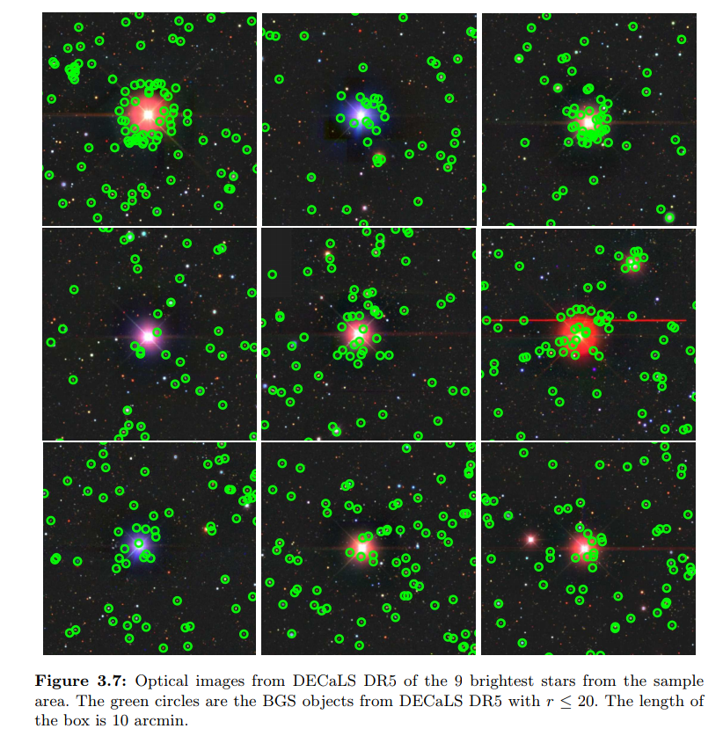
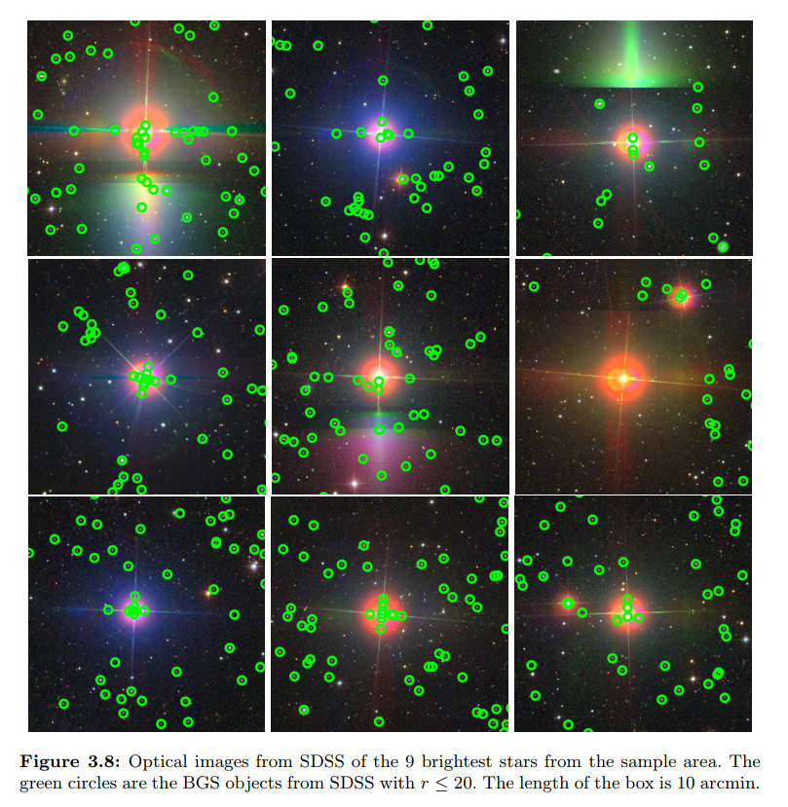
bright object mask — DR5
DECaLS DR5 Bright stars
SDSS Bright stars
Notes:
maybe a slide on legacy survey?

Slide 5
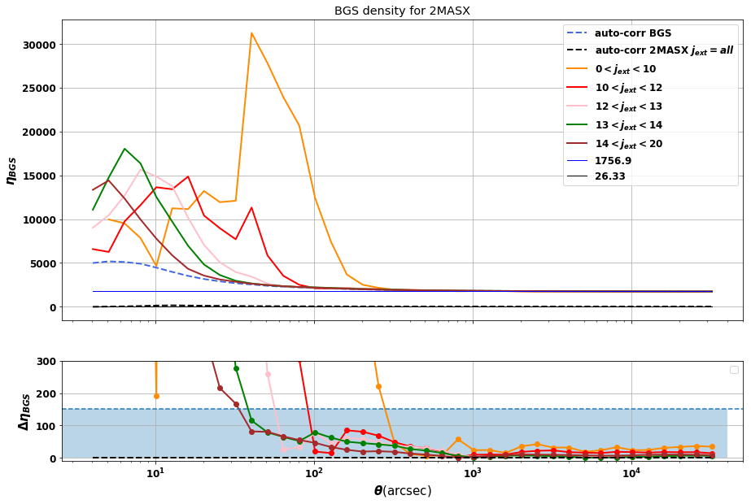
bright object mask — DR5
Cross-corr Twomass-DECaLS DR5 BGS
Notes:
maybe a slide on legacy survey?

Slide 6
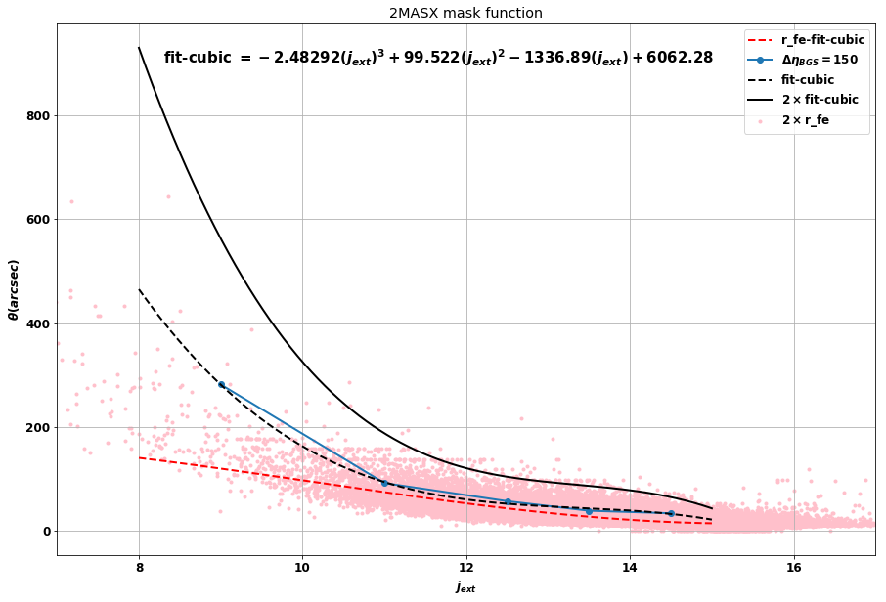
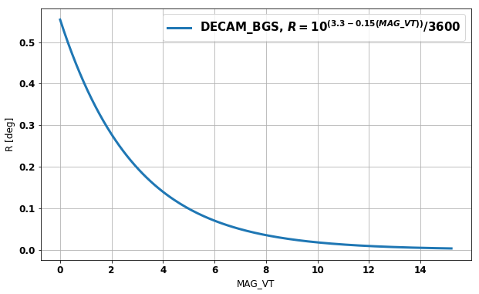
bright object mask — DR5
Mask functions for twomass galaxies
Mask function for Tycho2 Stars
Notes:
maybe a slide on legacy survey?

Slide 7
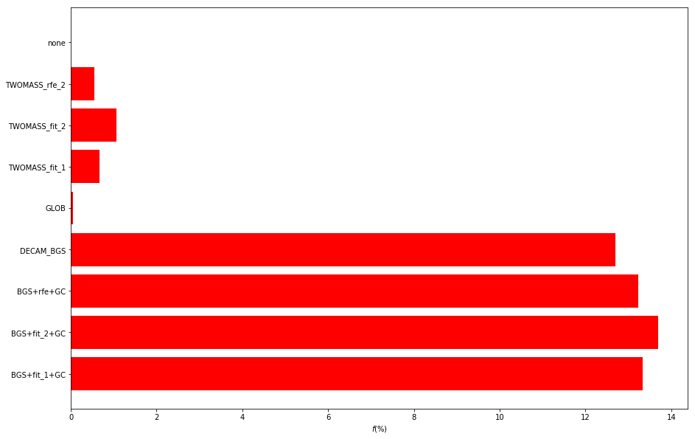
bright object mask — DR5
Rejected objects by each mask
Notes:
maybe a slide on legacy survey?

Slide 8
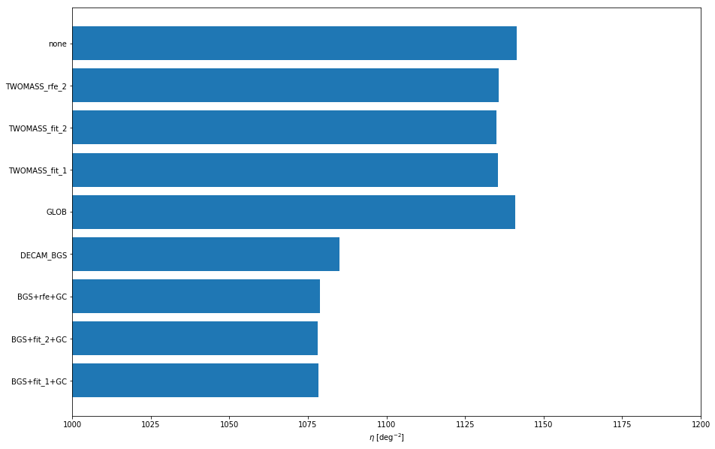
bright object mask — DR5
Number density
Notes:
maybe a slide on legacy survey?

Slide 9
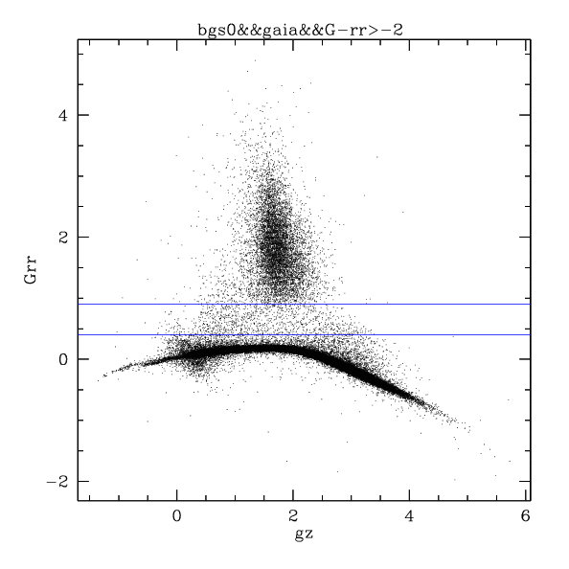
star-galaxy separation
tractor TYPE != “PSF” using GAIA
< 0.1% stars
GAIA G - r
stars
for the BGS superset, allow 10% of objects classified as stars to be targeted to test star-galaxy separation
credit: Daniel Eisenstein
Notes:
maybe a slide on legacy survey?

Slide 10
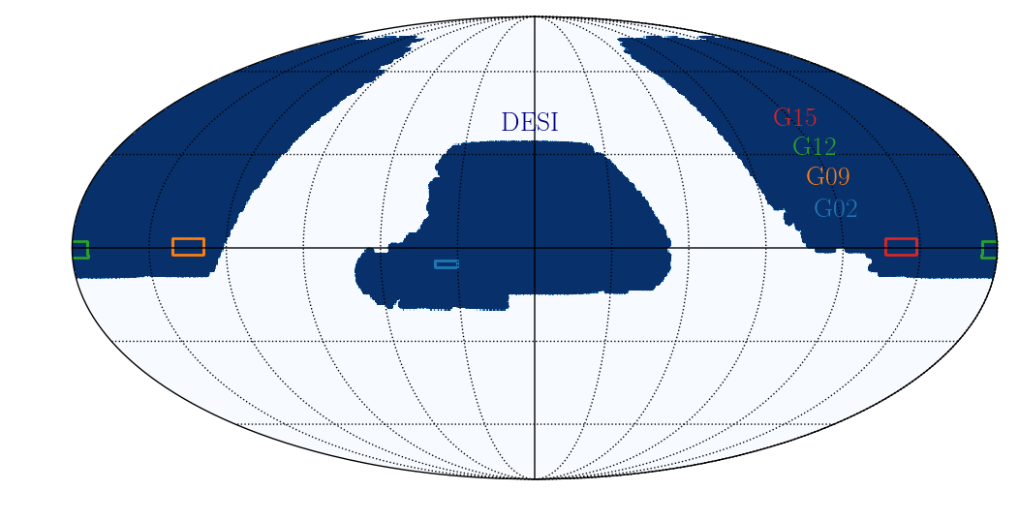
BGS survey validation
GAMA fields — spectroscopic truth tables
Notes:
maybe a slide on legacy survey?

Slide 11
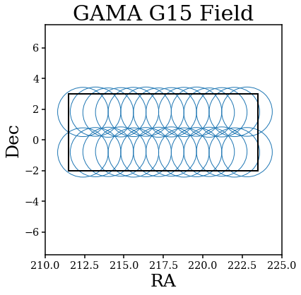
BGS survey validation
tiling by Kyle Dawson, David Schlegel
Notes:
maybe a slide on legacy survey?

Slide 12
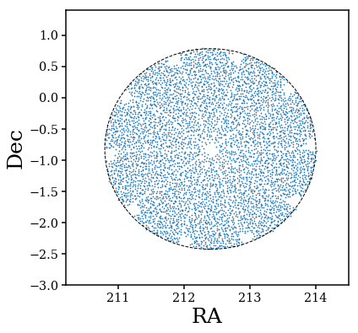
BGS survey validation
DECaLS DR5 targets by Adam Myers
fiberassign by Jaime Forero-Romero https://github.com/forero/fiberassign_sv/
Notes:
maybe a slide on legacy survey?

