Slide 1


Team Details
  Team name: Hey Merlion!
  Team leader name: Changhyeon Nam (team: Changhyeon Nam, Hyunho Yang)
  Problem Statement: BFSI: Intelligent Risk, Fraud & Financial Experiences

Slide 2
Why this matters
SOUTHEAST ASIA'S SMALL BUSINESSES RUN THE ECONOMY BUT CANNOT BORROW
8.8%
75.5%
of Vietnamese firms cannot borrow without collateral. What they have is PDFs, screenshots and paper receipts.
70%
of emerging-market MSMEs lack adequate financing. Reading their records by hand costs more than a small loan earns.
of Vietnam's 914,000 SMEs have a bank loan.
Large enterprises: 47.1%. The same small firms employ most of the region.
The opening
VPBank, Vietcombank and Agribank are moving from collateral to cash-flow lending. Someone still has to read the cash flow. LedgerLens makes that reading fast, sourced and auditable.
47.1% large firms
8.8% SMEs
Sources: FiinGroup via Viet Nam News (Aug 2026) · VCCI Private Economic Report 2025 · IFC MSME Finance · VTV (May 2026) · ADB Asia SME Monitor 2025

Slide 3
Brief about the idea
LedgerLens turns a shoebox of receipts, screenshots and bank PDFs into a credit memo a bank can trust.
1
Read with evidence
2
Challenge
3
Human signs
Gemini reads every document. Every value carries document id, page and bounding box. Python computes the cash flow. A memo with unsourced numbers is rejected and regenerated.
A second agent that never sees the first one's prompt runs 12 underwriting checks against the memo and raises severity-ranked objections with evidence.
The underwriter accepts or dismisses each objection and signs. Every decision is logged and re-weights the next Challenger run. The applicant gets the reasons in their own language.
Not a score. A memo. AI does the reading and the arguing; the underwriter keeps the decision.

Slide 4
Opportunities
Same documents. About 2 minutes per file. Every number defensible.
~2 min
~0.28
0 vs 62
per file, end to end (measured, live Gemini)
USD per case on a cold run; USD 0 on a cached re-run
unsourced numbers in the memo: LedgerLens vs a single prompt
How it is different
Who benefits
Writer and verifier are separate agents, so the memo is never graded by its author
Figures are computed by code and linked to their source line, not generated
Underwriter decisions re-rank the next Challenger run
Small businesses with records but no credit file get assessed on cash flow, not collateral
A declined applicant receives the reasons, in their own language
Lenders can offer small-ticket loans that were uneconomic to underwrite

Slide 5
List of features offered by the solution
Every feature hangs on one pipeline, and the pipeline ends with a person.
Intake
Extract
Cash flow
Analyze
Challenge
Decide
Explain
Multimodal intake
Evidence-linked extraction
Deterministic model
Clickable memo
Battery + 12 checks
Underwriter workbench
Letter and paper memo
PDF, screenshots, photos. Classified and quality-flagged.
Doc id, page, bbox on every value. PDF text layer verifies it.
Inflow, outflow, trend, volatility, debt service. Python, not the model.
Cites catalog figures only. Click one, the source line opens.
Image hash, balance chain, dates. Ranked objections with evidence.
Accept or dismiss, sign. Audit log. Decisions re-weight the checks.
Customer letter in the local language. Memo prints with footnoted sources.
Out of scope by design: credit scoring, loan pricing, core-banking integration. LedgerLens informs the decision; it does not make it.

Slide 6
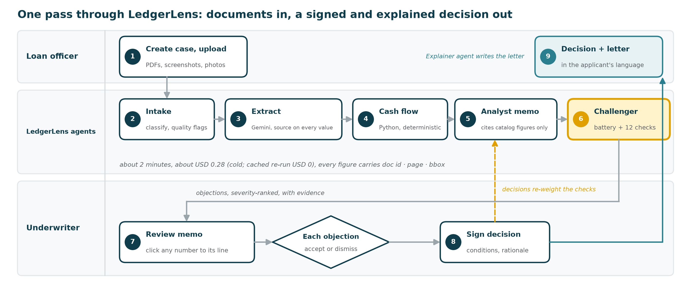
Process flow diagram
Three lanes: the loan officer uploads, the agents read and challenge, the underwriter decides. Decisions flow back into the Challenger's priorities.

Slide 7
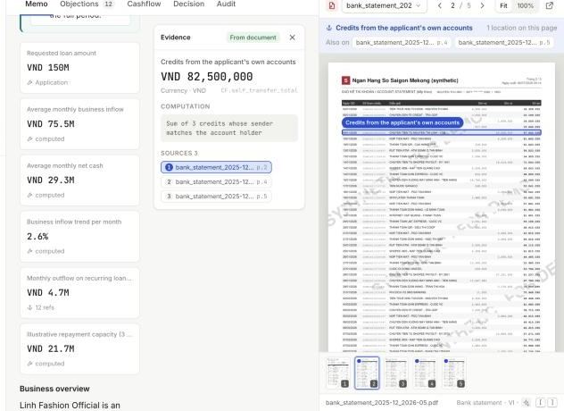
Wireframes / Mock diagrams of the proposed solution
THE PRODUCT IN ONE INTERACTION
Click the number. See the line.
1
The memo cites a figure
1
2
Every underlined value is a catalog figure with a source. Here: VND 82,500,000, credits from the applicant's own accounts.
3
2
One click opens the evidence
The computation (sum of 3 credits whose sender matches the account holder) and all 3 source references: pages 2, 4 and 5.
3
The source line lights up
The statement page opens with the extractor's bounding box drawn on the exact row. A memo with an unsourced number is rejected and regenerated.

Slide 8
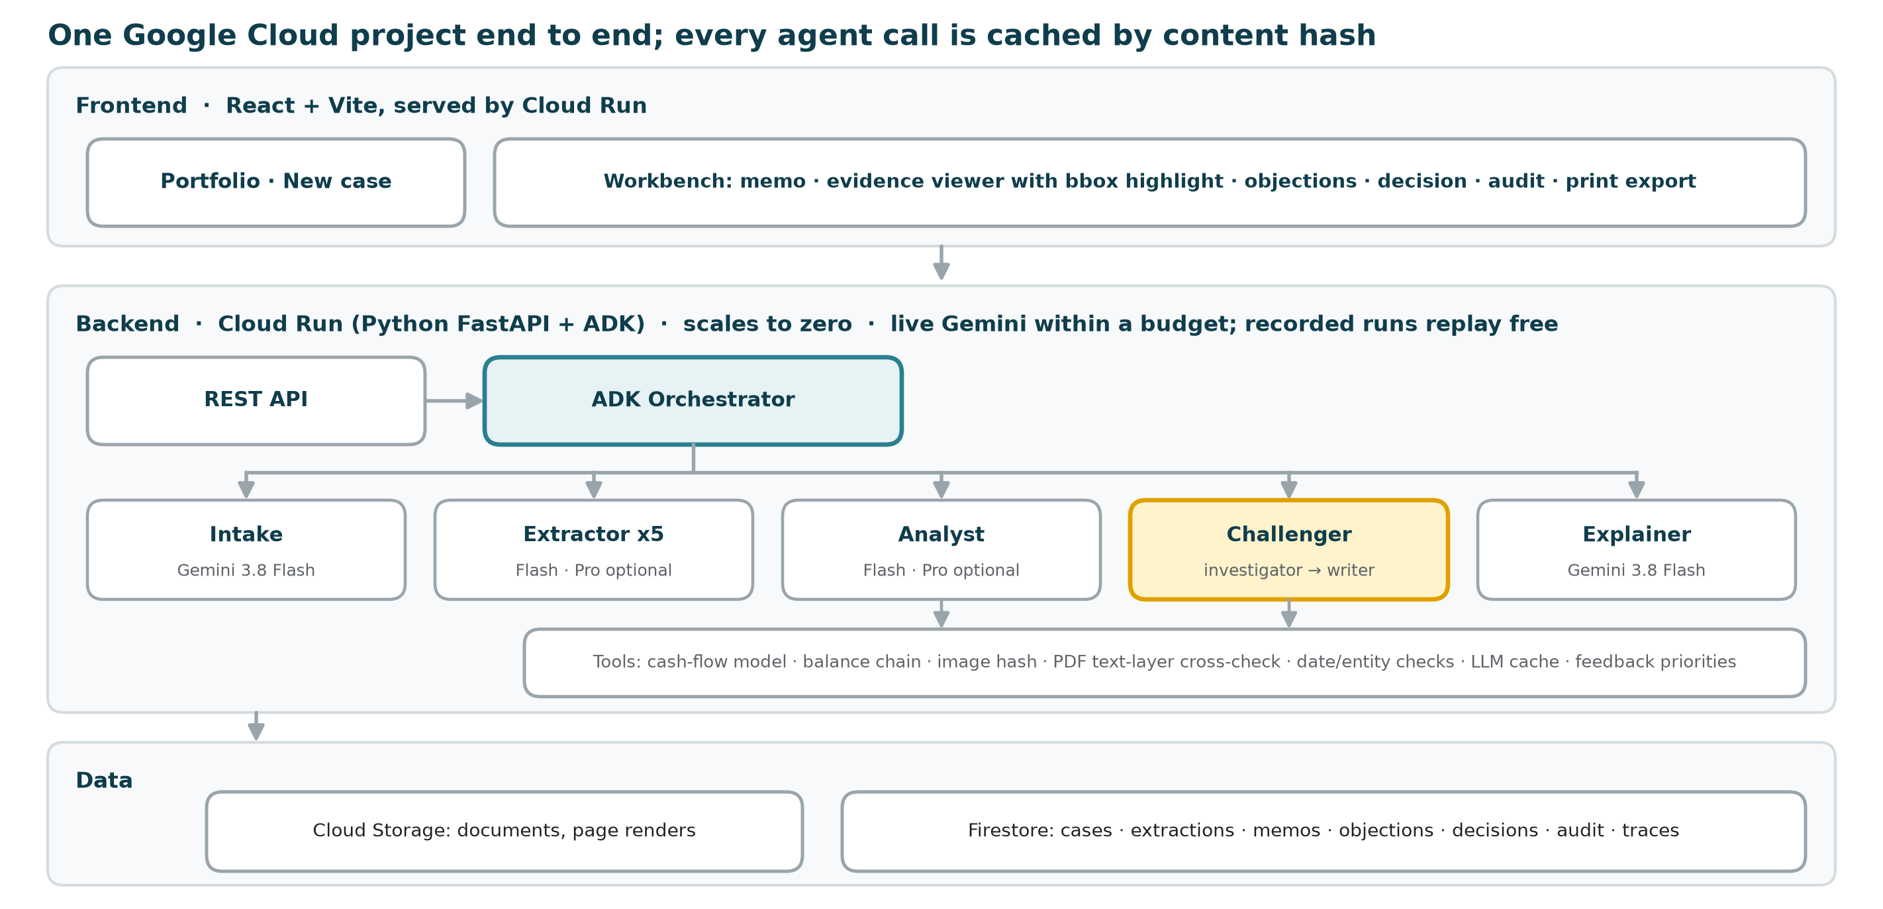
Architecture diagram of the proposed solution

Slide 9
Technologies to be used in the solution
Gemini reads, ADK orchestrates, Python computes, Cloud Run serves.
GOOGLE CLOUD
GOOGLE CLOUD
GOOGLE CLOUD
GOOGLE CLOUD
Gemini 3.8 Flash
Gemini 3.1 Pro
Agent Development Kit
Cloud Run
Default for every agent. Measured USD 0.26-0.31 per cold case; USD 0 cached.
One env var moves Extractor, Analyst and Challenger to Pro.
Intake, 5 Extractors, Analyst, Challenger (investigator and writer), Explainer.
One service: FastAPI, the ADK agents and the React workbench; scales to zero.
GOOGLE CLOUD
PYTHON
PYTHON
INTEGRATION
Firestore + Storage
Deterministic tools
LLM cache, budget cap
REST API
Cases, extractions, memos, objections, decisions, audit, traces; documents.
Cash-flow model, balance chain, image hash, PDF text-layer cross-check, date and entity checks.
Content-hash cache per model and prompt version; hard USD cap per process.
Any loan origination system can create cases, run stages and read memos.
Output schema requires source {doc_id, page, bbox} on every value. No separate OCR engine: pages are rendered to images and read by Gemini.

Slide 10
Estimated implementation cost
Measured: USD 0.26-0.31 per case on a cold Flash run, USD 0 on a cached re-run
Assumption | Value
Gemini 3.8 Flash list price | USD 0.75 / 3.75 per 1M tokens
Measured cold run | ~2 min and USD 0.26-0.31 per case
Cached re-run | USD 0 (content-hash LLM cache)
Public demo | Replays the recorded live Gemini run, USD 0; only the customer letter calls Gemini (~USD 0.0015)
Hosting | Cloud Run scales to zero; Firestore and Storage in free tier
Guardrail | Budget-cap env var stops Gemini calls once spent
Build | 2 engineers, 4 days, free tier and trial credits

Slide 11
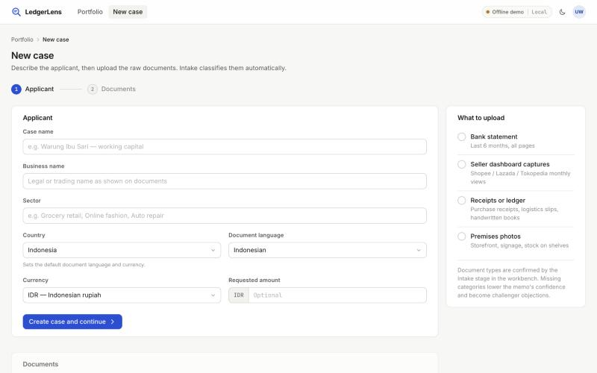
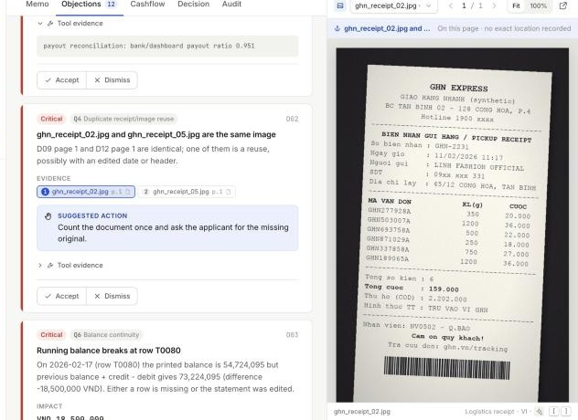
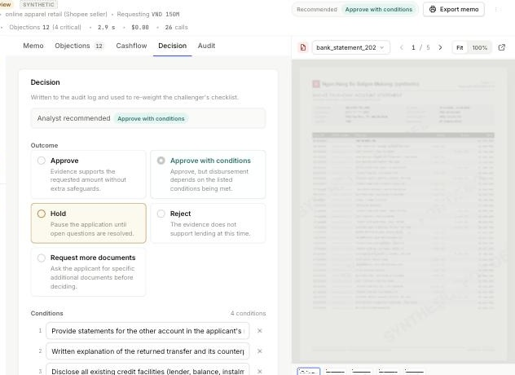
Snapshots of the prototype
1
New case
1
2
Applicant details, then the raw documents. Intake classifies and quality-flags them.
2
Click a number, see the line
Evidence panel with computation and all sources; the statement opens with the bounding box highlighted.
3
4
3
Challenger objections
Critical: two receipt photos are the same image with an edited date. Evidence chips open the photo.
4
The underwriter signs
Outcome, conditions and rationale, written to the audit log; accept/dismiss rates re-weight the checks.

Slide 12
Prototype performance report / Benchmarking
18 of 20 planted traps caught on live Gemini output; a single prompt on the same documents caught 3.
LEDGERLENS
SINGLE PROMPT
Metric | Target | Result
Trap recall (strict) | ≥ 16 / 20 | 18 / 20
Unsourced numbers | 0 | 0 (single prompt: 62)
Objections on clean case A | ≤ 20% | 0
Extraction row accuracy* | ≥ 97% | 100% (481 / 481)
Evidence-link accuracy* | ≥ 95% | 100%
Time per case (cold) | ≤ 180 s | ~2 min
Cost per case (cold) | ≤ USD 0.50 | USD 0.26-0.31
18
3
of 20 traps caught
95% Wilson CI 0.70-0.97
of 20, same documents
and same model
0
~2 min
How measured. Live gemini-3.8-flash runs, 2026-10-15/16: 3 synthetic businesses, 43 documents, 20 planted traps. Strict scoring: an objection counts only if it carries the trap's identifying amount or document, one objection per trap. n = 3 synthetic businesses with team-planted traps, so read as indicative. Missed: dashboard gross vs payout, COD vs cash deposits. Recommendation matched on C; A gave approve_with_conditions (expected approve), B request_more_documents (expected approve_with_conditions). *Clean born-digital synthetic PDFs; real scans will be lower.
unsourced numbers in the memo (single prompt: 62)
per case cold, USD 0.26-0.31; cached re-run USD 0

Slide 13
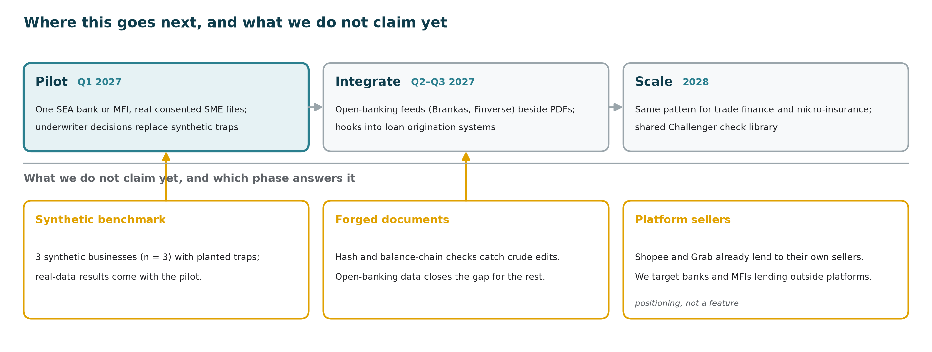
Additional details / Future development
Humans decide, every figure and decision is traceable, the prototype uses watermarked synthetic data only, and production keeps documents and model endpoints in-region.

Slide 14
Provide links to your:
GitHub public repository
English README, architecture, run instructions, synthetic-data notice, presentation/
github.com/changhyeonnam/ghack
Demo video (2 min 59 s)
Problem, how it works, one case end to end (click-to-source, Challenger, decision, letter), benchmark
TBD
Final product
Cloud Run, live Gemini within a fixed AI budget (on-screen notice when reached). Each browser gets its own copy of the three demo cases, which replay the recorded live run in seconds; visitors' cases are shared read-only. No login
ledgerlens-api-629502893425.asia-southeast1.run.app
Links are inserted at submission on 18 October 2026.

Slide 15
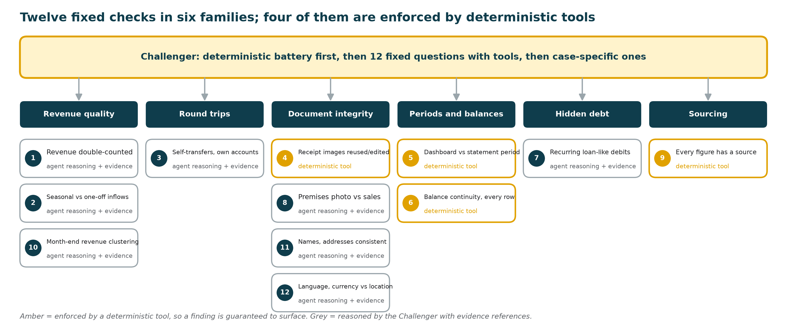
Appendix: the Challenger's 12 fixed checks

Slide 16
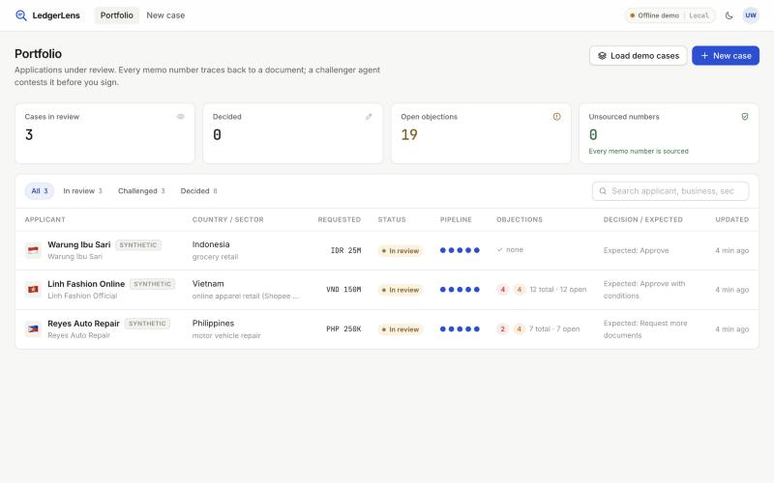
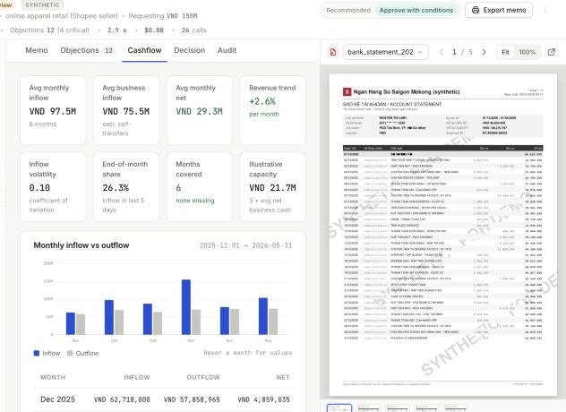
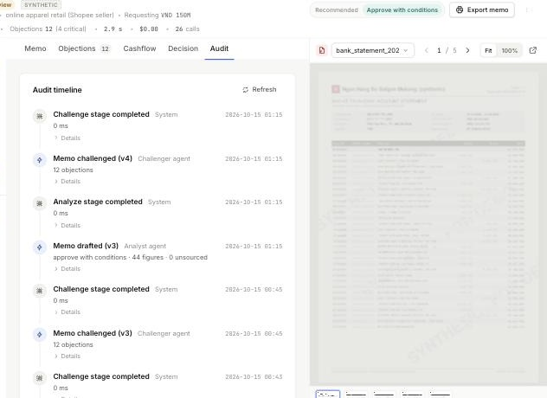
Appendix: portfolio, cash flow and audit views
Portfolio
Cash flow
Audit timeline
Cases in review, open objections and unsourced numbers across the book; filters by status.
Deterministic monthly model: inflow, net, trend, volatility, end-of-month share, repayment capacity.
Every stage and agent call with version, model and prompt; the trail a regulator can read.
Also in the build: dark and light themes, PDF text-layer cross-check on every extracted amount, content-hash LLM cache, cache_only demo mode, budget cap, printable paper memo with footnoted sources.

Slide 17


