Slide 1


Team Details
  Team name: LedgerLens
  Team leader name: Changhyeon (SK Telecom, AI CIC)
  Problem Statement: BFSI: Intelligent Risk, Fraud & Financial Experiences

Slide 2
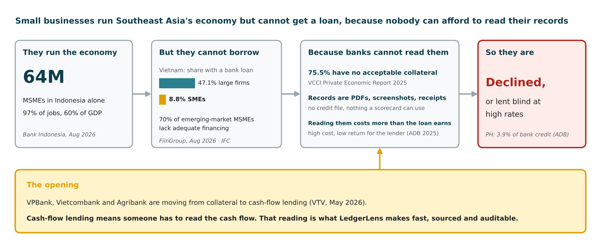
Why this matters
Sources: IFC MSME Finance · FiinGroup via Viet Nam News, Aug 2026 · ADB Asia SME Monitor 2025 · Bank Indonesia, Aug 2026 · VCCI Private Economic Report 2025 and VTV, May 2026

Slide 3
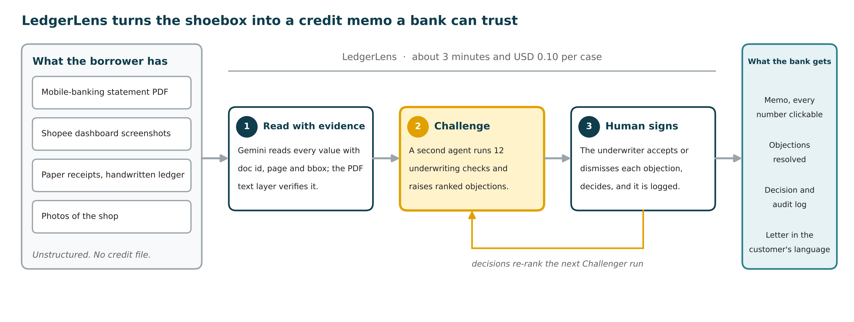
Brief about the idea
In one sentence: the first credit memo where every number can be clicked back to its source, and a second AI tries to break it before a human signs.

Slide 4
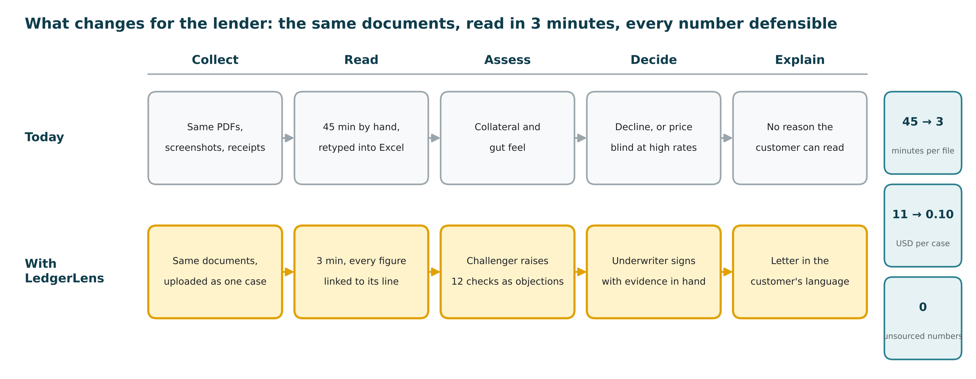
Opportunities
Why it is different: the memo is written by one agent and attacked by another, every figure is computed by code and linked to its source, and the underwriter's decisions re-rank the next run. A memo, not a score.

Slide 5
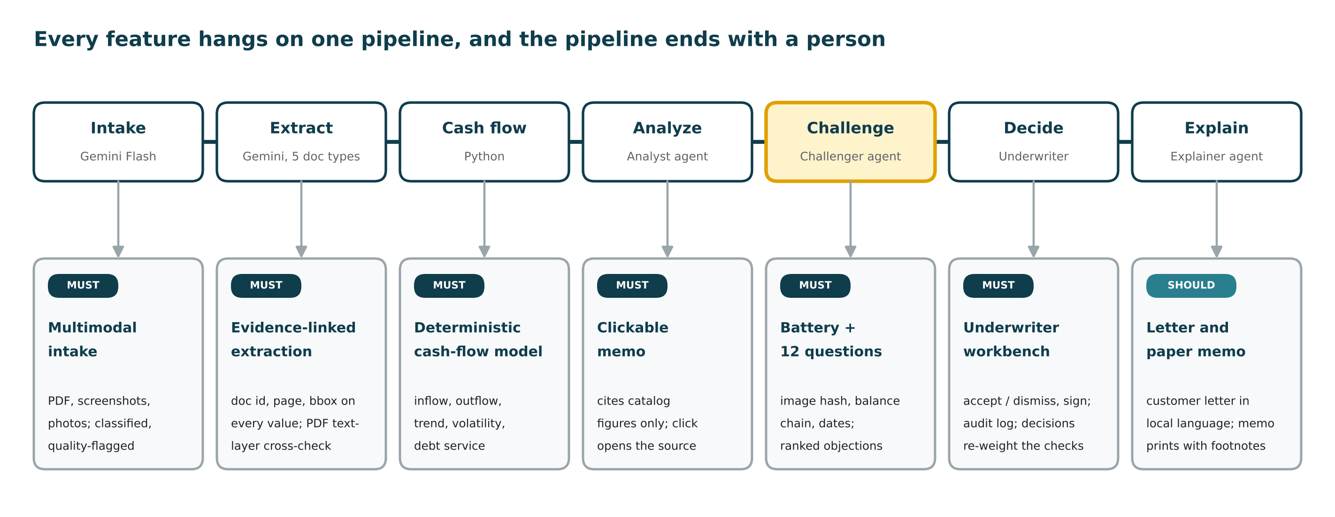
List of features offered by the solution
Out of scope by design: credit scoring, loan pricing, core-banking integration. LedgerLens informs the decision; it does not make it.

Slide 6
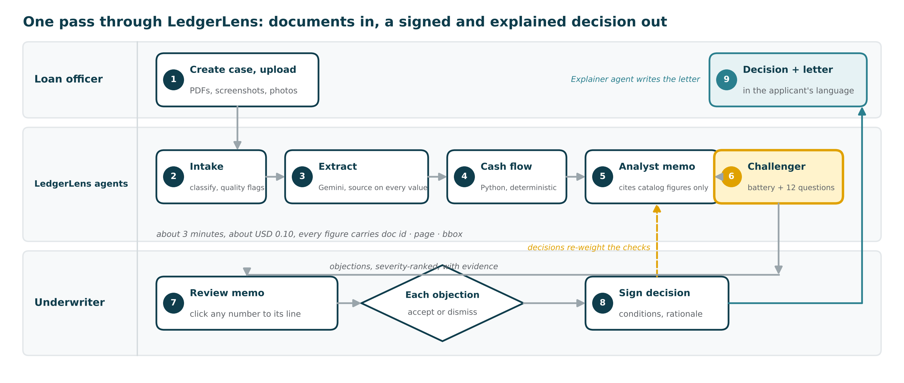
Process flow diagram
Three lanes: the loan officer uploads, the agents read and challenge, the underwriter decides. Decisions flow back into the Challenger's priorities.

Slide 7
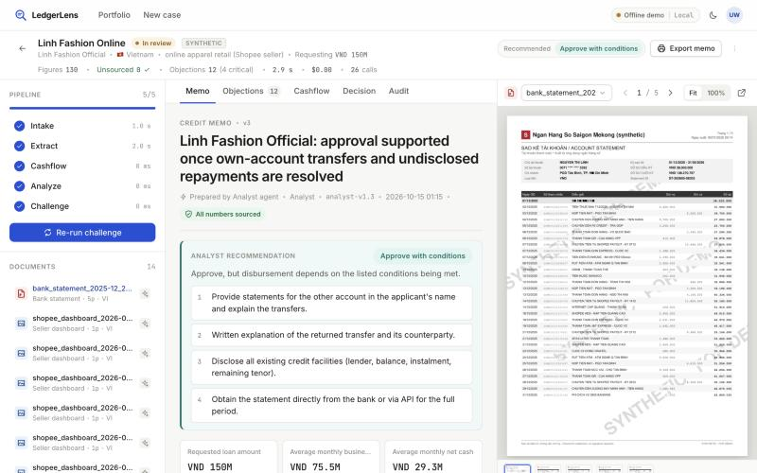
Wireframes / Mock diagrams of the proposed solution
1
Memo with a recommendation
Headline, conditions and every figure drafted by the Analyst, from catalog figures only
2
Underlined numbers are evidence
Click one: the source page opens with the bounding box highlighted
3
Unsourced 0, in the header
Enforced by the output schema; a miss becomes a Challenger objection
4
Pipeline, cost, calls
Five stages with timings; USD and LLM-call counters per case; Export memo prints a paper memo
Live prototype, case B: 14 documents, 130 figures, 0 unsourced, 12 objections.

Slide 8
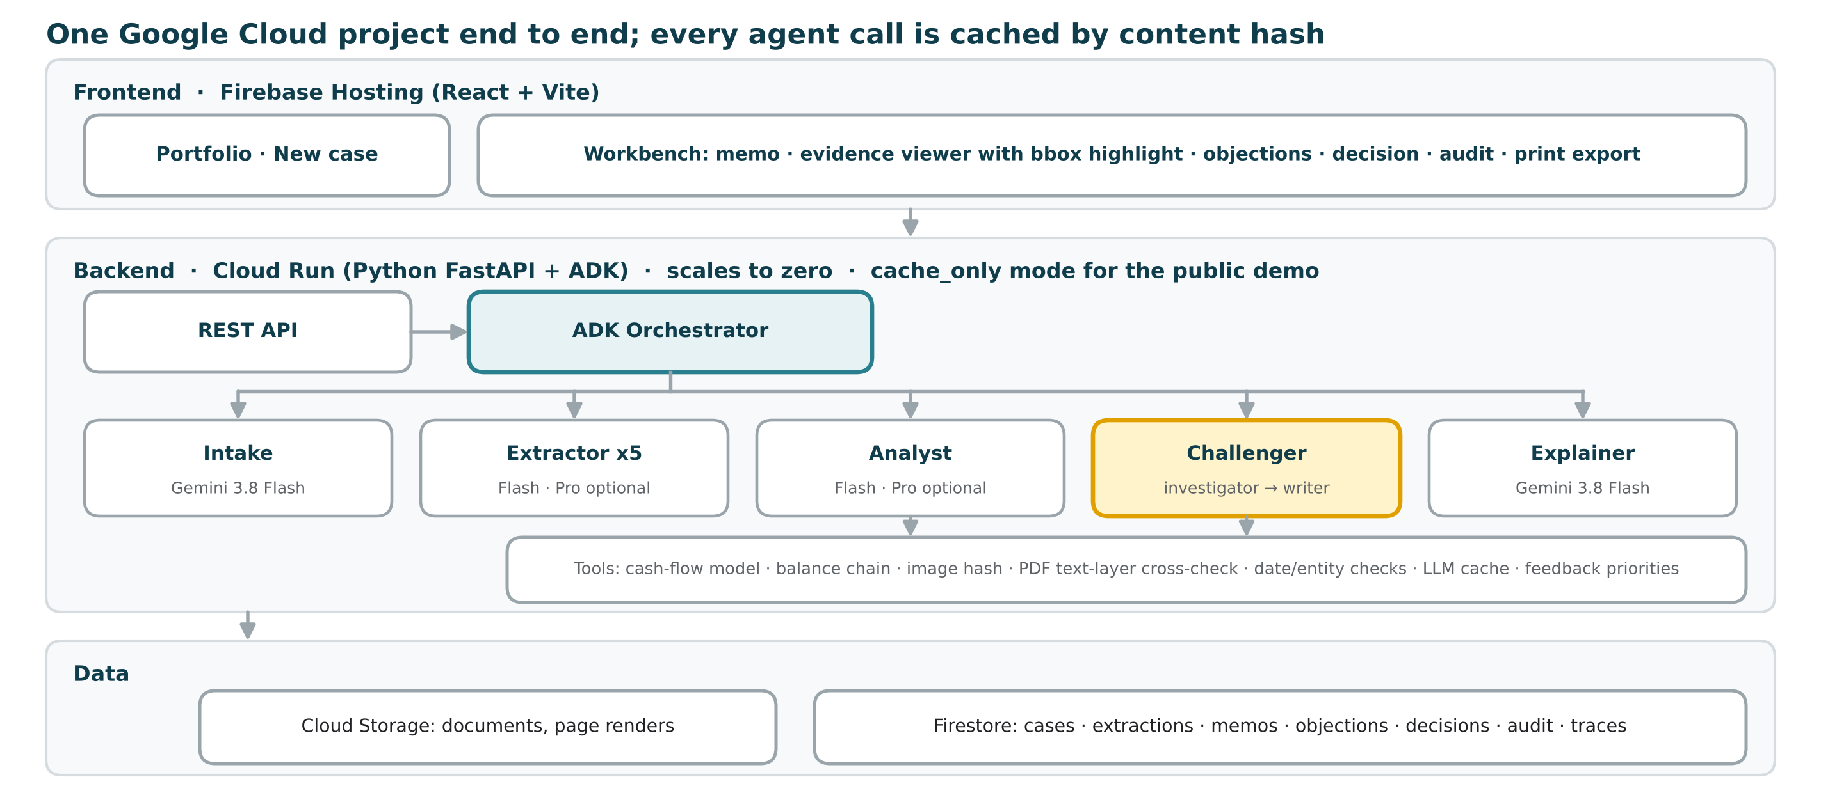
Architecture diagram of the proposed solution
One Google Cloud project end to end. Every agent call is cached by content hash, so re-runs are free and deterministic.

Slide 9
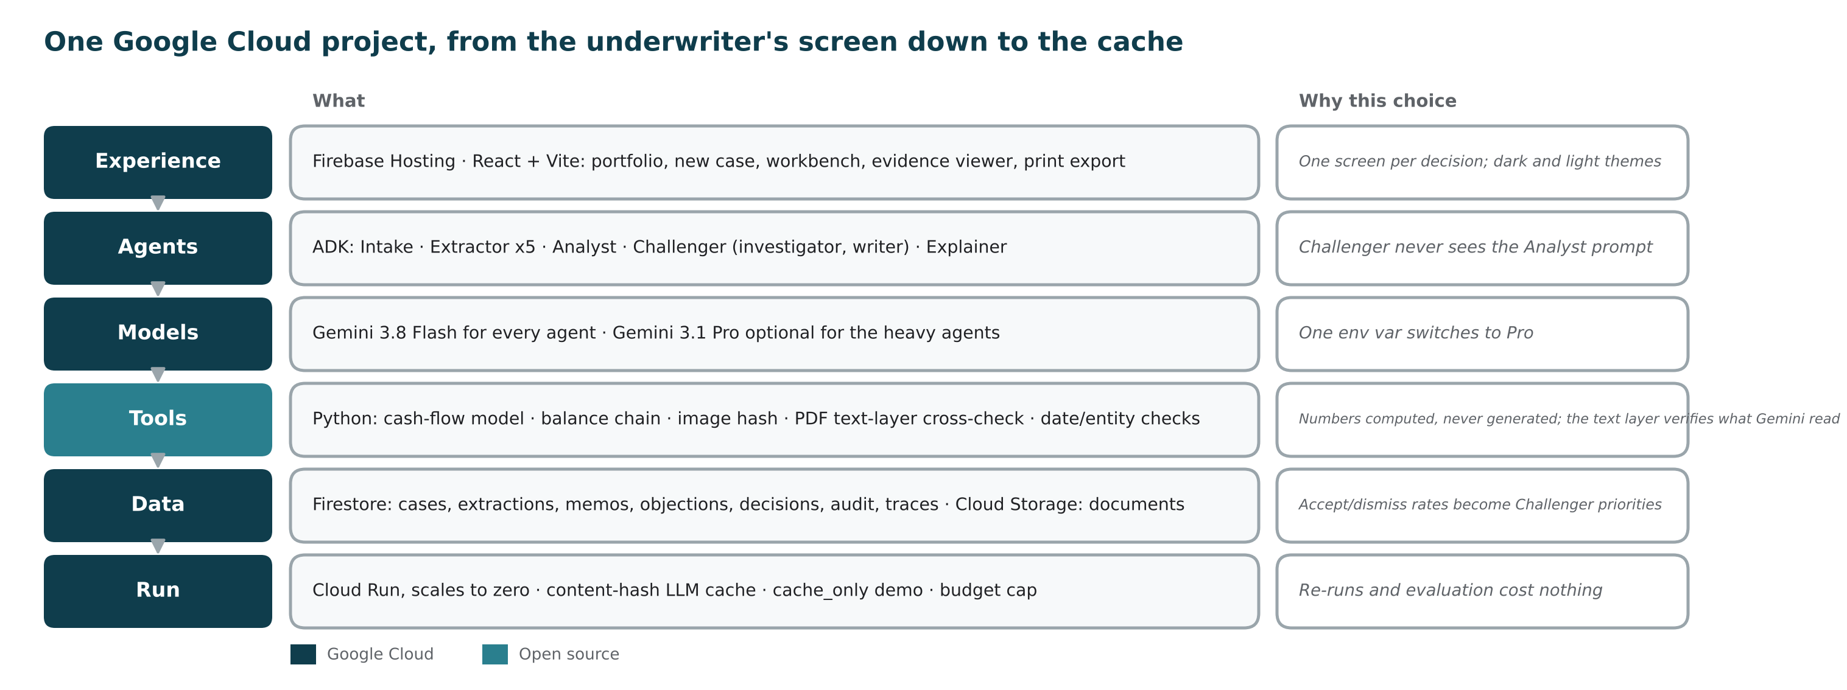
Technologies to be used in the solution
Output schema requires source {doc_id, page, bbox} on every value. LEDGERLENS_MODEL_PRO=gemini-3.1-pro-preview switches the heavy agents to Pro.

Slide 10
Estimated implementation cost
Cheap enough for small loans: about USD 0.10 per case on Flash, zero on a re-run
Assumption | Value
Gemini 3.8 Flash list price | USD 0.75 / 3.75 per 1M tokens
Gemini 3.1 Pro list price | USD 2.00 / 12.00 per 1M tokens
Tokens per 20-document case | 60-90k input, 15-25k output
Hosting | Cloud Run scales to zero; Firestore and Storage in free tier
Guardrail | Budget-cap env var stops Gemini calls once spent
Build | 4 engineers, 4 days, free tier and trial credits

Slide 11
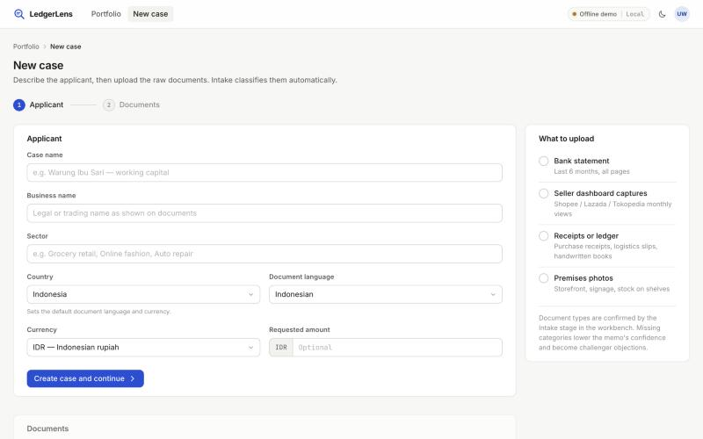
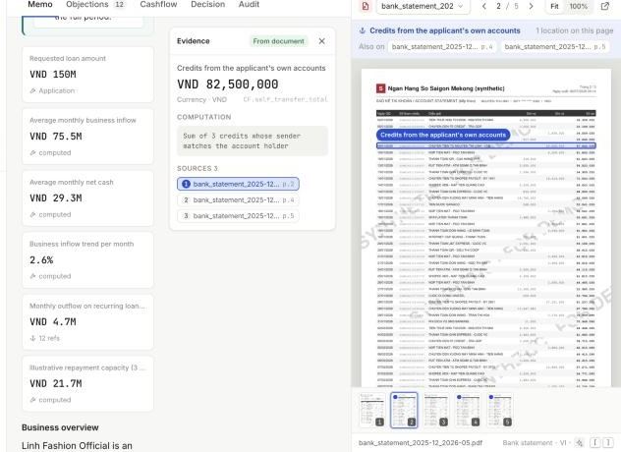
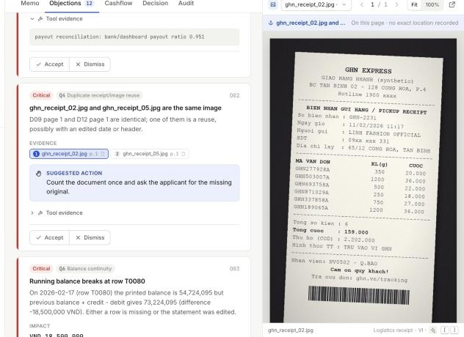
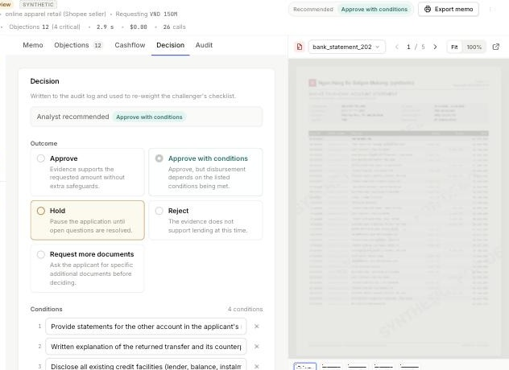
Snapshots of the prototype
1
New case
1
2
Applicant details, then the raw documents. Intake classifies and quality-flags them.
2
Click a number, see the line
Evidence panel with computation and all sources; the statement opens with the bounding box highlighted.
3
4
3
Challenger objections
Critical: two receipt photos are the same image with an edited date. Evidence chips open the photo.
4
The underwriter signs
Outcome, conditions and rationale, written to the audit log; accept/dismiss rates re-weight the checks.

Slide 12
Prototype performance report / Benchmarking
19 of 20 planted traps caught, zero unsourced numbers. A single prompt on the same documents caught none.
Metric | Target | Result
Trap recall | ≥ 16 / 20 | 19 / 20
Unsourced numbers | 0 | 0 (baseline 6)
Objections on clean case A | ≤ 20% | 0
Extraction row accuracy | ≥ 97% | 100%
Evidence-link accuracy | ≥ 95% | 100%
Time per case | ≤ 180 s | 4.5 s
Cost per case | ≤ USD 0.50 | USD 0.00
How measured. Run of 2026-10-14 in mock mode: full pipeline plus the deterministic Challenger battery, no Gemini calls, 3 synthetic businesses, 43 documents, answer key traps.json. Baseline is a stub in this mode; a live Gemini 3.8 Flash run replaces both before submission.

Slide 13
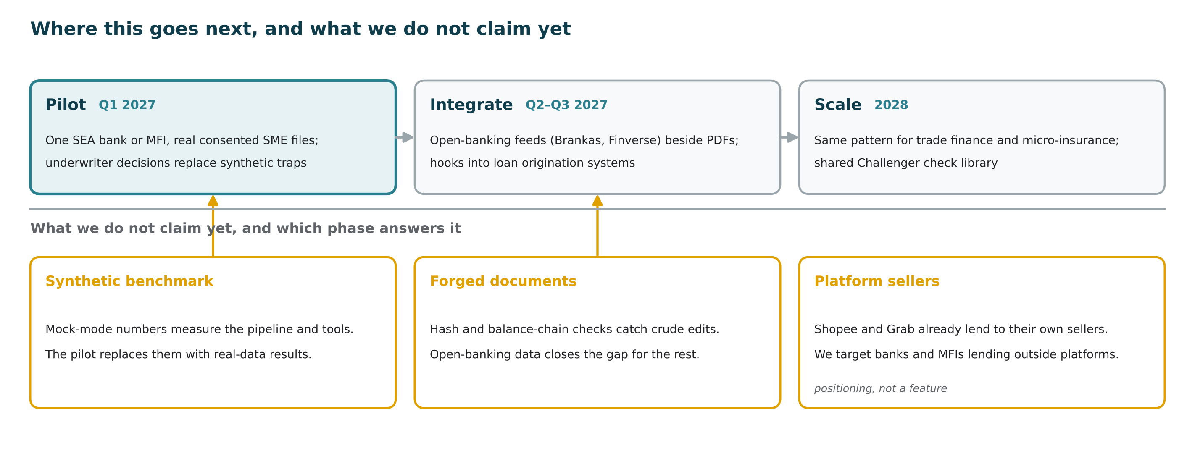
Additional details / Future development
Humans decide, every figure and decision is traceable, the prototype uses watermarked synthetic data only, and production keeps documents and model endpoints in-region.

Slide 14
Provide links to your:
GitHub public repository
English README, architecture, run instructions, synthetic-data notice
github.com/<team>/ledgerlens
Demo video (3 minutes)
Problem in 20 seconds, click-to-source and Challenger scenes, benchmark at 2:20
YouTube public link
Final product
Cloud Run service, three demo cases preloaded, warm through evaluation
ledgerlens-<hash>.a.run.app
Links are inserted at submission on 18 October 2026.

Slide 15
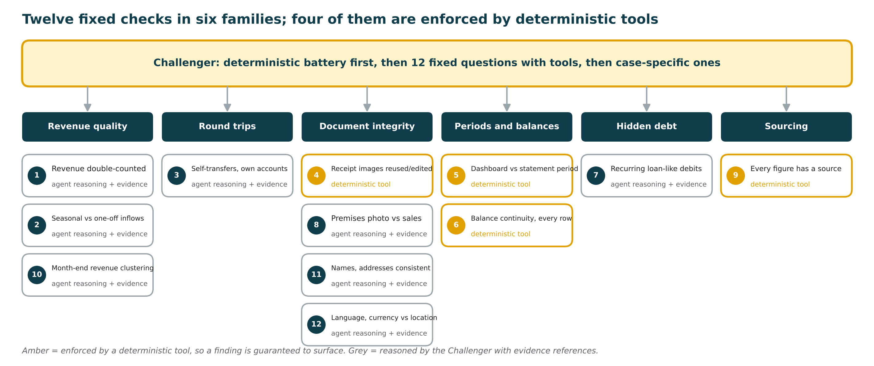
Appendix: the Challenger's 12 fixed checks

Slide 16
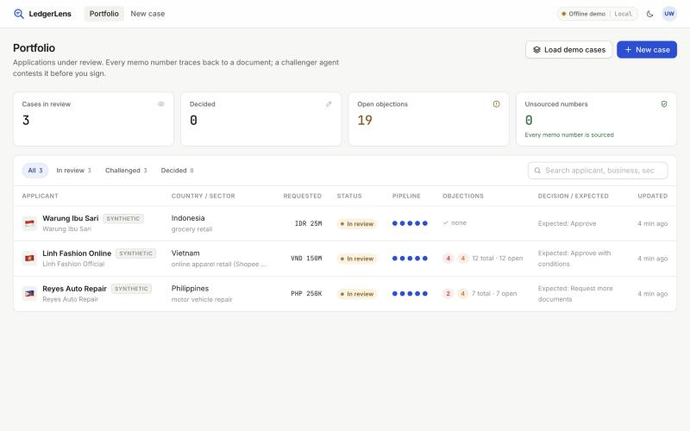
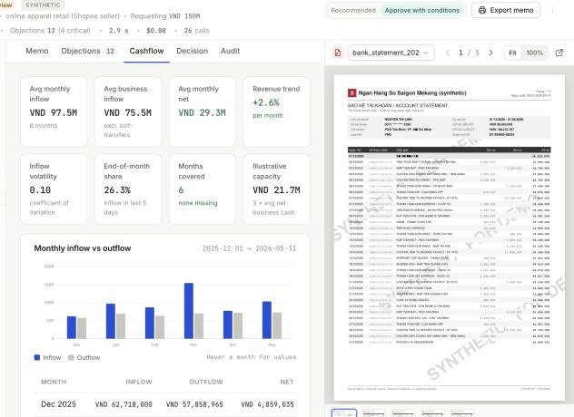
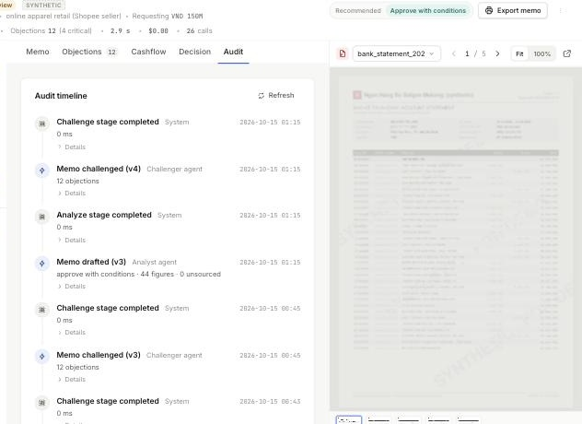
Appendix: portfolio, cash flow and audit views
Portfolio
Cash flow
Audit timeline
Cases in review, open objections and unsourced numbers across the book; filters by status.
Deterministic monthly model: inflow, net, trend, volatility, end-of-month share, repayment capacity.
Every stage and agent call with version, model and prompt; the trail a regulator can read.
Also in the build: dark and light themes, PDF text-layer cross-check on every extracted amount, content-hash LLM cache, cache_only demo mode, budget cap, printable paper memo with footnoted sources.

Slide 17


