Slide 1
Study of Financial Market based on S&P 500
Changhyun Ahn
Edward Cai
(Betti) Biwei Tao

Slide 2
Whose mind going to change?
Traders !! who believe in…
PART 1. (conventional methods)
  Fridays nights are BAD, and
PART 2. (time-series)
  Recessions are PERSISTENT

Slide 3
“Weekend Effect”
Investopedia Definition:
Stock returns on Monday Open are significantly lower than preceding Friday Close.
After Hours in the U.S. :
1) 4:00 p.m. to 8:00 p.m. ET, and
2) 4:00 a.m. to 9:30 a.m. ET.
Whose minds to change :
Traders who believe in this myth.
Notes:
20s
Tendency to release bad news on Friday after market, allowing market to buffer w/o trapped into self-fulfilling panic
Minds to change: people who believe this myth

Slide 4
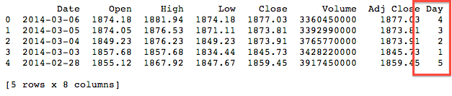
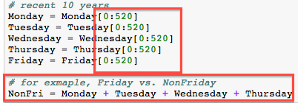
Quantity of Interest
Subset first 52 x 10 elements. Therefore, we have 10 years of data, roughly from March 2004 to March 2014.
Notes:
20s
Quantity of interest, Friday is control group
Create day of the week indicator, fill in the dynamic lists
Subset first 520 elements, so that we have 10-year data

Slide 5
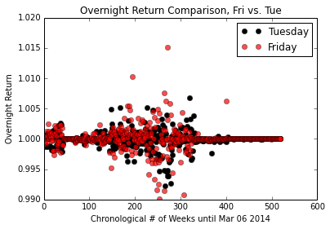
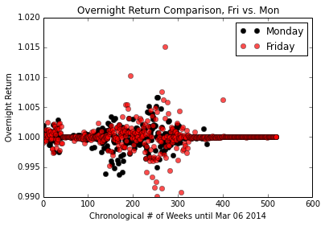
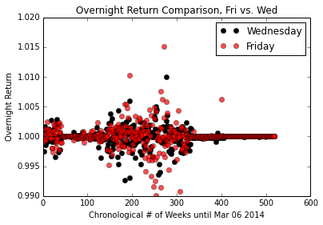
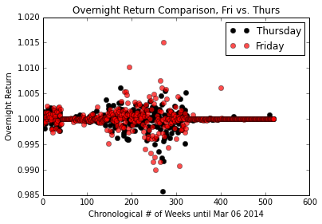
Reds below Blacks ?
Notes:
30s
Plot of Friday vs. Monday……. TWR
Vertical, overnight returns……horizontal, # of weeks until present time, 520 reds and 520 blacks
Reds on average below blacks? Run tests

Slide 6
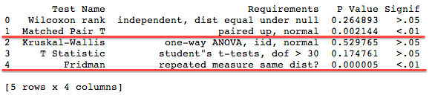
Conventional Tests
Perhaps not applicable for time-series data, but… let’s make
Aggressive Assumptions:
1) Group Independence (e.g. Friday indep. Thursday),
2) Normal Distribution,
3) Paired-up Match (i.e. grouping by week),
4) IID dist, and
5) Null Hypothesis true, in general μ_Friday = μ_nonFriday
Notes:
20s
1) Not applicable for time-series data, but for conventional statistical test, we gotta comprimise
2) List of assumptions, usually between mean(Friday) vs. mean(Pooled Sample)
3) Only two tests resulted in high significance, indicating treatment difference

Slide 7
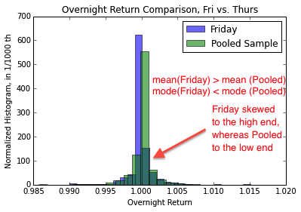
Skewed Histograms….
Notes:
20s
Histogram skewed, Friday has smaller mode but higher average
Might be a good indicator to bootstrap,
Behavior of mean

Slide 8
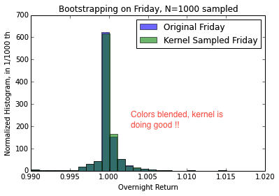
Spike-like “Tophat” Kernel
Notes:
10s
1) Given the shape of distribution, use spike-like kernel
2) Kernel sampled collide with original data, so it the bootstrapping is doing good

Slide 9
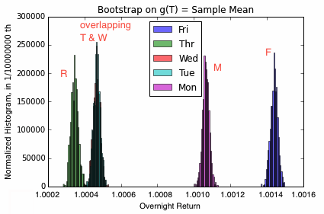
Equal B Bootstrap
Notes:
40s
Function of interest is Sample Mean
2) Bootstrap summary, individual boot, W&T overlap each other
3) Conclusion: Friday came up the most positive by exhibiting a higher expect overnight return mean

Slide 10
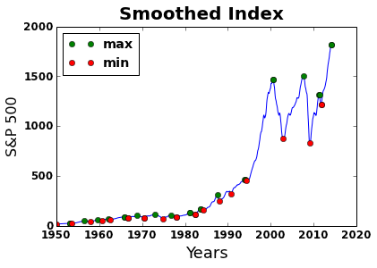
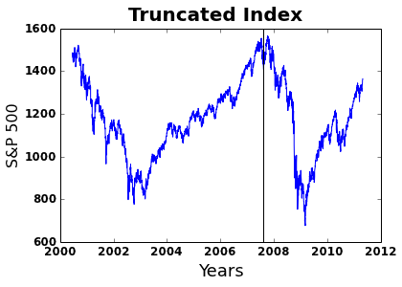
Historical S&P 500 Index
Smoothing the curve to get local maxima
Partitioning pre and post event

Slide 11
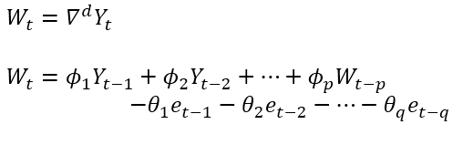
ARIMA Model
Pre Event
 | Coefficients | Standard Error | z-score | P-value
Constant | 1268.4289 | 145.104 | 8.741 | 0.000
AR | 0.9973 | 0.002 | 496.219 | 0.000
MA | -0.1581 | 0.035 | -4.561 | 0.000
Post Event
 | Coefficients | Standard Error | z-score | P-value
Constant | -0.0903 | 0.473 | -0.191 | 0.849
AR | 0.2611 | 0.153 | 1.712 | 0.087
MA | -0.4135 | 0.143 | -2.893 | 0.004

Slide 12
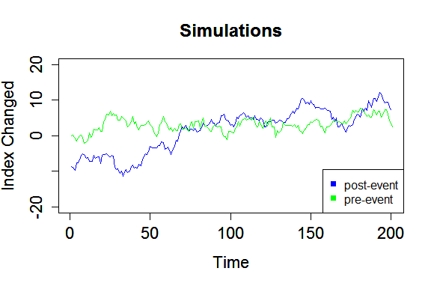
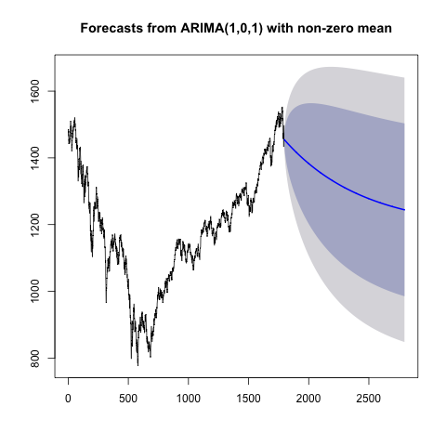
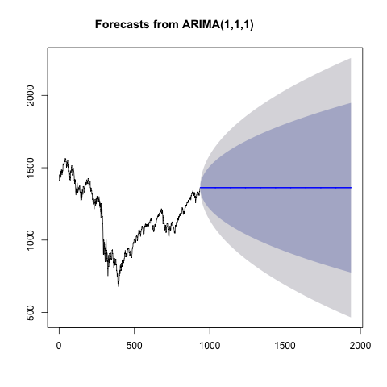
Simulation
&
Forecast
Pre Event
Post Event

Slide 13
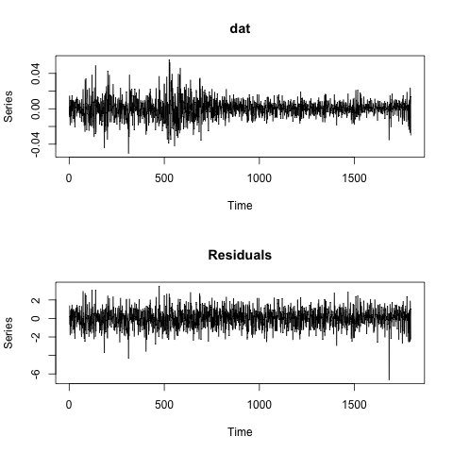
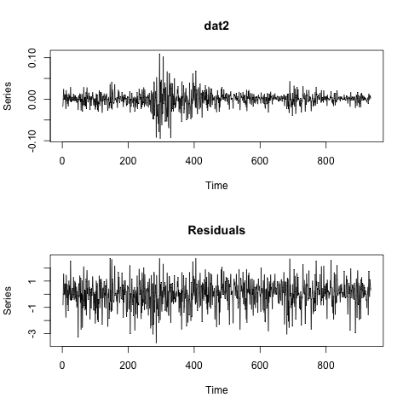
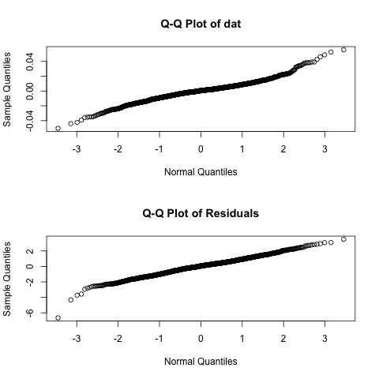
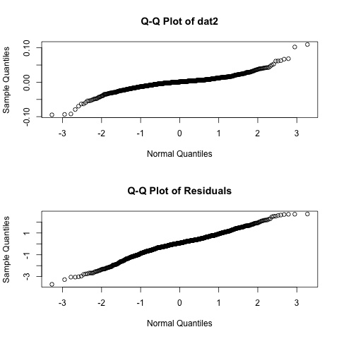
Log Returns and Residuals
Pre Event
Post Event

Slide 14

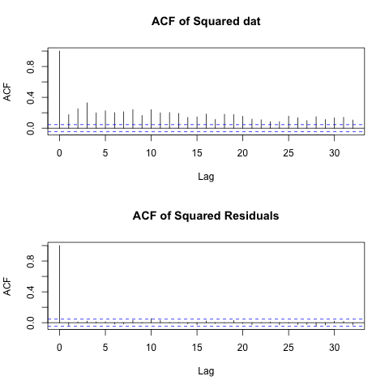
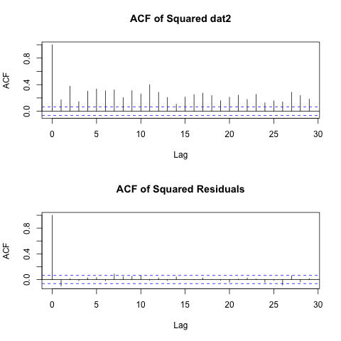
GARCH Model
& ACF
Pre Event
Post Event

Slide 15
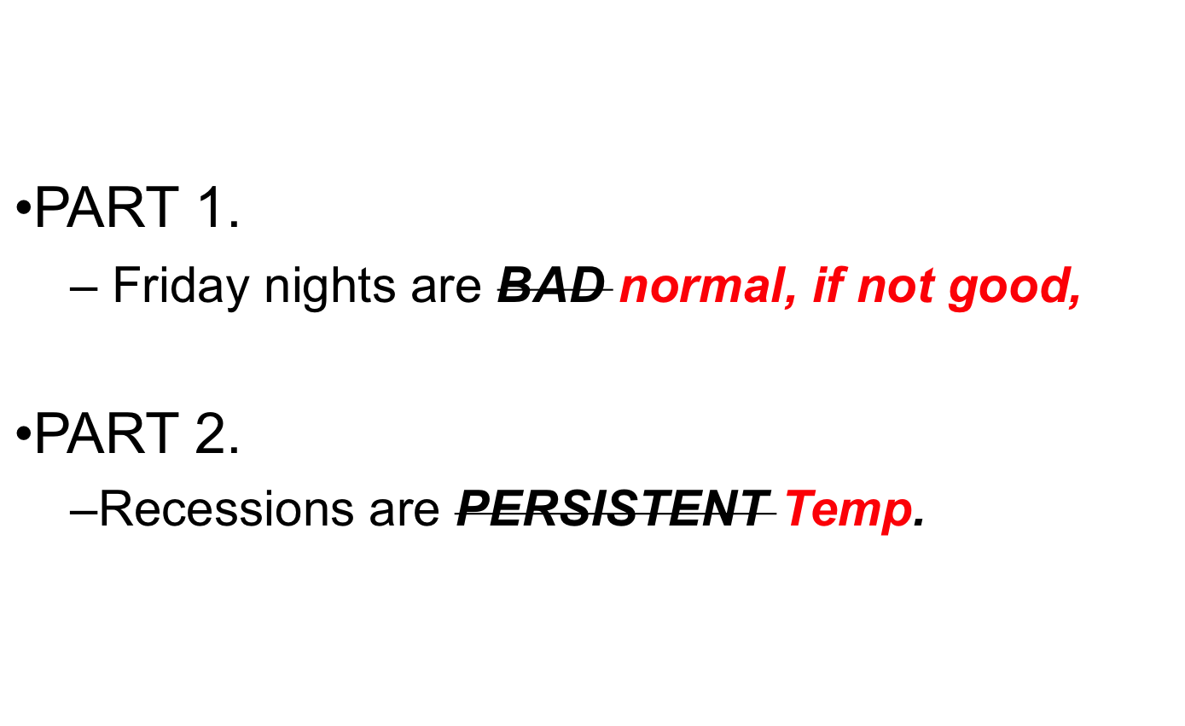
Conclusions

