Slide 1

SPWAL FINAL REPORT
A Systematical Approach on Regulating
and Reducing E-Waste
Team GangGreen
Guoliang Xue, Jonas Mattes, Changkun Ou, Bruno Müller, An Ngo Tien, Zhe Li, and Anita Baier
18th July, 2017
Seminar und Praktikum “Wissenschaftliches Arbeiten und Lehren” Sommersemester 2017

Slide 2
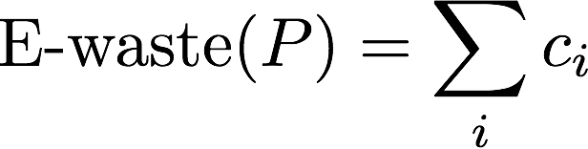
INTRODUCTION
Intents:
Electronics gains its porpularity;
Increasing demand of electronics;
Leads E-waste polution to our surroundings, even third world contries;
...
Our contribution:
The “Ingredient List” of products
Main idea:
Notes:
电子垃圾的流行
接下来我们会详细为你们展示一些数据
第三方国出口，如何权衡各国的利益？
我们的方案
主要想法：每个组件指定一个ewaste value，然后把他们加起来作为一个产品的ewaste值
这次演讲的的主要内容：
从整个product line来看的统一方案带来的影响：如何调控政府和制造商？—> Game Theory
行业统一的计算标准，是否会带来压力？
为什么这样一个简单的标准就能奏效，它带来的潜在应用是什么？
对于政府而言我们可以如何应用它？
对于制造商来说如何应用这个方案？
对于回收公司来说，又要如何应用这个方案？
当然，这个方案还是会带来一些问题，我们面临什么挑战

Slide 3
INTRODUCTION
Intents:
Electronics gains its porpularity;
Increasing demand of electronics;
Leads E-waste polution to our surroundings, even third world contries;
...
Our contribution:
The “Ingredient List” of products
Main idea:
Agenda
Backgrounds
Details on “Ingredient List”
Applications
Challenges
Outlook
Notes:
电子垃圾的流行
接下来我们会详细为你们展示一些数据
第三方国出口，如何权衡各国的利益？
我们的方案
主要想法：每个组件指定一个ewaste value，然后把他们加起来作为一个产品的ewaste值
这次演讲的的主要内容：
从整个product line来看的统一方案带来的影响：如何调控政府和制造商？—> Game Theory
行业统一的计算标准，是否会带来压力？
为什么这样一个简单的标准就能奏效，它带来的潜在应用是什么？
对于政府而言我们可以如何应用它？
对于制造商来说如何应用这个方案？
对于回收公司来说，又要如何应用这个方案？
当然，这个方案还是会带来一些问题，我们面临什么挑战

Slide 4
BACKGROUNDS
E-Waste backgrounds:
Most of the E-waste isn’t even getting collected and just thrown into the household waste;
80% of the E-waste which got collected is then getting exported in other countries;
Leads E-waste polution to our surroundings, even third world contries;
…
Huge amount of e-waste is going to increase and the need for new electronics keeps increasing.
To solve the problem of this steadily increasing E-Waste, recycling should become more important and more commonly used.

Slide 5
BACKGROUNDS
The EU emissions trading system (EU ETS):
The first large greenhouse gas emissions trading scheme;
“cap and trade” principle;
“Allowances” for emissions can subsequently be traded.;
A decrease of more than 8 percent since 2005.
Our goal
A E-waste trading system similar with EU ETS
Notes:
A cap is set on the total amount of certain greenhouse gases that can be emitted by installations covered by the system. The total emissions will fall if the cap is reduced over time.
in 2010 greenhouse gas emissions from big emitters covered by the EU ETS had decreased by an average of more than 17,000 tonnes per installation from 2005, a decrease of more than 8 percent since 2005.

Slide 6
BACKGROUNDS
System currently:
EWSI (E-waste Systems, Inc)
A company that offers customized end-to-end solutions in IT Asset Recovery.
Collection, conversion
E-waste system in the U.S.
Life Cycle Assessment (LCA)
Material Flow Analysis (MFA)
Multi Criteria Analysis (MCA)
Extended Producer Responsibility (EPR)
Notes:
EWSI is a company that offers customized end-to-end solutions in IT Asset Recovery, E-Waste Management, and Electronics Reverse Logistics. It can provide a variety of containers for onsite collection, audit and asset registration services on pickup, and either dedicated or consolidated routes and storage prior to processing.
Convert into new raw materials

Slide 7
INGREDIENT LIST SPECIFICATIONS
Goals of ingredients list
How much e-waste in total?
What kind of e-waste?
How much of e-waste is especially dangerous?

Slide 8
INGREDIENT LIST SPECIFICATIONS
Our requirements:
Show total mass of product
Ordered list by weight of ingredient materials
Special materials marked with bold font and exact percentages

Slide 9
INGREDIENT LIST SPECIFICATIONS
What are special materials?
Toxic materials
Dangerous to the environment
Rare materials
Hard to recycle

Slide 10
INGREDIENT LIST SPECIFICATIONS
But isn’t it hard for a manufacturer to create such a list?
No. Not at all.

Slide 11
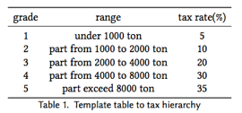
Tax Hierarchy
• Staircase-like structure to distinguish different tax rate
• Only for one degree(low, medium, high), different degrees means the basic tax rate should be different

Slide 12
Prevention Mechanism(1)
• Variables in Game Theory
• cost of remedial measurement R
• cost of regulation C
• cost of penalization industries have to pay for government F
• welfare (less contamination) W
• selling price of normal electronics P_{n}
• selling price of electronics with ingredient list P_{il}
• the cost of normal electronics C_{n}
• electronics with ingredient list C_{il}
• profit of electronics with ingredient list R_{il} =(P_{il} −C_{il})
• profit of electronics without ingredient list R_{n} =(P_{n} −C_{n})
• probability of government taking a regulation α
• probability of industry executing the ingredient list β

Slide 13
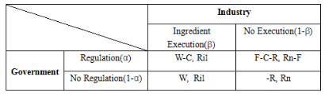
Prevention Mechanism(2)
Expectation
• E_{g} = αβ(W−C)+α(1−β)(F−C−R)+(1−α)βW+(1−α)(1−β)R
• E_{c} = αβR_{il} +α(1−β)(R_{n} −F)+(1−α)βR_{il} +(1−α)(1−β)R_{n}
Notes:
E = α(F-C-βF) + βW +βR

Slide 14


Prevention Mechanism(3)
Optimal reaction functions for this Game Theory Model
Equilibrium solution for this Game Theory Model
Government is intended to regulation the Industries at the probability of α∗, and the Industry execute Ingredient List at the probability of β∗

Slide 15
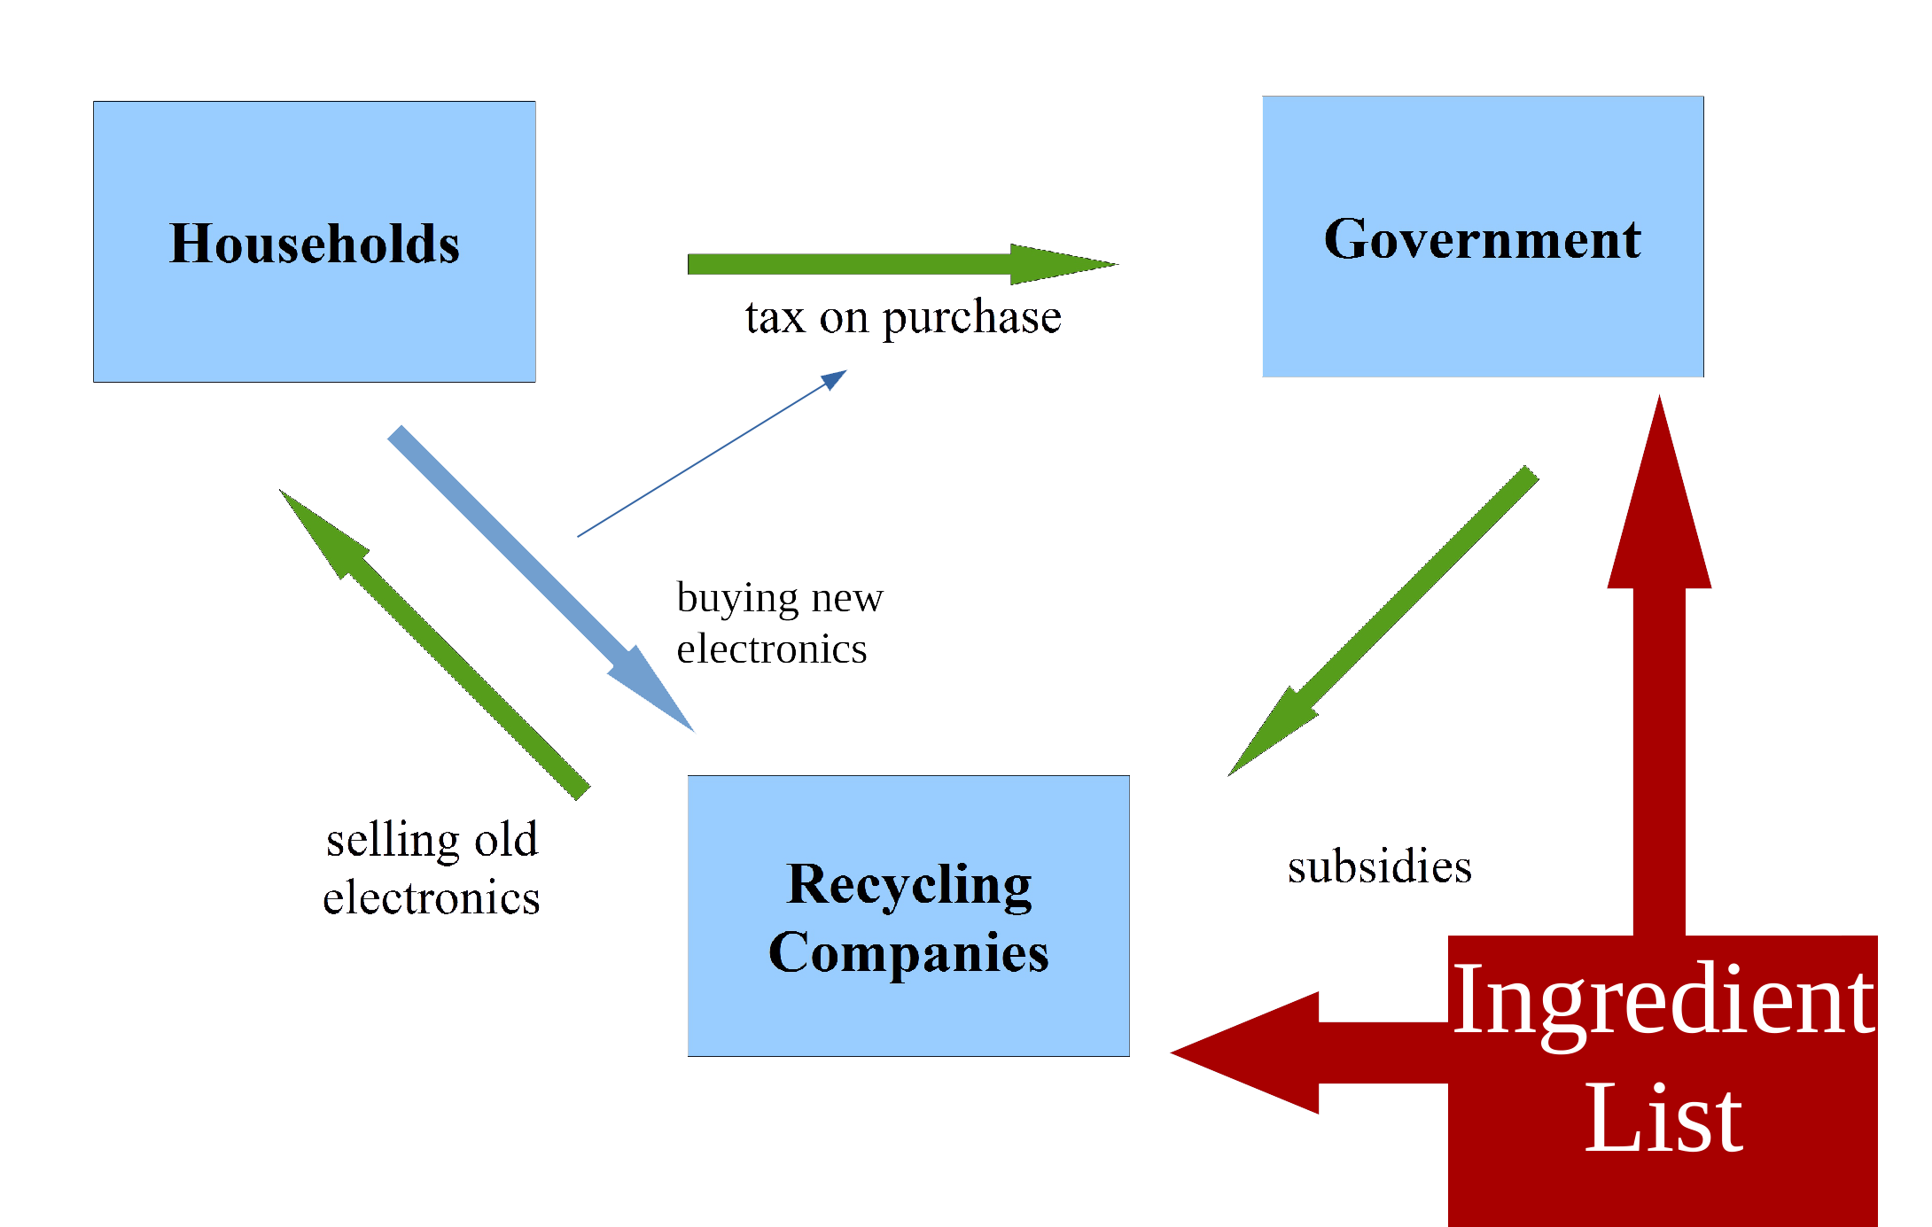
APPLICATIONS

Slide 16
CHALLENGES
Dependency on suppliers
Exceptions for “bad suppliers”
Precision of tiny contents
Discuss minimum precision
Calculation could be enough
Importing
Grade 5 on non labeled imports
Or calculation
Won’t persist very long
Notes:
Dependency on suppliers → Exception if a supplier can’t fulfill the ingredients (punishment, estimation, …)
Precision → Establishing practicable minimum precision (maybe only calc, instead of measuring)
Importing unlabeled products (cooling period) → Grade 5 / good estimation get better grade / won’t persist very long

Slide 17
OUTLOOK
Practicability?
Testing in the real world:
Additional applications:
Further list specifications?
Unconsidered aspects:
Side effects and negative impacts?
Responsibilities? Further development?
Real world migration:
Coming up with the derivation to the proposal?

Slide 18
Questions?

Slide 19
REFERENCES
[1] Bundesministerium fuer Umwelt, Naturschutz, Bau und Reaktorsicherheit. 2017. FAQ zur BMUB-Internetseite. http://www.bmub.bund. de/service/buergerforum/haeu ge-fragen-faq/faq-detailansicht/?no_cache=1&tx_irfaq_pi1. (2017). [Online; accessed May 11, 2017].
[2] Naturschutzbund Deutschland e.V. 2017. Alte Handys fuer die Havel. https://www.nabu.de/umwelt-und-ressourcen/ aktionen-und-projekte/alte-handys-fuer-die-havel/index.html. (2017). [Online; accessed May 11, 2017].
[3] Bundesministerium fuer Ernaehrung und Landwirtschaft. 2016. (2016). http://www.bmel.de/SharedDocs/Downloads/Broschueren/ Flyer-Poster/Flyer-LM-Kennzeichnung.pdf?__blob=publicationFile
[4] Bundesministerium fuer ErnaÌĹhrung und Landwirtschaft. 2017. (06 2017). http://www.bmel.de/DE/Ernaehrung/Kennzeichnung/ Verp ichtendeKennzeichnung/Verp ichtendeKennzeichnung_node.html
[5] Ramzy Kahhat, Junbeum Kim, Ming Xu, Braden Allenby, Eric Williams, and Peng Zhang. 2008. Exploring e-waste management systems in the United States. Resources, Conservation and Recycling 52, 7 (2008), 955–964.
[6] Peeranart Kiddee, Ravi Naidu, and Ming H Wong. 2013. Electronic waste management approaches: An overview. Waste Management 33, 5 (2013), 1237–1250.

Slide 20
REFERENCES
[7] Chen Lihong. 2007. Electronic industry green supply chain construction of the main behavior of Game Theory. Nankai University (2007). https://doi.org/10.7666/d.j015745.
[8] Erica Plambeck and Qiong Wang. 2009. E ects of e-waste regulation on new product introduction. Management Science 55, 3 (2009), 333–347.
[9] Brett H. Robinson. 2009. E-waste: An assessment of global production and environmental impacts. Science of The Total Environment 408, 2 (2009), 183–191. https://doi.org/10.1016/j.scitotenv.2009.09.044
[10] Munam Ali Shah and Rakhshanda Batool. 2015. An Overview of Electronic Waste Management, Practices and Impending Challenges. International Journal of Computer Applications 125, 2 (2015).
[11] Deutsche Umwelthilfe. 2017. Handy Recycling. http://www.duh.de/projekte/althandy/. (2017). [Online; accessed May 11, 2017].
[12] European Union. 2012. RICHTLINIE 2012/19/EU. http://eur-lex.europa.eu/LexUriServ/LexUriServ.do?uri=OJ:L:2012:197:0038:0071:de:PDF. (2012). [Online; accessed May 11, 2017].
[13] Rie Watanabe and Guy Robinson. 2005. The European Union emissions trading scheme (EU ETS). Climate Policy 5, 1 (2005), 10–14.
[14] Rolf Widmer, Heidi Oswald-Krapf, Deepali Sinha-Khetriwal, Max Schnellmann, and Heinz Böni. 2005. Global perspectives on e-waste. Environmental Impact Assessment Review 25 (2005).

