Slide 1

NCCU International Summer School 2026 · Course S3
Digital Communication and
Emerging Technologies
Day 1 · AI: The Big Picture & Neural Network Intuition
July 20, 2026 · 09:10–12:00 · Jia-Ming Chang, Dept. of Computer Science, NCCU
changlabtw.github.io/nccu-iss-2026

Slide 2




Today: from history to hands-on
One morning, three parts
09:10
Welcome, your instructor & course map Who's teaching you, how the 6 days fit, grading, teams
09:25
Lecture A: AI, the big picture 70 years of AI in one story, ending with a Nobel Prize
10:10
Lecture B: AI is reshaping work Real data on how millions of people work with AI today
10:30
Break (10 min) Stretch, grab water
10:45
Hands-on lab (~1.25 hr) Accounts, teams, and training your first neural network in the browser
Digital Communication & Emerging Technologies · NCCU ISS 2026 · Day 1 | 2

Slide 3


First: join our Zuvio classroom
We'll use Zuvio for quick polls and check-ins all week
1
2
3
Download or register online Get “Zuvio Campus” from the App Store / Google Play, or sign up at zuvio.com.tw
Register & log in Create an account in the Zuvio Campus app and sign in
Add this course In “Learning,” tap + and enter the course passcode
→
→
Course passcode
152422914
Stuck? Raise a hand — we'll set it up together in the first minutes.
Digital Communication & Emerging Technologies · NCCU ISS 2026 · Day 1 | 3

Slide 4
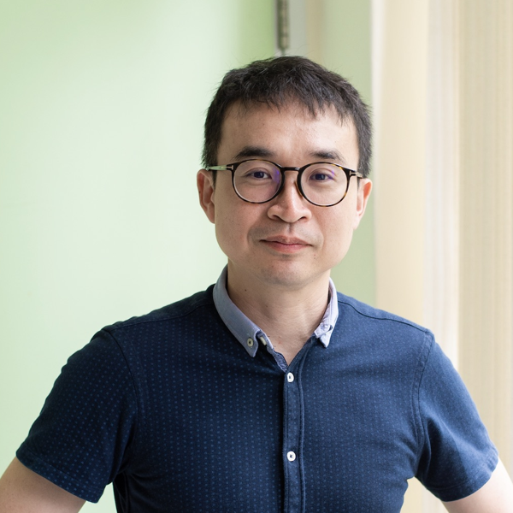
Who's teaching you
Jia-Ming Chang (張家銘) · Dept. of Computer Science, NCCU
I'm a computational biologist. I use computers to make sense of the data of life — genomes, proteins, cells.
Study BSc & MSc in Computer Science, National Tsing Hua University
PhD Centre for Genomic Regulation (CRG), Barcelona — La Caixa fellowship, with Cedric Notredame
Postdoc Institute of Human Genetics (IGH / CNRS), Montpellier — with Giacomo Cavalli
Now NCCU — I lead the Big / Biodata Science Lab (巨觀生物資料科學實驗室)
Also Deputy Editor, NAR Genomics and Bioinformatics (Oxford University Press)
Digital Communication & Emerging Technologies · NCCU ISS 2026 · Day 1 | 4

Slide 5
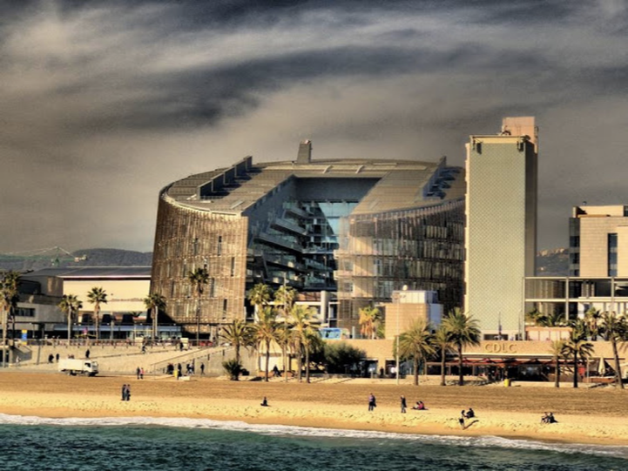
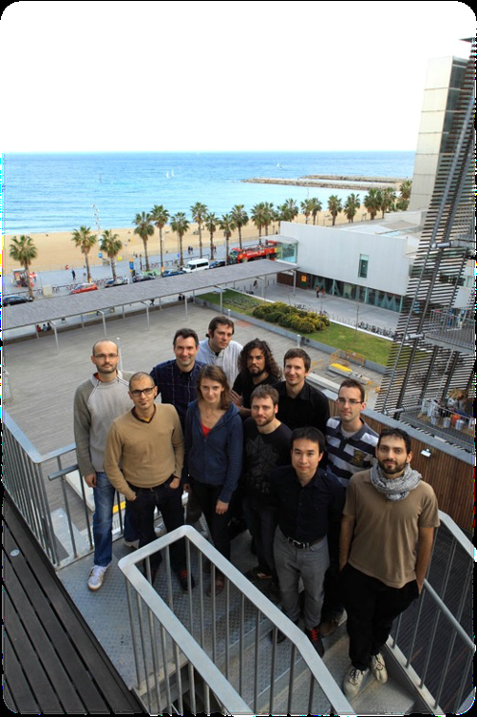
Where I trained: the PRBB, Barcelona
Centre for Genomic Regulation (CRG) — right on the Mediterranean
CRG at a glance Founded 2000 30+ research groups, 6 core facilities 437 staff · 69% from abroad Ranked #9 worldwide (SCImago, health sector, 2014) An international institute — much like this summer school.
The PRBB building on Barceloneta beach
Photo albums: album 1 · album 2
My CRG lab group
Digital Communication & Emerging Technologies · NCCU ISS 2026 · Day 1 | 5

Slide 6

Why a bioinformatician is teaching you AI
The two fields grew up together — and are merging again
Asked in 2024 what he'd study today, NVIDIA's CEO Jensen Huang reportedly pointed away from programming and toward the life sciences. The tools you'll meet this week — the same GPUs, the same neural networks — are now reading genomes and folding proteins.
RK
DK
Richard Karp Turing Award laureate who moved his combinatorial-algorithms expertise into computational biology in mid-career.
Donald Knuth The father of algorithm analysis said that if he were starting over, he'd be drawn to biology.
This course You'll see it on Day 4: AlphaFold (protein folding) and AI reading the genome — a Nobel-winning frontier.
The point: AI is not a topic apart from your field. It's a tool that's arriving in every field — including yours.
Digital Communication & Emerging Technologies · NCCU ISS 2026 · Day 1 | 6

Slide 7
The course in six days
From using AI, to understanding AI, to questioning AI
Mon 7/20
Tue 7/21
Wed 7/22
Thu 7/23
Mon 7/27
Tue 7/28
Big picture &
neural nets
Train an image
classifier
Generative AI,
LLMs & agents
AI at the frontier
of science
Deepfakes,
misinformation
& trust
Group
presentations
→
→
→
→
→
Every day: a short lecture + a ~1.5-hour hands-on lab in the browser. No programming background needed — that is a promise, not a disclaimer.
The thread that ties it together: how these technologies change what we communicate, and what we trust.
Digital Communication & Emerging Technologies · NCCU ISS 2026 · Day 1 | 7

Slide 8




Grading & how we work
Simple on purpose
Grading
Teams & tools
50%
Attendance & in-class participation
(including the daily computer labs)
4 teams (three of 4, one of 3) — formed today, you present together on 7/28
We standardize on Claude (claude.ai) for consistency — but you're welcome to use ChatGPT, Gemini, or others
50%
Group presentation on Day 6
(with Q&A; rubric on the course site)
Google Colab & NotebookLM — free accounts, set up in today's lab
Everything lives on the course website: schedule, readings, worksheets
Show up, take part, present well. That's it.
Digital Communication & Emerging Technologies · NCCU ISS 2026 · Day 1 | 8

Slide 9

You already know AI — from the movies
Warm-up: shout out a film about AI
2001: A Space Odyssey (1968) · The Terminator (1984) · The Matrix (1999) · A.I. (2001) · Her (2013) · Ex Machina (2014) · M3GAN (2022) · The Creator (2023) …
Movie AI is about robots that want things.
Real AI is about systems that
learn patterns from data — and that is already everywhere.
Where did you already use AI today? (Phone unlock? Translation? Maps? A recommendation? A chatbot?)
→ Zuvio poll
Digital Communication & Emerging Technologies · NCCU ISS 2026 · Day 1 | 9

Slide 10
What is artificial intelligence?
The field got its name at a summer workshop — like this one
“Making machines behave in ways that would be called intelligent if a human were so behaving.” — the working definition from the field's founding proposal
1956 Dartmouth Summer Research Project — McCarthy, Minsky, Shannon & colleagues coin the term “artificial intelligence”
Two big families of approaches since then:
Rules written by humans (“if the board looks like this, move here”) — brittle, limited. Patterns learned from data (machine learning) — the approach that won, and today's story.
Digital Communication & Emerging Technologies · NCCU ISS 2026 · Day 1 | 10

Slide 11
Three nested ideas
Every headline you read fits in one of these circles
ARTIFICIAL INTELLIGENCE
any technique that makes machines act “smart”
A chess program following hand-written rules AI, but not ML
MACHINE LEARNING
learn patterns from data instead of hand-written rules
A spam filter that learns from examples ML, but not deep
DEEP LEARNING many-layered neural networks — powers image recognition, ChatGPT, Claude, deepfakes
Claude, ChatGPT, face recognition, deepfakes Deep learning
Digital Communication & Emerging Technologies · NCCU ISS 2026 · Day 1 | 11

Slide 12
Quick check: AI, ML, or deep learning?
→ Zuvio poll
Vote on Zuvio — no wrong answers, just a warm-up
A thermostat that turns on the heat below 18°C
A
Netflix suggesting your next show
B
Your phone unlocking with your face
C
A calculator adding two numbers
D
Cast your vote for each — we'll reveal the answers next.
Digital Communication & Emerging Technologies · NCCU ISS 2026 · Day 1 | 12

Slide 13
… and the answers
The label matters less than the range “AI” covers
A thermostat that turns on the heat below 18°C
AI (simple rules)
no learning at all
A
Netflix suggesting your next show
Machine learning
it learns from what you watch
B
Your phone unlocking with your face
Deep learning
a neural network recognizes you
C
A calculator adding two numbers
None of them
it just follows fixed arithmetic
D
From fixed rules to systems that learn: that spread is exactly the story of the next 15 slides.
Digital Communication & Emerging Technologies · NCCU ISS 2026 · Day 1 | 13

Slide 14
70 years in two slides — Act I
High hopes, hard winters, first victories
1956 Dartmouth workshop “AI” is born
1970s–80s AI winters promises outrun computers; funding freezes
1997 Deep Blue beats Kasparov machines win chess
1958 Perceptron first learning neuron
1982 Hopfield network physics meets memory — today's paper
2011 IBM Watson wins Jeopardy! machines parse language on TV
Notice the rhythm: excitement → disappointment → quiet progress → breakthrough. Keep it in mind for today's AI hype, too.
Digital Communication & Emerging Technologies · NCCU ISS 2026 · Day 1 | 14

Slide 15
70 years in two slides — Act II
The deep learning decade becomes the AI decade
2012 AlexNet deep learning wins image recognition
2017 Transformer “Attention Is All You Need” (7/22)
2024 Double Nobel Physics & Chemistry go to AI pioneers
2016 AlphaGo beats Lee Sedol at Go (more on 7/23)
2022 ChatGPT AI reaches 100M users in 2 months
2025–26 The agent era AI that does tasks, not just chats
The last four years compressed decades of change. This course exists because that compression is now hitting communication: content, credibility, and trust.
Digital Communication & Emerging Technologies · NCCU ISS 2026 · Day 1 | 15

Slide 16
The idea behind it all: borrow from the brain
A neuron, simplified to arithmetic
A brain neuron
An artificial neuron
Collects signals from thousands of neighbors. If the combined signal is strong enough, it fires and passes the message on. 86 billion of these, wired together, produce you.
x1
Σ
fire / don't fire
x2
x3
weights = how much each input matters
Learning = adjusting the weights. That single sentence is 80% of what “training an AI” means. You will do it yourself in an hour, with sliders instead of code.
Digital Communication & Emerging Technologies · NCCU ISS 2026 · Day 1 | 16

Slide 17
1982: John Hopfield — memory as a landscape
Today's landmark paper (PNAS, 1982)
The question: how can a network of simple neurons store and recall memories? The physicist's answer: treat the network like a physical system rolling downhill in an energy landscape. Each valley is a stored memory. Show the network a noisy, partial pattern, and it “rolls” to the nearest valley — recalling the complete memory.
energy
memory
Why it matters: it made neural networks respectable science again — and it is why a physicist shares the 2024 Nobel Prize in Physics. Your brain finishing the lyric “Twinkle, twinkle, little …” is associative memory at work.
Digital Communication & Emerging Technologies · NCCU ISS 2026 · Day 1 | 17

Slide 18
1985–86: Geoffrey Hinton — learning from mistakes
Backpropagation: the algorithm that trains every modern network
1
2
3
4
Guess The network makes a prediction — probably wrong at first
Measure Compare with the right answer; the gap is the “loss”
Blame Trace the error backwards: which weights caused it?
Adjust Nudge every weight slightly to shrink the error. Repeat, millions of times.
→
→
→
With Boltzmann machines (1985) and backprop (1986), Hinton showed multi-layer networks could learn. One problem remained…
In the lab today, the “play” button on TensorFlow Playground runs exactly this loop — you will watch the loss shrink in real time.
Digital Communication & Emerging Technologies · NCCU ISS 2026 · Day 1 | 18

Slide 19


Why it took 30 more years: the scale problem
The ideas were ready in 1986. The world wasn't.
Data Networks learn from examples — and needed millions. The internet, smartphones, and social media created them.
Compute Training means billions of tiny weight updates. Gaming GPUs turned out to be perfect for it.
Ideas Better architectures (CNNs, then Transformers) let networks grow deep without falling apart.
2012, AlexNet: Hinton's students combine all three and crush the ImageNet competition. The deep learning era begins — and leads straight to the tools you use daily.
Digital Communication & Emerging Technologies · NCCU ISS 2026 · Day 1 | 19

Slide 20

The Nobel Prize in Physics 2024
“for foundational discoveries and inventions that enable machine learning with artificial neural networks”
JH
John J. Hopfield Princeton University
GH
Geoffrey E. Hinton University of Toronto
The Hopfield network (1982): memory as an energy landscape — the paper you're reading today
Boltzmann machines & backpropagation: how multi-layer networks learn from data
Same year, the Chemistry prize went to AlphaFold (Hassabis, Jumper) and protein design (Baker) — our 7/23 topic. Two Nobel Prizes for AI in one week.

Slide 21
“Why is this physics?” — and a warning
The laureates' own words, October 2024
Why physics? Hopfield borrowed the mathematics of magnetic materials (spin systems) to describe memory. The tools of physics explained how networks of simple units produce collective behavior — remembering, recognizing, learning.
The warning In his first interview after the prize, Hinton — who left Google in 2023 to speak freely — repeated his concern that we don't fully understand systems smarter than us in some ways, and urged more research on AI safety.
Hold that thought: it returns on 7/27, when we study deepfakes and trust.
Full lectures & interviews linked on the course site (nobelprize.org).
Digital Communication & Emerging Technologies · NCCU ISS 2026 · Day 1 | 21

Slide 22
How does a computer “think”? It searches.
Before deep learning, AI meant exploring possibilities — fast
1
3
5
Every move creates a new arrangement — a new “state.” The computer treats problem-solving as a search: from where I am, what moves can I make? And from each of those, what next? It builds a branching tree of possibilities and looks for a path to the goal. No learning yet — just disciplined trial and error, far faster than a human.
4
2
7
8
6
The 8-puzzle: slide tiles into the gap to reach the goal order.
This is the AI of the 1960s–90s: chess, puzzles, routes, logistics. It's still everywhere — GPS routing is search.
Digital Communication & Emerging Technologies · NCCU ISS 2026 · Day 1 | 22

Slide 23
A search tree — and why it explodes
Each move branches. The branches multiply. Fast.
start
The combinatorial explosion
Tic-tac-toe: ~10⁵ games — a computer checks them all instantly. Chess: ~10⁴⁰ positions — Deep Blue searched cleverly, not fully. Go: ~10¹⁷⁰ positions — more than atoms in the universe. Brute-force search is hopeless.
⋮
⋮
⋮
⋮
⋮
⋮
So the machine needs a way to guess which branches are worth exploring — without checking them all.
Digital Communication & Emerging Technologies · NCCU ISS 2026 · Day 1 | 23

Slide 24


One clever trick: play it out at random
Monte Carlo tree search — the idea inside AlphaGo
Can't check everything? Then don't. From the current position, pick a promising move to explore.
Play random games From there, let the computer play many quick games to the end, choosing moves at random.
Keep what wins Moves that led to more wins get explored more. Good branches grow; bad ones are pruned.
→
→
The insight: randomness plus memory beats brute force. But MCTS alone still wasn't enough for Go — it needed a sense of which positions are good. That intuition came from a neural network. Search met learning — and AlphaGo was born.
Digital Communication & Emerging Technologies · NCCU ISS 2026 · Day 1 | 24

Slide 25
Preview: when learning met intuition
AlphaGo, 2016 — a 30-second teaser
Go has more board positions than atoms in the observable universe — no rulebook can cover it. AlphaGo combined deep networks (the intuition you just met) with clever search, and in March 2016 defeated legend Lee Sedol 4–1, watched by 200 million people. Move 37 of game two was a move no human would play — commentators called it a mistake, then called it beautiful. We tell the full story (and AlphaFold's) on 7/23.
Optional homework tonight: the AlphaGo documentary is free on YouTube — 90 minutes, genuinely moving.
Digital Communication & Emerging Technologies · NCCU ISS 2026 · Day 1 | 25

Slide 26
Part B
How AI is reshaping work
(and communication)
Not predictions. Measured data from millions of real AI conversations.

Slide 27
The Anthropic Economic Index
Instead of asking people how they use AI, measure it
Since early 2025, Anthropic (the maker of Claude, our course tool) has published a recurring study of anonymized real conversations on Claude — mapping them to official job-task categories (O*NET).
What do people use AI for? Coding dominates; writing, analysis, and education follow. The top 10 tasks alone cover about a quarter of all conversations.
How widely? By late 2025, about half of occupations had at least a quarter of their tasks show up in Claude usage.
How do humans and AI split the work? Every conversation is classified into one of five collaboration modes → next slide.
Source: Anthropic Economic Index reports, 2025–2026 (anthropic.com/economic-index)
Digital Communication & Emerging Technologies · NCCU ISS 2026 · Day 1 | 27

Slide 28





Five ways people work with AI
Two are automation. Three are augmentation.
AUTOMATION — AI does the task
AUGMENTATION — AI works with you
Directive “Translate this press release.” Hand it over, take the result.
Feedback loop “Run it again — fix the tone.” AI works, you steer with corrections.
Learning “Explain how a neural network learns.” AI as tutor.
Task iteration “Let's draft this article together.” Co-writing, turn by turn.
Validation “Check my essay — what's weak?” You work, AI gives feedback.
Same technology, five different relationships. “Will AI take my job?” is really the question: which of these five modes will my tasks end up in? A translator in validation mode has a job; a translator in directive mode has a hobby.
Digital Communication & Emerging Technologies · NCCU ISS 2026 · Day 1 | 28

Slide 29
The tug-of-war: automation vs. augmentation
Share of Claude.ai conversations, by broad mode
Early 2025 — Collaboration dominates — people iterate and learn with AI.
Aug 2025 — Automation overtakes for the first time; “just do it for me” (directive) jumps from 27% to 39% of conversations.
Late 2025 — Augmentation edges back ahead — as tools get more collaborative, people work with AI again.
Meanwhile — Business use through the API stays ~75% automated: classifying emails, processing invoices…
Approximate shares; remainder unclassified. Source: Anthropic Economic Index reports (Sep 2025, Jan 2026).
Digital Communication & Emerging Technologies · NCCU ISS 2026 · Day 1 | 29

Slide 30
What it means for communication work
Map your future tasks onto the five modes
Translation & subtitles Already heavily directive — full drafts by AI, humans review high-stakes text
Journalism & research Mostly augmentation — learning, verification, and drafting with a human byline
PR & marketing copy Feedback loops — AI drafts, humans steer brand voice and strategy
Editing & fact-checking Validation — human judgment stays central; AI flags, humans decide
Discuss in pairs (2 min): Which mode do you actually use AI in? And for the news you read — which mode do you want journalists to use?
→ Zuvio poll
Digital Communication & Emerging Technologies · NCCU ISS 2026 · Day 1 | 30

Slide 31
Now: your first neural network
TensorFlow Playground — everything from Lecture A, as sliders
1 · Set up (10 min)
2 · Form teams (5 min)
3 · Playground (~1 hr)
Google account (Colab + NotebookLM)
Claude account (claude.ai)
Help your neighbor — teams that set up together, stay together
4 teams: three of 4, one of 3
Sit together, pick a team name
You'll present together on 7/28
playground.tensorflow.org
Challenge worksheet on the course site
Goal: Spiral test loss < 0.1 — and see overfitting with your own eyes
Deliverable: a screenshot of your best Spiral network + two sentences: what adding neurons/layers did, and what overfitting means in your own words.
Digital Communication & Emerging Technologies · NCCU ISS 2026 · Day 1 | 31

Slide 32
Before tomorrow
Read
Gates (2023), “AI is about to completely change how you use computers” — agents, in plain English
Skim
Hopfield (1982), the Nobel paper — read the first page; bring one question, however small
Watch
3Blue1Brown, “But what is a neural network?” — the best 19 minutes on today's topic (for tomorrow)
Tomorrow: you train a real image classifier — no code required. Same room, 09:10.
changlabtw.github.io/nccu-iss-2026 · chang.jiaming@gmail.com

