Slide 1


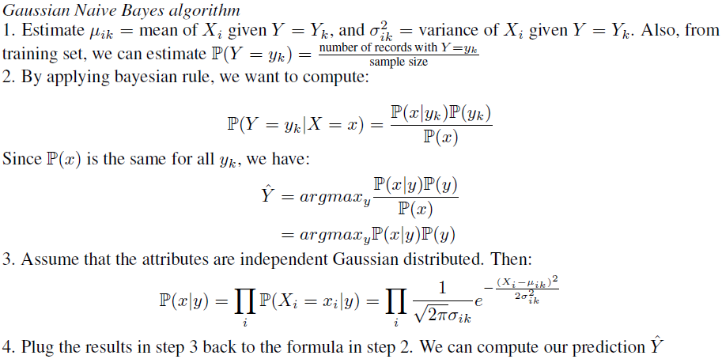
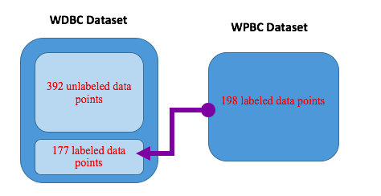
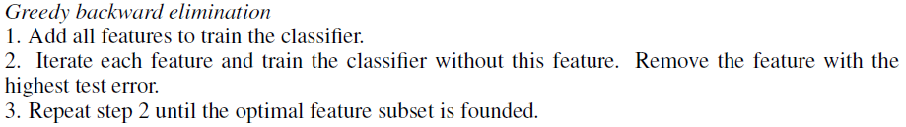
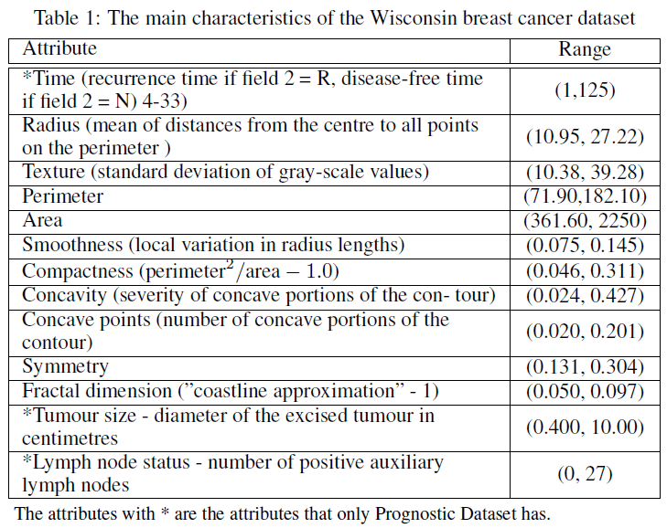
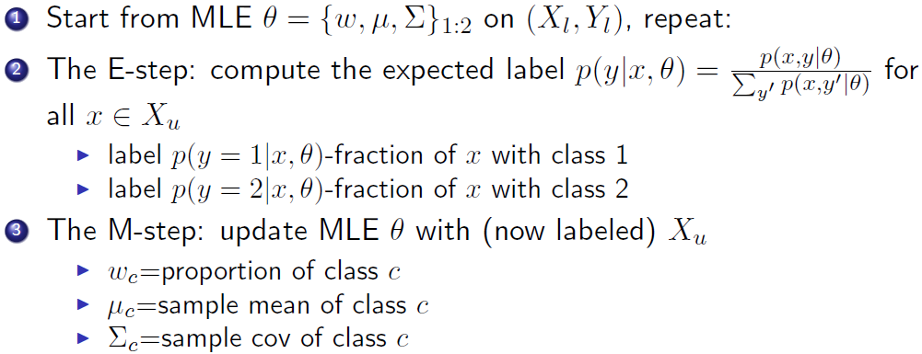
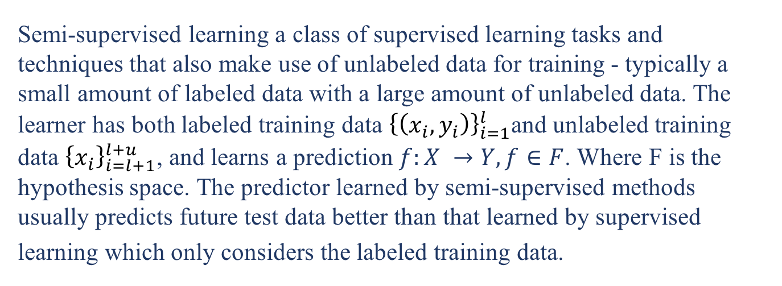
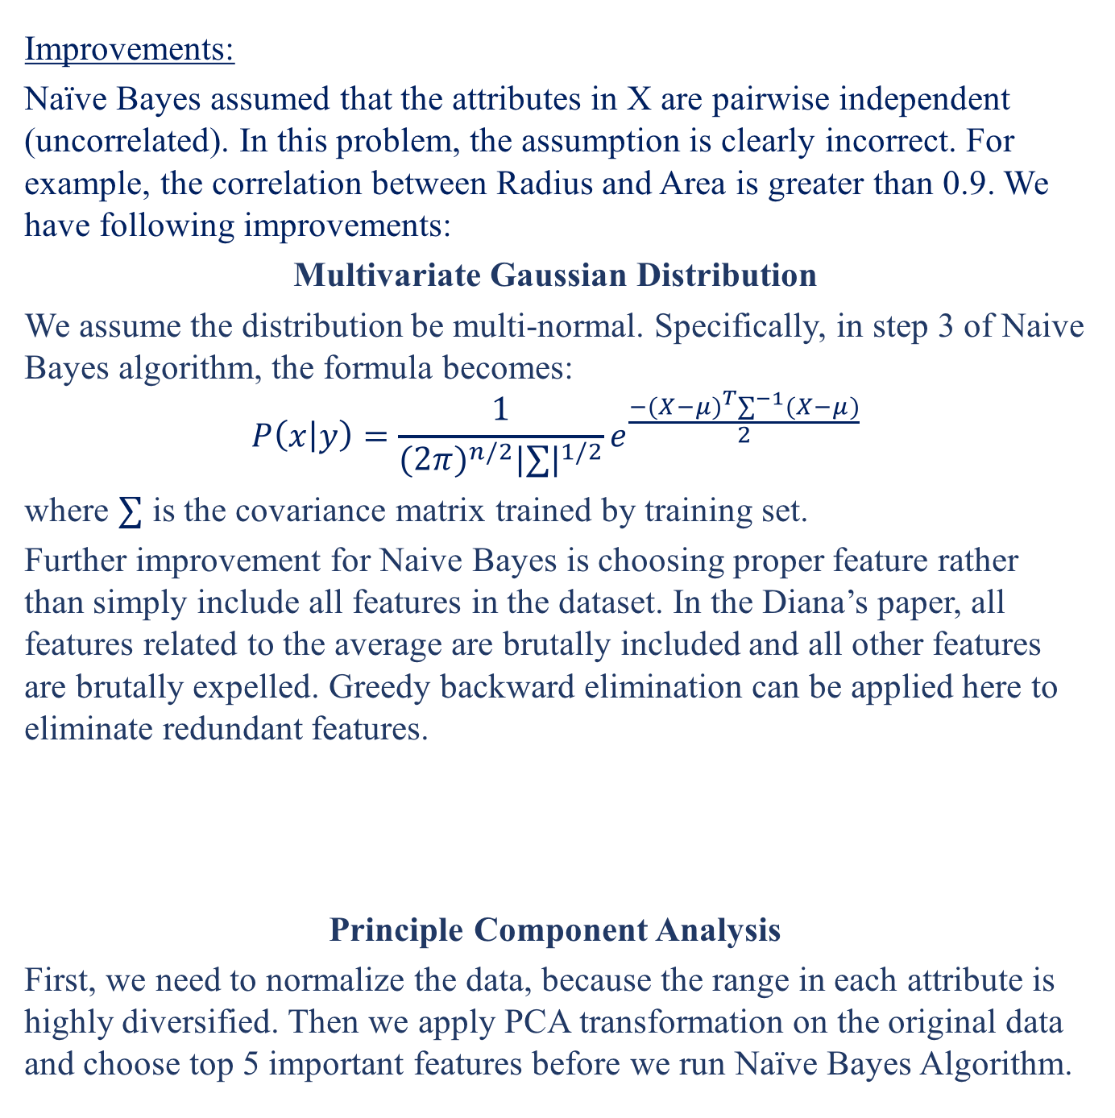
Breast Cancer Recurrence Prediction
Chang Liu Kangning Chen
College of Engineering＆Tepper Business School，Carnegie Mellon University
INTRODUCTION
METHOD 1 GUASSIAN NAÏVE BAYES
METHOD 3 SVM OR KNN
Breast cancer is considered to be the second leading cause of cancer deaths in women today. Nowadays, as the development on machine technique, the data mining skills are widely used in medical industry to effectively predict and diagnosis diseases, including cancer-curing. In this essay, we will use supervised learning and semi-supervised machine learning method to study the probability and time for the potential recurrence.
In real world applications, labeled data are relatively hard to get while unlabeled data are cheap. The target label y requires human annotation which takes a long time, and these experiments require a lot of resources including experienced experts and special devices. Therefore, a trend to utilize the surplus unlabeled data together with scarcely labeled data is desirable. In this project, we will incorporate unlabeled data set (Diagnostic Dataset) to improve the classifier.
Gaussian Naive Bayes is the methodology to model the generative distribution of (X, Y ) based on the training set, and predict the outcome by choosing the highest possible label. Despite its name and its naive intuition, it is still one of the most effective and efficient algorithms for data mining.
DATASET
RESULT
We use two datasets for this project. The Wisconsin Prognostic Breast Cancer data set contains 198 instances labeled first for recurrence of breast cancer. Along with the label for recurrence, this data set records the time before recurrence or the time when a patient remains disease free. Along with the recurrence and time, this data set contains 10 relevant attributes describing the characteristics of the cell nuclei present in the digitized image of a fine needle aspirate (FNA) of the breast mass.
The second Wisconsin Prognostic Breast Cancer dataset contains 569 instances with the ID number and the diagnosis outcome (malign or benign) and the same 10 relevant attributes as the prognostic dataset. Each attribute has three values: The mean, standard error, and ”worst” or largest. In addition, the prognostic dataset has more attributes: Time, Tumor size and Lymph node status. The detailed information is displayed in Table 1.
Improvements:
Naïve Bayes assumed that the attributes in X are pairwise independent (uncorrelated). In this problem, the assumption is clearly incorrect. For example, the correlation between Radius and Area is greater than 0.9. We have following improvements:
Multivariate Gaussian Distribution
We assume the distribution be multi-normal. Specifically, in step 3 of Naive Bayes algorithm, the formula becomes:
$$P\left(x | y\right)=\frac{1}{{(2π)}^{n/2}{|∑|}^{1/2}}e^{\frac{−{(X−μ)}^{T}∑^{−1}(X−μ)}{2}}$$
where $∑$ is the covariance matrix trained by training set.
Further improvement for Naive Bayes is choosing proper feature rather than simply include all features in the dataset. In the Diana’s paper, all features related to the average are brutally included and all other features are brutally expelled. Greedy backward elimination can be applied here to eliminate redundant features.
Principle Component Analysis
First, we need to normalize the data, because the range in each attribute is highly diversified. Then we apply PCA transformation on the original data and choose top 5 important features before we run Naïve Bayes Algorithm.
DATA PREPROCESSING
The data set relatively clean and complete. However, we need to do two steps before implement our data. The first step is to fill the missing data. There are a few unobservable values in the attribute Lymph node status of Prognostic Dataset. We simply use the mean to generate these field to avoid noises.
METHOD 2 SEMI-SUPERVISED LEARNING
Semi-supervised learning a class of supervised learning tasks and techniques that also make use of unlabeled data for training - typically a small amount of labeled data with a large amount of unlabeled data. The learner has both labeled training data ${\left\{\left(x_{i},y_{i}\right)\right\}}_{i=1}^{l}$and unlabeled training data ${\left\{x_{i}\right\}}_{i=l+1}^{l+u}$, and learns a prediction $f:X →Y,f∈F$. Where F is the hypothesis space. The predictor learned by semi-supervised methods usually predicts future test data better than that learned by supervised
learning which only considers the labeled training data.
REFERENCES
[1] Diana Dumitru. ”Prediction of recurrent events in breast cancer using the Naive Bayesian classification” Annals of University of Craiova (2009), Vol 36(2).
[2] Chapelle, Olivier; Schlkopf, Bernhard; Zien, Alexander (2006). Semi-supervised learning. Cambridge, Mass: MIT Press.ISBN978-0-262-03358-9.
[3] Zhu, Xiaojin.Semi-Supervised LearningUniversity of Wisconsin-Madison.
[4] K. Nigam, A. K. McCallum, S. Thrun, and T. Mitchell. Text classification from labeled and unlabeled documents using EM. Machine Learning, 39(2/3):103?134, 2000.

Slide 2

INTRODUCTION
We use two datasets for this project. The Wisconsin Prognostic Breast Cancer data set contains 198 instances labeled first for recurrence of breast cancer. Along with the label for recurrence, this data set records the time before recurrence or the time when a patient remains disease free. Along with the recurrence and time, this data set contains 10 relevant attributes describing the characteristics of the cell nuclei present in the digitized image of a fine needle aspirate (FNA) of the breast mass.
The second Wisconsin Prognostic Breast Cancer dataset contains 569 instances with the ID number and the diagnosis outcome (malign or benign) and the same 10 relevant attributes as the prognostic dataset. Each attribute has three values: The mean, standard error, and ”worst” or largest. In addition, the prognostic dataset has more attributes: Time, Tumor size and Lymph node status. The detailed information is displayed in Table 1.
College of Engineering＆Tepper Business School，Carnegie Mellon University
METHOD 3 SVM OR KNN
Breast cancer is considered to be the second leading cause of cancer deaths in women today. Nowadays, as the development on machine technique, the data mining skills are widely used in medical industry to effectively predict and diagnosis diseases, including cancer-curing. In this essay, we will use supervised learning and semi-supervised machine learning method to study the probability and time for the potential recurrence.
In real world applications, labeled data are relatively hard to get while unlabeled data are cheap. The target label y requires human annotation which takes a long time, and these experiments require a lot of resources including experienced experts and special devices. Therefore, a trend to utilize the surplus unlabeled data together with scarcely labeled data is desirable. In this project, we will incorporate unlabeled data set (Diagnostic Dataset) to improve the classifier.
[1] Diana Dumitru. ”Prediction of recurrent events in breast cancer using the Naive Bayesian classification” Annals of University of Craiova (2009), Vol 36(2).
[2] Chapelle, Olivier; Schlkopf, Bernhard; Zien, Alexander (2006). Semi-supervised learning. Cambridge, Mass: MIT Press.ISBN978-0-262-03358-9.
[3] Zhu, Xiaojin.Semi-Supervised LearningUniversity of Wisconsin-Madison.
[4] K. Nigam, A. K. McCallum, S. Thrun, and T. Mitchell. Text classification from labeled and unlabeled documents using EM. Machine Learning, 39(2/3):103?134, 2000.
Chang Liu Kangning Chen
RESULT
Improvements:
Naïve Bayes assumed that the attributes in X are pairwise independent (uncorrelated). In this problem, the assumption is clearly incorrect. For example, the correlation between Radius and Area is greater than 0.9. We have following improvements:
Multivariate Gaussian Distribution
We assume the distribution be multi-normal. Specifically, in step 3 of Naive Bayes algorithm, the formula becomes:
$$P\left(x | y\right)=\frac{1}{{(2π)}^{n/2}{|∑|}^{1/2}}e^{\frac{−{(X−μ)}^{T}∑^{−1}(X−μ)}{2}}$$
where $∑$ is the covariance matrix trained by training set.
Further improvement for Naive Bayes is choosing proper feature rather than simply include all features in the dataset. In the Diana’s paper, all features related to the average are brutally included and all other features are brutally expelled. Greedy backward elimination can be applied here to eliminate redundant features.
Principle Component Analysis
First, we need to normalize the data, because the range in each attribute is highly diversified. Then we apply PCA transformation on the original data and choose top 5 important features before we run Naïve Bayes Algorithm.
Gaussian Naive Bayes is the methodology to model the generative distribution of (X, Y ) based on the training set, and predict the outcome by choosing the highest possible label. Despite its name and its naive intuition, it is still one of the most effective and efficient algorithms for data mining.
Breast Cancer Recurrence Prediction
DATASET
REFERENCES
METHOD 1 GUASSIAN NAÏVE BAYES
DATA PREPROCESSING
The data set relatively clean and complete. However, we need to do two steps before implement our data. The first step is to fill the missing data. There are a few unobservable values in the attribute Lymph node status of Prognostic Dataset. We simply use the mean to generate these field to avoid noises.
METHOD 2 SEMI-SUPERVISED LEARNING
Semi-supervised learning a class of supervised learning tasks and techniques that also make use of unlabeled data for training - typically a small amount of labeled data with a large amount of unlabeled data. The learner has both labeled training data ${\left\{\left(x_{i},y_{i}\right)\right\}}_{i=1}^{l}$and unlabeled training data ${\left\{x_{i}\right\}}_{i=l+1}^{l+u}$, and learns a prediction $f:X →Y,f∈F$. Where F is the hypothesis space. The predictor learned by semi-supervised methods usually predicts future test data better than that learned by supervised
learning which only considers the labeled training data.

Slide 3


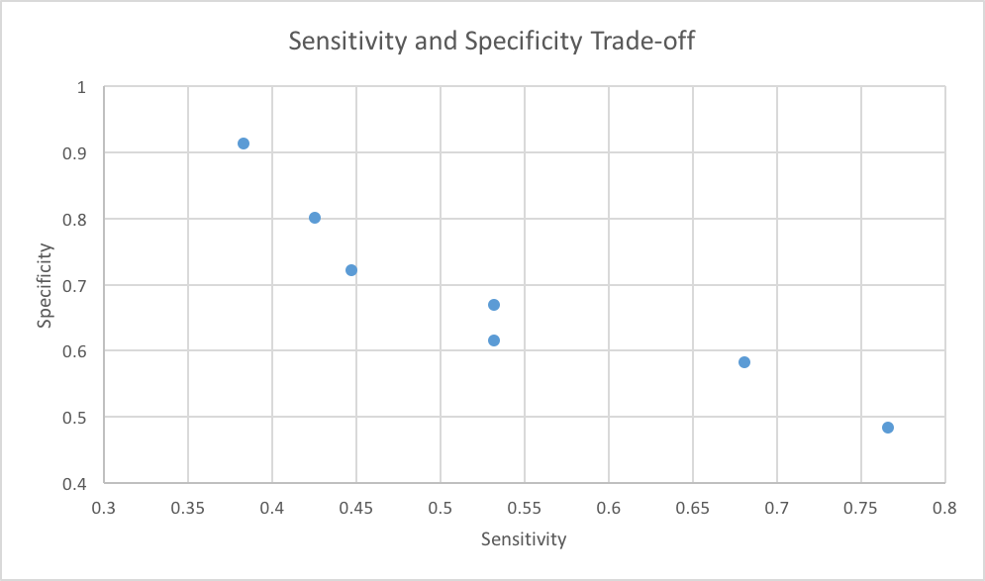
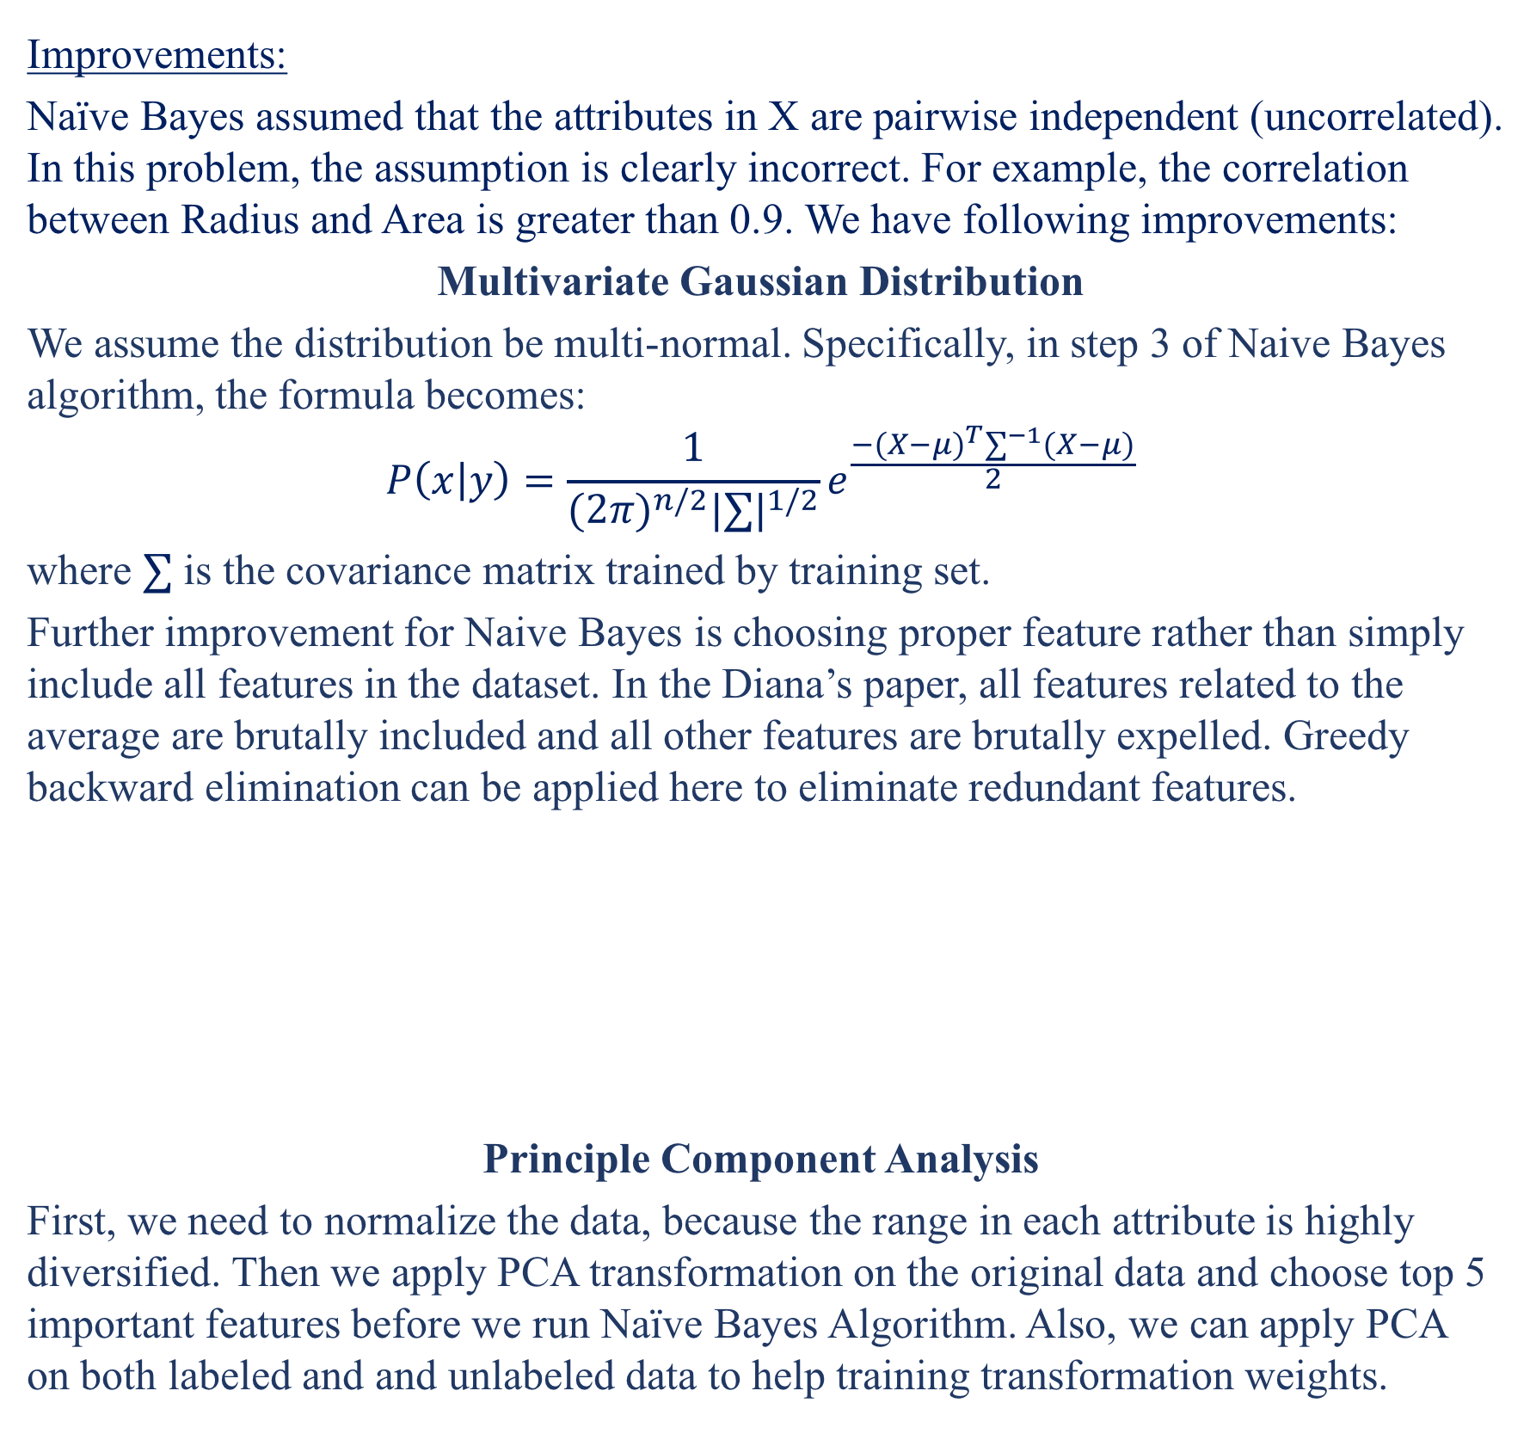
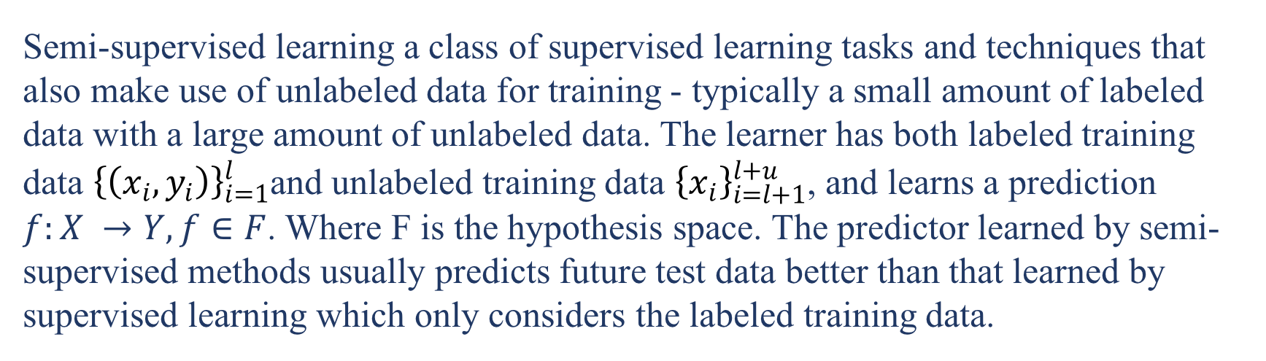
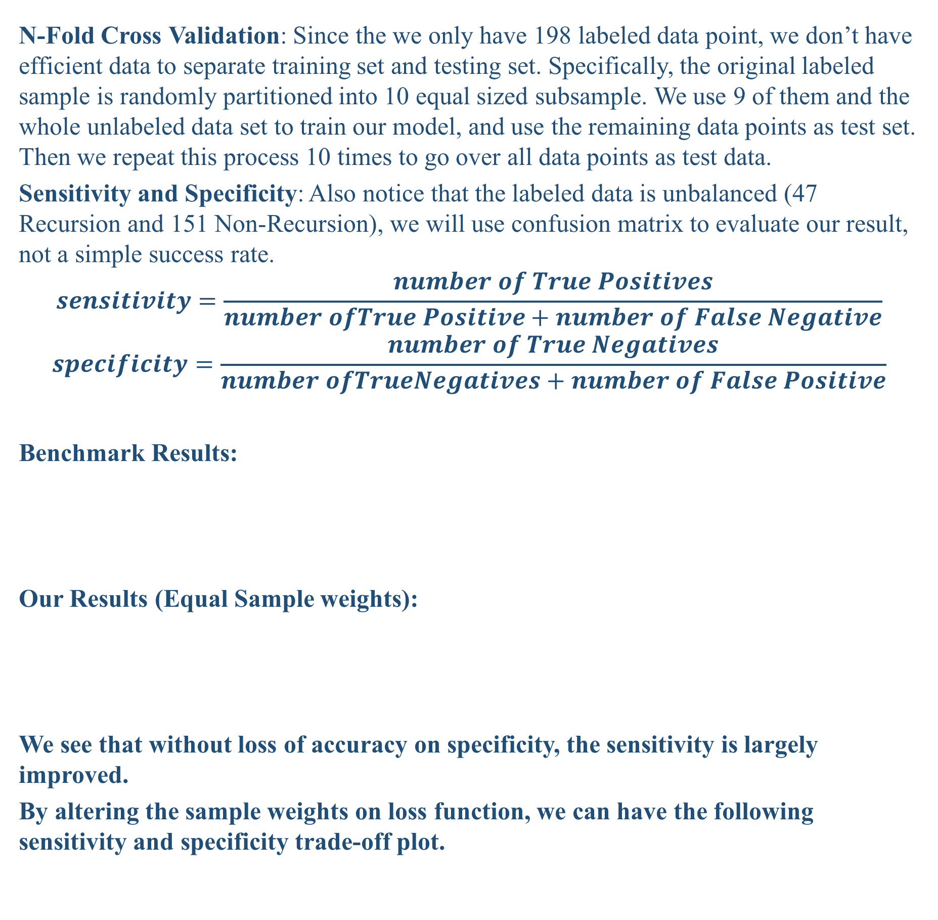
Breast Cancer Recurrence Prediction
Chang Liu Kangning Chen
College of Engineering ＆ Tepper Business School，Carnegie Mellon University
INTRODUCTION
METHOD 1 GUASSIAN NAÏVE BAYES
Breast cancer is considered to be the second leading cause of cancer deaths in women today. Nowadays, as the development on machine technique, the data mining skills are widely used in medical industry to effectively predict and diagnosis diseases, including cancer-curing. In this essay, we will use supervised learning and semi-supervised machine learning method to study the probability and time for the potential recurrence.
In real world applications, labeled data are relatively hard to get while unlabeled data are cheap. The target label y requires human annotation which takes a long time, and these experiments require a lot of resources including experienced experts and special devices. Therefore, a trend to utilize the surplus unlabeled data together with scarcely labeled data is desirable. In this project, we will incorporate unlabeled data set (Diagnostic Dataset) to improve the classifier.
Gaussian Naive Bayes is the methodology to model the generative distribution of (X, Y ) based on the training set, and predict the outcome by choosing the highest possible label. Despite its name and its naive intuition, it is still one of the most effective and efficient algorithms for data mining.
Evaluation and Results
N-Fold Cross Validation: Since the we only have 198 labeled data point, we don’t have efficient data to separate training set and testing set. Specifically, the original labeled sample is randomly partitioned into 10 equal sized subsample. We use 9 of them and the whole unlabeled data set to train our model, and use the remaining data points as test set. Then we repeat this process 10 times to go over all data points as test data.
Sensitivity and Specificity: Also notice that the labeled data is unbalanced (47 Recursion and 151 Non-Recursion), we will use confusion matrix to evaluate our result, not a simple success rate.
$$sensitivity=\frac{number of True Positives}{number ofTrue Positive+number of False Negative}$$
$$specificity=\frac{number of True Negatives}{number ofTrueNegatives+number of False Positive}$$
Benchmark Results:
Our Results (Equal Sample weights):
We see that without loss of accuracy on specificity, the sensitivity is largely improved.
By altering the sample weights on loss function, we can have the following sensitivity and specificity trade-off plot.
DATASET
We use two datasets for this project. The Wisconsin Prognostic Breast Cancer data set contains 198 instances labeled first for recurrence of breast cancer. Along with the label for recurrence, this data set records the time before recurrence or the time when a patient remains disease free. Along with the recurrence and time, this data set contains 10 relevant attributes describing the characteristics of the cell nuclei present in the digitized image of a fine needle aspirate (FNA) of the breast mass.
The second Wisconsin Prognostic Breast Cancer dataset contains 569 instances with the ID number and the diagnosis outcome (malign or benign) and the same 10 relevant attributes as the prognostic dataset. Each attribute has three values: The mean, standard error, and ”worst” or largest. In addition, the prognostic dataset has more attributes: Time, Tumor size and Lymph node status. The detailed information is displayed in Table 1.
Improvements:
Naïve Bayes assumed that the attributes in X are pairwise independent (uncorrelated). In this problem, the assumption is clearly incorrect. For example, the correlation between Radius and Area is greater than 0.9. We have following improvements:
Multivariate Gaussian Distribution
We assume the distribution be multi-normal. Specifically, in step 3 of Naive Bayes algorithm, the formula becomes:
$$P\left(x | y\right)=\frac{1}{{(2π)}^{n/2}{|∑|}^{1/2}}e^{\frac{−{(X−μ)}^{T}∑^{−1}(X−μ)}{2}}$$
where $∑$ is the covariance matrix trained by training set.
Further improvement for Naive Bayes is choosing proper feature rather than simply include all features in the dataset. In the Diana’s paper, all features related to the average are brutally included and all other features are brutally expelled. Greedy backward elimination can be applied here to eliminate redundant features.
Principle Component Analysis
First, we need to normalize the data, because the range in each attribute is highly diversified. Then we apply PCA transformation on the original data and choose top 5 important features before we run Naïve Bayes Algorithm. Also, we can apply PCA on both labeled and and unlabeled data to help training transformation weights.
DATA PREPROCESSING
The data set relatively clean and complete. However, we need to do two steps before implement our data. The first step is to fill the missing data. There are a few unobservable values in the attribute Lymph node status of Prognostic Dataset. We simply use the mean to generate these field to avoid noises.
METHOD 2 SEMI-SUPERVISED LEARNING
Semi-supervised learning a class of supervised learning tasks and techniques that also make use of unlabeled data for training - typically a small amount of labeled data with a large amount of unlabeled data. The learner has both labeled training data ${\left\{\left(x_{i},y_{i}\right)\right\}}_{i=1}^{l}$and unlabeled training data ${\left\{x_{i}\right\}}_{i=l+1}^{l+u}$, and learns a prediction $f:X →Y,f∈F$. Where F is the hypothesis space. The predictor learned by semi-supervised methods usually predicts future test data better than that learned by supervised learning which only considers the labeled training data.
REFERENCES
[1] Diana Dumitru. ”Prediction of recurrent events in breast cancer using the Naive Bayesian classification” Annals of University of Craiova (2009), Vol 36(2).
[2] Chapelle, Olivier; Schlkopf, Bernhard; Zien, Alexander (2006). Semi-supervised learning. Cambridge, Mass: MIT Press.ISBN978-0-262-03358-9.

