Slide 1
Easy Aid
EllenAndreYu

Slide 2
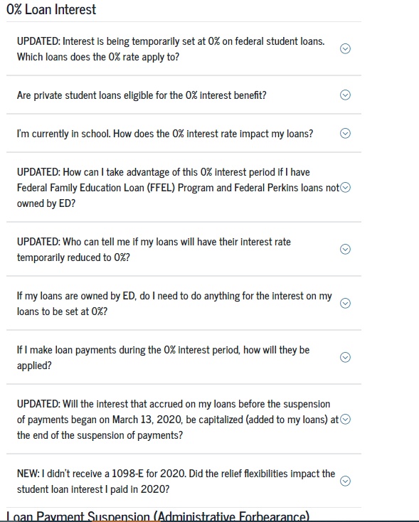
The Problem
Due to the pandemic, many students & their families lost income or had significant change to circumstance.
The US Department of Education attempted to create resources to help people receive aid, but these resources were poorly designed so they deterred people from seeking help.
The excess of information and convoluted structure on the student aid website does not clearly share ways students and families can seek extra financial help.
Notes:
Describe the problem and why it is important. If it is not obvious, make the case the problem is an important one for innovative living in a post-pandemic world.
Describe the components of the POV that motivates your solution
Describe why your solution is unique relative to other existing solutions people currently use to solve the problem
Convey what the interface does (a demo of the most interesting task would be great)
For one or more specific unexpected usability challenges you encountered (at any stage of the design process):
Describe how you discovered there was a problem
Describe the problem
Describe how you solved the problem
Describe some details of how you would formally evaluate your completed interface (e.g., what might an experiment look like/assess?)
Reflect on the semester. For this same idea, if you were starting over again, what would your team do differently?

Slide 3
Solution Motivation
Upon closer inspection of government interfaces, we felt that they violated several heuristic principles
Information density deterred people from seeking help
We realized that there was an opportunity to redesign the interface to provide a more encouraging and concise means of seeking financial help.
We believed that refining and streamlining these interfaces for groups of people like students will encourage people(s) to seek help and reduce the impact of the pandemic on higher education.
Notes:
Ellen
To solve this problem, we wanted to address

Slide 4
Demo

Slide 5
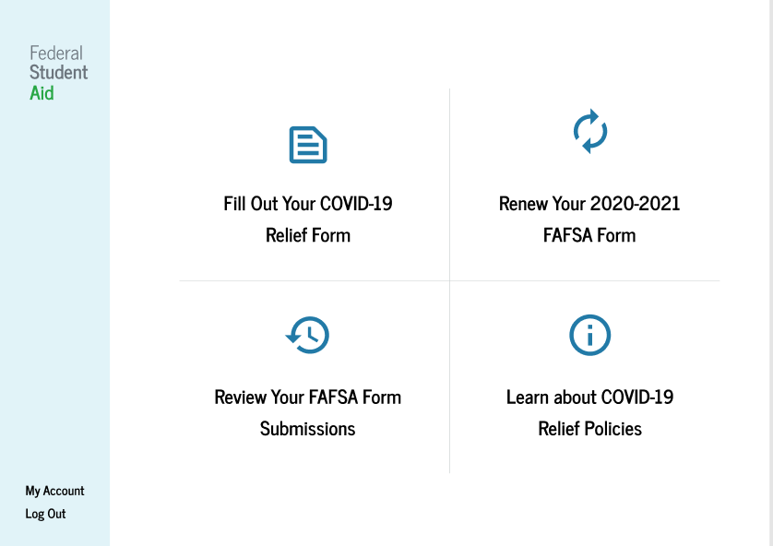
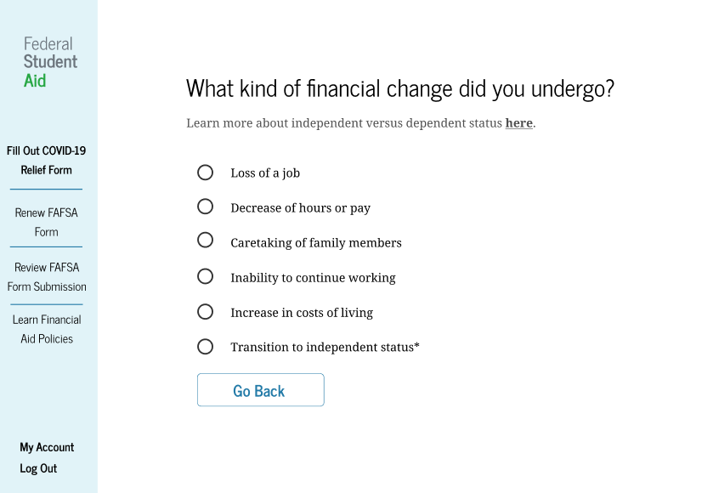
Uniqueness
We created a task-oriented homepage
Rather than creating a list of FAQ, we incorporated the questions into the form-filling process
Streamlines and curates information depending on the user’s goal or need
Limits information to complete one task at a time
Notes:
Describe why your solution is unique relative to other existing solutions people currently use to solve the problem

Slide 6
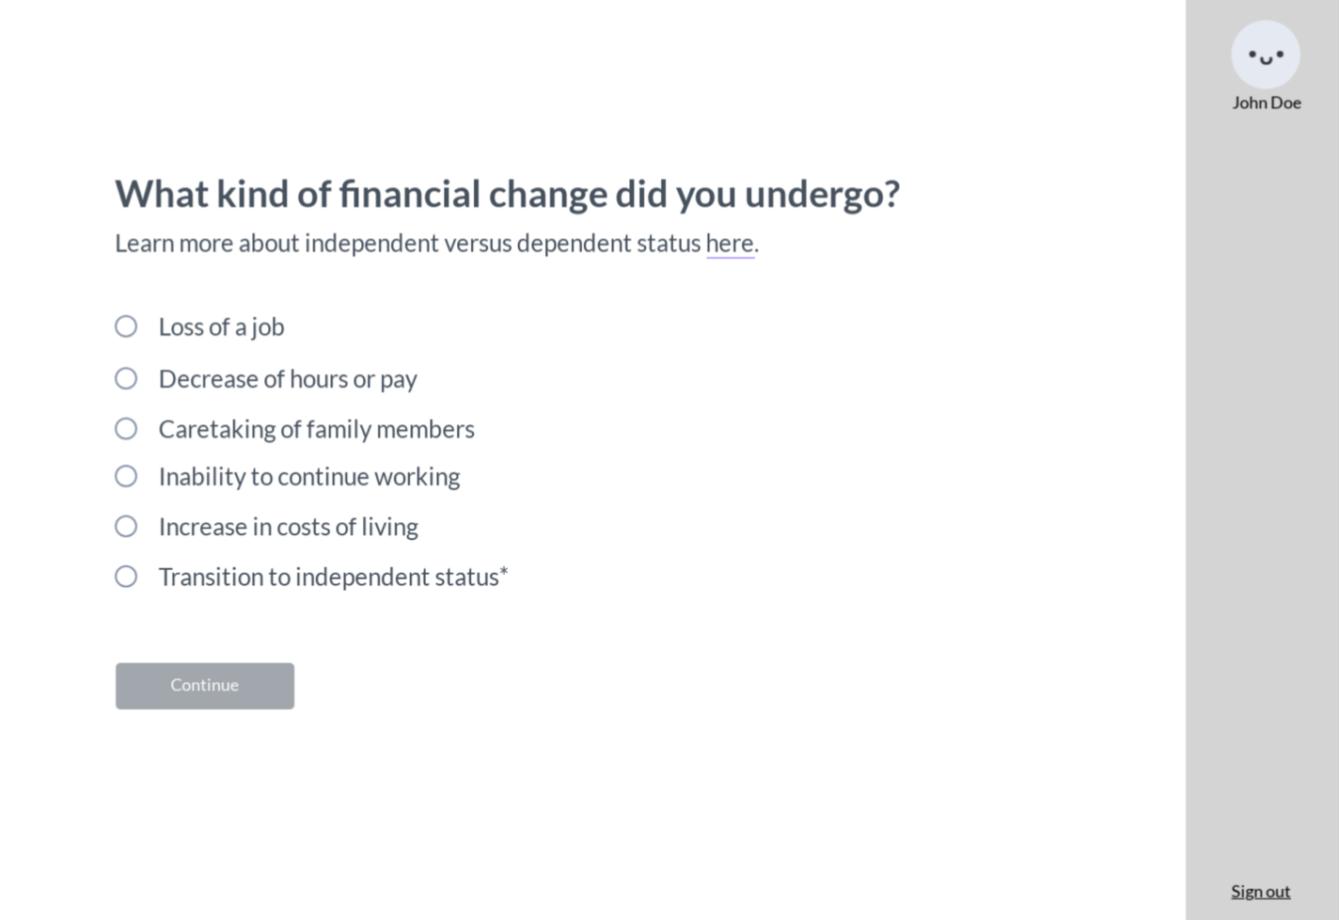
Usability Challenges
Miss of navigation bar and back buttons
Discovered during user testings
Users could not go back to the previous step or home if they made a mistake, and it was difficult to navigate among the tasks
Added navigation bar and back buttons

Slide 7
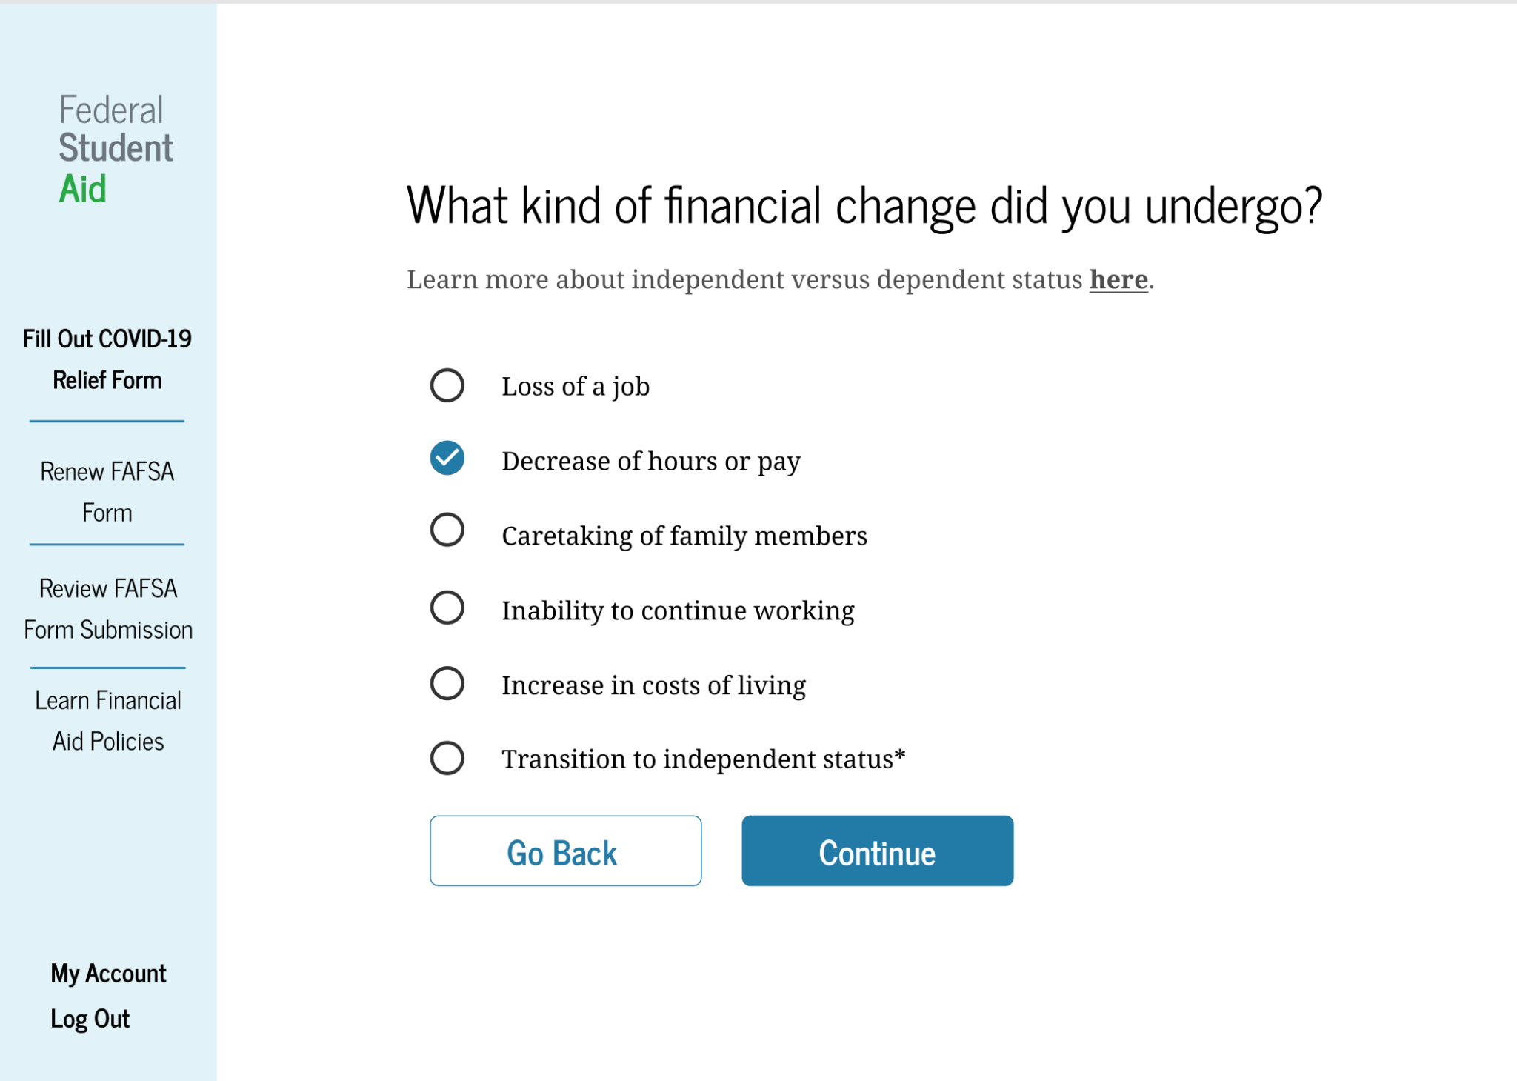
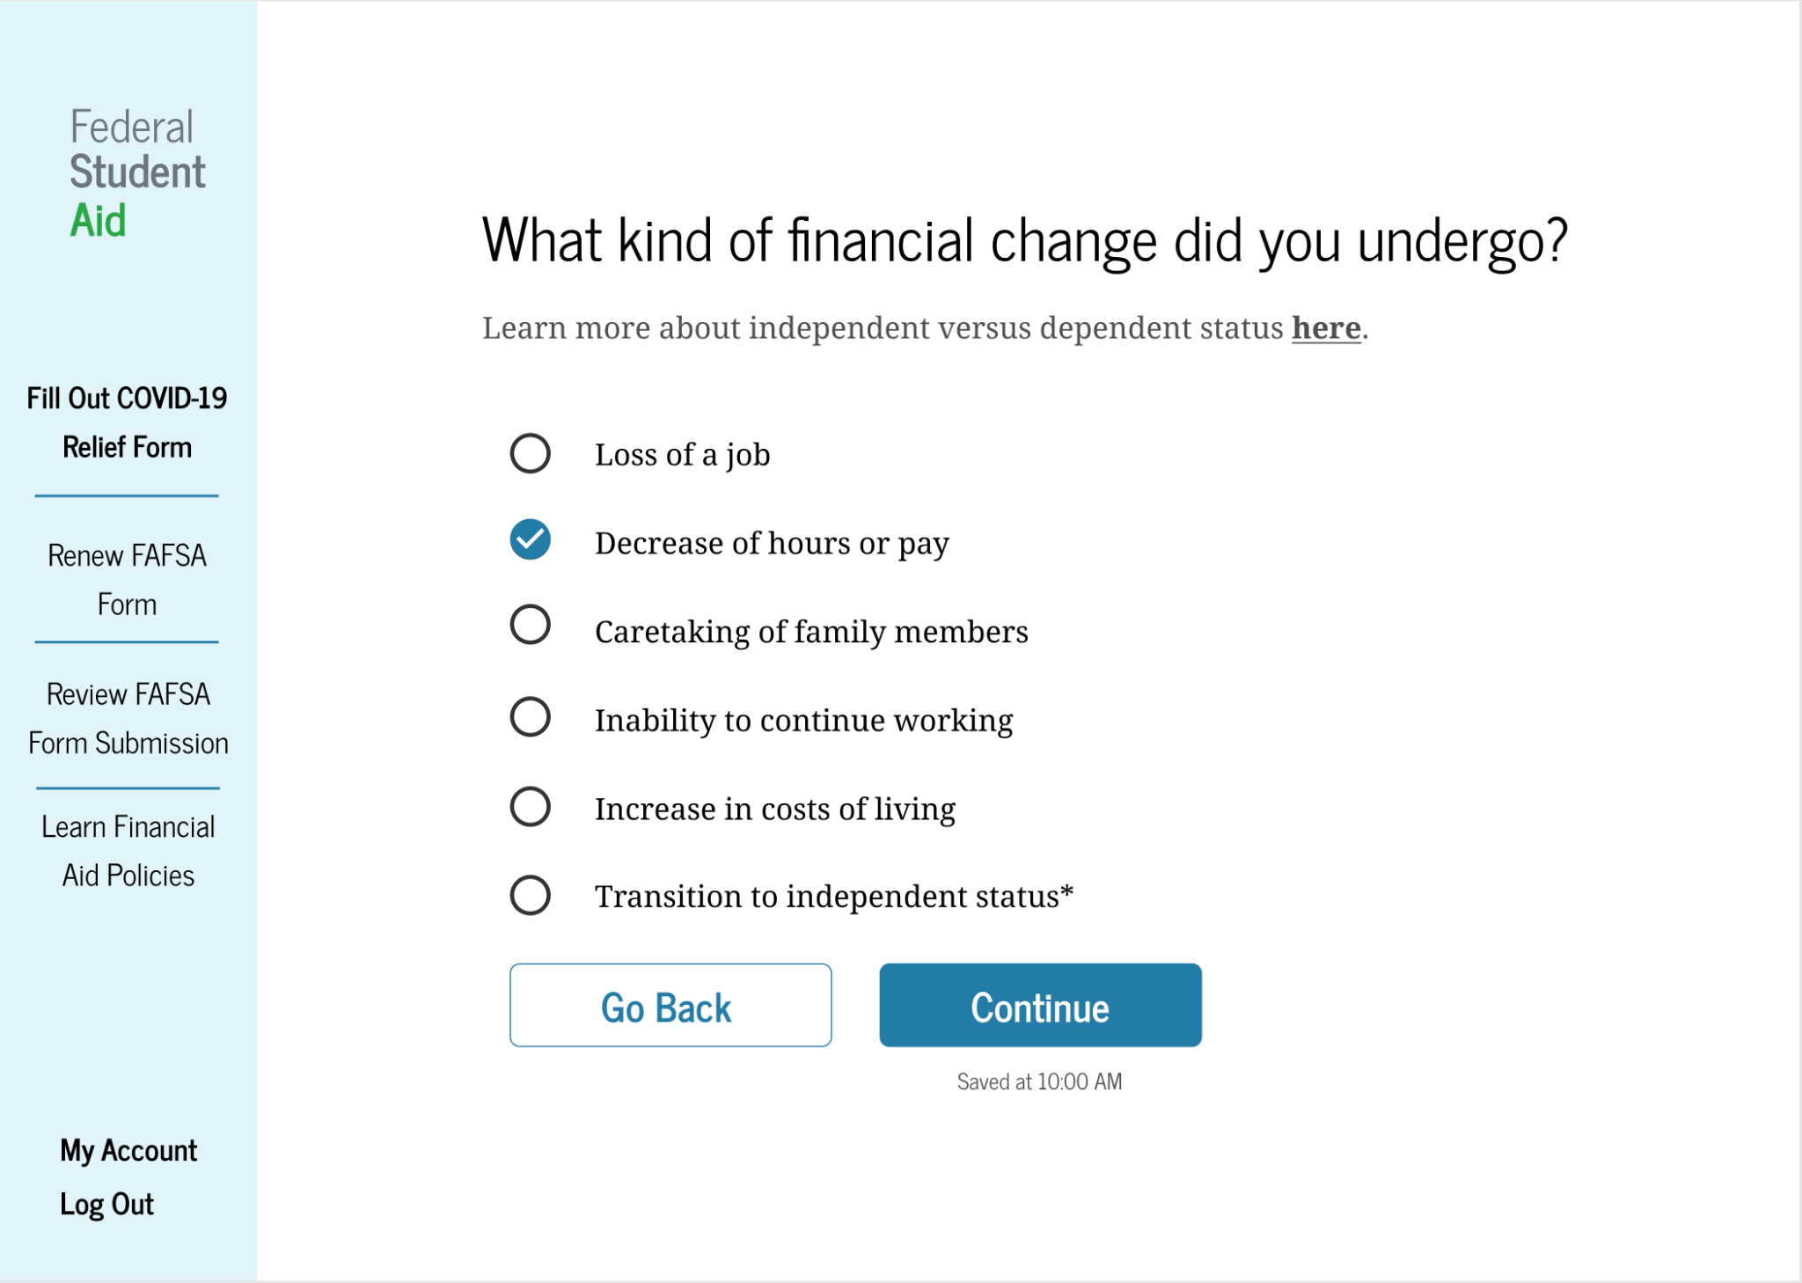
Usability Challenges
Lack of save indication on Relief Form
Users that might have to break up the task over a longer period of time weren’t sure if previous entries could be saved
Added a time stamped save indicator so users were assured that if they left the page their progress would be saved.
Notes:
Ellen

Slide 8
Evaluation During Design
We would evaluate our interface based on the Nielsen's heuristic principles especially the followings:
Flexibility and efficiency of use
How long would it take the user to complete a basic task such as reviewing FAFSA policies?
Aesthetic and minimalist design
Is the information or visual media present optimal or is there an abundance?
User control and freedom
Does the user feel they control over their workflow or do they feel restricted?
Consistency and standards
Does the interface design feel familiar and easy enough to use or is it too different from traditional industry practices?

Slide 9
Formal Evaluation
We would like to lead two types of interviews:
Individual (Students and school financial aid staff)
Small group interviews (Student & partner/parent/provider)
Both would be semi-structured, focusing around how our platform addresses their needs as compared to the existing solution as well as identifying further pain points. Example topics would include:
Investigate how users would find aid with old website and with the new one.
Investigate how users felt about the consistency and standards across the two websites.

Slide 10
Reflection
In the future, we would want to:
Expand to the entire FAFSA process, not just COVID-19 Relief
Run more user testing with students & their parents in their interviews
Give submission results right away, instead of making users wait a period of time to find out what they qualify for
If presented the opportunity to redo aspects of the project, we would:
Interview financial aid faculty at Northeastern to identify more pain points
Evaluate aspects of color contrast, compatibility with screen readers and accessibility more thoroughly -- ensure WCAG standards are met
Notes:
Ellen

Slide 11
Thank You
Notes:
Submit

