Slide 1
Project 1
How Do the Factors of Number of Police, Average Income, Unemployment and School Rating Impact the Safety of a City?
The June-ypers
June, Fang, Tigist, Christian P., Kyle Not to be mistaken with the June-pyters
Notes:
Good evening everyone, we are the June-ypers and our project is about How Do the Factors of Number of Police, Average Income, Unemployment and School Rating Impact the Safety of a City? (next slide)

Slide 2
Question to Answer
Our original question was: Can we use crime statistics to better a community?
The thought process behind this was can we could use a crime statistics data API to show where the most prevalent amount of crime happens in a city, and then distribute the officers in that area, according to the type/count of crime(s)?
We ran into the issue of insufficient data. The crime data API we found, did not have zip codes for the crimes themselves.
We have crime data, but it was based on the arresting police department.
A new question formed: Which cities are safest, and why?
Sample Size: State capitals and their respective police departments.
Crime Variables: Rape, Simple Assaults, and Stolen Property
How do these variables affect crime?.
Number of police officers
School Ratings
Avg. Unemployment Rate
Avg Income
Notes:
1-June
Our original question was: Can we use crime statistics to better a community? To answer this question, we used a crime statistics data API from FBI to show which cities have high crime rates and then distribute the officers in that area, in hopes to lower crime rate. However, we ran into the issue of insufficient data, there were no zip codes available in the API and crime data was based on the arresting police department spread out in different cities in a state. Therefore we refocused our project to a new question of how factors such as the number of police, average income, unemployment, and school rating impact the safety of a city.

Slide 3
Issues with data, and made assumptions
We could not find an API to get police department codes
The API source we used is an FBI data source. In order to get our specific crime numbers for capital cities, we needed police department codes, the ORI. Unfortunately there was no quick way to find them all, as there were 50+ in some locations, and they are broken out by county.
This will cause the numbers to be skewed, mainly a rather low amount of police officers.
Source: https://crime-data-explorer.fr.cloud.gov/api
School Ratings
The school ratings are based on an anonymous user rating system. Basically anyone can go in and rate the schools.
Statistically, you are far more likely to rate/take time to comment only if you had a bad experience.
https://www.fastcompany.com/90425093/why-your-brains-so-bad-at-letting-go-of-negative-comments
Schools can also be rated by someone who has no affiliation towards the school.
Rankings out of 10
Includes Public and Private schools
Unemployment Rating
Unemployment ratings were taken from the census, based on the state. This one was added late in our data collection, and we didn’t have enough time to lookup the rate for each city.
Script used from in-class instructor demo, and modified to suit just the unemployment and income ratings
Avg. Income
Same as above
Using Household Income
Notes:
1-June
To tackle this question, we used the same API, in addition to the factors I mentioned previously, we are now comparing the capital cities of each 50 states and we utilized the arresting police department information of each capital city, identified as “Originating Agency Identifier” number or O-R-I. We also focused on 3 types of crimes, namely: rape, simple assaults and stolen property. (next slide)

Slide 4
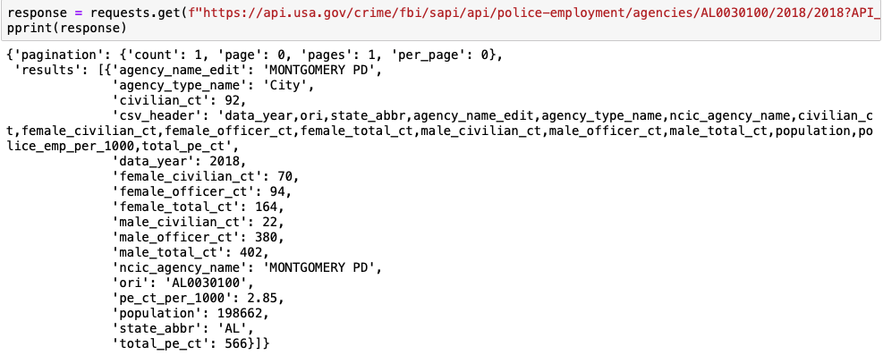
Getting Data-1
Example: Alabama Capital City, Montgomery Police Department
Notes:
FYC

Slide 5
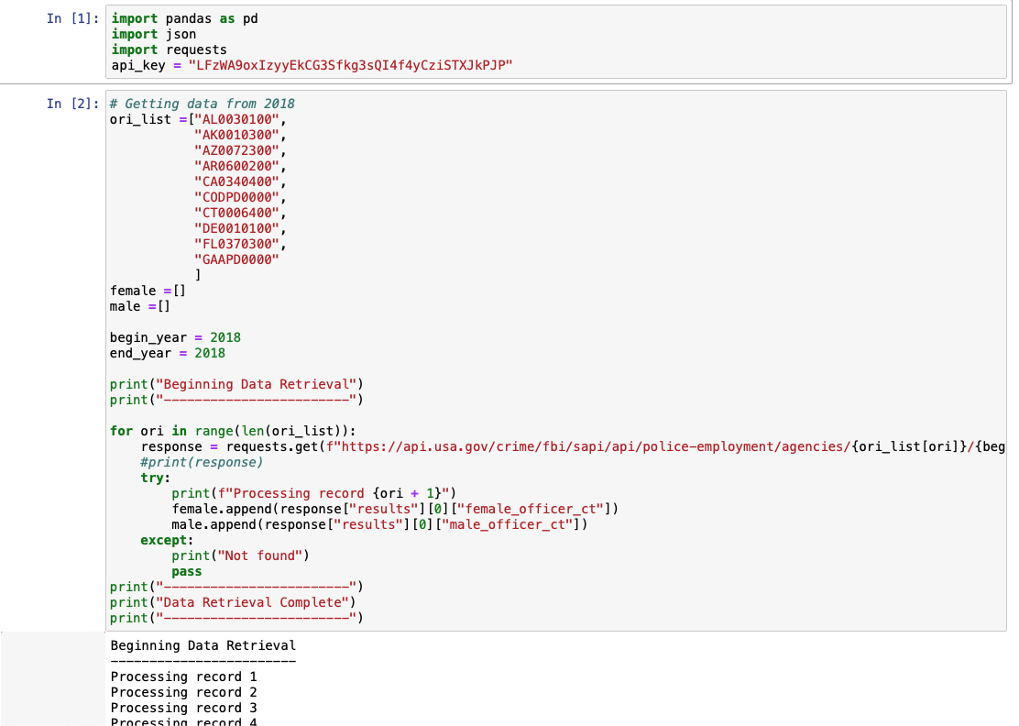
Getting Data-2
Notes:
FYC

Slide 6
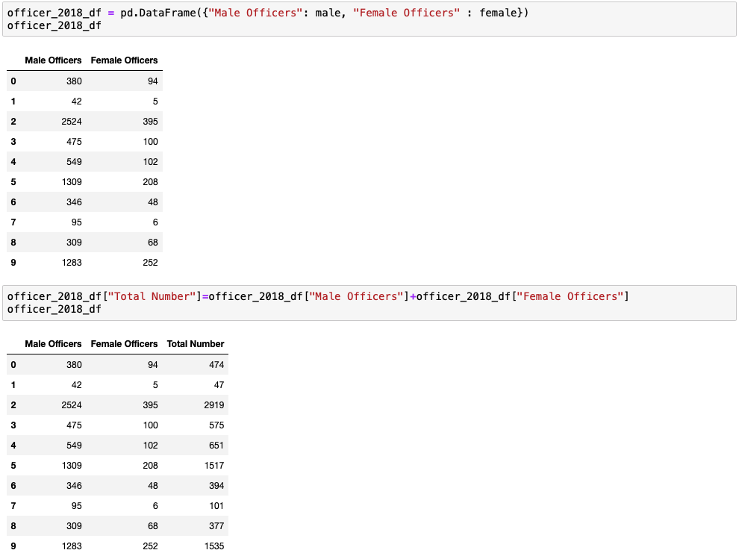
Getting Data-3
Example: Dataframe of 10 States
Notes:
FYC

Slide 7
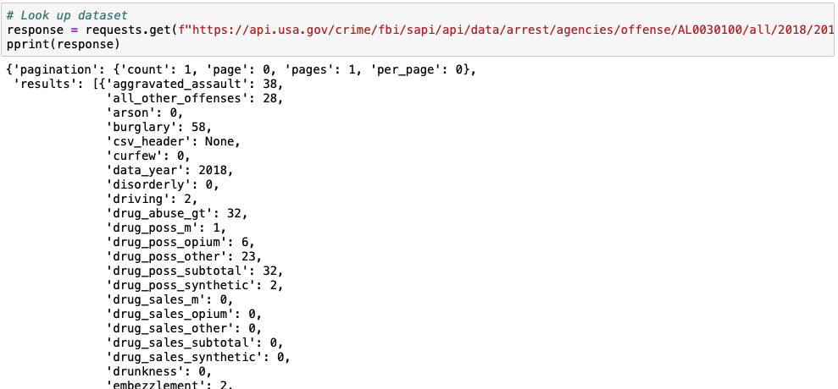
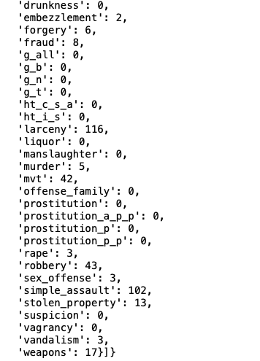
Getting Data-4
Example: Alabama Capital City, Montgomery Police Department
Notes:
FYC

Slide 8
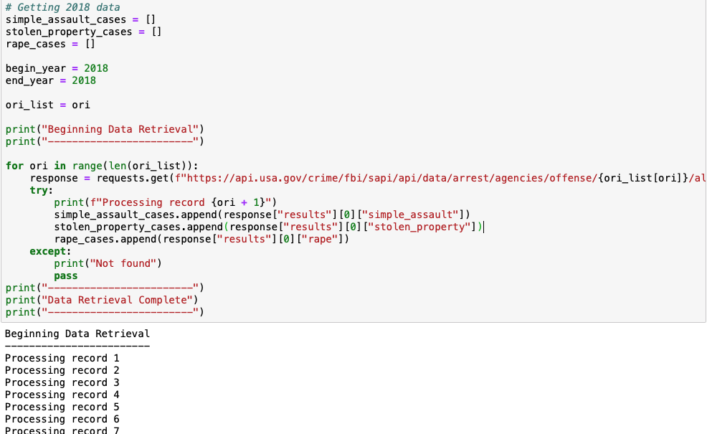
Getting Data-5
Notes:
FYC

Slide 9
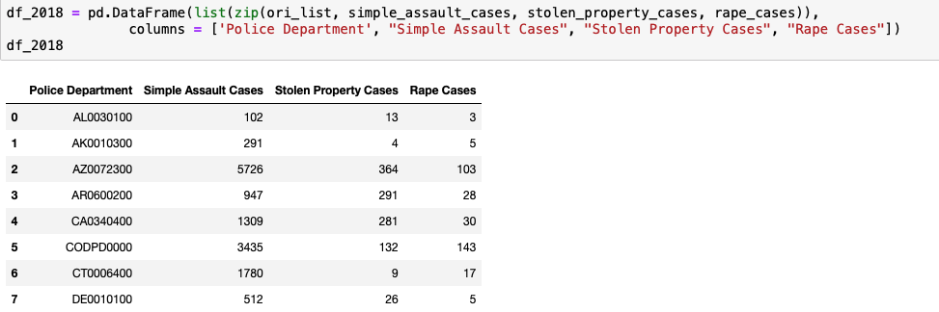
Getting Data-6
Example: Dataframe of 10 States
Notes:
FYC

Slide 10
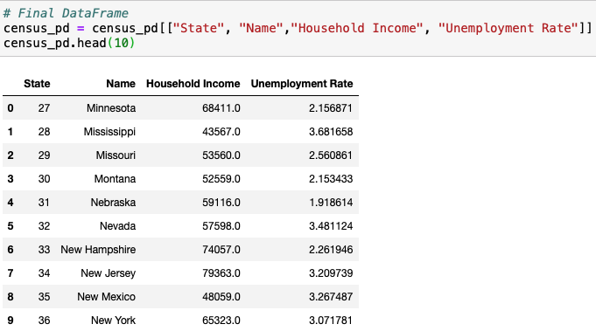
Getting Data-7
Example: Dataframe of 10 States
Coding reference: Python-APIs 09-Stu_Census_API_Gmap
Notes:
FYChang

Slide 11
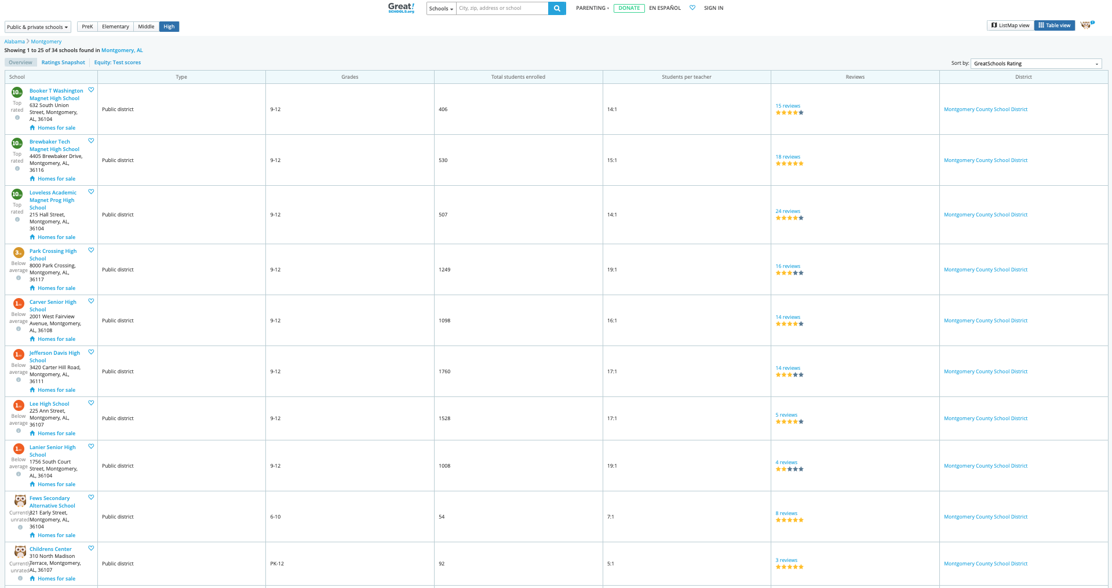
Getting Data-8
Example for School Rating: Alabama Capital City, Montgomery
https://www.greatschools.org
Notes:
FYChang

Slide 12
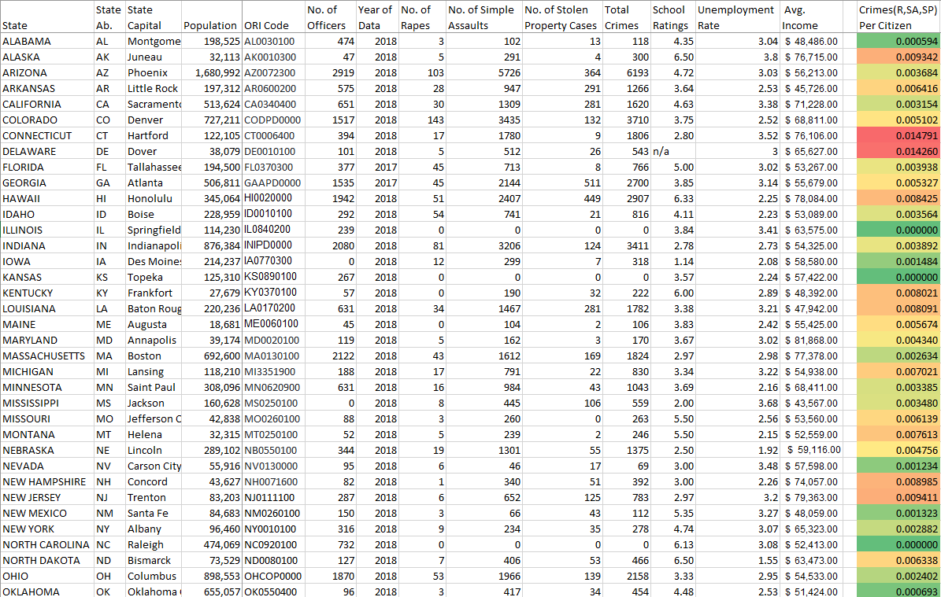
Table of Stats
Notes:
Kyle’s slide!

Slide 13
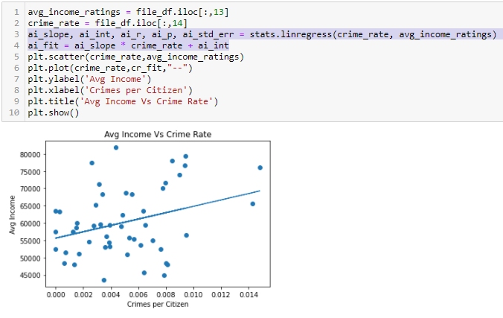
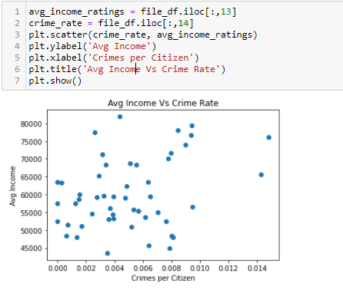
Scatter Plots
The line shows us the relationship between the two factors.
We started with our original Plots
Then we added our linear regression script
Notes:
Kyle’s slide

Slide 14
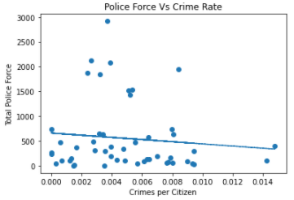
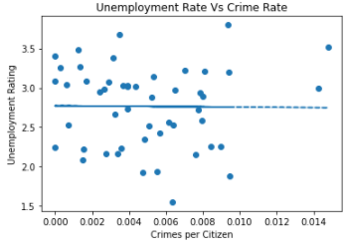
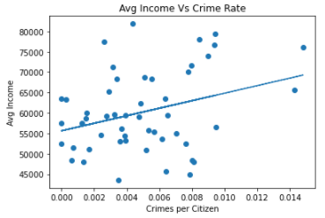
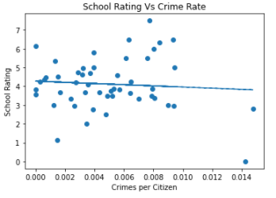
Linear Regression Plots Cont.
Number of Police Officers v Crime Rate
Avg Income Rate v Crime Rate
Unemployment Rate v Crime Rate
School Ratings v Crime Rate
Notes:
Kyle’s slide

Slide 15
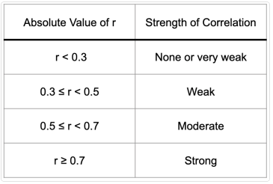
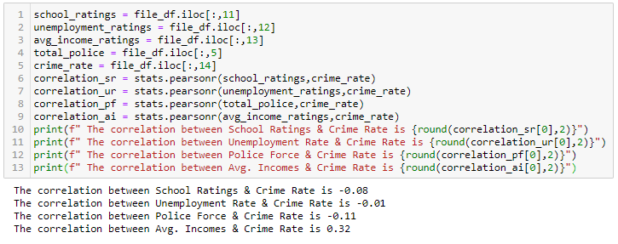
R values & Correlations
R Value table for reference
R Values for our factors

Slide 16
Conclusion
What makes a city safe?
How does number of police, average income, unemployment, and school rating affect crime rates`?
Minimal correlation between test variables and crime rate.
Fail to reject the null hypothesis
Improvements?
Larger sample size with more crime variables
Find a full collection of police data from the city rather than one station
Using more relevant cities and ORIs
Notes:
fail to reject the null: indicates that our sample did not provide sufficient evidence to conclude that the effect exists. However, at the same time, the lack of evidence does not prove that an effect does not exist.
obvious correlations existed such as high numbers of police officers were present where the most crime happened in our cities
so at the surface level it would make sense that ORIs with school ratings and avg incomes in the upper 3rd quartile would have low crime numbers but our data was somewhat scattered
There is interesting data within our dataframe and datasets. With more time, numerous tests and graphs could be constructed to discover possible correlations but within our context we couldn’t make a firm connection.
- What could this information lead to ?
- is this data on state capitals representative of the state overall? (not really)
- are our formulas easily interchangeable to quickly give results on a different ORI set?

Slide 17
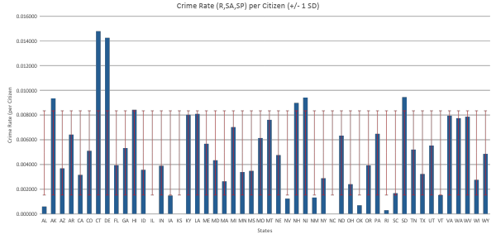
**Adding later**Crime Rate (R,SA,SP) per Citizen

