Slide 1

To Churn Or Not To Churn:
predicting customers’ churn rates
Iuliia Oblasova, Chang Shu, Yiran Chen

Slide 2
Topic and Motivation
What cause customers of telephone service providers to churn?
Customer base increase
Retaining existing customers
Acquiring new customers
Recurring revenue = stable company at lower cost

Slide 3
Topic and Motivation
What cause customers of telephone service providers to churn?
Customer base increase
Retaining existing customers
Acquiring new customers
Why do they churn?

Slide 4
Project question
Does a choice of an upgraded phone plan
(e.g., unlimited internet access / family plan) lead to a lower probability of churn?

Slide 5

Ideal Experiment
As if I were a God…
=
Regular plan
Upgraded plan
Compare the churn rates one year later.

Slide 6
Project Design
~
Control group
(regular)
Treatment group (upgraded)
Control for baseline difference.
Perform logistic regression (interpretability is the key!) and compare the coefficients for the treatment (phone plan) variable.

Slide 7
Data
Population
Individual users’ (not corporations) that have been using a plan for at least a year.
Variables
Demographic
Gender, age, marital status, household size, city location
Company-related
Type of services, number of paid periods, level of service satisfaction
Outcome variable
Did customer extended service or churn?
Source
IBM Cognos Analytics

Slide 8
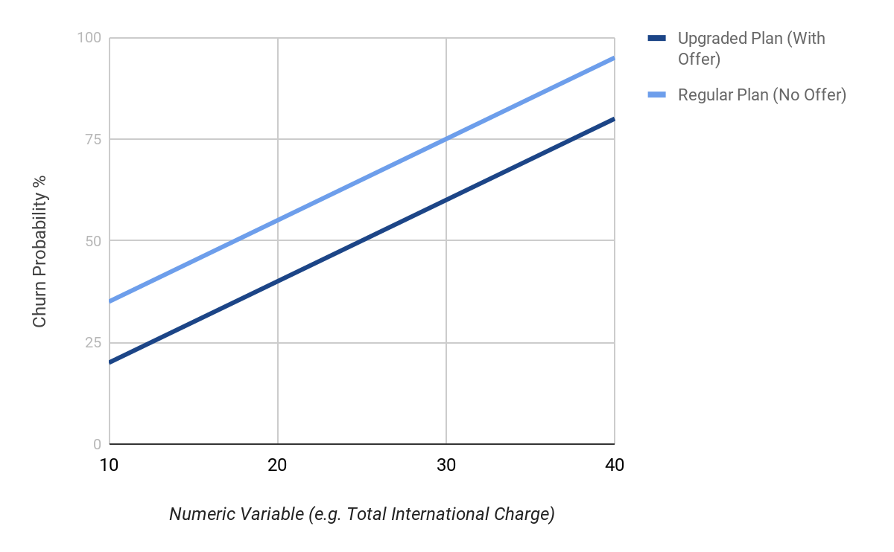
Expected
Result

Slide 9
Other
Factors
Income
Employment status
Education
How do they find the website/product?
Do they open newsletters, and other trigger emails or click on any links?
Store visits/online
Complaint resolutions
Complaint priority
Frequency and means of complaints
Number of calls to customers’ support
Competitors

Slide 10
Questions?

