Slide 1
aiworks Platform
Screen Reference
Edge AI
CREATION DATE | May 27, 2021
LAST UPDATE | July 7, 2020
DOCUMENT Ver. | Ver. 1.2

Slide 2
Document History
Version | History Detail
0.1 | - First written
0.2 | - Add UseCase
1.0 | - Requirement-based screen and function arrangement
1.1 | - Add Footer
1.2 | - aw_sc_s018: Add device deletion case

Slide 3
Edge AI POC

Slide 4
Edge AI POC
Requirements
Requirement ID | Classification |  |  | Requirement name | Requirement Details | state | screen definition | Writer
 | Main Category | Middle subcategory | Subcategory
aw_sc_r001 | AW | main | project | Smart Collector Project | A link to the smart collector page is displayed in card format. (hereinafter referred to as SC) | Planning completed | aw_sc_s001 | Minjae Yoo
aw_sc_r002 | AW | main | project | SC authority | Permissions can be set using an internal project | avatar |  | Minjae Yoo
aw_sc_r003 | AW | main | project | SC move | Move to SC page when selecting project | Planning completed | aw_sc_s002 | Minjae Yoo
aw_sc_r005 | SC | project |  | Project lookup | You can inquire about SC projects. The contents of inquiry are project name, AI model name, number of connected devices, and number of collected data. | Planning completed | aw_sc_s004, aw_sc_s005 | Minjae Yoo
aw_sc_r006 | SC | project | Create a project | Create a project | You can create SC projects. When creating a project, model setting and policy setting are required. Device setting should be possible when creating a project. | Planning completed | aw_sc_s006 to aw_sc_s012 | Minjae Yoo
aw_sc_r007 | SC | project | project change | project change | You can change the created project. You can change the model of the project, project name excluding objects, shooting interval, number of objects, and number of collected images. | Planning completed | aw_sc_s013 to aw_sc_s014 | Minjae Yoo
aw_sc_r010 | SC | project | data management | data lookup | You can view the images collected in the project. | Planning completed | aw_sc_s019 | Minjae Yoo
aw_sc_r011 | SC | project | data management | data filter | Collected images can be searched under the condition of date range. You can inquire data for each project. | Planning completed | aw_sc_s019 | Minjae Yoo
aw_sc_r012 | SC | project | data management | Download data | You can download the image selected by the user. | Planning completed | aw_sc_s019 | Minjae Yoo
aw_sc_r013 | SC | Device Management |  | Device lookup | Registered devices can be inquired. The contents of inquiry are device name, connection status, work status, connected project, and number of images taken. | Planning completed | aw_sc_s015 to aw_sc_s016 | Minjae Yoo
aw_sc_r014 | SC | Device Management |  | Device registration | You can register a new device. The required items for device registration are device name and device GUID. | Planning completed | aw_sc_s017 | Minjae Yoo
aw_sc_r015 | SC | Device Management |  | Device Settings | You can inquire/change the settings of the registered device. Inquiry items: device status, device name, device IP, device GUID, connected project Changeable items: device name | Planning completed | aw_sc_s018 | Minjae Yoo

Slide 5
Edge AI POC
Use Case – POC
POC version(with screen definition)
Data Collection First Customers
Edge AIenter
Trial Version information
Sign Up
login
Device registration guide
Create a project
project
Add device
device control
30for a day5justP Etc
Member link
Device registration
Select model
Job settings
connection status
object selection
Selection of shooting rules
Trial End
data lookup
data collection

Slide 6
Edge AI POC
menu tree
Depth1
Depth2
Depth3
Smart collection management
Create a project
model setting
Detailed setting
Device connection
project change
Project data management
Device Management
Device registration
Device Settings

Slide 7
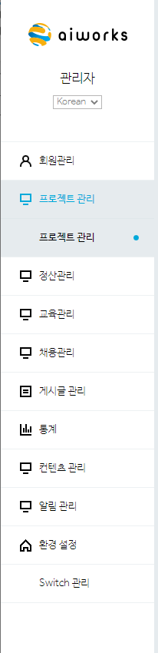
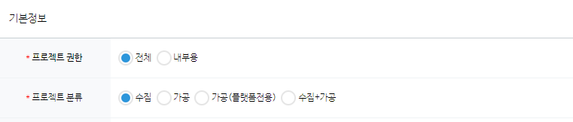
CHAPTER | Edge AI POC | Screen ID | aw_sc_s001
SCREEN PATH | AW main | remark
No. | DESCRIPTION
1 | Added “Edge AI” item to project classification selection
2 | When “Edge AI” is selected for project classification, “Edge AI” is displayed as selected in the project type
3
4
1
Edge AI
Add to project category
2
project type
Edge
in classificationEdge AIwhen addingin the formEdge Add single item

Slide 8
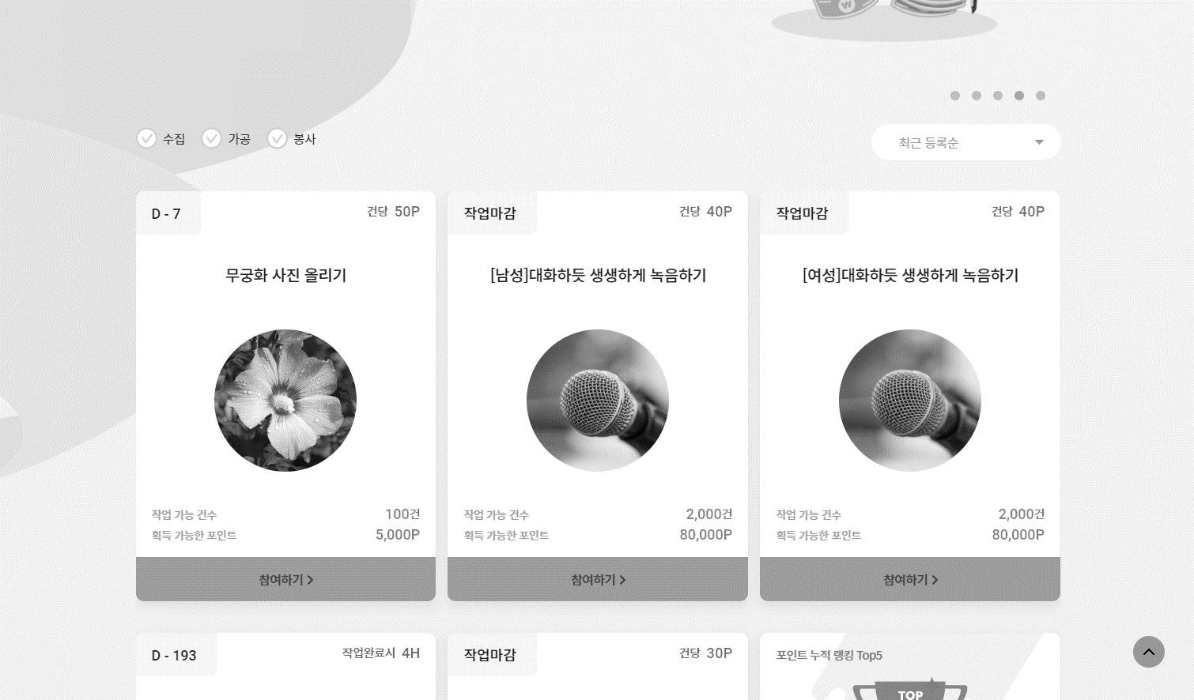

CHAPTER | Edge AI POC | Screen ID | aw_sc_s002
SCREEN PATH | AW main | remark
No. | DESCRIPTION
1 | - EdgeAI dedicated project card exists - Display the project only to the account with permission set (Permissions can be set on the admin page) - Move to Edge AI page when selecting a project - Page address: Edge.aiworks.co.kr (planned)
2
3
4
GNB
Only permission holders will see the project
1
Edge AI
general project
general project
go to>

Slide 9

CHAPTER | Edge AI POC | Screen ID | aw_sc_s003
SCREEN PATH | Edge GNB | remark
No. | DESCRIPTION
1
2
3
4
GNB PC
Smart collection management
Device Management
GNB
GNB MO
Smart collection management
Device Management
GNB

Slide 10
CHAPTER | Edge AI POC | Screen ID | aw_sc_s003-1
SCREEN PATH | Edge Footer | remark
No. | DESCRIPTION
1 | The function of the footer is the same as that of the existing AIWORKS.
2
3
4
1
Footer PC
About Us|Terms of service|Privacy Policy |data voucherSupport project|dataannotatorEducation inquiry
Songpa-gu, SeoulBaekje Gobun-ro 41way40 Booyoung Building401Ho Co., Ltd.testworksbusiness name(week)testworksCEO Yoon Seok-won Business Number517-88-00087e-mailhelp@testworks.co.krService centerT 070.4454.7370 (Consultation time:afternoon1city30minute~afternoon5city30minute weekend,excluding public holidays)
COPYRIGHT 2019. TESTWORKS. ALL RIGHTS RESERVED
Footer MO
About Us|Terms of service|Privacy Policy data voucherSupport project|dataannotatorEducation inquiry
Songpa-gu, SeoulBaekje Gobun-ro 41way40 Booyoung Building401Ho Co., Ltd.testworksbusiness name(week)testworksCEO Yoon Seok-won Business Number517-88-00087
e-mailhelp@testworks.co.kr
Service centerT 070.4454.7370
(Consultation time:afternoon1city30minute~afternoon5city30minute weekend,excluding public holidays)
COPYRIGHT 2019. TESTWORKS. ALL RIGHTS RESERVED
v1.1
-footerAdd page for display

Slide 11
CHAPTER | Edge AI POC | Screen ID | aw_sc_s004
SCREEN PATH | Smart collection management | remark
No. | DESCRIPTION
1 | project card When selected, it moves to the management screen of the project Information displayed on the card - Display project name - Display applied model name - Display the number of collected data - Project status (in progress/completed)
2 | Create a project - Go to the project creation page
3 | data management When clicked, it moves to the data management menu and displays the list collected in the project.
4
GNB
smart collection project
Automating Image Acquisition
선택 시 프로젝터 설정 페이지 이동
데이터 관리 페이지 이동
2
+Create a new collection project
1
3
등록된 기기가 없습니다.
지금 기기를 등록 하시겠습니까?
기기 등록하기>
Bus recognition smart collection#One
Model vehicle recognition model
Collected data999,999dog
state Proceeding
data management
Display project name
Model Display model name
Collected data999,999dog
state Proceeding
data management
Display project name
Model Display model name
Collected data999,999dog
state Proceeding
data management
Display project name
Model Display model name
Collected data999,999dog
state Proceeding
data management
Display project name
Model Display model name
Collected data999,999dog
state complete
data management
Display project name
Model Display model name
Collected data999,999dog
state complete
data management
< 1 2 3 4 … 9 10 >

Slide 12
CHAPTER | Edge AI POC | Screen ID | aw_sc_s005
SCREEN PATH | Smart collection management | remark
No. | DESCRIPTION
1 | 프로젝트가 존재하지 않을 경우 안내 문구 노출
2
3
4
GNB
smart collection project
Automating Image Acquisition
+Create a new collection project
1
진행중인 프로젝트가 없습니다.
“Create a new collection project”버튼을 눌러
스마트 수집기를 경험해 보세요

Slide 13
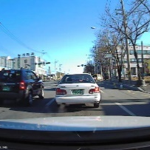
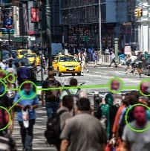
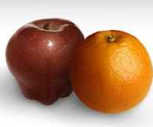
CHAPTER | Edge AI POC | Screen ID | aw_sc_s006
SCREEN PATH | 프로젝트 생성 - 모델선택 | remark
No. | DESCRIPTION
1 | 새 수집 프로젝트 생성 진입 시 “모델선택”에 대한 진행 표시 됨 POC에서 사용가능한 모델리스트 정의 [모델별 객체] 차량인식: Car, bus truck 사람인식: person 과일인식: apple, orange
2
3
4
GNB
Create a new collection project
1 Select model 2 Detailed setting 3 기기선택
1
1. black box vehicle recognition
By automatically recognizing the vehicle in black box
Image acquisition model suitable for autonomous driving model development
collection object:: car,bus,truck
2. CCTVperson recognition
CCTVA model suitable for recognizing a person from the top view, such as
collection object:: person
3.과일인식(사과,오렌지)
과일을 인식하고 구분이 가능한 수집 모델
수집객체:사과,오렌지
취소

Slide 14
CHAPTER | Edge AI POC | Screen ID | aw_sc_s007
SCREEN PATH | Create Project - Select Model | remark
No. | DESCRIPTION
1 | Displays a list of objects supported by the model when selecting a model (set all model description boxes as buttons, not buttons)
2 | Provides multi-selection buttons for objects supported by the model
3
4
GNB
Create a new collection project
1 Select model 2 Detailed setting 3 Device selection
1. black box vehicle recognition
By automatically recognizing the vehicle in black box
Image acquisition model suitable for autonomous driving model development
collection object:car,Bus,truck
1
Displays a list of objects supported by the model in accordion format
Select the objects to collect from the model(Ieast1more than)
Select model
2
Car
Bus
Truck
Disable button when object is not selected
2. CCTVperson recognition
CCTVA model suitable for recognizing a person from the top view, such as
collection object:: person
cancel

Slide 15
CHAPTER | Edge AI POC | Screen ID | aw_sc_s008
SCREEN PATH | Create Project - Select Model | remark
No. | DESCRIPTION
1 | It is activated when one or more objects are selected, and when the “Select Model” button is clicked, the detailed setting page is moved
2
3
4
GNB
Create a new collection project
1 Select model 2 Detailed setting 3 Device selection
1. black box vehicle recognition
By automatically recognizing the vehicle in black box
Image acquisition model suitable for autonomous driving model development
collection object:car,Bus,truck
1
Select the objects to collect from the model(Ieast1more than)
Select model
Car
Bus
Truck
1When more than one is selected“Activate the model selection button”
2. CCTVperson recognition
CCTVA model suitable for recognizing a person from the top view, such as
collection object:Person
cancel

Slide 16
CHAPTER | Edge AI POC | Screen ID | aw_sc_s009
SCREEN PATH | Create Project - Select Model | remark
No. | DESCRIPTION
1 | Close the accordion of the existing selected model when another model is selected
2
3
4
GNB
Create a new collection project
1 Select model 2 Detailed setting 3 Device selection
1. black box vehicle recognition
By automatically recognizing the vehicle in black box
Image acquisition model suitable for autonomous driving model development
collection object:car,Bus,truck
1
2. CCTVperson recognition
CCTVA model suitable for recognizing a person from the top view, such as
collection object:Person
Select the objects to collect from the model(Ieast1more than)
Select model
Person
Close the accordion of the current model when selecting another model
cancel

Slide 17
CHAPTER | Edge AI POC | Screen ID | aw_sc_s010
SCREEN PATH | Create project - detailed settings | remark
No. | DESCRIPTION
1 | Applied model, object setting The AI ​​model and object selected in the model selection stage are displayed
2 | Project name A text input field to identify the user-created project. *Only 4-20 letters, numbers, and spaces can be entered
3 | shooting interval The device automatically sets the interval in seconds to shoot *Only numbers can be entered
4 | Embedded objects per image Set to save only the number of images in the range selected by the user *Only numbers can be entered
5 | Maximum number of images to be acquired Set the maximum number of images to collect in the project When the number of collected images reaches the specified number, the project is automatically stopped.
6 | When all input fields necessary for project creation are filled out, the button is activated and when clicked, it moves to the device selection page.
GNB
Create a new collection project
1 Select model 2 Detailed setting 3 Device selection
Application Model
1
vehicle recognition
object settings
Car
bus
truck
the selected objectthe objectSave data only when it exists.
2
Project name
It is used to classify the created project..
3
second
shooting(Detection)interval
Connected devices take pictures at set time intervals.
4
embedded objects per image
Ieast
dogfrommaximum
dog
You can limit the number of embedded objects in an image to save.
5
Maximum number of images to be acquired
dog
When the set maximum number is reached, the project smart collection is stopped..
6
Previous
next
next

Slide 18
CHAPTER | Edge AI POC | Screen ID | aw_sc_s011
SCREEN PATH | Create Project - Select Device | remark
No. | DESCRIPTION
1 | A list of connectable (not added to another project) devices is displayed. - Devices in disconnected state are marked as inactive - Devices added to other projects are not displayed You can select only one device to add
2 | Done button activated after device selection
3
4
GNB
Create a new collection project
1 Select model 2 Detailed setting 3 Device selection
Choose your device
Please select a device to add to the project
1only dogs can choose.
1
Device nameDevice 1
state connected
Device nameDevice 2
state connected
Device nameDevice 3
state disconnected
2
Previous
complete
complete

Slide 19
CHAPTER | Edge AI POC | Screen ID | aw_sc_s012
SCREEN PATH | Create Project - Select Device | remark
No. | DESCRIPTION
1 | If there are no devices that can be added, a guide message is displayed, and clicking the “Device Management Shortcut” button moves you to the corresponding menu.
2
3
4
GNB
Create a new collection project
1 Select model 2 Detailed setting 3 Device selection
Choose your device
Please select a device to add to the project
1only dogs can choose.
1
There are no registered devices.
Please register your device in device management first.
Go to Device Management>
Previous
complete

Slide 20
CHAPTER | Edge AI POC | Screen ID | aw_sc_s013
SCREEN PATH | Project Settings | remark
No. | DESCRIPTION
1 | After creating the project, you can enter the setting screen and change the existing set project elements.
2
3
4
GNB
Project Settings
vehicle recognition project
Application Model
vehicle recognition
person recognition
fruit recognition
object settings
Car
Person
Bus
Dog
the selected objectthe objectSave data only when it exists.
1
Project name
It is used to classify the created project..
shooting(Detection)interval
second
Connected devices take pictures at set time intervals.
embedded objects per image
Ieast
dogfrommaximum
dog
You can limit the number of embedded objects in an image to save.
Maximum number of images to be acquired
dog
When the set maximum number is reached, the project smart collection is stopped.

Slide 21
CHAPTER | Edge AI POC | Screen ID | aw_sc_s014
SCREEN PATH | Project Settings | remark
No. | DESCRIPTION
1 | project status In Progress: Selectable while stopped The state in which the connected device of the project proceeds with the collection activity and the image data is saved Stop: Can be changed in the state when the project is first created or in the in progress state. The connected device has stopped collecting images Done: Selectable from in progress or stopped status. Smart collection no longer proceeds by completing the project.
2 | Delete project [confirm] Deletes the project and all related collected data. Do you want to proceed? It is possible to delete a project in the completed state, and when it is deleted, the project is not exposed, and it is deleted including the collected data.
3 | Save changes to the items set by the user
4
GNB
Project Settings
vehicle recognition project
1
Proceeding
stop
complete
project status
진행 중
중지
완료
Once the project is complete, there is no going back and the device associated with the project is disconnected..
2
Delete project
delete
delete
When entering the completed project setting screen
Project can be deleted only in the completed state.
When the delete button is selected
Confirm project deletion
Delete all relevant project and related collected data.do you want to proceed?
cancel
3
취소
삭제
change

Slide 22
CHAPTER | Edge AI POC | Screen ID | aw_sc_s015
SCREEN PATH | Device management | remark
No. | DESCRIPTION
1 | device card List and status of registered devices can be viewed Top: Show device name Linked project: Displays the project name to which the current device is added Connection Status: Displays the connection status of the device (connected/disconnected)
2
3
4
GNB
Device Management
connectedYou can manage and add devices..
+Device registration
1
device1
linked project Project name displayed
connection status connected
device1
linked project Project name
connection status connected
device1
linked project none
connection status disconnected
device1
linked project none
connection status disconnected
< 1 2 3 4 … 9 10 >

Slide 23
CHAPTER | Edge AI POC | Screen ID | aw_sc_s016
SCREEN PATH | Device management | remark
No. | DESCRIPTION
1 | Device registration When the device registration button is selected, the registration screen moves
2 | No registered device If there is no registered device, the device list is not displayed and a guide message is displayed
3
4
GNB
Device Management
connectedYou can manage and add devices..
1
+Device registration
2
There are no registered devices.
“Device registration”press the button
Experience the smart collection function

Slide 24
CHAPTER | Edge AI POC | Screen ID | aw_sc_s017
SCREEN PATH | Device registration | remark
No. | DESCRIPTION
1 | Device name Users can freely enter a name that can identify the device Only 4-20 alphanumeric characters can be entered
2 | Device GUID Device's unique ID input field Only alphanumeric characters, special characters (-) and dashes can be entered (up to 40 characters)
3
4
GNB
Register a new device
EdgeAIon mydeviceto add to your collection project.
Device registration
1
Device name
4-20English,Only numbers can be entered
2
deviceGUID
device specificID input
기기 등록 실패
기기 등록에 실패하였습니다.
입력된 항목이 맞는지 다시 확인해 주세요
확인
cancel
Device registration
Device registration

Slide 25
CHAPTER | Edge AI POC | Screen ID | aw_sc_s018
SCREEN PATH | Device Settings | remark
No. | DESCRIPTION
1 | Device Settings Device status: Check the current device connection status Periodically communicate with the device and then display the Connected/Disconnected text *Requires periodic reference discussion (approximately 10 seconds) Device Name: Displays the device name entered by the user Device IP: Displays the IP address received from the device (cannot be modified) Device GUID: Displays the ID entered when registering the device for the first time (cannot be modified) Connected project: Displays the project name to which the device belongs
2 | Delete device [confirm] Are you sure you want to delete the registered device? After that, it moves to the device management page and is deleted from the device list *Deactivated if a linked project exists
3
4
GNB
Device Settings
Check the settings of the registered device
Device Settings
1
device status
connected
disconnected
Device name
device1
deviceIP
111.222.33.444
deviceGUID
32SDF323LK
linked project
Vehicle photo collection project
Delete device
2
delete
delete
cancel
change
v1.2
Add device deletion case

Slide 26
CHAPTER | Edge AI POC | Screen ID | aw_sc_s019
SCREEN PATH | data management | remark
No. | DESCRIPTION
1 | Data of the selected project is displayed and other projects can be selected
2 | - Filter can be applied by selecting the date range where the image is saved - Enter in Date Picker format and delete the selected date when clicking the “X” button - Filter can be applied by selecting only the first or last day of the date range
3 | You can set the maximum number of images displayed on one page (10, 50, 200)
4 | Displays the total number of data set in items 1 and 2
5 | All or individual selection is possible and only selected data is downloaded
GNB
data management
List of collected data
1
차량인식프로젝트 #1
2
YY-MM-DD
~
YY-MM-DD
apply
3
number of displays
10
50
200
Set collection date
1-1
4
차량인식프로젝트 #1
Collected data99,999key
프로젝트1
프로젝트2
프로젝트3
프로젝트4
………
5
5-1
Select All
Select Download
img0001.jpg
img0001.jpg
img0001.jpg
img0001.jpg
img0001.jpg
2-1
YY-MM-DD
July 2020
Mo
Tu
We
Th
Fr
Sa
Su
1
2
3
4
5
img0001.jpg
img0001.jpg
img0001.jpg
img0001.jpg
img0001.jpg
6
7
8
9
10
11
12
< 1 2 3 4 … 9 10 >
13
14
15
16
17
18
10
20
21
22
23
24
25
26
27
28
29
30
31

Slide 27
CHAPTER | Edge AI POC | Screen ID | aw_sc_s020
SCREEN PATH | data management | remark
No. | DESCRIPTION
1 | Enlarge or display original when selecting an image *Displays up to 720px narrowed on PC standards Close the modal window by selecting an area outside the image
2 | Download a single image when you click download
3
4
5
GNB
data management
List of collected data
1
2
차량인식프로젝트 #1
Set collection date
YY-MM-DD
~
YY-MM-DD
apply
number of displays
10
50
200
Collected data99,999key
Select All
Download
img0001.jpg
img0001.jpg
img0001.jpg
img0001.jpg
img0001.jpg
img0001.jpg
img0001.jpg
img0001.jpg
img0001.jpg
img0001.jpg
img0001.jpg
< 1 2 3 4 … 9 10 >

Slide 28


