Slide 1
張維麟, Chang Wei Lin
宜蘭羅東人，物理背景的演算法工程師
擅長 C/C++/Python，熱愛登山、重訓與桌遊
關注 AI/LLM，善用 AI 工具學習與開發
#C #C++ #Python #Assembly
#TensorFlow #PyTorch #Qt #OpenCV #YOLO
#StableDiffusion #LLM #Bash #Matlab #LabVIEW

Slide 2
 | 九齊科技 NyQuest Technology | 亞迪電子 ADE Technology Inc. | 元鼎音訊 UnlimiterHear Co. | 廣達電腦 / 中央研究院 Quanta / Academia Sinica
Product | Voice-control IC Voice MCU / LCD MCU | Vital signs monitor Thermal posture system | Hearing aids Bluetooth headphones | RF components iSCAT paper
Work content | Speech algorithm library ADPCM/SBC, pitch tracking WSOLA, feedback suppression image scaling/compression | Radar vital-sign algorithms GUI labeling tools ML/DL symptom recognition OpenCV/YOLO fall detection | DSP on CSR/AB chips VAD/LRT/noise reduction EQ/DRC/binaural beats patent collaboration | Automated RF tests yield/error analysis nanoparticle tracking Optics Express paper
During | 2022/11 ~ now | 2020/07 ~ 2022/10 | 2016/05 ~ 2020/06 | 2014/11 ~ 2016/05 2013/07 ~ 2014/04
NyQuest
2022/11 ~ now
ADE
2020/07 ~ 2022/10
UnlimiterHear
2016/05 ~ 2020/06
Quanta / Academia
2014/11 ~ 2016/05, 2013/07 ~ 2014/04
Product
Voice-control IC
Voice MCU / LCD MCU
Vital signs monitor
Thermal posture system
Hearing aids
Bluetooth headphones
RF components
iSCAT paper
Work
Speech algorithm library
ADPCM / SBC
Pitch tracking
WSOLA
Feedback suppression
Image scaling / compression
Radar vital-sign algorithms
GUI labeling tool
ML/DL symptom recognition
OpenCV / YOLO fall detection
DSP on CSR / AB chips
VAD / LRT / noise reduction
EQ / DRC / binaural beats
Natural sound generation
Patent collaboration
Automated RF tests
Yield and error analysis
Nanoparticle localization
Random-walk tracking
Optics Express paper
Focus
MCU optimization
Python + C
Physiological signal
Computer vision
Audio DSP
Embedded implementation
Instrumentation
Research data analysis

Slide 3
NyQuest Technology Co. Ltd.
Speech algorithm library for voice-control IC, voice MCU, and LCD MCU
Python simulation; C implementation on resource-constrained MCU
Audio encoding: ADPCM / SBC
Pitch tracking; time-stretching and pitch-shifting: resampling + WSOLA
Feedback suppression, syllable segmentation, and beat tracking
Image scaling and image compression algorithms

Slide 4
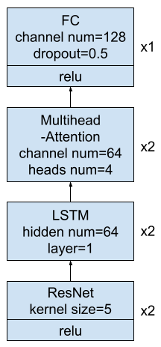
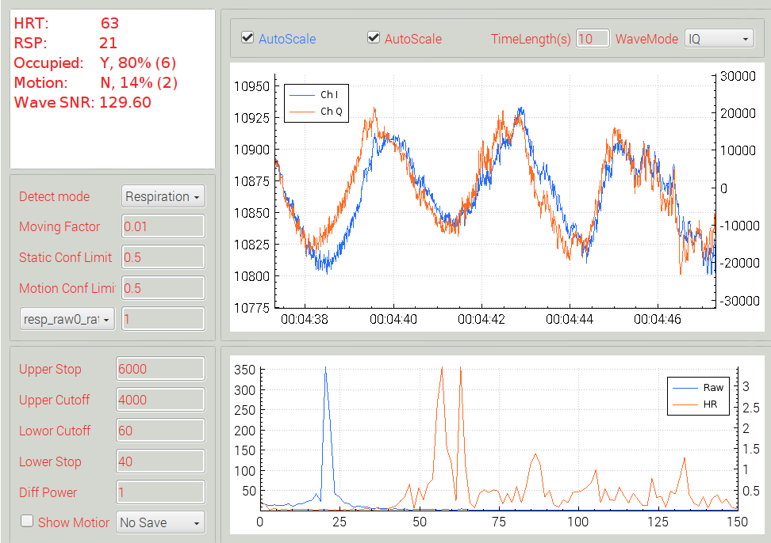
ADE Technology Inc.(1)
Non-contact vital-sign monitoring by microwave radar
Python simulation and C++ implementation
IIR / STFT / GMM / autocorrelation feature pipeline
Random Forest / CNN / DNN symptom recognition

Slide 5
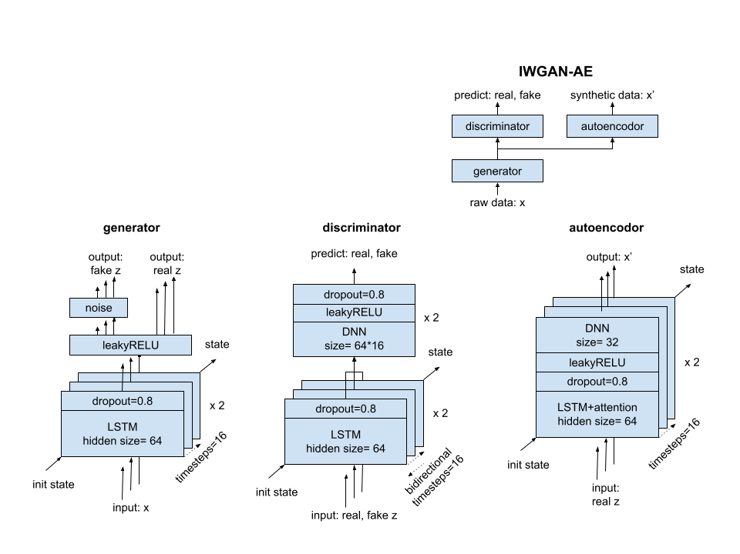
ADE Technology Inc.(2)
Vital-sign waveform pre-training
IIR / STFT feature extraction
IWGAN-AE pre-training and augmentation
Radar waveform robustness experiments

Slide 6
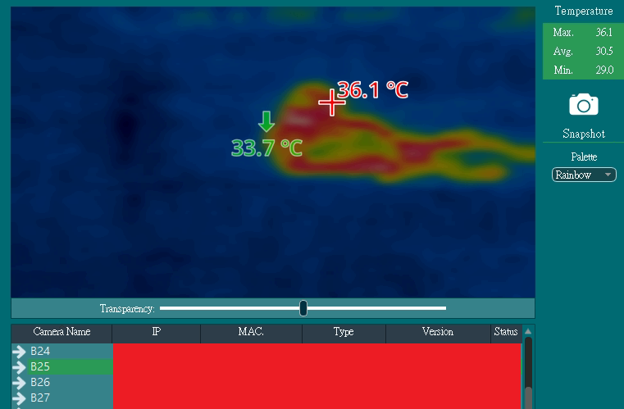
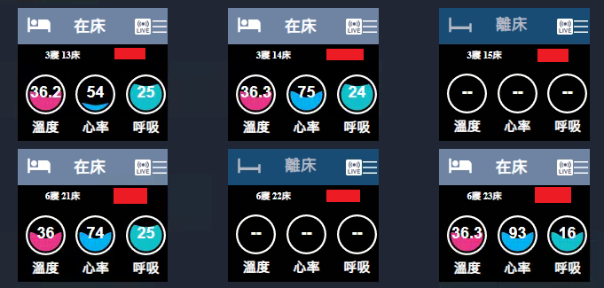








ADE Technology Inc.(3)
Thermal image posture and fall detection
OpenCV + YOLO thermal-image pipeline
3 classes: lying, sitting, standing
Fall alert for healthcare scenarios

Slide 7
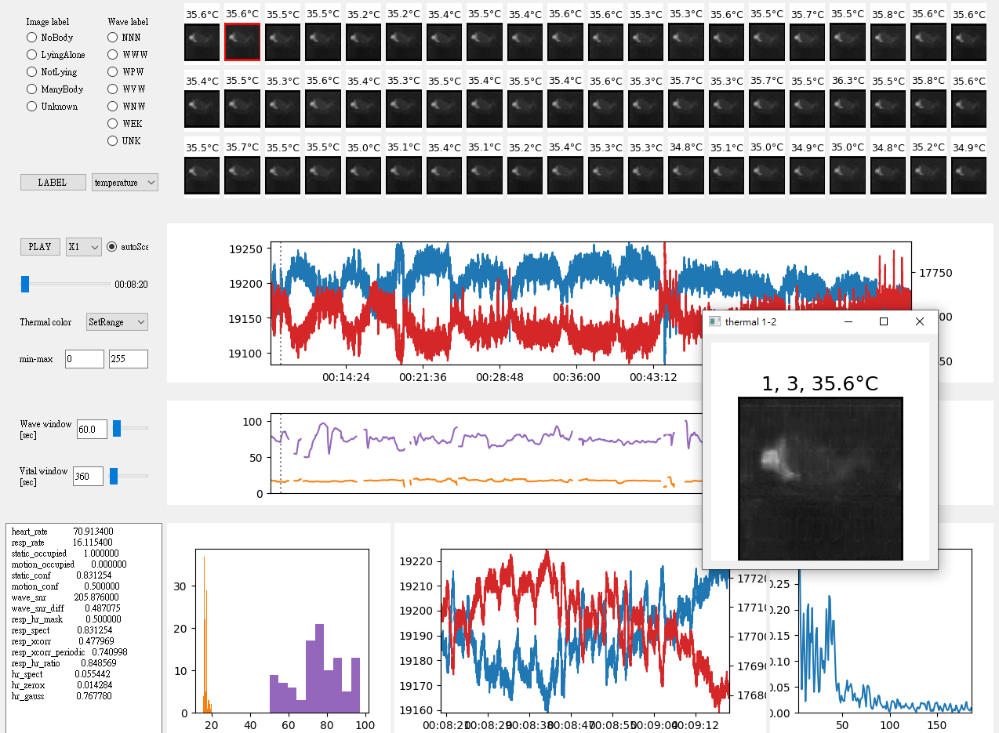
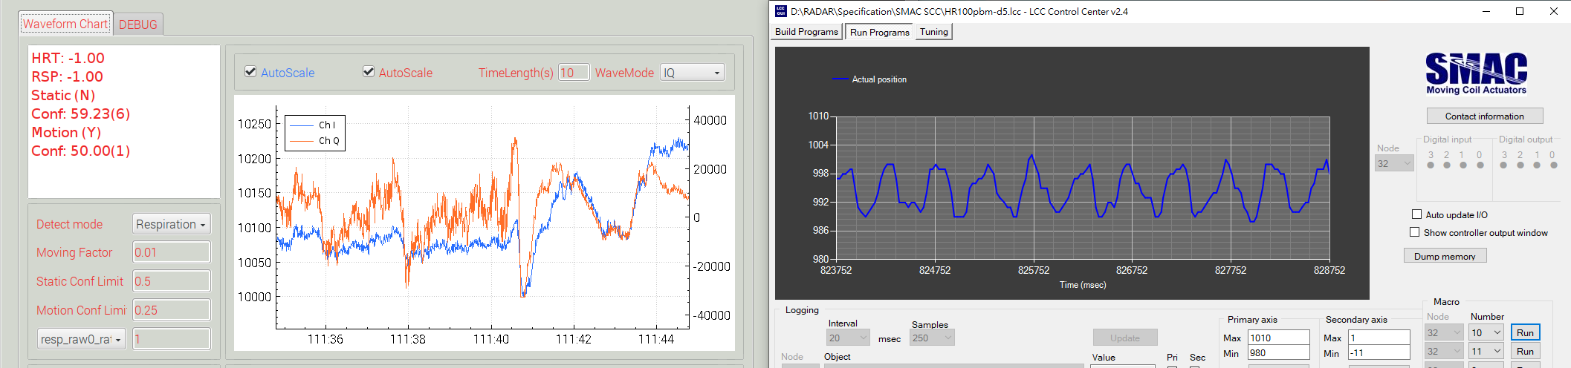
ADE Technology Inc.(4)
GUI Tool for vital-sign waveform dataset
Data visualization and labeling workflow
Client-server model between Windows and Linux
Bash / PowerShell automation for data collection
SMAC step motor simulates breathing and heartbeat

Slide 8

UnlimiterHear Co.
DSP (C or Assembly)
Convert floating-point algorithms to fixed-point operation
Voice enhancement: VAD, LRT, noise cancellation, subwoofer tune
Hearing protection: EQ, DRC, binaural beat generation
Natural sound generation: random number, white noise, droplet physics
Patent collaboration: hearing protection and masking-noise methods
降噪前
降噪後
原始音樂
±5Hz拍音
雨滴
水池

Slide 9
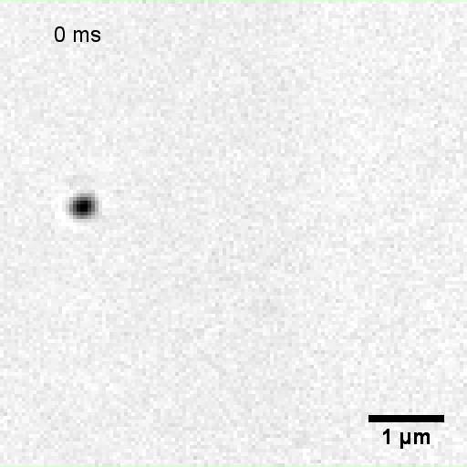
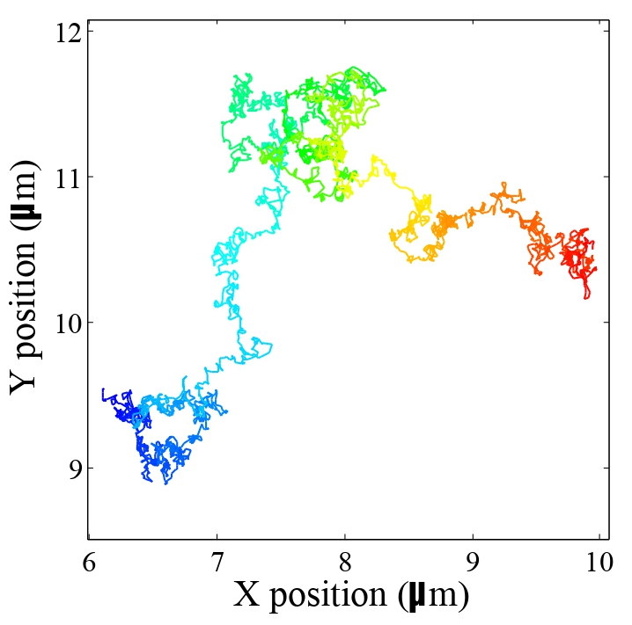
Academia Sinica
Nano-particles on cell membrane imaged by CMOS high-speed camera (1k ~ 100k fps)
Interferometric scattering optical microscope (iSCAT)
Nano-particle localization and random-walk tracking
Trajectory data analysis for cell membrane physical properties
Optics Express: shot-noise limited localization of single 20 nm gold particles

Slide 10
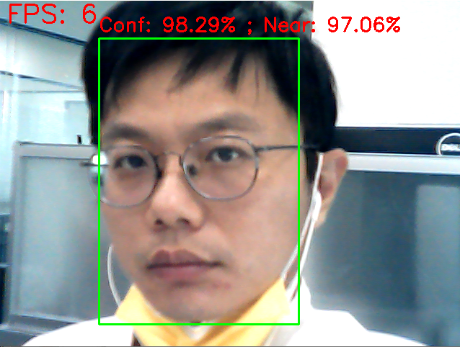
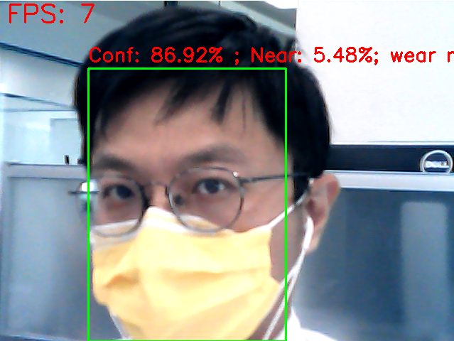
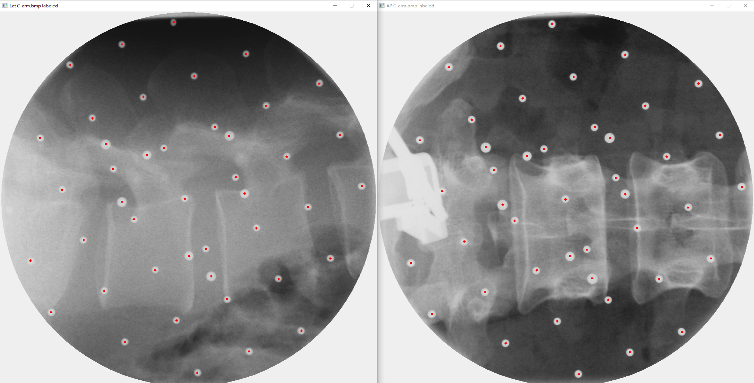
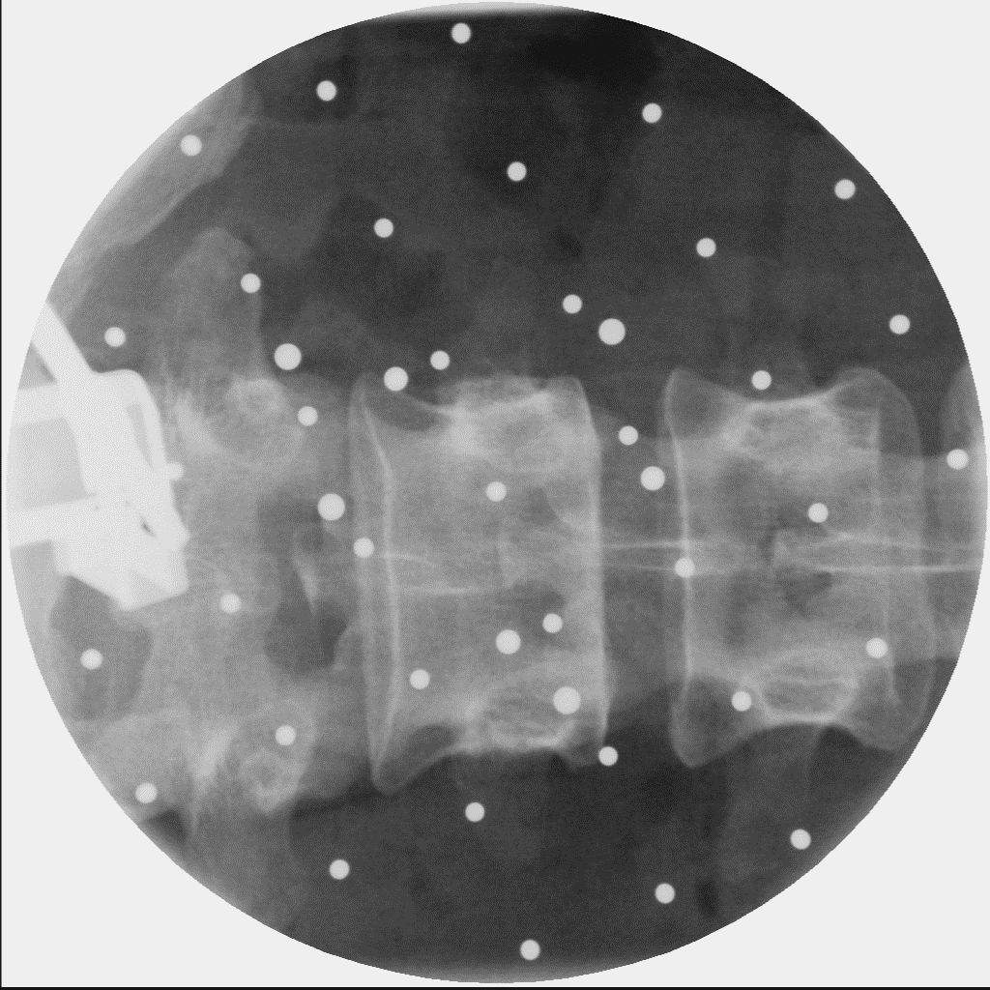
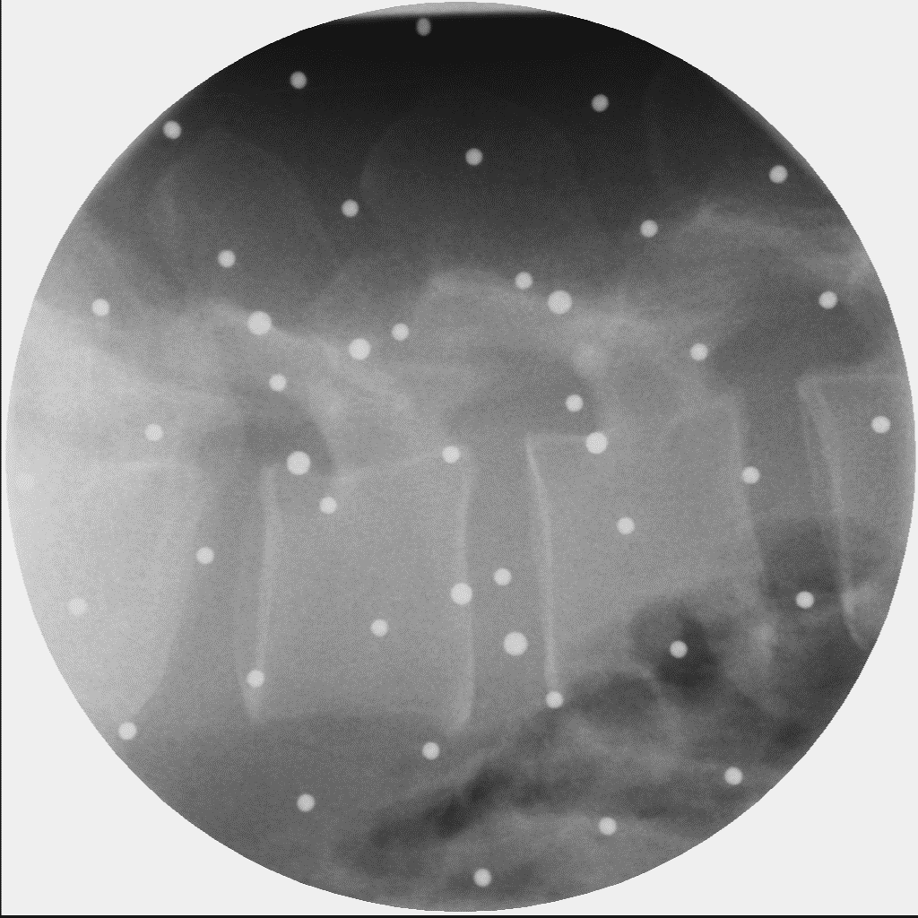
Other
AI / Deep Learning
- Stable Diffusion LoRA / finetune
- YOLO mask recognition
- Spine marker image processing
- LLM workflow: Gemini / ChatGPT / Claude / Grok
- Antigravity / Claude Code

Slide 11
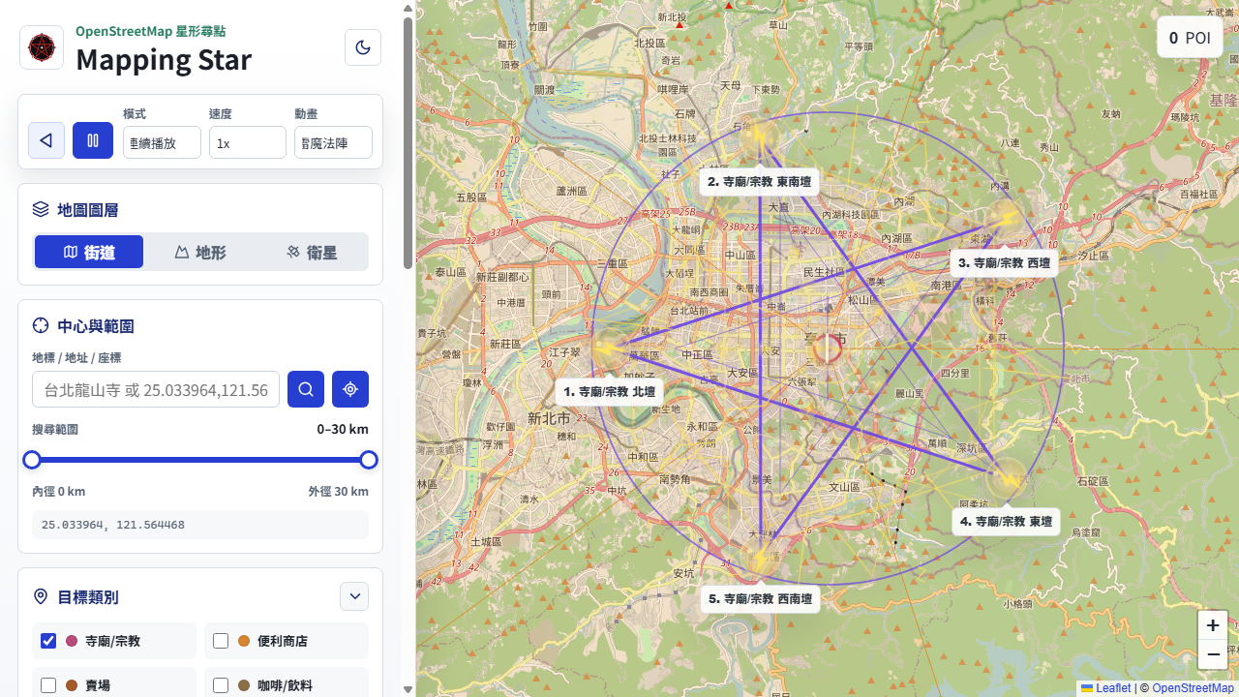
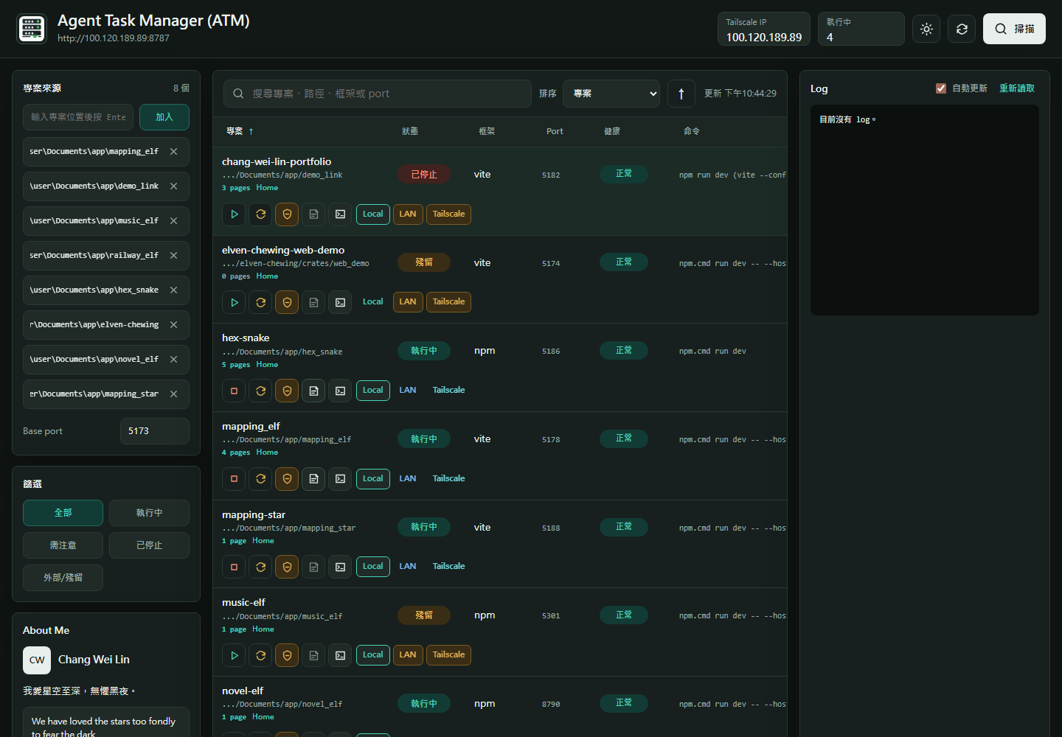
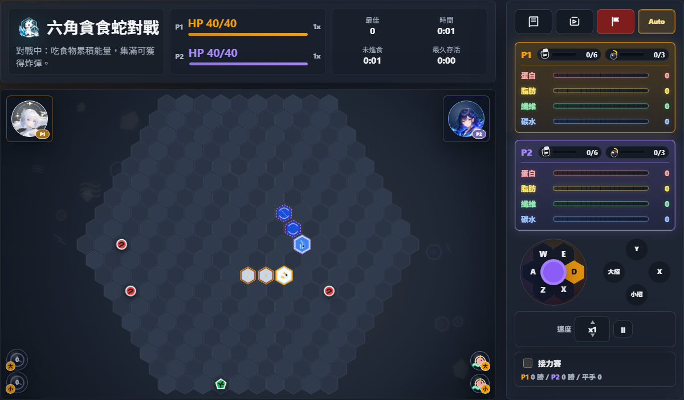
Project Demo / 專案分組
只保留 demo_link 目前有的 Demo，並統一使用桌面版截圖。
1. 地圖 / 路線：Mapping Elf、Mapping Star、Railway Elf。
2. 遊戲 / 音訊：Hex Snake、Music Elf。
3. 工作流 / 寫作 / 輸入：Agent Task Manager、Novel Elf、Elven Chewing。
4. 其他小工具：IIR Filter Tool、Web TSP App、Win Rate Calculator。
介紹重點：每個專案為什麼做、解決什麼問題、可以如何 demo。

Slide 12
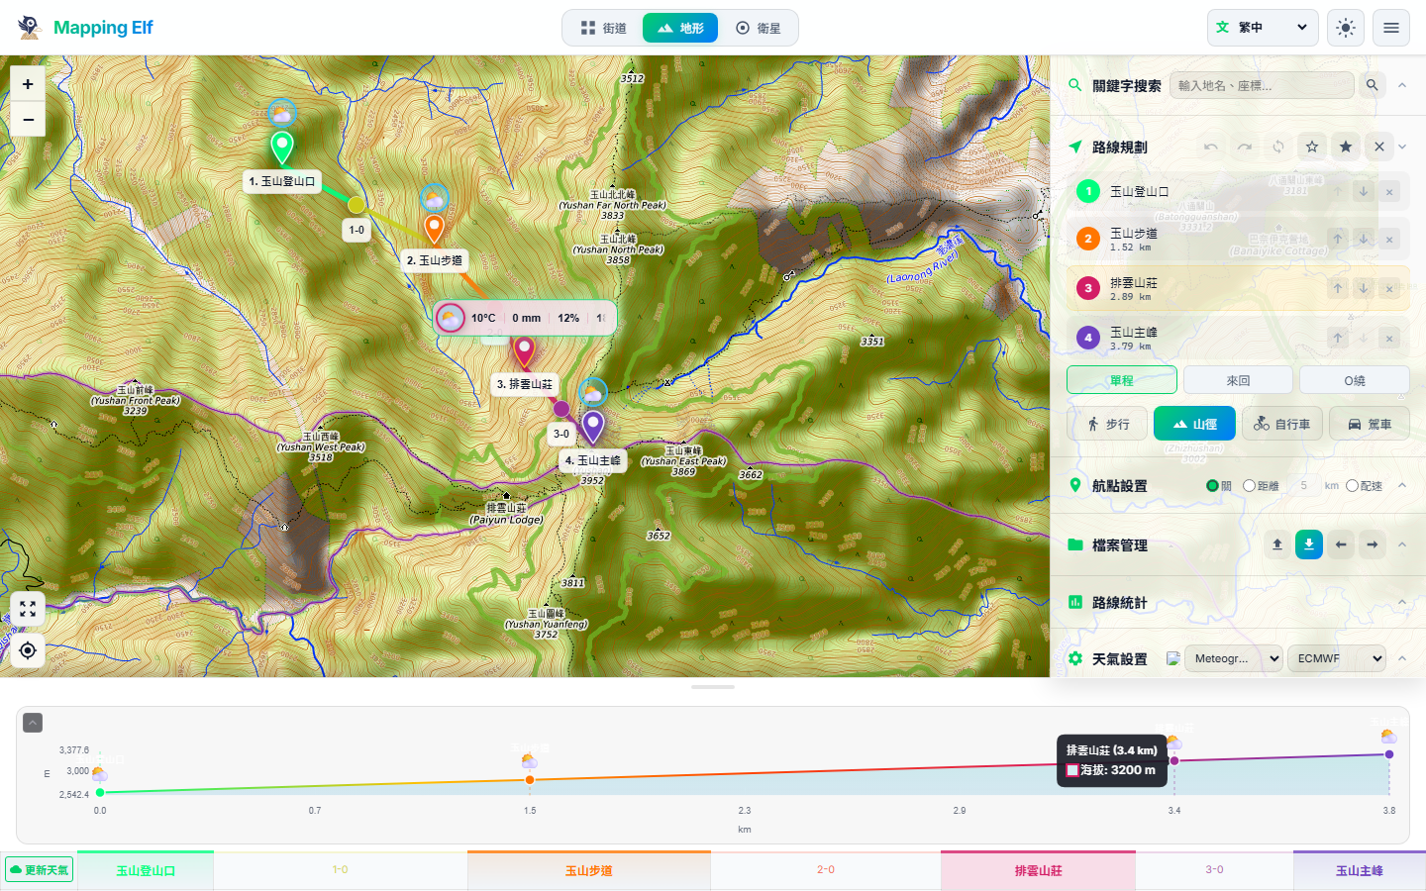
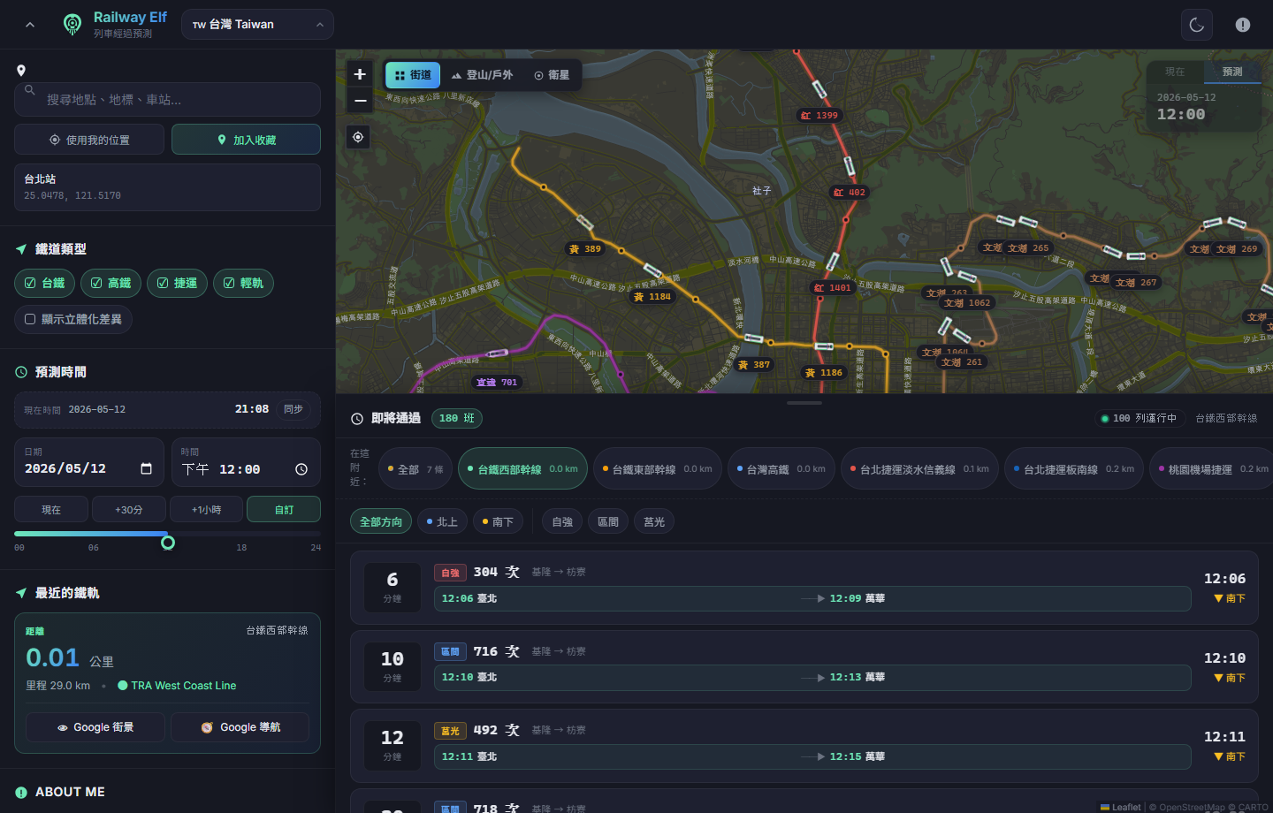
Mapping Elf / Mapping Star / Railway Elf
Mapping Elf
目的：把 GPX/KML 路線規劃、海拔剖面與天氣時間軸放在同一個戶外路線工具。
Mapping Star
目的：把 POI 搜尋與幾何排列轉成可互動的五/六芒星路線視覺化。
Railway Elf
目的：用地圖方式檢視鐵道路線與站點資料，做成可分享的輕量 Demo。

Slide 13
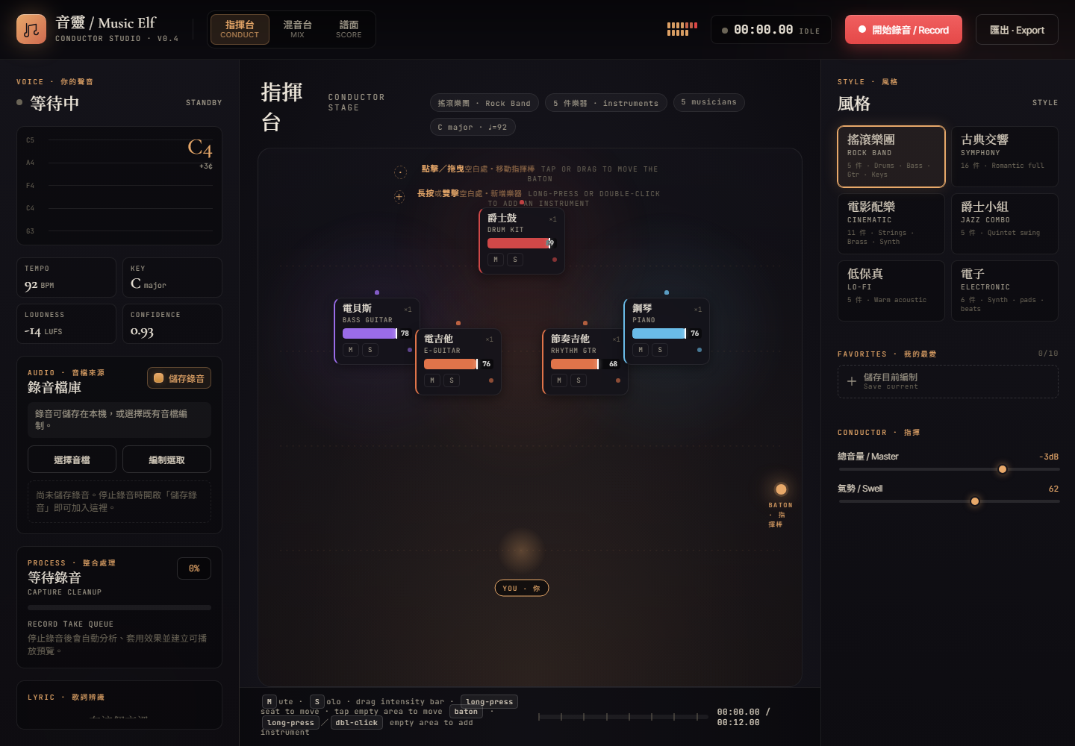
Hex Snake / Music Elf
Hex Snake
目的：用六角格蛇遊戲驗證 AI 對弈、角色技能、重播與平衡模擬。
Music Elf
目的：把歌聲或旋律分析成 MIDI / MusicXML，讓音高、節奏與和弦推斷可視化。
共同重點：把演算法做成可操作的互動 Demo，面試時能直接展示輸入與結果。

Slide 14
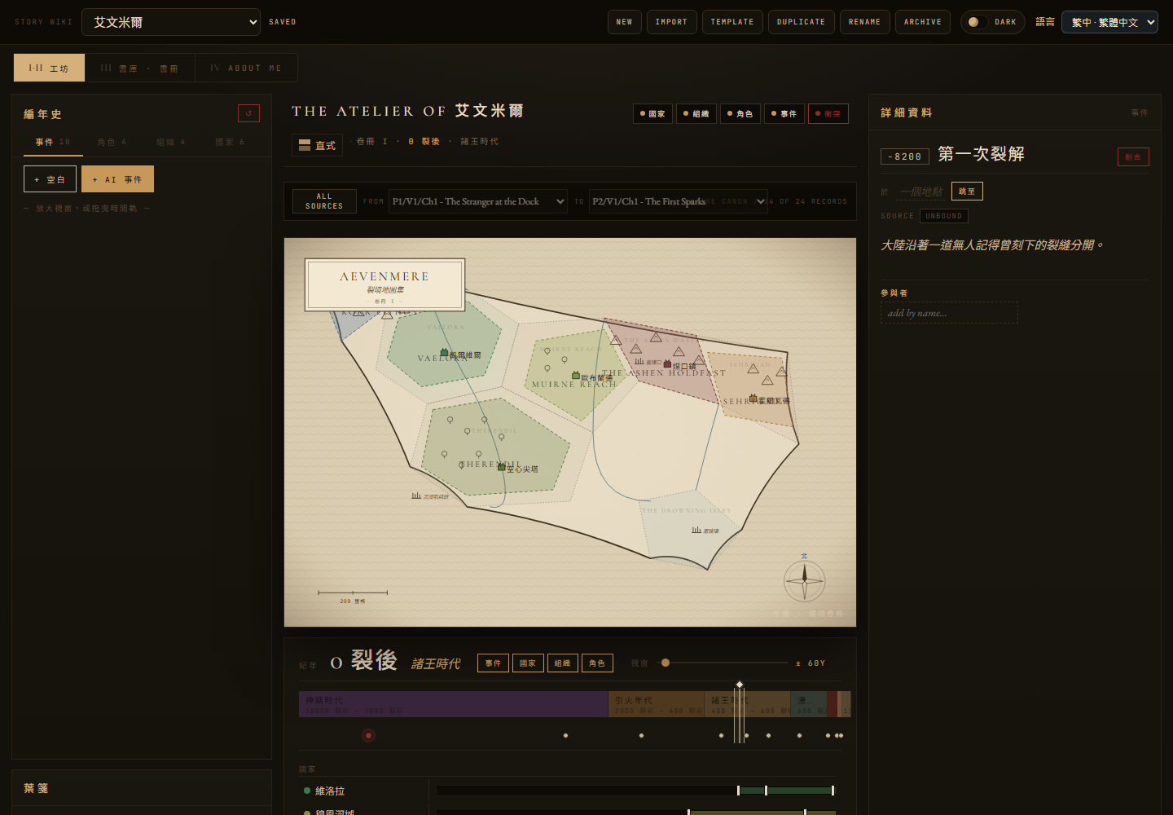
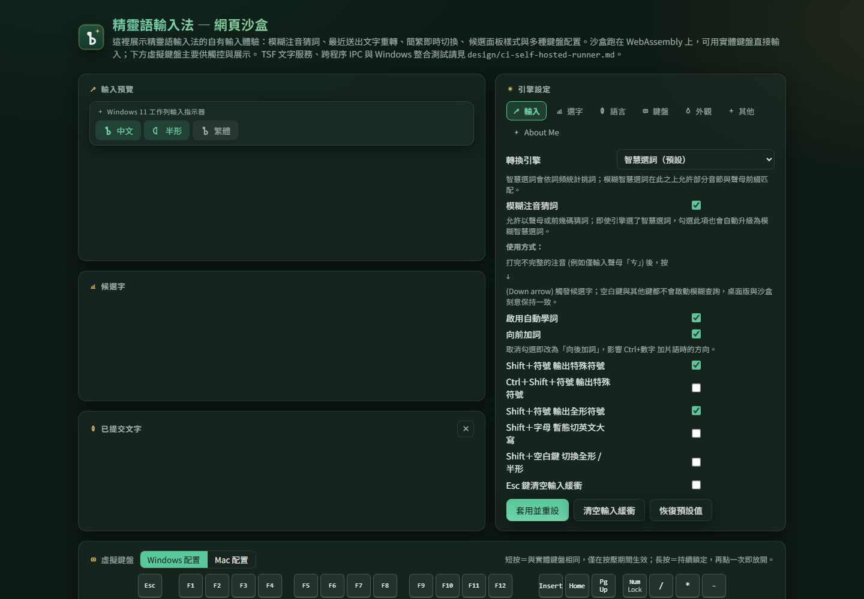
Agent Task Manager / Novel Elf / Elven Chewing
Agent Task Manager
目的：集中管理多個 dev server、log 與 health check，讓 Agent Coding 驗證流程更順。
Novel Elf
目的：整理長篇小說世界觀、角色、章節與寫作脈絡，讓 LLM 協作更可控。
Elven Chewing
目的：用 WebAssembly Demo 驗證注音輸入核心，再銜接 Windows TSF 輸入法。

Slide 15
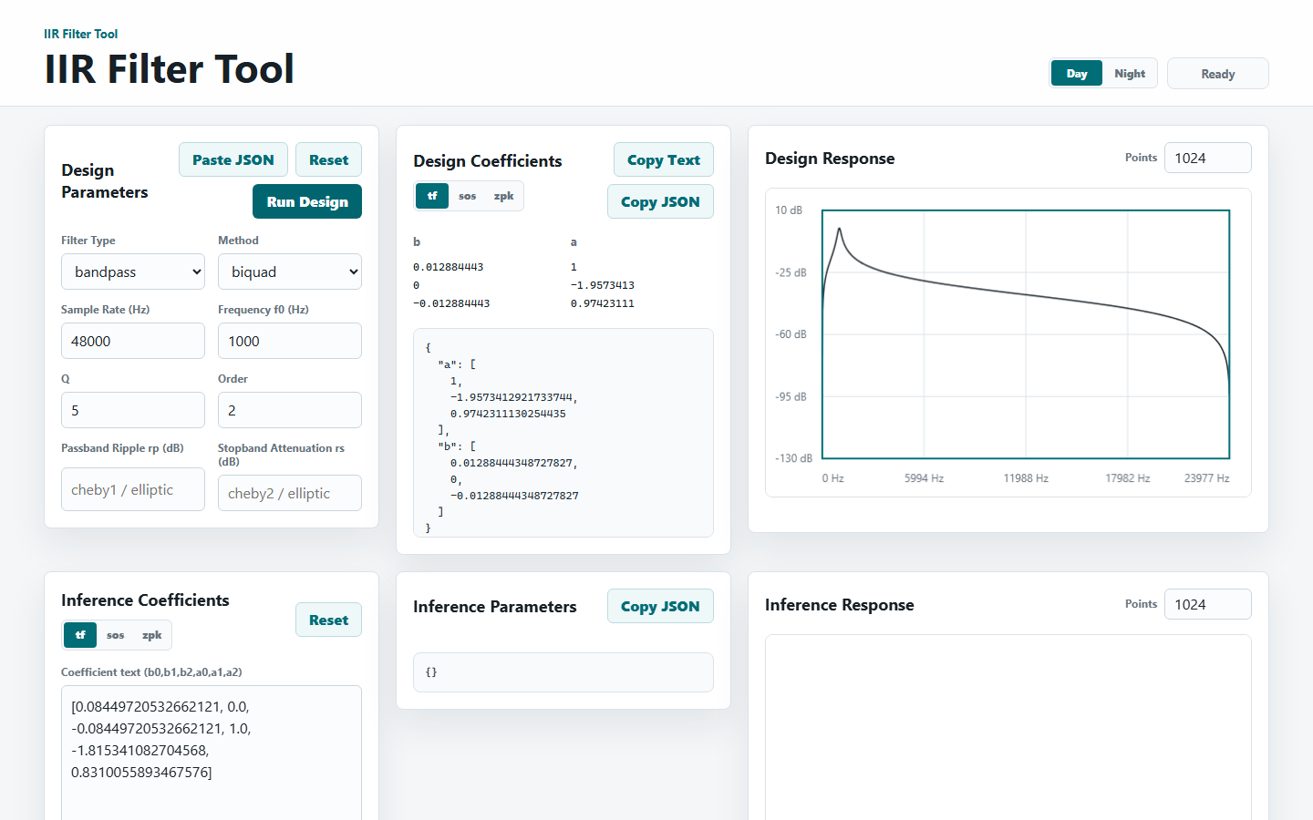
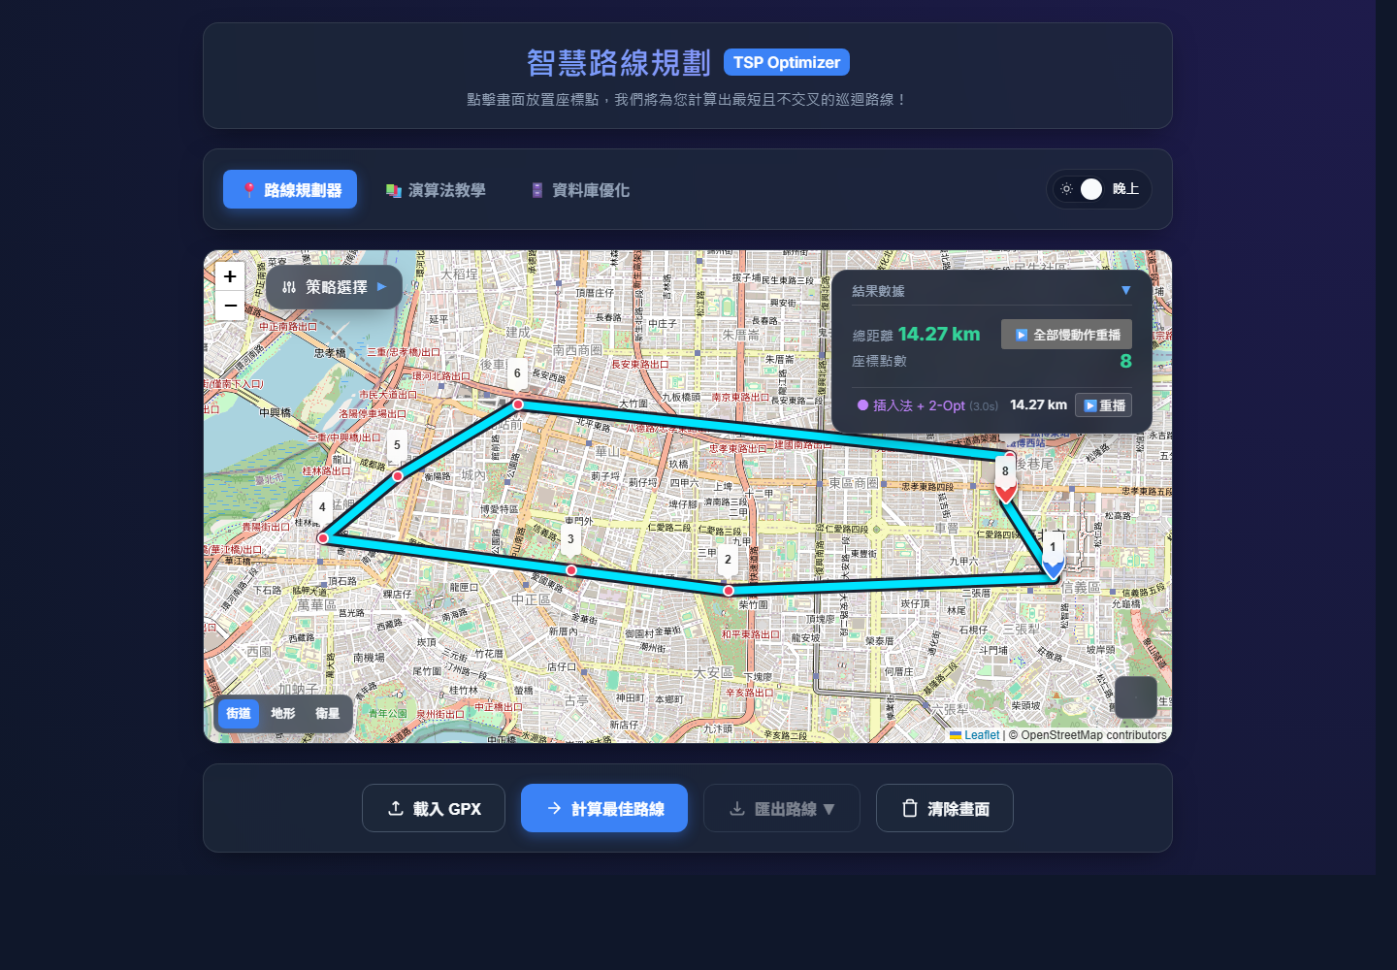
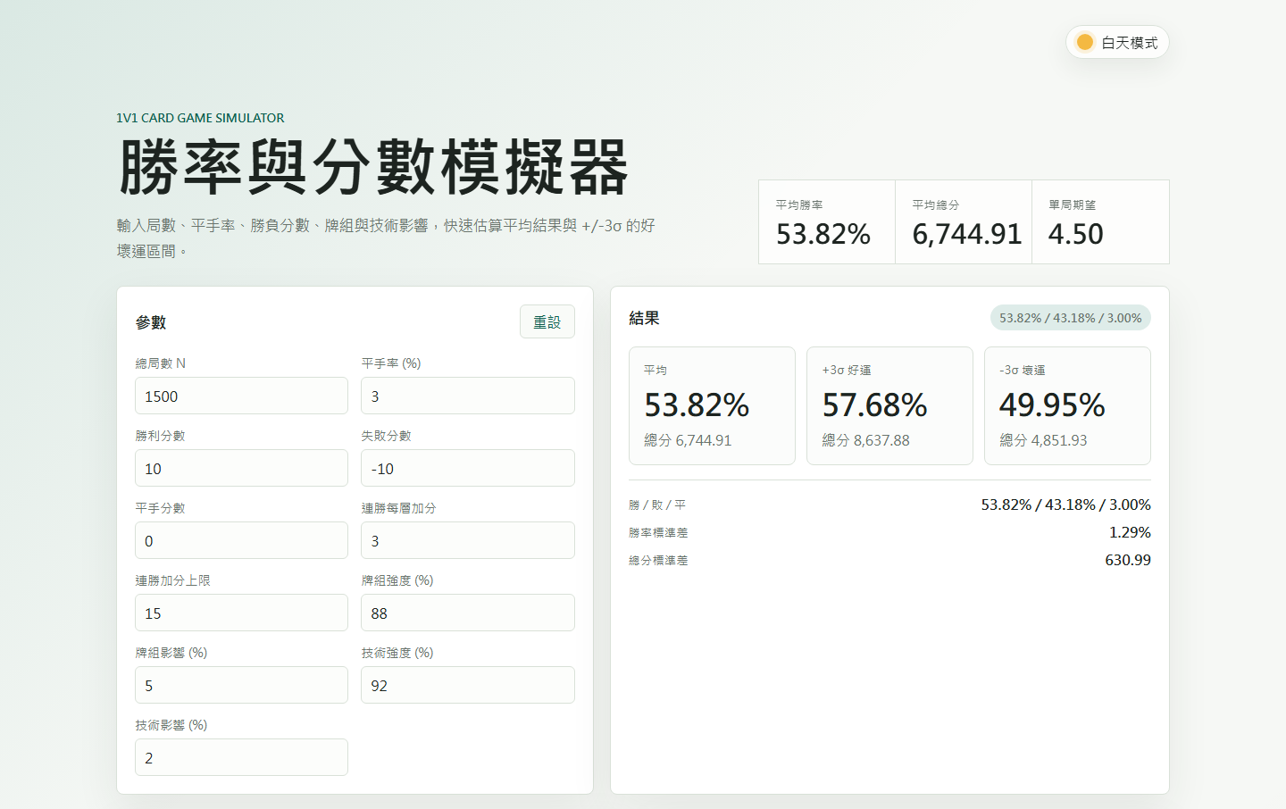
Other Tools / 其他小工具
IIR Filter Tool
目的：互動調整 DSP 濾波器係數，立即檢查頻率響應。
Web TSP App
目的：用視覺化方式展示旅行推銷員路徑最佳化。
Win Rate Calculator
目的：把勝率、機率與情境假設做成可快速試算的網頁工具。

