Slide 1
張維麟, Chang Wei Lin
宜蘭羅東人，物理背景的演算法工程師
擅長 C/C++/Python，熱愛登山、重訓與桌遊
關注 AI/LLM，善用 AI 工具學習與開發
#C #C++ #Python #Assembly
#TensorFlow #PyTorch #Qt #OpenCV #YOLO
#StableDiffusion #LLM #Bash #Matlab #LabVIEW

Slide 2
 | 九齊科技 NyQuest Technology | 亞迪電子 ADE Technology Inc. | 元鼎音訊 UnlimiterHear Co. | 廣達電腦 / 中央研究院 Quanta / Academia Sinica
Product | Voice-control IC Voice MCU / LCD MCU | Vital signs monitor Thermal posture system | Hearing aids Bluetooth headphones | RF components iSCAT paper
Work content | Speech algorithm library ADPCM/SBC, pitch tracking WSOLA, feedback suppression image scaling/compression | Radar vital-sign algorithms GUI labeling tools ML/DL symptom recognition OpenCV/YOLO fall detection | DSP on CSR/AB chips VAD/LRT/noise reduction EQ/DRC/binaural beats patent collaboration | Automated RF tests yield/error analysis nanoparticle tracking Optics Express paper
During | 2022/11 ~ now | 2020/07 ~ 2022/10 | 2016/05 ~ 2020/06 | 2014/11 ~ 2016/05 2013/07 ~ 2014/04
NyQuest
2022/11 ~ now
ADE
2020/07 ~ 2022/10
UnlimiterHear
2016/05 ~ 2020/06
Quanta / Academia
2014/11 ~ 2016/05, 2013/07 ~ 2014/04
Product
Voice-control IC
Voice MCU / LCD MCU
Vital signs monitor
Thermal posture system
Hearing aids
Bluetooth headphones
RF components
iSCAT paper
Work
Speech algorithm library
ADPCM / SBC
Pitch tracking
WSOLA
Feedback suppression
Image scaling / compression
Radar vital-sign algorithms
GUI labeling tool
ML/DL symptom recognition
OpenCV / YOLO fall detection
DSP on CSR / AB chips
VAD / LRT / noise reduction
EQ / DRC / binaural beats
Natural sound generation
Patent collaboration
Automated RF tests
Yield and error analysis
Nanoparticle localization
Random-walk tracking
Optics Express paper
Focus
MCU optimization
Python + C
Physiological signal
Computer vision
Audio DSP
Embedded implementation
Instrumentation
Research data analysis

Slide 3
NyQuest Technology Co. Ltd.
Speech algorithm library for voice-control IC, voice MCU, and LCD MCU
Python simulation; C implementation on resource-constrained MCU
Audio encoding: ADPCM / SBC
Pitch tracking; time-stretching and pitch-shifting: resampling + WSOLA
Feedback suppression, syllable segmentation, and beat tracking
Image scaling and image compression algorithms

Slide 4
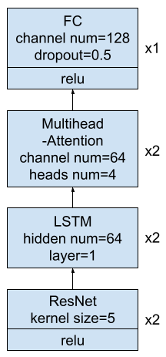
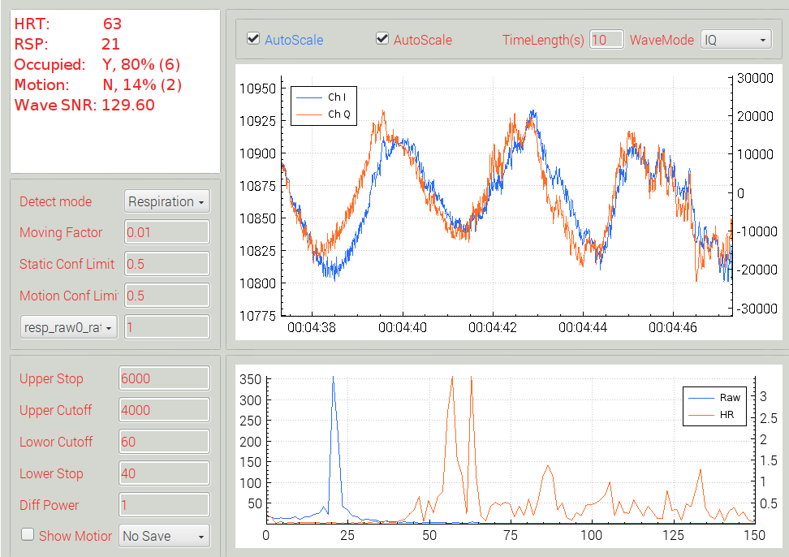
ADE Technology Inc.(1)
Non-contact vital-sign monitoring by microwave radar
Python simulation and C++ implementation
IIR / STFT / GMM / autocorrelation feature pipeline
Random Forest / CNN / DNN symptom recognition

Slide 5
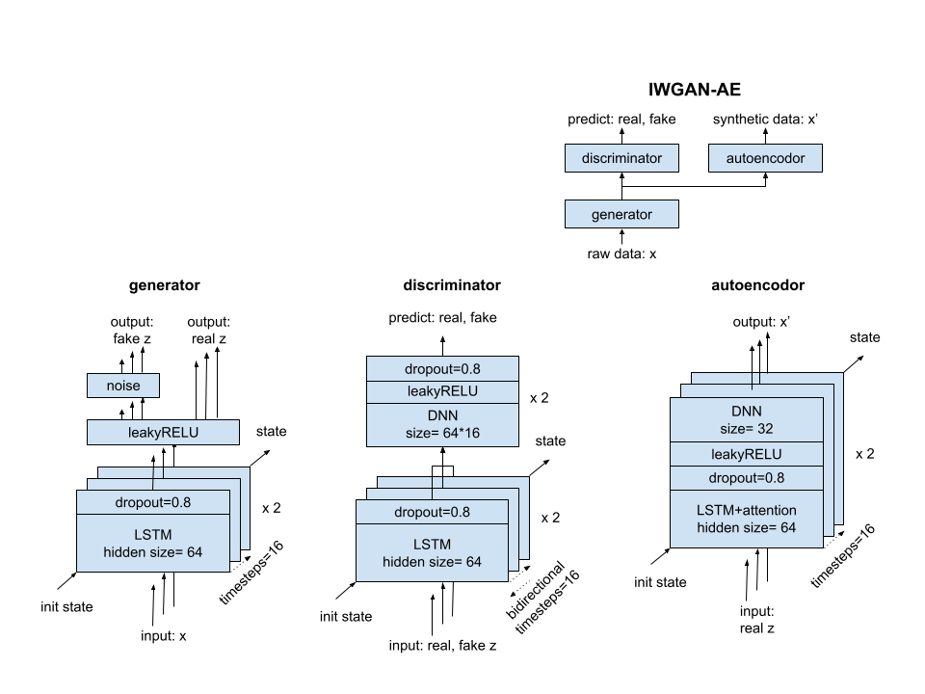
ADE Technology Inc.(2)
Vital-sign waveform pre-training
IIR / STFT feature extraction
IWGAN-AE pre-training and augmentation
Radar waveform robustness experiments

Slide 6
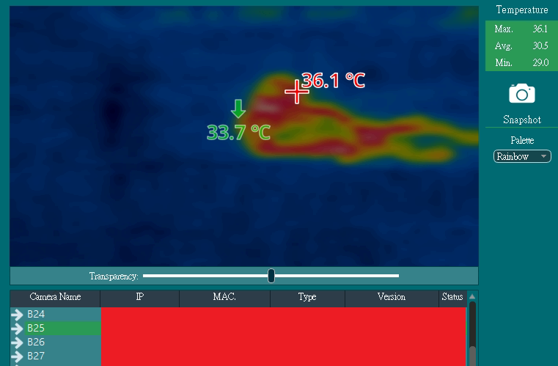
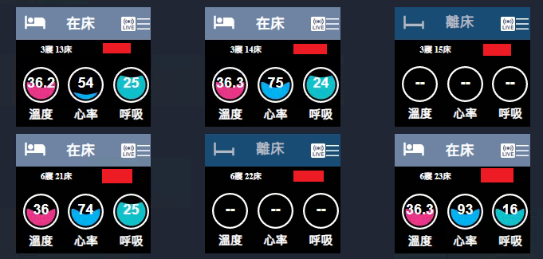








ADE Technology Inc.(3)
Thermal image posture and fall detection
OpenCV + YOLO thermal-image pipeline
3 classes: lying, sitting, standing
Fall alert for healthcare scenarios

Slide 7
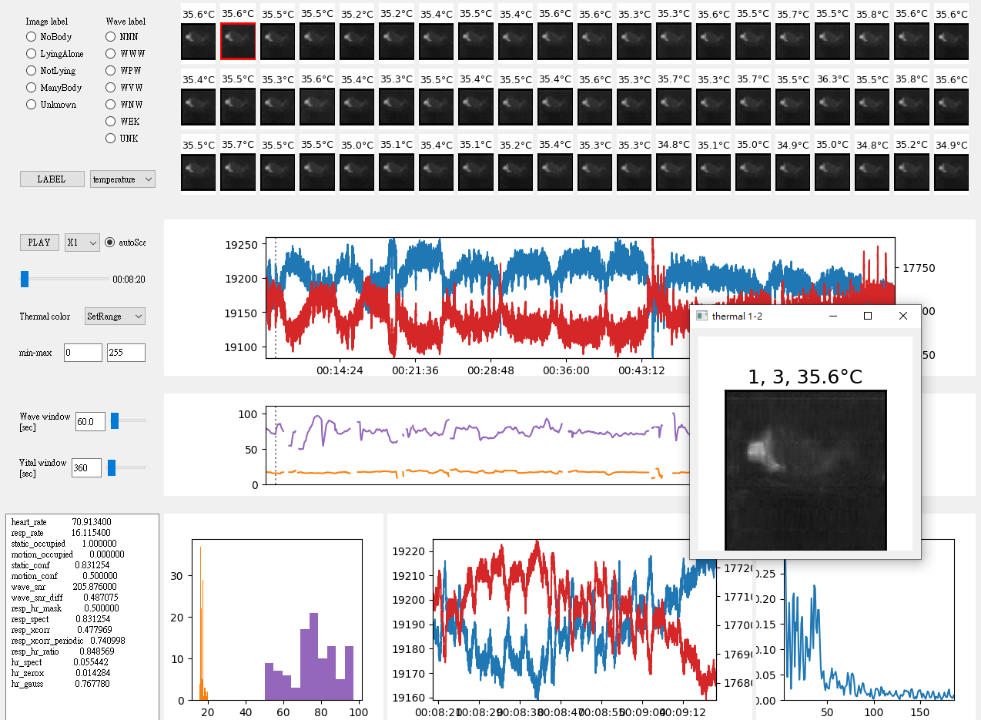
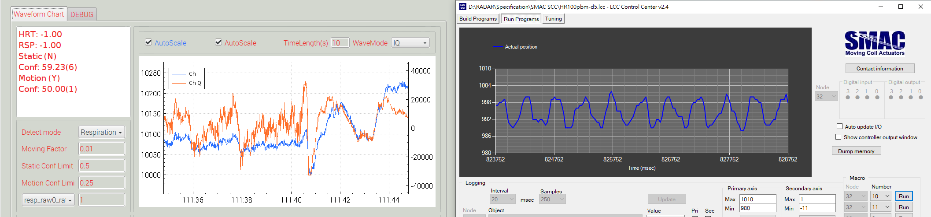
ADE Technology Inc.(4)
GUI Tool for vital-sign waveform dataset
Data visualization and labeling workflow
Client-server model between Windows and Linux
Bash / PowerShell automation for data collection
SMAC step motor simulates breathing and heartbeat

Slide 8

UnlimiterHear Co.
DSP (C or Assembly)
Convert floating-point algorithms to fixed-point operation
Voice enhancement: VAD, LRT, noise cancellation, subwoofer tune
Hearing protection: EQ, DRC, binaural beat generation
Natural sound generation: random number, white noise, droplet physics
Patent collaboration: hearing protection and masking-noise methods
降噪前
降噪後
原始音樂
±5Hz拍音
雨滴
水池

Slide 9
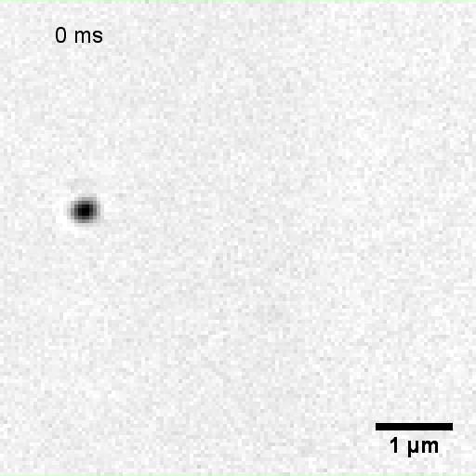
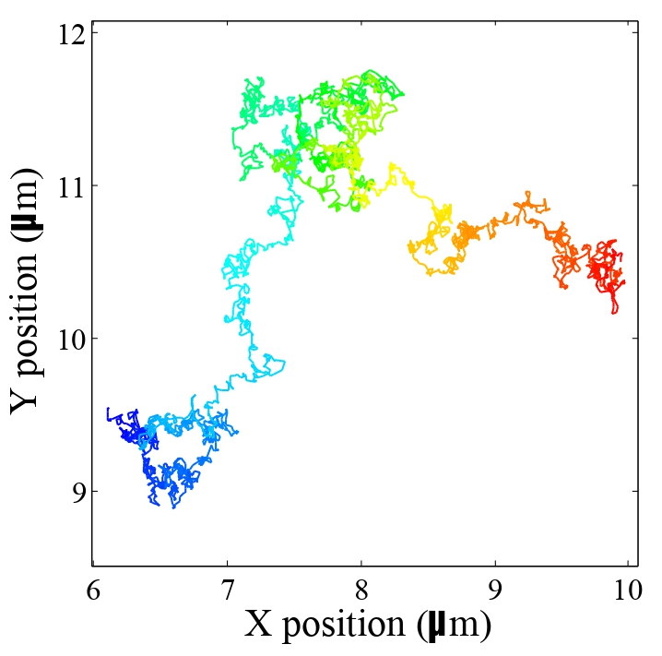
Academia Sinica
Nano-particles on cell membrane imaged by CMOS high-speed camera (1k ~ 100k fps)
Interferometric scattering optical microscope (iSCAT)
Nano-particle localization and random-walk tracking
Trajectory data analysis for cell membrane physical properties
Optics Express: shot-noise limited localization of single 20 nm gold particles

Slide 10
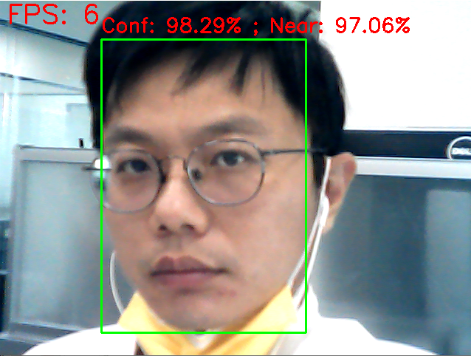
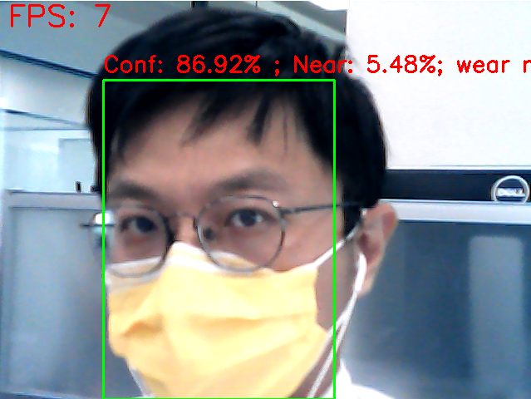
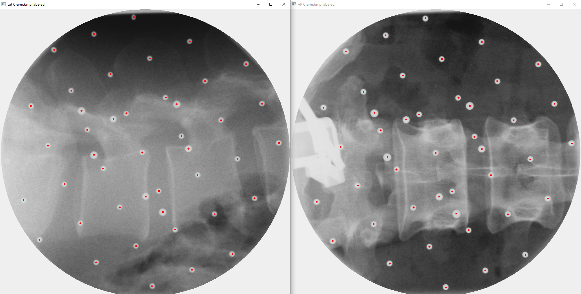
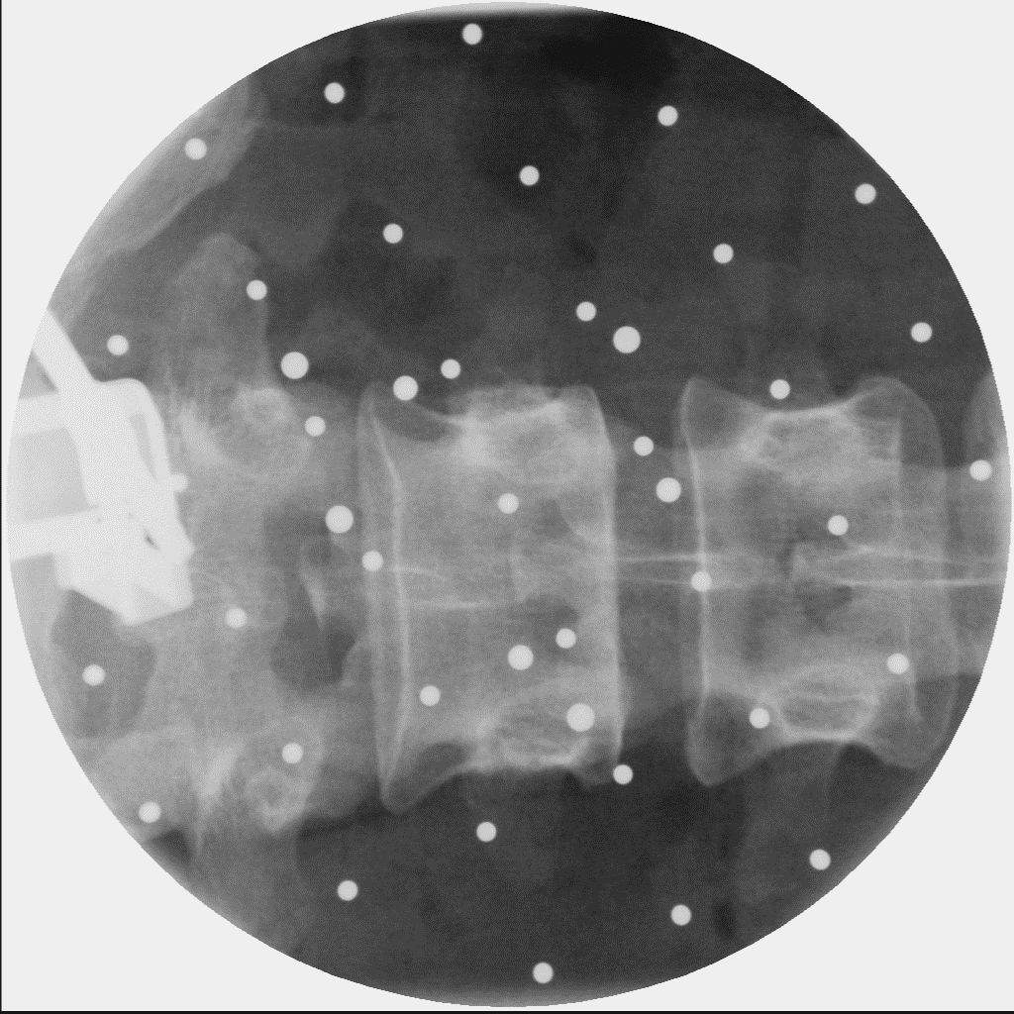
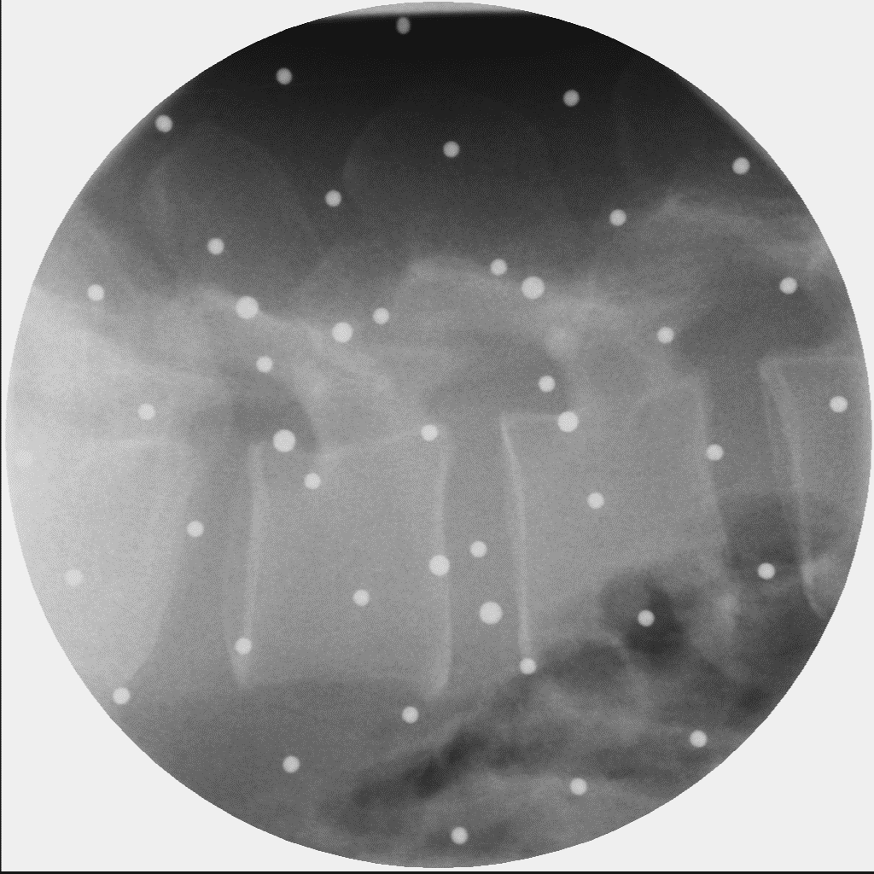
AI / Deep Learning
Stable Diffusion LoRA / finetune；YOLO mask recognition。
Spine marker image processing：ACE、Homomorphic filter、Canny、Hough Circle。
LLM workflow：Gemini / ChatGPT / Claude / Grok。
Antigravity / Claude Code：協助編碼、驗證與整理脈絡。
定位：把 AI 當作工程放大器，結合演算法、影像處理與 demo 能力。

Slide 11
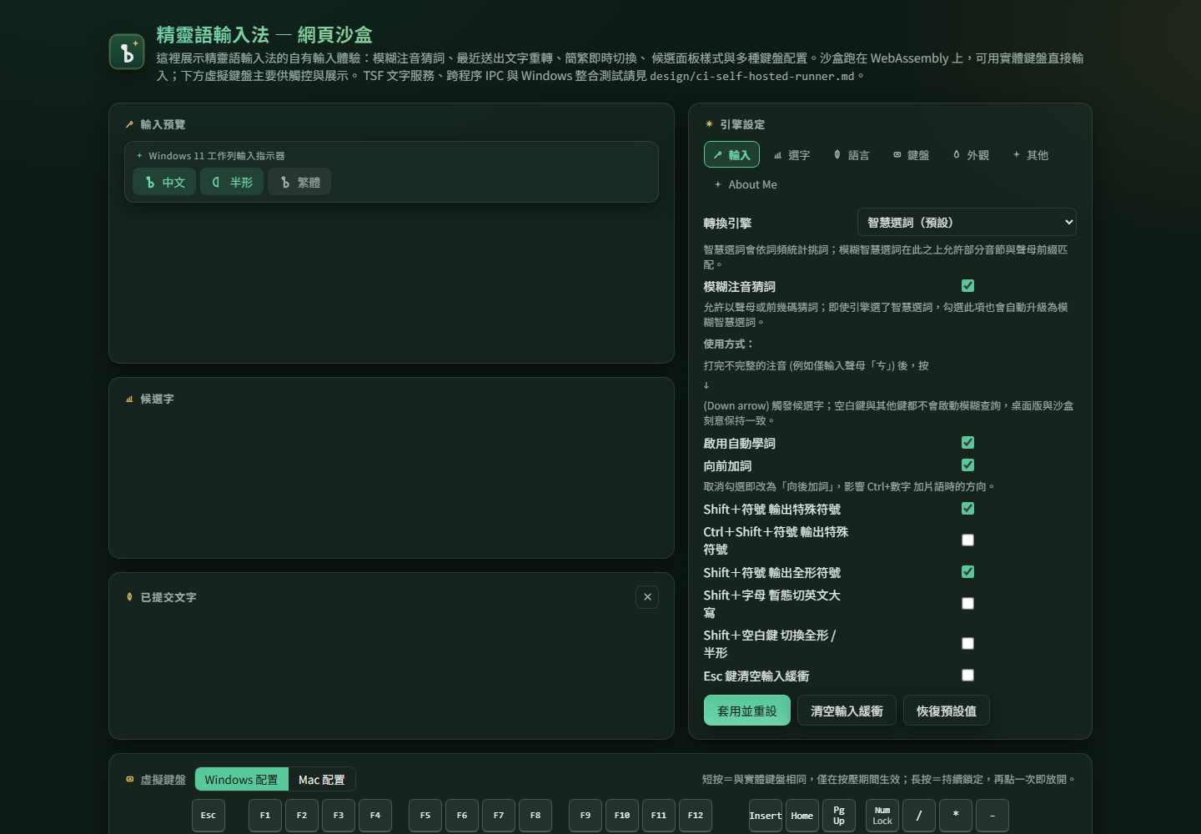
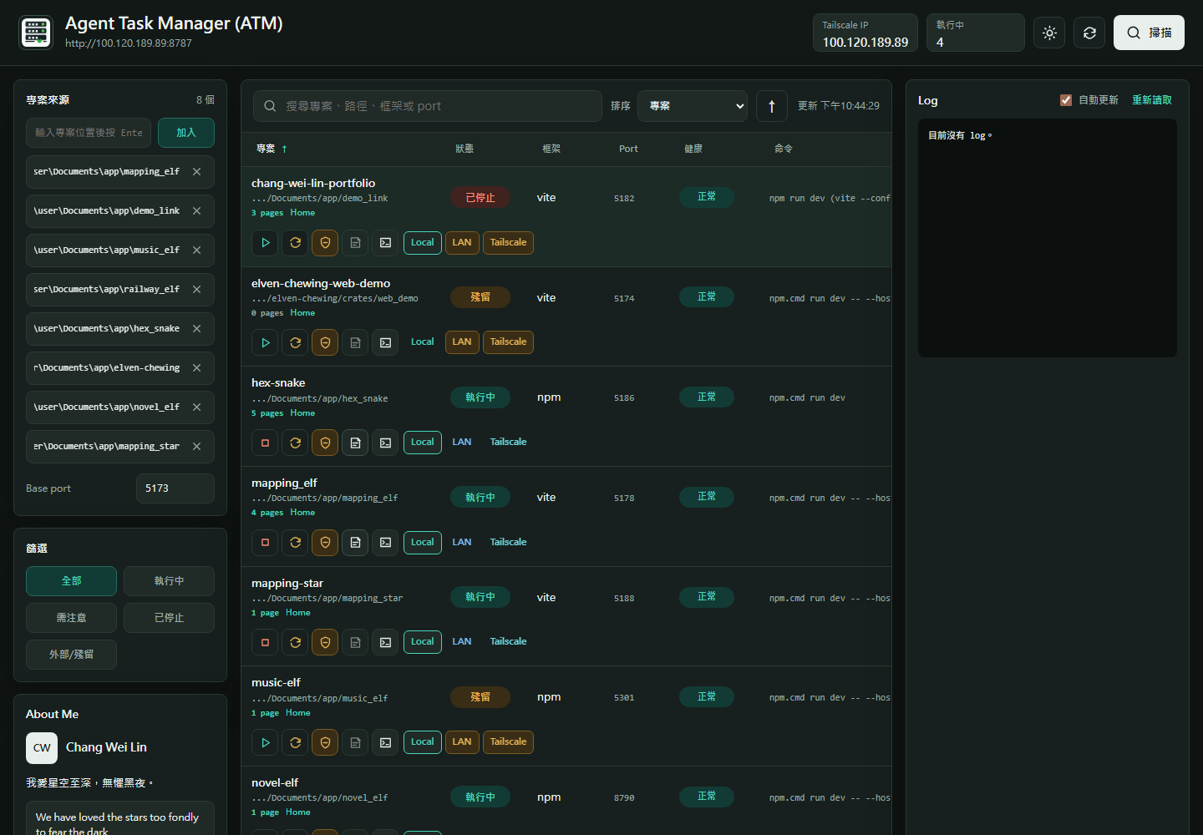
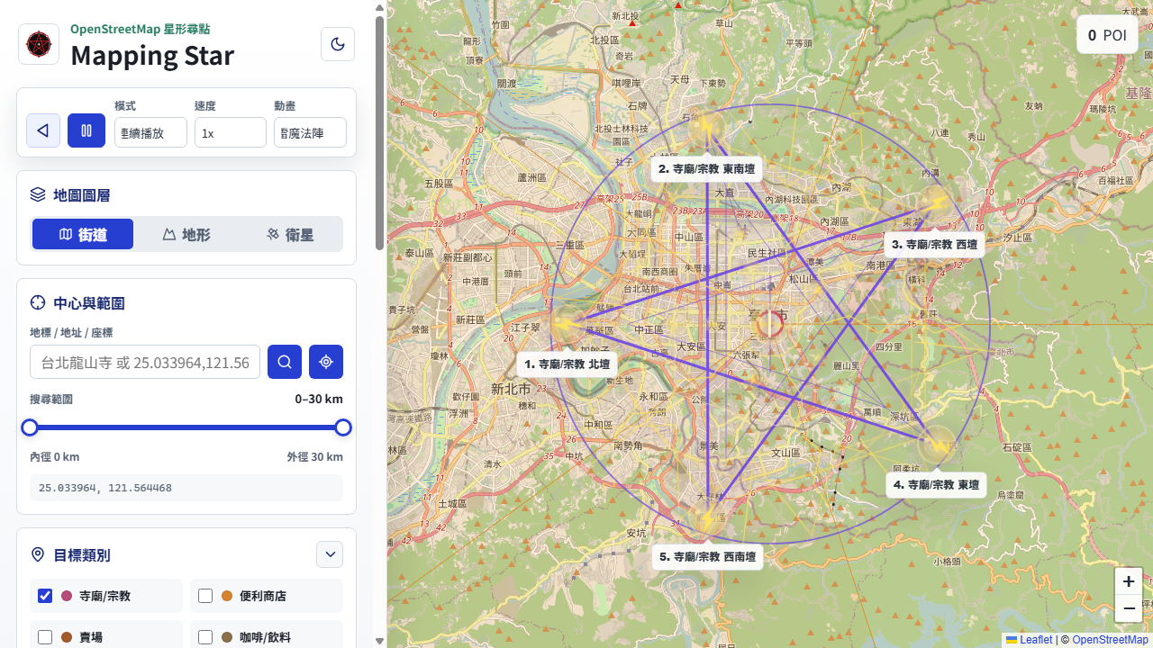
Current Projects / 近期專案分組
介紹順序：先用主題分組，再用代表成果收尾。
AI / 開發工作流：Agent Task Manager、Novel Elf。
系統互動工具：Elven Chewing、MIME Text Tool。
音訊 / DSP：Music Elf、IIR Filter Tool。
地圖 / 演算法視覺化：Mapping Star、Mapping Elf、Web TSP App。
共同成果：線上 Demo、GitHub repo、截圖、部署與測試驗證。

Slide 12
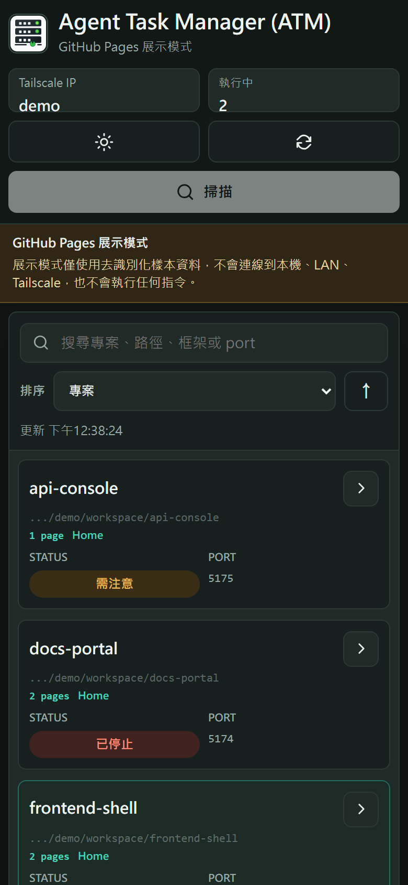
AI Workflow / System Tools
Agent Task Manager：Node.js/WebSocket + PowerShell。
- 集中掃描、啟停 dev server，整合 log / health check。
- Tailscale/mobile URL，方便 Agent Coding 驗證。
Elven Chewing：Rust + Windows TSF + WebAssembly demo。
- 注音核心、候選面板、模糊注音、重轉與簡繁切換。
共同價值：本機工具 + 系統輸入 + 瀏覽器 demo，可現場驗證。

Slide 13
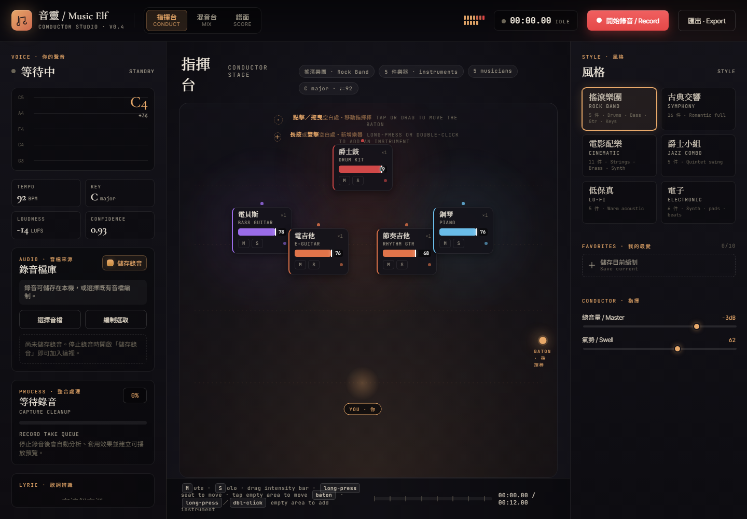
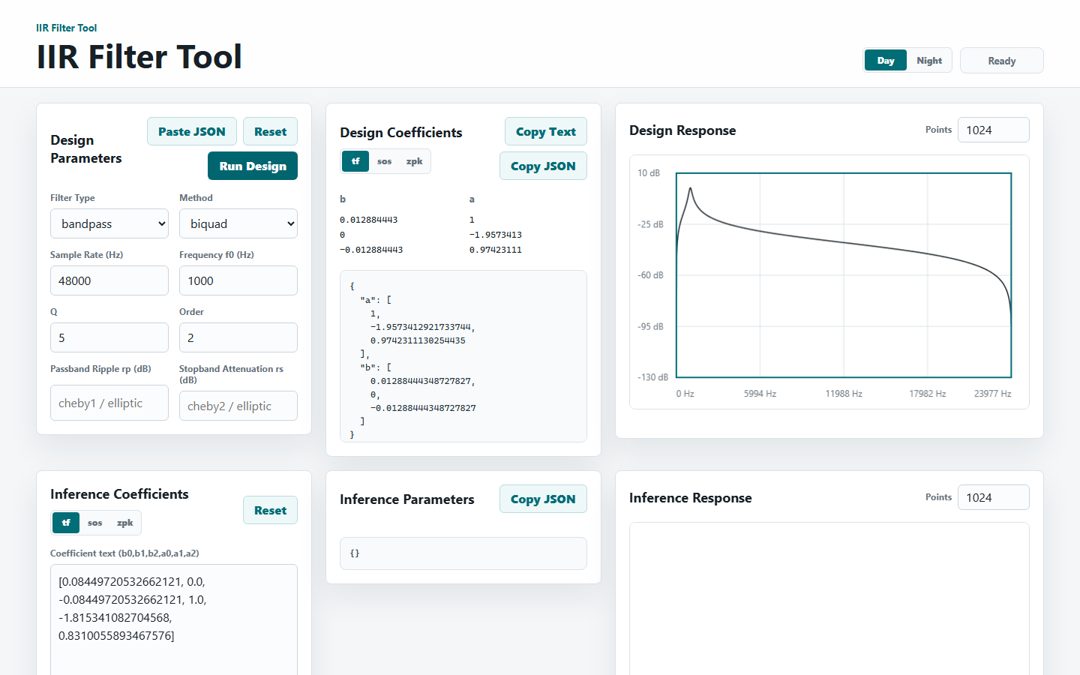
Audio DSP / Algorithm Pipeline
Music Elf：C++17 DSP，歌聲 -> MIDI/MusicXML。
- 音高偵測、音符切分、節奏量化、和弦/調性推斷。
IIR Filter Tool：濾波器參數調整與頻率響應視覺化。
- 把 DSP 設計變成可互動驗證的 demo。
延伸脈絡：呼應 MCU / fixed-point / VAD / LRT / noise cancellation。

Slide 14
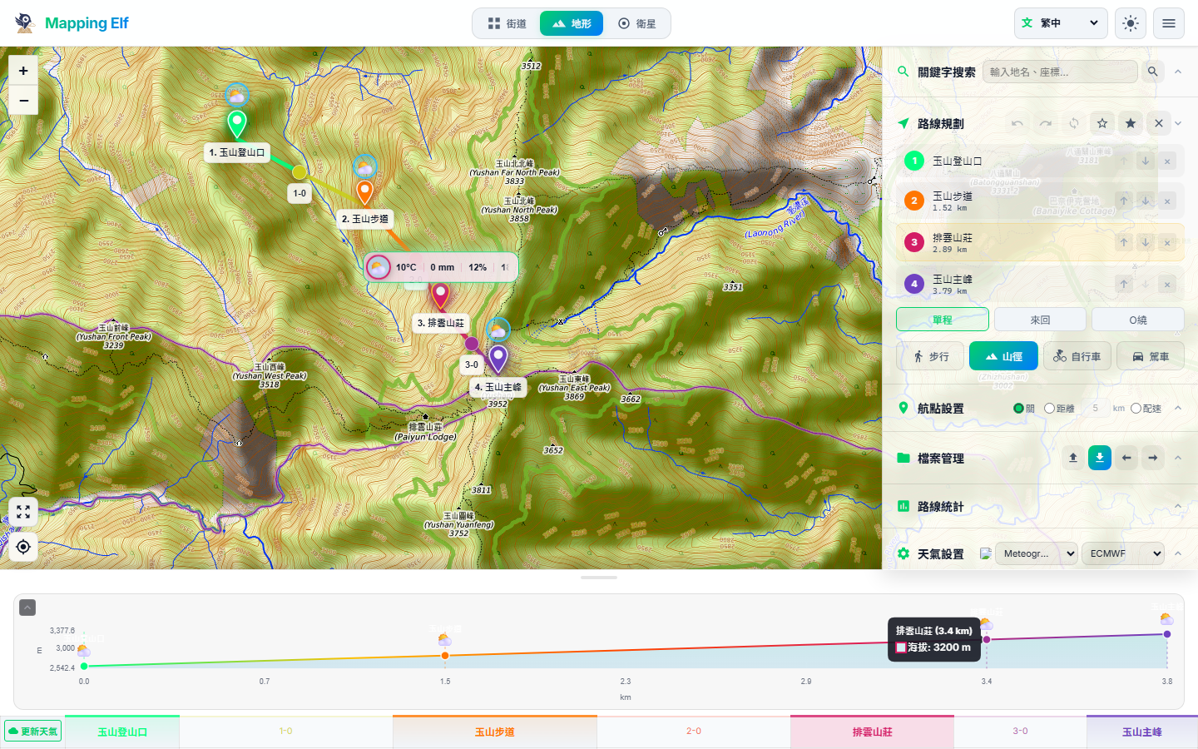
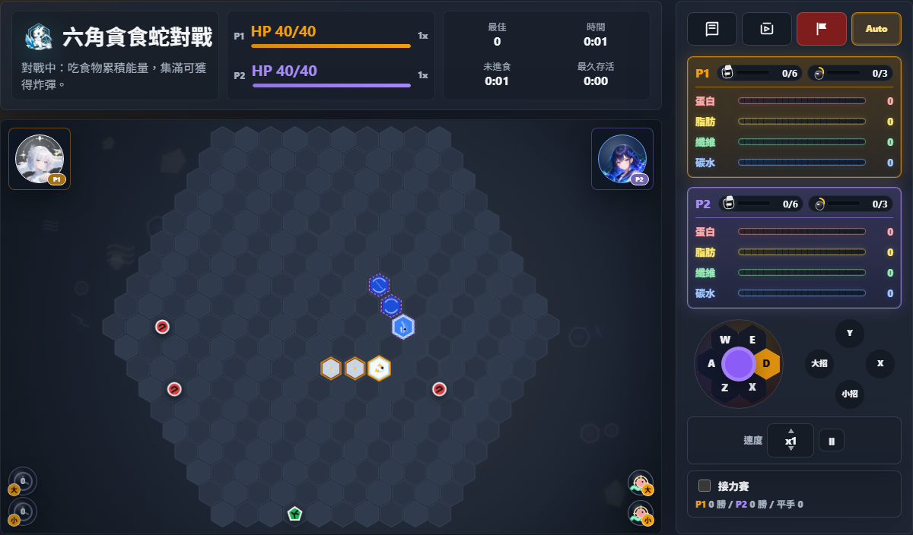
Map / Algorithm Visualization
Mapping Star：React + Leaflet + OSM/Overpass。
- POI 搜尋 -> 幾何求解 -> 五/六芒星排列動畫。
- GPX/KML 匯出，展示地圖互動與資料視覺化。
Mapping Elf：GPX/KML 路線規劃、高度剖面、天氣時間軸。
Web TSP App / Hex Snake：路徑最佳化與策略模擬，可說明演算法思考。

