Slide 1
2016.06.03 论文汇报
汇报人：常文龙

Slide 2
开源协议
  Esper有GPL协议版和企业版, 如果使用GPL协议版为基础进行开发包装并发布，则需要免费公开发布全部源代码，除非向EsperTech公司申请企业版授权。
  Jboss Drools Fusion, JBoss代码遵循LGPL许可，可以在任何商业应用中免费使用，而不用支付费用。
  常见开源协议：GPL、LGPL、Apache Licence、MIT、BSD
Notes:
GPL：只要你用了任何该协议的库、甚至是一段代码，那么你的整个程序，不管以何种方式链接，都必须全部使用GPL协议、并遵循该协议开源。商业软件公司一般禁用GPL代码，但可以使用GPL的可执行文件和应用程序。
AGPL：即Affero GPL，是GPL的更严格版本。只要你用了任何该协议的库、甚至是一段代码，那么运行时和它相关的所有软件、包括通过网络联系的所有软件，必须全部遵循该协议开源。据律师说，它的要求范围连硬件都包括。所以，一般公司通常禁用任何AGPL代码。
LGPL：就是GPL针对动态链接库放松要求了的版本，即允许非LGPL的代码动态链接到LGPL的模块。注意：不可以静态链接，否则你的代码也必须用LGPL协议开源。
Apache：修改版本必须保持其原始版权声明；修改过的文件要标明改动。
BSD2：修改版本必须保持其原始版权声明。
BSD3：修改版本必须保持其原始版权声明。未经许可不得使用原作者或公司的名字做宣传。
MIT：修改版本必须保持其原始版权声明。
MPL：修改版本必须保持其原始版权声明。如果发布了编译后的可执行文件，那么必须让对方可以取得MPL协议下程序的源码。
MsPL：修改版本必须保持其原始版权声明。注意：不含商标授权。

Slide 3
Rete算法
  Drools采用的是RETE算法。
  Rete是一种高效模式匹配算法，可被分为规则编译（rule compilation） 和运行时执行（runtime execution）两部分。
  规则编译是指根据规则集生成推理网络的过程，这个推理网络是一个有向无环图，用于过滤数据。（在网络的顶部，会有很多匹配，当深度加深，匹配会越来越少，到终端节点表示规则中的条件已完全匹配）
  运行时执行指将数据送入推理网络进行筛选的过程。
Notes:
http://docs.jboss.org/drools/release/6.0.0.Final/drools-docs/html/HybridReasoningChapter.html#ReteOO

Slide 4
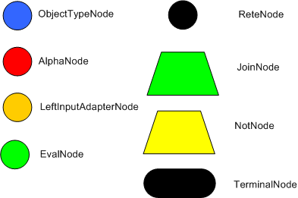
Rete算法基本结点
  Rete算法定义了四类基本节点：根结点，1-input，2-input和终端节点。
ReteNode为根结点
其他颜色的圆形节点为1-input
Terminal Node为终端节点
梯形表示的为2-input节点

Slide 5
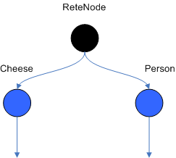
基本结点介绍
Object通过RootNode进入到推理网络，随后立即到达ObjectTypeNode。
ObjectTypeNode能够过滤掉所有类型不匹配的对象。只有指定类型的对象才能通过。（用HashMap保存合法的对象，进行instanceof检查）

Slide 6
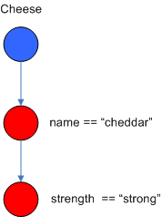
基本结点介绍
ObjectTypeNode 有三类子节点分别是AlphaNode, LeftInputAdapterNode and BetaNode。
AlphaNode 是1-input Node，用于提供Object进行字面条件。如Account.name == “Mr John”。
一个ObjectTypeNode可以多个AlphaNode结点，它们链接在一起形成一个条件链。在到达下一个AlphaNode时必须通过上一个AlphaNode。Rete维护一个HashMap用作AlphaNode的比较。

Slide 7
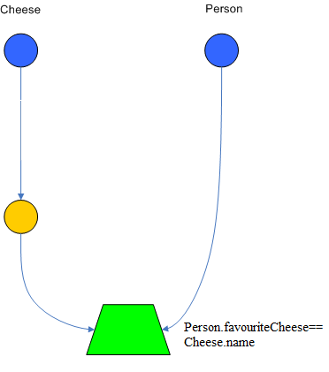
基本结点介绍
JoinNode 和 notNode是2-input结点，也成为BetaNode。
BetaNode用来比较两个对象包括它们的属性。两个对象可以属于同一类也可属于不同类。
BetaNode的左边输入是一个元组，右边输入则是一个单一的对象。
$cheese : Cheese
$person : Person( favouriteCheese == $cheese )

Slide 8
基本结点介绍
LeftInputAdapterNode用作BetaNode的左输入。维护一个元组。
TemimalNode表示一条规则匹配了所有的条件。

Slide 9
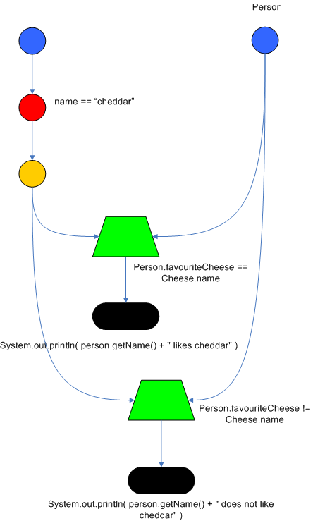
Node Sharing
rule
when
Cheese( $cheddar : name == "cheddar" )
$person : Person( favouriteCheese == $cheddar ) then
System.out.println( $person.getName() + " likes cheddar" );
end
rule
when
Cheese( $cheddar : name == "cheddar" )
$person : Person( favouriteCheese != $cheddar ) then
System.out.println( $person.getName() + " does not like cheddar" );
end
Notes:
规则在模式上重复 节点共享 消除冗余
Drools also performs node sharing. Many rules repeat the same patterns, and node sharing allows us to collapse those patterns so that they don't have to be re-evaluated for every single instance
As you can see below, the compiled Rete network shows that the alpha node is shared, but the beta nodes are not. Each beta node has its own TerminalNode. Had the second pattern been the same it would have also been shared.

Slide 10
ReteOO算法
Node Shareing 提供AlphaNode和BetaNode的共享
Modify-in-place 之前通过删除+新增实现Modify
Heap based agenda 使用heap维护规则的排序，而不是采用线性排序
Dynamic Rules 规则可以进行动态的新增和删除
Notes:
Node sharing
Sharing is applied to both the alpha and beta network. The beta network sharing is always from the root pattern.
Alpha indexing
Alpha Nodes with many children use a hash lookup mechanism, to avoid testing each result.
Beta indexing
Join, Not and Exist nodes indexing their memories using a hash. This reduces the join attempts for equal checks. Recently range indexing was added to Not and Exists.
Tree based graphs
Join matches did not contain any references to their parent or children matches. Deletions would have to recalculate all join matches again, which involves recreating all those join match objects, to be able to find the parts of the network where the tuples should be deleted. This is called symmetrical propagation. A tree graph provides parent and children references, so a deletion is just a matter of following those references. This is asymmetrical propagation. The result is faster and less impact on the GC, and more robust because changes in values will not cause memory leaks if they happen without the engine being notified.
Modify-in-place
Traditional RETE implements a modify as a delete + insert. This causes all join tuples to be GC'd, many of which are recreated again as part of the insert. Modify-in-place instead propagates as a single pass, every node is inspected
Property reactive
Also called "new trigger condition". Allows more fine grained reactivity to updates. A Pattern can react to changes to specific properties and ignore others. This alleviates problems of recursion and also helps with performance.
Sub-networks
Not, Exists and Accumulate can each have nested conditional elements, which forms sub networks.
Backward Chaining
Prolog style derivation trees for backward chaining are supported. The implementation is stack based, so does not have method recursion issues for large graphs.
Lazy Truth Maintenance
Truth maintenance has a runtime cost, which is incurred whether TMS is used or not. Lazy TMS only turns it on, on first use. Further it's only turned on for that object type, so other object types do not incur the runtime cost.
Heap based agenda
The agenda uses a binary heap queue to sort rule matches by salience, rather than any linear search or maintenance approach.
Dynamic Rules
Rules can be added and removed at runtime, while the engine is still populated with data.

Slide 11
THANKS!

