Slide 1
Aspect-Based Sentiment Analysis
On Google Maps Restaurants
Group 25
Name | Matriculation Number
Lin Yaohua | A0206212Y
Teo Ri Han Henry | A0199956Y
Lim Chang Yu | A0201946H

Slide 2
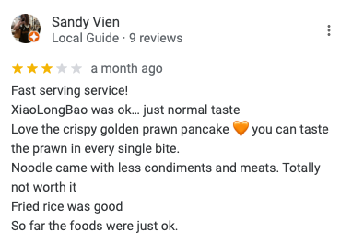
Introduction & Problem Description
Phenomenon
Reviews are a major factor in consumer purchase decision
Similarly Online reviews provide a direct feedback to Seller on Buyers opinion/Sentiment on their experience
However…
Normal reviews is a cluster of customer’s opinion of various aspects of their experience.
Solution
Aspect Based Sentiment analysis, which can be done in
Supervised learning way
Lexicon rule based way
…. And many more
Focus : Aspect based sentiment analysis on google maps restaurant reviews
Service quality
Food quality
Problem
Goals & Dataset
Extraction methods
Classification models
Results & future improvements
Agg scores & use cases

Slide 3

Project Goals & Dataset
General Process
Goal
Experiment with ways to extract and map relevant parts of text from restaurant reviews to their respective aspects to be used for learning
Identified Aspects
Food
Service
Ambience
Use the sentiment scores for business use case
Web Scraping google restaurant reviews
Labelling data
Aspect extraction and
Mapping, preprocessing
Classification and other models
Model evaluation + insights
Problem
Goals & Dataset
Extraction methods
Classification models
Results & future improvements
Agg scores & use cases

Slide 4

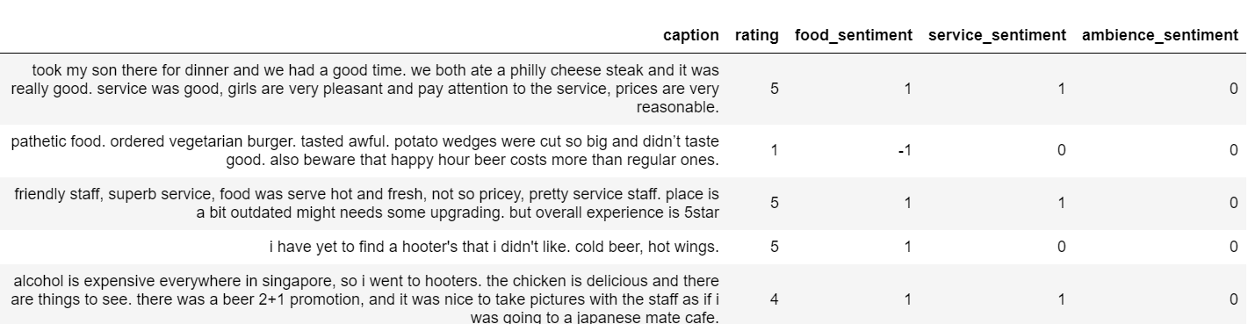
Project Goals & Dataset
Dataset
Restaurant reviews scrapped from google maps
3892 reviews of 7 restaurants containing reviews (str) + rating [1,5](int)
Sentiment scores hand labeled by our team for training.
Post labeling distribution of classes across different aspects. Existence of imbalance class
Labelled sentiment score
True distribution of sentiment scores
Aspect | Positive | neutral | negative
Food | 2564 | 981 | 347
Service | 778 | 2724 | 390
Ambience | 1199 | 2561 | 132
Problem
Goals & Dataset
Extraction methods
Classification models
Results & future improvements
Agg scores & use cases

Slide 5
Aspect extraction + mapping
Example review
“The food at this place is superb, the servers are friendly and the atmosphere is nice.”
Text relevant to food:
“The food at this place is superb,”
Text relevant to service
“Servers are friendly”
Text relevant to ambience
“Atmosphere is nice”
Feature extraction: Text vectorization (individual aspect) → Classification models
Problem
Goals & Dataset
Extraction methods
Classification models
Results & future improvements
Agg scores & use cases

Slide 6
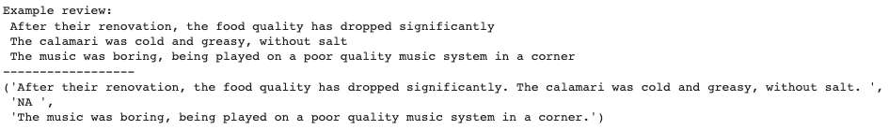
Extraction Method 1
Open Ai’s GPT (davinci variant)
To be used as a benchmark for aspect extraction & comparison of performance post learning
Prompt
f"extract all parts of text associated with food quality or service quality of ambience quality (can be NA). reply in the form [food: all parts of text , svc: all parts of text , amb: all parts of text] \n\n' '{text}'"
Food
Service
Ambience
Problem
Goals & Dataset
Extraction methods
Classification models
Results & future improvements
Agg scores & use cases

Slide 7
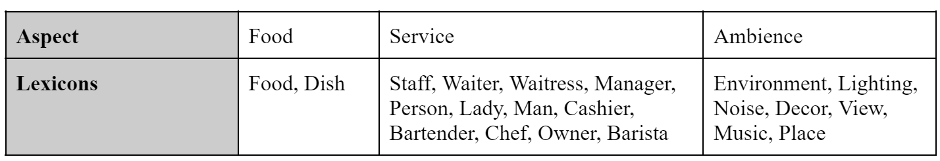
Aspect Lexicons
Lexicons relating to each aspect from YELP corpus used for both methods to extract Aspects
Additional lexicons identified and added
Problem
Goals & Dataset
Extraction methods
Classification models
Results & future improvements
Agg scores & use cases
Notes:
Using Aspect Lexicons to extract the 3 different aspects and the associate sentiment words. Lexicon list from Yelp with addition of some lexicons identified by our team. The same lexicon list will be used for both methods

Slide 8
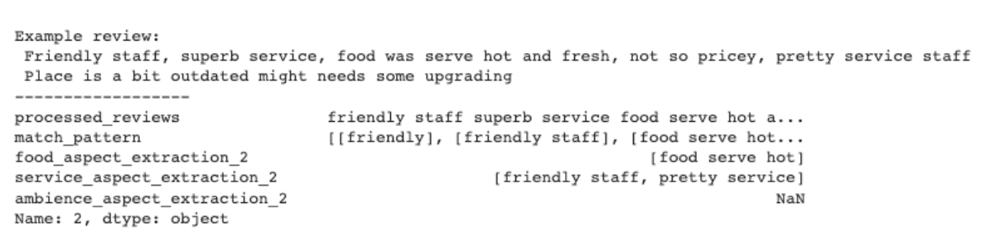
Aspect Extraction Method 2 (spacy)
Identify common POS patterns in reviews
Split review into chunks based on POS (Part of Speech) tags
Optional POS patterns included adverb ( Intensity indicator )
Preprocessing refinements : Customized Stop words - excluded removal essential words -> better POS matches
Filtered against different aspect lexicon list and grouped accordingly
Service Lexicons
Food Lexicon
Sentiment words
Problem
Goals & Dataset
Extraction methods
Classification models
Results & future improvements
Agg scores & use cases
Notes:
Method 2 relies on the POS patterns of the text in review. Based on common POS patterns observed, the text are POS tagged and split according to patterns matched. Patterns include optional adverbs which could provide info on intensity of sentiment. Preprocessing refinement made to exclude essential words that allows for POS pattern to be matched correctly. The chunks identified are then filter against the aspect lexicon list and grouped according-> example

Slide 9
Aspect Extraction Method 3 (NLTK)
Aspect keyword identified using aspect lexicon list
Search for associated adjectives and adverbs 5 words before and 10 words after aspect keyword
-2 -1 0
0 1 2 3 4
very good food
the chicken that we had yesterday
evening was absolutely delightful
5 6 7 8
-5 Position
+10 Position
Adjective/Adverb
Aspect KeyWord
Adjective/ Adverb
Problem
Goals & Dataset
Extraction methods
Classification models
Results & future improvements
Agg scores & use cases
Notes:
3rd method utilizes the NLTK library, First, aspect keywords identified using aspect lexicon list. Then, words associated with aspect key word is searched within the frame of 5 words before and 10 words after the aspect keyword.
Logic to searhc for 5 words before the aspect key word - adjectives and adverbs typically positioned near the noun if it appears before. Limited to 5 so to not extract chunks from previous sentence that can distort the sentiments extracted.
For searching 10 words after : adjectives and adverbs can be positioned further away from keyword if it appears after the keyword

Slide 10
Post Extraction
•After aspect extraction, the text/chunks associated with each aspect and overall rating are encoded using two different models
Bag of words Unigram Model
Tf-idf Model
Problem
Goals & Dataset
Extraction methods
Classification models
Results & future improvements
Agg scores & use cases
Notes:
•-5 logic : adjectives and adverbs typically positioned near the noun if it appears before
•+10 logic : adjectives and adverbs typically positioned further away from keyword if it appears after the keyword

Slide 11
Classification Models
•Encoded text trained on 3 different classification models with 3 different classes (Pos/Neu/Neg Sentiments)
Random Forest Classifier
Logistic Regression
XGBoost
Random Forest Classifier
Logistic Regression
XGBoost
Bag of words Unigram Model
Tf-idf Model
Problem
Goals & Dataset
Extraction methods
Classification models
Results & future improvements
Agg scores & use cases
Notes:
•-5 logic : adjectives and adverbs typically positioned near the noun if it appears before
•+10 logic : adjectives and adverbs typically positioned further away from keyword if it appears after the keyword

Slide 12
Benchmark Models
After the text/chunks associated with each aspect are extracted, sentiment analysis performed via two pre-trained models: BERT and Vader
Serves as a benchmark for comparison
Problem
Goals & Dataset
Extraction methods
Classification models
Results & future improvements
Agg scores & use cases
Notes:
In addition, we performed sentiment analysis on the chunks of text from aspect extraction using 2 pretrained models, BERT and vader which serves as benchmark for performance comparison against our classitifon models

Slide 13
Classification Results
Aspect | Model | Test Accuracy | Test Weighted F1
Food | BOW XGBoost | 0.853 | 0.848
Service | TFIDF XGBoost | 0.823 | 0.824
Ambience | TFIDF Random Forest | 0.835 | 0.817
Method 1
(OpenAI)
Slightly Better Than Method 3
Aspect | Model | Test Accuracy | Test Weighted F1
Food | BOW Random Forest | 0.747 | 0.711
Service | TFIDF Logistic Regression | 0.826 | 0.808
Ambience | TFIDF XGBoost | 0.777 | 0.745
Method 2
(spacy)
Aspect | Model | Test Accuracy | Test Weighted F1
Food | BOW XGBoost | 0.725 | 0.698
Service | BOW Random Forest | 0.819 | 0.800
Ambience | TFIDF Random Forest | 0.737 | 0.680
Method 3
(NLTK)
Problem
Goals & Dataset
Extraction methods
Classification models
Results & future improvements
Agg scores & use cases

Slide 14
Best-Performing Vader & Bert Models
Food
Extraction Method 2 (VADER):
Test Accuracy (0.564)
Test Weighted F1 (0.539)
Service
Extraction Method 3 (BERT):
Test Accuracy (0.612)
Test Weighted F1 (0.546)
Ambience
Extraction Method 3 (BERT):
Test Accuracy (0.723)
Test Weighted F1 (0.659)
Problem
Goals & Dataset
Extraction methods
Classification models
Results & future improvements
Agg scores & use cases
Notes:
These pre-trained models are likely to not have been fine-tuned with the vocabulary and sentence structures in the reviews.

Slide 15


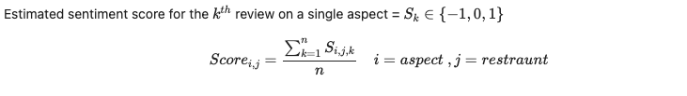





Aggregated Scores
Score Range (-1,1)
KokSen
Food: 0.757
Service: -0.054
Ambience: 0.037
Chicheti
Food: 0.884
Service: 0.103
Ambience: 0.140
Lola’s Cafe
Food: 0.863
Service: 0.124
Ambience: 0.316
Eggslut
Food: 0.679
Service: -0.009
Ambience: 0.065
Penny University
Food: 0.801
Service: 0.034
Ambience: 0.210
Hooters
Food: 0.686
Service: 0.055
Ambience: 0.162
Wheeler’s Yard
Food: 0.745
Service: -0.007
Ambience: 0.321
Problem
Goals & Dataset
Extraction methods
Classification models
Results & future improvements
Agg scores & use cases

Slide 16
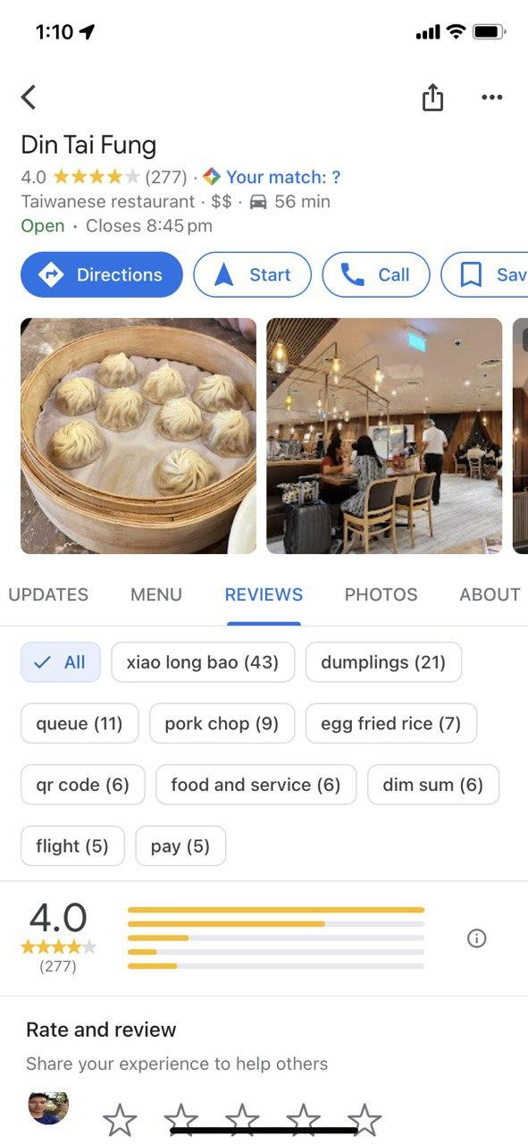

Use Cases: Consumers
Improved User Experience
Quick & Informed Decision Making, Tailored to User Preferences
Food Service Ambience
Increased App Usage & User Growth Rate
Increase Revenue
Problem
Goals & Dataset
Extraction methods
Classification models
Results & future improvements
Agg scores & use cases

Slide 17
Use Cases - Restaurant Owners
Welcome Back, Henry
Your performance at a glance (Hooters, Clarke Quay)
Business Plans
Your Restaurants
Account
Food
0.82
Food ratings are at an all time high, keep it up!
Service
0.56
Service ratings have been decreasing. Subscribe for detailed trends and insights.
Ambience
0.93
No changes in ambience ratings over the past 3 months, you’re doing great!
Problem
Goals & Dataset
Extraction methods
Classification models
Results & future improvements
Agg scores & use cases

Slide 18
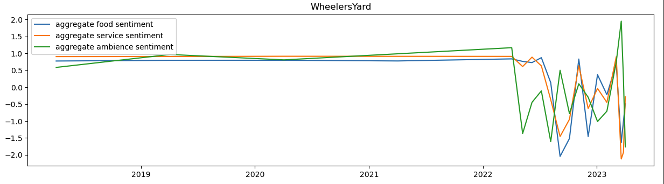
Use Cases - Restaurant Owners
Your performance over time:
(Din Tai Fung, Plaza Singapura)
Business Plans
Your Restaurants
Account
Add Checkpoint
1.0
0.8
0.6
0.4
0.2
0
1
Renovation:
Date: 2 Jan 2022
Tags: Ambience
Change: -60%
Insights from recent ratings
Edit Remove
Problem
Goals & Dataset
Extraction methods
Classification models
Results & future improvements
Agg scores & use cases
Notes:
Allow business owners to make effective business decisions based on sentiments of diners

Slide 19
Thank You!

